Slide 1
Outline
Additional measurements and diagnostics –
status and plans for the long shutdown
ELQA vs. general planning
  ELQA procedure overview,
  Advantages of additional campaigns,
  Its disadvantages,
Insulation monitoring system,
What new tests could be introduced,
Machine layout modifications which could make QA more efficient.
Notes:
This presentation is an extension of the Richards presentation. From ELQA point of view there are several things to be done that could increase the quality confidence and improve our understanding of the machine. I’m going to present tests and actions that we believe could be useful. I will provide pros and cons of each solution. These open questions will need to be answered in advance before the shut-down so that preparation can be made.

Slide 2
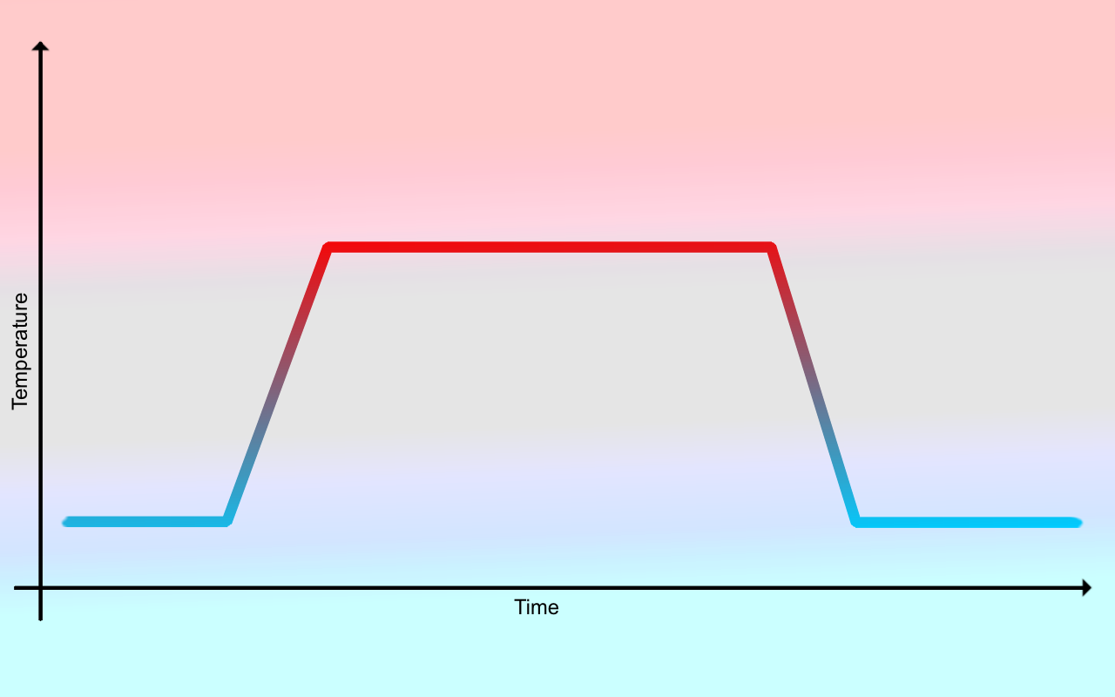
ELQA vs. general planning
ELQA @ warm
ELQA @ warm
?
ELQA during consolidation
ELQA @ cold
ELQA @ cold
?
LHC long shut-down planning

Slide 3
ELQA before the shut-down
Advantages:
Better understanding of changes in the circuits,
  During many current cycles and the beam operation some aging process could have taken place. We should know the tendency as soon as possible in order to profit from the long shut-down and to react,
If we discover any problems
  There will be time to treat them,
  It won’t delay the physics run,
We can apply more restrictive voltage withstand criteria,
We can test with a higher precision certain parameters (TFM, resistance checks) with upgraded HW and SW:
  Possibly new NCs,
  Reference for the future,
Certain parameters are accessible only at warm, some others at cold – both suggested campaigns are needed.

Slide 4
ELQA before the shut-down
Disadvantages:
We need a time slot – probably 2-4 weeks per campaign (@warm, @cold),
We need some resources to fit in the 2-4 weeks time window
  Shift work,
  Engineers and technicians from collaborations as it was in previous campaigns,
If we discover a break-down during the HV test close to the testing voltage
  We might not be able to localize it at warm (lower test voltages),
  Might need to forsee a time slot for investigations,
  Not absolutely true that during the shut-down we can fix whatever comes.

Slide 5
Insulation monitoring system
HV monitoring of the electrical insulation of the selected circuits during the warm-up and cool-down phases.
Some software tuning would be appreciated but for the moment the applications are stable enough,
We keep max 48 V for security reasons,
Do we need to monitor all the circuits powered via DFBAs or we should stay with monitoring only the main ones?
  Some software improvements needed for monitoring more than about 10-15 circuits
Would it be interesting to monitor the inner triplet magnets or the ones powered via the DFBLs (link)?
  We might be missing some hardware

Slide 6
New tests
Corrector circuits resistance measurements at cold (splices)
  Type test needed, the best if it could be performed in January or February 2011 during powering tests
Splice measurements after ICs are redone
  Is it possible/useful at warm?
  Possible resources sharing point
New possibilities with new devices like PowerTek Gain Phase Analyzer and upgraded TP4 system:
  Improved TFM vs. GND – precision to be evaluated – quality of the insulation information,
  Measurement of the protection diode characteristics (RB, RQD, RQF magnets) – application (and hardware) to be developed,
  Faulty QH recognition – up to now no good method exists, needs to be studied in more details.

Slide 7
Tunnel modifications
Additional V-taps?
  New V-taps in CC?
  Better to have protection resistors…
In order to ease the test of insulation between two conductors maybe we could install an additional DFB at the end of the circuit like in RB? It could be placed instead of the CC.
  MCS circuit case where TFM shown shorted bus-bars
  Insulation might be weak (breakdown at HV)
What about connecting some spools and some Line N circuits to the ‘spare’ CLs? It would help to understand how do the low current splices work.

Slide 8
Questions?
Thank you for your attention!

