Slide 1
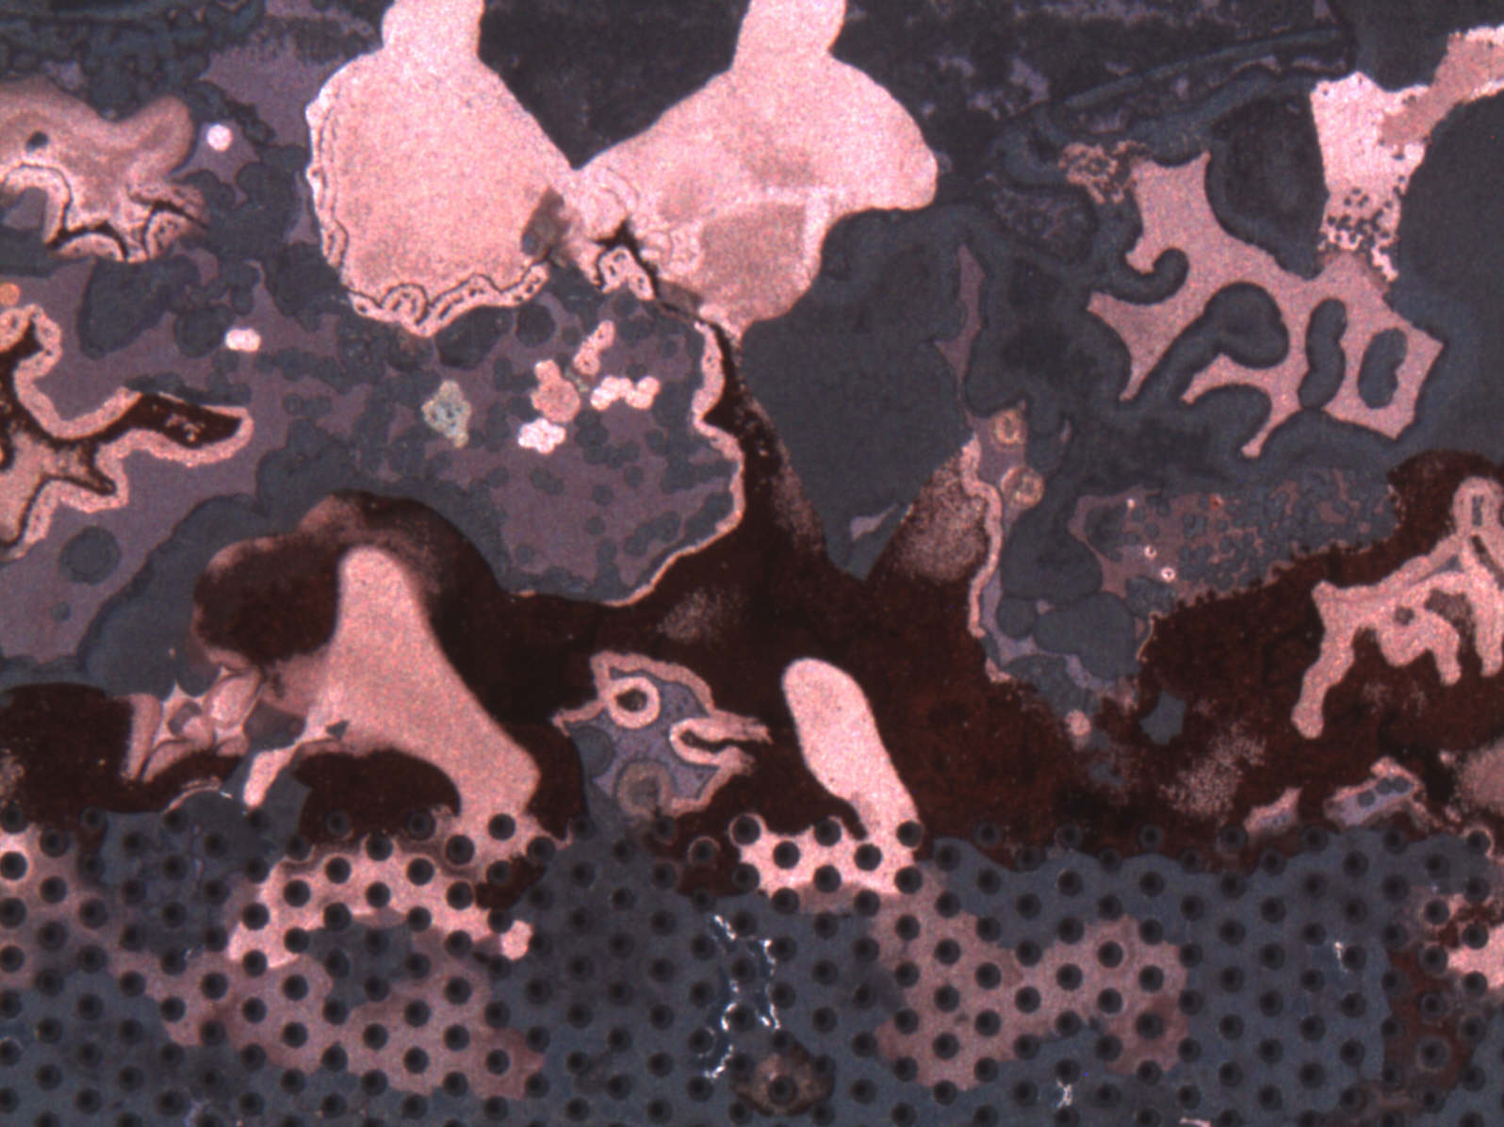
Summary
MPGD principle ( Micro Pattern Gas Detector)
  GEM
  Micromegas
Large detector projects
  CMS
  Atlas
Timing/equipment/ man power

Slide 2
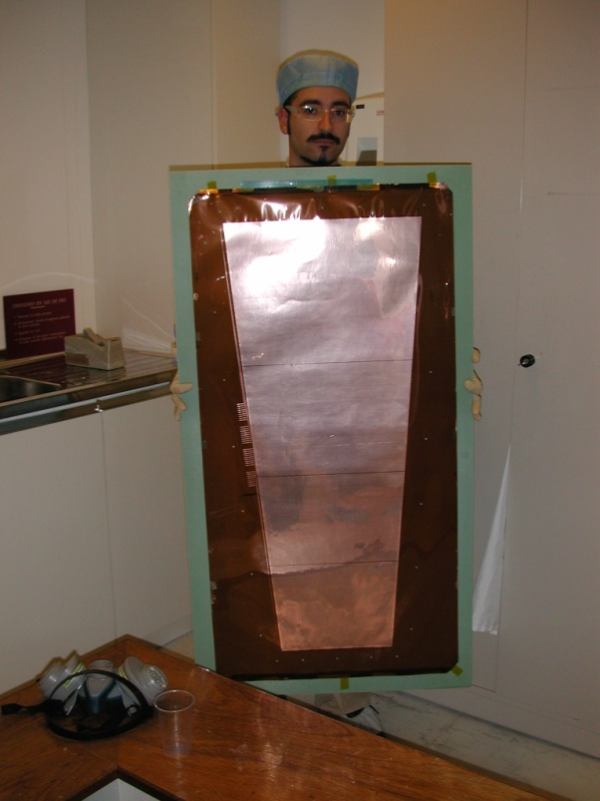
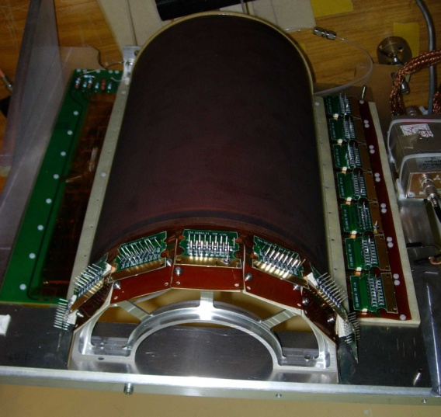
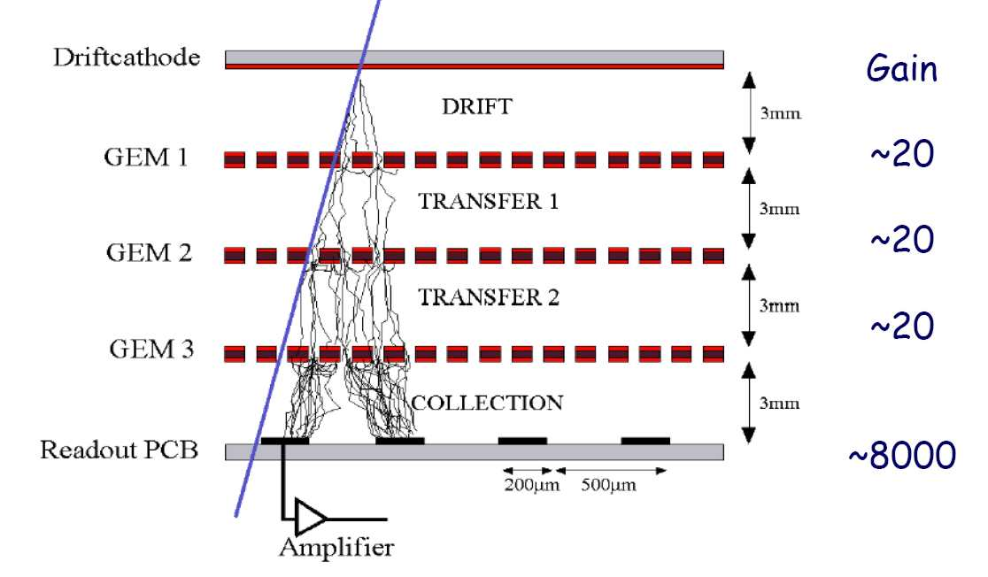
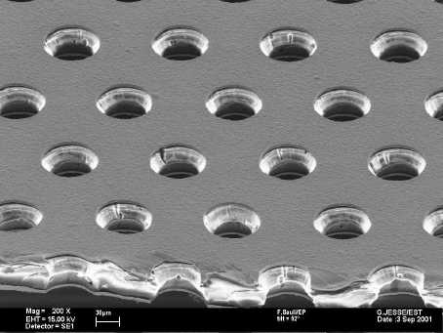
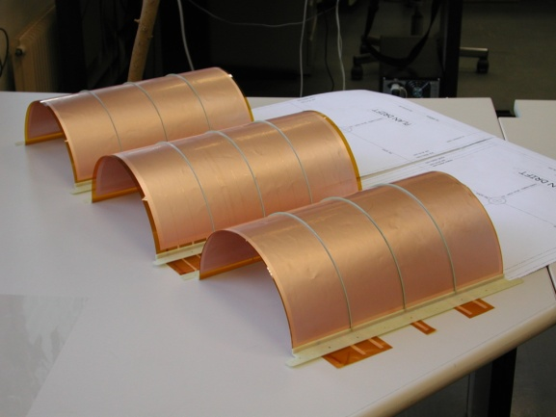
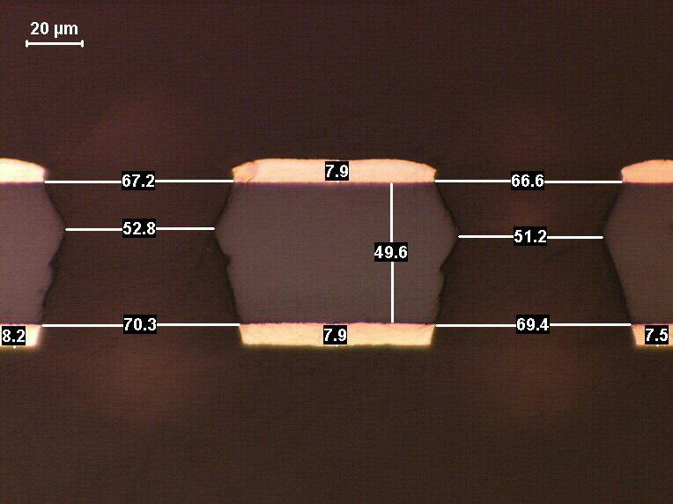
GEM detector principle
Row material
Copper etch
Kapton etch

Slide 4
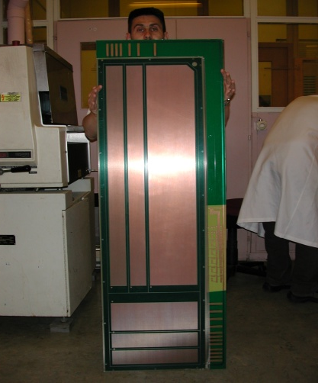
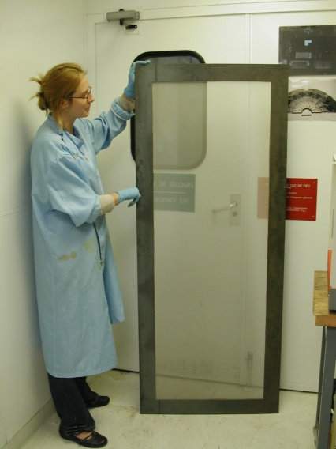
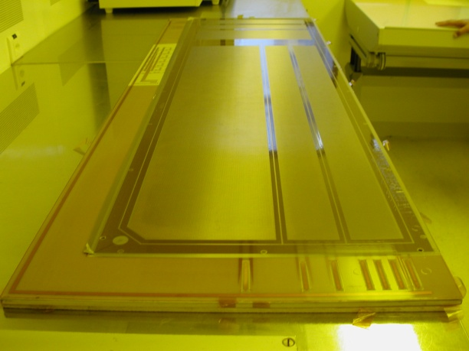
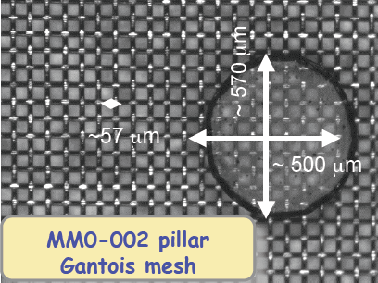
Micromegas
PCB
lamination
Mesh deposit
lamination
development

Slide 5
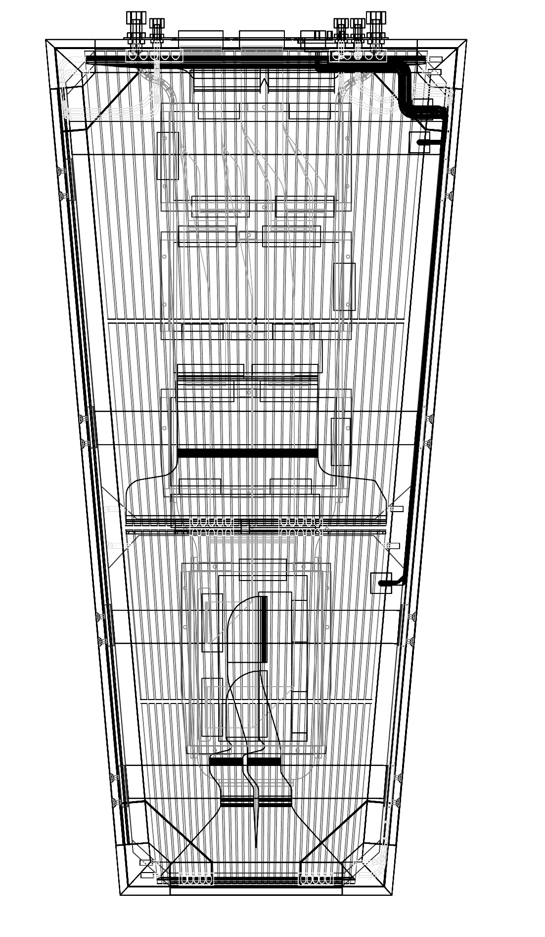
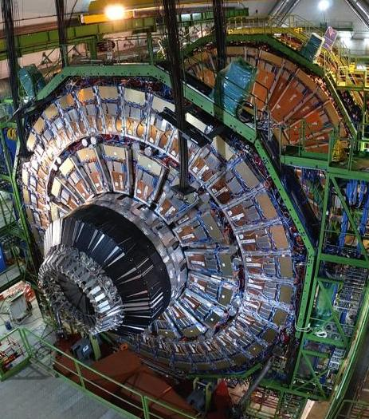
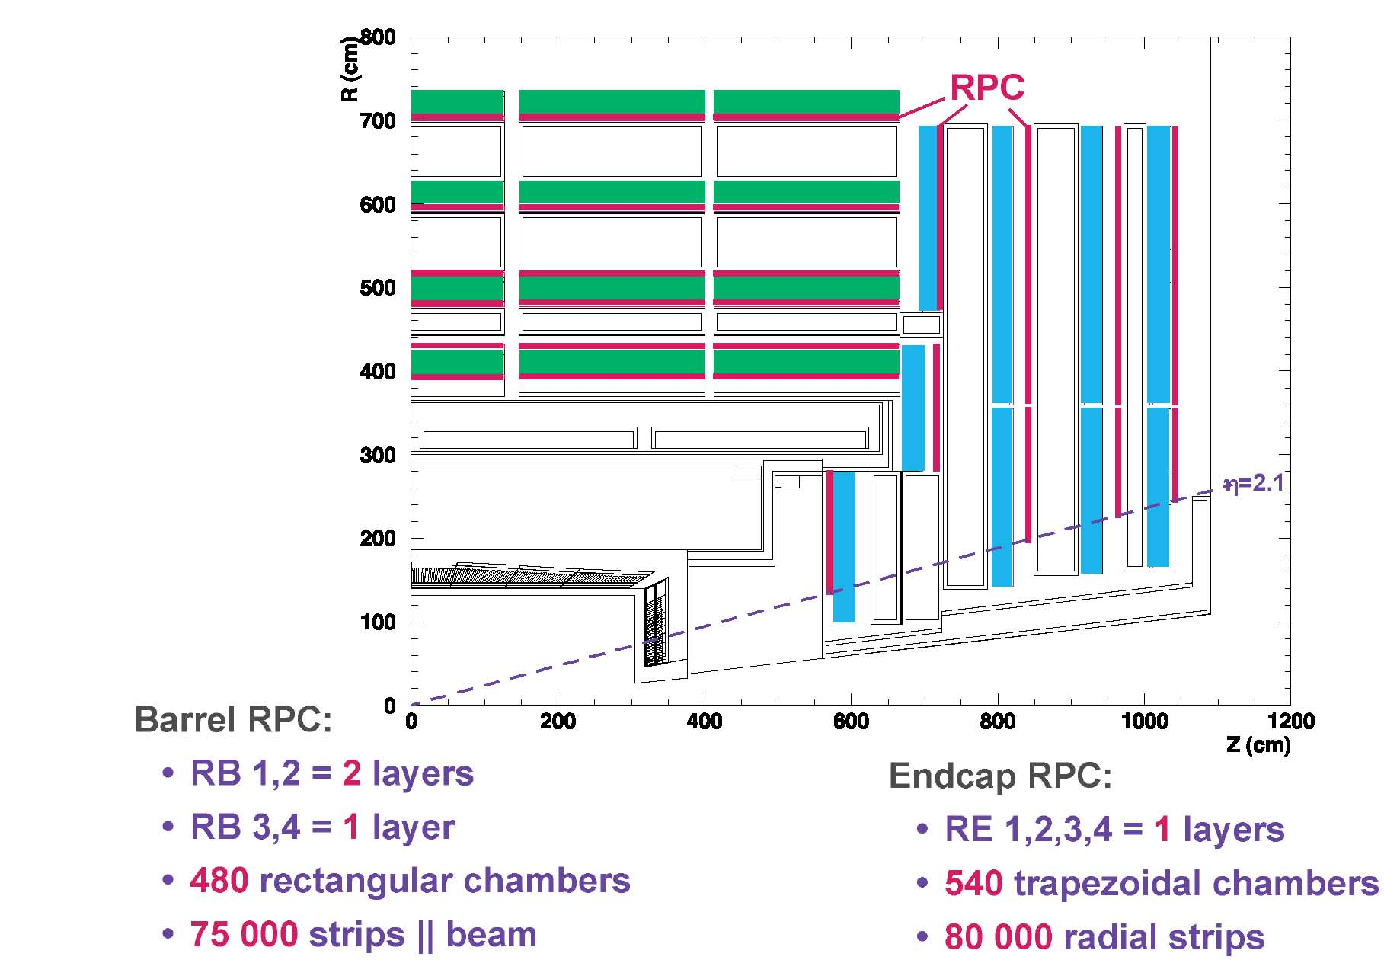
CMS RE1-1 project
1m x 0.5m
MPGD Vs RPC
Faster
Radiation hardness

Slide 6
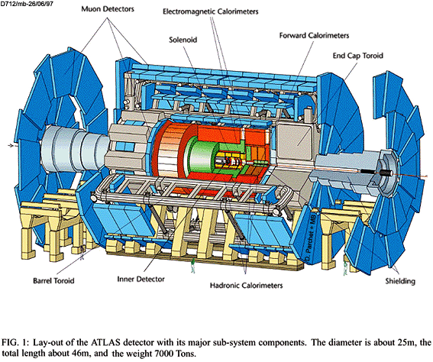
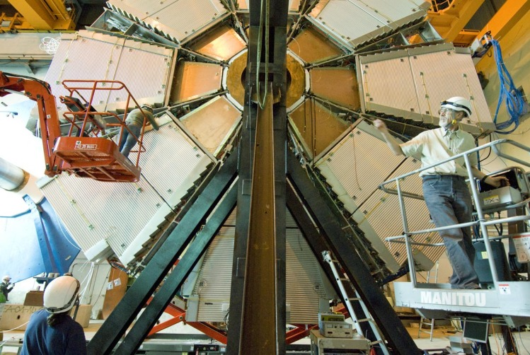
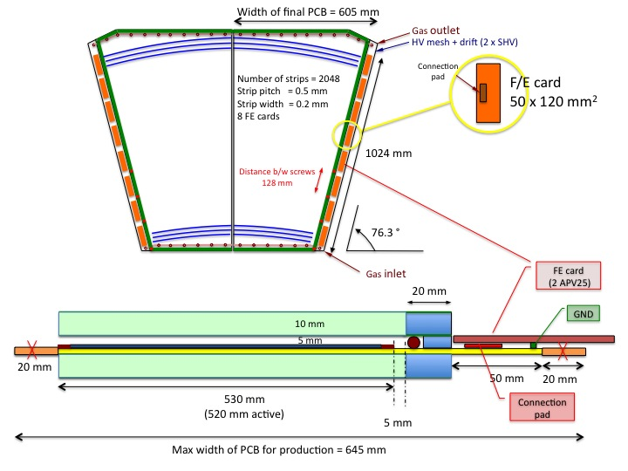
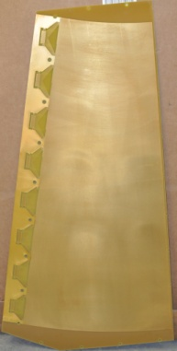
Atlas CSC replacement project
1.1m x 600

Slide 7
Timing
CMS
  2010 → 2 prototypes OK
  2011→ build 2 new prototype for test beams
  2012→ large production of 80 detectors at CERN
  2013→ large volume production with industry
Atlas
  2010→ prototype Normal Bulk OK
  2011→ build large protected Bulk
  2012→ install few detectors in ATLAS
    Start large volume production with industry (100pieces)

Slide 8
Equipment
Investment of 785 KChf 2010-2011
  Large developing machine (DR)
  Large copper etching machine (DR)
  Large stripping machine (DR)
  Large laminator (ordered)
  Large dryer (ordered)
  Large oven (ordered)
  Large exposure machine(OK)
  Continuous Kapton etching machine(ordered)
  Electro-chemical copper etching line(study)
All the machine should be running by mid 2011

Slide 9
Man power
No problem for 2011
  1 staff + 1FSU affected to CMS project
  1 staff + 1fellow affected to Atlas project
2012
  CMS →2 FSU for large production (100 detectors)
    +1 staff for technology transfer with industry
  Atlas→ 1 staff affected to technology transfer with industry
2013
  CMS+Atlas → 2 staff to follow the subcontracted productions

Slide 10
Thank you
Questions?

Slide 11
Back up slides

Slide 12
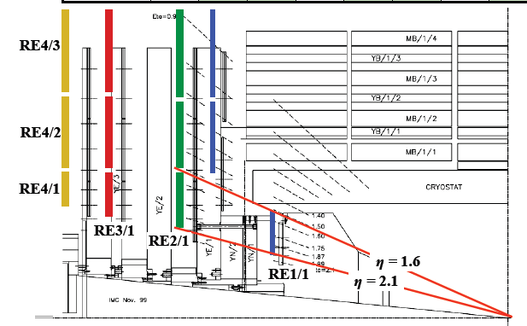
Initial RE system –tailored to budget
Reduced RE system
|η| < 1.6
η 2.4
η=2.4
STAGED

Slide 13
Estimated Particle rates in Forward CMS
RPC Region | Rates Hz/cm² LHC (10³⁴ cm²/s) | High Luminosity LHC ^{2.3 x LHC} | (10³⁵cm²/s) Phase II SLHC ??
RB | 30 | Few 100 | kHz (tbc)
RE 1, 2, 3,4 η < 1.6 | 30 | Few 100 | kHz (tbc)
Expected Charge in 10 years | 0.05 C/cm² | 0.15 C/cm² | ~ C/cm²
RE 1,2,3,4 η > 1.6 | 500Hz ~ kHz | Few kHz | Few 10s kHz
Total Expected Charge in 10 years | (0.05-1) C/cm² | few C/cm² | Few 10s C/cm²

Slide 14
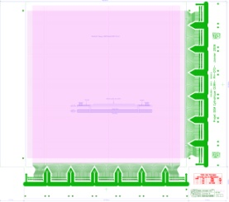
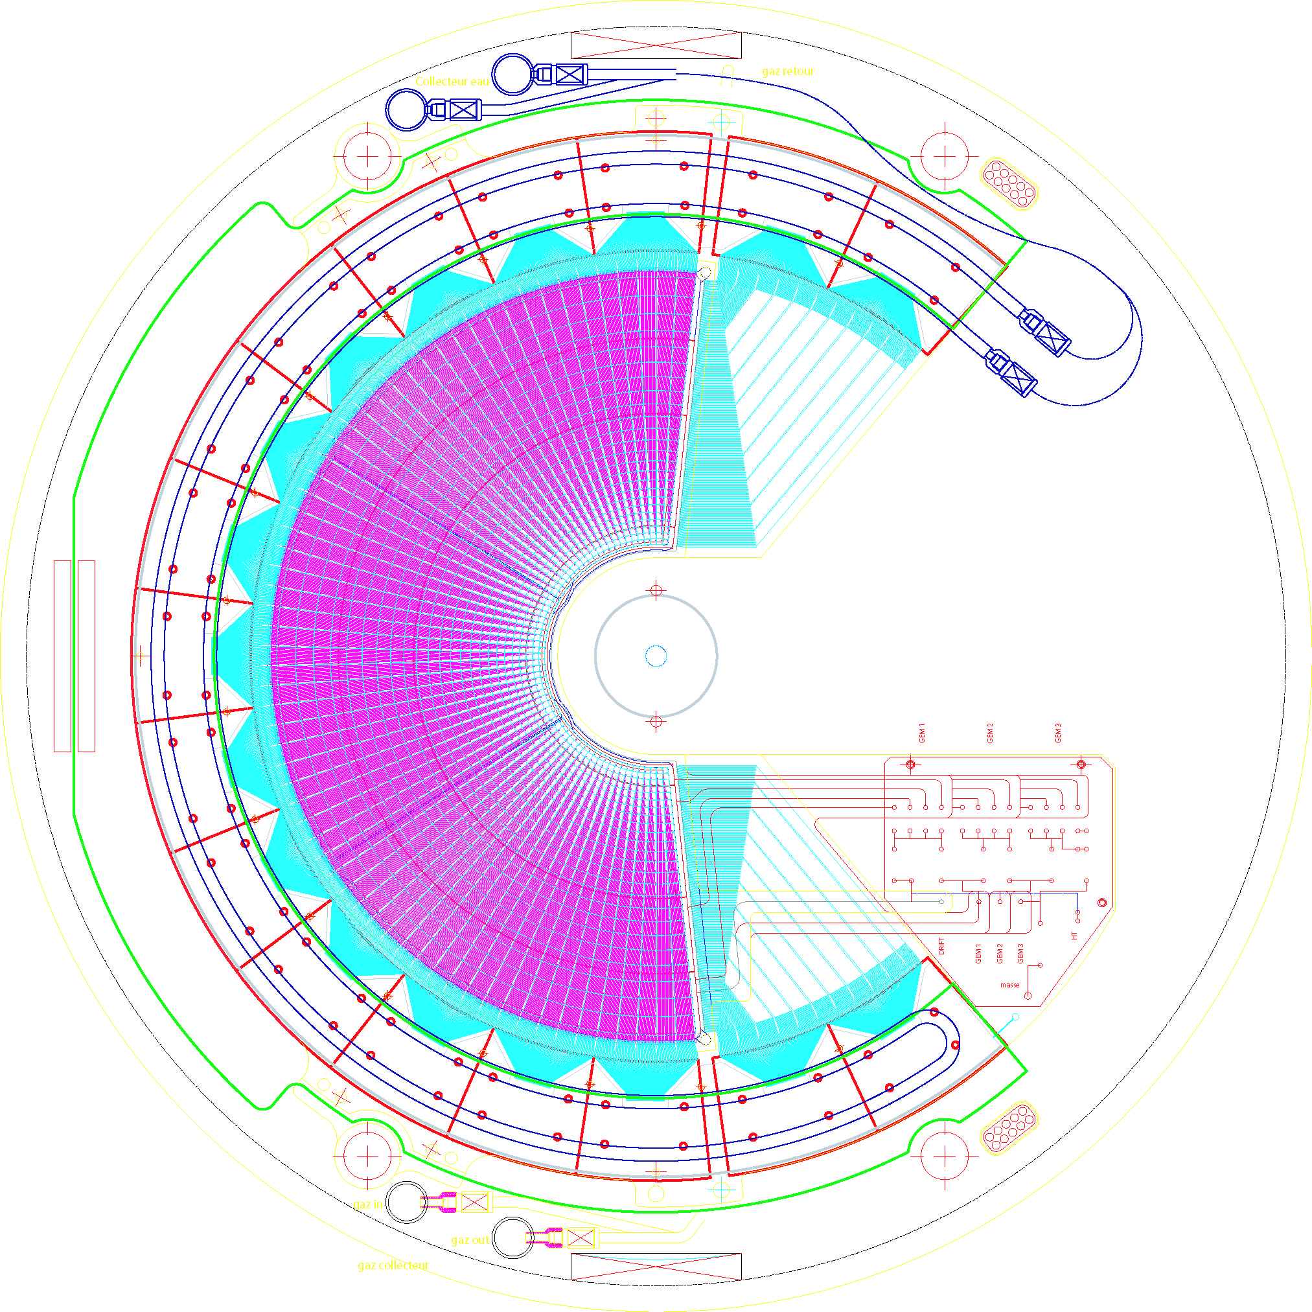
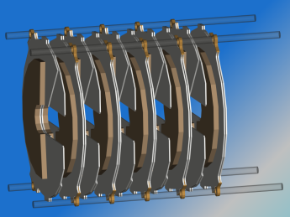
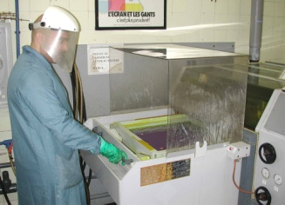
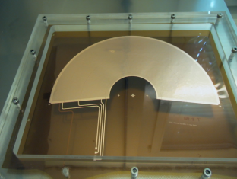
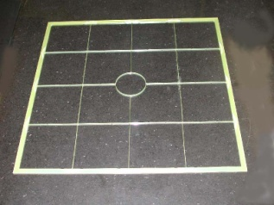
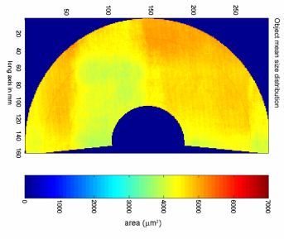
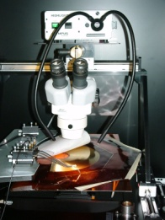
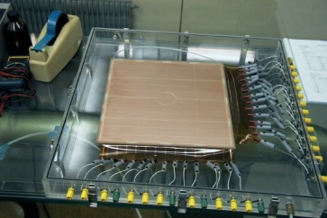
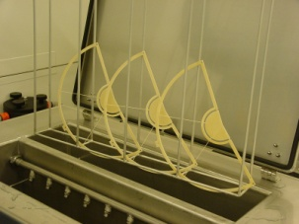
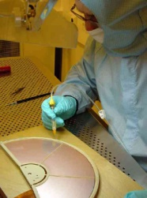
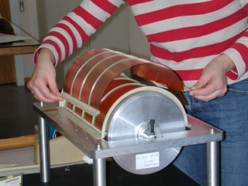
GEM Detectors at CERN
CERN is involved in all aspects of GEM detectors design, production and applications.
Detector Design
Component Production
Component Quality
Control
Detector Assembly

Slide 15
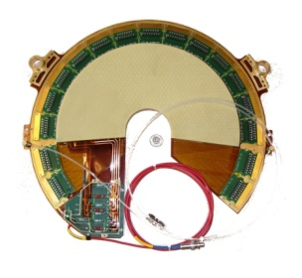
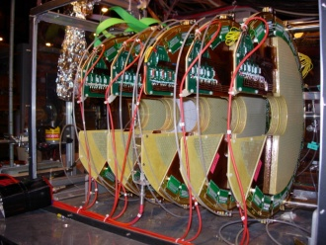
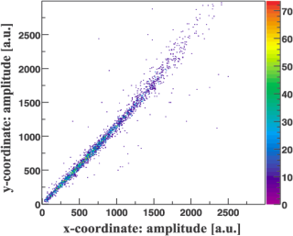
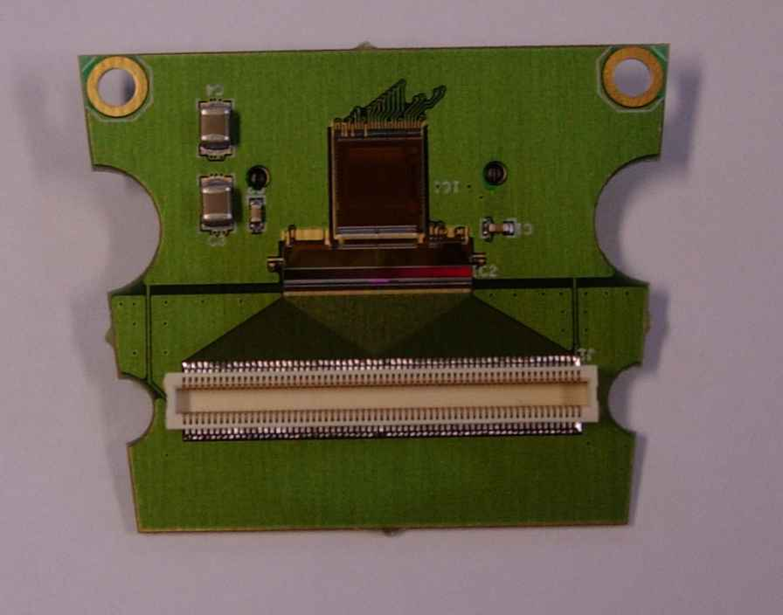
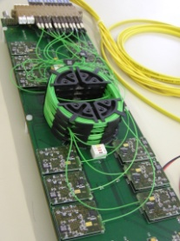
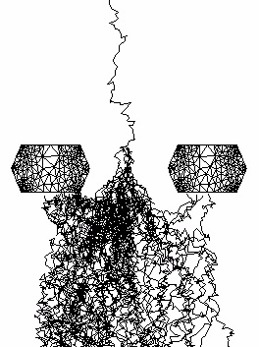
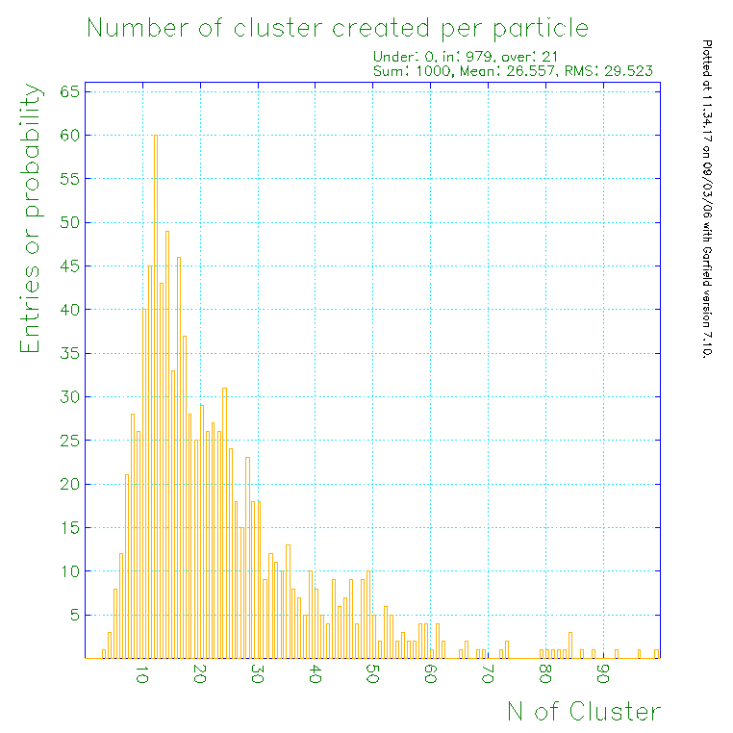
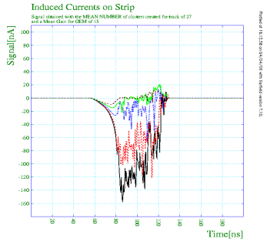
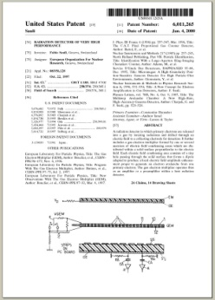
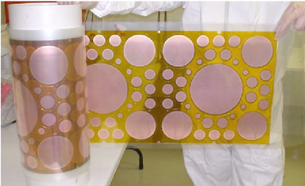
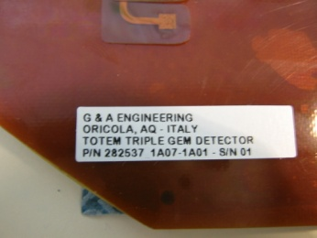
GEM Detectors at CERN
Detector Test
Readout Electronics
Detector Simulations
Technology Dissemination

