Slide 1
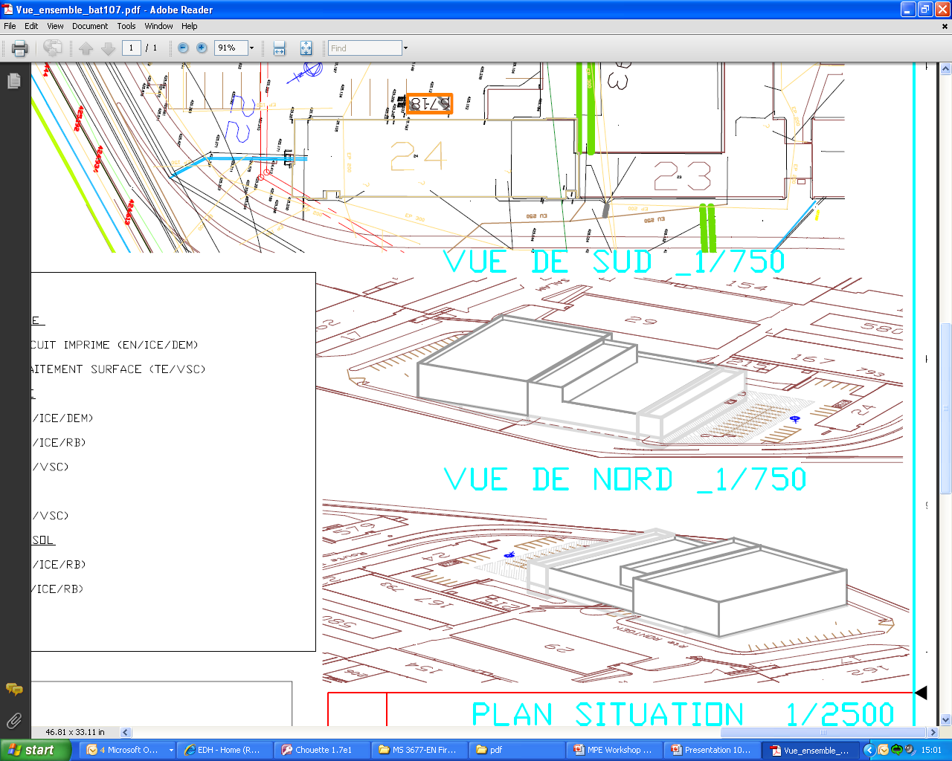
MPE Workshop
14/12/2010
Building 107- project
Raphaël Berberat 14.12.2010 1

Slide 2
Building 107-project
TE-MPE-EM: structure & organisation
Section Leader: Fabio Formenti Number of workers: 41
Planning Office
technological and commercial choices
invoicing
Design Office
Subcontracting
ordering, collecting components, tracking
Industry
PCB Manufacturing Workshop
Assembly Workshop
Raphaël Berberat 14.12.2010 2

Slide 3
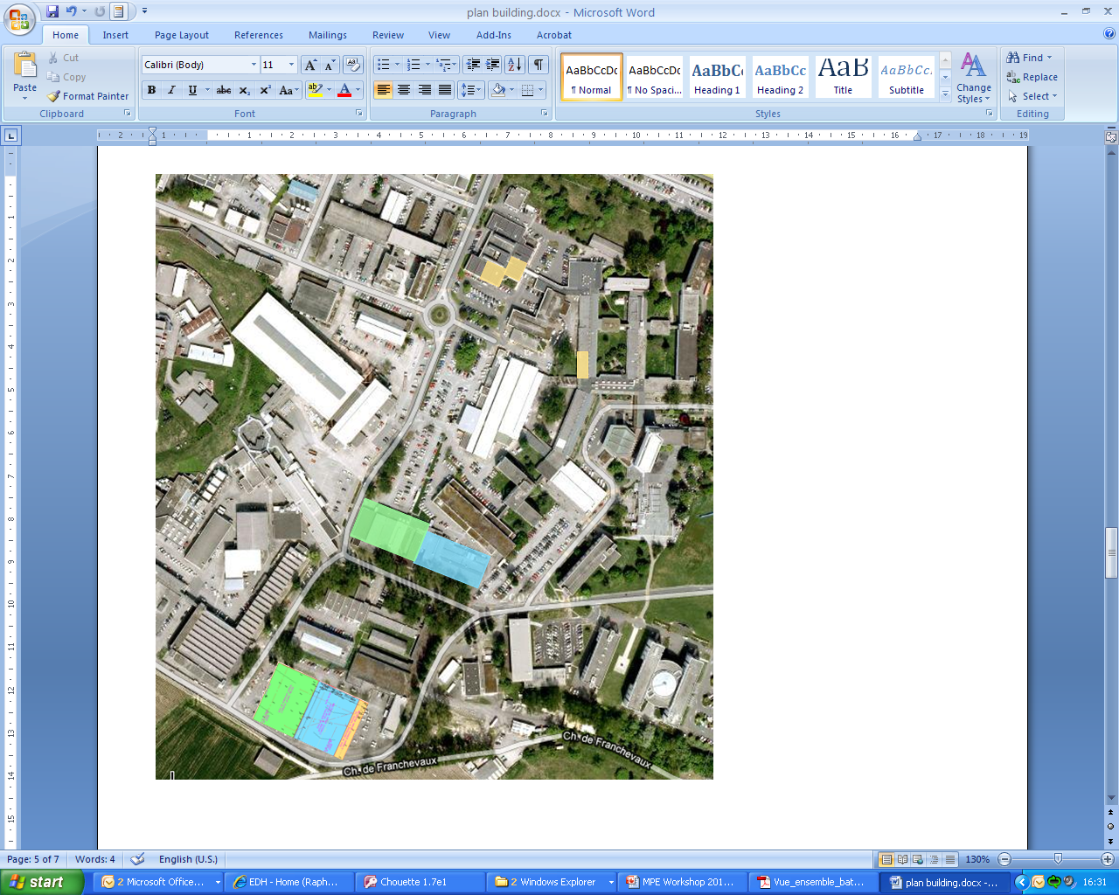
Building 107-project
A new building - why?
DG stated that this project is a priority for CERN
Conformity with the current regulation
Need more space for new physics development and for the new machines dedicated to these products (MPGD)
Safety for environnement and personel
Who is concerned?
TE-VSC-SCC (Surface, chemistry & coating)
TE-MPE-EM (Electronic modules)
  Design & planning office
  PCB manufacturing
  Assembly WorkShop
Opportunity for EM to be grouped in one building
Raphaël Berberat 14.12.2010 3

Slide 4
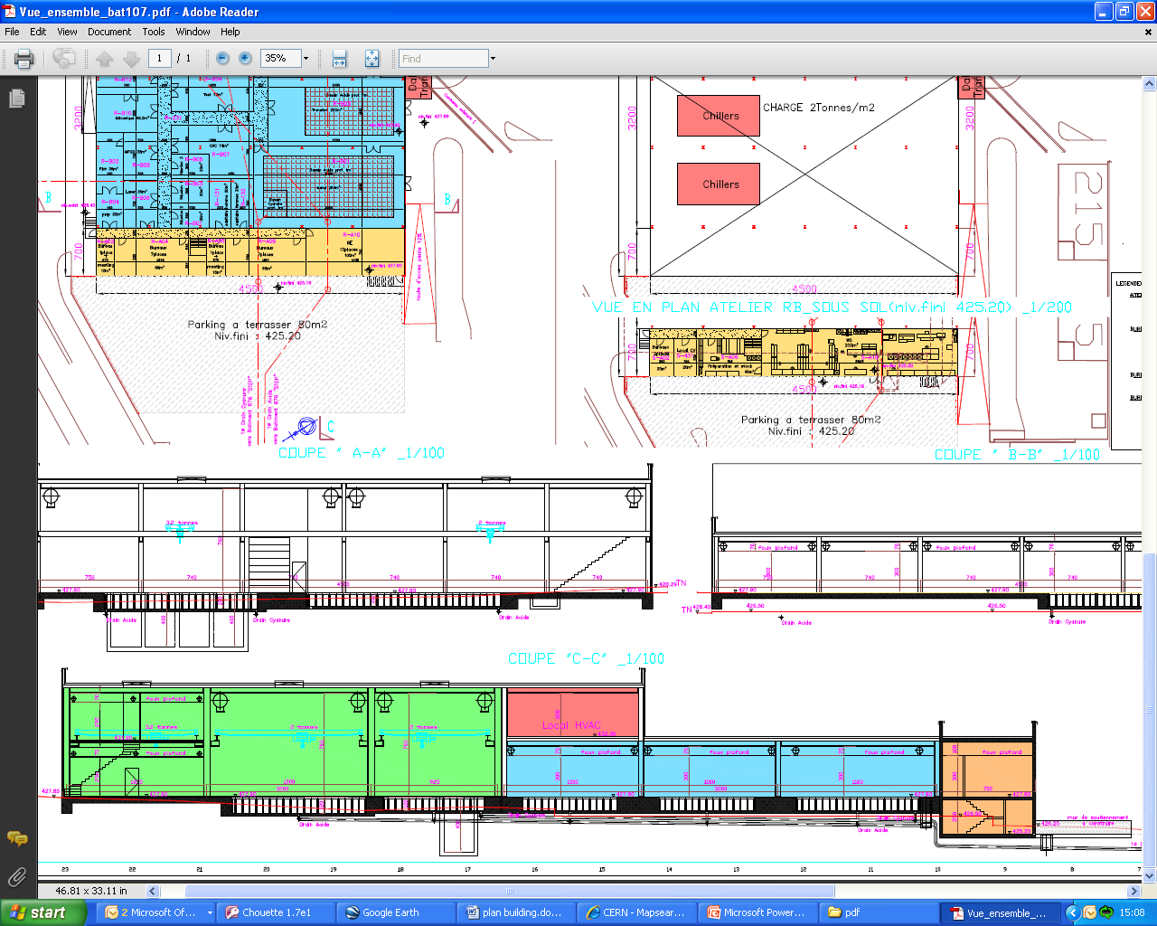
Building 107-project
TE-MPE-EM: proposed layout 1/2
TE-MPE-EM
TE-VSC-SCC
PCB manufacturing
Design office
PCB Assembly WS
Raphaël Berberat 14.12.2010 4

Slide 5
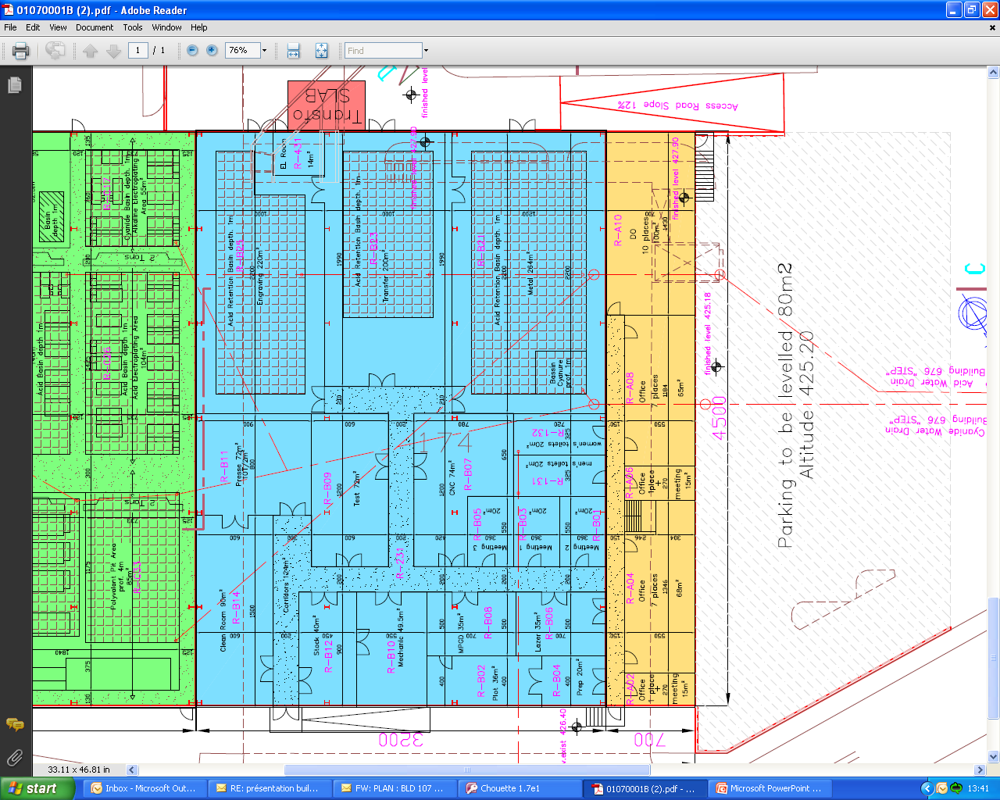
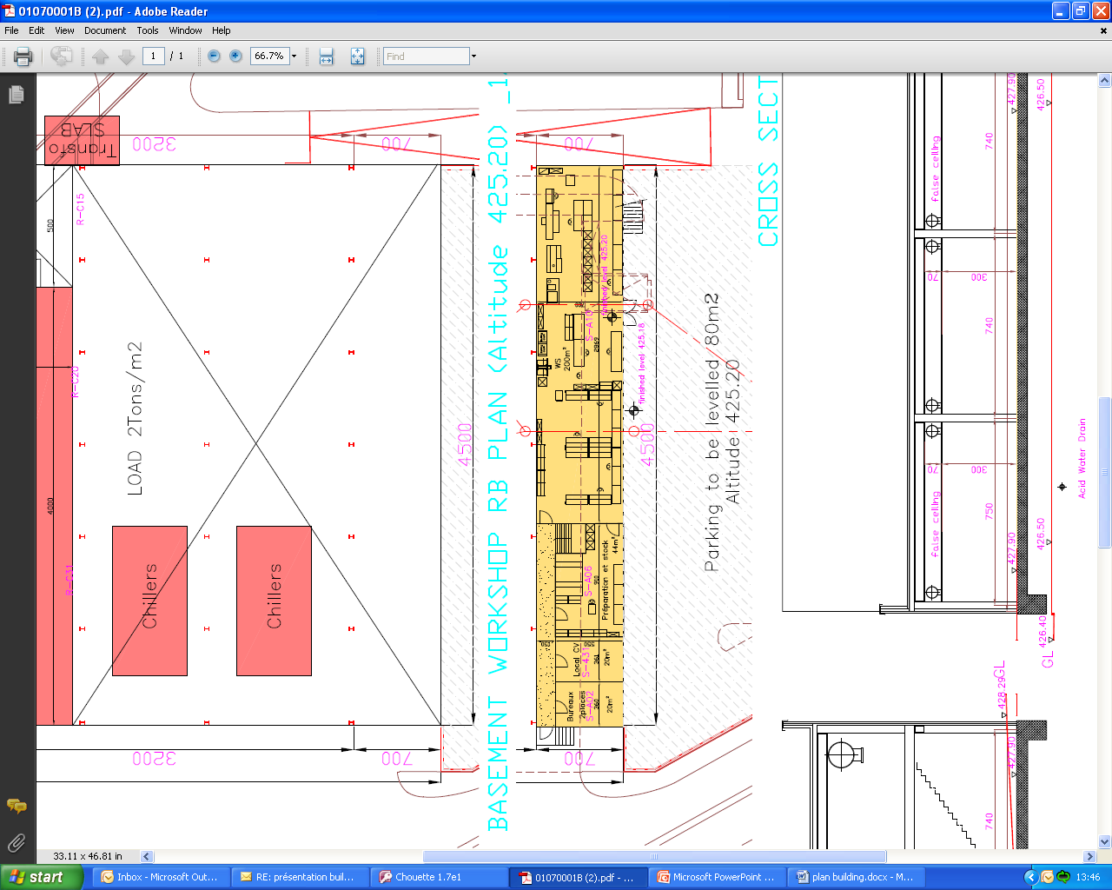
Building 107-project
TE-MPE-EM: proposed layout 2/2
PCB manufacturing
First floor:
Design office
Ground floor:
PCB Assembly WS
Wet area
Open space offices
Clean room
Dry area
Common mecanical WS
Raphaël Berberat 14.12.2010 5

Slide 6
Building 107-project
Main characteristics of the new building
Civil engineering:
  Total floor Area of the building: 3200m²
  Underneath the ground floor of the wet processes, collecting basins for retention means have to be installed
    100% of the capacity of the largest tank and
    50% of the total capacity of all associated tanks
  Connection to the existing waste water treatment plant (building 676) located approx. 100m from the building 107 site
Cooling and ventillation infrastructure:
  Hazardous air extraction and treatment
  Air conditionning and humidity control
Electrical infrastructure:
  Connection to an existing 18kV sub-station with a new transformer dedicated for the new building
  UPS, 48VDC and diesel back-up network
Other:
  Access control
  IT Network
  Alarms (fire and gas detection)
Raphaël Berberat 14.12.2010 6

Slide 7
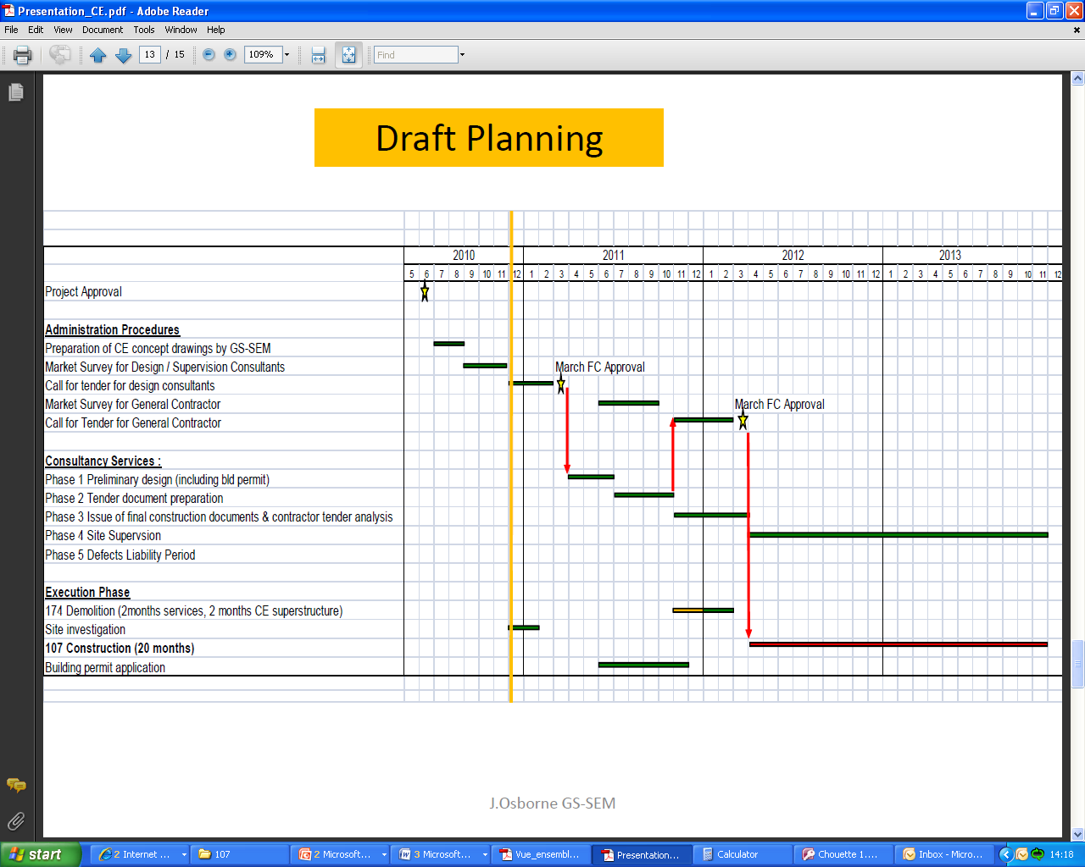
Building 107-project
Organization and planning
Due to the short planning, the project will be split in 2 contracts:
For the design and supervision
For construction works
Phase 1:Preliminary design [April - June 2011]
Phase 2:Tender design [July - October 2011]
Phase 3:Construction design [November 2011 - March 2012]
Phase 4:Site supervision of the construction works [April 2012- November 2013]
Phase 5:Defects liability period [one year after the end of construction]
Raphaël Berberat 14.12.2010 7

Slide 8
Building 107-project
Summary:
A new building to be:
  conforming with the current regulation
  Able to build new physics big detectors (MPGD, GEM)
  Safety for environment and personel
TE-VSC-SCC & TE-MPE-EM are concerned
  Opportunity for EM to be grouped in one building. Benefit for team spirit and for synergies
Big challenges for the new building regarding all the processes implemented on site
  Waste water treatment
  Cooling and ventillation treatment
  Electrical with connection to the sub-station 18kV with new transformer
Short planning from April 2011 to November 2013
  Project split in 2 contracts
Raphaël Berberat 14.12.2010 8

