Slide 1
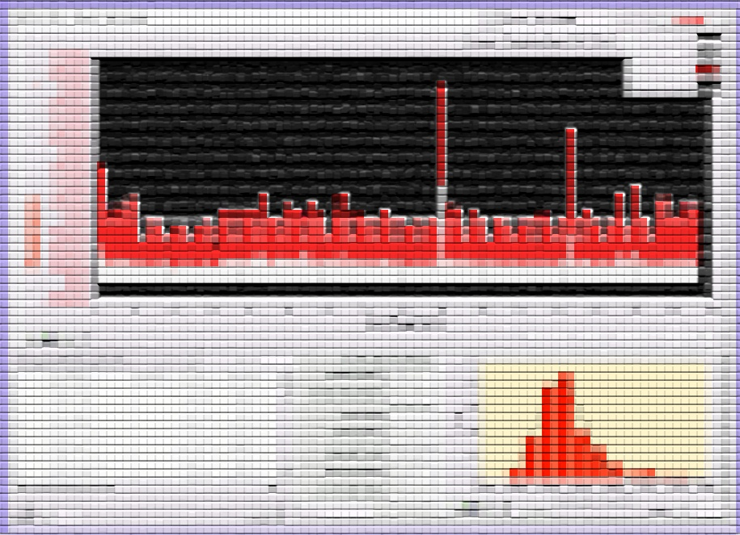
MPE Workshop
14/12/2010
Analysis of the RB and RQF/D splice data recorded with nQPS - status and plans towards full automation
Zinour Charifoulline

Slide 2
Analysis of the RB and RQF/D splice data recorded with nQPS - status and plans towards full automation
Splice Resistance Monitor application had been developed based on the following input signals:
nQPS RB and RQF/D Splice Data, recorded to LoggingDB (2048 channels):
U_RES(time), voltage drop on Bus Segments, ±12.8mV@24bits(1.5nV), 5Hz, 10s moving average (~50points);
U_RES_SPLICE(time), decimated version of U_RES(time), every 10th points;
U_MAG(time), voltage drop on Magnets, ±15.9V@24bits(1.9µV), 5Hz, 10s moving average (~50points);
U_MAG_SPLICE(time), decimated version of U_MAG(time), every 10th points;
FGC Data, recorded to MeasDB and LoggingDB, 24 channels
I_MEAS(time), main magnet circuits currents, 10Hz@MeasDB or decimated clone in LoggingDB;
Originally Splice Resistance Monitor was designed to measure the bus segment splice resistances (main target),
but it had acquired some important additional functionalities (development & commissioning at the same time):
nQPS (BS&DS) signals monitoring interface – widely used during LHC HWC and start up (cables connections check,
powering events analysis, …)
compensation coefficients calculation - done by analyzing of U(I)-curves during the ramps;
noise statistics, noisy channels detection;
bus segment resistance calculation – done by a linear fit of U(I)-curves taking into account only plateau points;
linear fit details window;
statistical analysis of a whole powered sector – average splice resistance, excess resistances, statistics, …;
magnet resistance calculation (but resistance being evaluated by statistical approach on outputs from many ramps!);
Still missing (☹): user manual, technical report about analysis details, results summary report;
Under development: special sophisticated analysis of a single bus segment together with neighbored magnets – might be useful for RRR tests, quench propagation investigations, …

Slide 3
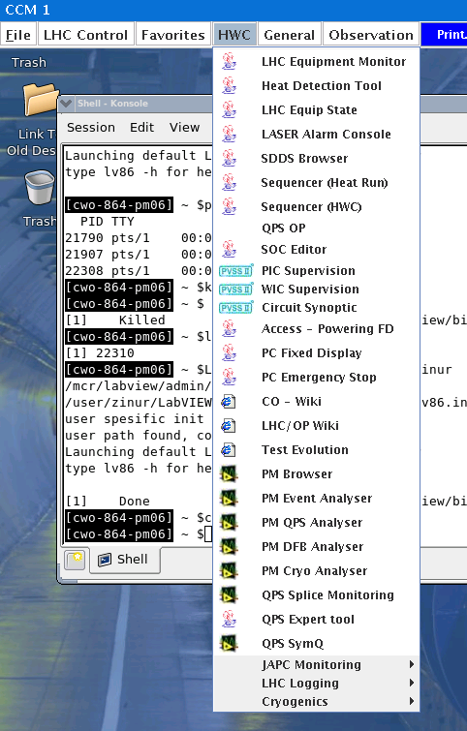
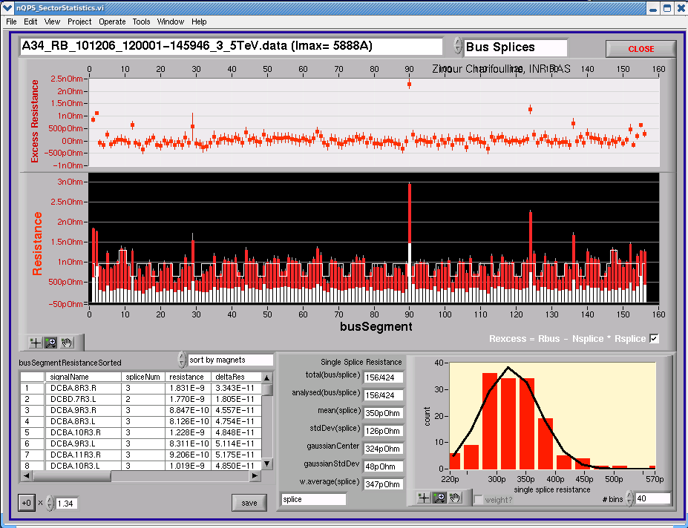
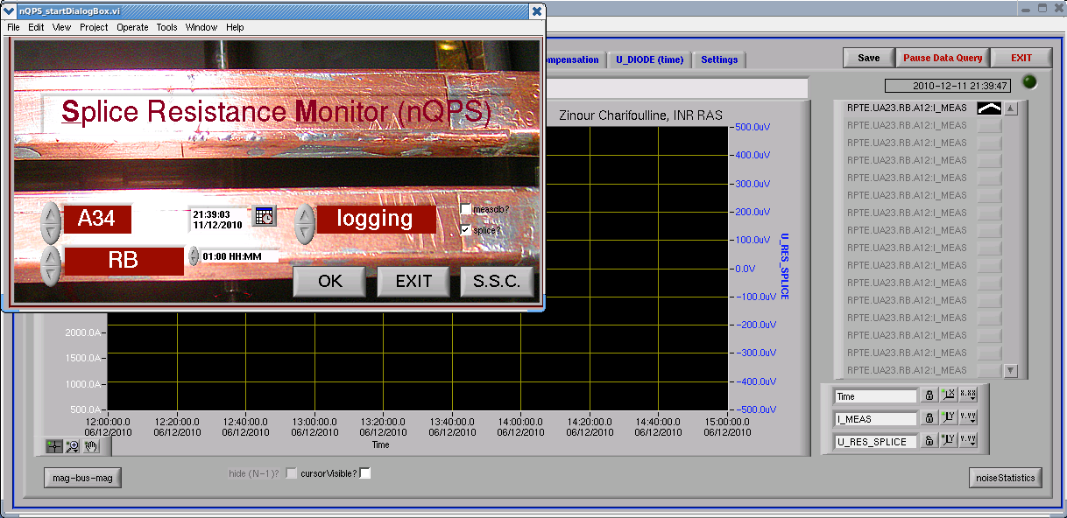
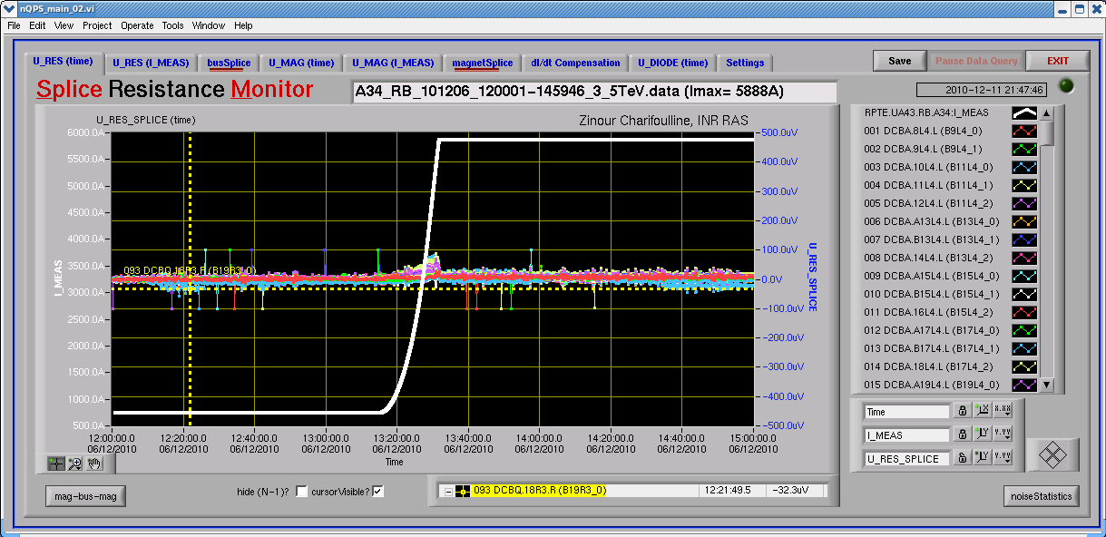
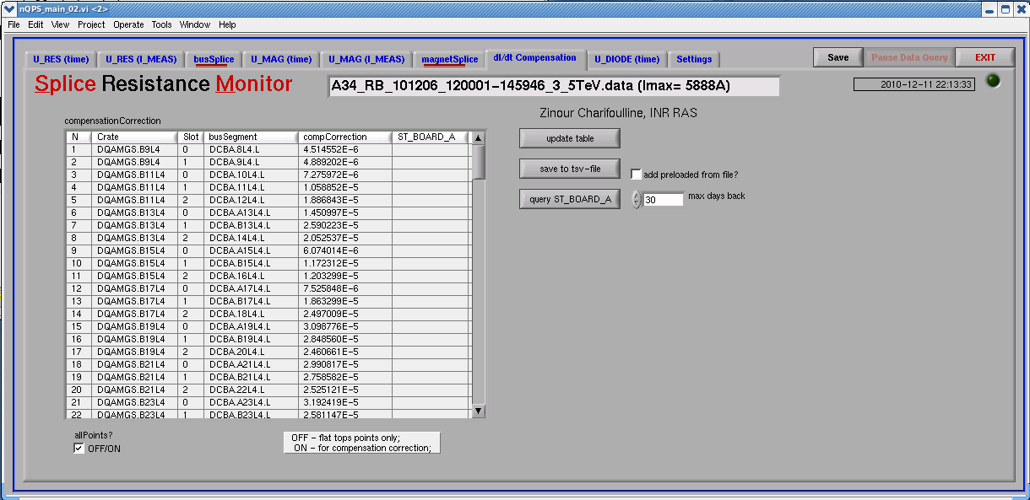
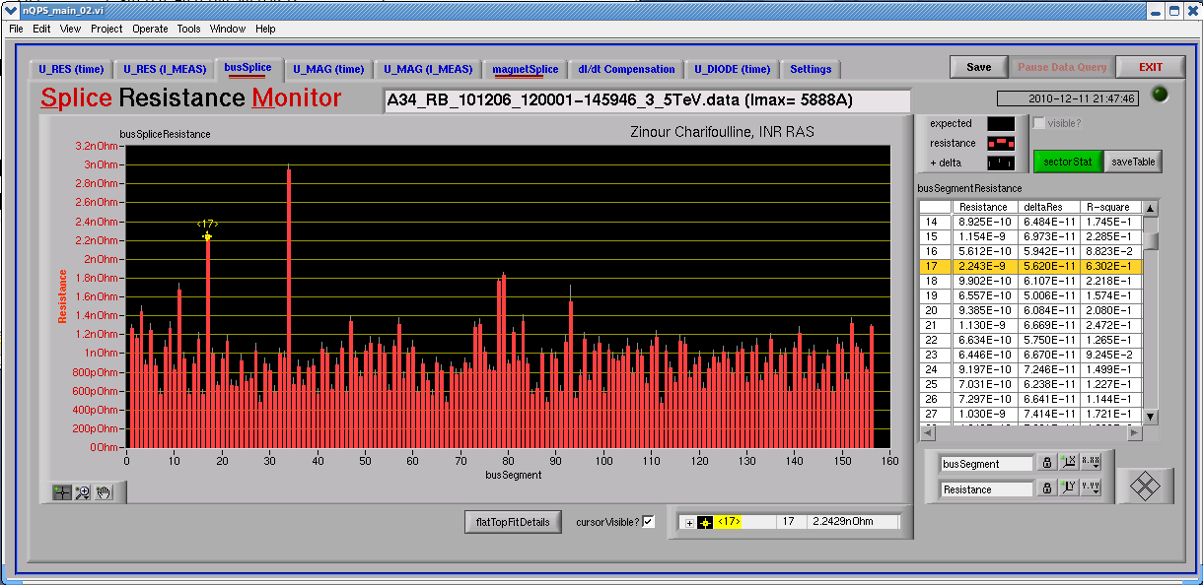
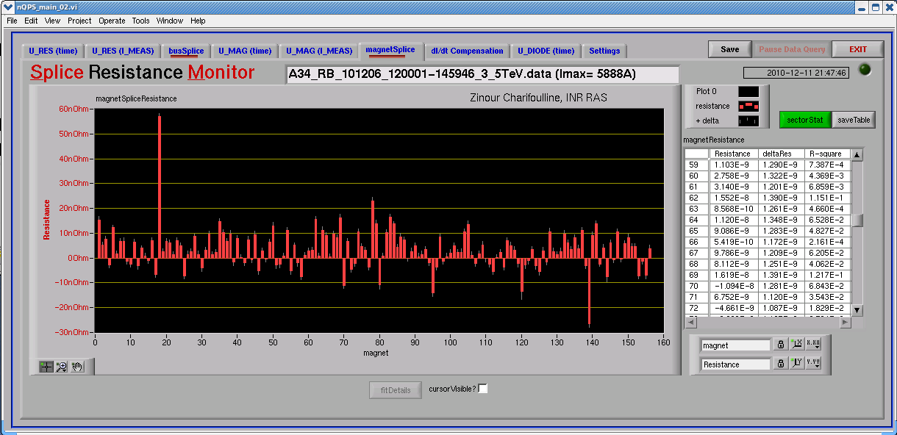
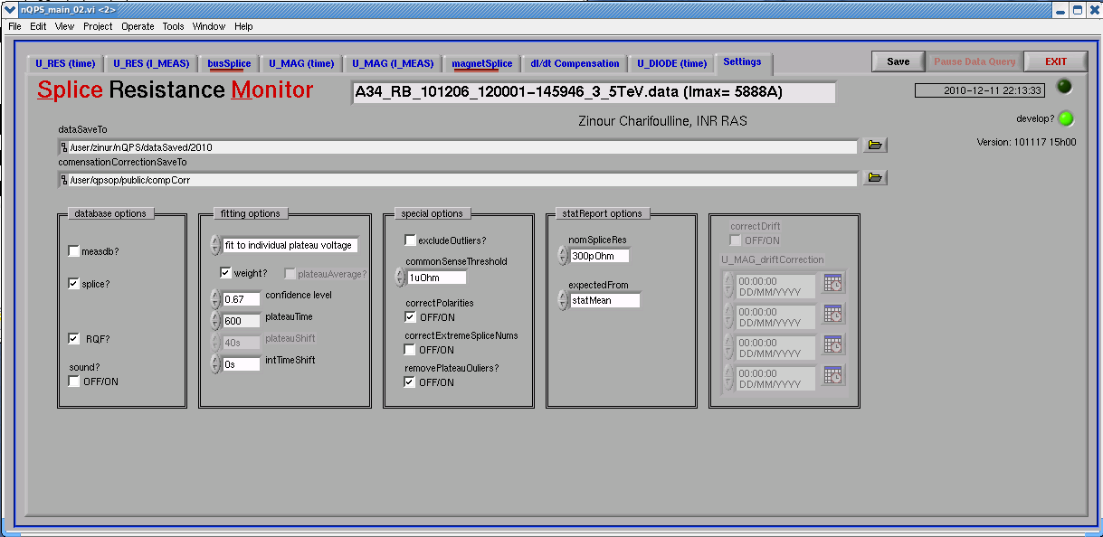
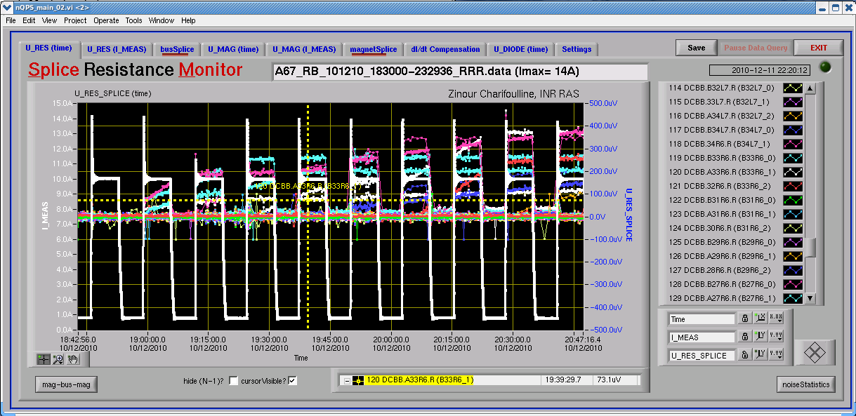
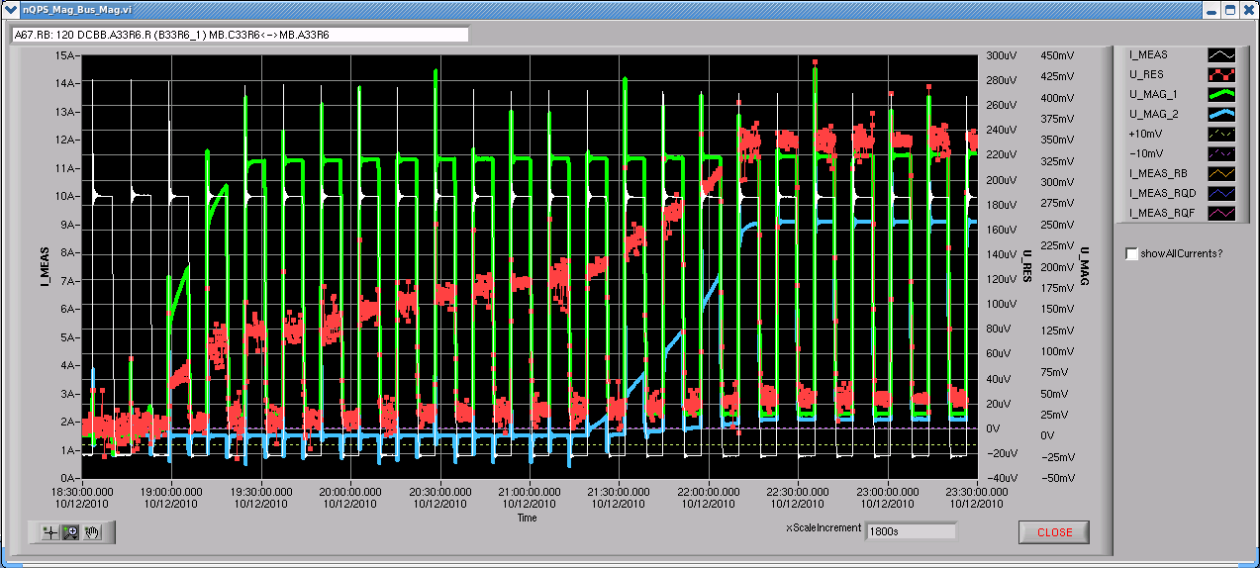
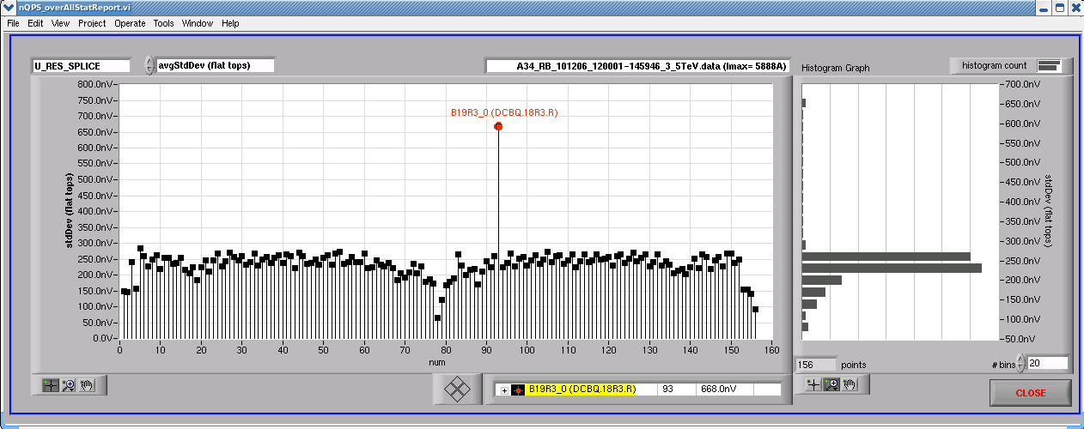
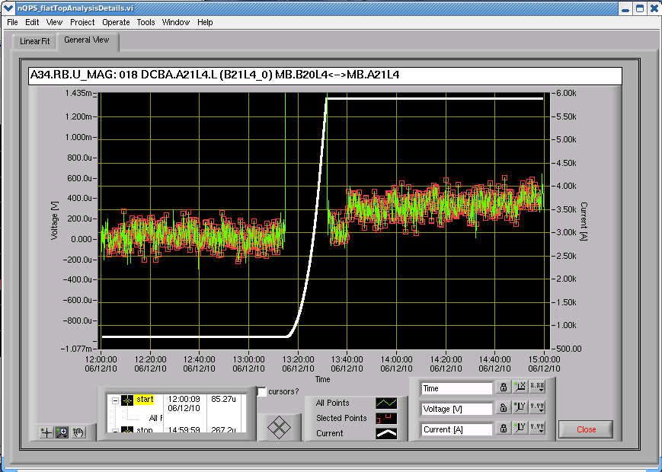
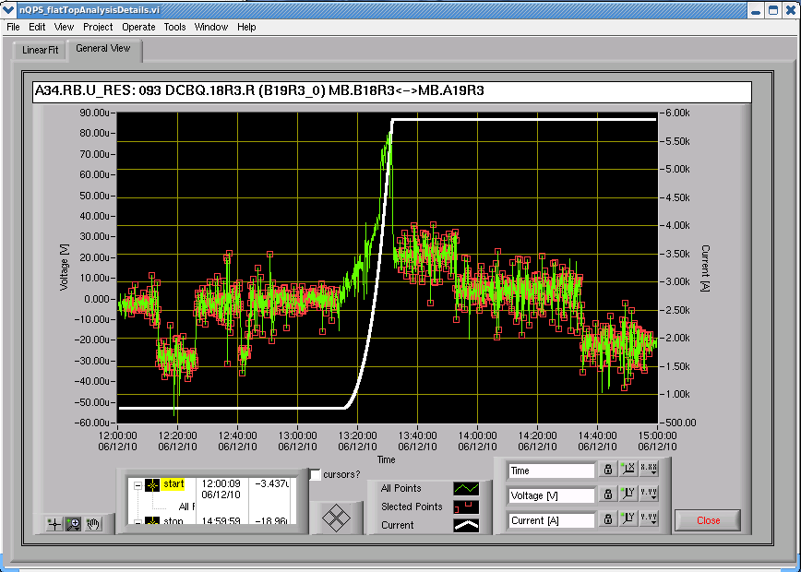
Analysis of the RB and RQF/D splice data recorded with nQPS - status and plans towards full automation
Missing documentation?
Compensation coefficients
Whole sector signals view
Noise statistics
“steps” noise
[abcopm**]> sm - production version
[abcopm**]> sm prev - previous version
“…/user/pma/PM_app86/nQPS/prod”

Slide 4
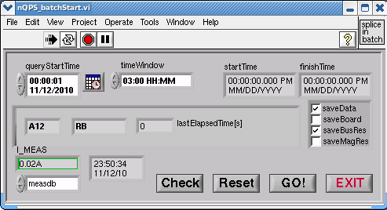
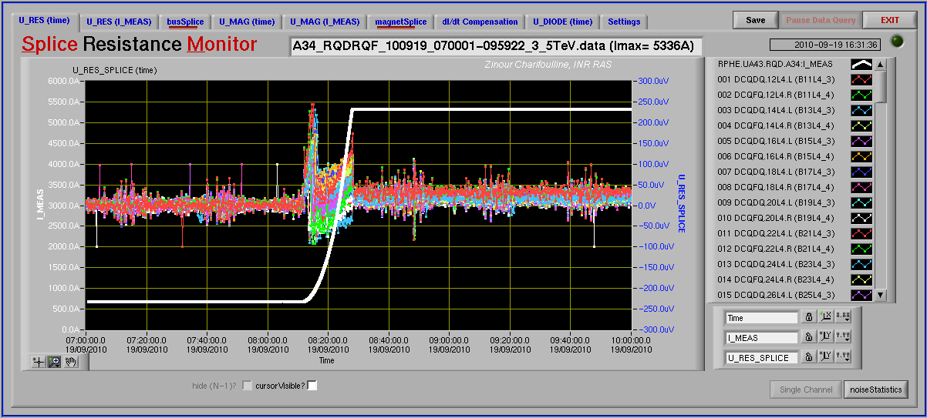

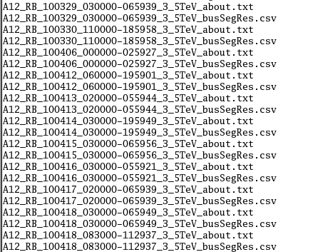
Analysis of the RB and RQF/D splice data recorded with nQPS - status and plans towards full automation
Special “nQPS_batchStart” application:
detects “good” 3.5TeV ramps (1h@inj & 1h@top);
triggers resistance calculations for all sectors in batch mode;
save results (ascii csv-files for the time being);
Status:
- debugged, run 3-4 months on the desktop;
- manual and fully automated modes;
- ready to start in server mode (on “cs-ccr-qpsm”, qpsop?);
- main target was to collect the internal magnet splice data;
Problem to solve: “step” noise filtering;
Triggers calculations
Injection ~3 hours 3.5TeV
Pilot version of Splice Statistical Control package
is included now to the production version of
Splice Monitor. It allows to:
analyze all saved results,
check time evolutions,
- create last ramp report, …
Not yet realized:
- user friendly interface (for experts now);
- no criteria to send an alarm/sms;
Next step: fix alarms criteria and apply them just
after the new ramp resistances being saved.
It will be not so simple to avoid fake alarms …
Saves resistances
batch mode, no front panels

Slide 5
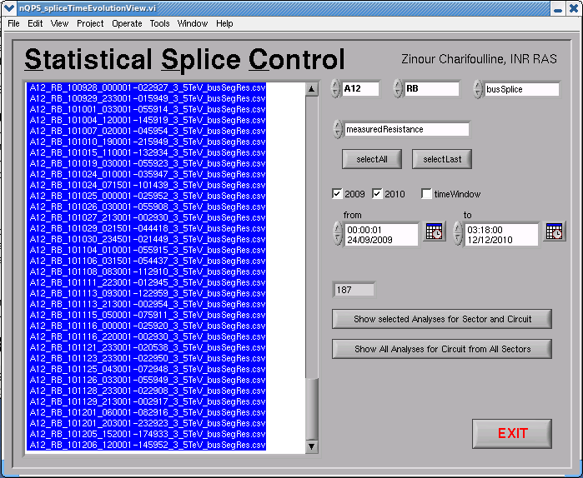
Analysis of the RB and RQF/D splice data recorded with nQPS - status and plans towards full automation
Resistance results storage?
- now they are saved to ASCII csv-files;
- it takes already some time to read the data back: about 200 files per circuit already being collected;
- it would be faster to save results in binary format, but it may create other problems;
Best solution -> Oracle with properly designed tables containing all information from SM application
and from EXCEL tables collected by Mike.
Advantages:
- centralized data storage with relatively easy access from anywhere;
- automatic data integrity (uniqueness, primary keys, constraints, …);
- possibility to trigger alarms by PL/SQL code integrated with tables;
- plenty of instruments for data selection and user interfaces: SQL/Plus, java, Benthic, ApEx, LabView … ;
In future it may become quite useful and powerful database for Splice Consolidation task.

Slide 6
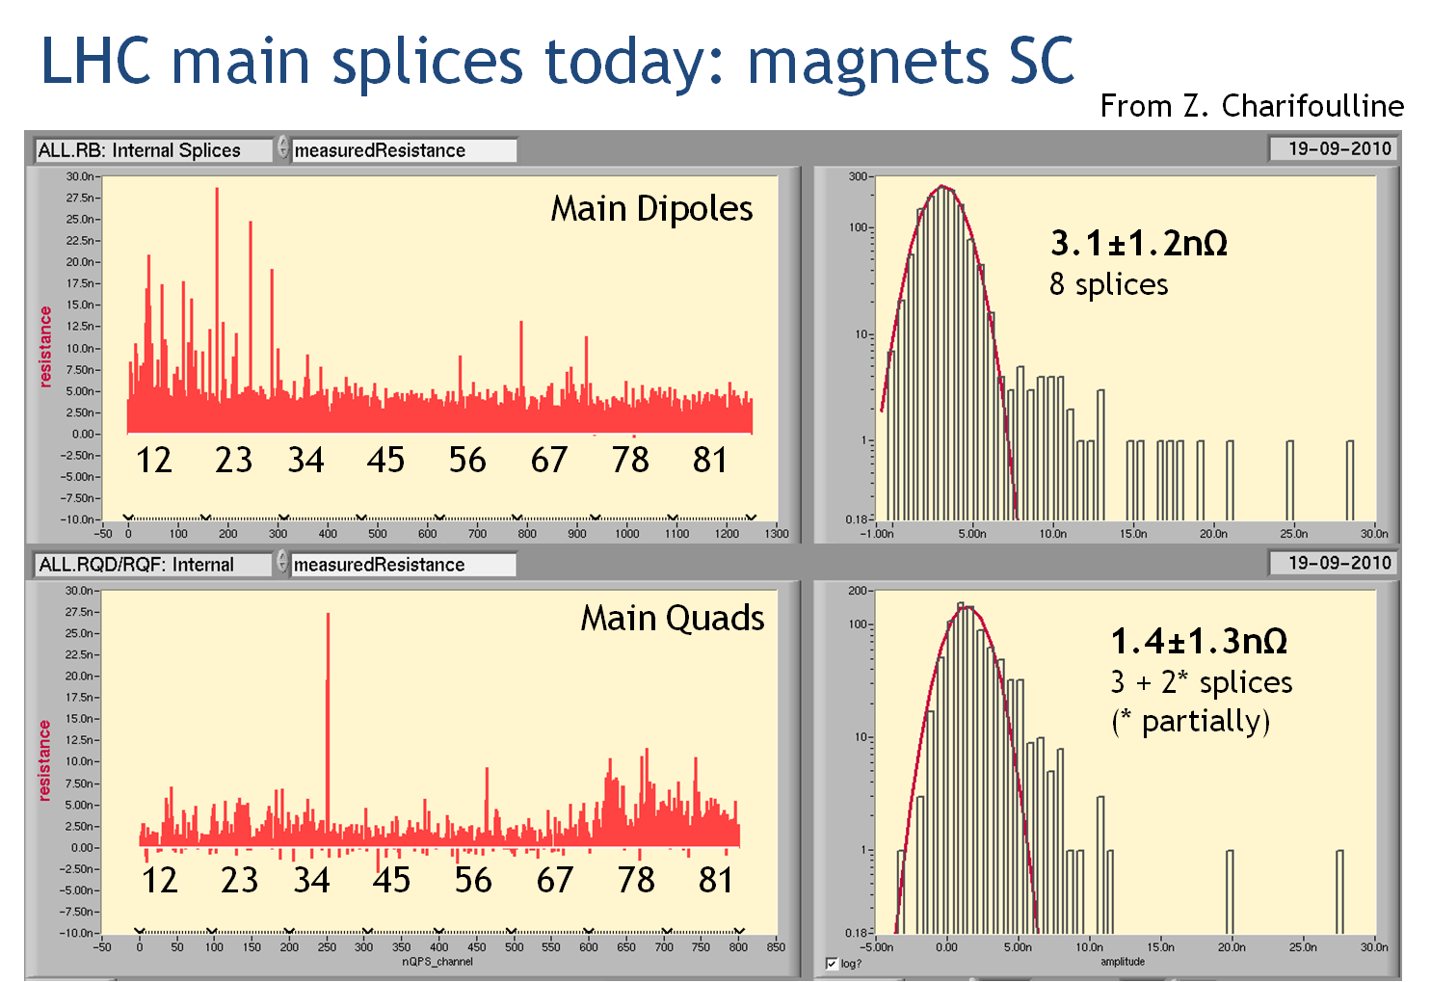
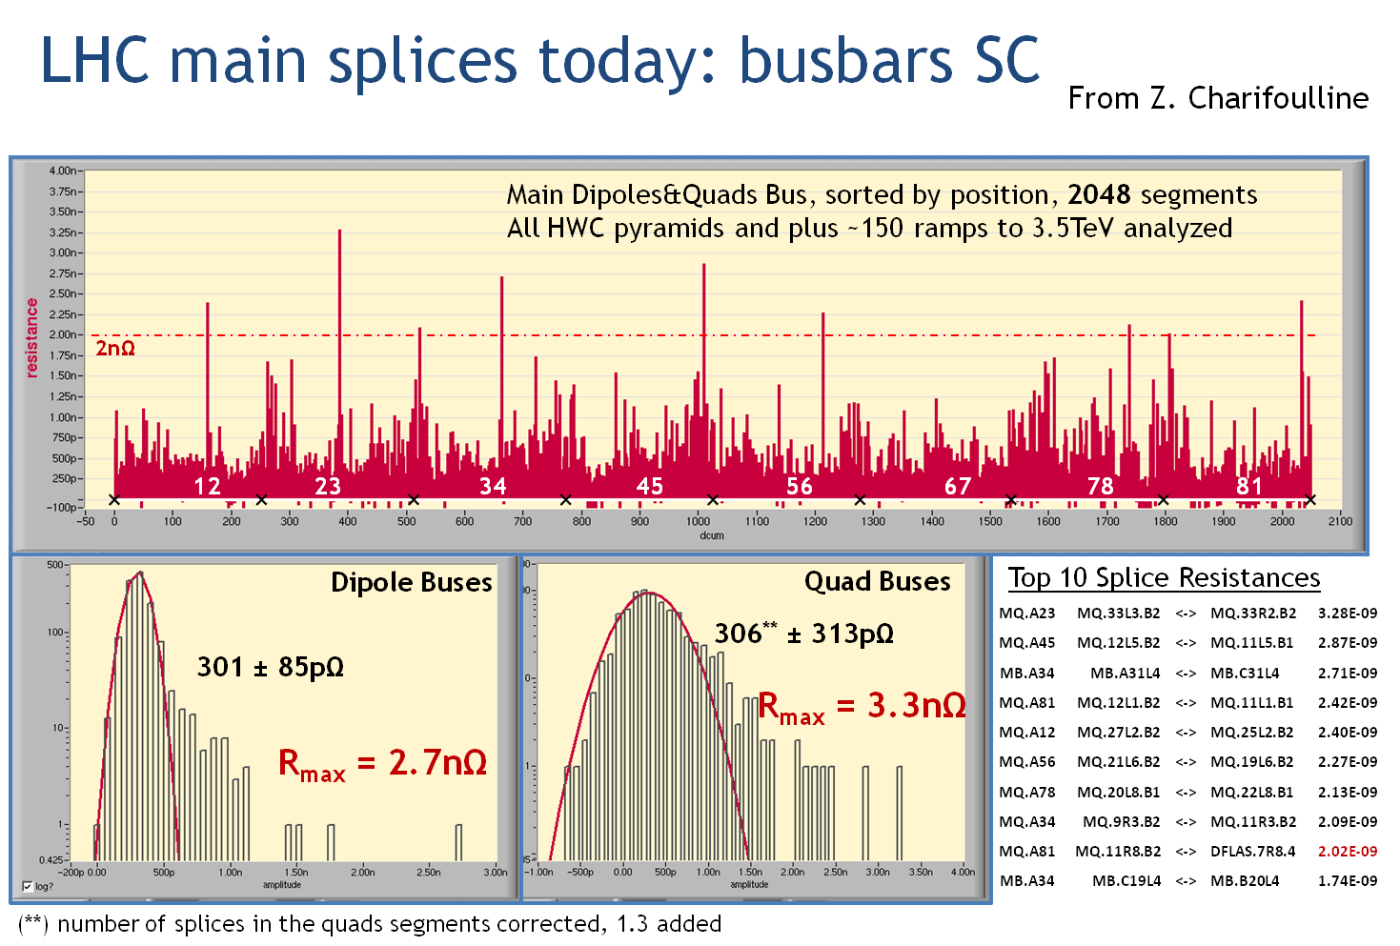
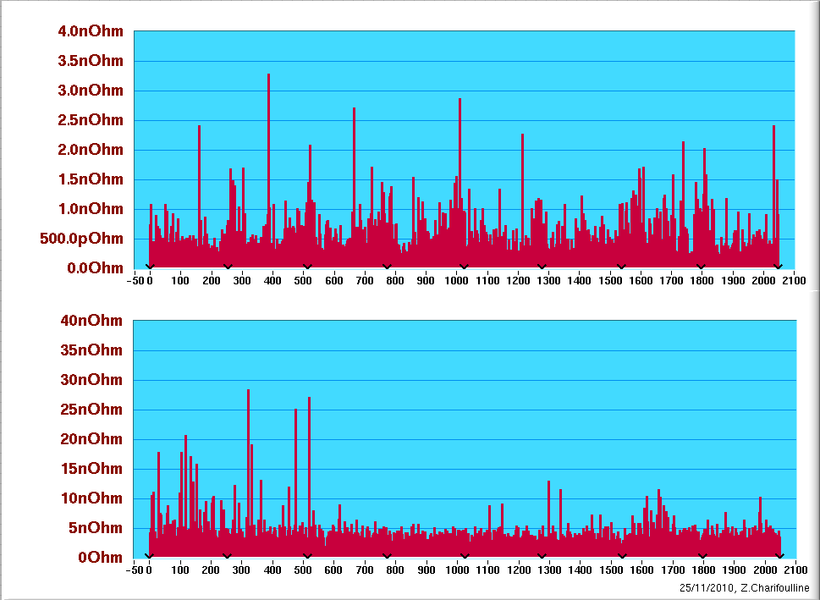
Analysis of the RB and RQF/D splice data recorded with nQPS - status and plans towards full automation
Maximum Splice Resistance in a Bus Segments over LHC
25-Nov-2010
12 23 34 45 56 67 78 81
Main Magnet Resistances over LHC
25-Nov-2010
12 23 34 45 56 67 78 81

Slide 7
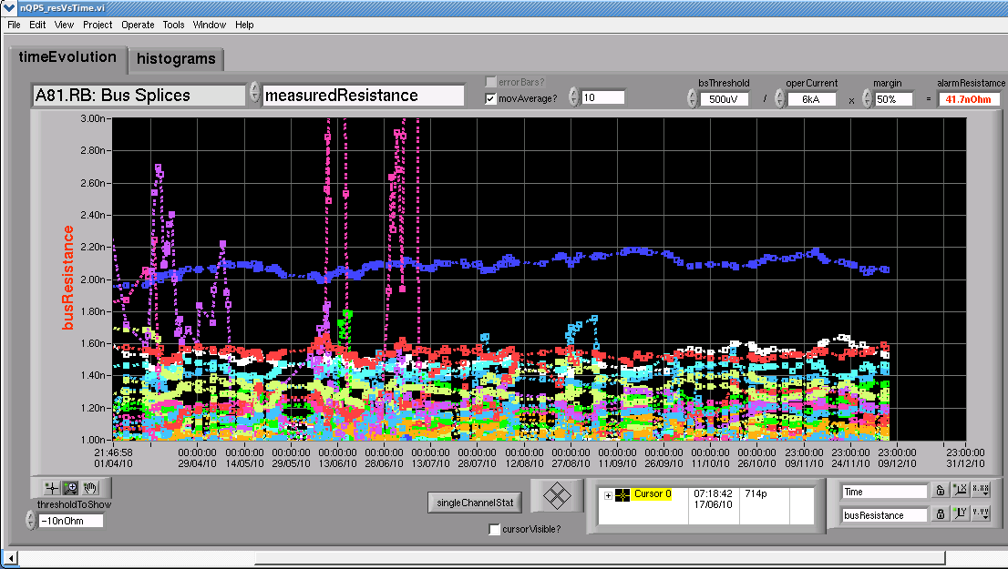
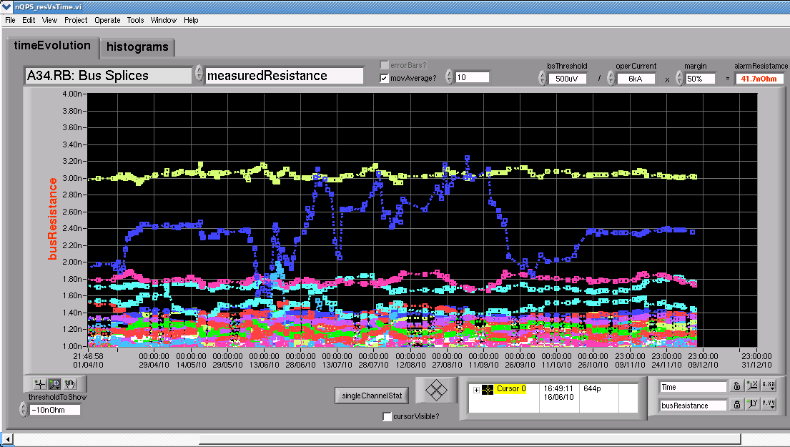
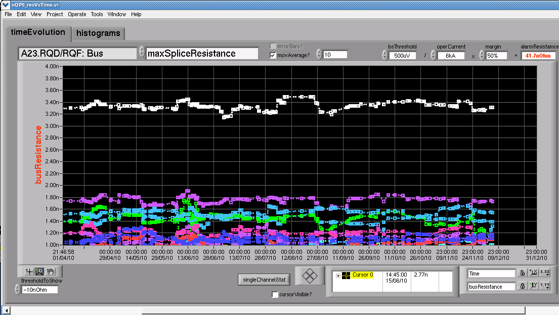
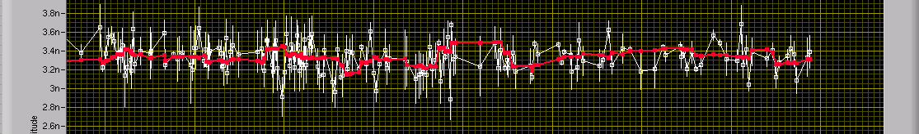
Analysis of the RB and RQF/D splice data recorded with nQPS - status and plans towards full automation
Few examples of “Splice Resistance versus Time” plots.
?
Highest outlier in the machine
highest RB bus outlier
BS board replaced!
B
A
Status: Alarms criteria need to be fixed before switching to full automation

Slide 8
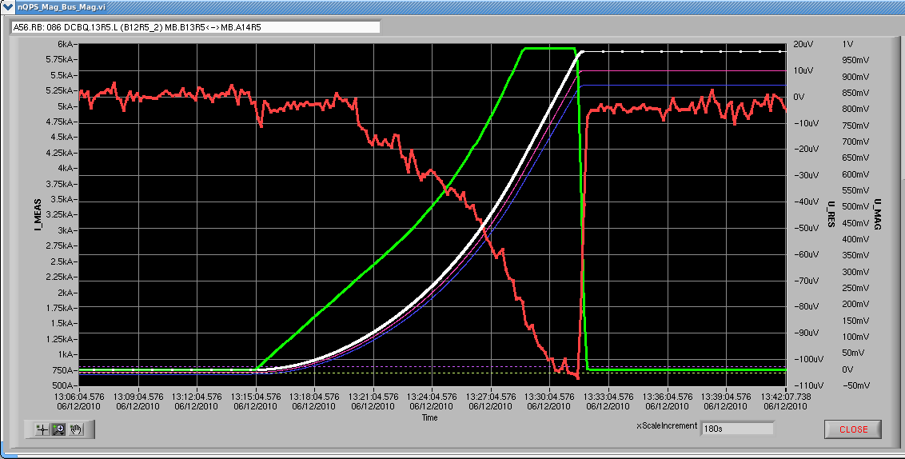
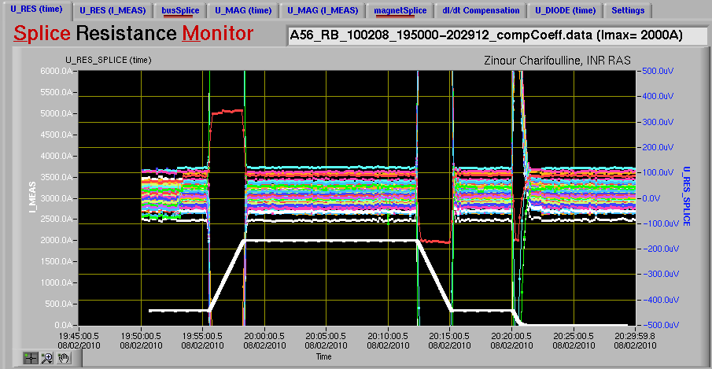
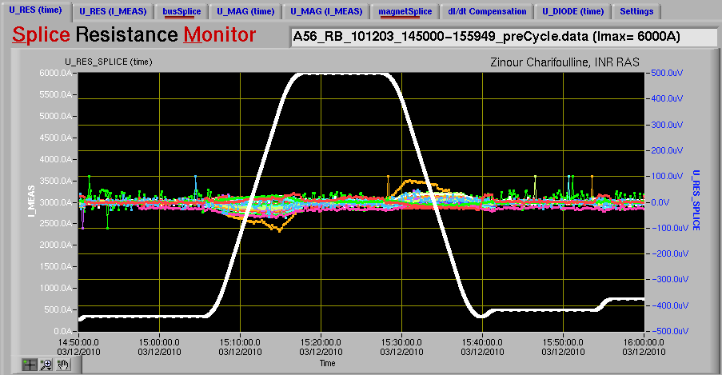
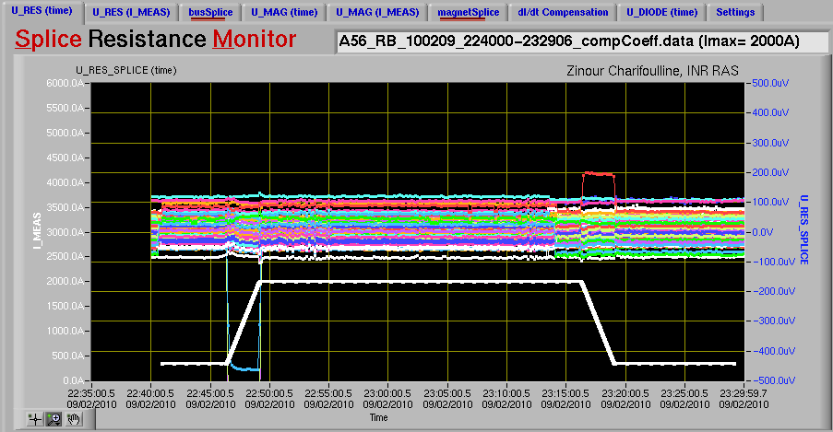
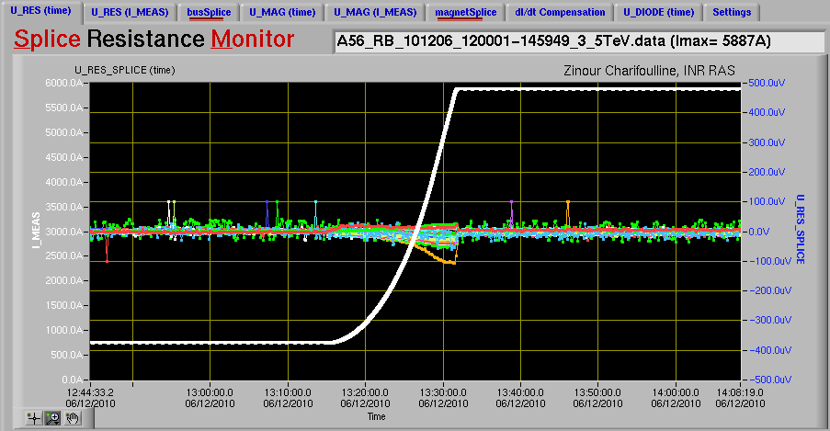
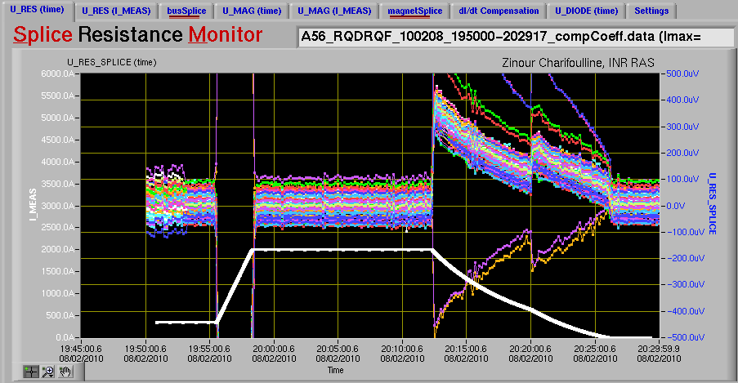
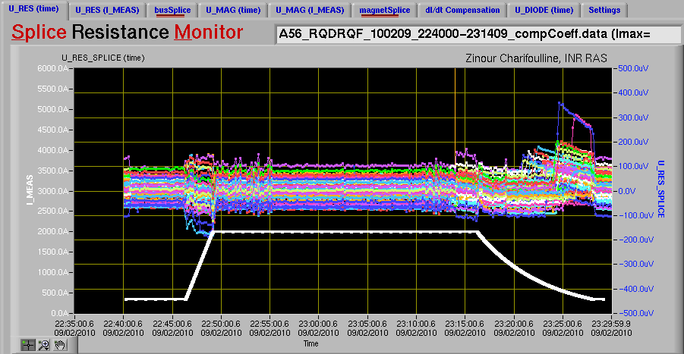
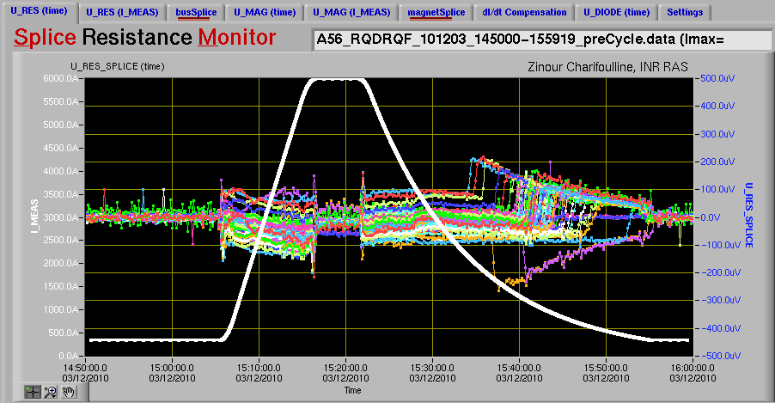
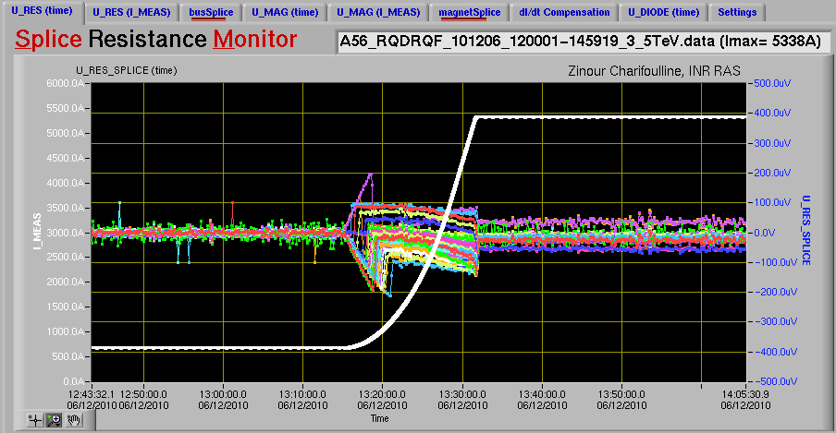
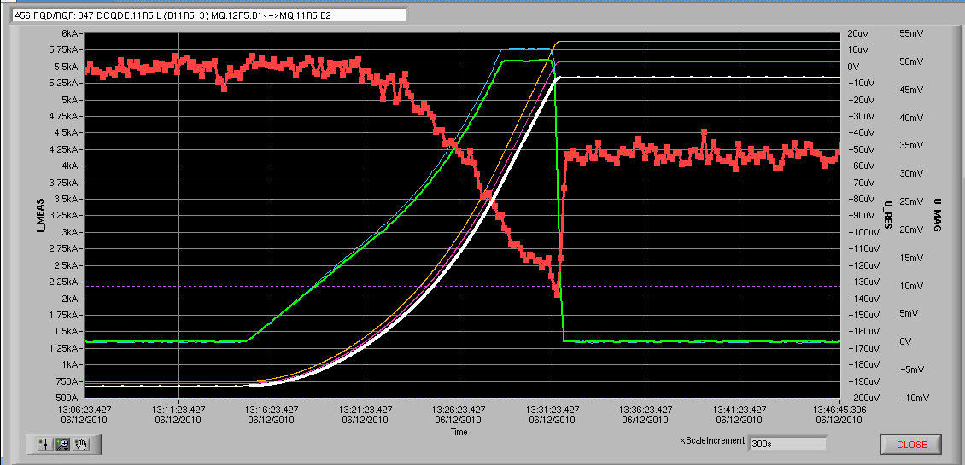
Few examples of “Compensation Coefficients” efficiency (sector 5-6).
“Towards 7 TeV”
U_RES
weird?
U_MAG
- Compensation coefficients need to be re-tuned,
especially if we will go back to 300µV thresholds.
- Long quad buses: 32*350pΩ*12.5kA => 140µV!!!
- Some strange cases need to be explained.
Some special cases
Last 3.5TeV Ramp
HWC Ramps, 10A/s
Last Pre-Cycling Ramp
32 joints!
But if the Splice Consolidation
will be done before “7 TeV”
we don’t need the compensation
anymore!
weird?

Slide 9
Session on “Towards 7 TeV”
16:45 Analysis of the RB and RQF/D splice data recorded with nQPS (Z.CH.?)
  Status of data analysis, are we making use of all recorded data?
  If “nQPS_batchStart” is active, every long enough 3.5TeV ramp up will be analyzed, 1h@INJ&1h@TOP.
  So it is about 2.5-3.0 hours of a front edge of long ramps, but not all data recorded to loggingDB.
  How can the analysis and result recording of splice data be automated, eventually triggering warnings in case of substantial increases over time?
  “nQPS_batchStart” running on any of “abcopm” machine will do the job (see above).
  But the automatic warning mechanism is not established yet: “substantial” criteria, what to do with
  noisy channels, where to save the growing amount of analysis results (I think as few months of work).
  Outlook to 7TeV, do we need additional work/analysis to identify out layers?
  Periodic check of known outliers; it will be nice to replace few “insensible” and noisy channels to be
  sure than nothing is hidden behind;
  Are the tools adapted to work for 7TeV and with the additional shunts,…?
  From machine safety point of view the tools will be adapted for 7TeV after complete automation.
  Will we need “really online” resistance monitoring during ramps? If so, additional work will be required.
  Shunts -> re-measuring all splices at cold, which will be the part of re-commissioning.
  Accessibility for non experts, integration into OP software environment, maintenance of software tools, software platform …?
  Application Splice Monitor integrated into OP software since November 2009.
  Software platform is linux, but it can be adapted to windows as well. It needs RADE library
  to query data from logging database. There is a small “How to” in MP3-QPS Repository (thanks to B.A.)
  Maintenance …

Slide 10

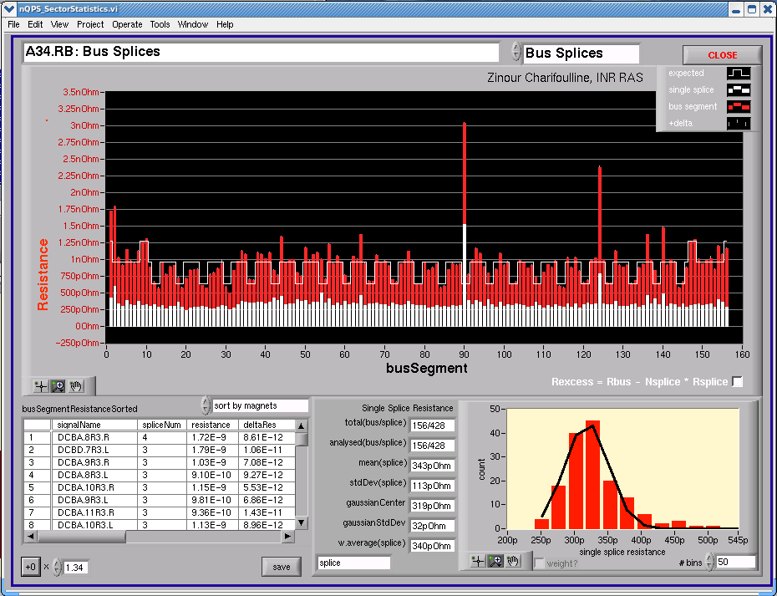
Thanks for attention!
Z.Charifoulline, INR RAS
Marry Christmas!
Happy New Year!

