Slide 2

Menu
Starter
Reminder on Injectors complex,
on Machine Interlocks,
on current installations.
Main course
Future deployments for the WIC system Future deployments for the BIS
Resources and possible issues
Desserts
None !
Digestives
Wrap-up

Slide 3
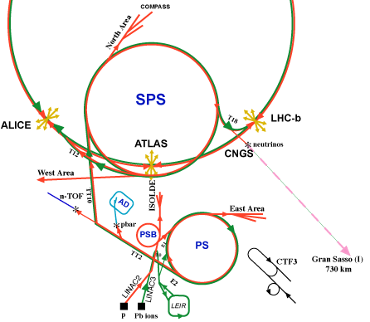
What do we call “Injectors”?
Transfer line
Transfer line
TT2
P Injectors chain: Linac2 ➔ Booster
➔
TT60 & Ti2 lines
PS ➔ SPS
TT40 & Ti8 lines
Ions Injectors chain : Linac3 ➔ LEIR
➔
Transfer line
Transfer line
Other machines & facilities:
Isolde
AD
N-ToF
CTF-3
TT41 line (CNGS)
SPS North area
…
In the coming months:
TT66 line (HiRadMat)
3MeV Test Stand of Linac4
In the future:
  Booster upgrade
  Linac4
  Elena ring
  HIE-Isolde
  … PS2 ?

Slide 4
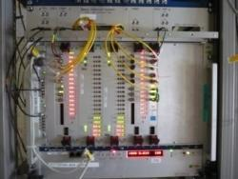

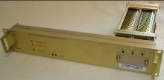


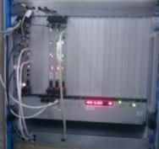
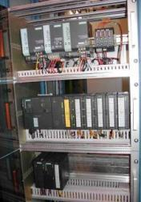

What are the “Machine Interlocks”?
for protecting the Equipments
for Beam Operation
for protecting Super Conducting Magnets
and Normal Conducting Magnets
BIS
Beam
Interlock
System
(VME based)
PIC
Powering Interlock Controllers
(PLC based)
+
+
Safe Machine Parameters System
(VME based)
WIC
Warm magnet
Interlock
Controllers
(PLC based)
SMP
FMCM
Fast Magnet Current change Monitor

Slide 5
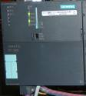
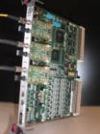

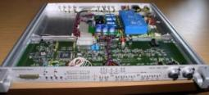
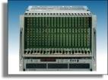
Common Approach
BIS
PIC
Projects
Design
SMP
WIC
FMCM
Fail Safe concept
Reliability vs. Availability
Redundancy
Maintainability
Critical functions in Hw
RS422
Pre operational checks
Full online consistency monitoring during operation
Post operational checks
+

Slide 6

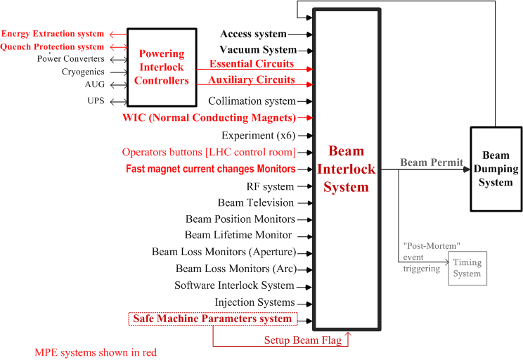



Machine Interlocks Hierarchy
LHC layout
( MPE systems shown in red )

Slide 7
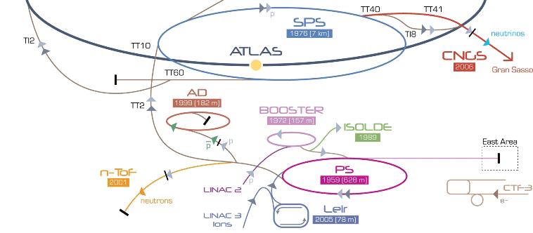
already deployed in the Injectors…
WIC
BIS
SMP
FMCM
no
no
FMCM
no
no
FMCM
no
no
FMCM
no
YES
YES
FMCM
TT60 & Ti2 lines
Linac2 ➔ Booster ➔ PS ➔ SPS
YES
YES
YES
YES
Except these ones, MI systems not deployed in other machines & facilities of the complex, like Isolde,
AD,
N-ToF,
CTF-3,…
TT40 & Ti8 lines
PIC
TT41 line (CNGS)
YES
no
YES
no
➔
Linac3 ➔ LEIR
WIC
BIS

Slide 8
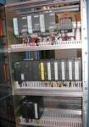

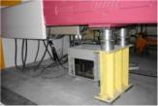
Future deployments of the WIC system
Machine | Number of |  |  | Installation date
 | Protected Magnets | PLC crate | Remote I/O crates
HiRadMat | 25 | 2 | 2 | Jan. 2011
Booster | 172 | 4 | 53 | during 2011 + Xmas 2011/12
Linac4 & Transfer line | 98 | 2 | 6 | 2013/2014
Isolde | 17 | 1 | 2 | not yet known
Elena ring | 48 | 1 | 1 | not yet known
PS main | 100 | 1 | 11 | not known
PS Auxiliary | 50 | 2 | 1 | not known
SPS ring +auxiliaries | 900 | 9 | 15 | Deployment not approved
Machine | Number of |  |  | Installation date
 | Protected Magnets | PLC crate | Remote I/O crates
HiRadMat | 25 | 2 | 2 | Jan. 2011
Machine | Number of |  |  | Installation date
 | Protected Magnets | PLC crate | Remote I/O crates
HiRadMat | 25 | 2 | 2 | Jan. 2011
Booster | 172 | 4 | 53 | during 2011 + Xmas 2011/12
Linac4 & Transfer line | 98 | 2 | 6 | 2013/2014
Machine | Number of |  |  | Installation date
 | Protected Magnets | PLC crate | Remote I/O crates
HiRadMat | 25 | 2 | 2 | Jan. 2011
Booster | 172 | 4 | 53 | during 2011 + Xmas 2011/12
Linac4 & Transfer line | 98 | 2 | 6 | 2013/2014
Isolde | 17 | 1 | 2 | not yet known
Elena ring | 48 | 1 | 1 | not yet known
Notes:
HiRadMat :
25 aimants à protéger – (41 entrées, Elettas + câbles refroidis + aimants)
2 PLC (BA6 et BA7)
2 unités déportées
Installation 2ème quinzaine de janvier
Booster :
172 aimants à protéger environ
4 PLC (1 pour les aimants principaux et 3 pour aimants auxiliaires
53 unités déportées
Installation durant 2011 et durant Xmas 2011/2012
PS Main :
100 aimants à protéger
1 PLC
11 unités déportées
Installation non définie
PS auxiliaires :
50 aimants à protéger – (41 entrées, Elettas + câbles refroidis + aimants)
2 PLC
1 unité déportée
Installation non définie
Linac4 et ligne de transfert :
98 aimants à protéger – (Refroidis à air et à eau)
2 PLC (Linac4 et TL)
6 unités déportées
Installation 2013/2014
Rex-Isolde :
17 aimants à protéger
1 PLC
2 unités déportées
Installation non définie
SPS Ring + auxiliaires
900 aimants à protéger environ
9 PLC
15 unités déportées
Installation AZAP
Peut-être faut-il aussi parler du futur ring Elena ?
48 aimants à protéger – (Ring + TL)
1 PLC
1 unité déportée
Installation non définie

Slide 9
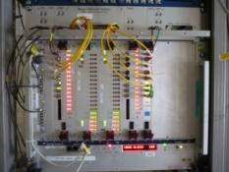

Future deployments of the BIS
Machine | Number of |  | Installation date
 | User Interface | Controller
HiRadMat | 10 | 1 | Jan. 2011
3 MeV Test Stand (*) | 7 | 1 | during 2011
Linac4 & Transfer line | 23 | 3 | 2013/2014
Booster ring & ejection | 24 | 2 | 2015?
Machine | Number of |  | Installation date
 | User Interface | Controller
HiRadMat | 10 | 1 | Jan. 2011
3 MeV Test Stand (*) | 7 | 1 | during 2011
Machine | Number of |  | Installation date
 | User Interface | Controller
HiRadMat | 10 | 1 | Jan. 2011
(*) low energy part of future Linac4

Slide 10
Straight forward activities?
Enough resources?
WIC deployment:
  1 Staff + 1 FSU member: Preparation, Procurement, Test, Installation, & Commissioning
  Support from EN/ICE (PLC software + PVSS)
  Support from BE/CO (Configuration DB)
BIS deployment:
  1 Staff + 1 FSU member: Prep., Procurem., Test, Installation, & Commissioning
  1 student (FESA class, SW configuration, DB,…)
  Support from BE/OP (Java application)
  Support from BE/CO (Configuration DB)
Technical issues?
WIC : compatibility between Siemens items
BIS : future HW no longer “identical” to current one?
  New VME system (new CPU, new OS, new crate, new Power supply…)
  Obsolescence of components
see 1st talk of session#3

Slide 11
“MI in the injectors”: Wrap-up
Few MI systems already present in Injectors complex.
But not uniformly installed:
  BIS deployed in SPS transfer-lines to LHC & CNGS and in SPS-ring
  WIC deployed in SPS transfer-lines to LHC & CNGS (but not in SPS-ring),
  and also in LINAC3 & LEIR.
Next deployments:
  2011 => HiradMat ( BIS + WIC ), 3MeV Test stand (BIS) and Booster ( BIS + WIC )
  Later on: Linac4 ( BIS + WIC ), HIE-Isolde ( WIC + PIC?), Elena ring ( WIC ),….
Foreseen to be expanded with “copy/paste” LHC solution
  But possible issues with backward compatibility and with components obsolescence
Resources
  Rely on support from external manpower: FSU, Fellows, Students, EN/ICE group,…
  Minimal level of staffing for the coming deployments (and subsequently the maintenance)
  Not possible to tackle large installations in the near future
What about “piquet” type?

Slide 13

Spare slides

Slide 14
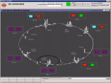
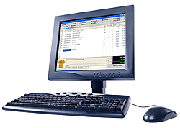
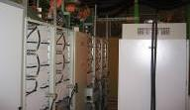
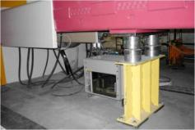
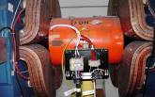
WIC Principle
WIC solution = PLC crate + remote I/O crates
Configuration File
based on Safety* PLC
collects inputs from:
- thermo-switches,
- flow meters,
- red buttons, …
gives Power Permit for the corresponding converter
PVSS
Operator Console
PLC + I/Os
Ethernet
Beam Permit
BIS interface
Power Converter
PC Status
Power Permit
Profibus
Several thermo-switches @ 60°C
Thermoswitches
Water Flow
Red button…
Magnet 1
remote I/Os
Magnet 2
(*) the Transfer Lines WIC (the first one that has been deployed) is not based on Safety PLC

Slide 15
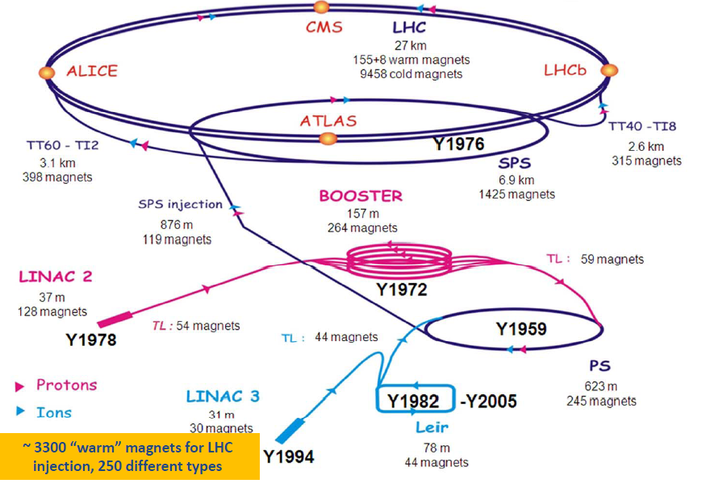
Magnets in the LHC Injectors

Slide 16
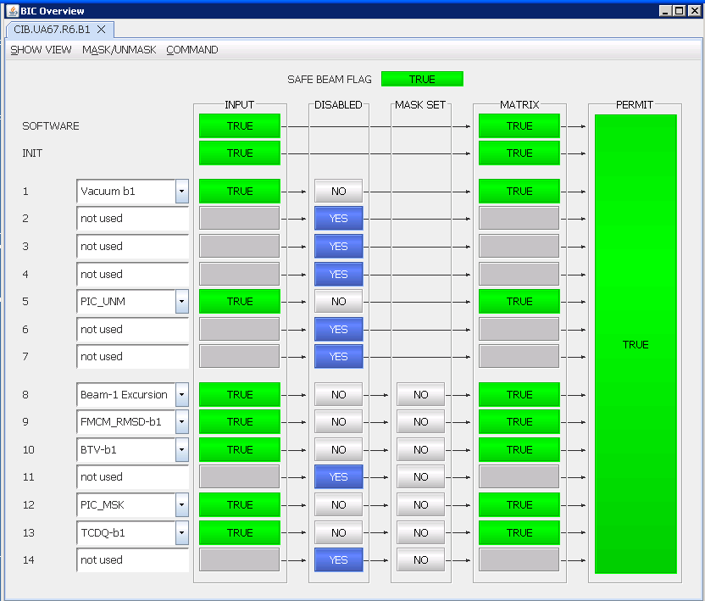
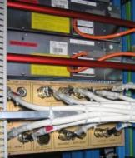
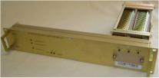
BIS simplified layout
BIS Hw = User Interfaces + Controller(s)
based on fast electronic
Collects Permits inputs from User Systems
Gives Permit for beam operation
JAVA
Application
Technical
Network
User
Permit
User System #1
#1
FESA class
User System #2
#2
Beam
Permit
Loops
(F.O.)
copper cables
or
fiber optics links
copper cables
rear
front
User System #14
#14
Beam Interlock Controller
(VME chassis)
User Interfaces
(installed in User’s rack)

Slide 17
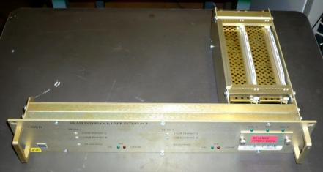
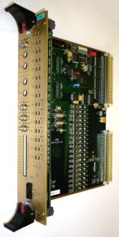
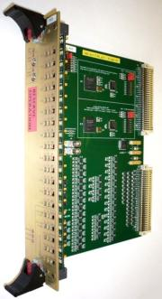
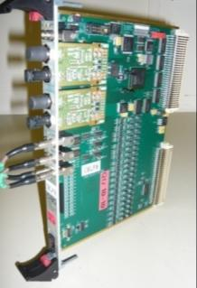

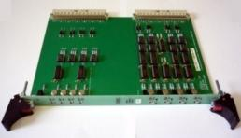
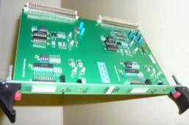
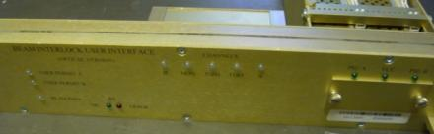
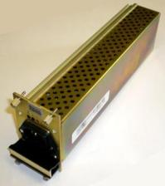
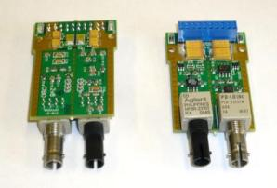

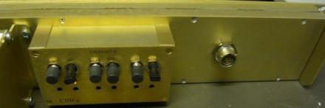
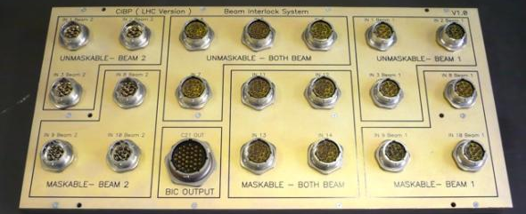


BIS boards
CIBUD & CIBUS
CIBS
CIBT
CIBM
CIBG
CIBX
CIBI
CIBFu & CIBFc
CIBE
CIBD
CIBO
CIBMD & CIBTD
~20 types of boards
have been designed
CIBPL & CIBPS

Slide 18
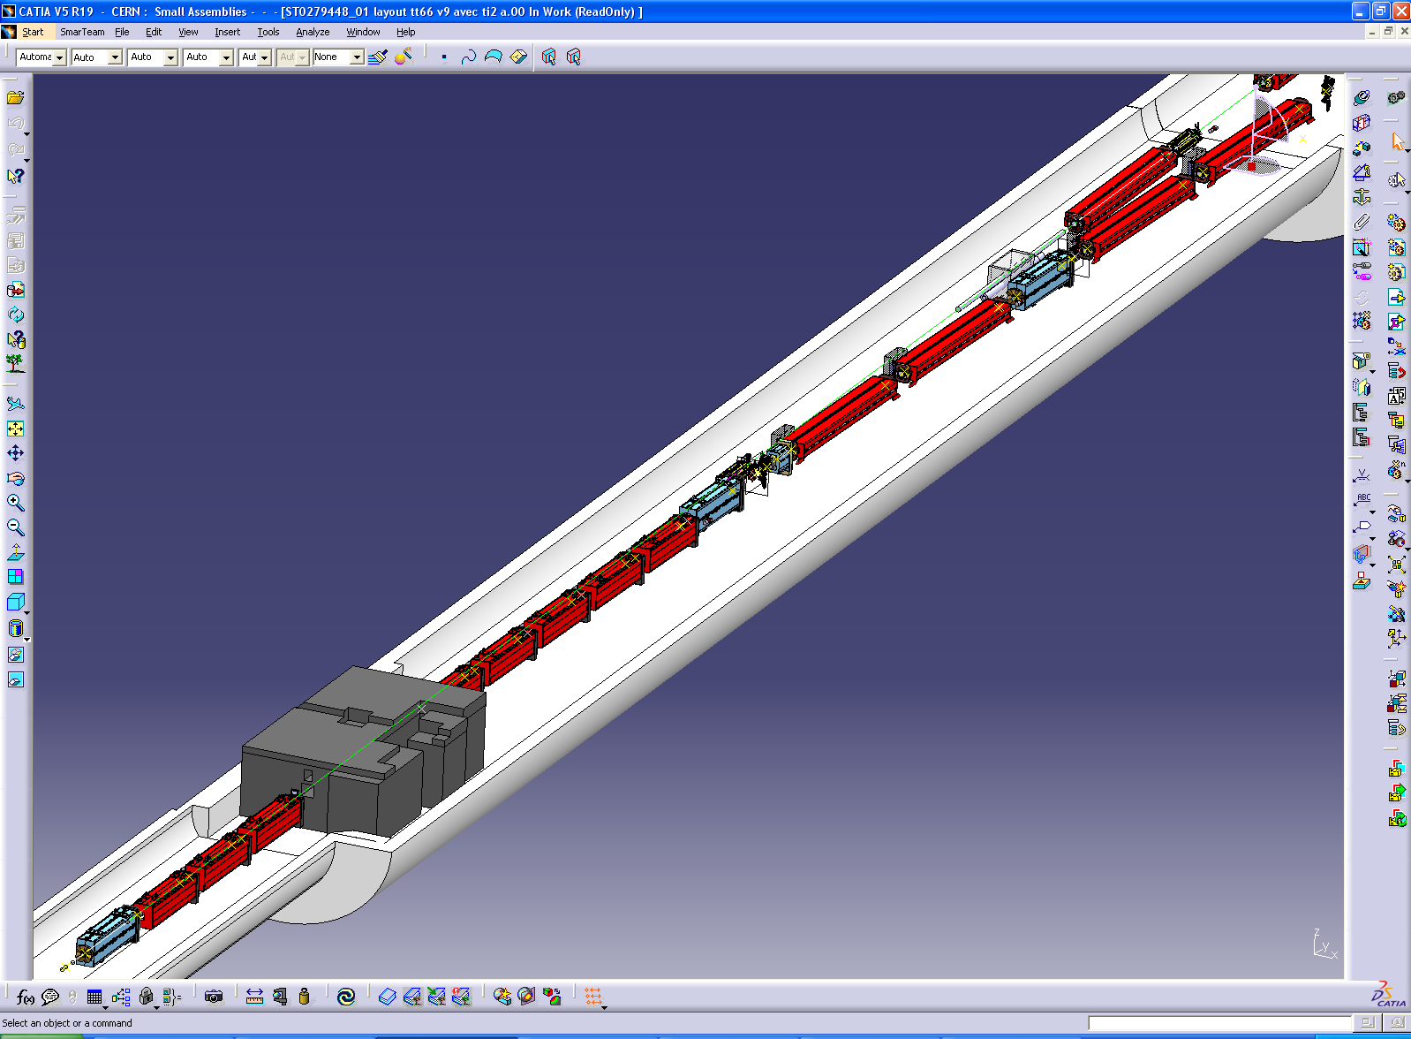
HiRadMat

Slide 19
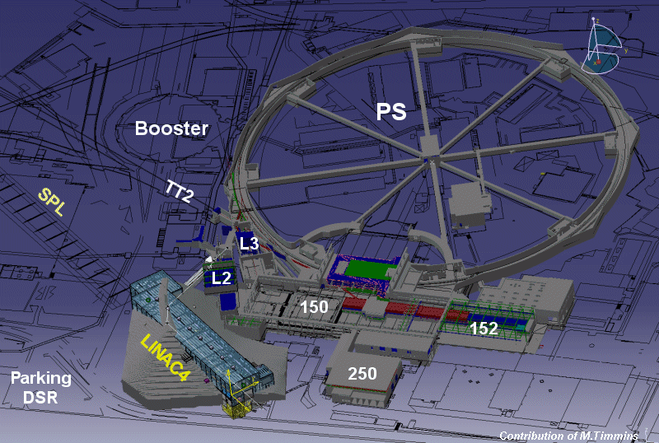
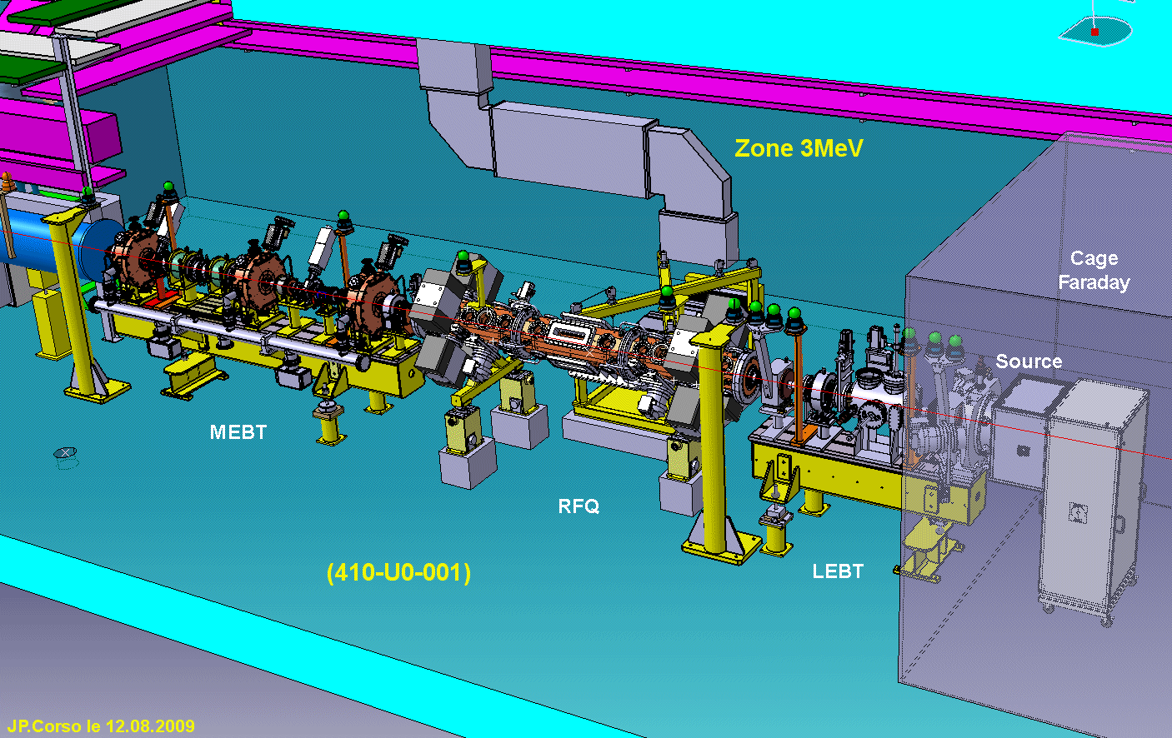
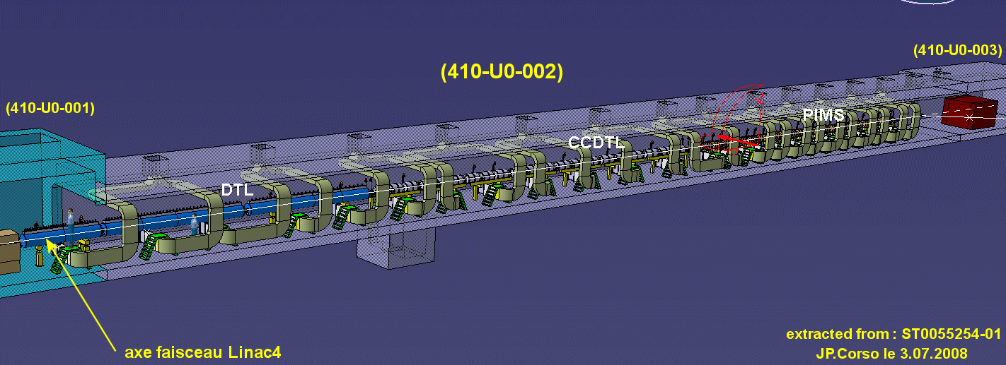
Linac4

Slide 20
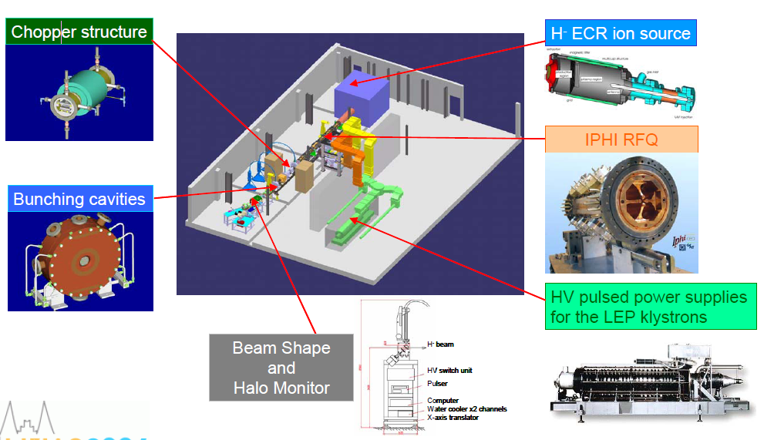
3MeV Test Stand

