Slide 1
Development of Radiation Tolerant Systems, Including VHDL codes – Status and Plans
R. Denz
TE-MPE-CP

Slide 2
Development of radiation tolerant systems – outline
2010 experience and conclusions
Field-bus couplers
Quench detection systems
Long term perspectives
Resources

Slide 3
QPS events during 2010 which have been caused by radiation induced faults (not necessarily due to Single Event Upsets)
Event type | Cases | Electronics failure | Remark
Loss of communication DQQBS type circuit board (nQPS splice protection) | 1 | Stalled interface or microcontroller | Remote recovery by power cycle, during ion run
Permanent trigger on DAQ systems type DQAMC | 12+3 | Latched digital I/O of digital isolator (ISO150) | 8 during proton run (basically during specific tests), 7 during ion run, 3 events observed with updated firmware → no stalling of DAQ system
Lost fieldbus communication DAQ systems type DQAMC | 2 | MicroFipTM chip (old version) | During ion run

Slide 4
Conclusions from 2010 run
So far only non-destructive faults recoverable by power cycles
  With one exception only DAQ systems affected
  Faults were not stopping a fill but required access prior to refill
  Firmware upgrade of DQAMC type DAQ systems cures most of the problems → on the way for all hot zones (3, 7, L2, R8)
    Additional benefit: secondary DAQ trigger on DQHDS discharge
  No real showstoppers so far and no events outside hot zones
Fault occurrence in contradiction to some of the radiation test results
  Consistent with CNGS data but in contradiction to TCC2 and some PSI tests
Radiation to electronics is real – not the result of simulations
Electronics exposed to radiation in the long term to be minimized not to be extended
  E.g. relocation of systems located in UJ14, UJ16 and UJ56
  ALARA principle for exposure of people to radiation

Slide 5
New developments – fieldbus couplers
Present fieldbus coupler based on the MicroFIPTM chip shows more problems in radiation environments then expected from some test results
  Firmware upgrade will cure most of the problems
Chip will become obsolete soon → replacement needed
  Proposed solution by BE-CO: nanoFIP
    Based on ACTEL PROASIC3TM FPGA (in use by QPS and others ...)
    Neither hardware nor software compatible with existing device
    For the time being nanoFIP and MicroFIPTM cannot coexist on one QPS fieldbus segment (at least upgrade of gateways required …)
Development of new QPS fieldbus coupler in 2011 (DQAMCN)
  Additional requirements to be defined soon (see Joaquim’s talk)
Re-configuration and extension of QPS fieldbus networks in order to allow relatively smooth upgrade
  Number of tunnel segments (not clients!) to be doubled
  Initial phase will only concern segments around hot zones

Slide 6
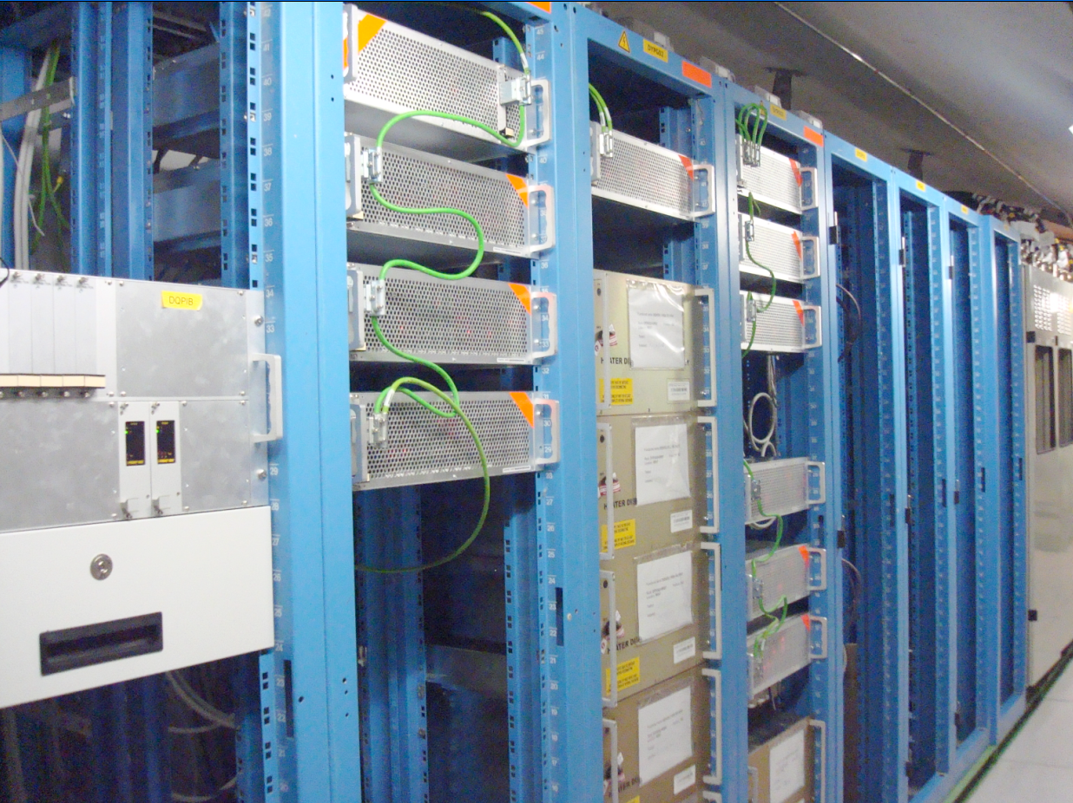
New developments – quench detection systems
Concerns in the midterm devices currently installed in areas formerly known as radiation free, e.g. RR17 …
Replacement of quench detection systems type DQQDI (IPQ, IPD, IT) and DQQDG (600 A circuits)
  Prototype of DQQDIN currently under lab test including firmware
  Based on PROASIC3TM FPGA – optional hardening of VHDL code provided by tool chain (implementation of triple module redundancy TMR)
  Hardware compatible with DQQDI – only minor changes for local DAQ system
  Next step will be the DQQDGN, which is a non trivial task
    Significant effort in the past to get the 600 A detectors working without the radiation constraint
  No immediate action required for detection systems type DQQDC and DQQBS (splice and HTS lead protection) due to satisfying results in CNGS tests 2009 and 2010 (not to forget LHC operation in 2010)

Slide 7
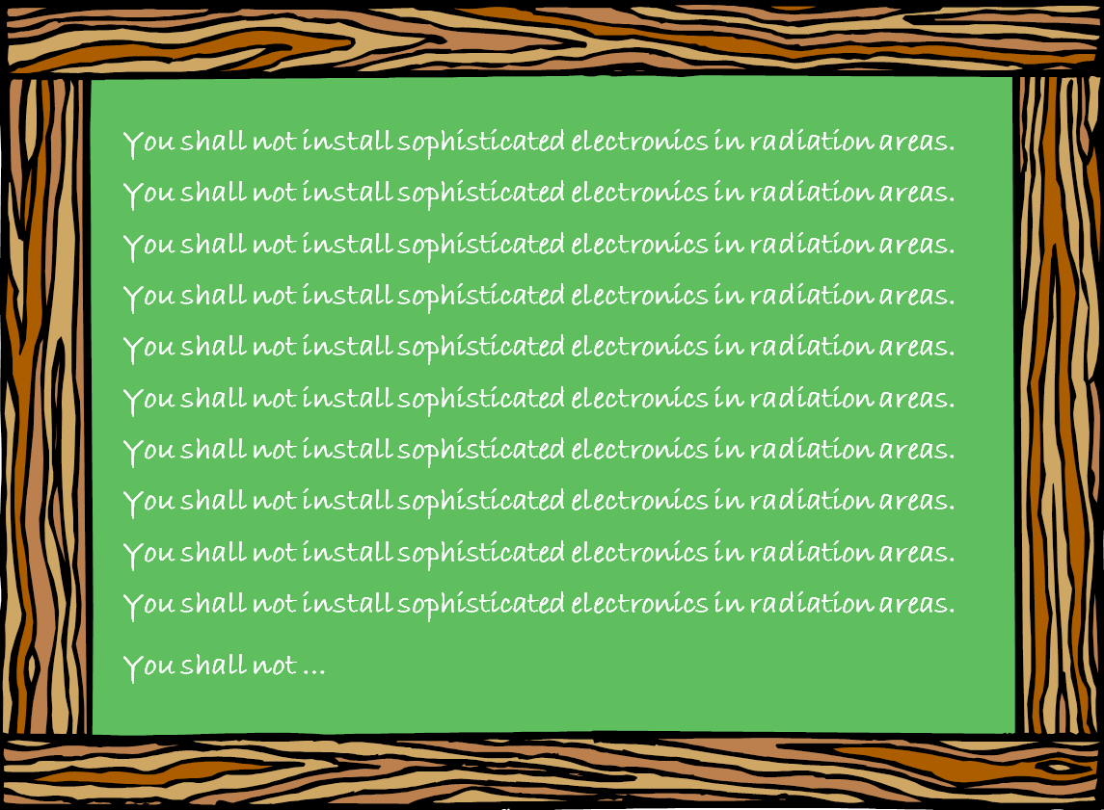
New developments – long term considerations
Work horse for all new developments is the PROASIC3TM FPGA device which may become as well obsolete
  Manufacturer has recently been bought by another company …
Permanent problem is the availability of a radiation tolerant ADC especially high precision devices as used for splice and HTS lead protection
  Dedicated development may become necessary
  Main magnets are and IPQ, IPD and IT magnets can be protected with classical devices not using ADCs for quench detection
  Not possible for 600 A circuits without additional instrumentation
  Not possible for leads and bus-bar splices
The CNGS radiation test area will probably not be available beyond 2011/2012
  No real alternative so far
Further relocation of equipment to be studied carefully

Slide 8
New developments – resources
All new developments will be performed in parallel to LHC exploitation
  Limited expert availability as LHC has priority
  All developments require a close collaboration of several experts
    QPS hardware experts, controls experts etc.
  Additional resources would be highly appreciated e.g. Marie Curie fellows
Some upgrades will implicate significant costs
  e.g. DQAMCN for complete machine (1624 devices) estimated to 0.5 MCHF plus installation
Experience with existing devices to be integrated into all new developments
  Additional requirements to be defined at an early stage
Radiation tests to be minimized and closely coordinated with R2E community
  Time consuming in preparation and execution
  Lack of suitable test facilities (mixed radiation fields)

