Slide 1
Workshop 14th december 2010
nQPS for insertion region magnets– Status and Plans
V. Froidbise
TE-MPE-CP

Slide 2
nQPS for insertion region magnets - outline
Current measurement principle : diagram
Improvement : busbars measurement : diagram
Hardware requirements
Status
Resources
Conclusion

Slide 3
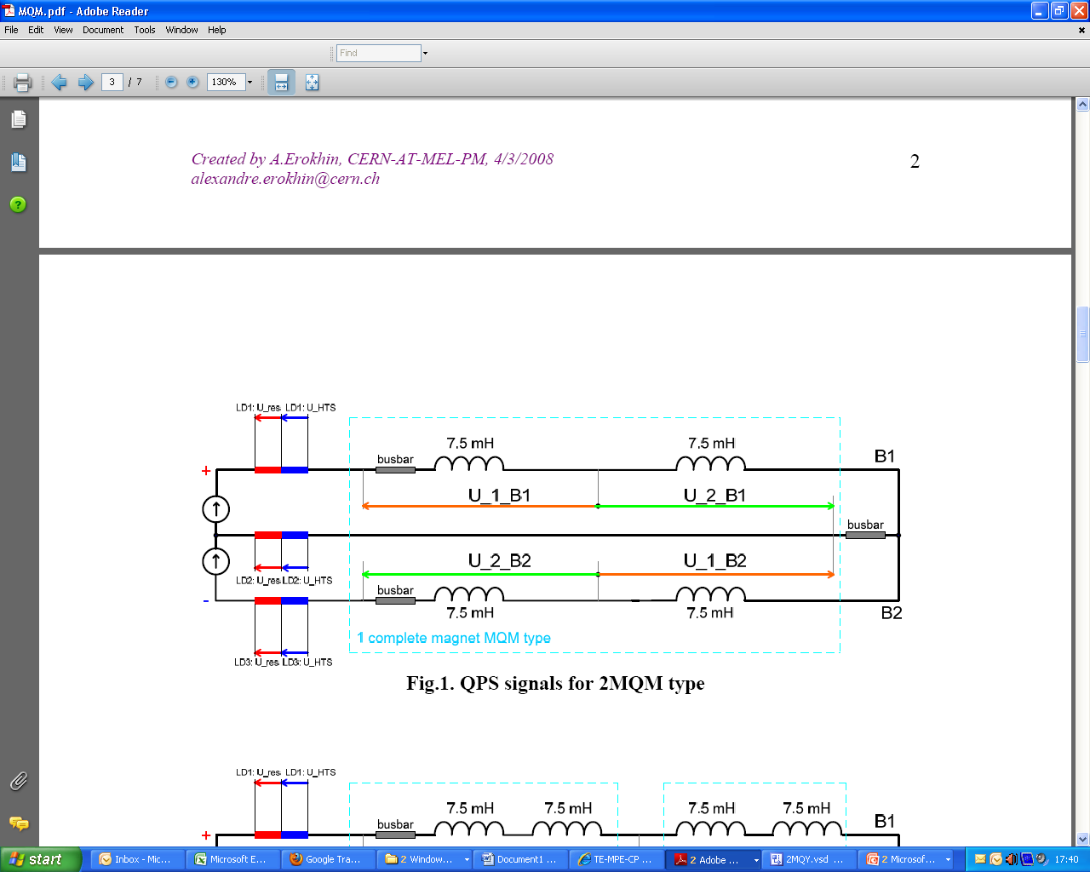
nQPS for insertion region magnets - Current measurement principle
Created by Sandrine le Naour & A.Erokhin, CERN-AT-MEL-PM, 4/3/2008

Slide 4
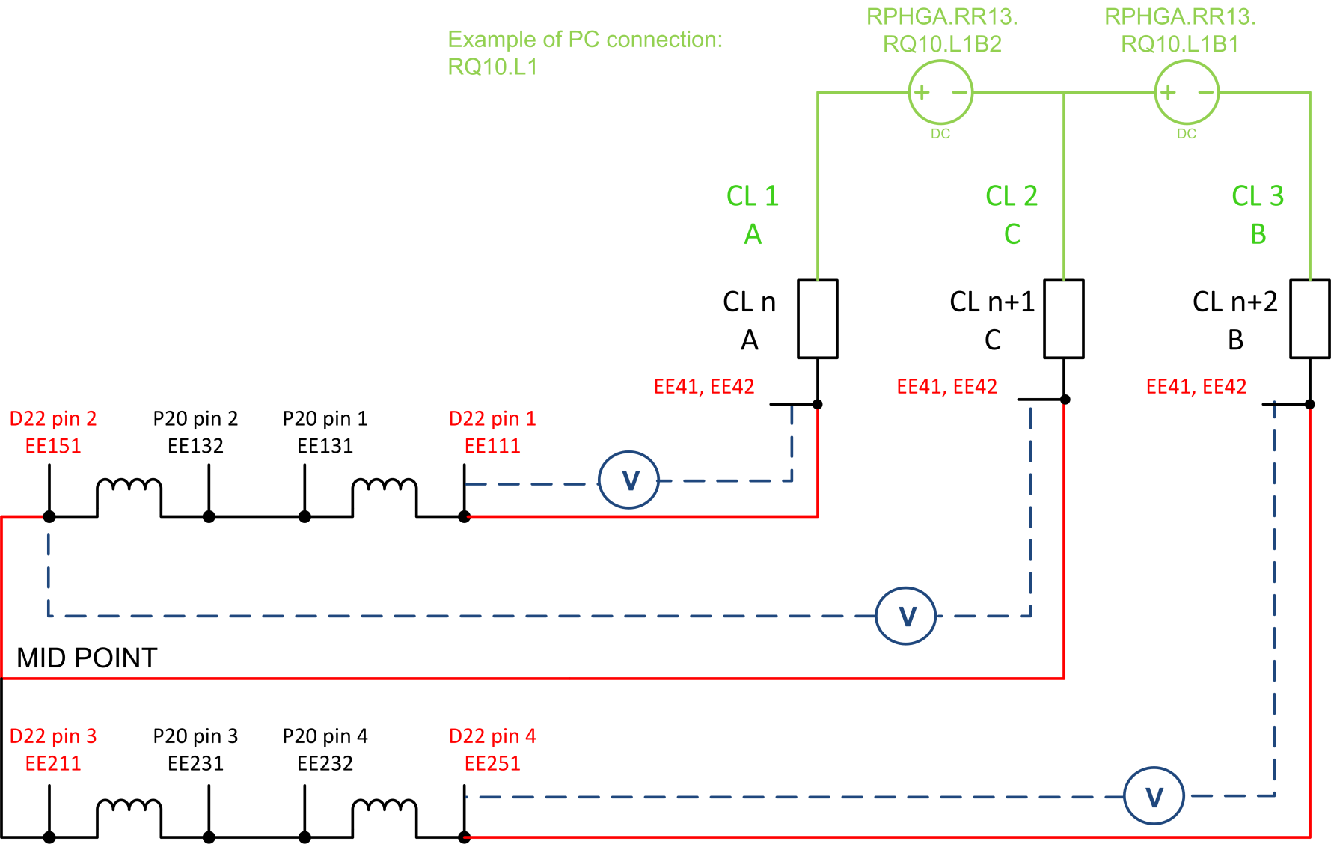
nQPS for insertion region magnets - improvement
One BusBar = up to six splices
Created by R. Mompo

Slide 5
nQPS for IPQ, IPD and IT - hardware requirements
  Dedicated supervision (not protection) of superconducting bus-bars
    Protection fully ensured by existing system
  94 crates required in total
  The 68 existing old crates in principal can be modified
    To be checked with RP for crates currently installed in RR’s and UJ’s
  Cable patches for the IFS box, interlocks and WFIP connection
  Non conformities
  In addition there might be remote reset units
    Remote restart of stalled racks

Slide 6
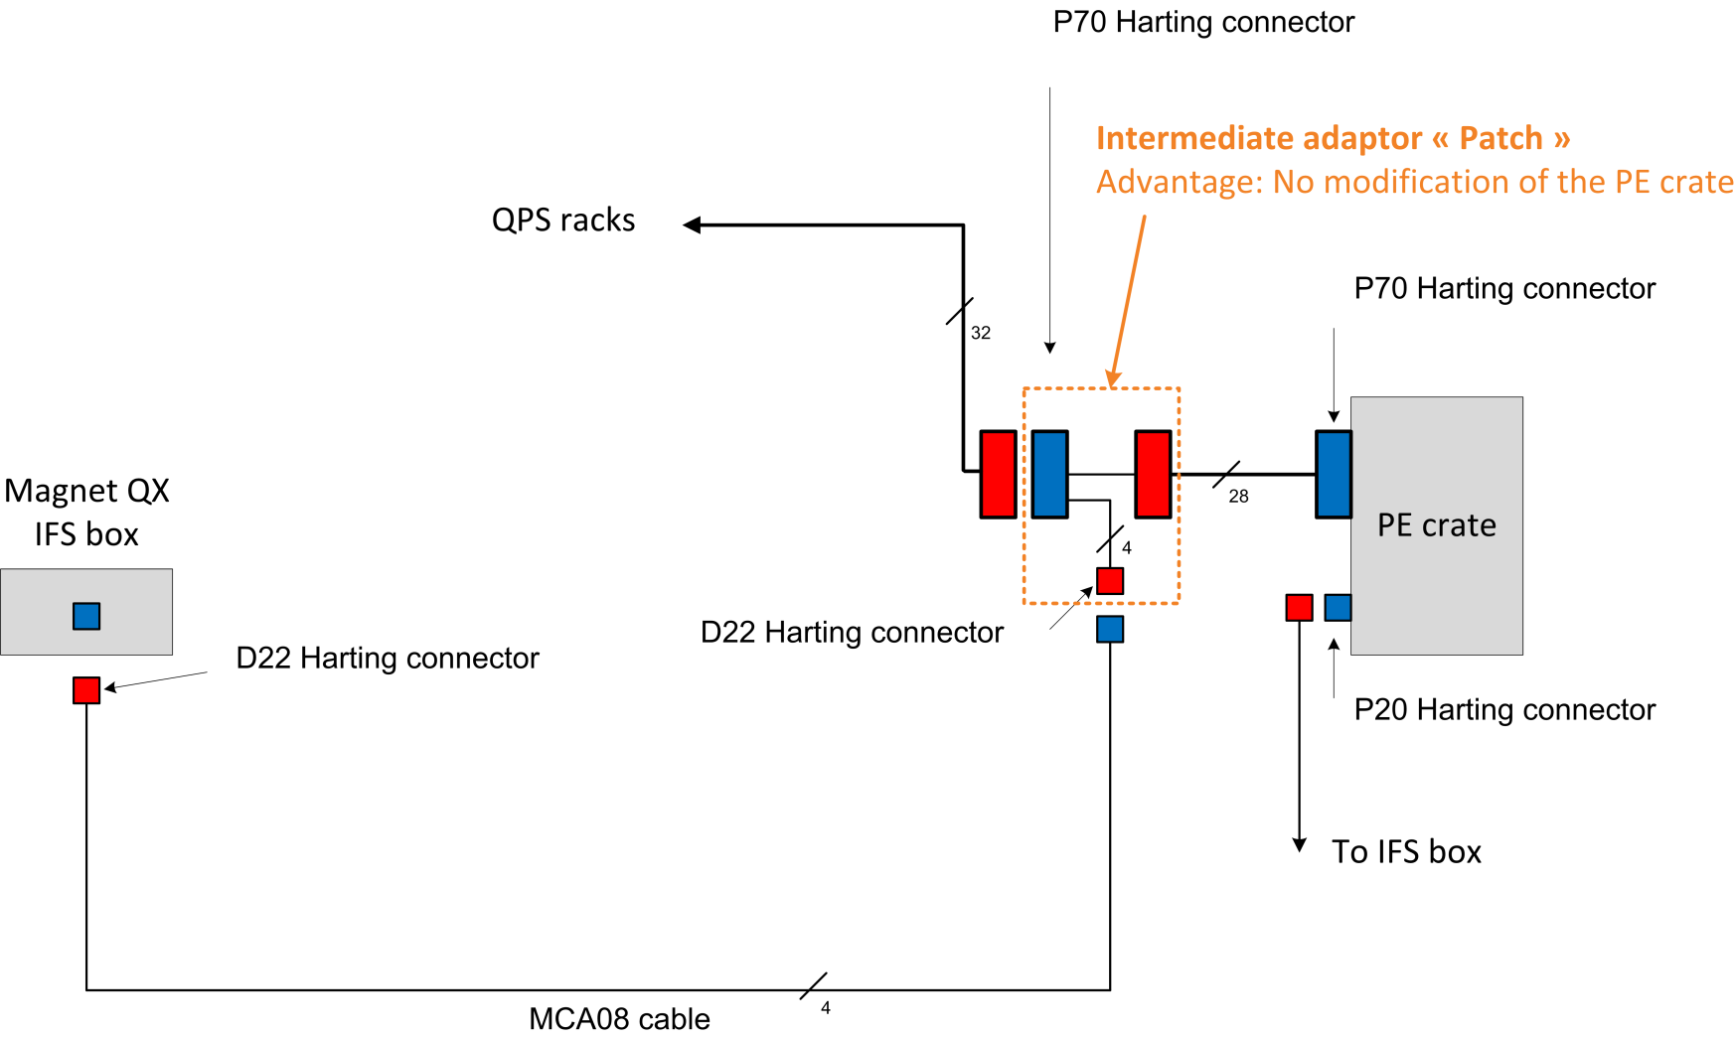
nQPS for IPQ, IPD and IT – patches : several versions
Created by R. Mompo

Slide 7
nQPS for IPQ, IPD and IT - status
Prototype production and type testing in 2011, installation of first systems during winter shutdown 2011/2012
Definition of controls interface started and first discussions launched
  Update will be transparent for PIC
  New software agent type to be defined
Advancing smoothly - no showstoppers so far
Precision of magnet signals will be increased as well
  As well revision and change of maximum input voltage range (±200 V → ±10 V)
Some additional commands for device maintenance
Radiation tolerant version of DQQDI board taken into account (new version with FPGA under developpement)

Slide 8
nQPS for IPQ, IPD and IT - resources
Approved, partial installation feasible
  First crates could be updated in 2011
Sufficient resources for R&D, firmware development, test and installation inside CP section
  Additional resources needed for modifications of the QPS supervision
For prototype and series production IGM (“In Group Manufacturing”) envisaged
  Small contract for DQQBS board production to be launched
30 new crates → 150 kCHF
300 DQQBS boards → 60 kCHF (splice diagnostics)
100 cable patches → 20 kCHF
Firmware update for DQAMGRQx, DQAMGC (102 units)

Slide 9
nQPS for IPQ, IPD and IT - conclusion
Protect magnet and busbars separately. This will allow to reduce the threshold and make diagnostics / monitoring measurements of splices
Accuracy measurement improved by 20 (alredy done for some IPQs)
Ongoing for Q9-Q10 and some Q8

