Slide 1
MPE Workshop
14/12/2010
Post Mortem Project
Status and Plans
Arkadiusz Gorzawski
(on behalf of the PMA team)

Slide 2
who we are and what is project ...
We are an inter departmental co-operation (BE/CO, TE/MPE and EN/ICE) of over 10 people + another ~ 5 module developers
Post Mortem Files contain transient data from LHC equipment, pushed to a redundant central data storage architecture
Arriving data files will trigger an Event Builder, automatically recognizing interesting powering, beam dump, XPOC,…events
Online mode – for operational data analysis in CCC
Playback mode – allows play-pack of previous events for additional expert analysis, debugging,…

Slide 3
PMA server architecture
GUI
PMA server
PMA
Scheduler
runs
Modules
triggers
Modules
uses
Libraries
(references,
DB Access
Logging)
triggers
reads writes
Database
Event
Builder
PM Data
Manager
browses
notifies
LHC
Logging
PM Data
files
Data
Collection
PM buffers
Courtesy of Vito

Slide 4
... what is the main aim of the PM project?
  In case of event, provide efficient and deterministic analysis of transient data recordings:
Check if all the devices and systems behaved as expected with an emphasis on machine protection systems
Provide evidence for the cause of the beam dump / event
Decide if it is safe to continue with the next injection
Block the next injection if the analysis is not satisfactory
Super Lock the circuit if the analysis result failed
Give a brief summary when, where and what happened
Currently 4 servers running on SAME infrastructure:
PMA (beam dumps), PMP (Powering), XPOC (Beam Dumping System) and IQC (Injection Quality Check)

Slide 5
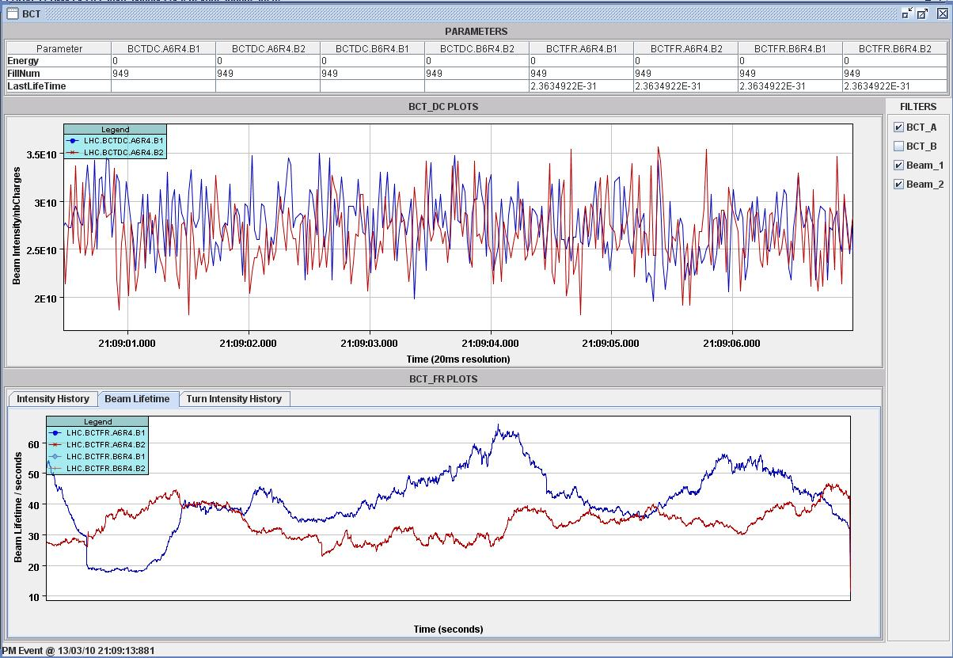
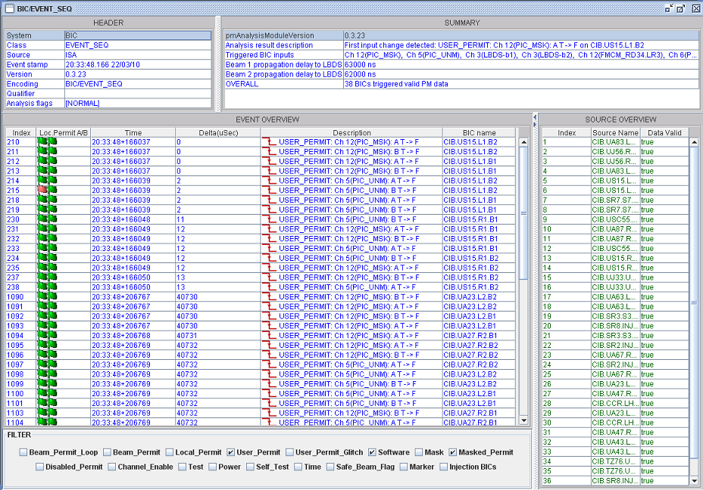
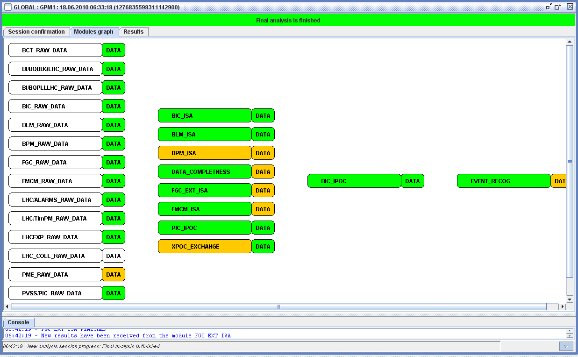
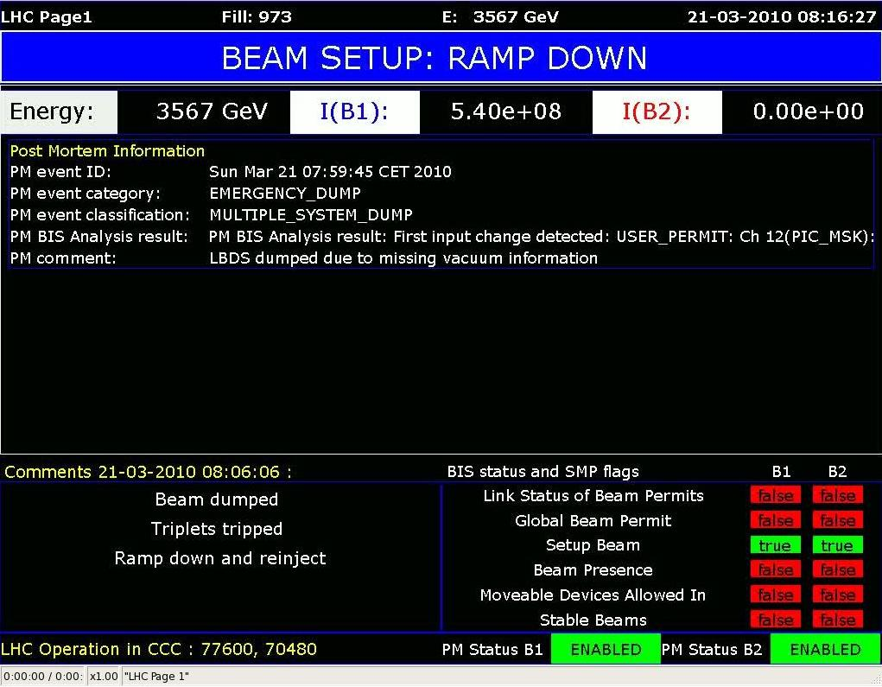
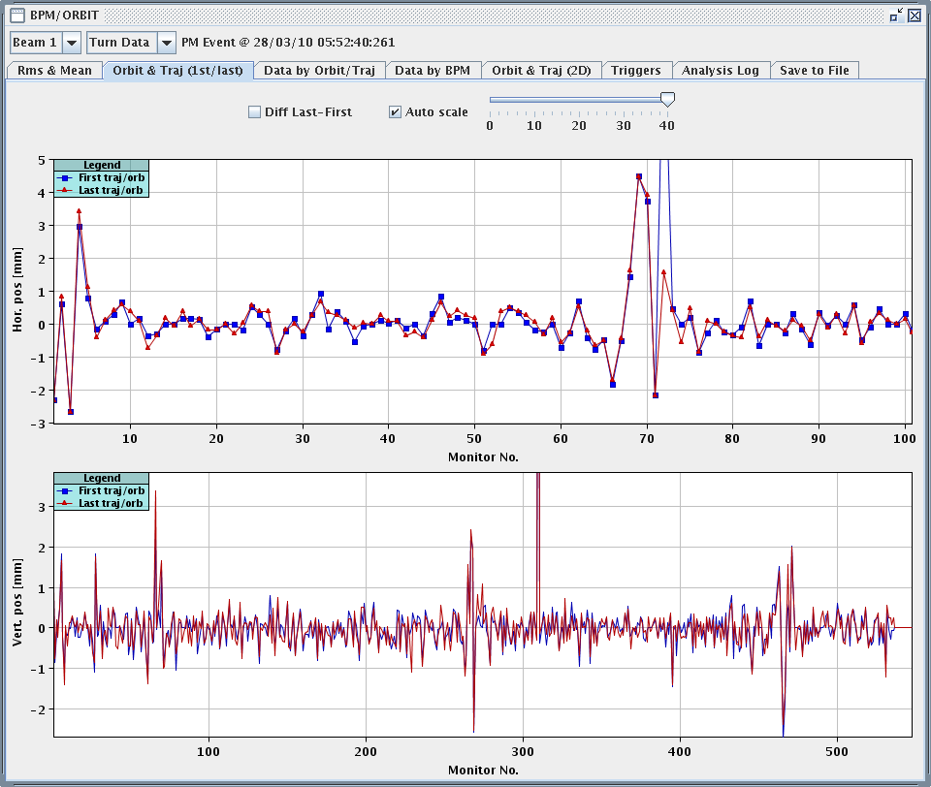
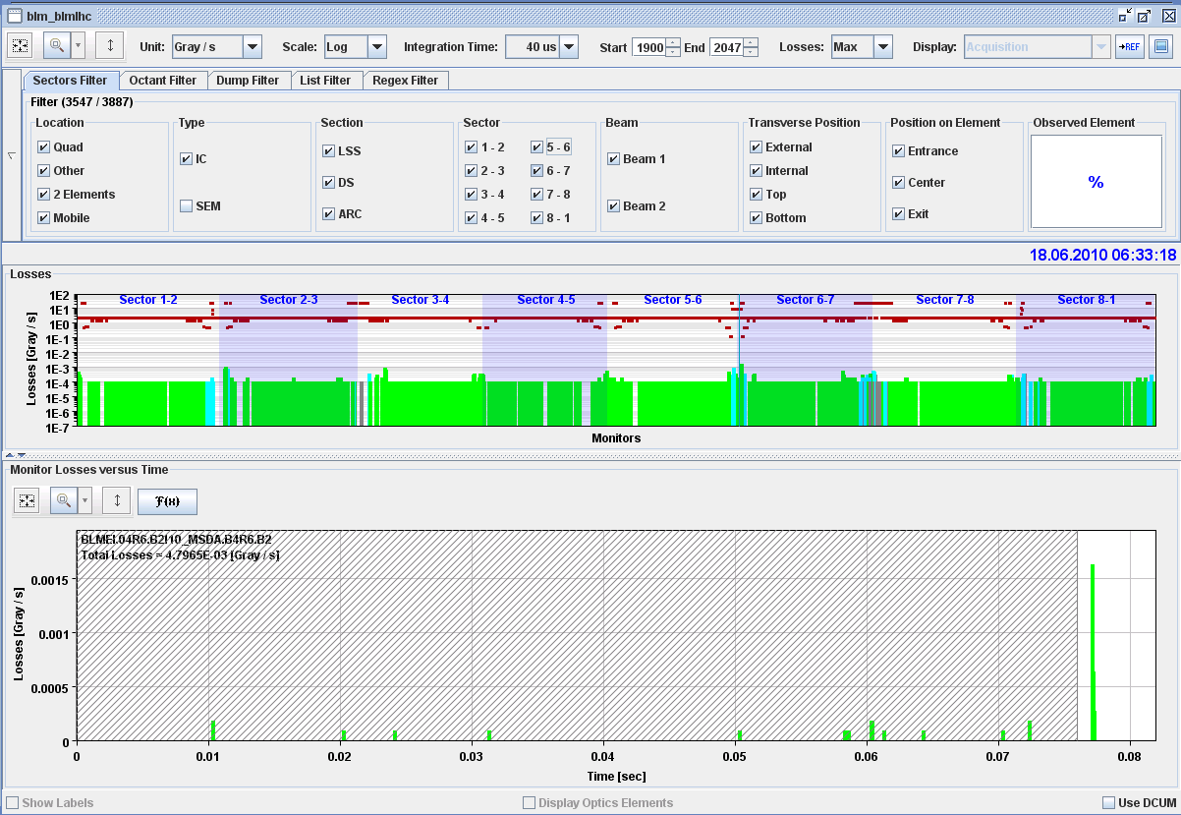
PMA Powering Server Status …
Modules implemented:
  BIS, PIC, FMCM IPOC
  BLM Losses
  BPM Orbit
  XPOC
  FGC ext for Feedback
  Fill Statistics
  …
Event Sequence
Beam Intensities, Lifetime
Beam position / orbit
Behavior:
  Injection Interlock
  sending email / sms notifications
  Page 1 entry
Beam Losses

Slide 6
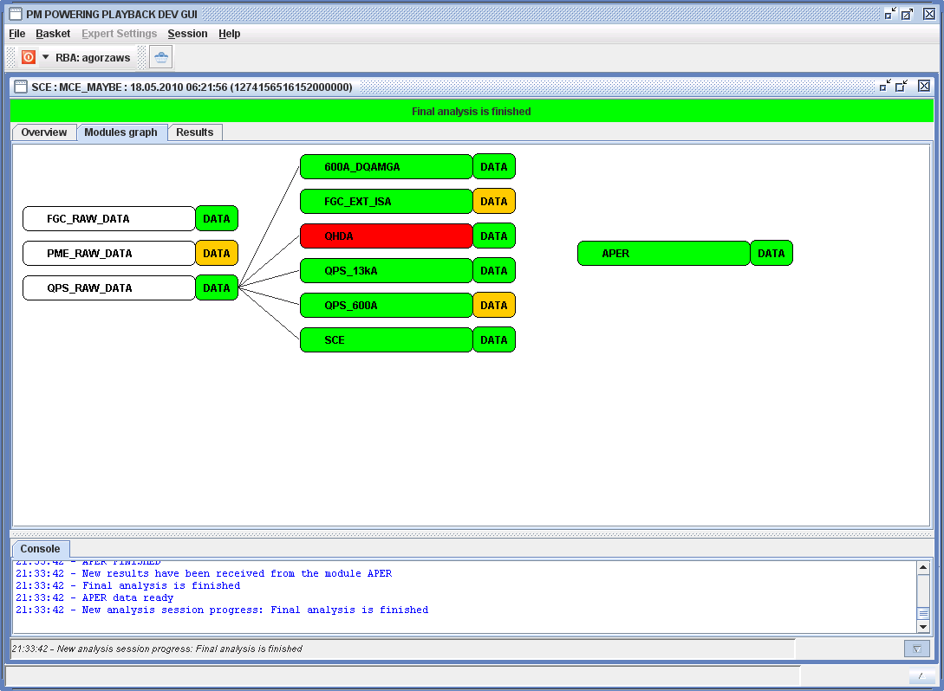
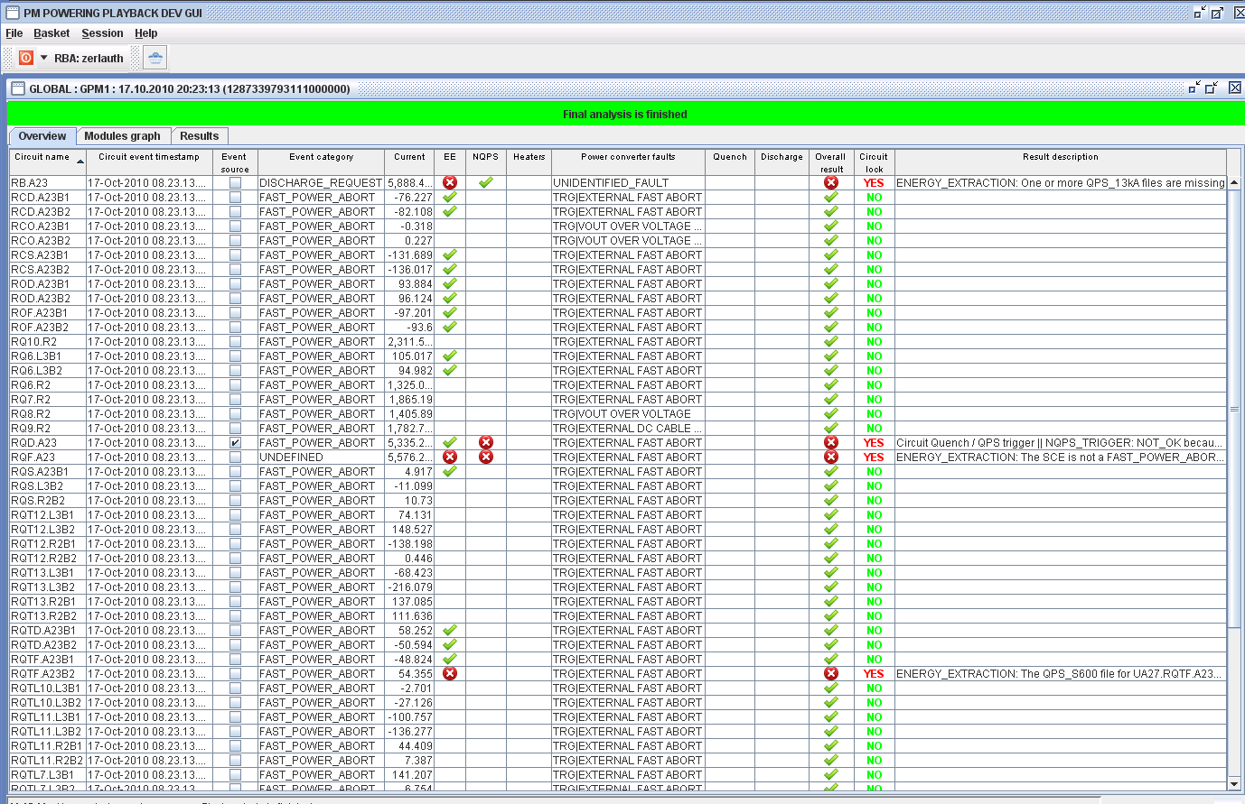
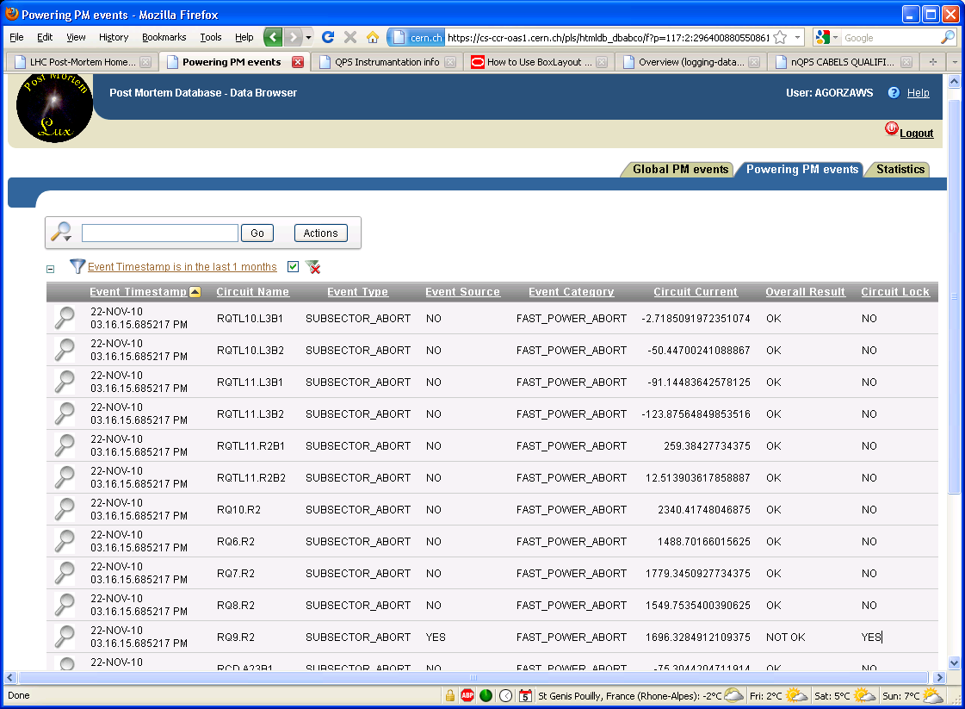
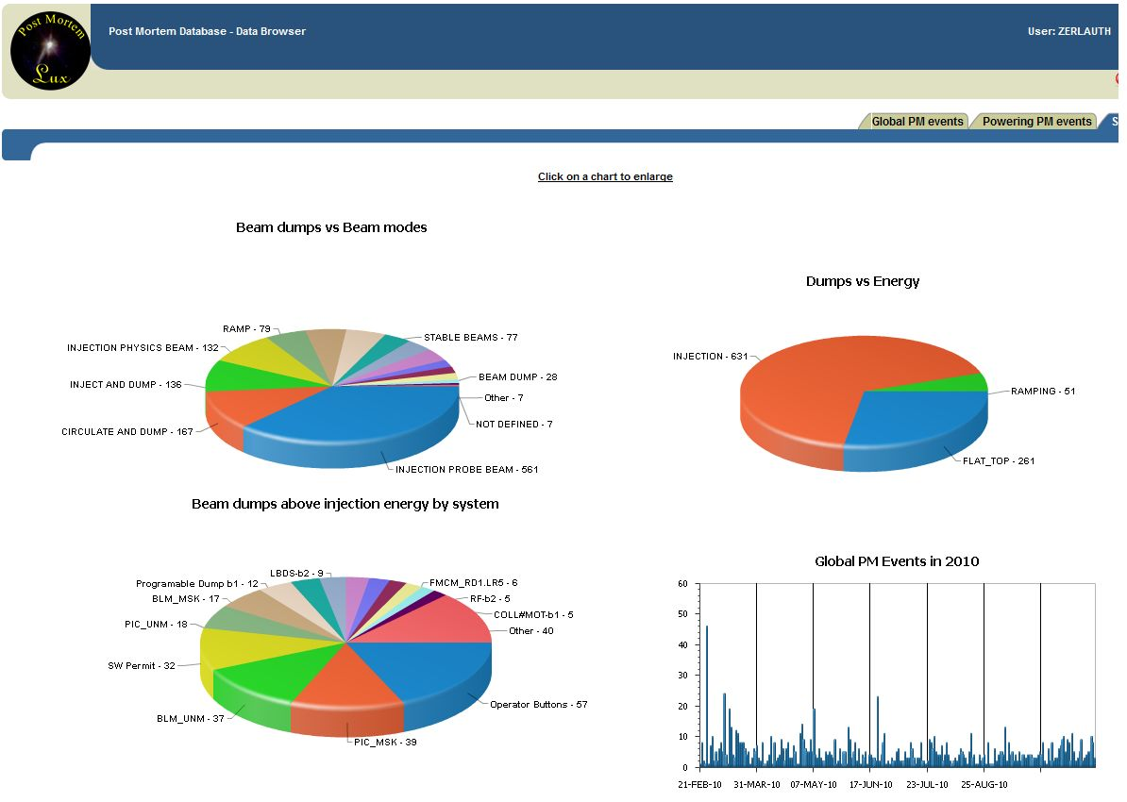
PMP Powering Server Status
Modules implemented:
  EE 600A & EE 13kA
  Heater Discharge
  FGC
  600A Anti-Quench
Behavior:
  sending email / sms notifications
  Locking circuit

Slide 7
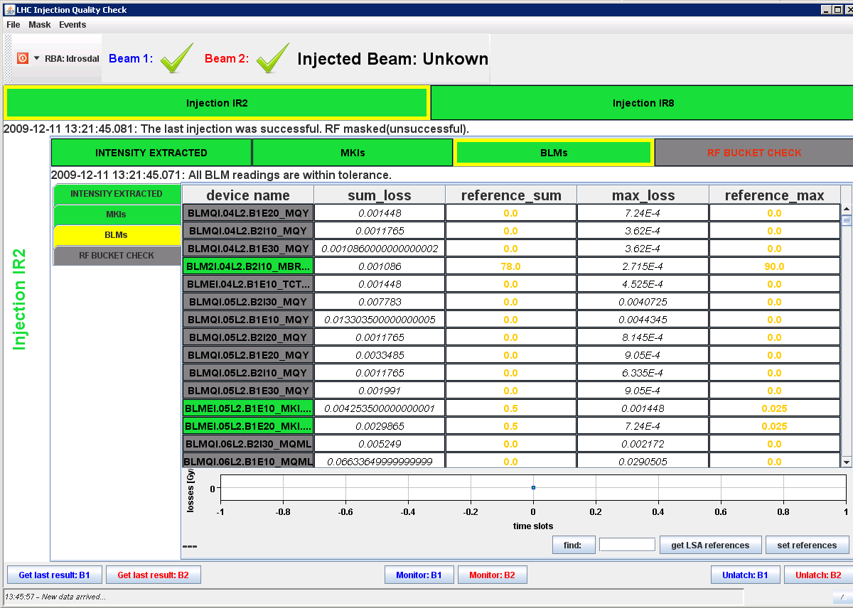
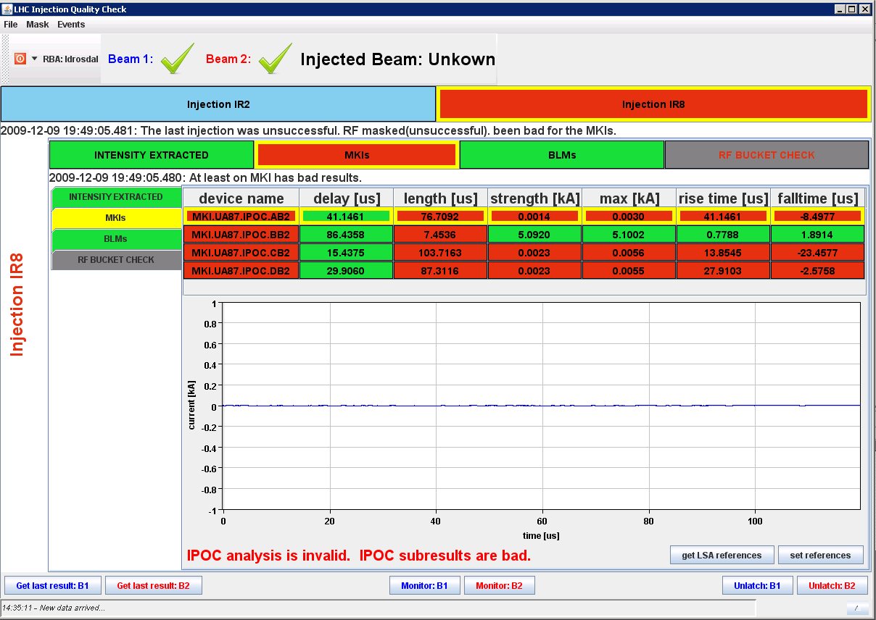
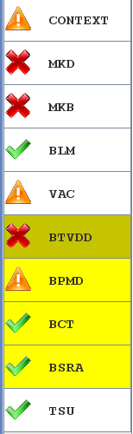
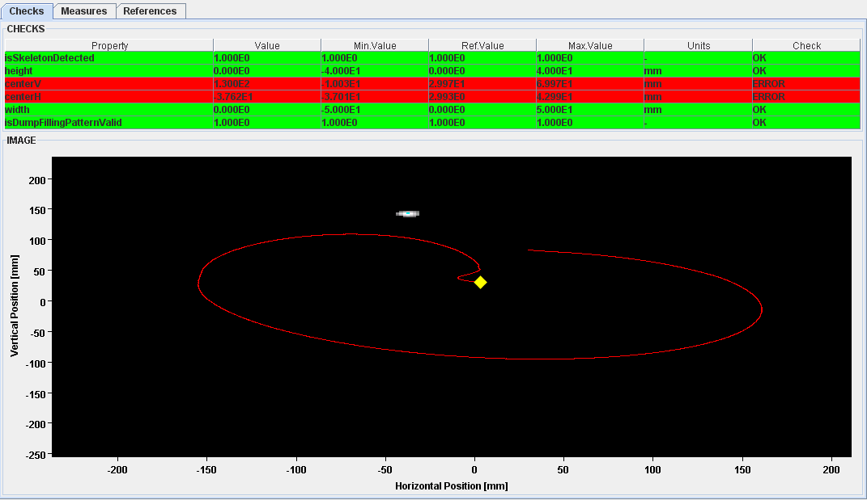
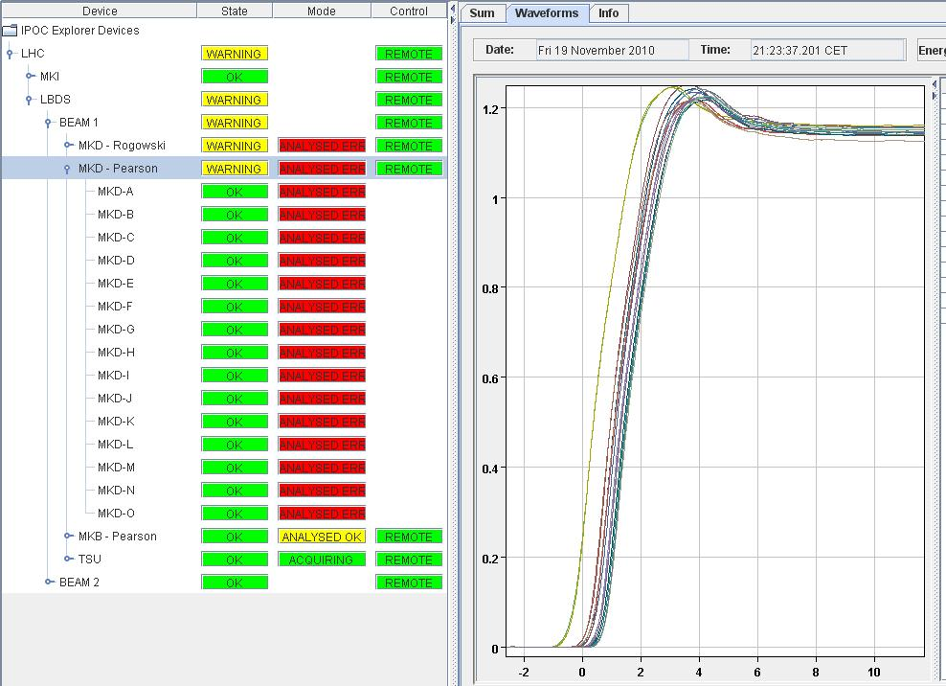
XPOC and IQC Server Status
Modules implemented:
  Automated analysis of injection quality and beam dump firing
Behavior
  sending email / sms notifications
  Fix Display
  Injection interlocks

Slide 8
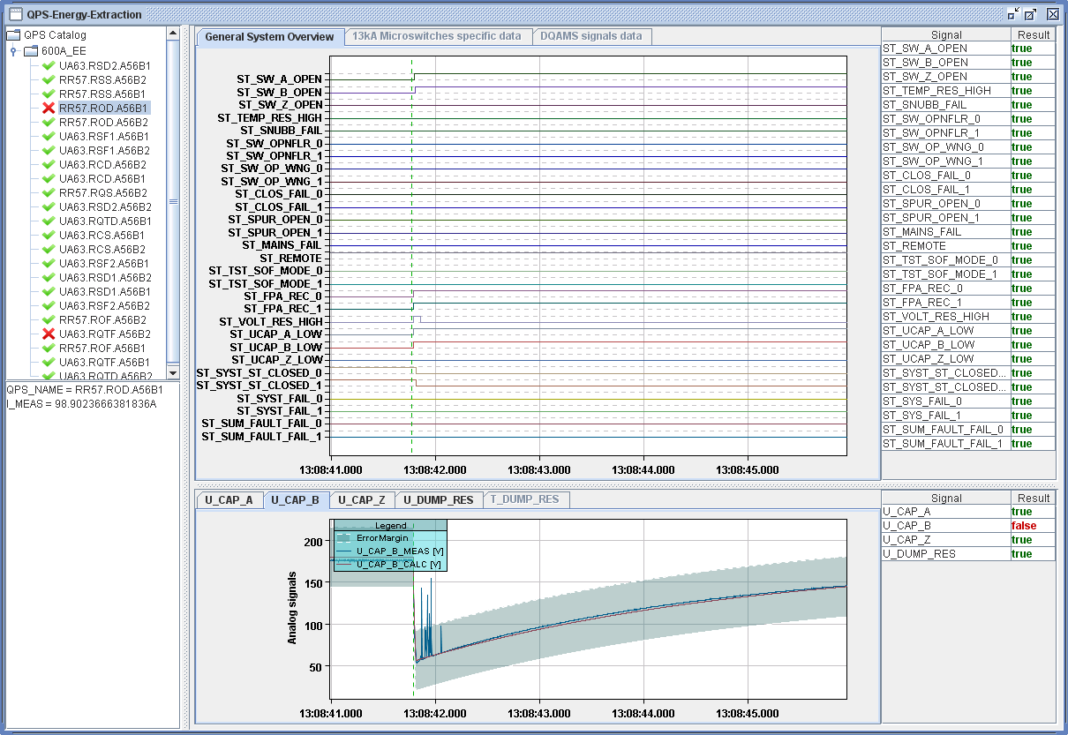
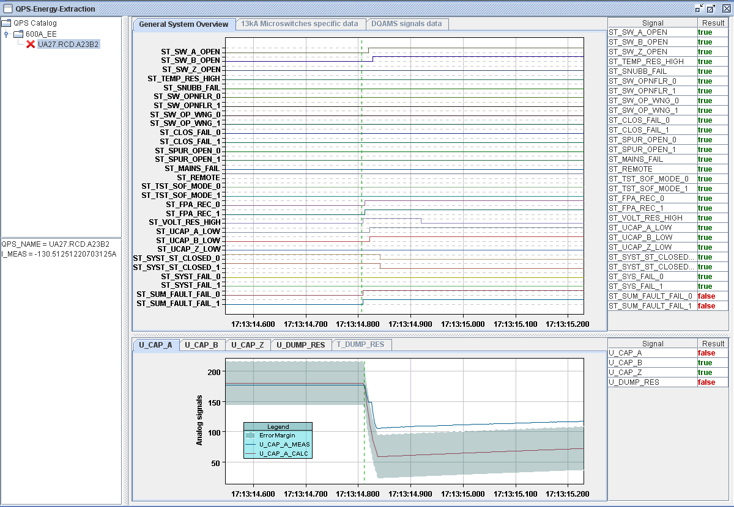
Unforseen discoveries...
Development of 600A EE module revealed minor issue in EE firmware (present during all HWC campaigns)!
Allowed to identify 5 600A EE systems needing intervention during Xmas stop
Some problems with Cap in 600A EE racks!!

Slide 9

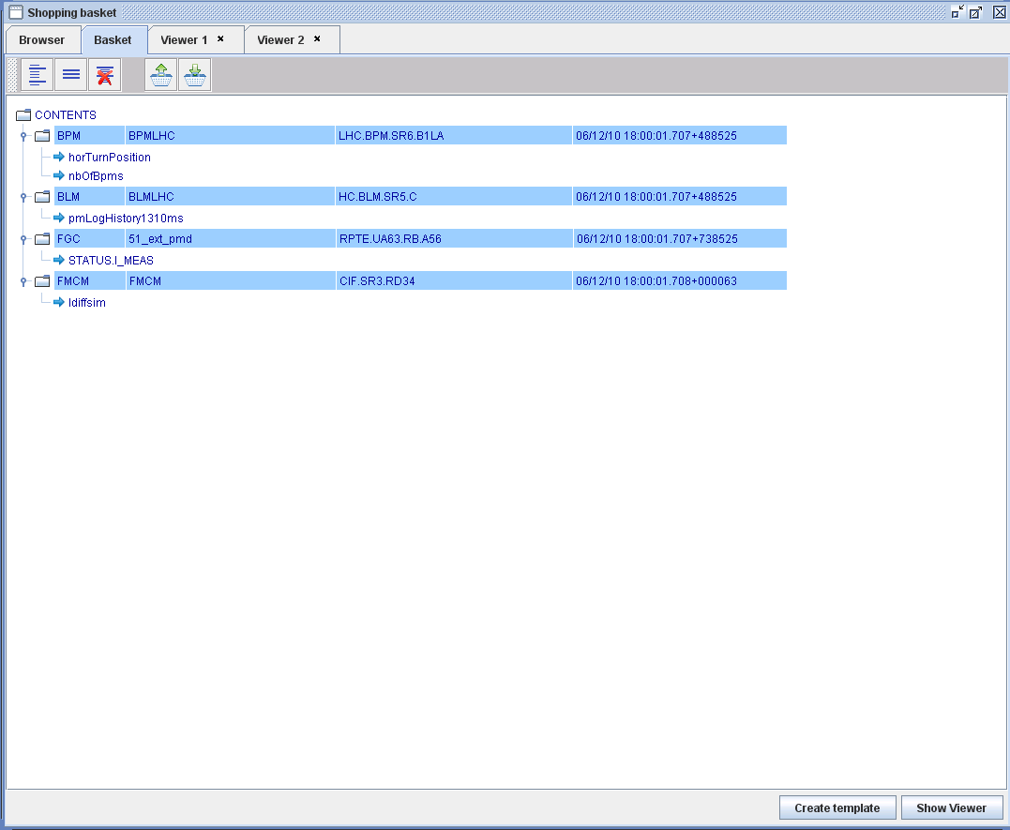
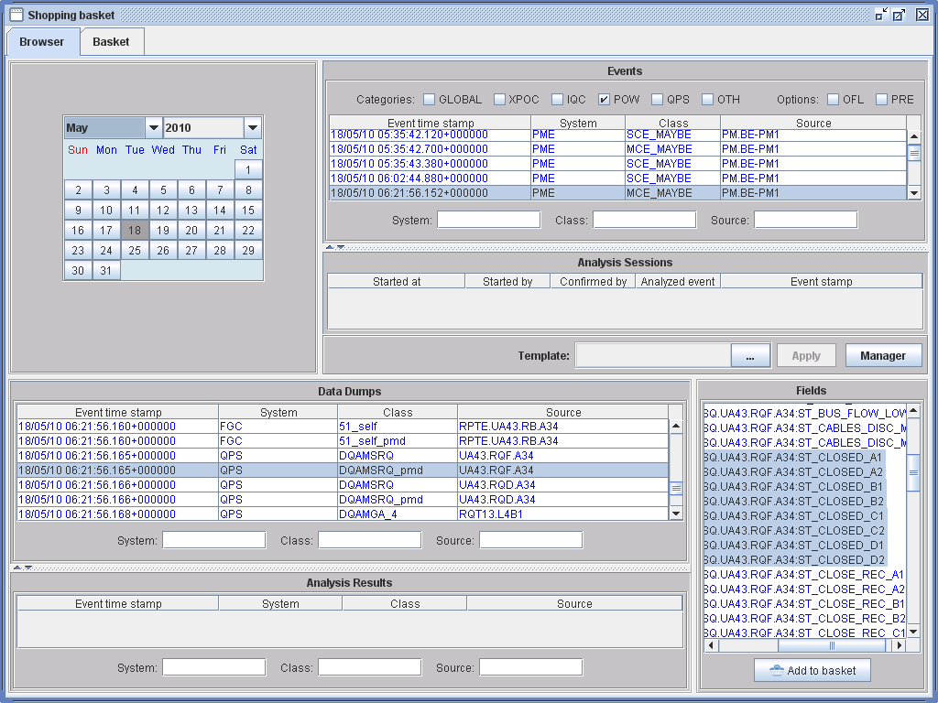
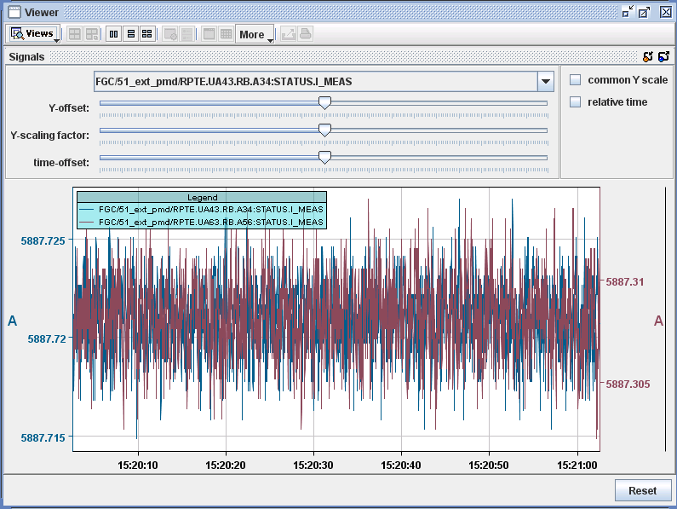
Data correlation with the Post Mortem Basket
PM Project is not only performing automated analysis, but allows for manual analysis by providing configurable displays to operators/experts
Work ongoing to allow correlation of any PM data set (beam, powering,..) against each other, preparations ongoing to include Logging Data
PM Browser & The PM Shopping Basket + Template Manager...

Slide 10
Outlook and future challenges
Data collection infrastructure
  Continuous HW upgrades needed + need to follow CO evolutions (OS, middleware libraries,..)
    Worrying evolution towards CORBA eradication, which would require ~ 2 months of new developments + testing
  Finalization of monitoring, diagnostics and synchronization tools
  Use standard data format for FGC/QPS data to avoid intermediate conversion? (time for validation and backward compatibility)
PM Basket/Template/Viewers
  Finish integration of all data types + ‘alternative’ x-scales (ie transformation of beam related data into time domain), eventually allow inclusion of Logging Data
  Finalize (J-)Data-Viewer (add standard data treatment features, scaling,…)
PM analysis Servers
  Extension of PMA servers towards expert system, development of additional modules ongoing (mostly outside of MPE)
  Further develop Powering Servers, e.g. for nQPS buffers, automated splice analysis, PC discharges… with ultimate goal to be used for Hardware Comissioning in 2012/13

Slide 11

Thanks a lot for your attention!

