Slide 1



HIE-ISOLDE (High Intensity and Energy) project
Protection of superconducting solenoids
MPE work shop – December 14, 2010
G.J. Coelingh TE-MPE-CP

Slide 2
Overview
HIE-ISOLDE Project
  Overview, layout, work structure, QPS budget
Circuits to protect
Quench Detection
  Magnet, Current Leads
Energy Extraction
Resources
MPE work shop – December 14, 2010 G.J. Coelingh TE-MPE-CP
Y. Kadi HIE-ISOLDE Proposal, IEFC, August 21, 2009

Slide 3
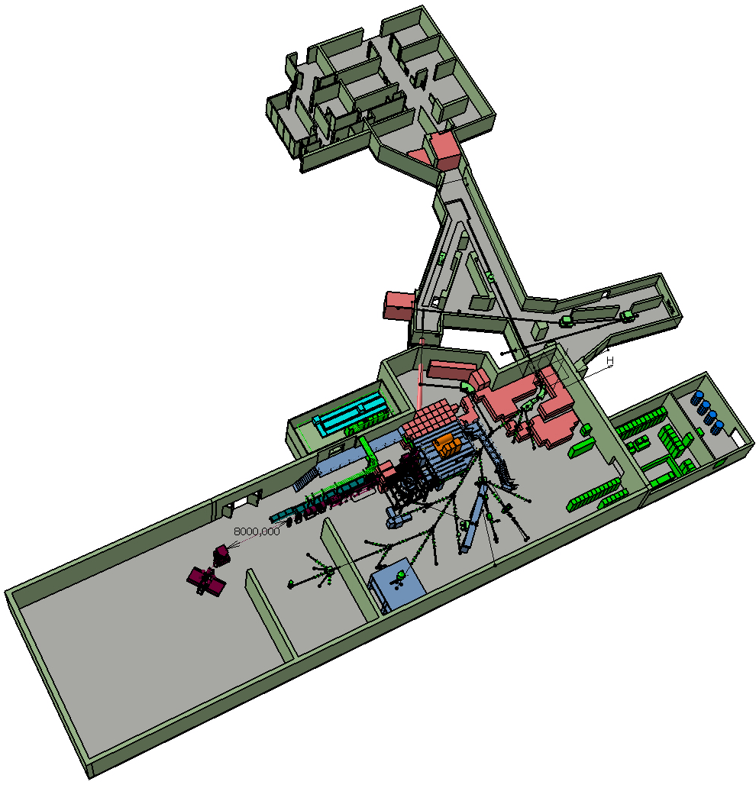
Scope of HIE-ISOLDE
Energy Upgrade:
The HIE-ISOLDE project concentrates on the construction of the SC LINAC and associated infrastructure in order to upgrade the energy of the post-accelerated radioactive ion beams to 5.5 MeV/u in 2013 and 10 MeV/u by 2014/2015
Intensity Upgrade:
The design study for the intensity upgrade, also part of HIE-ISOLDE, starts in 2011, and addresses the technical feasibility and cost estimate for operating the facility at 10 kW once LINAC4 and PS Booster are online. The 30 kW option (SPL beam) will be studied at a later stage

Slide 4
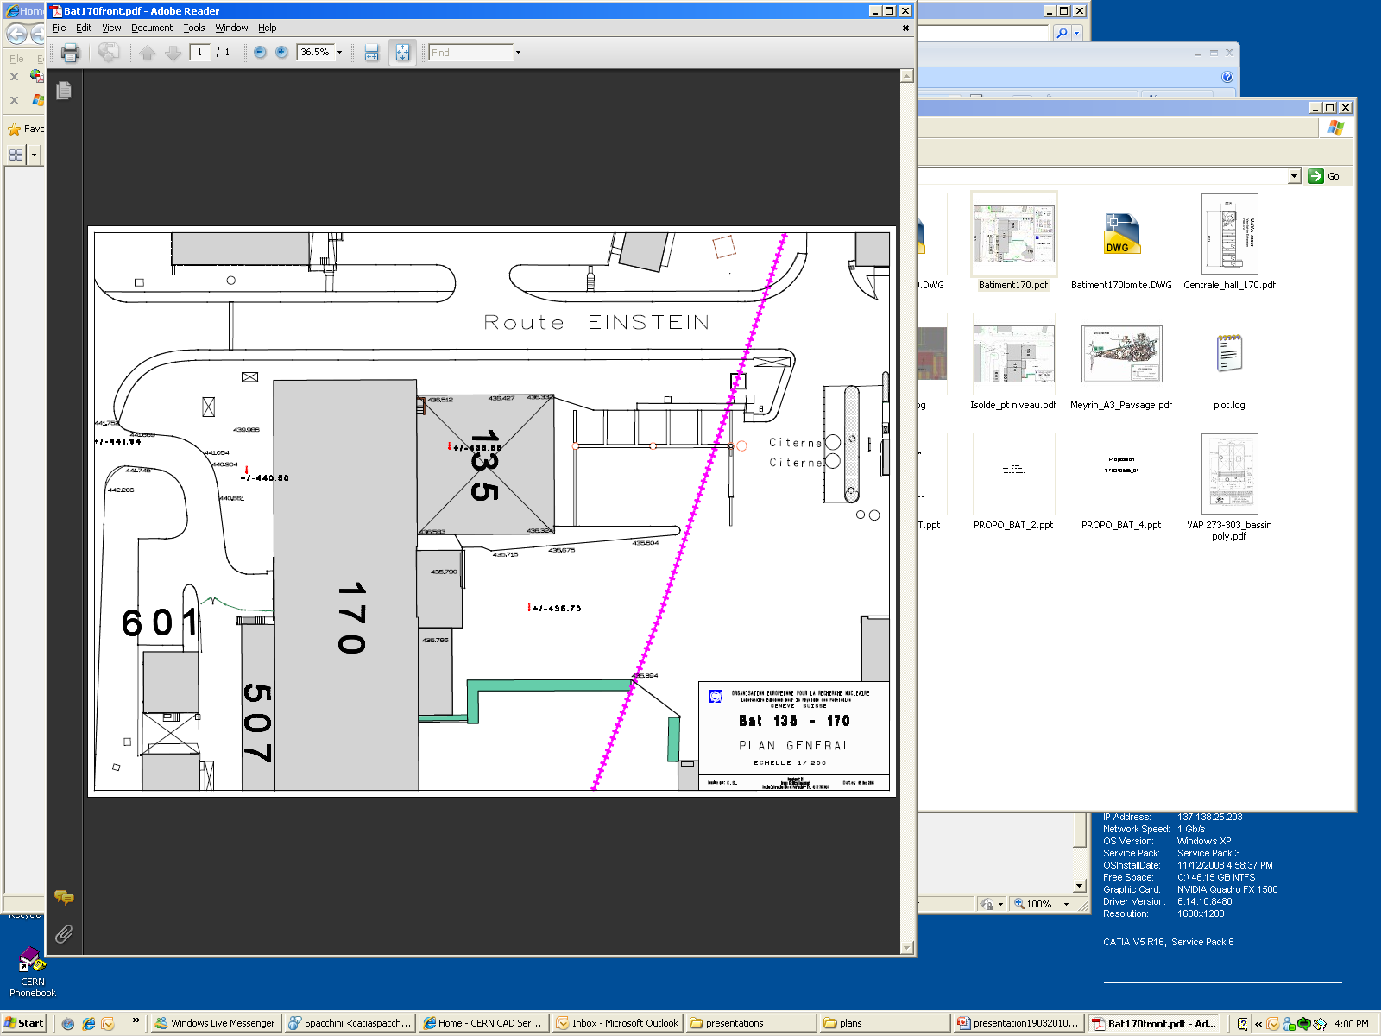
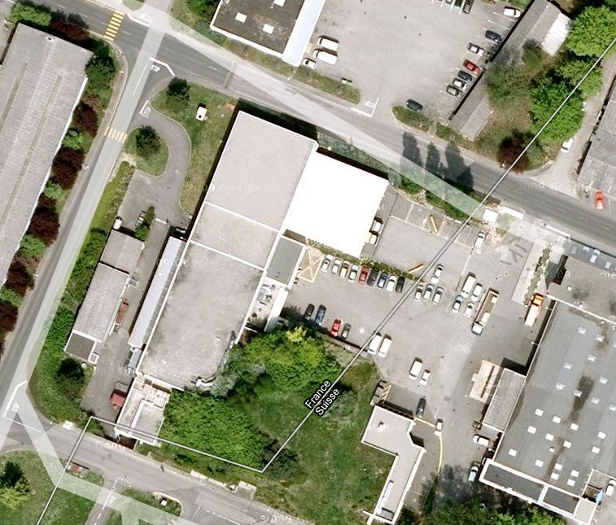
HIE-ISOLDE Layout

Slide 5
Steering Committee
International Advisory Panel
1.1 Project Leader – Y. Kadi (EN/HDO)
1.2 Project Safety Coordinator – A.P. Bernardes
HIE-ISOLDE Project
1. Project Management
1.3 Technical Coordinator – M. Pasini BE/RF
1.4 Design Study Coordinator–R.Catherall EN/STI
HIE-LINAC
2. Linac Systems
2.1 Cavity RF BE/RF
1.5 Budget and Planning – E.Delachenal EN/GMS
2.2 Cavity Design manufacturing EN/MME TE/VSC
1.6 Administration – E. Cochet EN/GMS
2.3 Beam dynamics BE/RF-ABP
2.4 Cryomodules TE/MSC EN/MME
2.5 Beam Instrumentations BE/BI
2.6 SC Solenoid TE/MSC
2.7 Beam transfer line (magnets) TE/MSC
8.1 Safety Coordinator GS/DI
2.8 Linac Integration EN/MEF
8. Safety
8.2 Radioprotection DG/SCR
2.9 Vacuum TE/VCS
8.3 Access System GS/ASE
2.10 Survey BE/ABP
3. Infrastructure
&
Integration
3.1 Civil Engineering GS/SEM
8.4 Access System GS/ASE
3.2 Integration EN/MEF
Work Breakdown Structure
3.3 Cooling ventilation EN/CV
3.4 Electrical systems EN/EL
3.5 Cryogenic system TE/CRG
3.6 Power converters TE/EPC
3.7 Industrial Control system EN/ICE
3.8 Beam Control system BE/CO
3.9 Interlocks TE/MPE
4. Installation
&
Commissioning
4.1 Single cavity test BE/RF
4.2 Cryomodule test BE/RF
4.3 Transport & Handling EN/HE
4.4 Planning & Installation EN/MEF
4.5 Linac commissioning BE/RF-OP
Design Study
5. Target Study
5.1 Target design EN/STI-HE
5.2 Front Ends EN/STI TE/EPC-ABT
5.3 Beam Diagnostics BE/BI
7. Injection & Beam distribution
6. Target Area and Class-A Lab Integration
6.1 Layout upgrade EN/MEF
7.1 Off line separator EN/STI
6.2 Cooling and ventilation EN/CV
7.2 Separator areas EN/STI
6.3 Electrical systems EN/EL
7.3 Experiment Hall EN/MEF
6.4 Vacuum TE/VCS
7.4 Beam lines BE/ABP
6.5 Survey BE/ABP
6.6 Civil engineering GS/SEM
6.7 LL Control system EN/STI

Slide 6
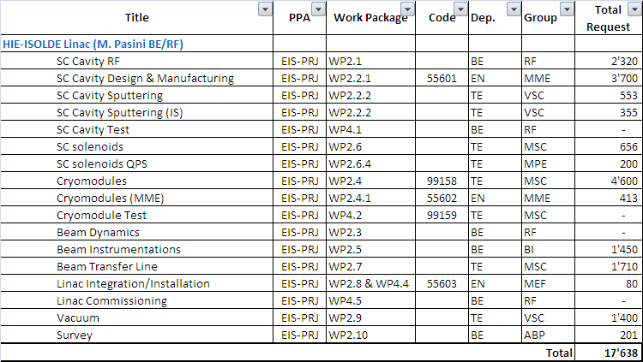
HIE-ISOLDE material budget
MPE work shop – December 14, 2010 G.J. Coelingh TE-MPE-CP

Slide 7
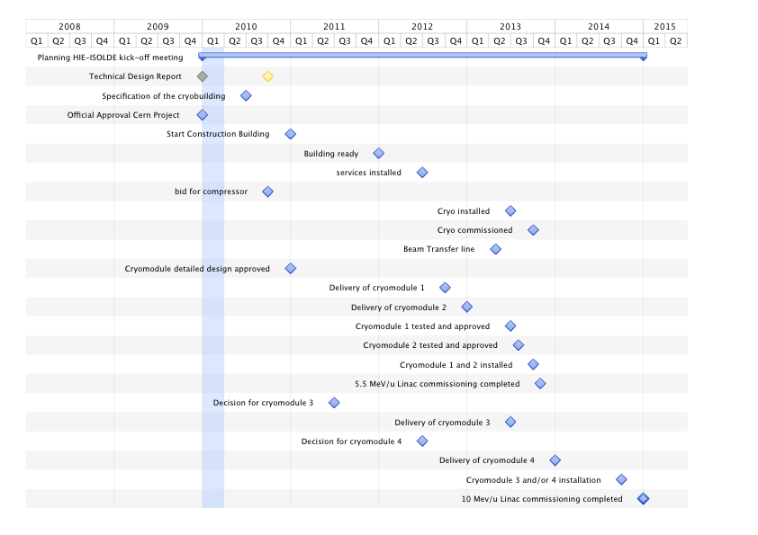
HIE-ISOLDE Schedule
Important milestones for Energy Upgrade:
Start project Jan 1st 2010
Start construction by Jun 2010
Launch Procurement of Cryogenics equipment:
  Market survey by Mar 2010
  Tech. Specific. By May 2010
  Finance Committee by Sep. 2010
Cryogenics installed and commissioned Jun 2013
High energy beam line (5.5 MeV/u) installed by Oct 2013
10 MeV/u Linac installed by 2014/2015
Commissioning organized inline with L4 and PSB commissioning
April 2010 planning - to be updated
Cold test of first cryo-module in April 2013
MPE work shop – December 14, 2010 G.J. Coelingh TE-MPE-CP

Slide 8
Circuits
8 individually powered circuits with S.C. solenoids of 130 mH each
Nominal current 450 A – Stored Energy 13 kJ
Powering scheme tbd. Grounding, Series/parallel extraction
Protection delay tbd. This will determine EM or SSt switch
MPE work shop – December 14, 2010 G.J. Coelingh TE-MPE-CP
Y. Kadi HIE-ISOLDE Proposal, IEFC, August 21, 2009

Slide 9
Quench Detection
Magnet Detection based on existing digital LHC – SAM detectors
    4 redundant voltage taps on layer 0, layer 8, layer 12 and layer 20.
    First tap on the top and the redundant at the bottom.
      The difference will be 0.5 turns which should be negligible for the detection system
MPE work shop – December 14, 2010 G.J. Coelingh TE-MPE-CP
Y. Kadi HIE-ISOLDE Proposal, IEFC, August 21, 2009

Slide 10
Quench Detection & Controls
Lead detection depending on lead type but most likely conventional cupper model will be used. Tbd.
Controls/Data transfer to be determined – Field Bus or Ethernet?
  Valid for Detection and Extraction
Interlocks – PC-QPS-EE-PIC. Tbd.
MPE work shop – December 14, 2010 G.J. Coelingh TE-MPE-CP
Y. Kadi HIE-ISOLDE Proposal, IEFC, August 21, 2009

Slide 11
Strategic Plan for EE
Solid State Switch development recently started
  Goal: Prototype by May/June 2011
  Challenge to finish series production before 2.5 years from now
In parallel: upgrade existing LHC 600 A EE system; improvements from exploitation/maintenance points of view
  10 systems can be delivered within 2 years
If choice will be Solid State - use EM systems as spares for LHC
MPE work shop – December 14, 2010 G.J. Coelingh TE-MPE-CP
Y. Kadi HIE-ISOLDE Proposal, IEFC, August 21, 2009

Slide 12
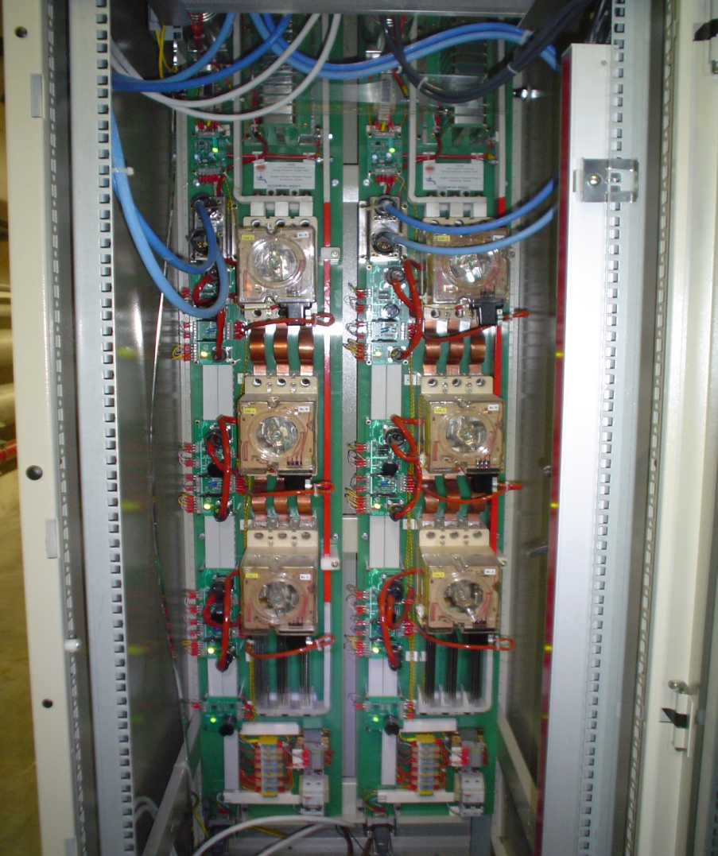
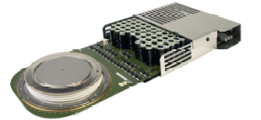
EE: Solid State or EM
Solid State Switch: Semi-conductor IGCT
  Integrated Gate Commutated Thyristor
  Fast and “maintenance” free vs
  Forward Losses – water cooling
Electro-Magnetic circuit breaker
  very low forward losses vs
  maintenance (preventive & corrective)
Two, 600A extraction systems in a common rack
IGCT and its integrated drive electronics.
MPE work shop – December 14, 2010 G.J. Coelingh TE-MPE-CP
Y. Kadi HIE-ISOLDE Proposal, IEFC, August 21, 2009

Slide 13
Resources 2011 - 2012
Project Manager: 20% - 2011 15% - 2012
Project Engineer EE: 20% - 2011 20% - 2012
Project Engineer QPS: 25% - 6 months 2011
10% later
Technician: 20% - 2011 10% - 2012
Design: 35-50% - 6 months 2011 10% later
MPE work shop – December 14, 2010 G.J. Coelingh TE-MPE-CP
Y. Kadi HIE-ISOLDE Proposal, IEFC, August 21, 2009

Slide 14
Thank you for your attention
MPE work shop – December 14, 2010 G.J. Coelingh TE-MPE-CP

