Slide 1
RELIABILITY OF 600 A
ENERGY EXTRACTION SYSTEMS
MPE work shop – December 14, 2010
G.J. Coelingh TE-MPE-CP

Slide 2
Overview
600 A EE; what, where, how ?
Reliability
  Operational reliability – protection point of view
  Overall reliability – hardware failures point of view
Availability and Mean Time Between Failure – MTBF
Future
Improvements - manpower
MPE work shop – December 14, 2010 G.J. Coelingh TE-MPE-CP

Slide 3
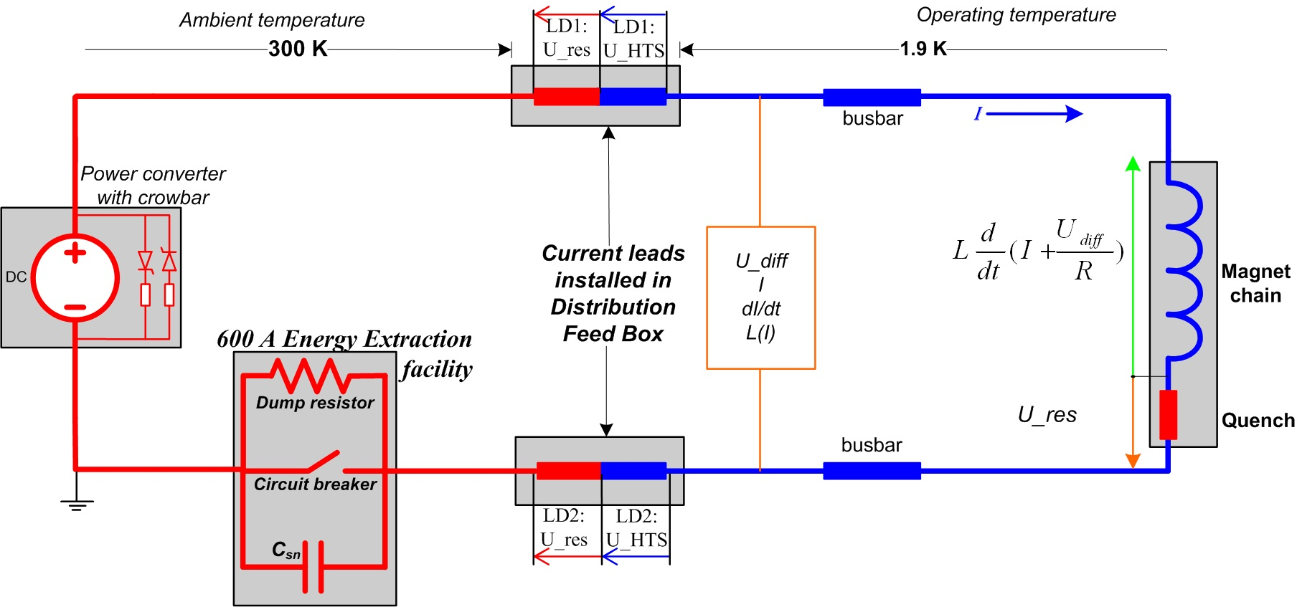
Energy Extraction 600 A EE
MPE work shop – December 14, 2010 G.J. Coelingh TE-MPE-CP
Notes:
Normally circuit breaker closed and C and R shorted. In case of a problem, quench or other, stored energy in the magnet chain must be extracted by opening the switches. Transformation of stored magnetic energy into heat.

Slide 4
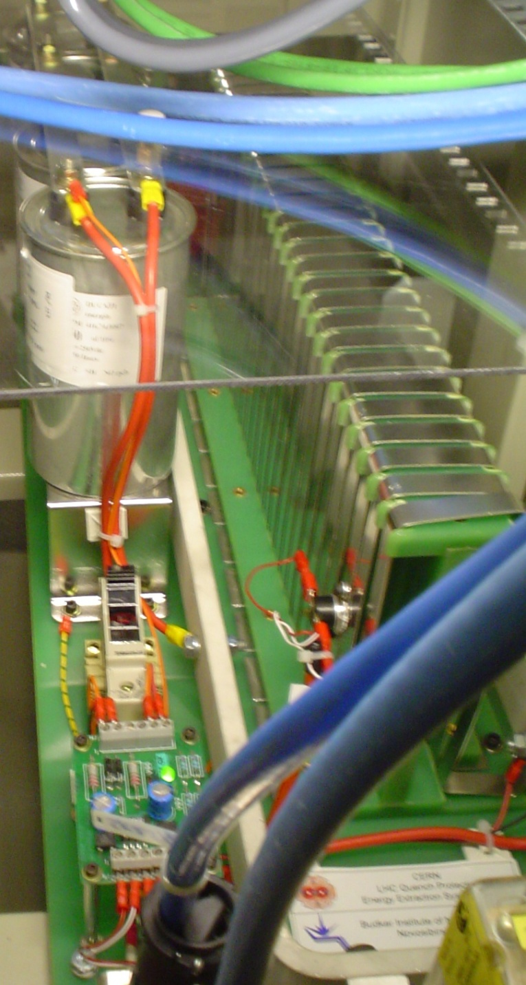
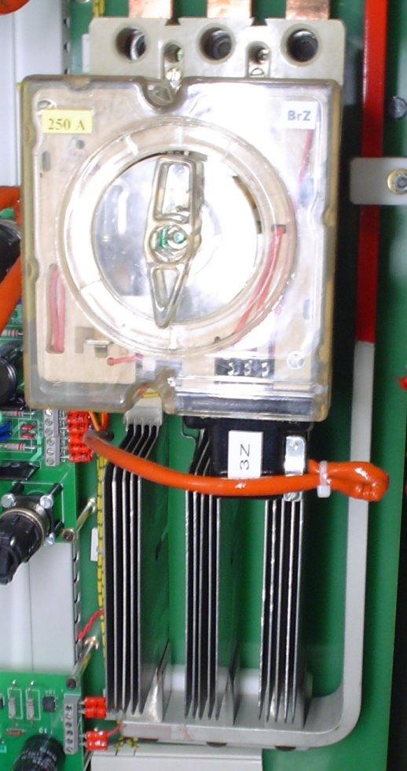
Notes:
3 breakers in series. Always open A and B. Z is backup and only used when A and B fail, therefore is still new.
Used 3 AC breakers, with snubber C to be able to open DC current.

Slide 5
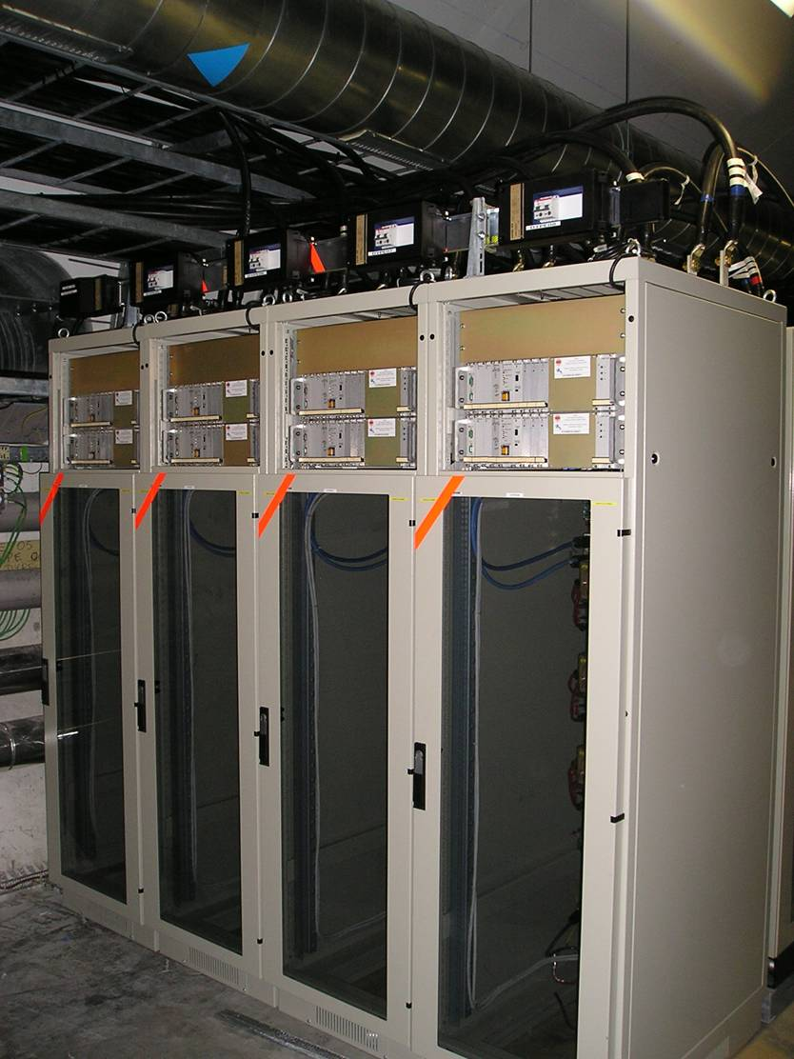
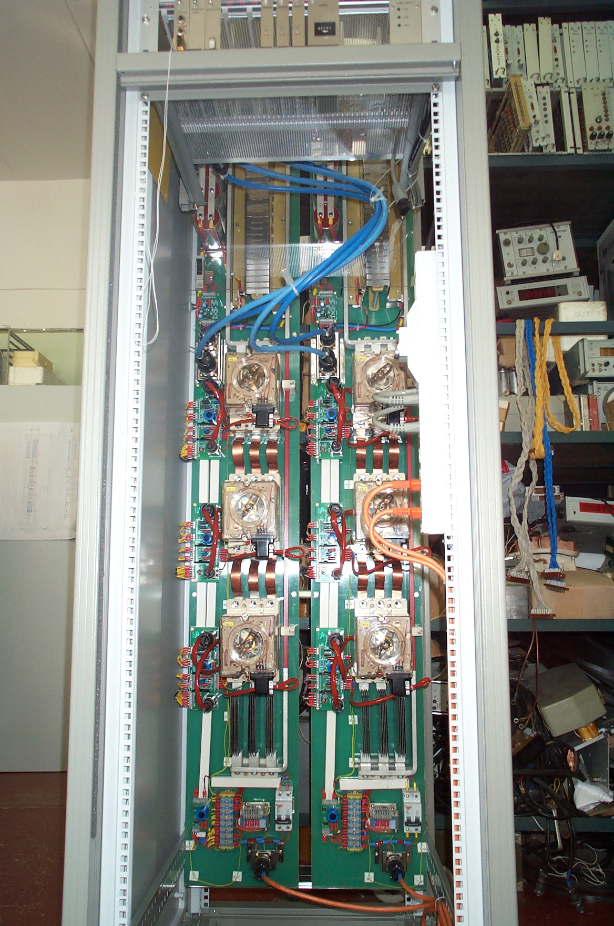
600A Energy Extraction Systems
202 systems installed in the LHC tunnel in corrector circuits with stored energy between 2.2 and 150 kJ
In 15 different locations;
  8 x UA parallel service tunnel and 6 x RR and 1 x UJ tunnel caverns
Systems developed in close collaboration between CERN and the Budker Institute of Nuclear Physics (BINP), Novosibirsk, Russia.
MPE work shop – December 14, 2010 G.J. Coelingh TE-MPE-CP

Slide 6
Reliability
Systems reliability from protection point of view:
  No failures during Fast Power Abort events
2 independent opening circuits per breaker guaranteeing 6-fold redundancy
Calculated by Antonio Vergara in December 2003:
  System Failure probability after 20 years of the 600 A EE systems: < 0.01%
MPE work shop – December 14, 2010 G.J. Coelingh TE-MPE-CP
Notes:
One active opening device – pulse coil
Second passive opening device – holding coil

Slide 7
Reliability (2)
Systems reliability from hardware failure point of view:
  6 hardware failures - always during closing procedure
    FAIL-SAFE!
  Mean Time To Recovery (LHC machine including access and travel time)
    4 hours/intervention = 6 failures * 4 hours
      In total, 1 day down time for 202 systems
MPE work shop – December 14, 2010 G.J. Coelingh TE-MPE-CP

Slide 8
Availability
All systems: 280 days – 1 day downtime = 99.643 %
280 days
One system: 280 days*202 systems – 1 day downtime = 99.998 %
  280 days*202 systems
MPE work shop – December 14, 2010 G.J. Coelingh TE-MPE-CP
Notes:
Availability = Uptime / (Uptime + Downtime)
Un-Availability = 1 – A or Downtime / (Uptime + Downtime)

Slide 9
Mean Time Between Failures - MTBF
  All systems: (6720 hours – 24 hours downtime)
  6 failures
  = 1116 hours = 46.5 days
  One system: (6720 hours – 24 hours downtime) * 202 systems
  6 failures
  = 225.432 hours = 9393 days = 25.7 years
MPE work shop – December 14, 2010 G.J. Coelingh TE-MPE-CP

Slide 10
Failures
6 failures in total:
4 cases of excessive closing failures
Loosening of holding coil mechanism
Last intervention for this on September 11, 2010
1 case of discharging Fast-Off capacitor.
Changed breaker’s PCB but no fault found.
Suspicion of a loose wire but no repetition of the problem since July 2010
1 case of broken holding coil.
Heritage of overheating during 2 heat-runs in UJ33 in 2008.
Solutions were implemented and case is considered as solved or SE (July 2010)
MPE work shop – December 14, 2010 G.J. Coelingh TE-MPE-CP

Slide 11
Actions
are on-going to decrease the number of closing failures
“Normal” closing failures: (2%) will be transparent for operation.
Excessive closing failures: In contact with manufacturer to overcome problem which is the fixation of the holding coil mechanism.
MPE work shop – December 14, 2010 G.J. Coelingh TE-MPE-CP
Notes:
The manufacturer will study these cases to find out if:
Worst case: it is deteriorating because of (ab)use
or
Better case: it was an assembly fault/weakness.

Slide 12
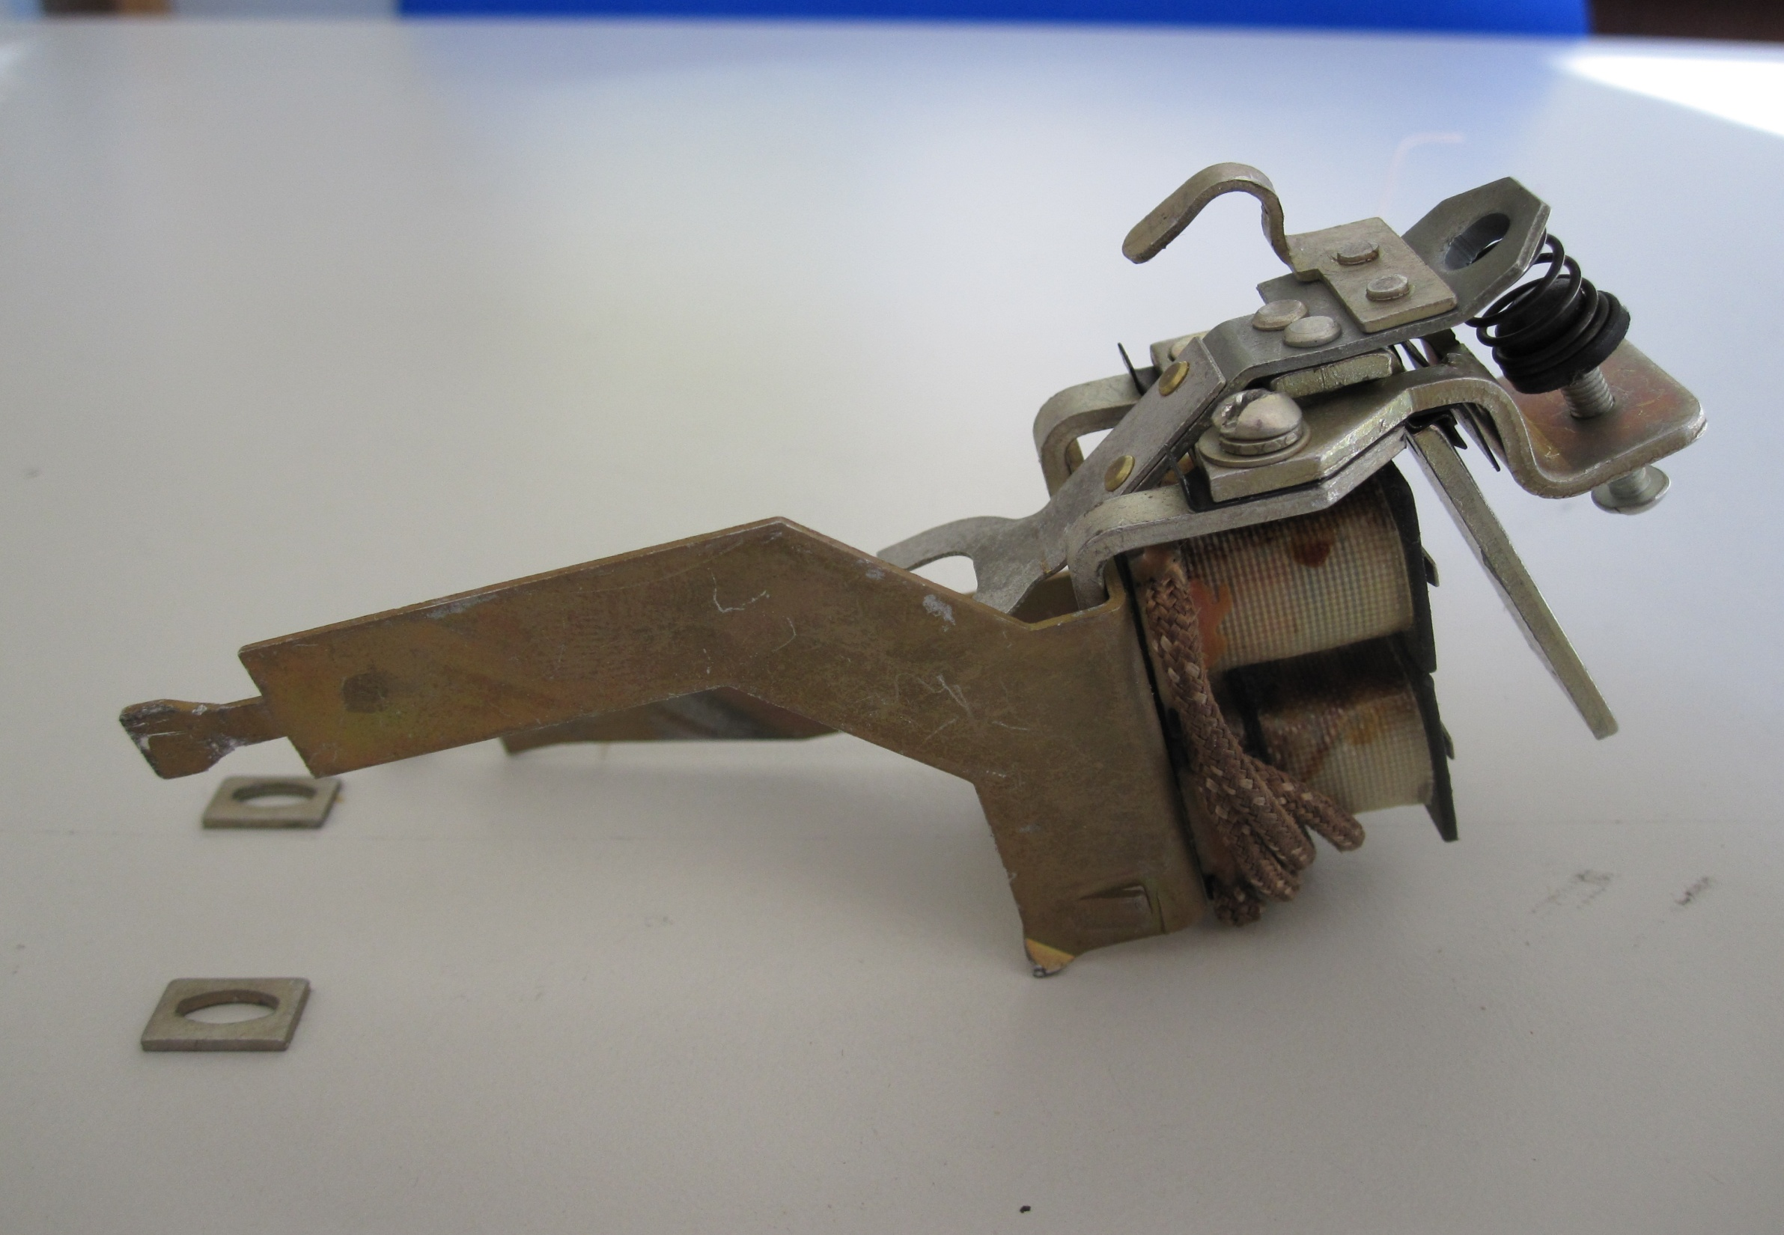
Improvements
Manufacturers conclusion
IF decided to take action on holding coil mechanism:
Dismount/open all 606 breakers in the LHC machine.
Adapt fixation at surface or in tunnel
Need again IST tests and partially HWC
Estimated working time > 1200 man-hours
(specialists team; 4 persons – 7 to 8 weeks, not included HWC)
MPE work shop – December 14, 2010 G.J. Coelingh TE-MPE-CP
Notes:
Must follow up this problem -

Slide 13
Future MTBF
MTBF after upgrade (recalculated 2010: keep 2 failures):
All systems: = 3.356 hours (approx. 5 months)
One system: = 677.912 hours (approx. 77 years)
Probably maximum reasonably achievable
MPE work shop – December 14, 2010 G.J. Coelingh TE-MPE-CP

Slide 14
Resources
Exploitation, Maintenance (interventions, scheduled and unscheduled TS)
Improvement, Follow-up (scheduled TS)
CERN resources:
Specialist: 15-20%
Detailed engineering: 10-15%
Technician: 10-15%
MPE work shop – December 14, 2010 G.J. Coelingh TE-MPE-CP

Slide 15
Thank you for your attention!
MPE work shop – December 14, 2010 G.J. Coelingh TE-MPE-CP

