Slide 1
Non-conform MCBY circuits
Introduction
Hypothesis
Model
Tests planned
Conclusions
2011 Planning

Slide 2
Introduction
We have found an unexpected behavior in some 120A circuits (individual powered correctors).
6 MCBY & 3 MCBC magnets are quenching when ramping up/down, usually when going to 0A.
  List of circuits:
Several tests have been made in 2008, 2009 to discard power converters, cryo conditions…
    RCBCV8.L1B2
    RCBYHS4.L5B1
    RCBCH7.L8B1
    RCBYH4.L2B2
    RCBYHS5.R8B1
    RCBCV7.L2B2
    RCBYH4.R8B1
    RCBYV5.L4B2
    RCBYHS4.R2B1

Slide 3
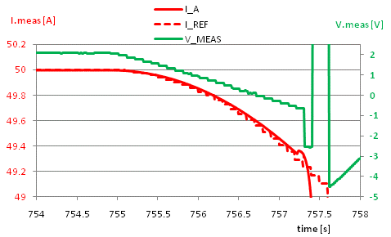
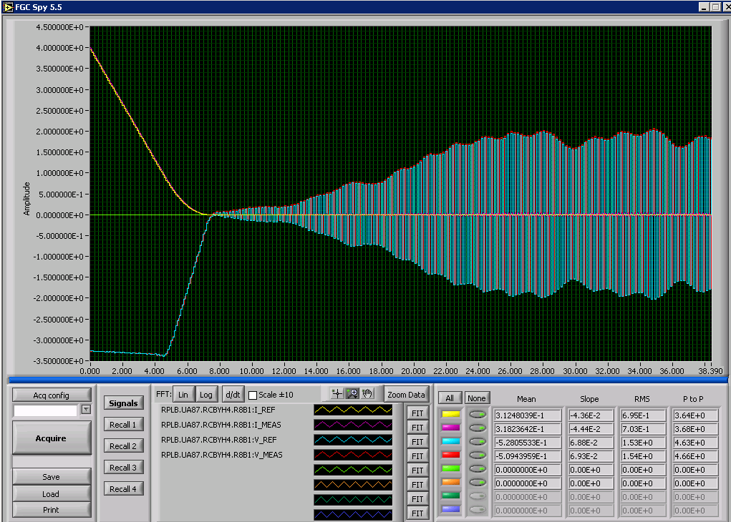
Introduction
Symptoms:
  The magnets cannot stand the nominal di/dt
  We can observe a bump in the
  measured current when the magnet
  quenches
  No appreciable degradation in the quenches
  Power converter instability problem, due
  to different TF of the magnets.
  This was solved by EPC group adding
  a virtual resistance of 70 Ohm in parallel
  to the magnet in the PC model.

Slide 4
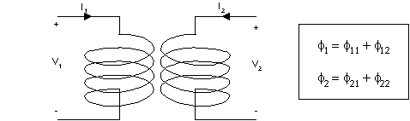
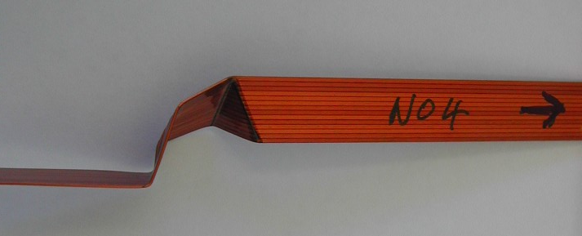
Hypothesis
The first idea, pointed by Glyn Kirby, was a kind of transformer effect.
That could happen when a loop is shorted in the middle of the coil.
We will have N1=29 and N2=1.
The change in flux in the large
inductance will produce a high
current in the lower inductance,
that will quench the loop in short.
This is a detail of the presumable
place for the short.

Slide 5
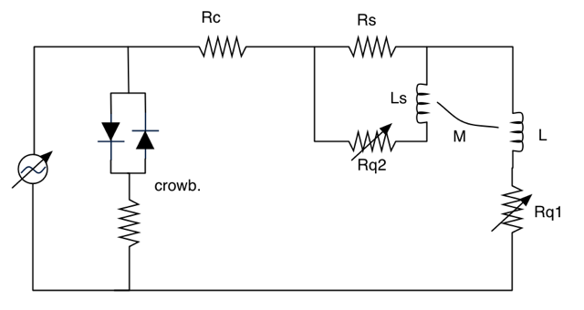
Model
A model of the MCBY with the short is done in Matlab. It’s based on the work started by Bernhard Auchmann.
The circuit is analytically resolved and simulated in Matlab, adding the thermodynamic calculations.

Slide 6
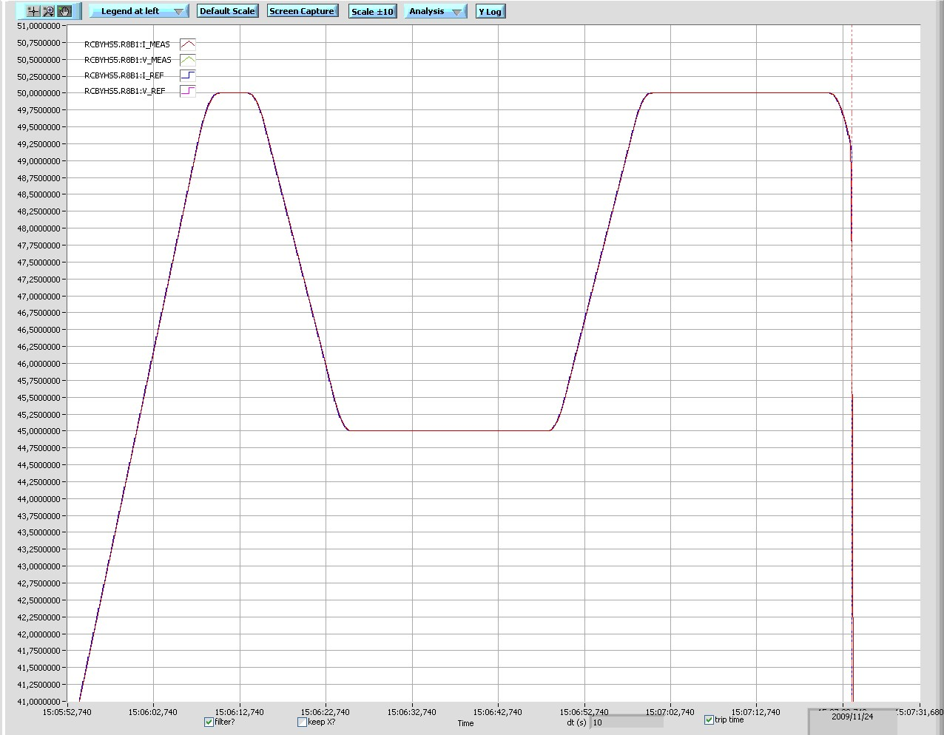
MCBY vs Model (replica of a real quench)
Real quench. PM file: 091124-50723.820
Simulation in Matlab, with the same ramps and times.
Similar results.
Differences:
Magnitude of the bump
Current in the quench

Slide 7
MCBY vs Model (replica of a real quench)
Explanation of the quench, seeing what is happening in
the loop in short.
Imax

Slide 8
Temperatures & Voltages
The simulations are done assuming the adiabatic case, so
we are in the worst case, to be sure that the magnet will be
safe.
Currents
Temperatures
Voltages
(in the magnet)
Voltage
in the PC

Slide 9
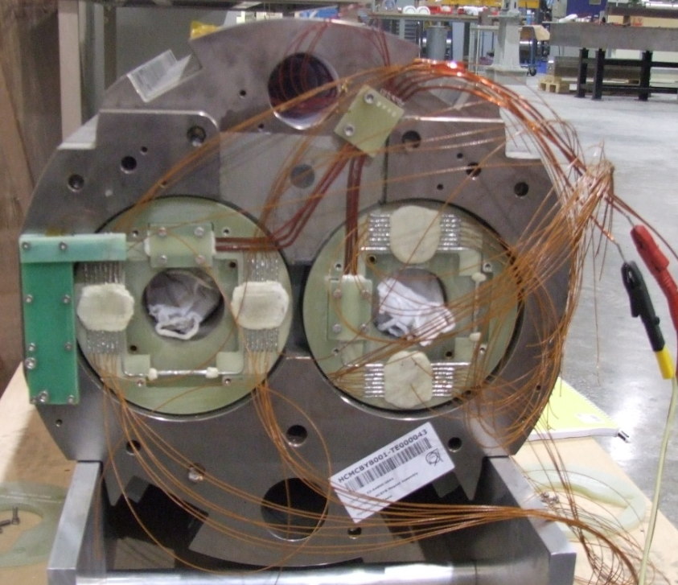
Tests planned
To validate the model and fix some parameters affecting the simulations, we need to fake a short and see what is happening in this turn.
Test proposals:
  Magnet: Using a spare one (HCMCBYB001-TE000043). It’s ready and stored in building 927.
  Place for the tests: Block 4 (SM18)
  Instrumentation: both apertures with
  Vtaps in all turns
  Faking a short in one aperture.
  This is done with a stainless steel
  piece soldered between two turns,
  with an Rs=0.0015 Ohm.

Slide 10
Tests planned
Examples of the current cycles planned:

Slide 11
Conclusions
Main parameters affecting the results of the simulation are:
  modeling and value of the short resistance
  quench velocity propagation
  exact current that makes the loop in short quench
We will know them empirically, measured in the tests, to have better and more realistic simulations. Once these parameters are fixed, we should be able to reproduce the measured voltages and currents.
We will be able to know the maximum voltage developed inside an MCBY coil during a quench, in a healthy and in an sick magnet.
Voltage withstand could be re-defined for these magnets, as it was not fully measured.

Slide 12
2011 Planning
The maximum time length for the tests should be around one week, including installation of the magnet, cooling, tests and warming.
The date is not fixed, we are waiting for the confirmation.
Relative to LHC:
  There’s a good margin with the sick MCBY’s and MCBC’s. They are working well within their safety parameters. In fact, some of them are not being used, but the working parameters are changing depending on the optics.
  Just taking in account the safe maximum ramp rate (different for each magnet) there shouldn’t be any problems to go to 4 Tev or 4.5 Tev.

Slide 13
Thank you for your attention.

