Slide 1
CLIC: Ideas for Machine Protection and Interlock systems 15'
M.Jonker
With ideas from (and for !) others

Slide 2
CLIC
CLiC = Compact Linear Collider:
A machine to study new phenomena with high precision:
  Higgs, Susy, other exotic phenomena
  (to be discovered at LHC
LHC: P-P collisions (non elementary quark bags)
CLIC: e+ e- (elementary particle / anti-particle)
  All beam energy available to produce new stuff (LHC: E_{quark} ≈ 1/6 E_{proton} ≈ 1 TeV)
  Well defined centre of mass
  No spectator quarks
  Clean process
  Prerequisite for precision measurements
CLIC Energy required to cover LHC energy reach
~ 7 TeV/6 +50% ≈ 1.5 TeV x 2 beams

Slide 3
Linear ?
Circular machines:
  Relative energy loss/turn = 88.5 E³/ρ TeV⁻³ km turn⁻¹ (ρ = arc radius)
  LEP @ E=104.5 GeV, ρ=3.6 km, E-loss/turn = 2.8 %
@CLIC energies 1.5 TeV
For similar losses as in LEP we need
ρ =15³ x 4 km = 13500km (about twice the radius of the earth).
For 100% loss @ 1.5 TeV ρ = 300 km
LEP was the last circular e⁺ e⁻ machine.
Notes:
8.85 10⁻⁵ MeV E⁴/ρ GeV⁻⁴ km turn⁻¹ /E GeV/GeV
=8.85 10⁻⁸ GeV E⁴/ρ GeV⁻⁴ km turn⁻¹ /E
=8.85 10⁻⁸ E³/ρ GeV⁻³ km turn⁻¹
=88.5 E³/ρ TeV⁻³ km turn⁻¹
Lep 0.1 TEV

Slide 4
Compact ?
With an accelerating gradient of 100 MV/m 1.5 TeV needs 15 km
Need space for quadrupoles, BI, etc. (5 km)
Need space for beam delivery (4 km: cleaning, diagnostics, final focus)
Total span : 2x24 km = 48 km
Compact?
Not a table top accelerator, but with conventional accelerating gradients 30 MV/M we would need 140 km
Notes:
8.85 10⁻⁵ MeV E⁴/ρ GeV⁻⁴ km turn⁻¹ /E GeV/GeV
=8.85 10⁻⁸ GeV E⁴/ρ GeV⁻⁴ km turn⁻¹ /E
=8.85 10⁻⁸ E³/ρ GeV⁻³ km turn⁻¹
=88.5 E³/ρ TeV⁻³ km turn⁻¹
Lep 0.1 TEV

Slide 5
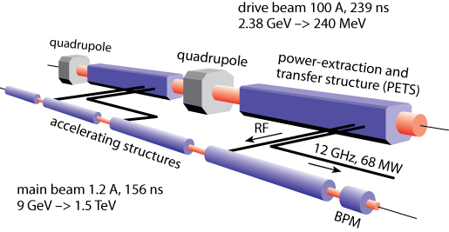
The tricks
High acceleration gradient: ~ 100 MV/m
  `Compact’ – total length < 50 km at 3 TeV
  Normal conducting acceleration structures at high frequency 12 GHz
Novel Two-Beam Acceleration Scheme
  The energy of a high intensity low energy beam is extracted to accelerate a low intensity beam to high energy
  Frequency multiplication of low energy beam to produce high frequency
  Cost effective, reliable, efficient
  Simple tunnel, no active elements, modular, easy energy upgrade in stages

Slide 6
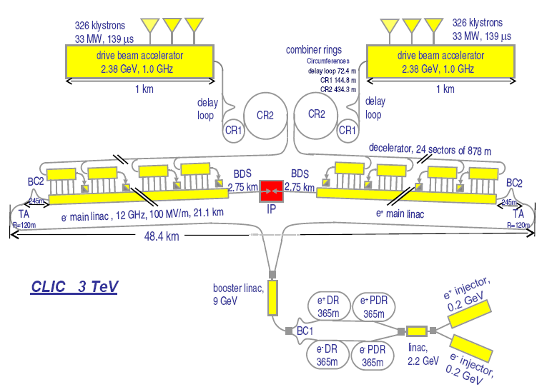
CLIC
A complex and extensive machine
~ 60 Km of beam tunnel, numerous accelerators equivalent to ~2x the actual full CERN accelerator complex.
High beam power
  Drive beam 2 x 70 MW,
  main beam: 2 x 14 MW
Microscopic beam spots
Size matters: at 3 GeV main beam is 4 orders above damage threshold in the extraction channel of a damping ring. (A single bunch is 1ne order above damage threshold)
Picture: single pulse damage in 1.4 mm of cupper (holes size 10 x 20 um)
CLIC study program:
Conceptual design report end of 2010.
Technical design phase and proposal 2011-2016

Slide 7
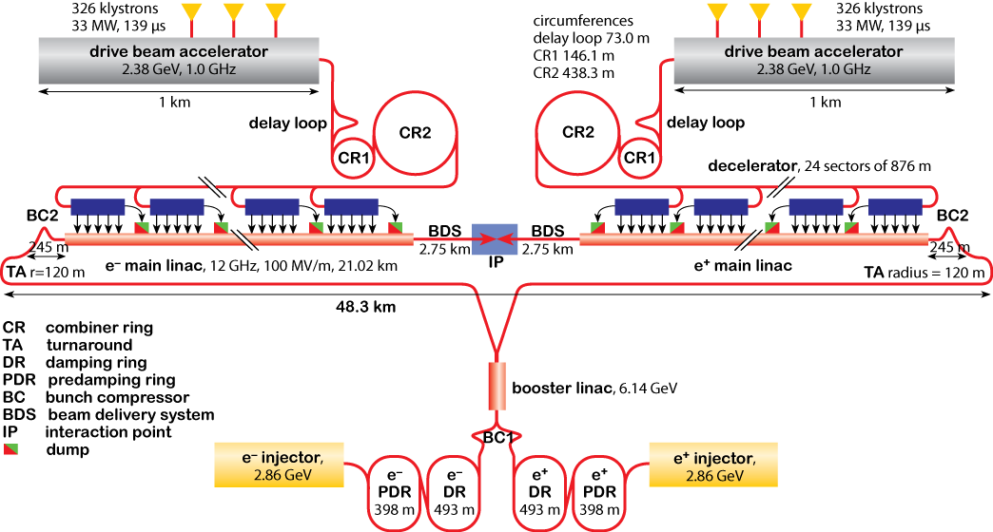
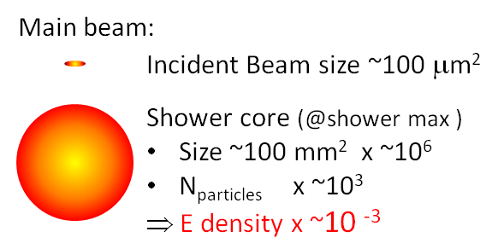
Beam Power and destructive capacity
Beam Power = BeamCharge × ParticleEnergy × CyclingRate
Drive Beam: 2 × 70 MWatt Main Beam: 2 × 14 MWatt
this makes a sustained disposal of this power a challenging task.
Energy Density = BeamCharge × BeamSize⁻¹ × dE/dx (ionisation loss)
Destructive potential: determined by BeamCharge × BeamSize⁻¹ not Beam Power.
Safe Beam:: yield limit in copper (62 J g⁻¹)
Drive beam 70 MW @ 50 Hz
1.4 MJ /pulse = 340 Kcal
3.4 ^{O}C in 100 litre of water for a single pulse
Not too much? @ 50 Hz It will be steaming hot after 0.5 seconds.
Main beam, 14 MWatt @ 1.5 TeV
289kJ / pulse = 70 Kcal
0.7 ^{O}C in 100 litre of water for a single pulse
@ 2.8 GeV ? ⇒ 14 cal ⇒ 0.14 ^{O}C in 1 glass of wine
This will not harm?
Do not ignore the ENERGY DENSITY
 | Particle Energy [GeV] | Pulse Charge [μC] | Beam Size [mm²] | Energy Density in copper [J g⁻¹]
 |  |  |  | Incident Beam | Shower Core
Drive Beam Train (1 of 24) | 2.4 | 25 | 1 | 3.4 10³ | 40
Main Beam @ Damping Ring | 2.8 | 0.20 | 125 10⁻⁶ | 1.8 10⁵ | 0.34
Main Beam @ β collimation | 1.5 10³ | 0.18 | 40 10⁻⁶ | 6.7 10⁵ | 120
Energy density in shower core is less significant than energy density of the incident beam.
Main beam already unsafe in the damping ring even with low beam power.
Particle energy is not the primary worry, however,
no doubt at 1.5 TeV you ‘drill’ deeper holes.
￼
Main Beam : 10000 × ‘safe beam’
Drive Beam : 100 × ‘safe beam’
Notes:
Historically, electron machines have been less impressive than hadron machines, in part because hadron machine have a larger activation potential.
CLIC challenge: Drive beam of unprecedented power (70 MW/beam)
Note 70 MW @ 50 Hz = 1.4 MJ for a single pulse = 340 Kcal = 3.4 ^{O}C in 100 litre of water. Not so much? It will become steaming hot after 0.5 seconds.
Charge densities: (orders above damage thresholds)
2 orders (drive beam)
4 orders (main beam)
main beam already destructive at 2.8 GeV (such beam exists in light sources, but are they ever extracted?)
Challenging task: fixed masks to protect extraction channels against RT errors.

Slide 8
CLIC Layout 3 TeV (not to scale)
5.8 µs
… 24 x
245 ns

Slide 9
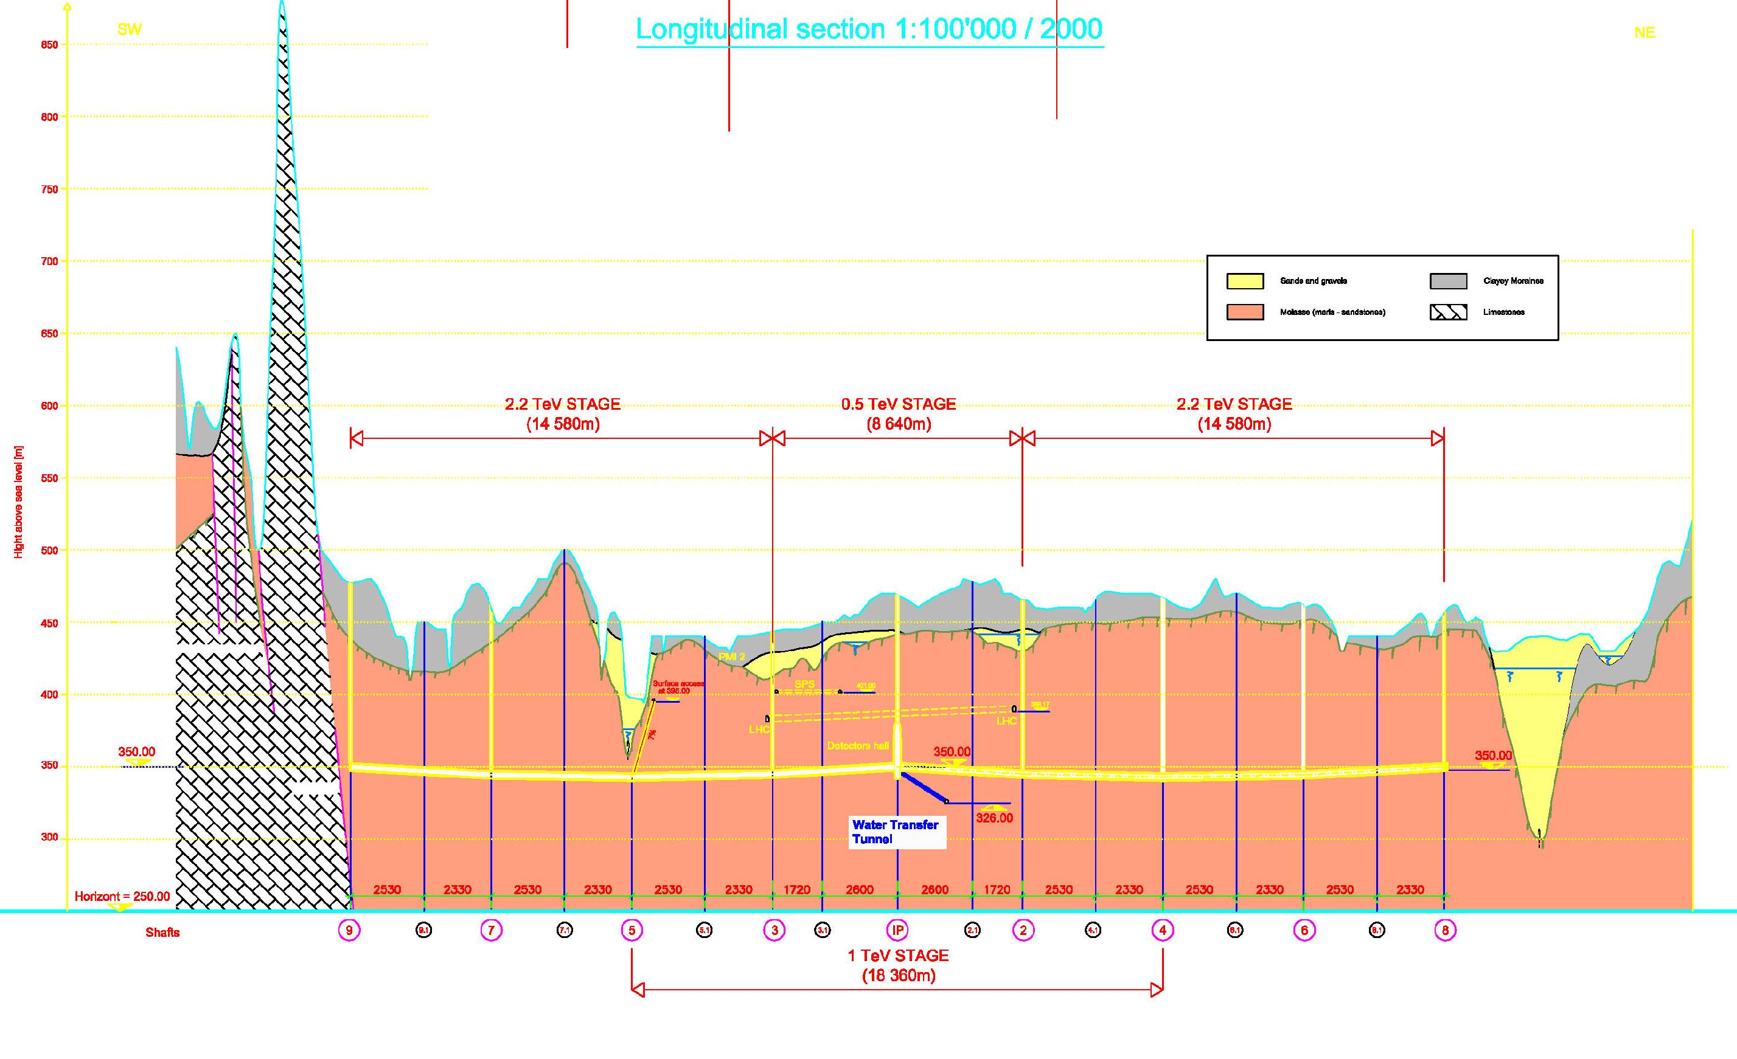
3 TeV (48 384m)
CLIC Long Profile for CDR

Slide 10
70cm
Notes:
Xsection 4.5 to 5.6
5.6m std for European subways
Transversal ventilation
CV pipes in slab isolated from machine by a compressible filler
Power converter community requested a lot more space => increase diameter of tunnel
Cable trays are not earmarked for now

Slide 11
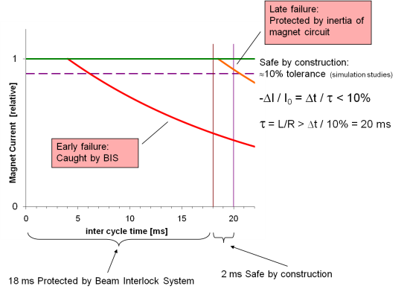
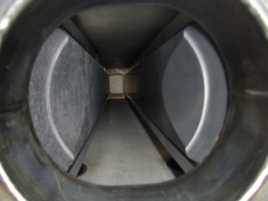
Failure types and Protection strategies
Slow Failures
Time scale larger than the machine cycle period (10 ~ 20 ms) .
  Temperature drifts
  Alignment drifts
  Beam feedback saturations.
    N.B.: Normally, the beam feedback system should keep drifts under control. Any deviation of the expected behaviour is potentially dangerous.
Inter-Cycle Failures
Time scale comparable to machine cycle period (10 ~ 20 ms).
  Power supply failures
  Positioning system failures
  Vacuum system failures
Last moment Equipment Failures
As above but to late for the Interlock system to react (< 2 ms)
Fast Failures
Time scale of beam flight time through the accelerator complex (in flight < 0.2 ms).
  RF breakdown: (transversal kicks...)
  Kicker misfiring: (damage to septum magnet).
  RF klystron trip. (disrupt beam, large losses)
  N.B. the drive beam linac: 1.5 drive beam train in the pipeline: i.e. two orders above damage level.
Next Cycle Permit
Systematically revoked after every cycle
Re-established if predefined beam and equipment quality checks have passed:
≈10 ~ 20 ms to analyse the previous cycle and to decide if OK for next cycle.
Post Cycle Analysis
BEAM Interlock
Safe by construction
Static Protection
Combination of hardware and embedded software.
False PASS decisions rate must not lead to intolerable risks.
False VETO decisions rate should have a low impact on the system availability.
Certification protocol: Strict test procedures must be defined to certify the reliability of the post cycle analysis. These test procedures must revalidate the system every time a quality check implementation has been modified.
All beam observation systems will be scrutinized for abnormalities
Beam Loss Monitoring system: workhorse of next cycle permit and line of last defence for detecting any failure.
In flight failures:
Difficult to detect beam failures and dump the misbehaving beam.
Impossible for the head of the beam (causality, speed of light).
Passive protection: masks and spoilers.
Make passive protection robust enough to provide full protection for the whole pulse.
Many of the systems are already designed along this principle.
Locations (mostly associated with kickers)
Extraction channels
damping ring
Extraction from
combiner rings
Drive Beam
turn around
Covering the 2 ms blind period prior to the each cycle:
Remain within tolerance (for safe beam passage) for 2 MS after a power converter fault (Magnet circuits inertia τ=L/R)
Preliminary studies: acceptable tolerances ~10%
⇒ need magnet circuits with a τ=L/R > 20 ms.
Same principle for all active equipment (vacuum, positioning systems, RF-HV, kicker-HV etc.)
Beam permits
Beam permits
Local Abort
Local
MP Supervisor
4 Beam-permit chains: DB e⁻, DB e⁺, MB e⁻ MB e⁺
Local Abort
Local
MP Supervisor
Local Interlocks
Beam permits
Beam permits
Local Interlocks
Beam permits
Beam permits
Local Abort
Local
MP Supervisor
Local Abort
Local
MP Supervisor
Local Interlocks
Beam permits
Beam permits
Local Interlocks
Beam permits
Beam permits
Local Abort
Local
MP Supervisor
Local Abort
Local
MP Supervisor
Next Cycle Permit
BEAM Interlock
Local Interlocks
Beam permits
Beam permits
Local Interlocks
Beam permits
Beam permits
Master MP Supervisor
Post Cycle Analysis
Safe by construction
Network for diagnostics and control
Static Protection
4 Beam-Permit-Chains (2 drive beams and 2 main beams).
permits (in both directions) for different beam types (pilot, tests, nominal).
contains local nodes with user permit inputs
the local node also provides local beam and equipment abort signals.
Decision time: 2 ms before next pulse
￼Protective masks. (Picture of an LHC Collimator)

Slide 12
Machine Protection Timeline
20 ms:
Last delivered pulse
-2 ms
Next Pulse permit
-0.1 ms
Beam in flight
Slow errors and drifts:
Post pulse analysis
In flight errors:
Masks and RT protection
Inter pulse equipment errors:
Interlock system
Last moment equipment errors:
Safe by design (equipment inertia)
Notes:
No modification in the basic concept:
Post pulse analysis to protect against slow machine drifts.
Interlock for equipment faults at inter-pulse time down to 2 ms (next pulse permit decision).
Safe by design for last moment equipment errors
Fixed masks for “In Flight” error (or RT where possible in the injector complex).

Slide 13
Topics with potential MPE implications
Machine Protection
  Conceptual design of CLIC MP system and operational scenario
  Failure simulation and risk analysis
  Interlocks and post pulse analysis
  Static protection
  Quench protection system
  RT protection (Emergency dumps)
Electronics
  Rad hard electronic developments
  200 000 electronic cards to build (cost reduction is an issue)
  Not detailed in this presentation, will be addressed in the future.

Slide 14
Failure simulation
Study beam failure modes in the CLIC complex
  Estimate potential damage
  Estimate frequency
  Revise protective measures if the risk is too high
  Resources: Fellow since Nov. 2010 (Carlos Maidana)
  Tools: Simulation tools (Placet, others)
  Deliverables:
  maximum tolerances on main beam kicks/displacements to stay clear of collimators
  then failure in decelerators
  etc...

Slide 15
Interlocks and post pulse analysis
Failure types and mitigation
  Slow machine drifts
  Post pulse analysis to detect correct behaviour for next pulse.
  Like LHC PM analysis, but: 18 ms for data collection + decision on 6 10⁶ channels
  Automated analysis, embedded systems, certified software modules
Equipment failures:
  Interlock system: 20 ms - 2 ms before next pulse permit
  185 stations, 1800 user channels.
Concepts to be demonstrated by a prototype implementation in CTF3
Interlock system (BIC HW based)
Post pulse analysis
RT protection for drivebeam linac
Resources: Doctoral student starting in January (Patrice Nouvelle)

Slide 16
Thesis proposal Patrice Nouvel
“Proof of concept of electronics systems optimized on reliability for CLIC machine protection”
  1. System development
  The purpose of the exercise is to make the proof of concept of electric equipments for CLIC MPS. THE MPS will be designed in the CLIC point of view but developed and commissioned for the CTF3 (Clic Test Facility version 3). :
1.1. CLIC Beam Interlock System (BIS)
The purpose of Beam interlocks system is to detect equipments failures during two beams on the four accelerator chains (two main beams and two drive beams). The goal would be to design a control system inspired by LHC BIS which would fulfill CLIC requirements (cost, reliability, radiation tolerant, etc).
1.2. Next_Cycle_Permit system
The Next_cycle_Permit system is a post-cycle analyzer. It collects data about quality of beam and allows the next pulse if only no unexpected behavior has been deduced from the analysis. The goal is to find an adequate and scalable solution combining hardware and embedded software which will fulfill the requirements.
1.3. MPS for CLIC installation
CLIC is constituted of many systems (booster, damping ring, combiner ring, etc). There is a need to protect the entire machine in all parts. This involves MPS for drive beam linac (linear accelerator), for drive beam combiner complex, for main beam injector complex and for main beam damping ring.
2. Reliability study
All systems developed have to be optimized on reliability. Consequently a reliability study has to be done. The goal would be to determine risks, reliability and availability involved by developed systems and what could be solutions to improve them.

Slide 17
Failure types and mitigation (continued)
Fast Equipment failures (< 2ms)
  safe by design (i.e. slow magnet current circuits with τ=L/R >> 2 ms)
  Resources: Responsibility of equipment groups
In flight errors (RT failures after next pulse permit was delivered)
  Failures types:
    Kicker misfiring
    RF breakdowns
    Drivebeam production errors
  Studies:
    Failure simulations
    Design of masks (Material studies)
    RT protection
  Resources: next slides

Slide 18

Safe by construction
Cover the 2 ms blind period prior to the each cycle:
Stay within tolerance (for safe beam passage) for 2ms after a power converter fault
Studies: acceptable tolerances ~10% ⇒ need magnet circuits with a τ=L/R > 20 ms.
Same principle for all active equipment (vacuum, positioning systems, RF-HV, kicker-HV etc.)

Slide 19
6.2.1 Masks
Required to protect against kicker failures in all extraction channels:
Combiner rings
Turn arounds
Damping rings
Specification yet unknown TE/BT
Possible new project:
Study effects of high brilliance electron beams in matter.
i.e. find a material that can survive a CLIC beam impact.
In collaboration with EN/STI

Slide 20
6.2.2 Emergency Dumps
Intermediate emergency dumps (Kicker + internal dumps)
RT protection in case of rt error in DR or DB linac
Locations:
Drive beam linac (up to 5 locations)
Damping rings (0-2 dumps)
  Unknown:
  Number of required emergency dumps
  Alternatives
  Cost of emergency dumps
  To be studied for TDR phase

Slide 21
6.2.3 Quench protection system
Scaling parameters:
  Detection channels 8 x 13
  Energy extraction systems 8
  Cabling 6 km
  Total estimated cost 220KCHF
Developments and studies
  Based on LHC quench protection system
  New development energy extraction system: (semiconductor switch as used in HIE-Isolde project)
  Simulations quench heat dissipation / propogation (Emmanuele Ravaioli)

Slide 22
CLIC Quench protection
The concept changed significantly after the first estimation -due to new information from Daniel. With the new voltage and current data it is no longer possible to envisage a copy of the EE systems developed for the LHC corrector circuits. The basic choice of extraction switch can no longer be the modified ac breakers, as those installed in LHC. With the new requirements we shall turn towards semiconductor switches. The much higher energy will require a water-cooled extraction resistor.
CLIC may well profit from a development of such systems which we intend to elaborate for the HIE-Isolde project. Therefore, there shouldn't be any significant additional development if use the same topologies and component choice.

Slide 23
6.2.4 Interlock system
Component estimate
Scaling parameters:
  User channels 1800 840
  Interlock stations 185 100
Cost knowledge:
Based on LHC Beam Interlock hardware (BIC)
  VME crate 15 k
  BIC (14 channels) 5 k
  CIBU (1 channel) 1.5 k
  Cabling CIBU 0.01 k/m
Uncertainties:
  Conceptual (i.e. interlock implemented by independent system, or part of the global acq system)
  Technology (VME replacement)
Comments:
  fibre interconnects to be included

Slide 24
6.2.4 Interlock system
Interlock Channel Counting: 2-beam accelerator 12, Injector complex: 8
Station price tack depends on location, beam type, number of stations depends on physical location
Beam zone 1 6 stations 6 x 69 k = 414 k (6 x 42 k = 252 k) Drivebeam linac
Beam zone 2 6 stations 6 x 69 k = 414 k (0.5 TeV: 6 x 42 k = 252 k) Combiner complex
Beam zone 3 5 stations 5 x 42 k = 210 k Main beam source and linac
Beam zone 4 5 stations 5 x 42 k = 210 k Damping ring complex e⁺
Beam zone 5 5 stations 5 x 42 k = 210 k Damping ring complex e⁻
Beam zone 6 2 stations 2 x 69 k = 138 k Booster Linac
Beam zone 7 7 stations 7 x 69 k = 483 k Surface to main tunnel transfer
Beam zone 8 29 (8) stations 29 x 72 k = 2’088 k (8 x 72 k = 576 k) two beam accel., bds, dump e⁺
Beam zone 9 29 (8) stations 29 x 72 k = 2’088 k (8 x 72 k = 576 k) two beam accel., bds, dump e⁻
Beam zone 10 1 stations 42 k = 42 k Experimental region
Central system 5 stations 5 x 42 k = 210 k
Total 6'507 k (3'159 k)
Note:
1 station 2 BIC + 2x12 CIBU + cabling = 72 k
1 station 2 BIC + 2x8 CIBU + cabling = 69 k
1 station 1 BIC + 8 CIBU + cabling = 42 k

Slide 25
6.1.1 Frond End Acquisition and Controls
Scaling parameters:
  Channel count 7 10⁶ 1.7 10⁶ (CLIC .5 TeV)
1 control chassis per module (250 channels)
Chassis + controller + power supply = 5000€
N carriers + mezzanines. First guess n=8
25000 chassis, 200000 boards
Cost knowledge:
  (VME) LHC control system
  New developments
Uncertainties: (Large)
  New developments
  New concepts
  Rad-hard electronics
  Cost reduction through mass industrialization
  Status:
  Work in progress
  Collaborate with Mick Drapper, Marc Vanden Eynden, Lars Soby, Javier Cerano for detailed cost estimate.
  Proposed cost boundary between (sub-)components and 6.1.1

Slide 26
The end
Thanks for your attention
Some spare slides…

Slide 27
Failure types and
Protection strategies
Next Cycle Permit
Systematically revoked after every cycle
Re-established if predefined beam and equipment quality checks have passed:
≈ 10 ~ 20 ms to analyse the previous cycle and to decide if OK for next cycle.
Post Cycle Analysis
Implemented in a combination of hardware and embedded software.
False PASS decisions rate must not lead to intolerable risks.
False VETO decisions rate should have a low impact on the system availability.
Certification protocol: Strict test procedures must be defined to certify the reliability of the post cycle analysis. These test procedures must revalidate the system every time a quality check implementation has been modified.
All beam observation systems will be scrutinized for abnormalities
Beam Loss Monitoring system: workhorse of next cycle permit and line of last defence for detecting any failure.
Slow Failures
Time scale larger than the machine cycle period (10~ms) .
  Temperature drifts
  Alignment drifts
  Beam feedback saturations.
    N.B.: Normally, the beam feedback system should keep drifts under control. Any deviation of the expected behaviour is potentially dangerous.
Inter-Cycle Failures
Time scale comparable to machine cycle period (10~ms).
  Power supply failures
  Positioning system failures
  Vacuum system failures
Fast Failures
Time scale of beam flight time through the accelerator complex (in flight).
  RF breakdown: (transversal kicks...)
  Kicker misfiring: (damage to septum magnet).
  RF klystron trip. (disrupt beam, large losses)
  N.B. the drive beam linac: 1.5 drive beam train in the pipeline: i.e. two orders above damage level.
Static Protection
BEAM Interlock
Safe by construction
In flight failures:
Difficult to detect beam failures and dump the misbehaving beam.
Impossible for the head of the beam (causality, speed of light).
Passive protection: masks and spoilers.
Make passive protection robust enough to provide full protection for the whole pulse.
Many of the systems are already designed along this principle.
Locations (mostly associated with kickers)
Extraction channels
damping ring
Extraction from
combiner rings
Drive Beam
turn around
Beam Interlock System
controls 4 parallel Beam-Permit-Chains (2 drive beams and 2 main beams).
Each chain carries the beam permits (in both directions) for different beam types (pilot, tests, nominal).
A Beam-Permit-Chain contains n local nodes with user permit inputs that can inhibit the beam permit chain .
In case the beam permit chain is interrupted, the local node also provides local beam and equipment abort signals.
Decision time:
2 ms before next pulse
After this time, the machine must be:
Covering the 2 ms blind period prior to the each cycle:
Remain within tolerance (for safe beam passage) for 2 MS after a power converter fault (Magnet circuits inertia τ=L/R)
Preliminary studies: acceptable tolerances ~10%
⇒ need magnet circuits with a τ=L/R > 20 ms.
Same principle for all active equipment (vacuum, positioning systems, RF-HV, kicker-HV etc.)
Beam permits
Beam permits
Local Abort
Local
MP Supervisor
4 Beam-permit chains: DB e⁻, DB e⁺, MB e⁻ MB e⁺
Local Abort
Local
MP Supervisor
Local Interlocks
Beam permits
Beam permits
Local Interlocks
Beam permits
Beam permits
Local Abort
Local
MP Supervisor
Local Abort
Local
MP Supervisor
Local Interlocks
Beam permits
Beam permits
Local Interlocks
Beam permits
Beam permits
￼
Protective masks. (Picture of an LHC Collimator)
Local Abort
Local
MP Supervisor
Local Abort
Local
MP Supervisor
Local Interlocks
Beam permits
Beam permits
Local Interlocks
Beam permits
Beam permits
Master MP Supervisor
Network for diagnostics and control

Slide 28
Not discussed here
RT protection and dumps for drive beam linac (24 x 100 x safe beam)
RT protection and dumps damping rings (and/or fast emittance control)
Beam loss monitoring specifications (covered in BI session)
Radiation issues, implication for electronic systems
CLIC @ 100 Hz
  Not really a problem, if needed we can do fast post pulse analysis in 8 ms on limited systems and detailed post pulse analysis over a few pulses.
For TDR phase:
Detailed analysis of fault scenario
Validation of bootstrap procedure (i.e. beam optimisation procedures at low intensities)
Detailed operational availability studies
Protection of extraction channels in case of kicker failures
Fixed protection masks and protection recovery (spare surface)
RF breakdown effects

Slide 29
Work packages for TDR phase
Machine protection related work packages
TE/ABT:
  specification of masks to protect against kicker failures.
  Internal emergency dumps
EN/STI
  Implementation and materials for protective masks and internal dumps
TE/MPE
  Specifications of MP based on simulations of MP subsystems
  Specification of interlock system
  Implementation of a scaled down CLIC MPS in CTF3 and validation of general principles
  Prototyping of CLIC BLMs in CLEX (BE/BI)
  Prototyping of CLIC BLMs in CLEX (BE/BI)
  Radiation qualification of components (HES/RP)
Notes:
overall proposal of a CLIC MP scenario based on pulse to pulse permit and passive protection
detailed specifications based on computer simulations for MPS subsystems (controls, PC, BI, kickers, dumps…
prototyping of MPS equipment, radiation qualification of components
CTF3 Machine Protection and Electrical Integrity
tasks
implementation of a scaled down CLIC MPS in CTF3 and validation of general principles
prototyping of CLIC BLMs in CLEX

Slide 30
MP Workshop 2011
Machine Protection and Operations workshop
Duration: Three days.
Date: tbd. Possibly linked to the (i.e. before) ILC-CLIC or other workshop?
Objectives: Review issues raised in the CDR and program up to the TDR
Participants from:
Beam dynamics experts
Structures experts
Experts on equipment with impact on beam:
  Kickers
  RF
  Power Converters
  Vacuum
Beam transfer experts
Detector interface experts
Interlock and controls experts
Instrumentation
Collimators and material experts
Institutes: CLIC, ILC, Light sources, LHC
Program
Parameters of CLIC/ILC
Protection issues
Interlock systems
Operational aspects
Topics:
Fault studies
Fast failures
Equipment failures
Slow drifts
Risk analysis
Requirements for fixed masks (in flight protection)
Interlock systems
Safe by construction
Post Pulse analysis
Beam Loss detection
Fault Detection and instrumentation
Material Damage
Operational procedures
Fast emittance control
MP with beam based feedback
Availability issues
Notes:
Materials are of common interest
Team up with HB activities

Slide 31
CLIC
Machine protection, operational scenario and costing
Conceptual design of CLIC MP system
Elaboration of operational scenario
Detailed simulation of failure modes and main accelerator and decelerators.
Quench protection and energy extraction system for super conduction wigglers of the CLIC damping rings.
Quench simulation in SC wigglers with PSpice
Costing estimations

Slide 32
Single Pulse Damage in 1.4 mm Cu

