Slide 1
MPE involvement in the HiRadMat project
- status and plans

Slide 2
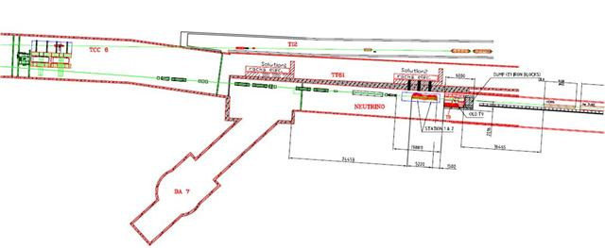
Introduction to HiRadMat
High Radiation to Materials.
Currently being built in the old West Area Neutrino Facility [WANF]
Designed to allow testing of accelerator components (LHC) to the impact of high intensity beams.
Complements the CERN East Area irradiation facility.
Commission during September 2011
Initial run in October 2011.

Slide 3
HiRadMat Beam parameters
Energy
  440GeV for protons (3.5MJ max pulse energy) → 0.49TW (24.5TW)
  173.5GeV/A (36.1TeV) for ions (21kJ max pulse energy) → 0.4GW (0.8TW)
Beam intensity (SPS-Beam type)
  288 bunches of 3E9 to 1.7E11 protons
  52 bunches of 3E7 to 7E7 ions.
Beam size
  Sigma_{x,y} = 0.1*-2mm *Not available in all positions
Repetition frequency
  18 sec.
Time structure
  7.2us pulse. 0.5ns bunch length and 25ns intra-bunch spacing.
  5.2us pulse for ions. 100ns bunch spacing.

Slide 4
HiRadMat Users
Title | User
ISOLDE – Target and Ion Source Development | CERN EN-STI
Radiation tolerance test for electronic equipment | CERN EN-STI
Dynamic vacuum properties of amorphous carbon films bombarded with heavy ion and proton beams at the SPS | CERN TE-VSC
LHC beam dump entrance window robustness | CERN TE-VSC
LARP Rotatable Collimator Robustness Test | CERN BE-ABP
SPS TPSG diluter robustness and protection test | CERN TE-ABT
LHC TCDQ diluter robustness and protection test | CERN TE-ABT
LHC TCDS diluter robustness and protection test | CERN TE-ABT
Qualification of LHC Phase II Collimators | CERN BE-ABP
Beam Loss Monitor developments | CERN BE-BI
Tungsten powder thimble shock test | STFC Rutherford Appleton Laboratory
HEDM damage experiments | CERN TE-MPE
Sources
Electronic radiation
Vacuum
Collimators
BLM
Damage experiments

Slide 5
Current state of simulations
Two physical processes:
  Energy deposition by the beam.
  Hydrodynamic motion of the target’s particles.
Both processes are coupled, changes provoked by one affects the other.
  Solution: run iteratively in steps t[us].
Overestimated energy deposition
Previous simulations:
  Initial energy deposition map
  → FLUKA.
  Subsequent deposition maps scaled from the initial one.
  hydrodynamic motion →BIG2 code
Newer simulations combine:
  At each step :
  → FLUKA → BIG2 →

Slide 6
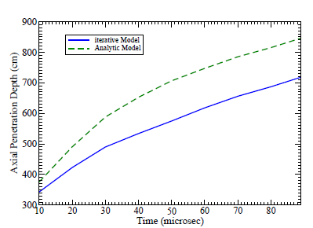
Current state of simulations
Newer simulations also show a density depletion region on the longitudinal direction. “Tunneling effect”
Previous simulations overestimate the “penetration range” of protons. Higher energy deposition → stronger shock waves → Faster penetration speed
Protons penetration range: length of damaged material (t > melting point)
Overestimated penetration range of protons
Slope = penetration speed

Slide 7
Plans for an experiment
Irradiate different materials beyond the damage threshold.
Observe the effect of the hydrodynamic process that occurs and how it affects the beam damage potential.
Is the beam damage potential amplified by the action of the hydrodynamic process? (“Tunneling effect”)

Slide 8
State of the art
Previous Studies
  Hydrodynamic Calculation of 20-TeV Beam Interactions with the SSC Beam Dump. D.C.Wilson, C.A.Wingate, J.C.Goldstein, R.P.Godwin and N.V.Mokhov (1992)
  Particle accelerator physics and technology for high energy density physics research. D.H.H.Hoffmann et al. (2006)
  Interaction of the CERN Large Hadron Collider (LHC) Beam with the Beam Dump Block. R.Assman, A.Ferrari, B.Goddard, R.Schmidt and N.A.Tahir (2008)
  Large Hadron Collider at CERN: Beams generating high-energy-density matter. N.A.Tahir, R.Schmidt et al. (2008)
Previous Experiments
  Damage Levels – Comparison of Experiment and Simulation. V.Kain, (2005).
Facilities
  FAIR, Facility for Antiproton and Ion Research. (Future)

Slide 9
FIN

