Slide 1

Comparisons between Event Generators and Data
Peter Richardson
IPPP, Durham University

Slide 2
Summary
Introduction
Basics Of Event Generation
Multiple Parton-Parton Scattering
Jets
Vector Bsons with Jets
Conclusions
Most plots taken from talks at last weeks SM@LHC and DIS meetings.

Slide 3
Introduction
Monte Carlo event generators are designed to simulate hadron collisions using a combination of:
  Fixed order perturbative calculations;
  Resummation of large QCD logarithms;
  Phenomenological Models.
It’s important to understand the different pieces of the simulation.
Some are on firm theoretical ground and we’d be surprised if they didn’t work, others might break down in the new energy regime of the LHC.

Slide 4
A Monte Carlo Event
Hard Perturbative scattering:
Usually calculated at leading order in QCD, electroweak theory or some BSM model.
Modelling of the soft underlying event
Multiple perturbative scattering.
Perturbative Decays calculated in QCD, EW or some BSM theory.
Initial and Final State parton showers resum the large QCD logs.
Finally the unstable hadrons are decayed.
Non-perturbative modelling of the hadronization process.

Slide 5
Introduction
The different models are generally tuned to different types of data:
  parameters relating to the final-state parton shower and hadronization are tuned to LEP data;
  parameters relating to initial-state parton showers and multiple parton-parton interactions are tuned to data from the Tevatron and UA5.
We expected that the shower and hadronization models would work at LHC energies, less sure about the underlying event.

Slide 6
The Underlying Event
Protons are extended objects.
After a parton has been scattered out of each in the hard process what happens to the remnants?
Two Types of Model:
Non-Perturbative: Soft parton-parton cross section is so large that the remnants always undergo a soft collision.
Perturbative: ‘Hard’ parton-parton cross section is huge at low p_{T}, dominates the inelastic cross section and is calculable.

Slide 7
Multiparton Interaction Models
The cross-section for 2g2 scattering is dominated by t-channel gluon exchange.
It diverges like
This must be regulated used a cut of p_{Tmin}.
For small values of p_{Tmin} this is larger than the total hadron-hadron cross section.
More than one parton-parton scattering per hadron collision

Slide 8
Multiparton Interaction Models
If the interactions occur independently then follow Poissonian statistics
However energy-momentum conservation tends to suppressed large numbers of parton scatterings.
Also need a model of the spatial distribution of partons within the proton.

Slide 9
Multiparton Interaction Models
In general there are two options for regulating the cross section.
where or are free parameters of order 2 GeV.
Typically 2-3 interactions per event at the Tevatron and 4-5 at the LHC.
However tends to be more in the events with interesting high p_{T} ones.

Slide 10
Prior to LHC
Before the LHC data from:
  UA5 experiment;
  CDF at 630, 1800 and 1960 GeV.
were used to constrain the parameters of the underlying event model.
The data at the higher Tevatron energies is the best for tuning the parameters at a specific energy.
Need the other points to extrapolate the parameters to LHC energies.

Slide 12
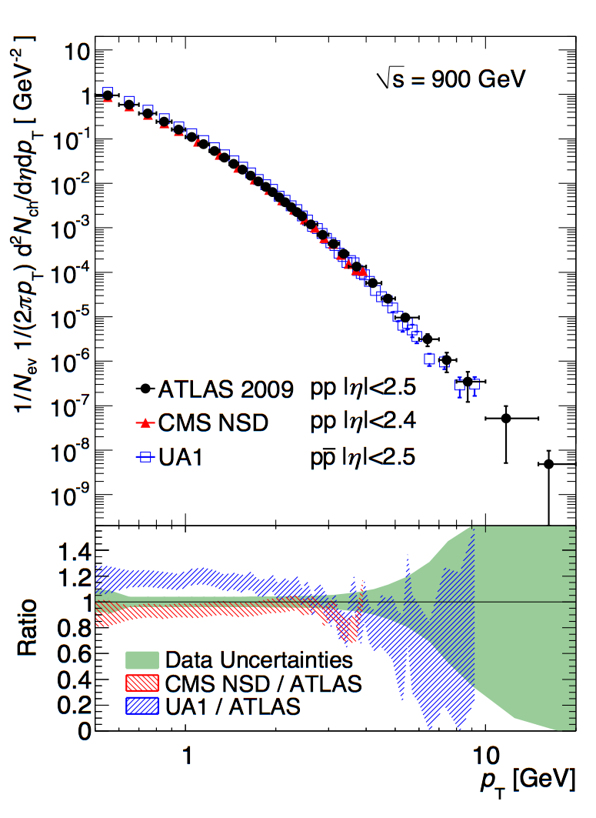
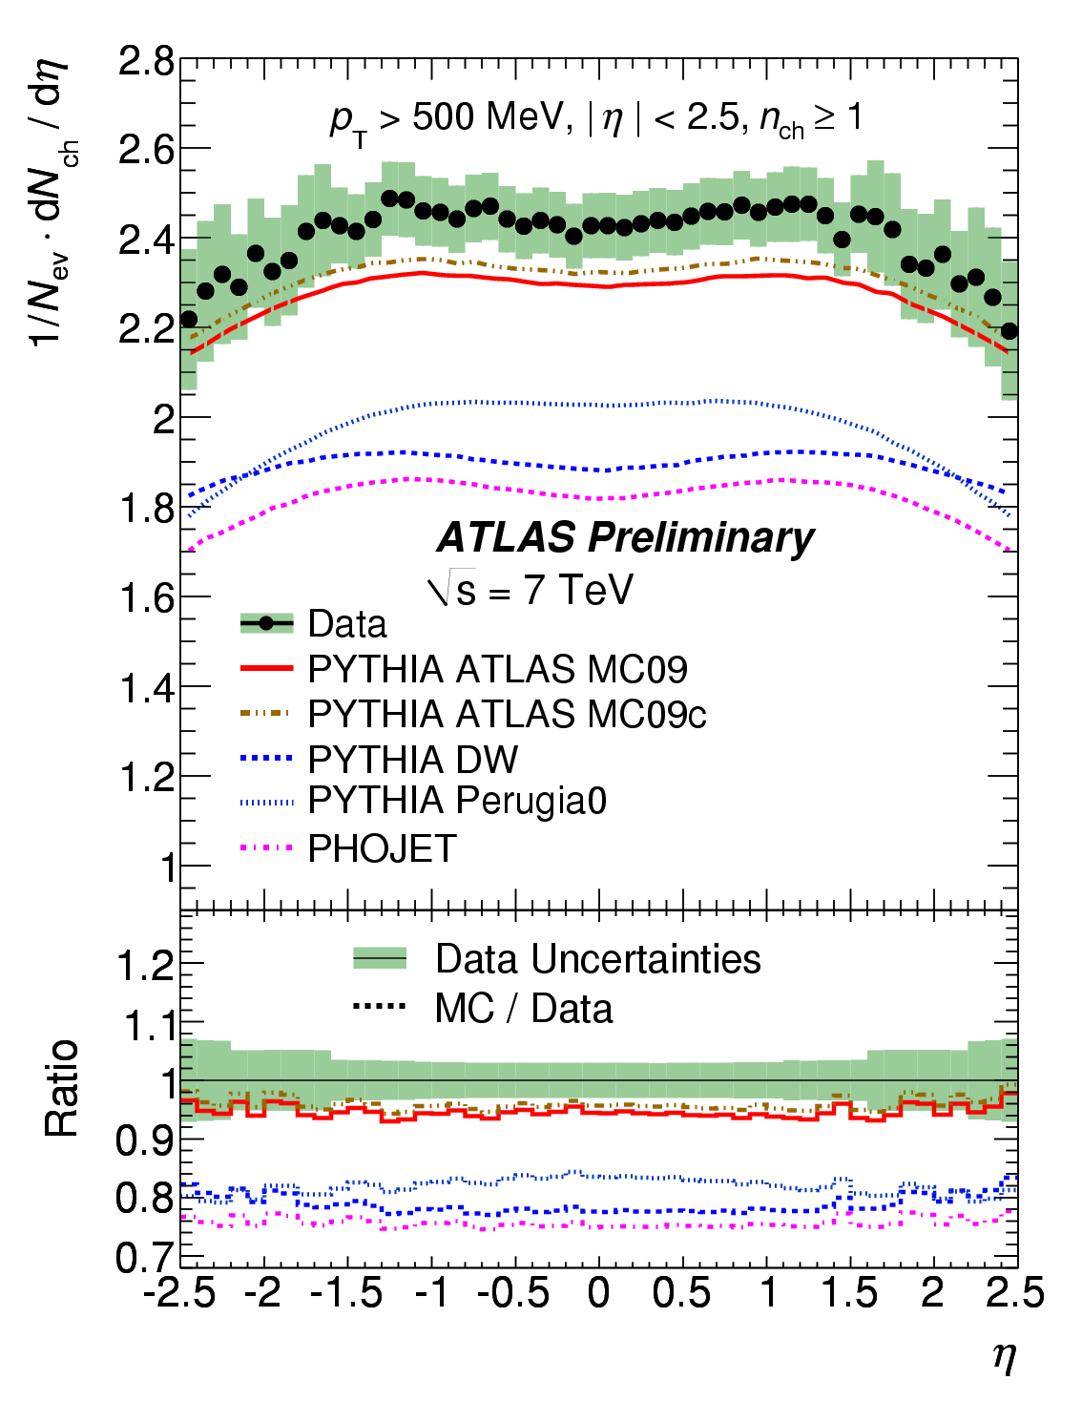
Charged Particle Multiplicities at √s=0.9, 7 TeV
Monte Carlo underestimates the
track multiplicity seen in ATLAS

Slide 13
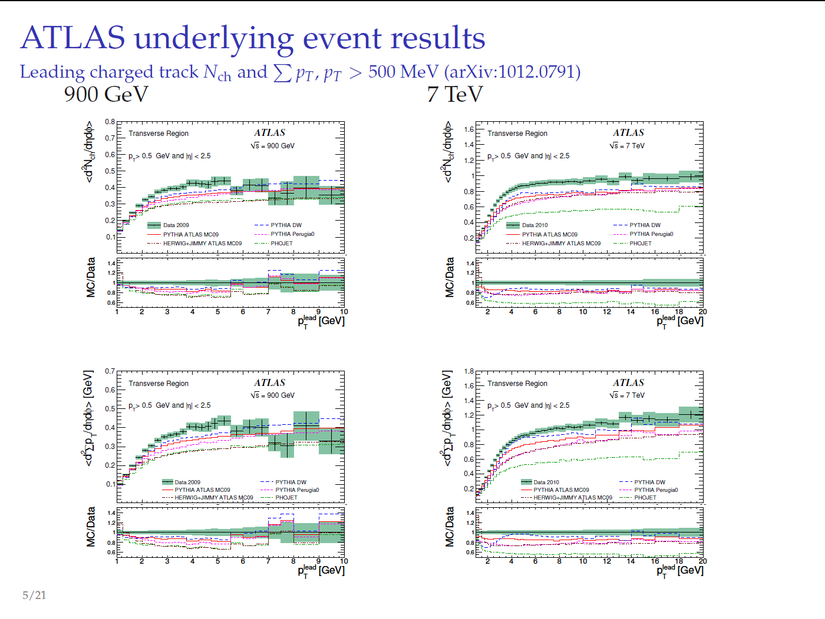
A. Buckley SM@LHC, Durham

Slide 14
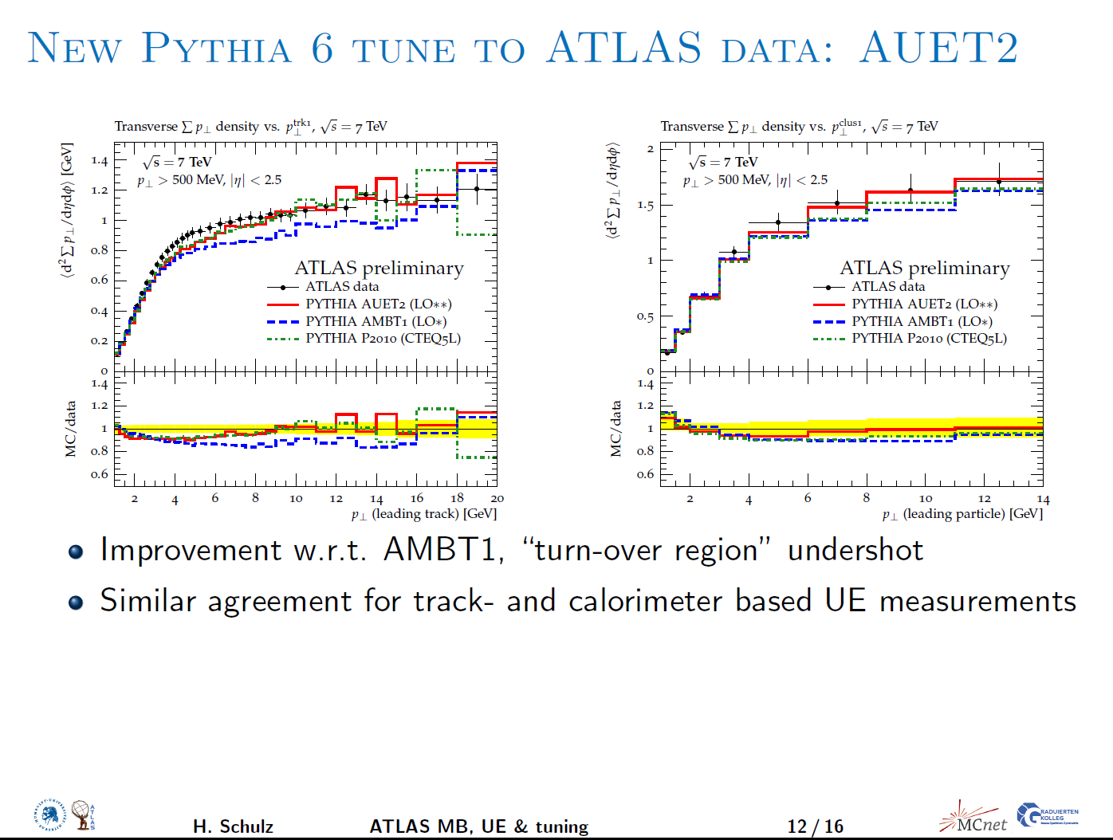

Slide 15
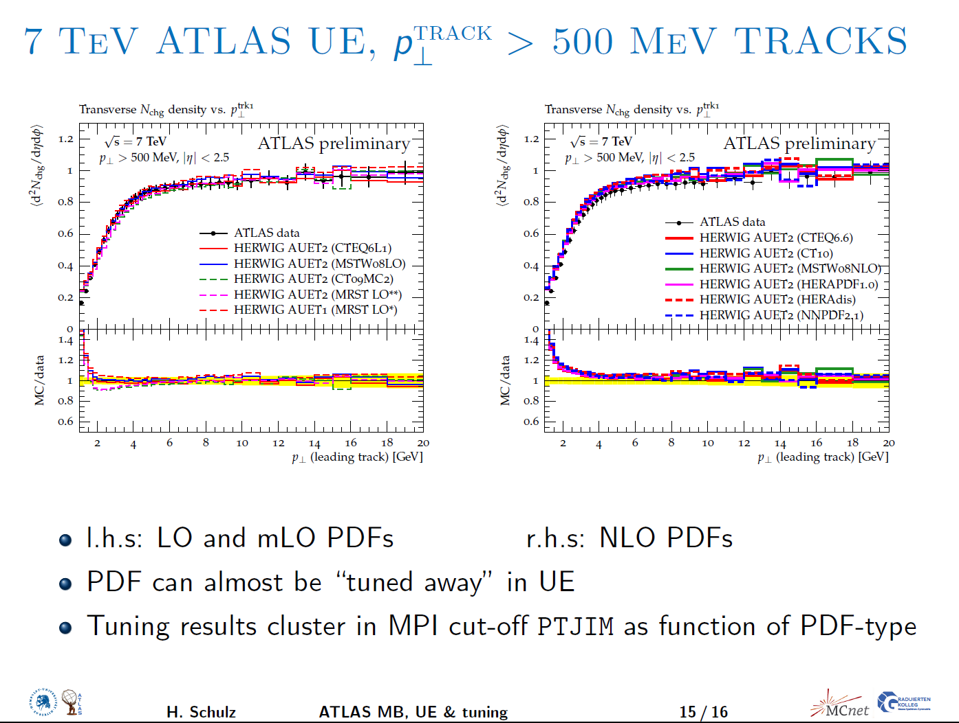

Slide 16
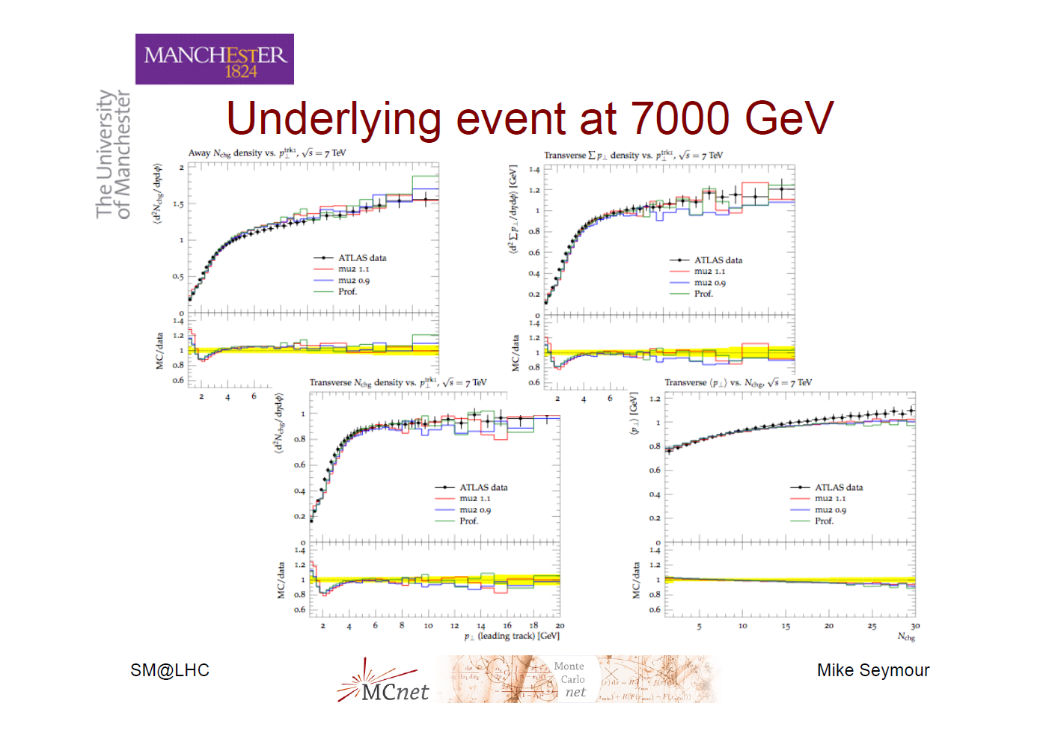

Slide 17
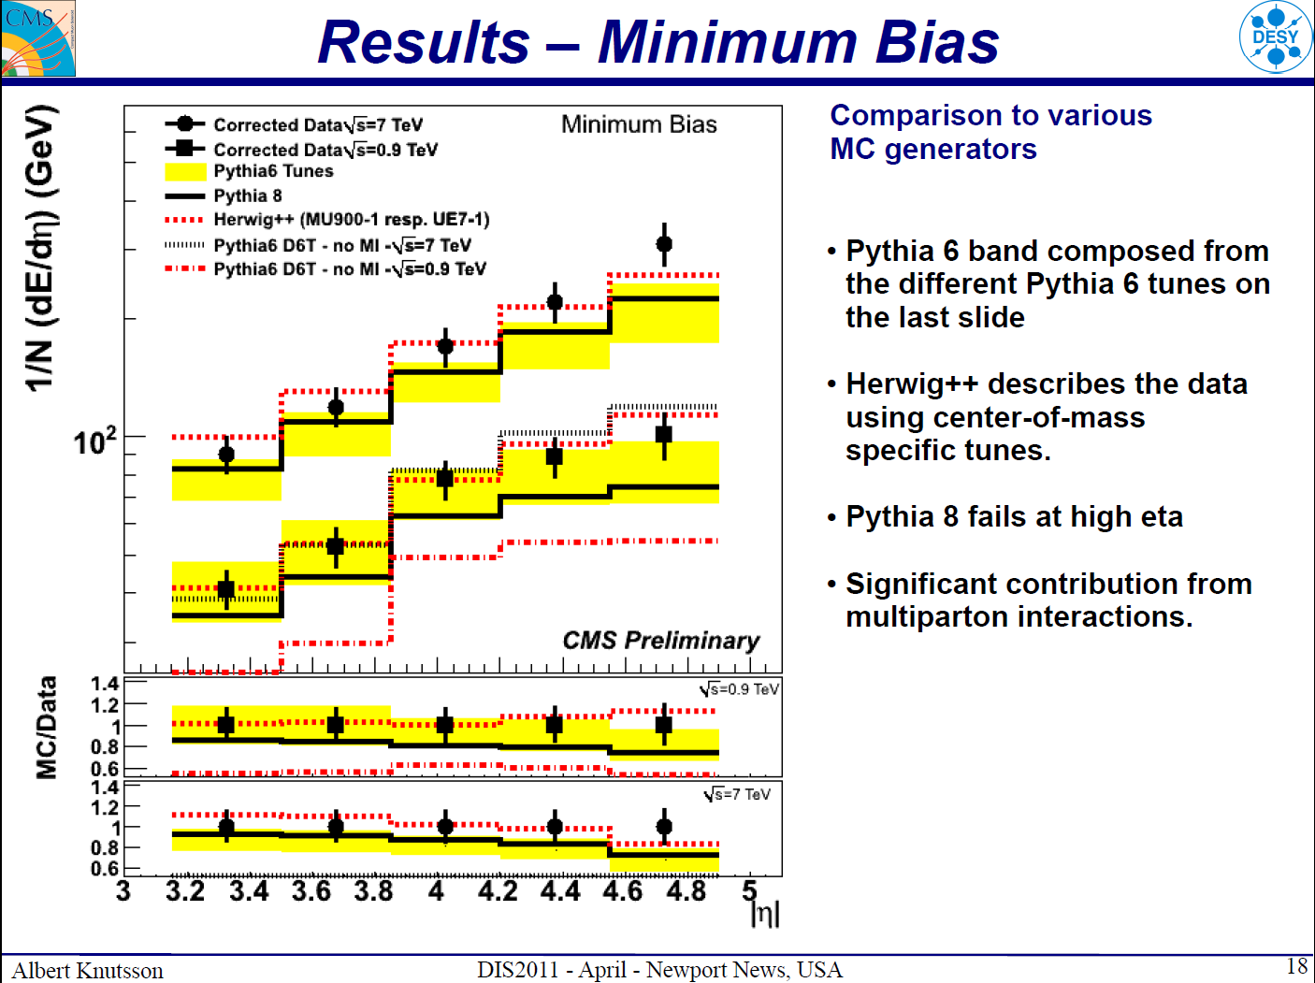

Slide 18
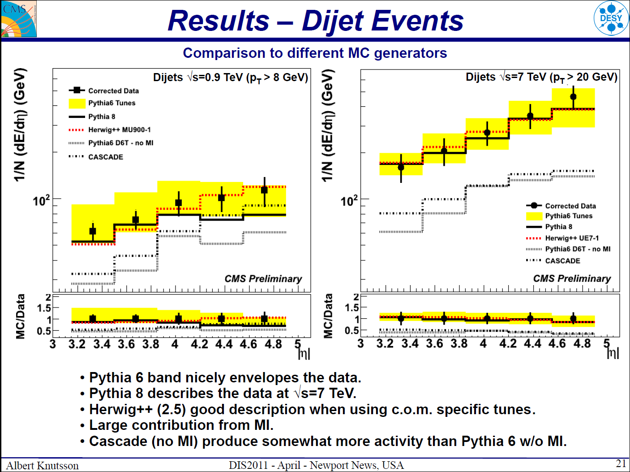

Slide 19
Multiple Parton Scattering
Results are encouraging.
The results of the tunes made before data taking don’t exactly agree with the data but aren’t orders of magnitude off.
Including the new results in the fitting gives good agreement.
The models therefore seem reasonable, although some theoretical tweaking, e.g. colour reconnection in Herwig++ required, but not a major rethink of the whole approach.

Slide 20
Improving the Simulations
Prior to the LHC there was a lot of theoretical work designed to improve parton showers by merging the results:
  with NLO calculations giving the correct NLO cross section and description of the hardest emission (MC@NLO Frixione and Webber, POWHEG Nason);
  with LO matrix elements to give the correct description of many hard emissions (MLM and CKKW);
  Combining both approaches MENLOPS Hamilton and Nason.

Slide 21
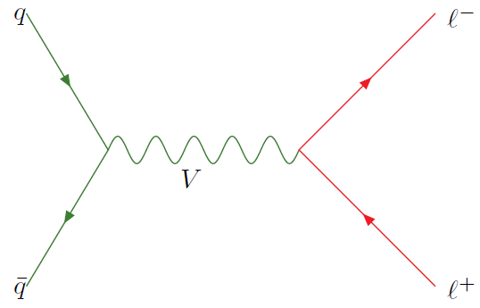
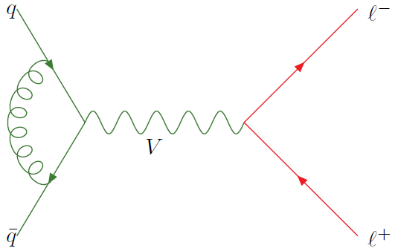
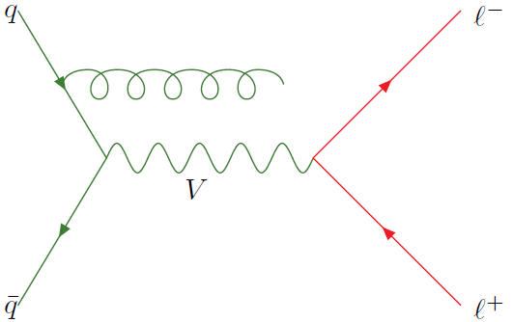
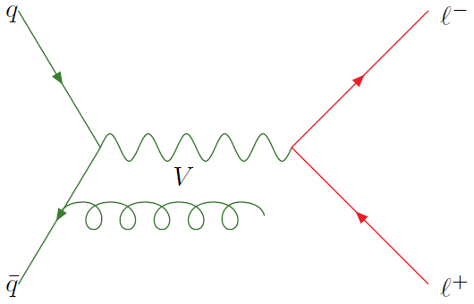
NLO Simulations
NLO simulations rearrange the NLO cross section formula.
Either choose C to be the shower approximation
MC@NLO (Frixione, Webber)

Slide 22
NLO Simulations
Or a more complex arrangement POWHEG(Nason)
where

Slide 23
Pros and Cons
POWHEG
MC@NLO
Positive weights.
Implementation doesn’t depend on the shower algorithm.
Needs changes to shower algorithm for non-p_{T} ordered showers.
Differs from shower and NLO results, but changes can be made to give NLO result at large p_{T.}
Negative weights
Implementation depends on the specific shower algorithm used.
No changes to parton shower.
Reduces to the exact shower result at low p_{T} and NLO result at high p_{T}

Slide 24
Drell Yan
Herwig++
POWHEG
MC@NLO
CDF Run I Z p_{T}
D0 Run II Z p_{T}
JHEP 0810:015,2008 Hamilton, PR, Tully

Slide 25
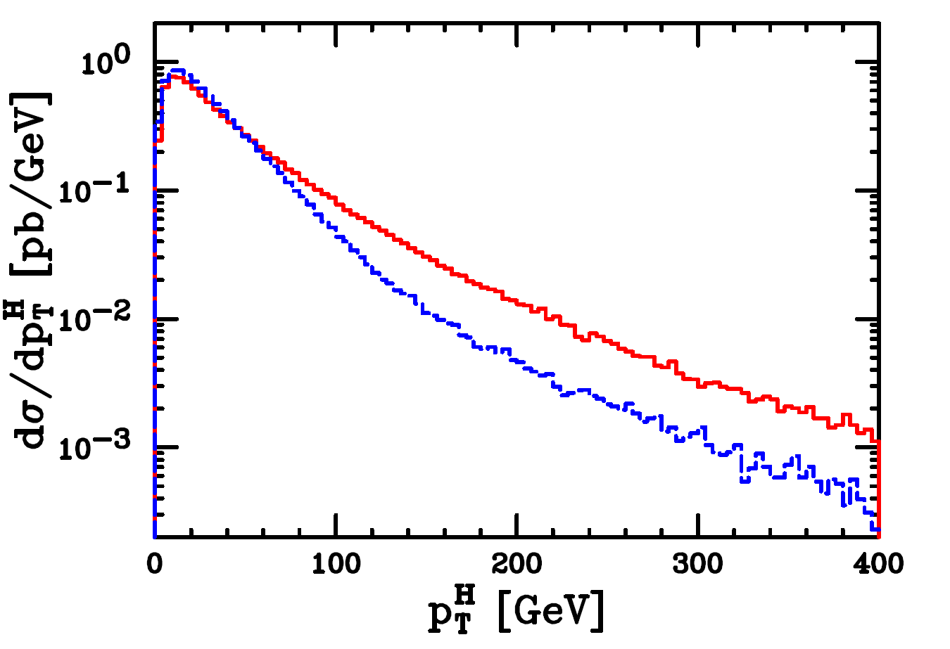
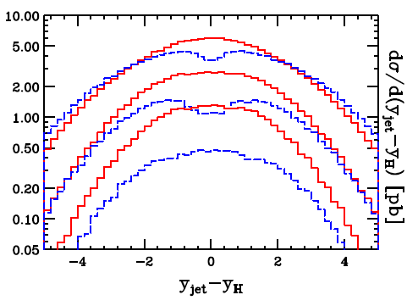
Different Approaches
The two approaches are the same to NLO.
Differ in the subleading terms.
In particular at large p_{T}
MC@NLO
POWHEG
JHEP 0904:002,2009 Alioli et. al.

Slide 26
Multi-Jet Leading Order
While the NLO approach is good for one hard additional jet and the overall normalization it cannot be used to give many jets.
Therefore to simulate these processes use matching at leading order to get many hard emissions correct.
The most sophisticated approaches are variants of the CKKW method (Catani, Krauss, Kuhn and Webber JHEP 0111:063,2001)
Recent new approaches in SHERPA( Hoeche, Krauss, Schumann, Siegert, JHEP 0905:053,2009) and Herwig++(JHEP 0911:038,2009 Hamilton, PR, Tully)

Slide 27
Jets
We would expect the parton shower simulations to describe most properties of up to dijet systems, apart from the total cross section.
For higher jet multiplicities need either CKKW/MLM or the recent POWHEG simulation of jet production.
For the NLO rate the only option is the POWHEG simulation.

Slide 28
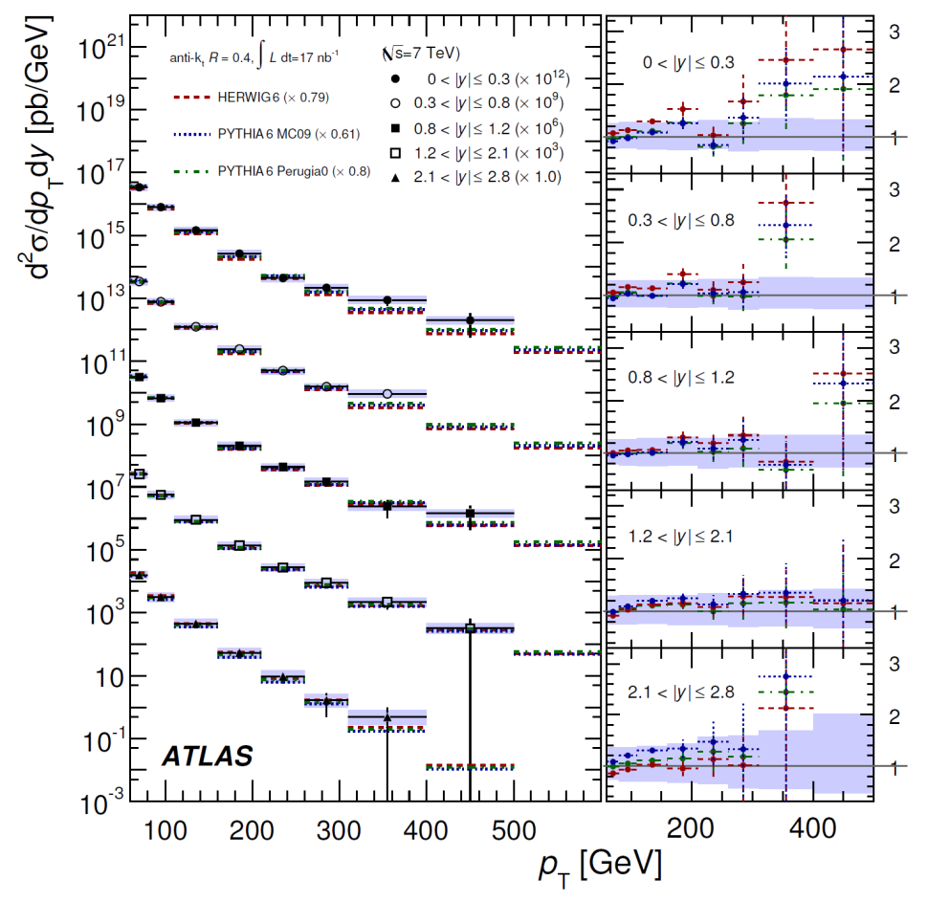
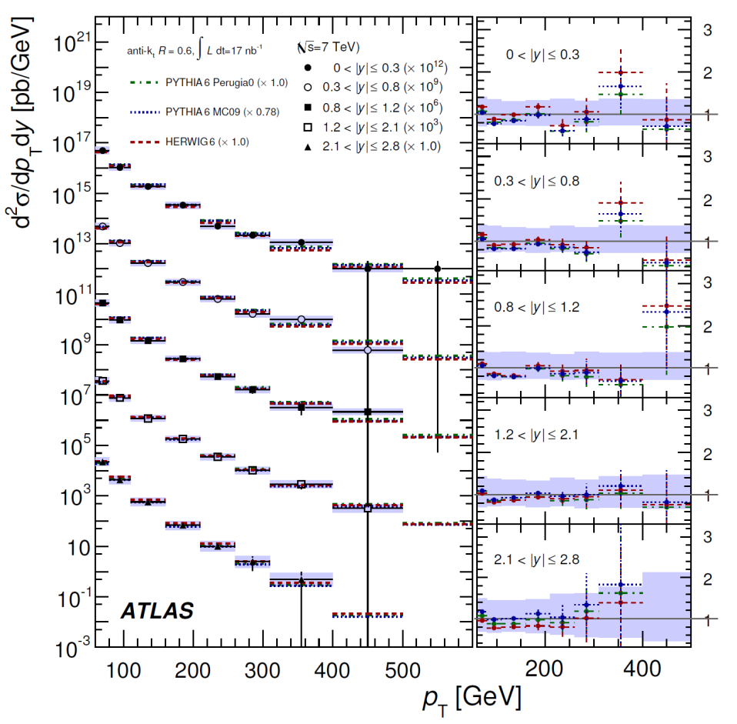
Inclusive Jet Production
Taken from 1009.5908 ATLAS

Slide 29
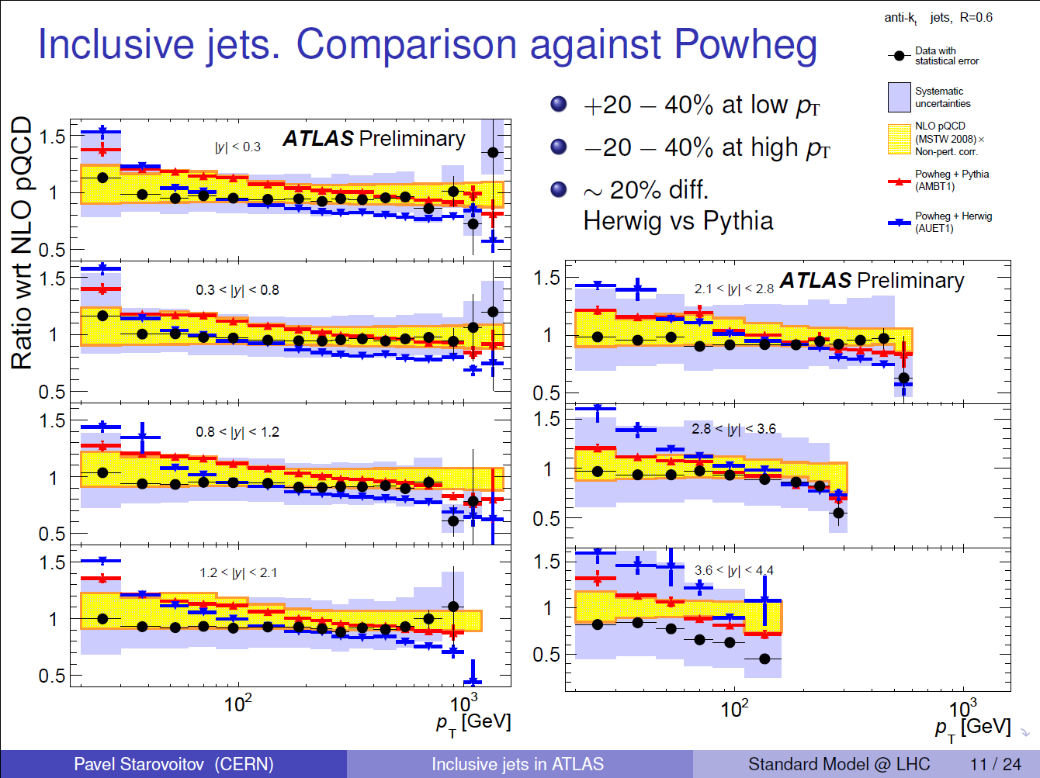

Slide 30
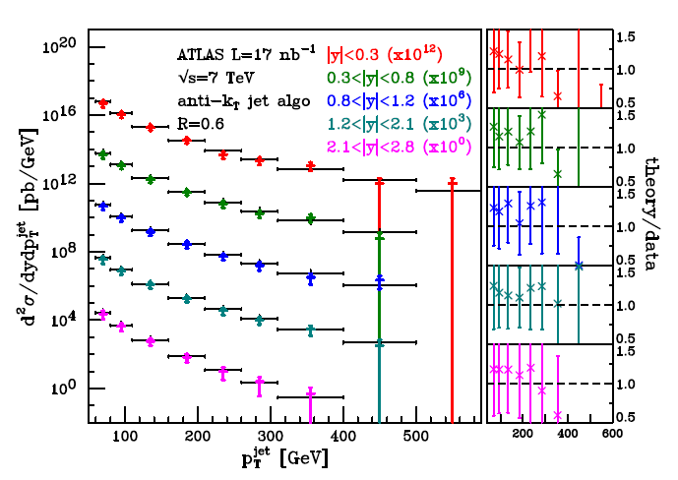
NLO Jet Production
POWHEG compared to ATLAS data arXiv:1012.3380 Alioli et. al.

Slide 31
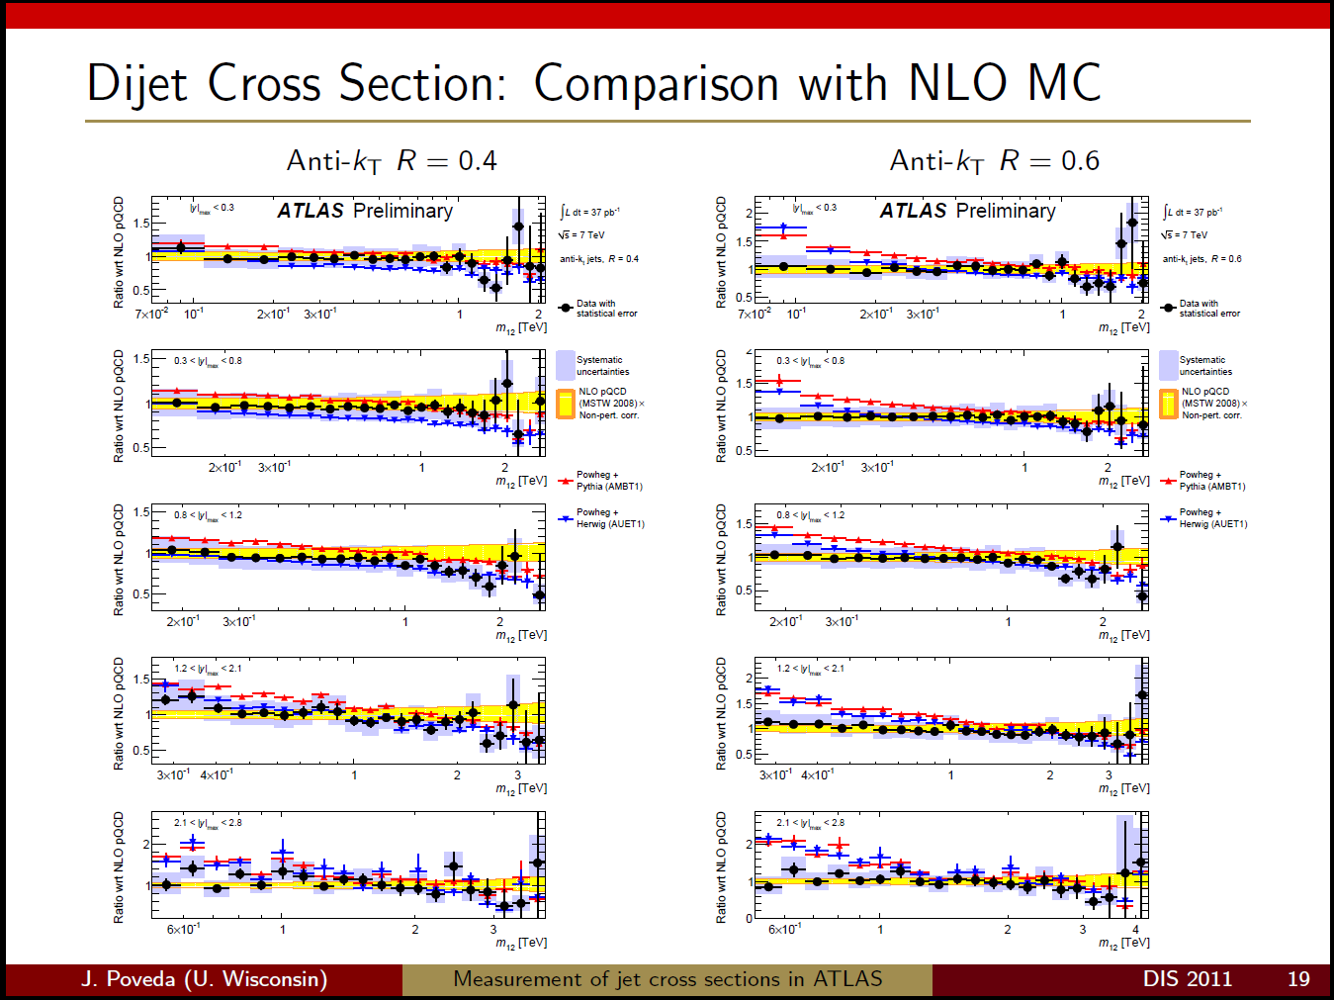

Slide 32
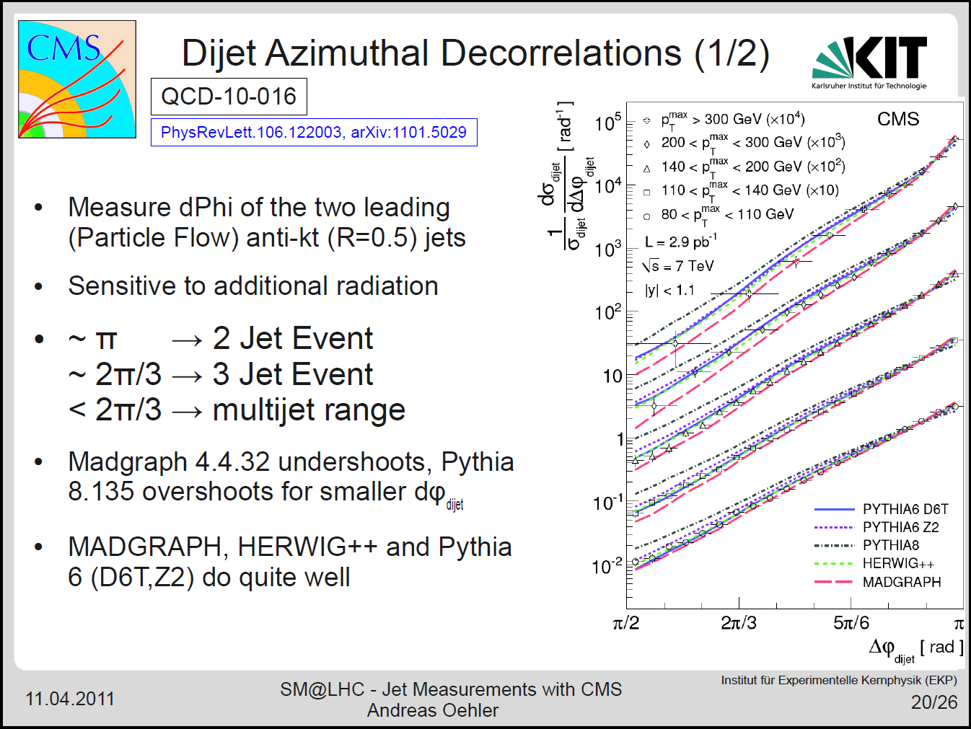

Slide 33
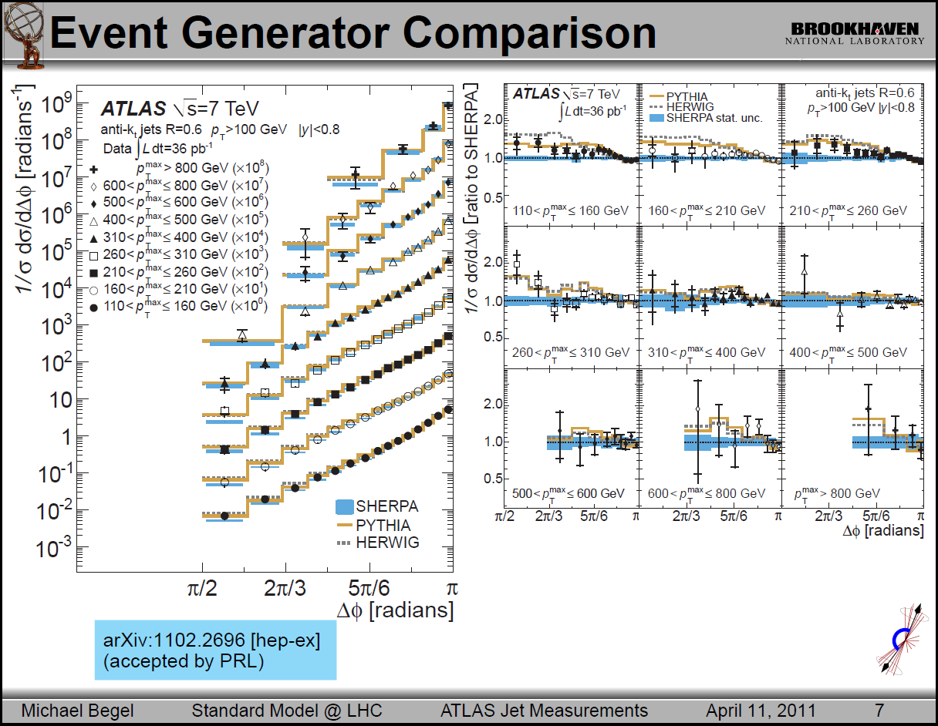

Slide 34
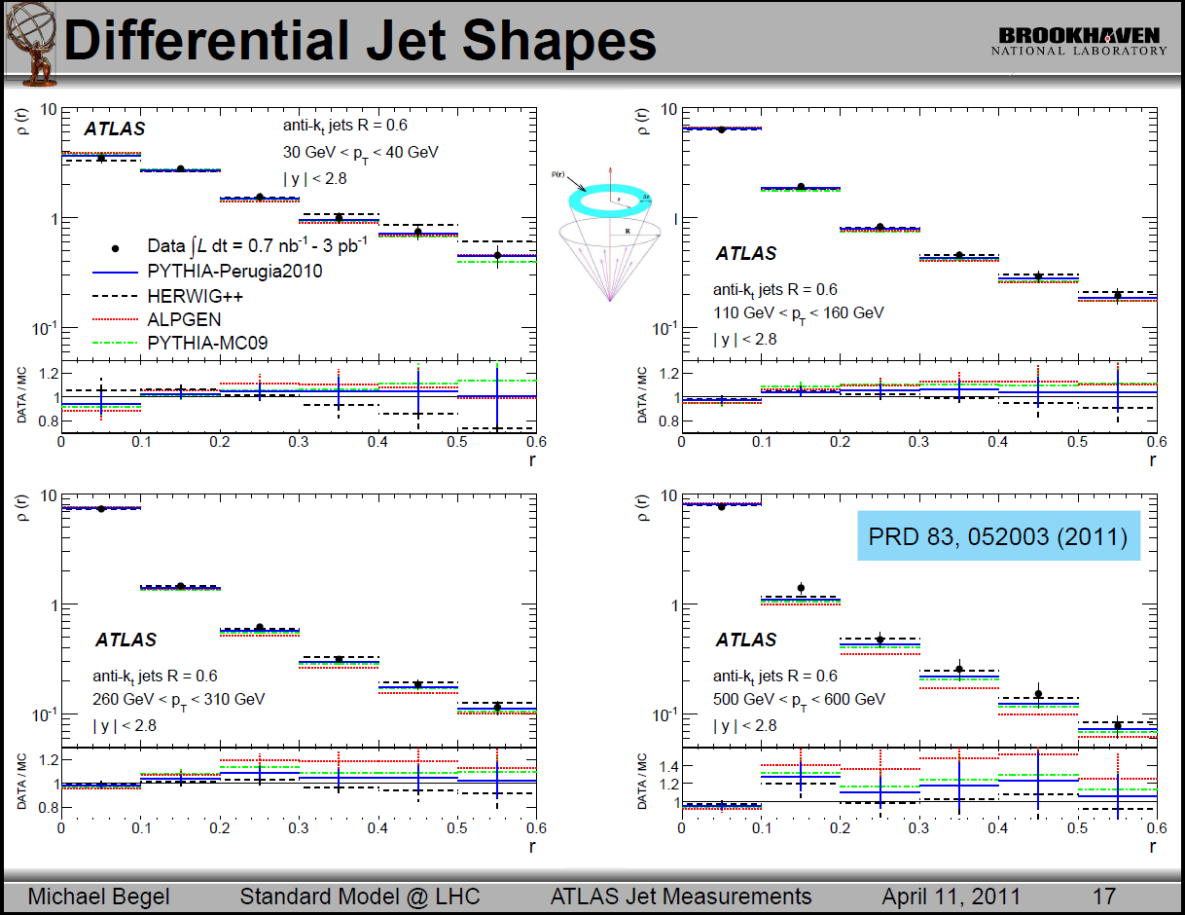

Slide 35
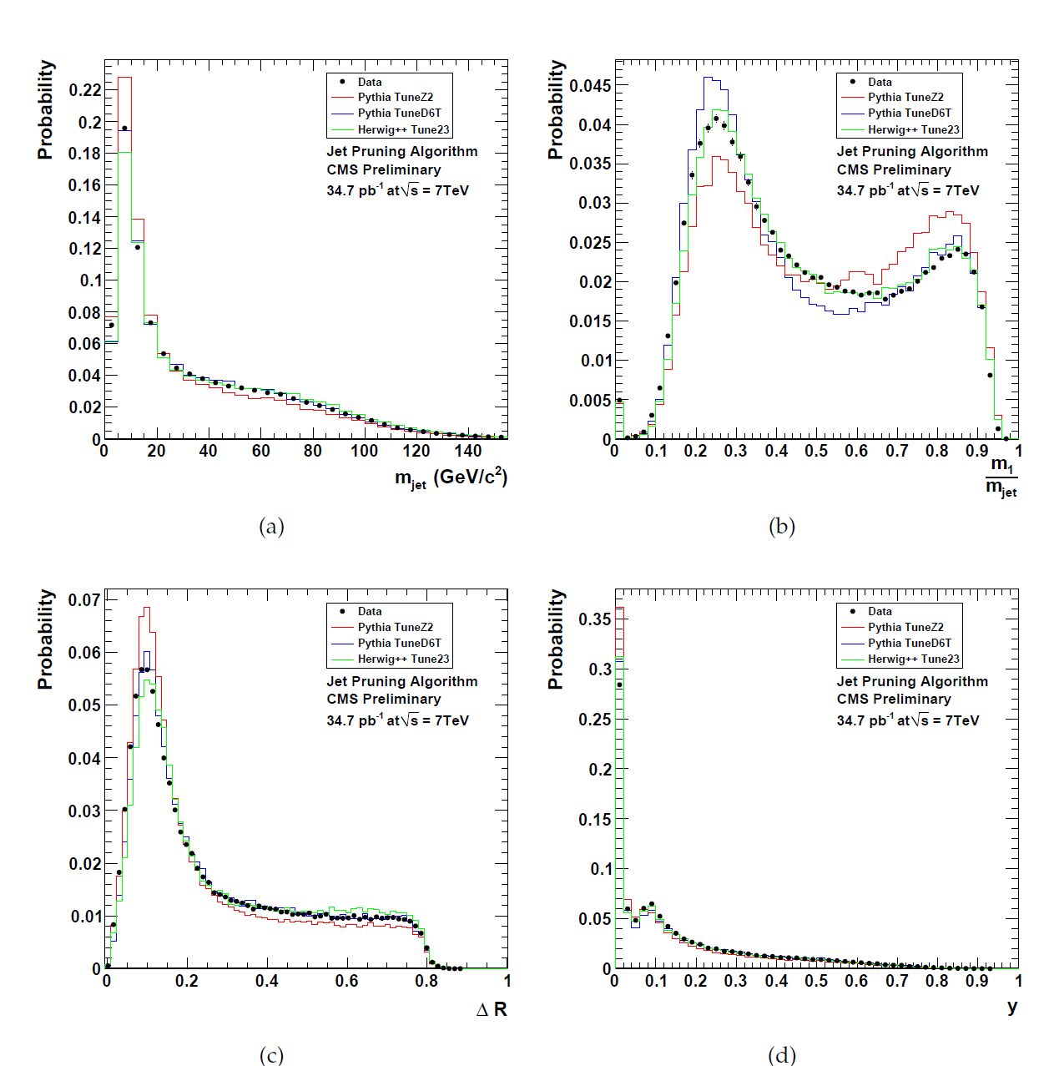
Jet Substructure
Taken from CMS PAS JME-10-013

Slide 36
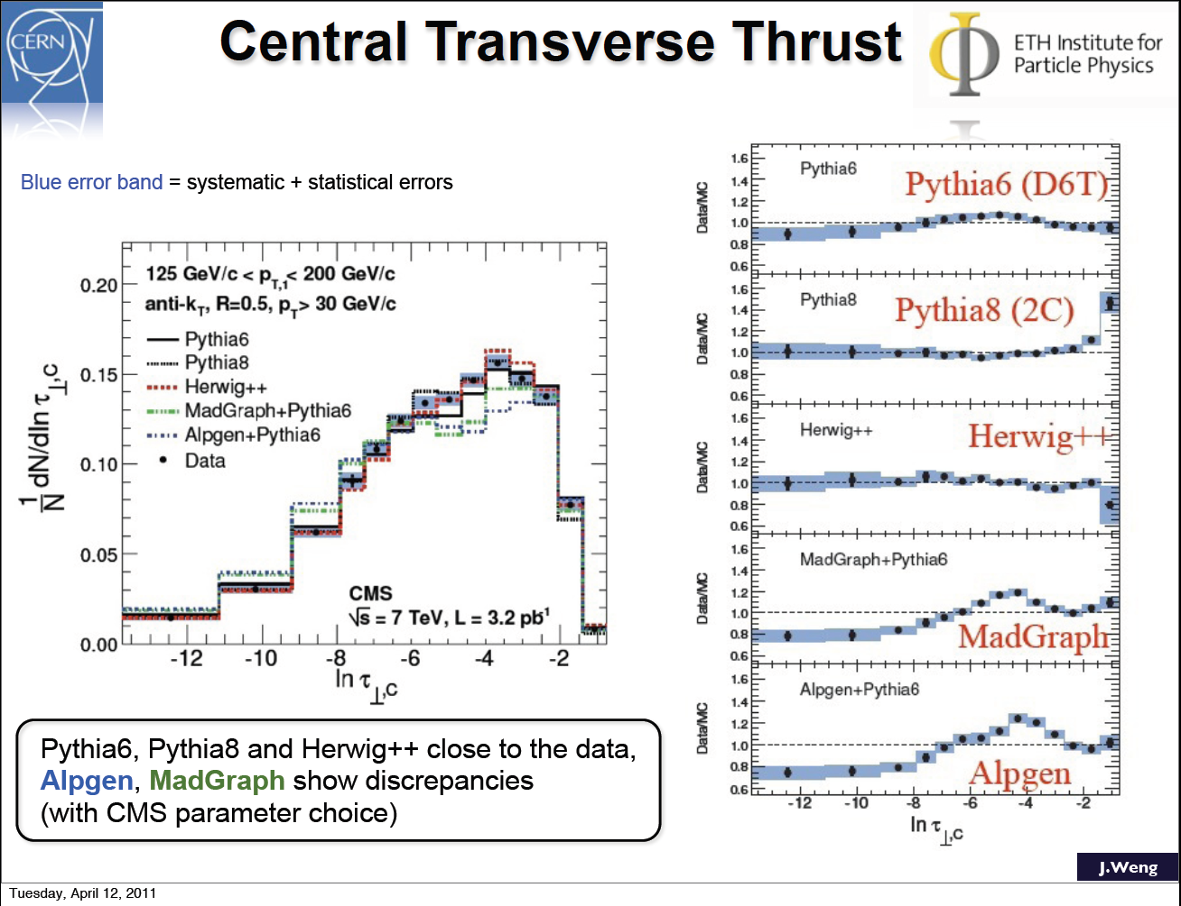

Slide 37
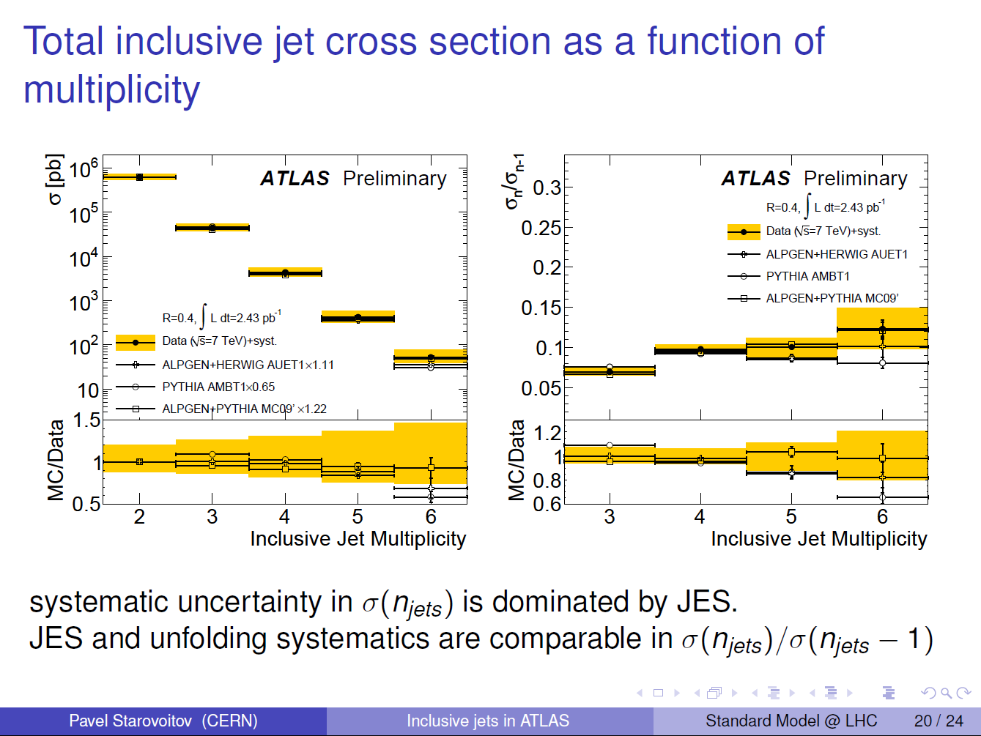

Slide 38
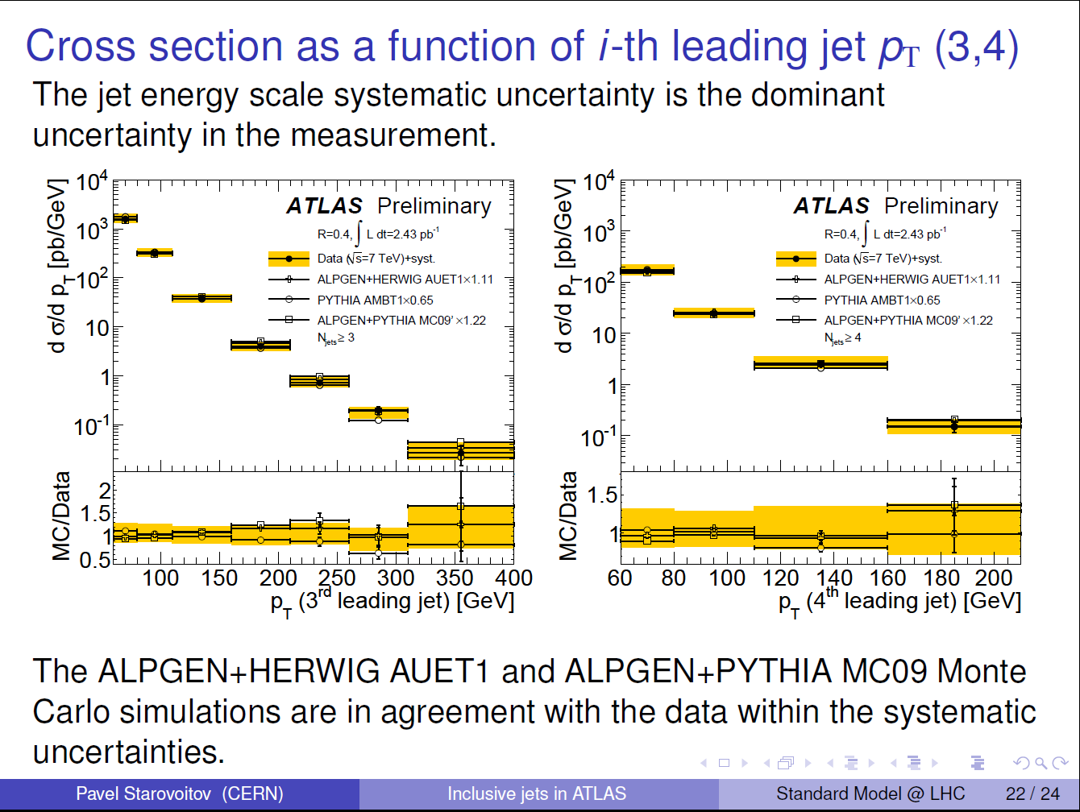

Slide 39
V+jet production
Traditionally the production of W/Z bosons in association with many jets has been an important test of improvements to the parton shower, e.g. CKKW and MLM.
Easier to calculate than pure jet production and has the advantage of a large scale from the mass of the boson.

Slide 40
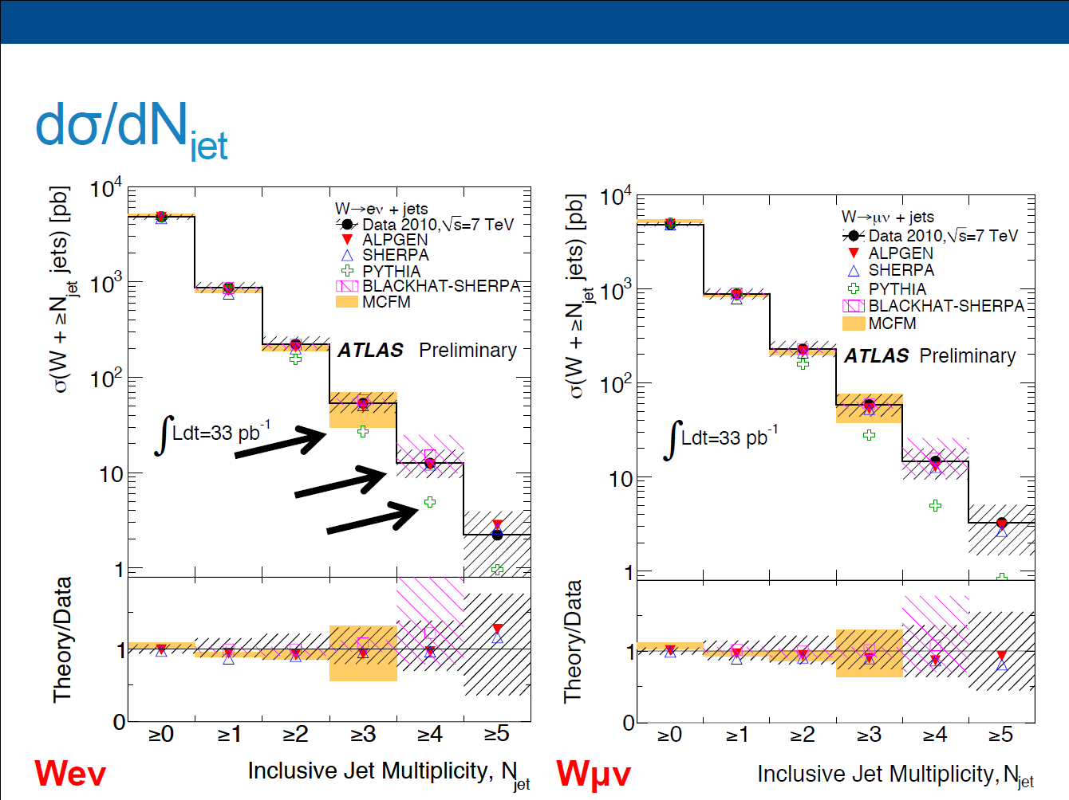
E. Dobson SM@LHC

Slide 41
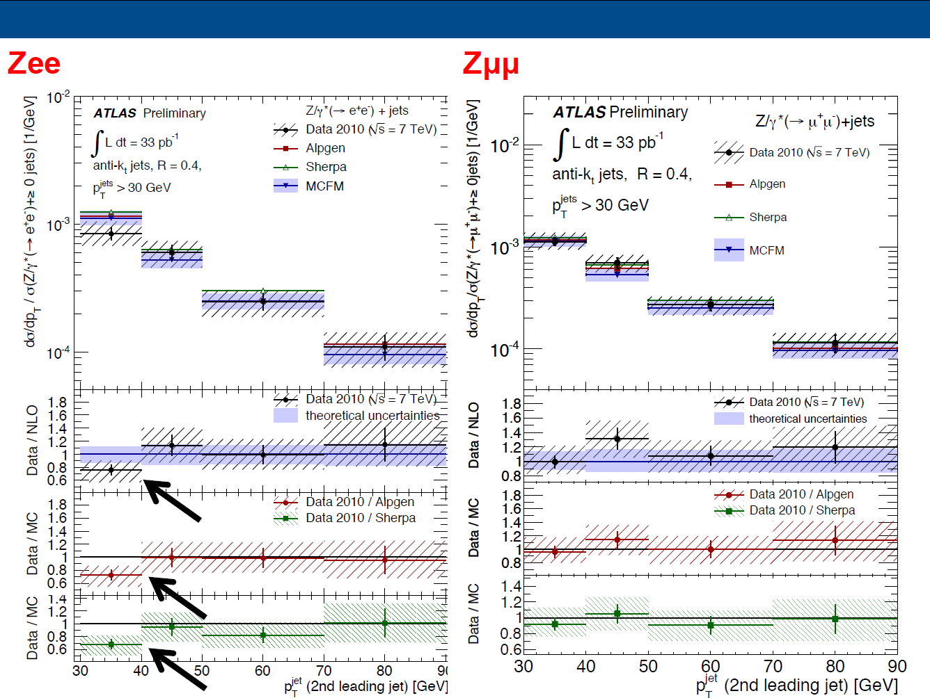
E. Dobson SM@LHC

Slide 42
Summary
We’ve spent a long time developing a new generation of simulations for the LHC.
So far things look O.K. but that may well change as statistics improve and systematic errors reduce.
A tune of PYTHIA can describe pretty much anything, not clear that there’s a tune of PYTHIA that can describe everything.
Limited use of the new generation of tools, hopefully this will improve as higher statistics requires more accurate predictions.

