Slide 1
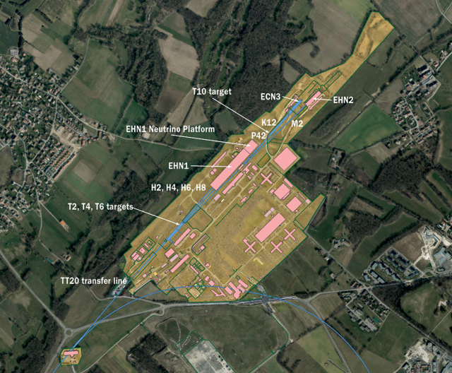
North Area and Slow Extraction
Interlocking Task Force – 3rd meeting
I. Romera on behalf of the BIS team

Slide 2
Objectives
Protect the North Area from receiving beam under unsafe conditions
Protect the extraction and transfer line elements from themselves by either:
  Hardware errors, e.g. current deviating from reference or power supply trip
  Setting errors, e.g. incorrect trim, test or local functions
  Differences between LSA settings, FGC function and measured current
Ensure that slow extraction only takes place when FTARGET destination is set and all extraction elements have the correct settings
Allow all other destinations to continue unaffected (maximise beam availability)
…the use of the beam destination as main interlocking criteria to allow slow extraction needs to be reinforced

Slide 3
Simplified SPS slow extraction
Ext sextupoles ON and bump ON – Beam extracted to TT20 channel
MSE
MST
ZS
Ext sextupole
Ext sextupole
Bump1
Bump2
Bump3
In reality bump is more complex containing 9 magnets of both planes
MPSH.21202
MPSV.21303
MPLH.21431
MPSV.21503
MPNH.21732
MPLH.21995
MPSV.22103
MPLH.22195
MPSV.22303
Courtesy J. Ridewood

Slide 4

Simplified SPS slow extraction
Bump not closed – Potentially dangerous situation regardless of extraction sextupoles.
Any bump element can cause a similar effect. We rely on BLM dump so far
MSE
MST
ZS
Ext sextupole
Ext sextupole
Bump1
Bump2
Bump3
In reality bump is more complex containing 9 magnets of both planes
MPSH.21202
MPSV.21303
MPLH.21431
MPSV.21503
MPNH.21732
MPLH.21995
MPSV.22103
MPLH.22195
MPSV.22303
Courtesy J. Ridewood

Slide 5
Simplified SPS slow extraction
Extraction element OFF – potentially dangerous situation.
Any extraction element will have a similar effect. We rely on BLM dump
MSE
MST
ZS
Ext sextupole
Ext sextupole
Bump1
Bump2
Bump3
In reality bump is more complex containing 9 magnets of both planes
MPSH.21202
MPSV.21303
MPLH.21431
MPSV.21503
MPNH.21732
MPLH.21995
MPSV.22103
MPLH.22195
MPSV.22303
Courtesy J. Ridewood

Slide 6
What is needed for slow extraction to take place?
Extraction sextupoles and bumpers (besides ZS, MST, MSE) are mandatory to extract the beam towards TT20 and therefore they should be an active part of the interlocking
Extraction sextupoles are required to put the beam in resonance and no beam can be extracted without them
Extraction bumpers are very critical for slow extraction and single failures on these magnets can potentially provoke equipment damage
Powering failures on magnetic septa can also be dangerous and must be interlocked
Monitoring/interlocking of magnet currents for sextupoles, bumpers, septa is required to ensure that:
  Slow extracted beam can be safely extracted for FTARGET beams
  Slow extraction is inhibited for all other beams (for non-FTARGET beams)

Slide 7
Power converters to be monitored/interlocked
Extraction sextupoles:
  LSE.10602, LSE.22402, LSE.40602, LSE.52402
Extraction bumpers:
  MPLH.21431, MPLH.21995, MPLH.22195, MPNH.21732, MPSH.21202
  MPSV.21303, MPSV.21503, MPSV.22103, MPSV.22303
Magnetic septa:
  MSE.2183, MST.2177
TT20 main dipole string:
  MBE.2103
  *SY-EPC confirmed that all PCs powering the magnets above will be equipped with new FGC controls in LS3

Slide 8
Destination reinforcement (1/2)
  #for non-FTARGET beams
  IF destination != FTARGET AND all extraction sextupole or bumper measured currents < Imin (+tol) THEN
  ALLOW circulating beam
  ELSE
  DUMP circulating beam
  #for FTARGET beams
  IF destination == FTARGET AND all PC* measured currents are following reference function (± tol) AND
  all PC status == ON AND all PC not in simulation THEN
  ALLOW slow extraction
  ELSE
  DUMP circulating beam
  In addition, a tool should verify the consistency of LSA and FGC functions against the reference functions to mitigate the risk of misconfigurations and send interlock to the BIS if needed
  * all PC: refer to all power converters up to TED in TT20 (i.e. extraction sextupoles and bumpers, MSE, MST and TT20 main dipole string MBE.2103)
  *It seems feasible for SY-EPC to implement the interlock logic above on the mentioned PCs

Slide 9
Destination reinforcement (2/2)
To configure the destination equations on slide #8 “destination reinforcement”, I’ve checked with an example that it would be straight forward, see below:
Timing 0 condition: non-FTARGET beams #limited to 4 distinct destination timing conditions#
Timing 1 condition: FTARGET beams #limited to 4 distinct destination timing equations#
  DEVICE.MULTI_PPM ENABLED
  INTERLOCK.USE_PPM DISABLED
  INTERLOCK.CONTROL CONDITIONAL
  0: INTERLOCK.PC_STATE ENABLED #remove permit if PC is not operational#
  0: INTERLOCK.I.MID 0 #remove permit if Imeas more than +-5A#
  0: INTERLOCK.I.DELTA 5 #remove permit if Imeas more than +-5A#
  1: INTERLOCK.PC_STATE ENABLED #remove permit if PC is not operational#
  1: INTERLOCK.MAX_REG_ERROR 10 #remove permit if more than 10A difference compared to reference#
So only the part which requires to verify the reference function, to ensure it is not inadvertently changed, remains without a known solution for the moment. I was in contact with the BE controls team (Roman), and this may be a future functionality. So the requirement would be an action on either BE/CSS or BE/OP to assure this check.
Courtesy D. Nisbet

Slide 10
Layout of the TT20 and NA beam lines

Slide 11
SPS LSS2 Master BIC equations
Ch. | 0 | 1 | 2 | 3 | 4 | 5 | 6 | 7 | 8 | 9 | 10 | 11 | 12 | 13 | 14 | 15 | 16 | 17 | 18 | 19 | 20 | OUT
Interlock users | SIS | FTARGET destination | Sextupole current monitoring | Bumper current monitoring | TT20 Upstream BIC | TT20 Downstream BIC | MBE.2103 dipoles partial | MBE.2103 dipoles full | TT20 TED in | TT20 TBSE in | P41-K12 BIC | M2 BIC | P42 TAX in | P42 TAX out | M2 TAX in | M2 TAX out | not used | not used | not used | not used | not used | 1) SPS beam permit
Matrix equations | 1 | 0 | 1 | 1 | x | x | x | x | x | x | x | x | x | x | x | x | x | x | x | x | x | 1 | 1) Beam allowed for non-FTARGET destinations
 | 1 | 1 | 1 | 1 | 1 | x | 1 | 0 | 1 | x | x | x | x | x | x | x | x | x | x | x | x | 1 | 2) Beam to TED
 | 1 | 1 | 1 | 1 | 1 | 1 | 0 | 1 | 0 | 0 | 1 | 1 | 0 | 1 | 0 | 1 | x | x | x | x | x | 1 | 3) Beam to NA with P42 TAX out and M2 TAX out
 | 1 | 1 | 1 | 1 | 1 | 1 | 0 | 1 | 0 | 0 | x | 1 | 1 | 0 | 0 | 1 | x | x | x | x | x | 1 | 4) Beam to NA with P42 TAX in and M2 TAX out
 | 1 | 1 | 1 | 1 | 1 | 1 | 0 | 1 | 0 | 0 | 1 | x | 0 | 1 | 1 | 0 | x | x | x | x | x | 1 | 5) Beam to NA with P42 TAX out and M2 TAX in
 | 1 | 1 | 1 | 1 | 1 | 1 | 0 | 1 | 0 | 0 | x | x | 1 | 0 | 1 | 0 | x | x | x | x | x | 1 | 6) Beam to NA with P42 TAX in and M2 TAX in

Slide 12
Possible scenarios for FTARGET beams - TED
Beam from
ZS, MST, MSE septa
TED.210358
Splitter 1
Splitter 2
T2
SPS
TT20
TT20
TT22
TT23
T4
TAX
T10
TT24
P42
P42
K12
NA62
ECN3
T6
TAX
TT25
M2
M2
NA58 COMPASS
EHN2

Slide 13
Truth table of the TT20 Upstream BIC
Ch. | 0 | 1 | 2 | 3 | 4 | 5 | 6 | 7 | 8 | 9 | 10 | 11 | 12 | 13 | 14 | 15 | 16 | 17 | 18 | 19 | 20 | OUT
Interlock users | SIS | MSE current monitoring | MST current monitoring | Girder position ZS | Girder position MSE | Girder position MST | Vacuum | ZS voltage | Collimators | WIC | BLM | BTV | SEM grids | not used | not used | not used | not used | not used | not used | not used | not used | TT20 upstream Beam Permit
 | 1 | 1 | 1 | 1 | 1 | 1 | 1 | 1 | 1 | 1 | 1 | 1 | 1 | x | x | x | x | x | x | x | x | 1

Slide 14
Possible scenarios for FTARGET beams– NA
P42 TAX out, M2 TAX out
P42 TAX in, M2 TAX out
P42 TAX out, M2 TAX in
P42 TAX in, M2 TAX in
TED.210358
Beam from
ZS, MST, MSE septa
Splitter 1
Splitter 2
T2
SPS
TT20
TT20
TT22
TT23
T4
TAX
T10
TT24
P42
P42
K12
NA62
ECN3
T6
TAX
TT25
M2
M2
NA58 COMPASS
EHN2

Slide 15
Possible scenarios for FTARGET beams– NA
P42 TAX out, M2 TAX out
P42 TAX in, M2 TAX out
P42 TAX out, M2 TAX in
P42 TAX in, M2 TAX in
TED.210358
Beam from
ZS, MST, MSE septa
Splitter 1
Splitter 2
T2
SPS
TT20
TT20
TT22
TT23
T4
TAX
T10
TT24
P42
P42
K12
NA62
ECN3
T6
TAX
TT25
M2
M2
NA58 COMPASS
EHN2

Slide 16
Possible scenarios for FTARGET beams– NA
P42 TAX out, M2 TAX out
P42 TAX in, M2 TAX out
P42 TAX out, M2 TAX in
P42 TAX in, M2 TAX in
TED.210358
Beam from
ZS, MST, MSE septa
Splitter 1
Splitter 2
T2
SPS
TT20
TT20
TT22
TT23
T4
TAX
T10
TT24
P42
P42
K12
NA62
ECN3
T6
TAX
TT25
M2
M2
NA58 COMPASS
EHN2

Slide 17
Possible scenarios for FTARGET beams– NA
P42 TAX out, M2 TAX out
P42 TAX in, M2 TAX out
P42 TAX out, M2 TAX in
P42 TAX in, M2 TAX in
TED.210358
Beam from
ZS, MST, MSE septa
Splitter 1
Splitter 2
T2
SPS
TT20
TT20
TT22
TT23
T4
TAX
T10
TT24
P42
P42
K12
NA62
ECN3
T6
TAX
TT25
M2
M2
NA58 COMPASS
EHN2

Slide 18
Truth table of TT20 Downstream BIC
Ch. | 0 | 1 | 2 | 3 | 4 | 5 | 6 | 7 | 8 | 9 | 10 | 11 | 12 | 13 | 14 | 15 | 16 | 17 | 18 | 19 | 20 | OUT
Interlock users | SIS | Vacuum | WIC | Splitter BLMs | TT20 BLMs | PC Current monitor TT20 | PC current monitor TT21 | PC current monitor TT22 | PC current monitor TT24 | PC current monitor TT25 | T4 cooling | T6 cooling | Splitter 1 cooling | Splitter 2 cooling | not used | not used | not used | not used | not used | not used | not used | TT20 downstream Beam Permit
 | 1 | 1 | 1 | 1 | 1 | 1 | 1 | 1 | 1 | 1 | 1 | 1 | 1 | 1 | x | x | x | x | x | x | x | 1

Slide 19
Truth table of P42-K12 BIC
Ch. | 0 | 1 | 2 | 3 | 4 | 5 | 6 | 7 | 8 | 9 | 10 | 11 | 12 | 13 | 14 | 15 | 16 | 17 | 18 | 19 | 20 | OUT
Interlock users | SIS | PC current survey | WIC | T10 cooling | K12 TAX cooling | K12 vacuum valves | T10 collimators | Radiation monitors | not used | not used | not used | not used | not used | not used | not used | not used | not used | not used | not used | not used | not used | P42-K12 slave Beam Permit
 | 1 | 1 | 1 | 1 | 1 | 1 | 1 | 1 | x | x | x | x | x | x | x | x | x | x | x | x | x | 1

Slide 20
Truth table of M2 BIC
Ch. | 0 | 1 | 2 | 3 | 4 | 5 | 6 | 7 | 8 | 9 | 10 | 11 | 12 | 13 | 14 | 15 | 16 | 17 | 18 | 19 | 20 | OUT
Interlock users | SIS | SM1 spectrometer current monitor | SM2 spectrometer current monitor | COMPASS dipole current monitor | WIC | not used | not used | not used | not used | not used | not used | not used | not used | not used | not used | not used | not used | not used | not used | not used | not used | M2 slave Beam Permit
 | 1 | 1 | 1 | 1 | 1 | x | x | x | x | x | x | x | x | x | x | x | x | x | x | x | x | 1

Slide 21
Next steps
Confirm that the monitoring of the sextupole and bumper currents is reliable enough to complement the use of destination as interlock criteria
Review the list of users to be connected to the BIS and interlock layout
Contact equipment owners to discuss technical details of connections to BIS
Optimise the BIS layout to minimize cable lengths
Confirm rack space and cabling requests

Slide 22
Backup slides

Slide 23
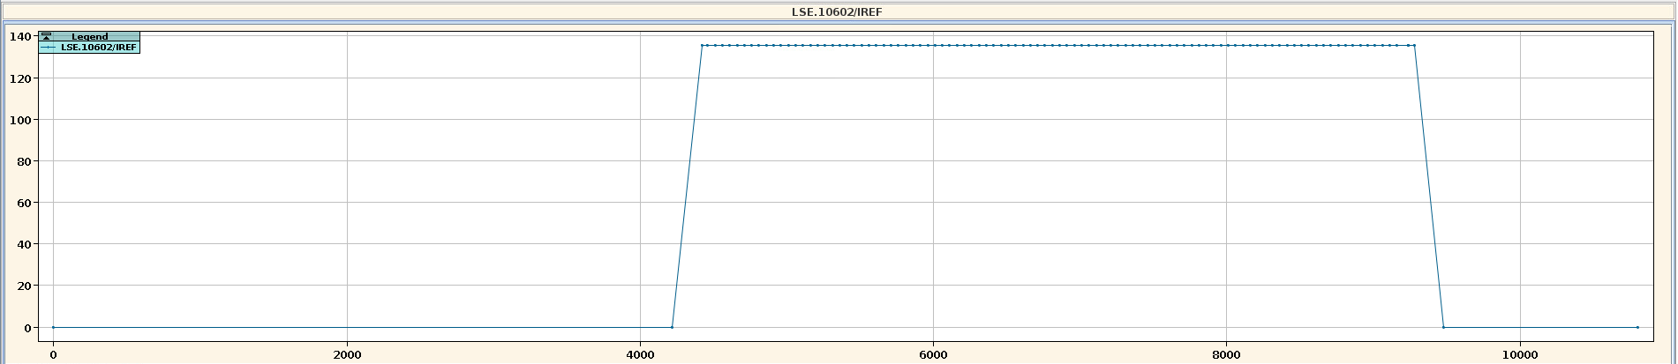
Reference function for extraction sextupole
LSE.10602
LSE.22402
LSE.40602
LSE.52402
LSA reference current for LSE.10602 for FT destination

Slide 24
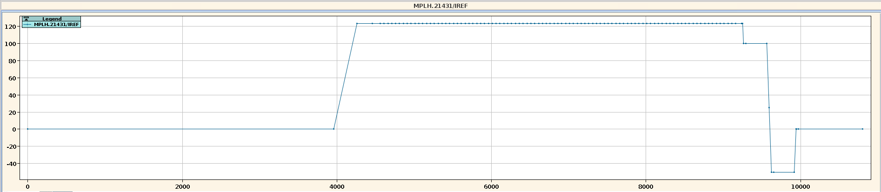
Reference function for extraction bumper
MPLH.21431
MPLH.21995
MPLH.22195
MPNH.21732
MPSH.21202
MPSV.21303
MPSV.21503
MPSV.22103
MPSV.22303
LSA reference current for MPLH.21431 for FT destination

Slide 25
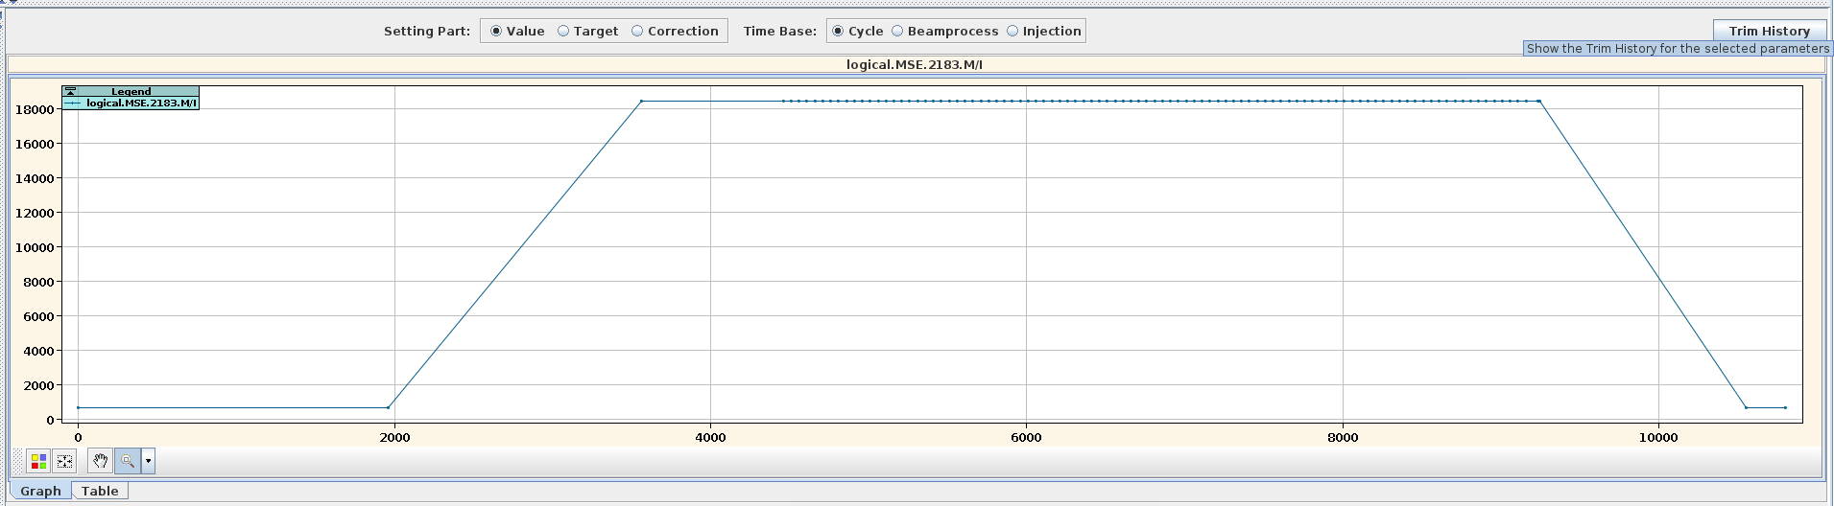
Reference function for magnetic septa MSE
LSA reference current for MSE for FT destination

