Slide 1
FCC-ee tuning & alignment mini-workshop 11 & 12 May 2022
- hybrid event - https://indico.cern.ch/event/1153631/
organized by Tor Raubenheimer, Rogelio Tomas, Frank Zimmermann
Frank Zimmermann, 154th FCC-ee Optics Design Meeting, 5 May 2022

Slide 2
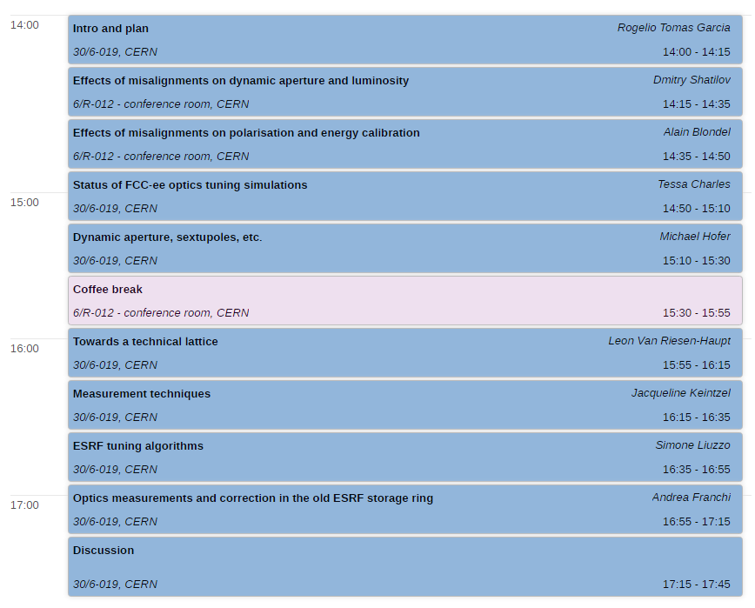
Day 1:
optics tuning,
11 May ‘22
Chair:
Pantaleo
Raimondi,
SLAC
+ Motivation by Dmitry Shatilov

Slide 3
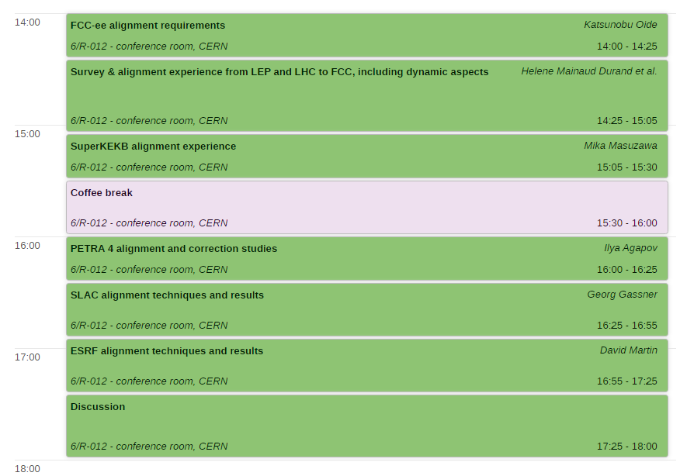
Day 2:
alignment,
12 May ‘22
Chair:
Johan Wickström,
PSI

