Slide 1
Organization and governance of the large LHC experimental collaborations
Pippa Wells, May 2022

Slide 2
Accelerators & Experiments
Convention for the Establishment of a European Organization for Nuclear Research of 1953 stipulates the operation of particle accelerators and the necessary ancillary apparatus for use in the research programmes
Since the days of LEP (1980s)
  the accelerators are funded from the CERN budget (from Member States) and project contributions from non-member states (NMS)
  the experiments are predominantly constructed by (in-kind) contributions of the institutes from Members States and non-Member States; this may be supplemented by a cash contribution to the Common Fund for construction for the joint procurement of infrastructure
  the experiments are operated jointly by the collaborating institutes and supported by a Maintenance and Operations Budget financed by all participating institutes (through their funding agencies), of which CERN is typically one

Slide 3
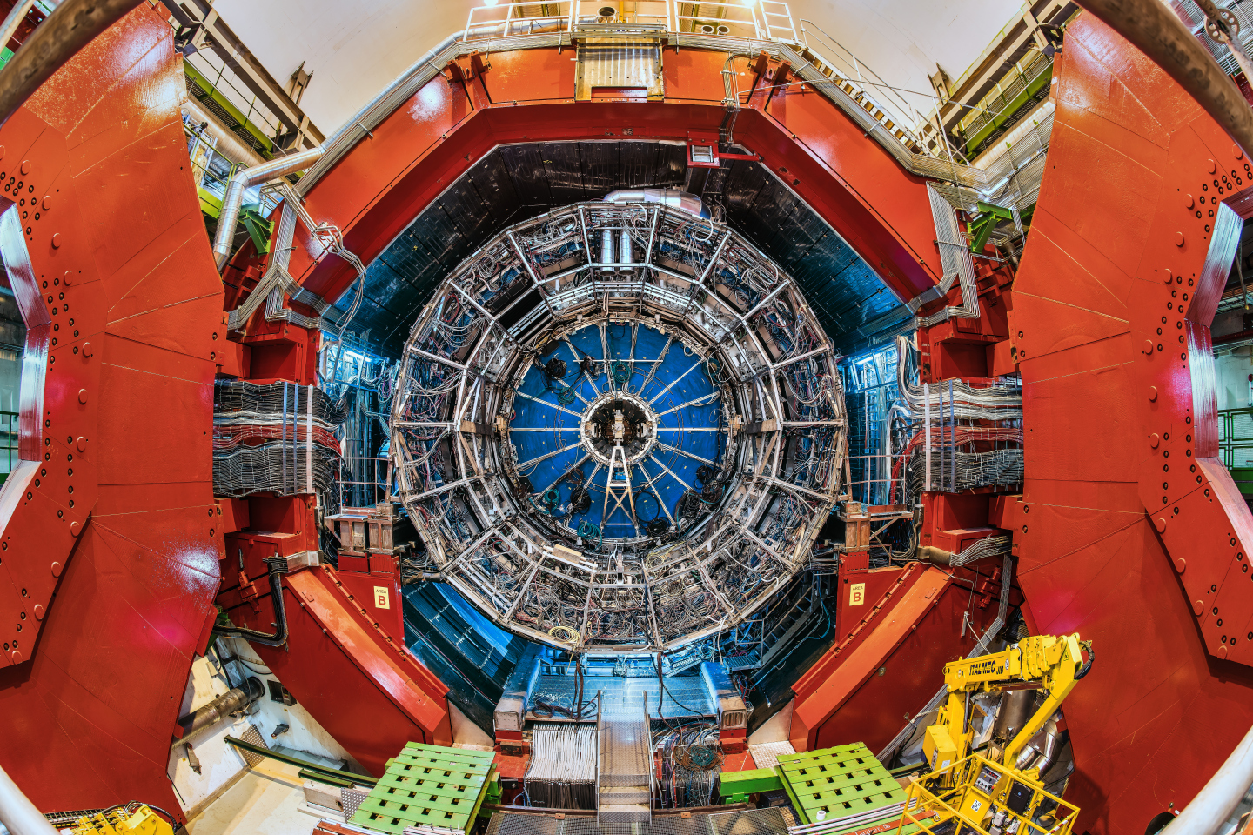
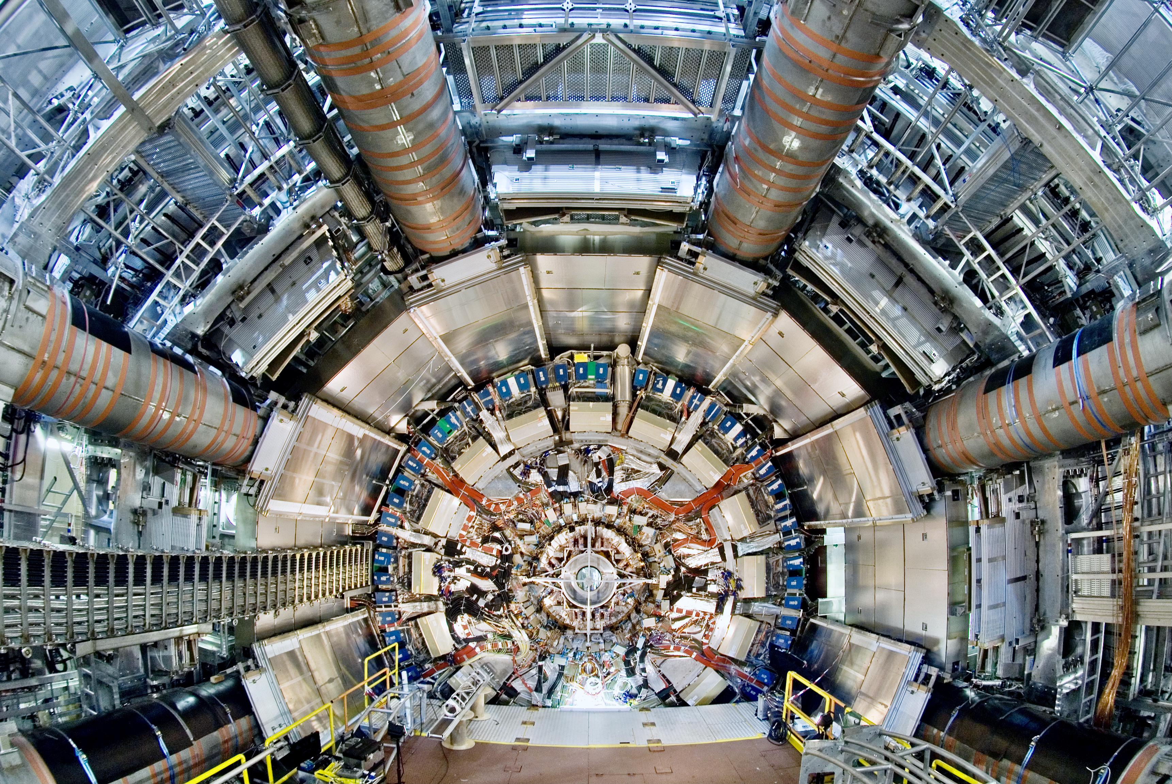
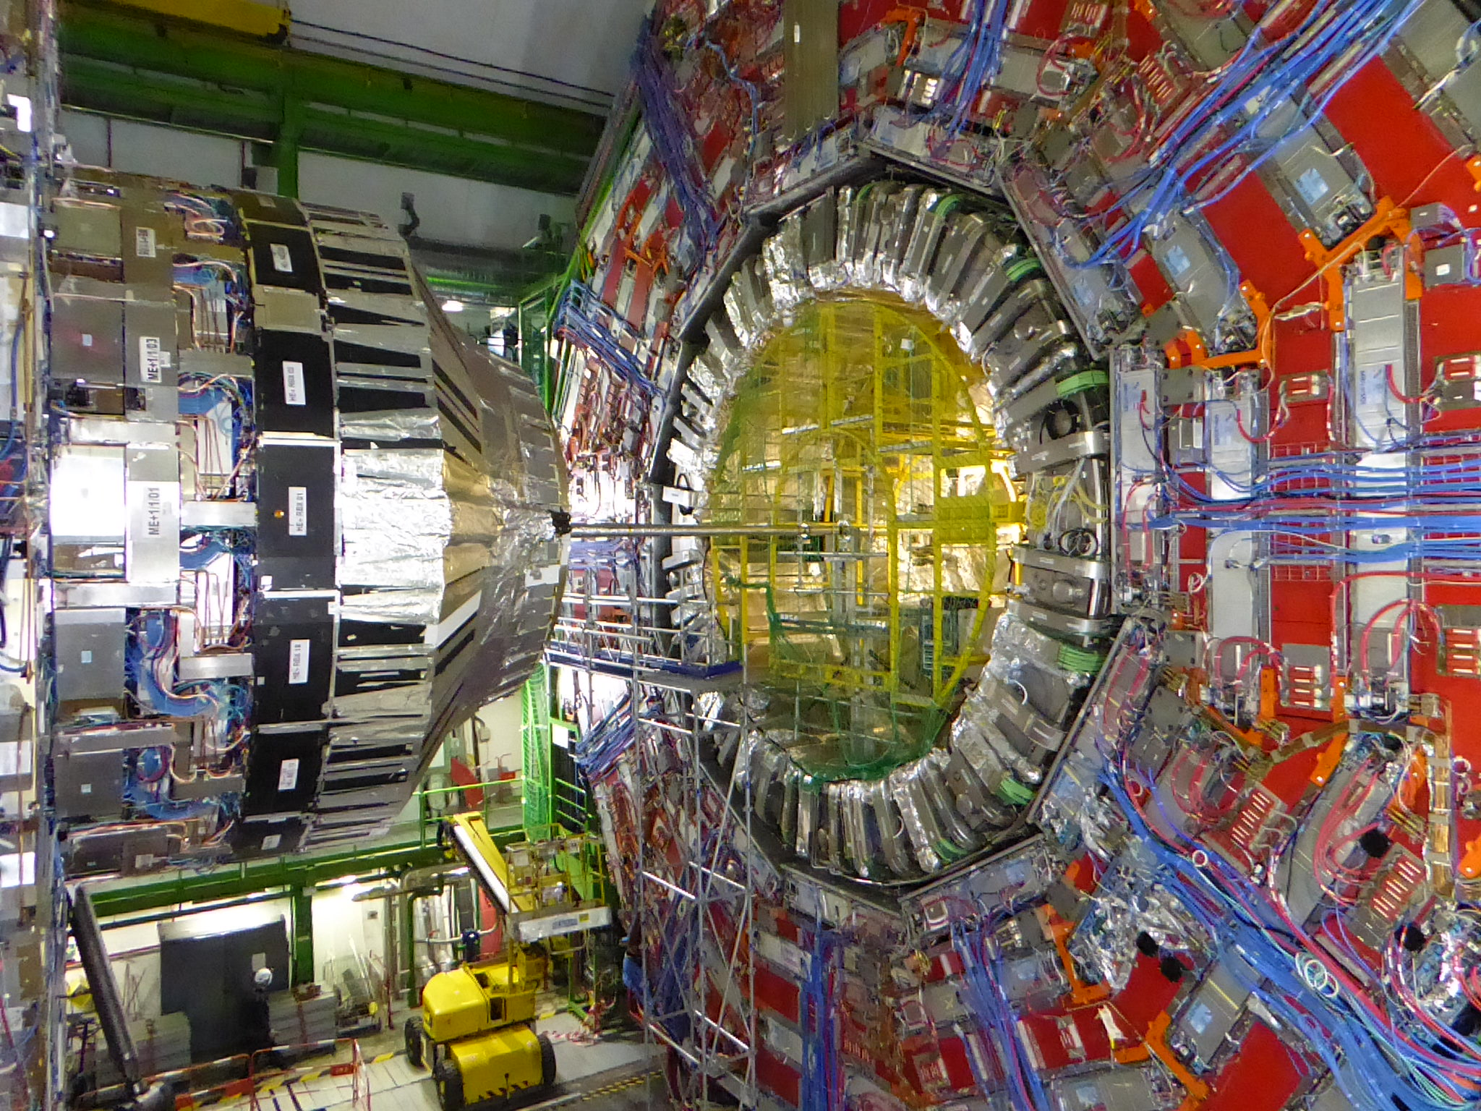
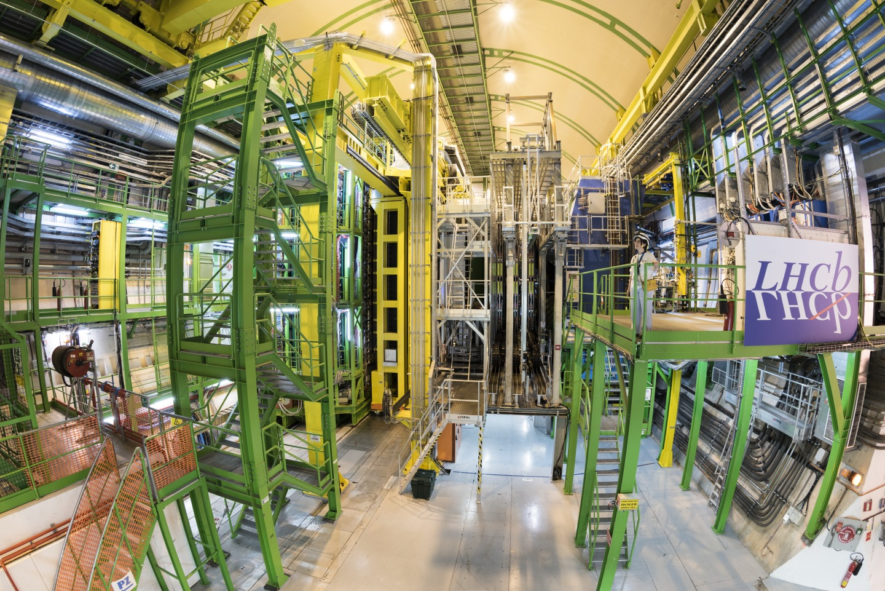
LHC Experiments at CERN
ALICE
~2000 members
ATLAS
>3000 members
CMS
>3000 members
LHCb
>1400 members

Slide 4
Experimental Collaborations
  Interested physicists form a proto-Collaboration and propose an experimental set-up that is deemed capable of carrying out a measurement programme of interest using infrastructure at CERN
  Once approved the physicists constitute a formal Collaboration with the aim to build and operate the apparatus and to analyse and publish the data recorded jointly
    their home institute commits to support their activity
    the results are published under the name of the Collaboration
  Collaborations are open - new institutes may join following a well-defined procedure

Slide 5
Approval and Review by Competent Scientific Committee
  The competent Scientific Committee (LHCC) is called by the Director responsible for research. These committees are constituted by international and independent experts that peer-review the proposals and progress reports
  Progress is compared to milestones set at the approval of the experiment (or its upgrade)
  Deviations are flagged and reported back to the experiments, CERN management and funding agencies to allow for counter measures
  Research Board receives the concise reports of the Committee

Slide 6
Research Board
  The Research Board (RB) is chaired by the Director General of CERN and consists of the Directors, the CERN Department Heads and the chairs of the competent Scientific Committees
  The RB approves the experiment – or not – based on
    scientific recommendations of the competent Scientific Committee
    assessment of the financial situation of the experiment and
    resource implication at CERN (support, services, technical installation, technology requirements). The Department Heads of the relevant technical groups at CERN assess the implications beforehand
  Final decision is taken by Council through the approval of the MTP

Slide 7
Participation in Experiments at CERN
General Conditions (GC) are the legally binding basis for participation in a CERN hosted experiment
    GC set out the rules for users and
    describe the host lab responsibilities
The particular engagement for an experiment is concluded by a Memorandum of Understanding (MoU) between the collaborating institute (funding agency) and CERN, signed by the Director responsible for research as the legal responsible for the CERN hosted experiment
    MoUs describe the responsibilities for the construction of the experiments, the operation of the apparatus and its dismantling
    Funding Agencies have direct oversight of their funds via the Resources Review Board
GC last update Dec 2020:

Slide 8
Memoranda of Understanding
  The MoUs describe the core contributions (deliverables) of the institutes to the construction of experiments
  Core contribution is the value of components purchased and the external labour. Internal (institutional) labour is not included.
    Depending on the salary scale and overheads the full cost may be considerably higher than core cost
  Collaborating institutions are expected to contribute core cost at the level of their share in the experiment, e.g. by authors or other agreed scheme
    (This also defines their fair share contribution to the Common Fund for joint purchases of some infrastructure and to the annual Maintenance and Operation costs)

Slide 9
Example: ATLAS
Broad engagement of the
participating institutes
Groups of institutes build
parts of the apparatus
The data are available to
all physicists for analysis,
organised in dedicated
working groups

Slide 10

ATLAS detector
25m high, 44m long
Total weight 7000 tonnes
100 million “pixels” per picture.
3000 scientists including 1000 students

Slide 11
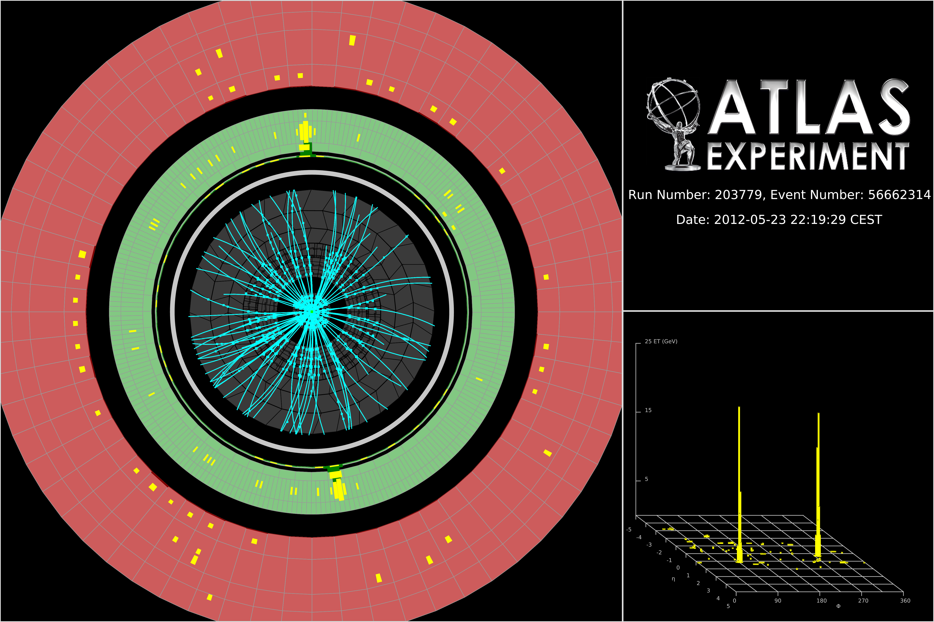
Higgs boson candidate with two photons

Slide 12
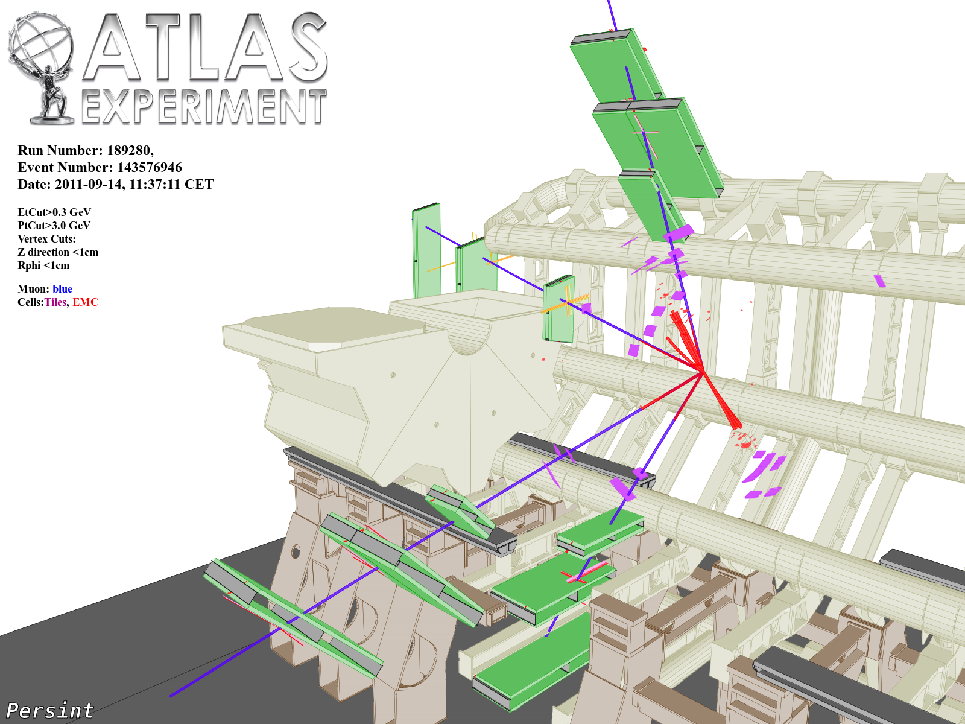
ZZ → μμμμ

Slide 13

Open Science
Open Access Policy (2014)
  >90% of research produced at CERN published OA
  (CC-BY licenses)
  Sponsoring Consortium for Open Access Publishing in Particle Physics - SCOAP³
  Global collaboration across 44 countries
  Inspired major global OA initiatives: PlanS, OA2020, etc.
LHC Open Data Policy (2020)
  LHC experiments committed to release experimental data for diverse scientific and educational uses
  Data released together with associated analysis tools

Slide 14
Sketch on Reporting on LHC experiments
LHCC: LHC Experiments Committee
P2UG: Phase 2 Upgrade Group
RRB: Resource Review Board
SPC: Science Policy Committee
UCG: Upgrade Cost Group
CERN Council
Ex off. SPC Chair
DG
SPC
Ex off: PoC, DG, DRC
LHCC chair
Research Board
Chair: DG,
DRC, ex off: LHCC chair
DRC
RRB
Chair: DRC,
ex off: DG, LHCC chair
LHCC
Ex off: DG, DRC
Information
P2UG ATLAS/CMS
Ex off: LHCC & UCG chairs
UCG
Ex off: LHCC & SG chairs
Scrutiny Group

Slide 15
Summary
  The governance of experiments at CERN has a long and highly successful tradition
    it has grown from small experiments of some ten people in the 1960s to the large collaborations comprising more than 3000 members today
  It is built on fair sharing, on a joint (physics) goal and the determination to succeed
  Risks are transparently and well managed
  The monitoring of the scientific success and the efficient use of resources involves committees with international experts
  The experiment results and data are available in the spirit of Open Science

Slide 16
Backup

Slide 17
Project Follow-up
  Experiments put in place a project management
  In case of technical difficulties in a component
    internal review identifies origin and initiates mitigation actions (by Technical Coordinator or Spokesperson)
    competent review committee signals failure and exposes problem
    milestone tracking
    spokesperson negotiates new solutions and reports to Resource Review Board
  Schedule changes
    agreed upon with the Spokesperson, the Technical Groups at CERN and the CERN directorate

Slide 18
Common Fund
  The construction of the experiment necessitates joint purchases of some infrastructure
    support structures that hold the detector in place
    specific cooling, heating, distribution systems, …
    components not covered by the host laboratory responsibilities, since they are specific to the experiment
    which is financed through the Common Fund
    financed by funding agencies
    monitored by RRB
  Host lab responsibilities cover the cost to enable an experiment in the first place: experimental cavern, radiation protection, supply of services such as electricity, cooling and gas; provision of transport of components to the site…

Slide 19
Maintenance and Operation
  The experiment (Technical and Resource Coordinators) presents on an annual basis a budget for Maintenance and Operation (M&O) of the experiment to the Resource Review Board (RRB) and its subordinate expert body, the Scrutiny Group.
    before submission to the RRB the M&O requests are scrutinized internally by the experiments
  The M&O budget is used for (M&O A)
    maintenance of detector components
    replacement of broken or obsolete equipment
    maintenance of online system (typical useful life time of CPUs ~4 years)
  Detector specific Maintenance and Operation budget (M&O B)
    institutes that contribute to a specific detector
  The RRB is composed of members of the funding agencies contributing to the experiments and meets twice a year
  M&O sharing is based on the number of authors with PhD, updated every year

