Slide 1
Fast drawing in the
ICRP Human Phantoms examples
/examples/advanced/ICRP110HumanPhantoms
  an old example with faster drawing
/examples/advanced/ICRP145HumanPhantoms
  a new example
“Special Mesh Rendering”
  a new feature presented in the vis session by John Allison and Evgueni Tchaerniev

Slide 2
ICRP110—an old example with improved visualisation
Macros modified to take advantage of developments in graphics_reps (Evgueni Tcherniaev) and in visualization (John Allison) (described elsewhere)
The human phantom and beam trajectories can be visualised in a performant way—10 fps or better on my old Mac (MacBook Pro (Retina, Mid 2012), 2.7 GHz Quad-Core Intel Core i7, 16 GB)
Rectangular parameterisation rendered as dots: 3,885,291 dots:
  /vis/viewer/set/specialMeshRendering
  /vis/drawVolume
Try “/viewer/interpolate g4views 1000 0”, which runs a cutaway plane through the phantom.
  See examples/extended/visualization/movies for how to create and interpolate “view-files” for interpolation
Can also be rendered as surfaces:
  /vis/viewer/set/specialMeshRenderingOption surfaces

Slide 3
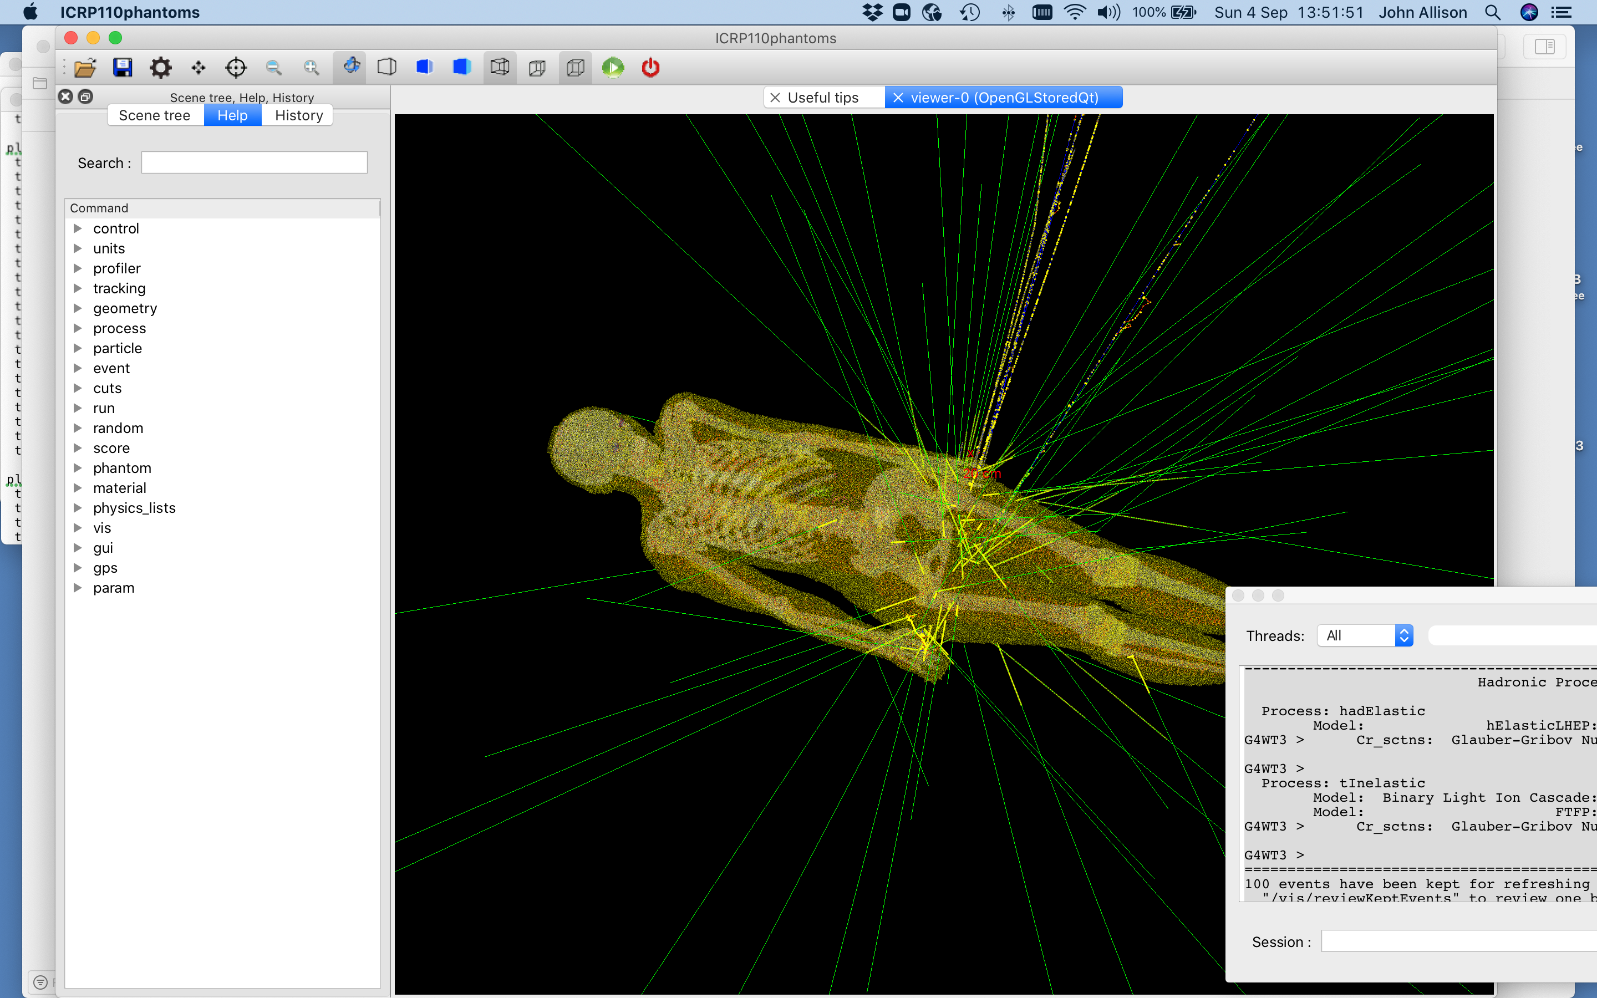

Slide 4
ICRP145
A new example
From icrp.org/publication.asp?id=ICRP%20Publication%20145
ICRP, 2020. Adult mesh-type reference computational phantoms. ICRP Publication 145. Ann. ICRP 49(3)
C.H. Kim, Y.S. Yeom, N. Petoussi-Henss, M. Zankl, W.E. Bolch, C. Lee, C. Choi, T.T. Nguyen, K. Eckerman, H.S. Kim, M.C. Han, R. Qiu, B.S. Chung, H. Han, B. Shin

Slide 5
Implementation as a Geant4 example
Source code implemented and provided in ICRP Publication 145. Ann. ICRP 49(3).
Principle coder: haeginh@hanyang.ac.kr
Modified to take advantage of developments in graphics_reps (Evgueni Tcherniaev) and in visualization (John Allison) (described elsewhere)
The human phantom and beam trajectories can be visualised in a performant way—1 fps or better on my old Mac.
Total number of tetrahedra: 8,233,413 (32,933,652 faces) are reduced to
4,807,770 facets (14%) for visualisation (tracking is not affected):
  /vis/viewer/set/specialMeshRendering
  /vis/viewer/set/specialMeshRenderingOption surfaces
  /vis/drawVolume

Slide 6
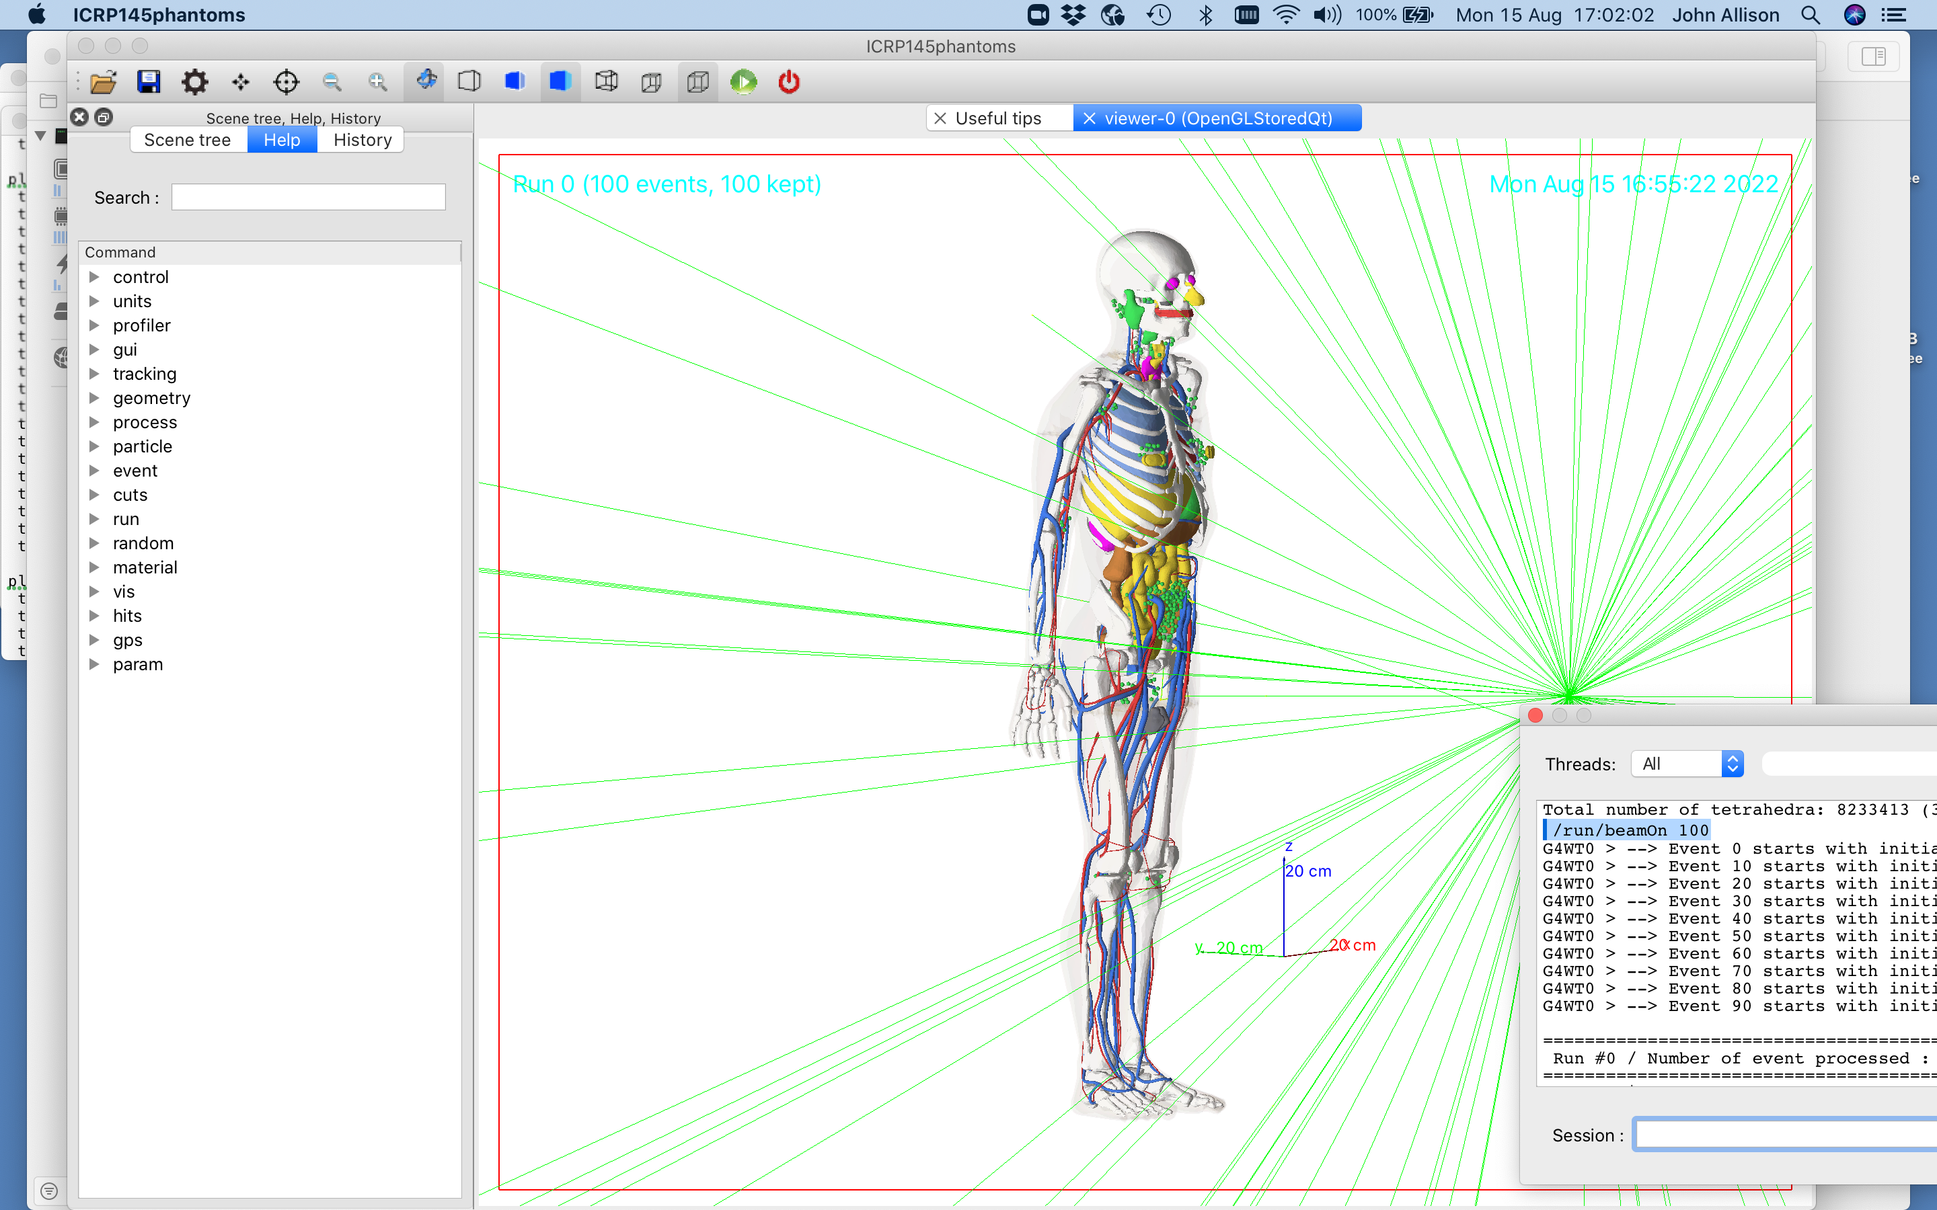

Slide 7
Thankyou

