Slide 1




AdePT status report
Witek Pokorski for the AdePT team
26.09.2022
27th Geant4 Collaboration Meeting

Slide 2
Project targets
Understand usability of GPUs for general particle transport simulation
  Prototype e+, e− and γ EM shower simulation on GPU, evolve to realistic use-cases
Provide GPU-friendly simulation components
  Physics, geometry, field, but also data model and workflow
Ensure correctness and reproducibility
  Validate the prototype against Geant4 equivalent, ensure reproducible results in all modes
Integrate in a hybrid CPU-GPU Geant4 workflow
  Understand possible limitation in such an environment
Understand bottlenecks and blockers limiting performance
  Estimate feasibility and effort for efficient GPU simulation

Slide 3
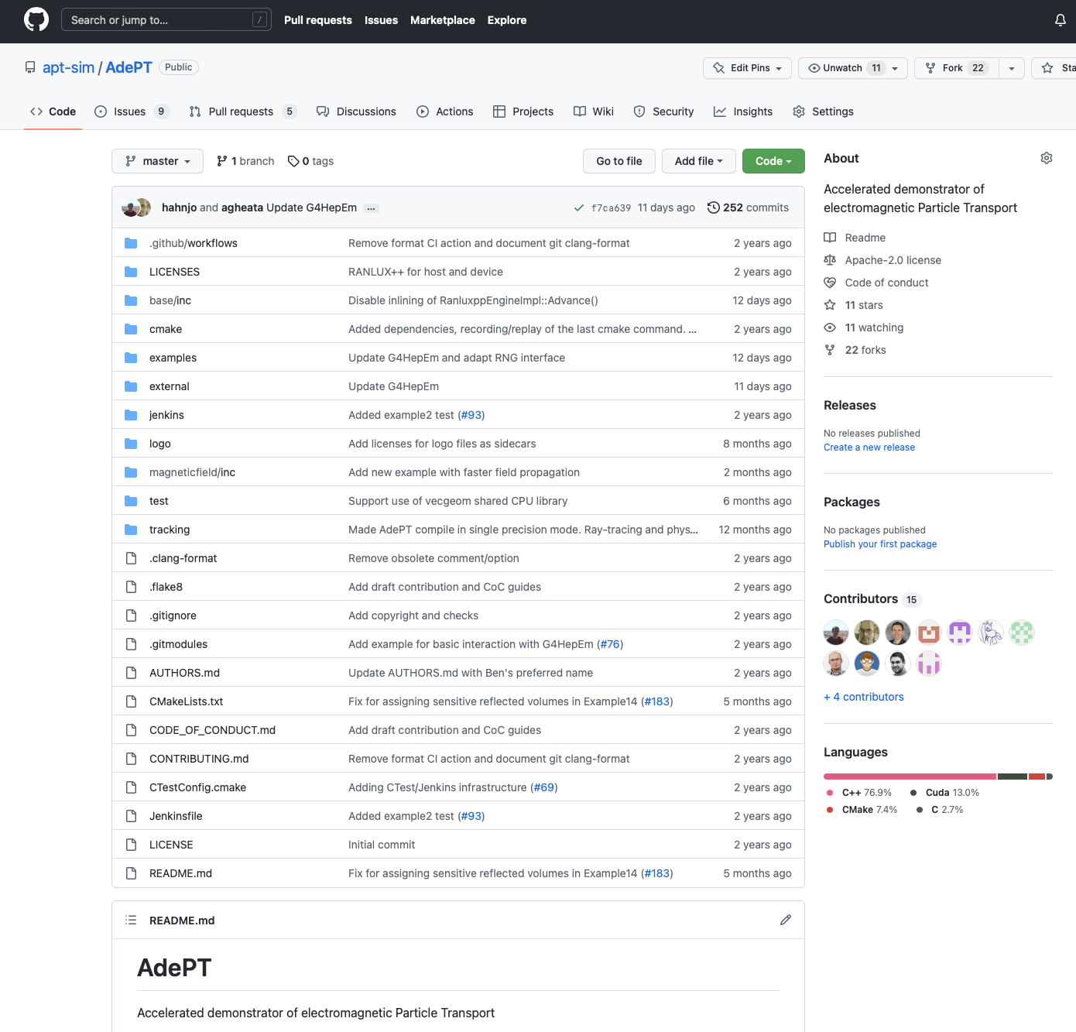
Development approach
Strategy: integrate gradually features as new examples
  No library build, maximize flexibility to explore different directions
Build-up gradually common functionality (services)
  Infrastructure: custom containers and helpers
  Geometry: VecGeom library, adapting & developing for GPU
  Physics: G4HepEm library, a GPU-friendly port of Geant4 EM interactions
Portability aspects not a major priority in this project phase
  Initial study identified VecGeom as blocking issue
Demonstrate usability in native Geant4 workflows
  Early integration to allow then optimizing a hybrid CPU-GPU workflow
Git repository
  Initial commit in Sep 2020, O(10) contributors

Slide 4
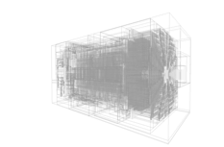
GPU geometry:VecGeom
Built on top of the original VecGeom GPU/CUDA support
  C++ types re-compiled using nvcc in a separate namespace/library
  In AdePT we wrote a custom global navigation layer calling lower level VecGeom APIs
Improving gradually GPU support
  Developed custom optimised navigation state, single-precision support
  Moved from a simple “loop” navigator to an optimized BVH navigator
  Adopting modern CMake GPU support
Specializing the VecGeom GPU navigation support
  Portable, less complex code
New ability to read GDML files allowing to run with almost any geometry
Although being a working first solution, CSG-based approach seems to be a bottleneck on GPU
  investigating surface-based models (see geometry parallel session)

Slide 5
GPU-friendly rewrite of EM physics
G4HepEm: compact library of EM processes for HEP
  Covers the complete physics for e−, e+ and 𝛾 particle transport
  Initialization of physics tables dependent on Geant4, but usage on GPU standalone and lightweight
  Excellent physics agreement between Geant4 processes and G4HepEm
Design of library very supportive for heterogeneous simulations
  Interfaces: standalone functions without global state
  Data: physics tables and other data structures copied to GPUs
  Reusing > 95% of the code from G4HepEm for GPU shower simulation

Slide 6
GPU workflow
The GPU workflow has probably the largest impact on performance
  Very different on GPU compared to CPU, it has to be massively parallelizable
    AdePT ‘steps’ all active tracks at once
Different properties to the simulation workflow of Geant4
  No “thread-local” state, everything associated with a track
  At the same time: track must be as lightweight as possible
  Data structures must not create bottlenecks (prefer atomics)
In AdePT we adopted so far an approach based on active track slots queues scheduled for per-particle kernels (see following slides)
    A “per-event” approach so far, easier to integrate in realistic simulation workflows

Slide 7
Track storage
Properties stored per track:
  Random number generator state
  Kinetic energy
  Position, direction, and current navigation state (volume)
  State to be preserved across steps (number-of-interaction-left, MSC properties)
Pre-allocate arrays of tracks per particle type (array of structures)
  One for electrons, one for positrons, one for gammas
  Advantage: can call specialized kernels, potentially specialize stored properties
  Atomic counter to hand out “slots” (to allow compaction)
Properties not stored per track:
  Particle type / PDG number (implicit from array)
  Charge, mass (can be inferred from particle type)

Slide 8
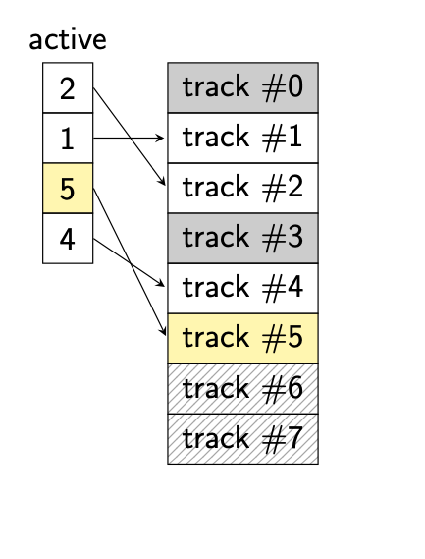
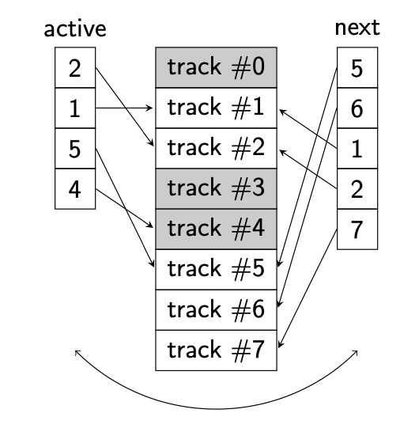
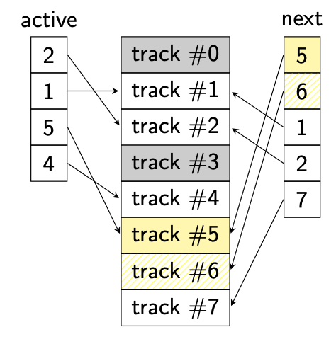
Arrays of active and next tracks
Store indices of active tracks (per particle type)
  Parallelize transportation kernels over these indices
Queue indices for “next” active tracks
  Both secondaries and “surviving” tracks
  Implemented with atomic counter
  Tracks are killed by not enqueuing
Run transportation kernels stepping the active tracks
  Here track #1, #2 and #5 survive, track #4 dies, and track #6 and #7 are produced
Swap ‘active’ with ‘next’ before next iteration
  Compacting unused slots now possible
AOS
Pre-allocated buffer

Slide 9
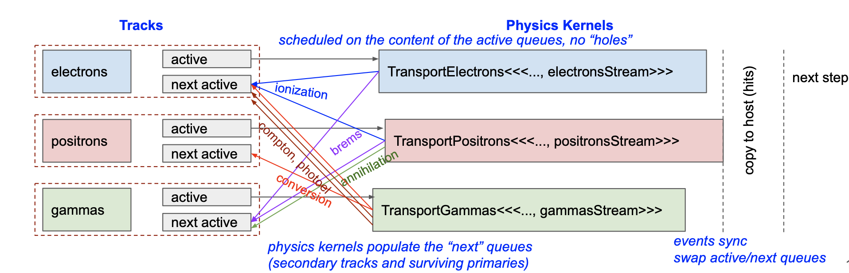
Stepping workflow – first approach
Can start kernels for particle types in parallel streams (transport is independent)
Synchronization means overhead
  Synchronize with host once at the end of the step (stepping loop control)
Main optimization playground
  Better work balancing between warps, reducing impact of tails, better device occupancy
  Experimenting with smaller kernels (separating discrete and continuous interactions)

Slide 10
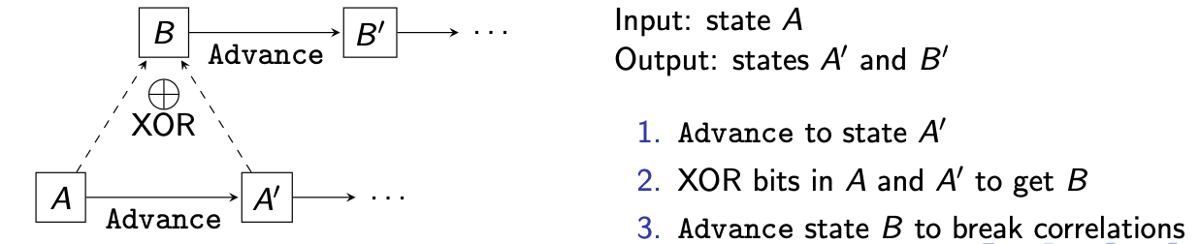
Random number handling
To assure reproducibility, RNG state needs to be associated with each track
  Guarantees identical results no matter the parallel execution order and kernel configuration
  Essential for debugging during development and production
Need to initialize new RNG state for secondary particles
  Must only depend on parent track to guarantee reproducibility
  Can re-use RNG state of dying track in annihilation or conversion

Slide 11
Random number generator: RANLUX++
Based on the well-known RANLUX generator
  Uses the equivalent LCG and therefore faster
  Excellent statistical properties: inherited from RANLUX, only shared by MIXMAX
    (XORWOW used by default in cuRAND known to fail some statistical tests)
Portable implementation available, written with GPUs in mind
  See J. Hahnfeld, L. Moneta: A Portable Implementation of RANLUX++
Advantage over MIXMAX: smaller state
  Even for N = 17, the default generator in Geant4 (148 bytes of state)
  Compared to 80 bytes for RANLUX++

Slide 12
Magnetic Field: Runge-Kutta field propagation
Propagation using Dormand-Prince 4/5th order RK method
Field Propagator templated on field type, driver
RK Driver templated on stepper, equation of motion
First results with TestEm3, Bz= 3.8T
Better than per-mille agreement in observables with helix results
Improved handling of particles ‘stuck’ at boundaries - flip volume at boundary
Runtime about 1.5x helix ( 98 s vs 65 s in TestEm3 3.8T test case)
Next steps - further testing and performance evaluation
Use semi-realistic field (simplified CMS or ACTS ‘texture’-based interpolation)

Slide 13
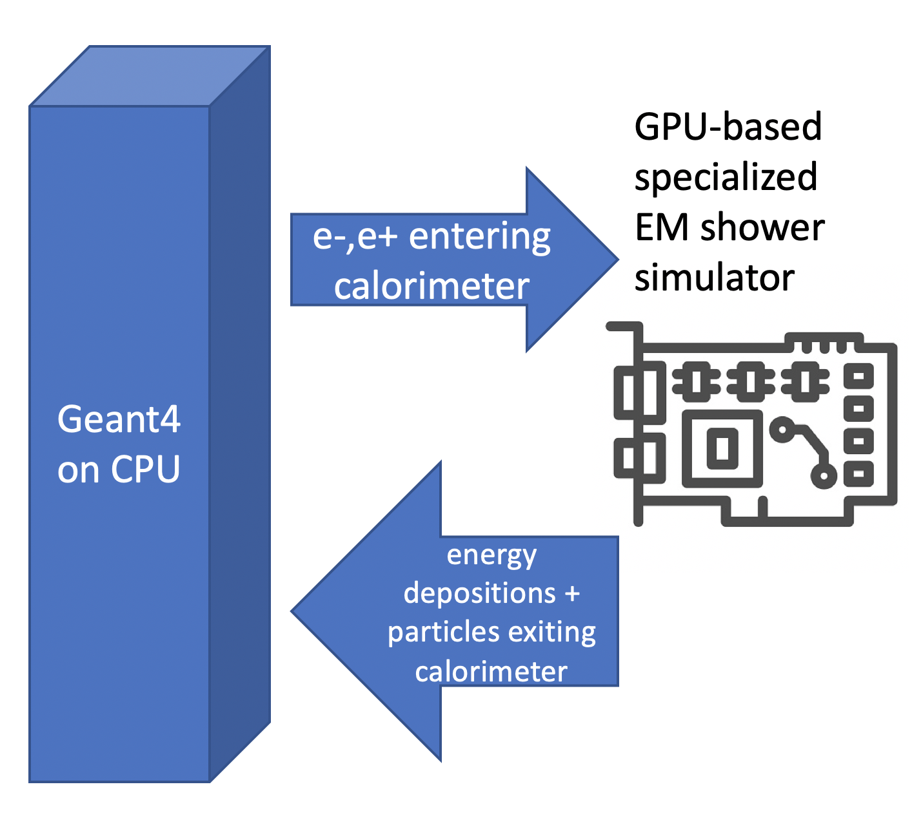
Prototype integration strategy
region-based approach for delegating simulation to an external transport
  particle killed on the Geant4 side and passed to the other transport engine
  energy depositions and ‘outgoing’ (from that region) particles returned
this follows ‘fast-simulation’ approach in Geant4
  allows the use of (most of the) existing fast-simulation hooks
  easy integration with the physics list
  ability to switch between full Geant4 and Geant4 + AdePT at runtime (from macro file)
one difference:
  we buffer particles to process them together when some threshold is reached (or when there are no more Geant4 particles on the stack)

Slide 14
Scoring
GDML (currently macro) with sensitive volume information
sensitive volumes marked on the GPU with a flag while initializing geometry
  list of sensitive volumes provided in Geant4 macro file or read from GDML auxiliary information (not fully implemented yet)
energy deposition per volume (per event) recorded by AdePT in sensitive volumes
  other types of ‘hits’ can be implement by user
array of energy depositions per volume is transfered to the host once the AdePT ‘shower’ finished
  indices of volumes on GPU mapped to the Geant4 ones
SensitiveDetector::ProcessHit method (overloaded) called to translate this array of energy deposition into Geant4 hits
  the output looks the same regardless running full Geant4 or Geant4 + AdePT
    can be then processed/analysed in the same way
Geant4 application
AdePT
Geant4 hits

Slide 15
‘Outgoing’ particles
if a particle leaves AdePT region (or can’t be handled by AdePT physics) it is put in the ‘from device’ buffer
after AdePT shower has finished, ‘from device’ buffer is transformed in Geant4 tracks and put on the Geant4 stack
  Geant4 continues the event loop to process those particles
    to guarantee reproducibility (also in MT) particles ‘from device’ are sorted according to some unique key
event finishes when no more particles are in the AdePT buffer (‘to device’) and Geant4 stacks are empty

Slide 16
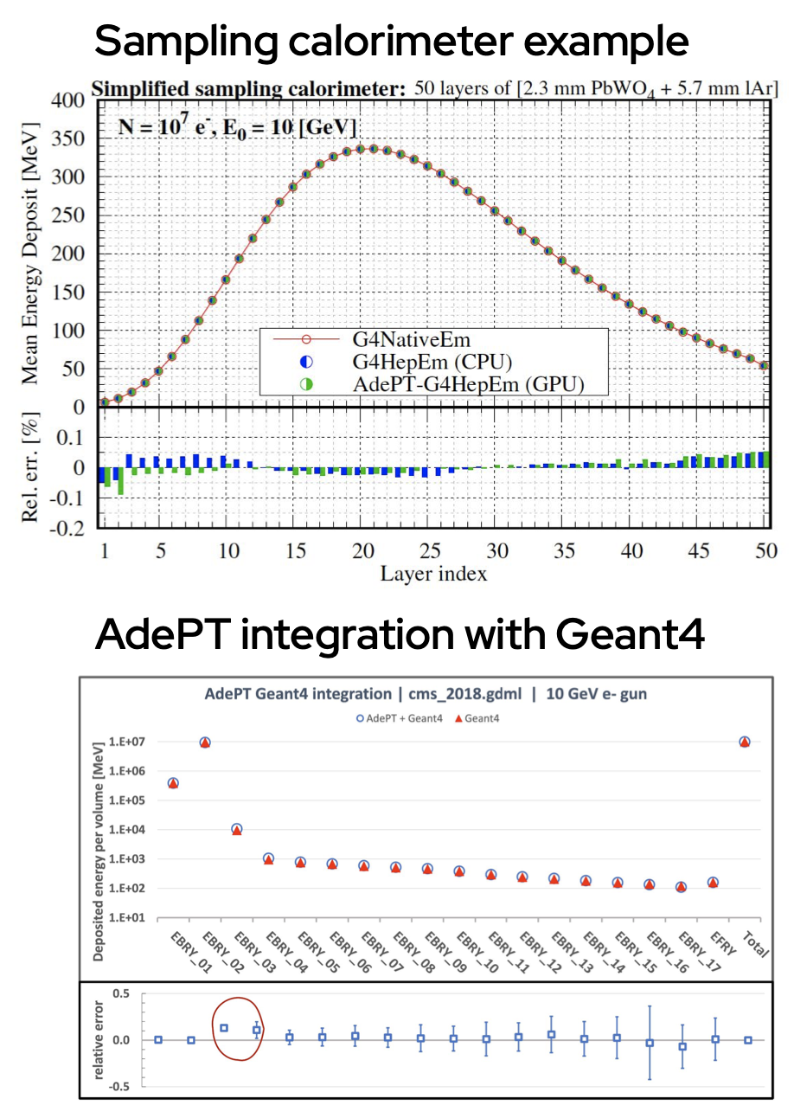
Validation
Validation against Geant4 standalone is essential
  Comparisons to CPU references (in general Geant4-based) done for each added item of functionality
  Both for standalone and Geant4 integration examples
EM physics now fully validated
  At ‰ level in the sampling calorimeter test case
  Still working on the last bugs/features in the hybrid workflow

Slide 17
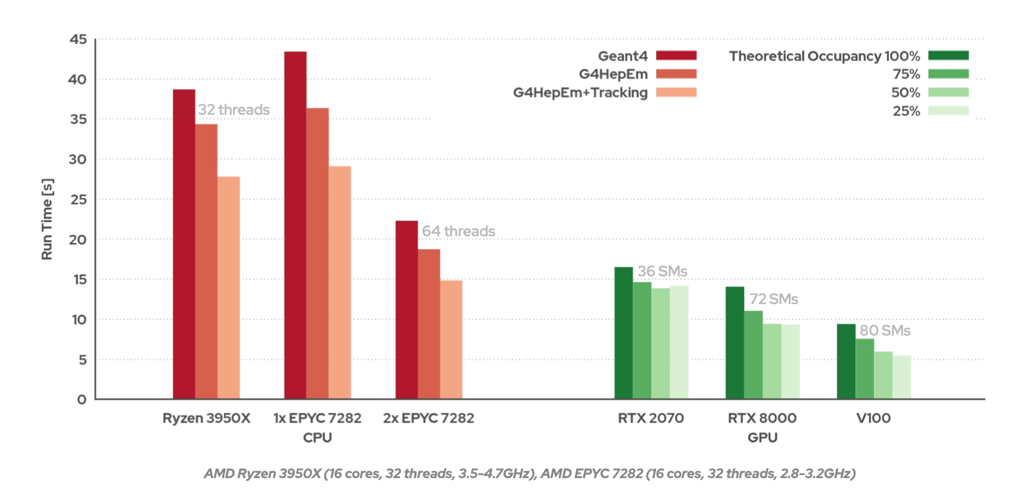
CPU vs GPU Performance
(Sampling Calorimeter example)
roughly speaking, running Geant4 simulation on a CPU, using its full capacity, takes the same order of magnitude of time as running AdePT simulation on a ‘comparable class’ GPU

Slide 18
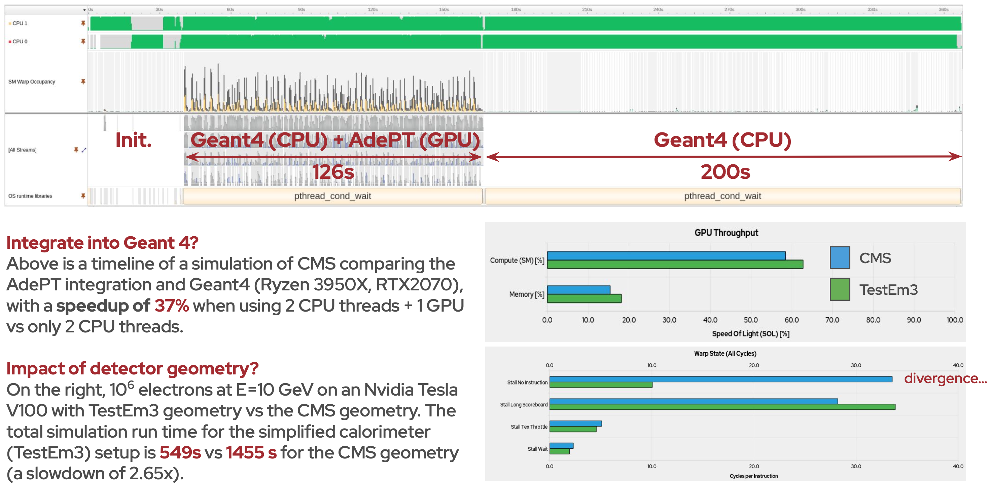
CMS simulations: integrated and standalone
Comparison to Geant4
Above is the timeline of CMS simulation comparing AdePT integrated into Geant4 to Geant4 (Ryzen 3950X, RTX2070), with a speedup of 37% when using 2 CPU threads + 1 GPU vs only 2 CPU threads.
Impact of detector geometry
On the right, 10⁶ electrons at 10GeV on Nvidia Tesla V100 with TestEm3 geometry vs the CMS geometry. The total simulation run time for the simplified calorimeter (TestEm3) setup is 549s vs 1455s for the CMS geometry

Slide 19
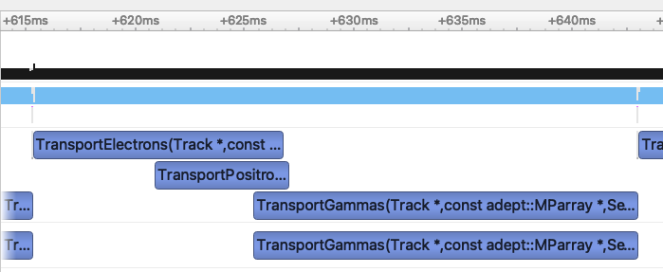
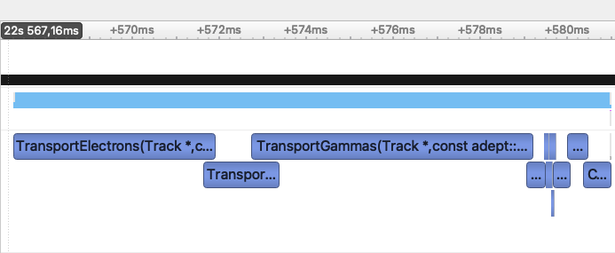
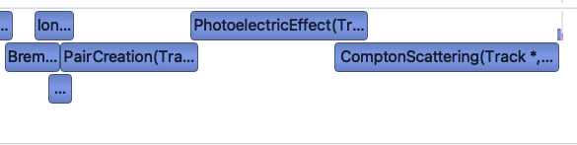
Thread Divergence on GPU
Problem:
Threads in transport kernels diverge over time; the longer the kernel runs the more this happens
Navigation and interactions branch frequently
5.5 / 32 threads active on average (Example 18, 10k primaries, CMS 2018 geo)
GPU underutilised, even though all queues are full
AdePT Example 19:
Split off interaction computations from cross-section and geometry kernels
Test on Tesla V100, 10k primaries, CMS geo
    4.5 / 32 threads active for TransportGammas (= physics + navigation)
    {6.4,12.8,20.8} / 32 threads active for {pair creation, photoelectric effect, Compton scattering}
    Run time: 23.5 s → 15.4 s
Conclusion: Strive for thread coherence where possible
28 ms
14 ms

Slide 20
Ongoing and future work
geometry: trying out alternatives to reduce code complexity and divergence -> surface models
magnetic field: transforming workflows to balance the work and reduce the tails better
scheduling and kernels refactoring and simplification for smaller register footprint and better work balancing
understanding better and optimizing the G4 integration workflow, now penalized by too many CPU-GPU exchanges
aiming for fully GPU-confined simulation, learning how to deal with GPU-produced tracker hits for example
Common points to both AdePT and Celeritas projects – looking forward to establish closer collaboration on those.

Slide 21
Summary
challenging project, simulation clearly not an easy problem for GPUs
  need to recast the diverse physics interactions and geometry elements for the regularity of the GPU
AdePT GPU prototype provides full EM physics and geometry support to run simulations of CMS calorimeter complexity in standalone and Geant4 integrated modes
  encouraging and motivating first result!
current geometry model is a big bottleneck, we are addressing it with development of a new surface-based model
further work on integration with experiments software frameworks will allow to better understand other potential stumbling blocks
we invite collaborators to join this R&D !

