Slide 1
Special Mesh Rendering
John Allison and Evgueni Tcherniaev

Slide 2
What is a “G4Mesh”?
In many applications, especially medical applications, the material world is represented in part by a G4PVParameterised (including G4VNestedParameterisation).
Each element has a different location (and size?) and may be programmed to have a different material and colour.
On request
/vis/viewer/set/specialMeshRendering
the vis manager asks G4PhysicalVolumeModel to look out for candidates. If a volume’s descendents (up to 3 deep) is a G4PVParameterised, the volume is declared a “container” and wrapped in a special class, G4Mesh, and passed to the scene handler for ”special rendering”.
G4Mesh anticipates 5 types (see inset) but only 3—rectangular(2 types) and tetrahedron—are programmed at present.
The user may ask for specific meshes:
/vis/viewer/set/specialMeshVolumes <container-name>
There are two options:
/vis/viewer/set/specialMeshRenderingOption [dots|surfaces]
The above commands must come before
/vis/drawVolume
class G4Mesh {
public:
enum MeshType {
invalid
, rectangle
, nested3DRectangular
, cylinder
, sphere
, tetrahedron
};

Slide 3
Special mesh rendering
When a mesh is asked for and is found, instead of descending the geometry tree, G4PhysicalVolumeModel passes the whole mesh to the vis driver.
  The driver may (optionally) implement AddCompound(const G4Mesh&)
  Otherwise the base class default is invoked, drawing just the “container”.
The following drivers invoke “standard special mesh rendering”:
  OpenGL, ToolsSG, Qt3D and OpenInventor
void G4OpenGLSceneHandler::AddCompound(const G4Mesh& mesh) {
StandardSpecialMeshRendering(mesh);
}

Slide 4
Standard special mesh rendering
void G4VSceneHandler::StandardSpecialMeshRendering(const G4Mesh& mesh)
// Standard way of special mesh rendering.
// MySceneHandler::AddCompound(const G4Mesh& mesh) may use this if
// appropriate or implement its own special mesh rendereing.
{
G4bool implemented = false;
switch (mesh.GetMeshType()) {
case G4Mesh::rectangle: [[fallthrough]];
case G4Mesh::nested3DRectangular:
switch (fpViewer->GetViewParameters().GetSpecialMeshRenderingOption()) {
case G4ViewParameters::meshAsDots:
Draw3DRectMeshAsDots(mesh); // Rectangular 3-deep mesh as dots
implemented = true;
break;
case G4ViewParameters::meshAsSurfaces:
Draw3DRectMeshAsSurfaces(mesh); // Rectangular 3-deep mesh as surfaces
implemented = true;
break;
}
break;
case G4Mesh::tetrahedron:
switch (fpViewer->GetViewParameters().GetSpecialMeshRenderingOption()) {
case G4ViewParameters::meshAsDots:
DrawTetMeshAsDots(mesh); // Tetrahedron mesh as dots
implemented = true;
break;
case G4ViewParameters::meshAsSurfaces:
DrawTetMeshAsSurfaces(mesh); // Tetrahedron mesh as surfaces
implemented = true;
break;
}
break;
case G4Mesh::cylinder: [[fallthrough]];
case G4Mesh::sphere: [[fallthrough]];
case G4Mesh::invalid: break;
}
if (!implemented) {
G4VSceneHandler::AddCompound(mesh); // Base class function - just print warning
}
return;
}
4 programmed possibilities:
  Draw[3DRect|Tet]MeshAs[Dots|Surfaces]
Each involves a descent into the geometry sub-tree of the mesh, picking up the coordinates of the individual elements of the mesh, with their material and colour.
  For “dots”, each element gets a random point within it and a std::multimap is filled by material (with its colour).
    Exploits fast rendering of points (G4Polymarker::dots) in OpenGL.
  For “surfaces”, each element is accumulated and used to construct a G4Polyhedron with G4PolyhedronBoxMesh or G4PolyhedronTetMesh as appropriate.
    This is where the magic happens. Shared surfaces are removed by a very clever fast algorithm (Evgueni Tchernaiev) leaving a tractable G4Polyhedron of the outer faces.

Slide 5
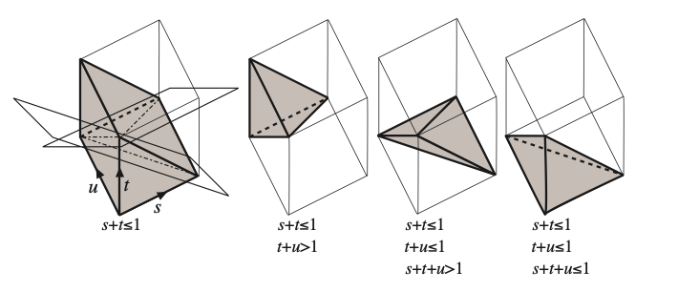
Generating Random Point in Tetrahedron
Steps to generate a random point inside a tetrahedron defined by four vertices (v₀,v₁,v₂,v₃):
  Generation of three random values: s, t, u. The point corresponding to these values is inside of a cube with the sides equal to 1
  The cube can be subdivided in six equal tetrahedra. Appling a transformation that places the point into the tetrahedron at the origin
  Calculation of the position in the original tetrahedron: p = v₀(1- s - t - u) + v₁ s + v₂ t + v₃ u
Detailed explanation of the algorithm:
C.Rocchini and P.Cignoni, Generating Random Points in a Tetrahedron, Journal of Graphics Tools, Volume 5, Issue 4 (2000)

Slide 6
Constructing Polyhedron from rectangular mesh
G4PolyhedronBoxMesh(sx, sy, sz, positions)
  sx, sy, sz – voxel dimensions
  positions – array of voxels centers
The construction of a polyhedron is fast, it takes O(N) time, and is done in two steps:
  Step one: Construction of a 3D grid surrounding the mesh, the grid cells corresponding to the mesh voxels are marked (grey cells on the sketch image)
  Step two: Only cell faces that do not have marked neighboring cells are included into the resulting polyhedron (blue edges on the sketch)

Slide 7
ICRP110 Performance
ICRP110 is an existing Geant4 advanced example:
  From ICRP, 2009. Adult Reference Computational Phantoms. ICRP Publication 110. Ann. ICRP 39 (2).
  Contains a G4VNestedParameterisation of 299x137x348 (14,255,124) boxes:
    3,885,291 of which are “visible” representing 52 organs
    one dot per box are sorted into 52 G4Polymarker objects of different materials (and colour)
  These 3,885,291 dots are rendered at about 5 fps on MacBook Pro (Retina, Mid 2012), 2.7 GHz Quad-Core Intel Core i7, 16 GB

Slide 8
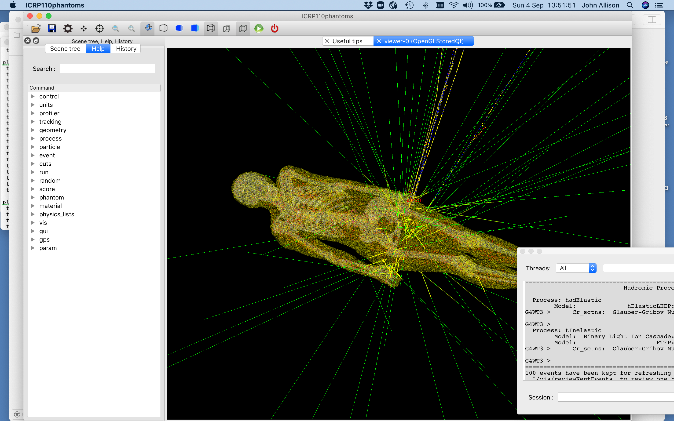

Slide 9
Constructing Polyhedron from tetrahedron mesh
G4PolyhedronTetMesh(vertices)
  vertices – tetrahedra, four vertices per tetrahedron
Elimination of internal (shared) faces is done in two steps using a technique similar to “hash map”. Objects are sorted into lists, the index of the list for an object is calculated by applying a hash function to this object
  Step one: Identification of coincident vertices. Below is a C++ code to generate a hash value for a vertex:
    auto index = std::hash(v.x());
    index ^= std::hash(v.y());
    index ^= std::hash(v.z());
    index %= n_of_lists;
  Step two: Identification of internal/external faces and selecting the external ones. The faces are sorted into lists using smallest index among the three vertex indices that define the face

Slide 10
ICRP145 Performance
ICRP145 is a new advanced example, presented in the Examples Session:
  From ICRP, 2020. Adult mesh-type reference computational phantoms. ICRP Publication 145. Ann. ICRP 49(3)
  C.H. Kim, Y.S. Yeom, N. Petoussi-Henss, M. Zankl, W.E. Bolch, C. Lee, C. Choi, T.T. Nguyen, K. Eckerman, H.S. Kim, M.C. Han, R. Qiu, B.S. Chung, H. Han, B. Shin
  Contains a one-level G4PVParameterised of 8,233,413 G4Tets (32,933,652 faces):
    The 8,233,413 G4Tets represent 187 organs
    By eliminating internal shared faces, tetrahedra are converted to 187 G4Polyhedron objects by material (and colour) with only 4,807,770 faces (14% of original number of faces)
    Timings:
      Geometry construction: 20 s
      Physics tables: 90 s
      Closing geometry: 20 s
      Creating graphical database: 20 s
      Rendering: 2 fps on MacBook Pro (Retina, Mid 2012), 2.7 GHz Quad-Core Intel Core i7, 16 GB

Slide 11
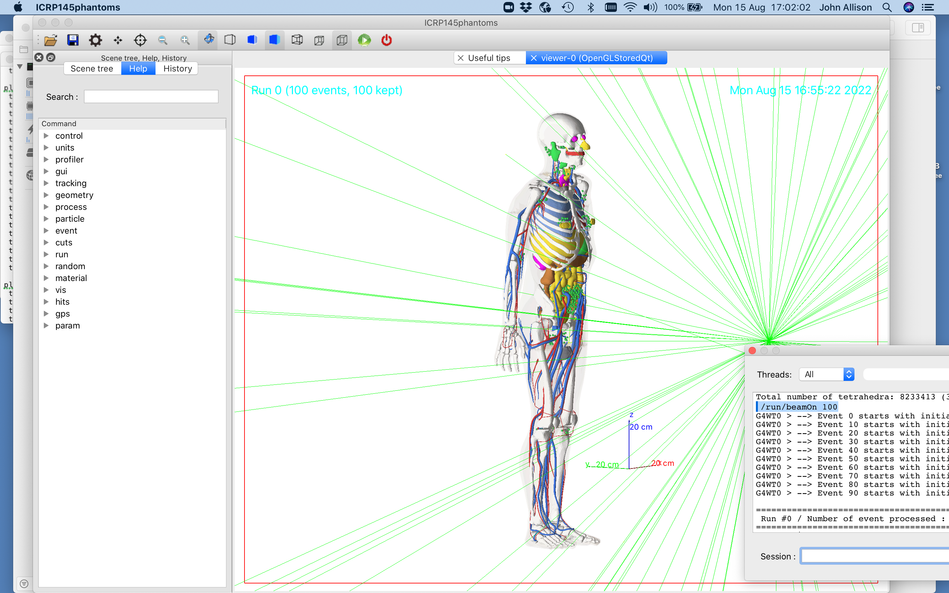

Slide 12
That’s it
Thankyou
…except for documentation !!! 😧

