Slide 1

EP R&D SEMINAR
Signal formation in detectors with resistive elements
Djunes Janssens
djunes.janssens@cern.ch
Supervisor: F. Blekman, J. D’Hondt , E. Oliveri,
W. Riegler, H. Schindler and R. Veenhof.
Monday June 13th, 2022
Presenter Name
Date

Slide 2
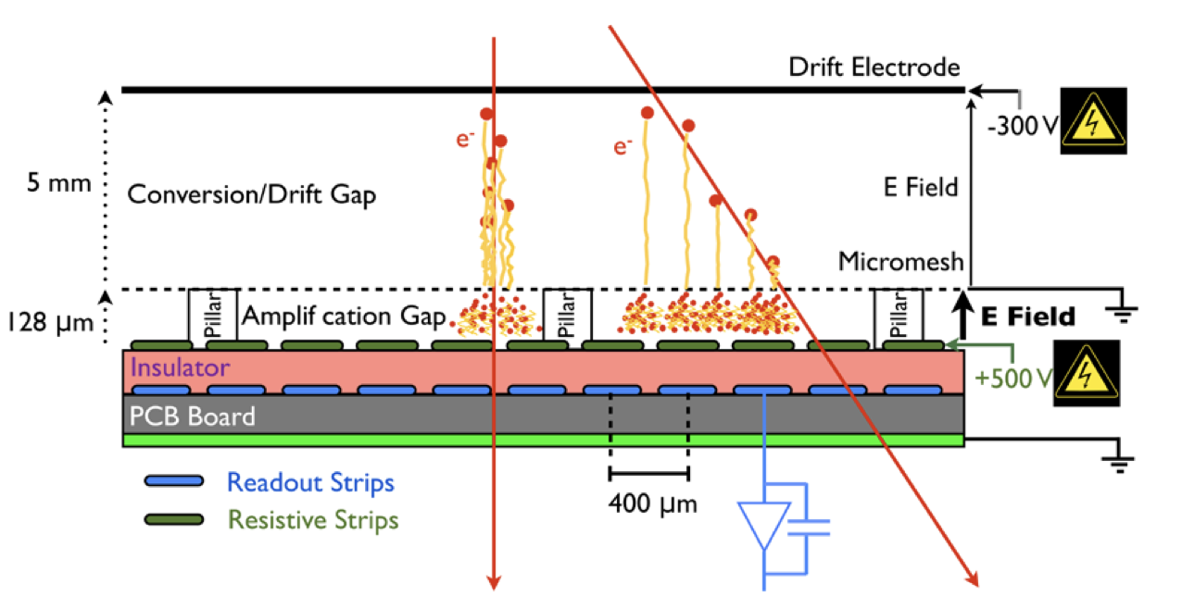
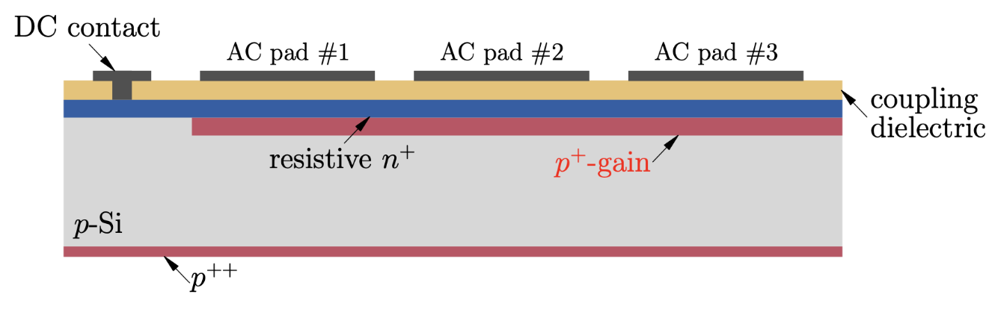
Introduction
  Novel detector structures are proposed regularly, mixing old and new ideas, with detectors containing resistive elements widening the landscape of possible configurations.
  The use of these technologies in experiments makes it necessary to understand and characterize its the response for the design and optimization of the next generation of particle detectors and their application.
Resistive-strips micromegas
AC-Coupled LGAD
T. Alexopoulos et al., Nucl. Instrum. Meth. A 640 (2011) 110.
M. Tornago, R. Arcidiacono, N. Cartiglia et al., Nucl. Instrum. Meth. A 1003 (2021).

Slide 3
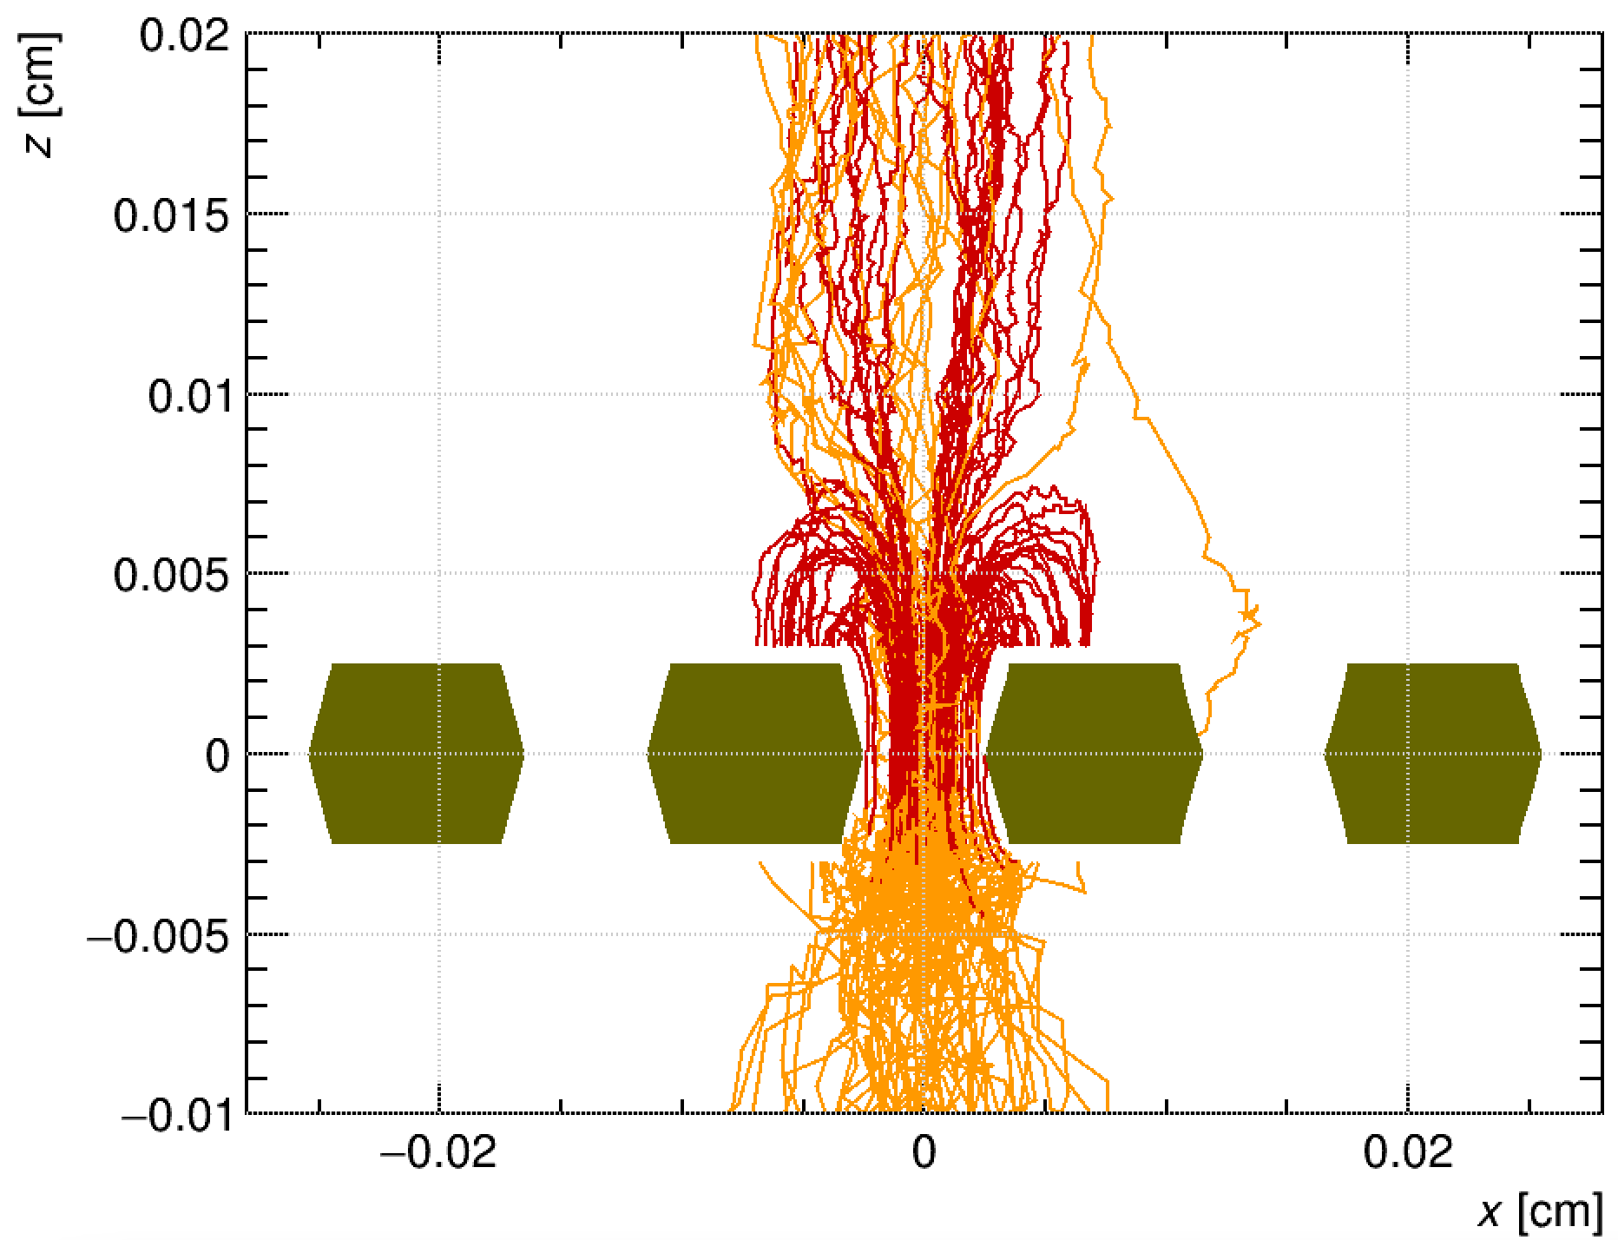

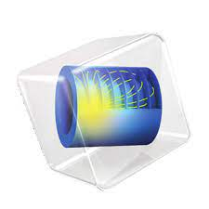
Overview
Drift lines of a GEM in Garfield++
  We want to use Garfield++ and COMSOL to model the signal formation in detectors with resistive elements by applying an extended form of the Ramo-Shockley theorem.
  Outline:
  Ramo-Shockley theorem extension for conductive media
  Overview of the numerical approach
  Examples of signals induced in various detectors
  Summary
Ion
Electron
Garfield++: https://garfieldpp.web.cern.ch/garfieldpp/
H. Schindler’s dissertation: Microscopic simulation of particle detectors
COMSOL Multiphysics: https://www.comsol.ch

Slide 4
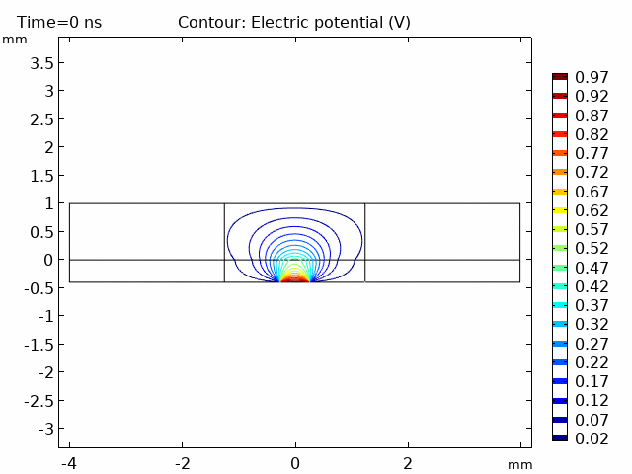
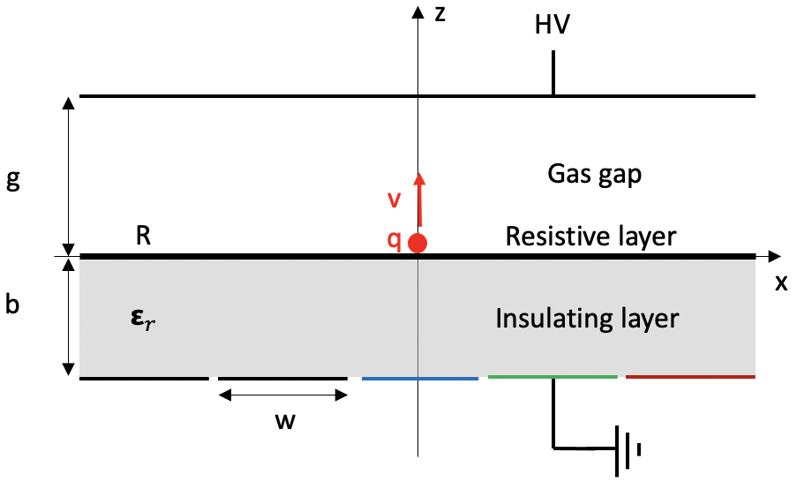
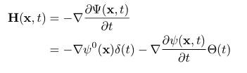
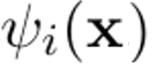
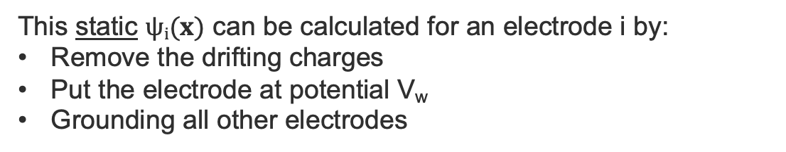

Ramo-Shockley theorem
  The Ramo-Shockley theorem allows the current induced by an externally impressed charge density on any electrode to be calculated by the usage of a so-called weighting potential $ψ(x)$.
This static $ψi(x)$ can be calculated for an electrode i by:
Remove the drifting charges
Put the electrode at potential V_{w}
Grounding all other electrodes
Weighting potential for only perfect insulators and electrodes with infinite conductivity.
Gas gap
Cathode/Mesh
Insulator
Readout strip
V_{w}ϴ(t)
S. Ramo, PROC. IRE 27, 584 (1939).
W. Shockley, Journal of Applied Physics. 9 (10): 635 (1938).

Slide 5
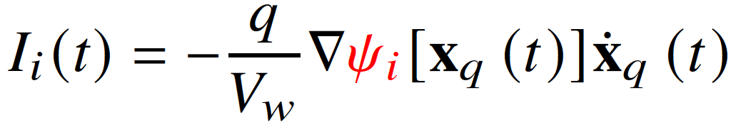
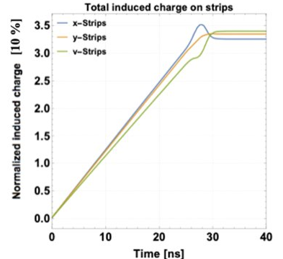
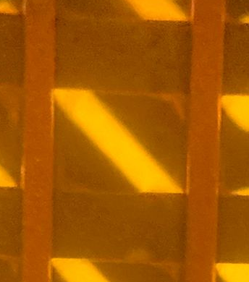
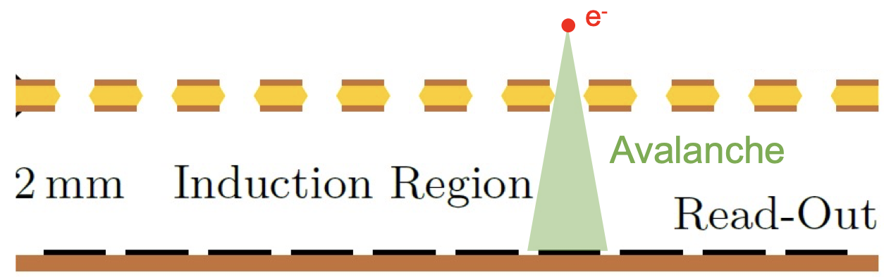
Ramo-Shockley theorem
  Using this framework, the induced current sourced by a point charge q can, for example, be calculated in a single GEM geometry with x- and y-strips. This is done by first calculating the weighting potential of the strips.
XYU Readout image
y
GEM
u
x
This XYU-Readout design is a project in progress with F. Sauli and K. J. Flöthner.
First results will be presented tomorrow by K. J. Flöthner :
https://indico.cern.ch/event/1138814/contributions/4917313/

Slide 6


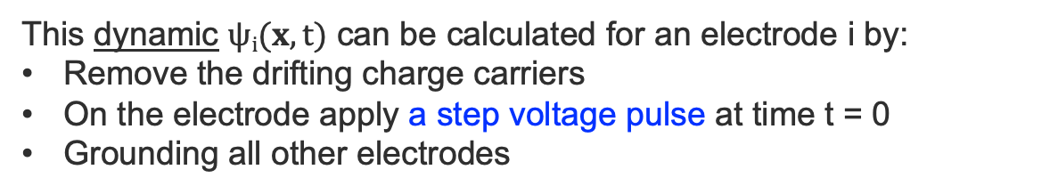
Ramo-Shockley theorem extension for conducting media
  For detectors with resistive elements, the time dependence of the signals is not fully given by the movement of the charges in the drift medium but also by the time-dependent reaction of the resistive materials.
Weighting potential for a resistive layer separating the gas gap and insulating layer.
This dynamic $ψi(x,t)$ can be calculated for an electrode i by:
Remove the drifting charge carriers
On the electrode apply a step voltage pulse at time t = 0
Grounding all other electrodes
V
Gas gap
Cathode/Mesh
R layer
Insulator
Readout strip
V_{w}ϴ(t)
W. Riegler, Nucl. Instrum. Meth. A 535 (2004), 287-293.
W. Riegler, Signals in Particle Detectors, CERN’s Academic Training Lecture Regular Programme (2019):
https://indico.cern.ch/event/843083/

Slide 7
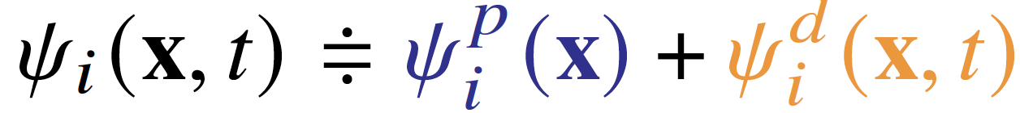
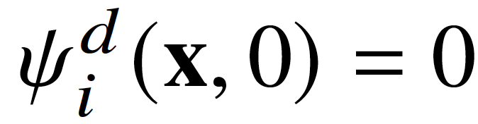
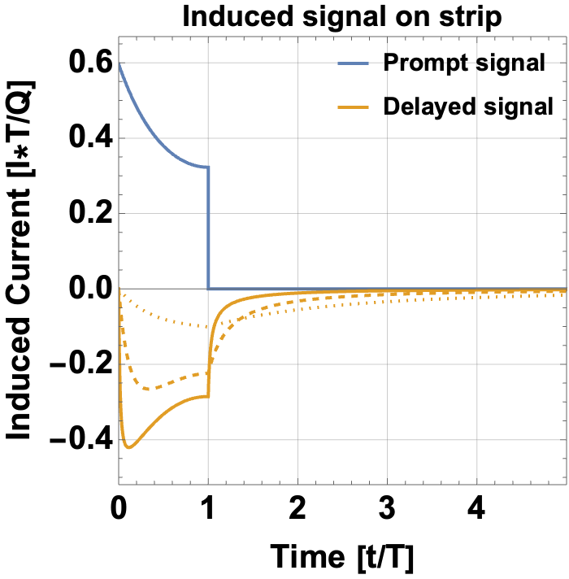
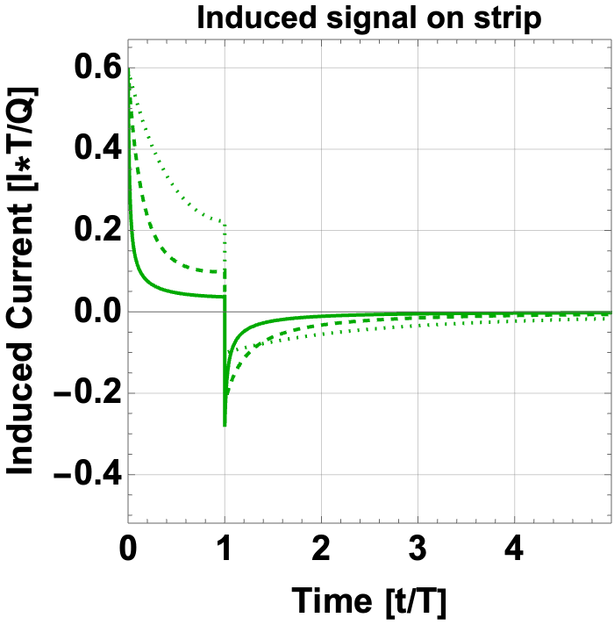
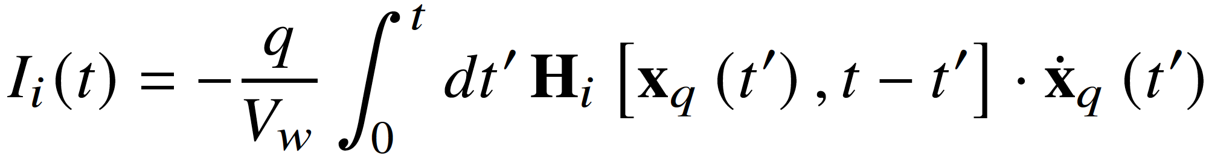
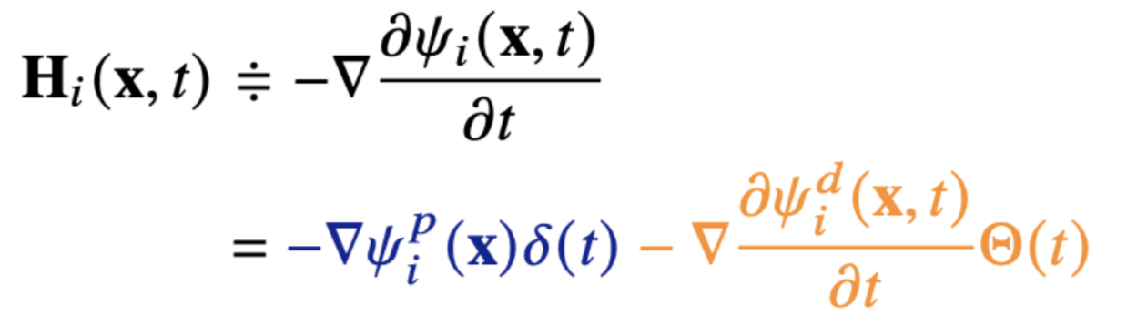
Ramo-Shockley theorem extension for conducting media
250 μm
  The time-dependent weighting potential is comprised of a static prompt and a dynamic delayed component:
10 μm
where .
400 μm
The current induced by a point particle q is given by:
Charge has reached the cathode at t = T
=
R = 10 kΩ/❑
R = 10 kΩ/❑
R = 1 kΩ/❑
R = 1 kΩ/❑
R = 100 Ω/❑
R = 100 Ω/❑
Direct induction
Reaction from resistive material
Examples of systems of which the weighting potential is analytically obtainable see W. Riegler, JINST 11 (2016) no.11, P11002.
Further reading: W. Riegler, P. Windischhofer, Nucl. Instrum. Meth. A 980 (2020)

Slide 8
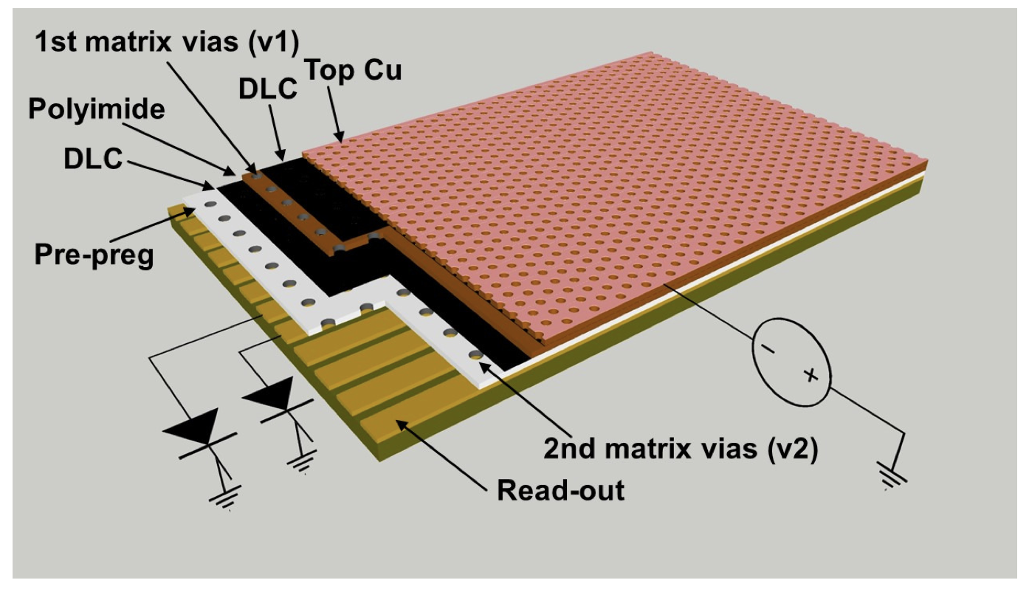
Overview of the numerical methodology
  These weighting potentials can only be obtained analytically for a small subset of the larger group of existing detectors; thus, a numerical method is used.
  COMSOL® :
  Numerically obtain the dynamic weighting potential.
  Garfield++:
  Detailed microscopic simulation of particle detectors based on ionization measurements in gases or semiconductors.
Sketch of the Double-Resistive layout μRWELL:
Garfield++: https://garfieldpp.web.cern.ch/garfieldpp/
COMSOL Multiphysics: https://www.comsol.ch /
G. Bencivenni et al., JINST 14 P05014 (2019).

Slide 9
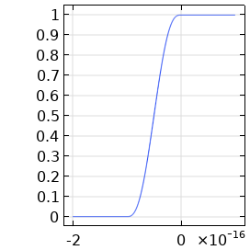
Overview of the numerical methodology
  COMSOL is a finite element solver capable of solving the electrodynamics field equations using the Electric Currents module and time solver.
  The ramping time of the step function for the V_{w} pulse is taken is taken smaller than the reaction time of the resistive material.
Resistive-strips micromegas
Mesh
Resistive Stips
V_{w} pulse [V]
y-Strips
Insulator
x-Strips
Time [s]

Slide 10
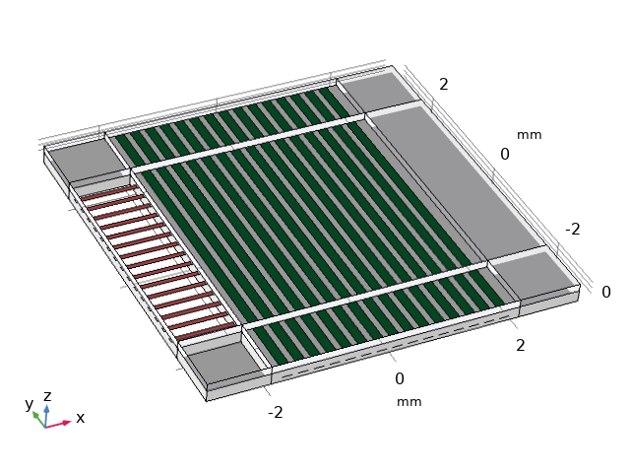
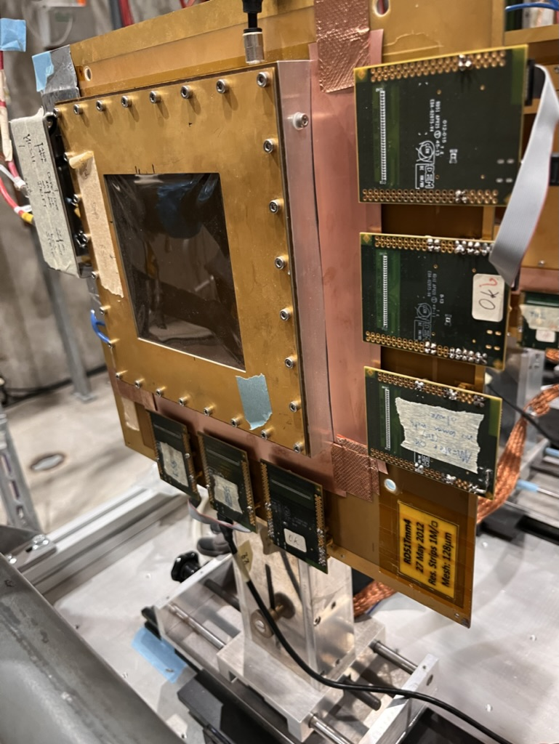
Overview of the numerical methodology
  Coordinate mapping allows to modelling large area detectors such as a Resistive-strips micromegas.
Image taken at the May-June 2022 SPS test beam
COMSOL model of the geometry
4.8 cm
4 mm
T. Alexopoulos et al., Nucl. Instrum. Meth. A 640 (2011) 110.
M. Byszewski1 and J. Wotschack, JINST 7 C02060 (2011).
COMSOL coordinate mapping: link.

Slide 11
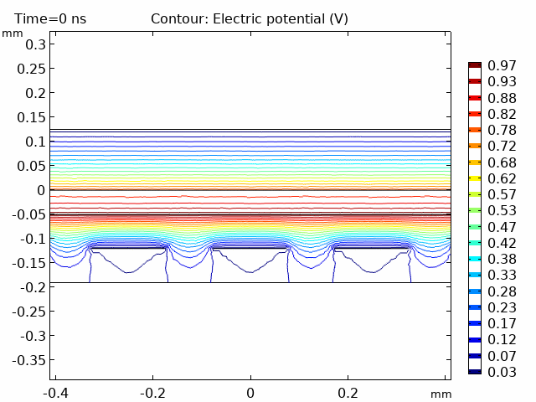
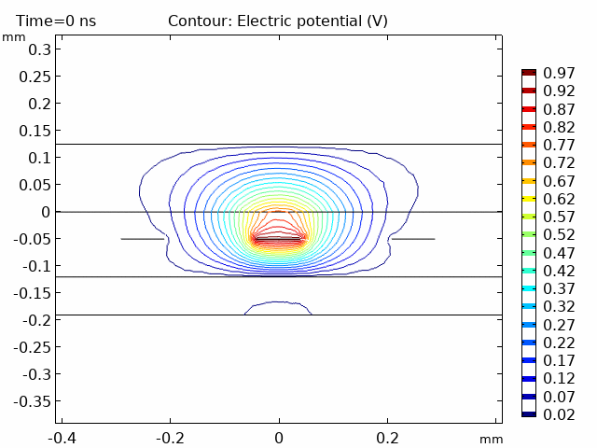
Overview of the numerical methodology
  The resulting solutions are imported into Garfield++ as a finite collection of time sliced potential maps using its ComponentComsol class.
Weighting potential of a y-strip at y = 0.
Weighting potential of a y-strip at x = 0.
v
v
Resistive strips
Mesh
Resistive strip
Mesh
z-Axis
z-Axis
x-strips
y-strip
x-strips
y-strips
x-Axis
y-Axis
There is a tutorial on the Garfield++ webpage on the importing of field maps of COMSOL:
https://garfieldpp.web.cern.ch/garfieldpp/examples/comsol/

Slide 12
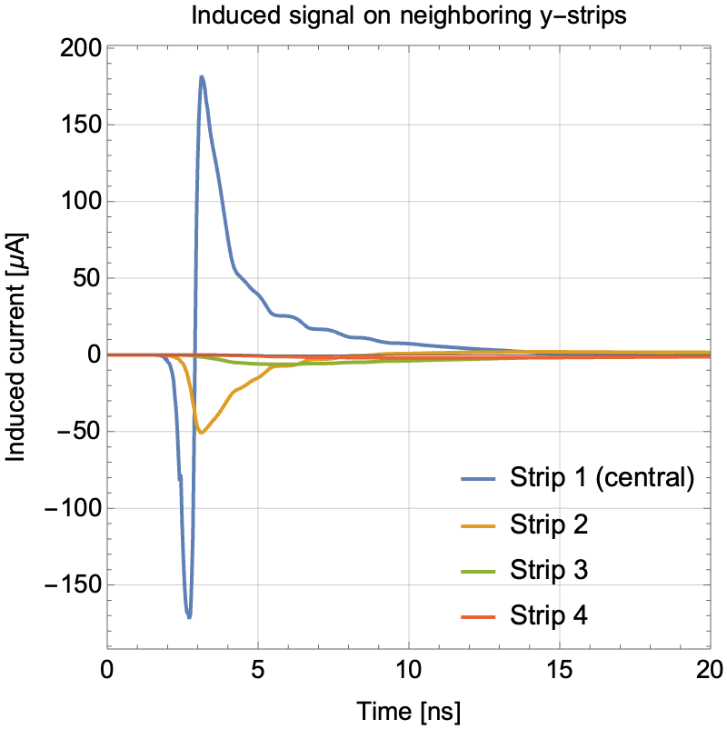
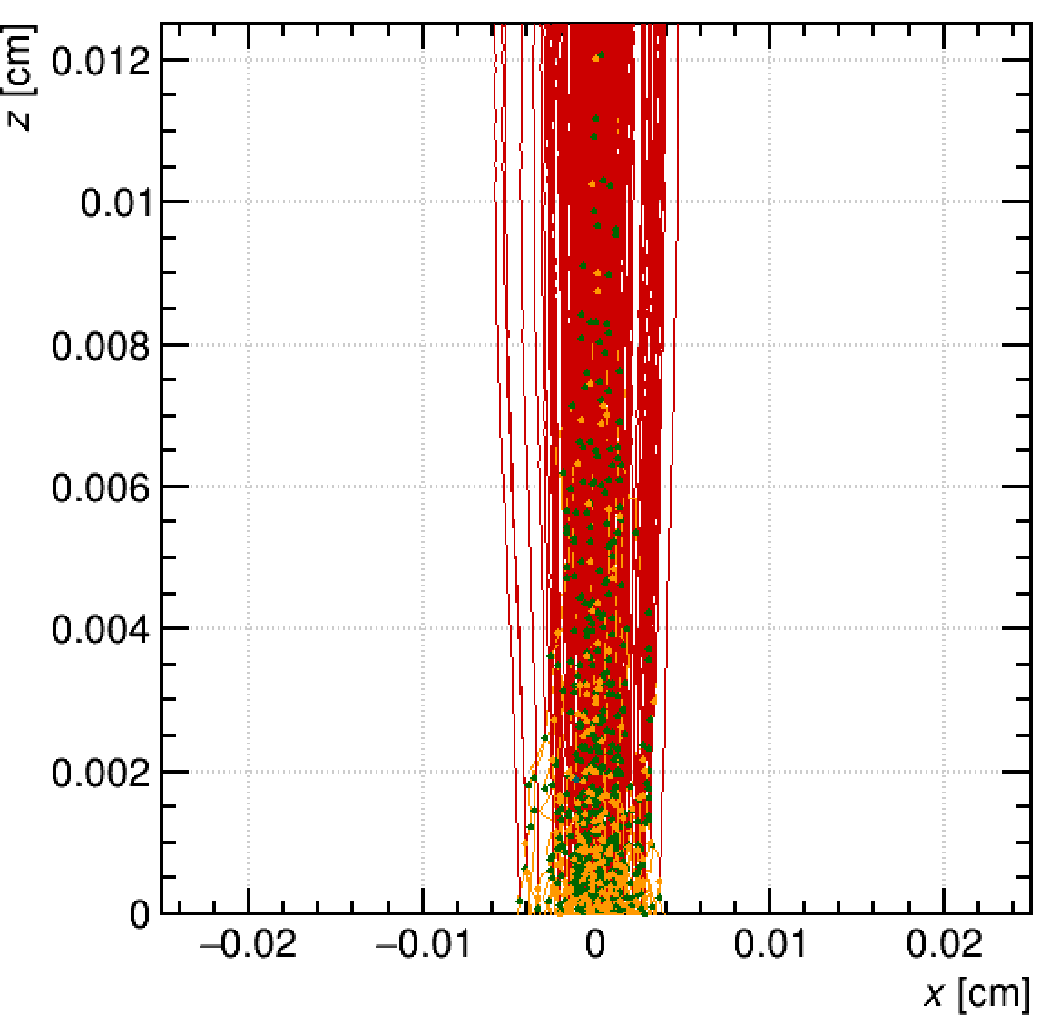
Overview of the numerical methodology
  Given the trajectories of all charge carriers in your geometry, the induced current on the readout can be calculated.
Drift lines in the induction gap as modelled by Garfield++
Mesh
Ion
Electron
Resistive Stips

Slide 13
Overview of the numerical methodology
  With the assurance of the accuracy of the methodology based on toy model examples which enjoy an analytic solution, we are deploying it to characterize the signals obtained from a wide variety of resistive particle detectors.
1 mm
= 100 kΩ/❑
400 μm
= 8
500 μm
Examples of systems of which the weighting potential is analytically obtainable see W. Riegler, JINST 11 (2016) no.11, P11002.

Slide 14
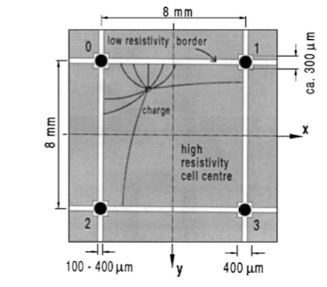
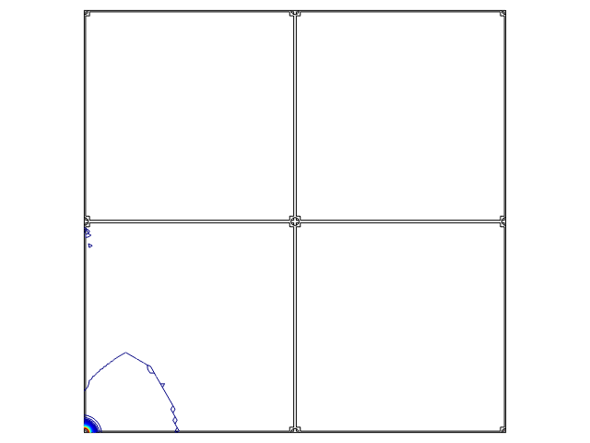
Signal formation in a MicroCAT detector
  The MicroCAT’s two-dimensional interpolating readout structure allows for a reduced number of electronic readout channels without loss of spatial resolution.
  This resistive readout concept recently has enjoyed renewed interest within the development of a DC-Coupled LGAD device
Weighting potential map for one readout node
F. Bartol et al. J. Phys. III France, 6 (1996), p. 337
A. Sarvestani et al., Nucl. Instrum. Meth. A 410 (1998) 238–258
H. Wagner et al. Nucl. Instrum. Meth. A 482 (2002) 334–346
DC-coupled LGAD: N. Cartiglia, The 39th RD50 Workshop (Valencia) (17-19 November 2021).

Slide 15
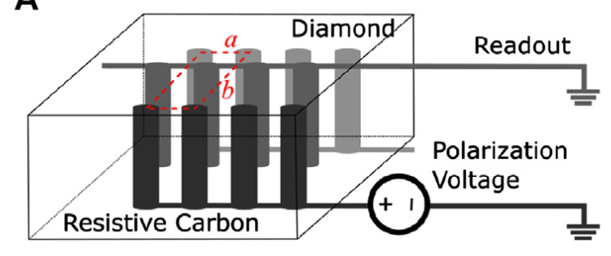
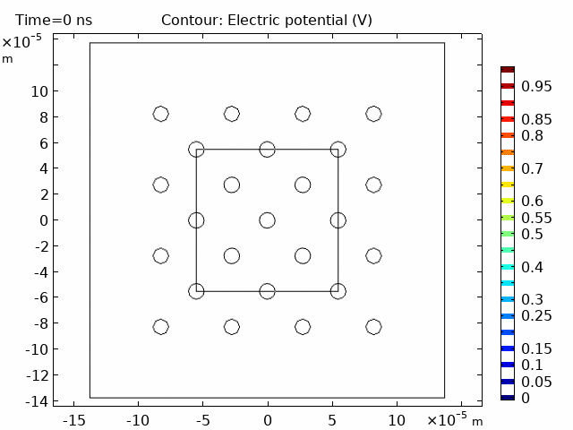
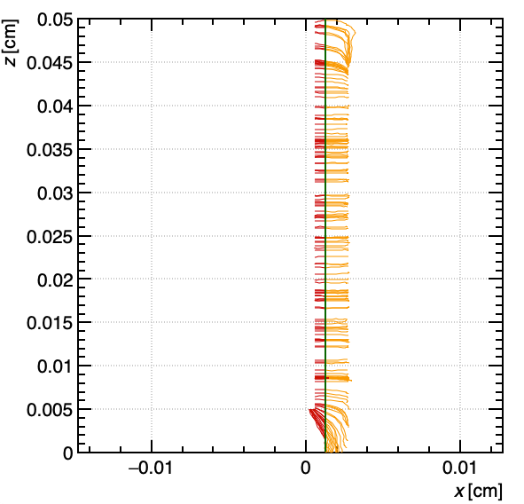
Diamond 3D Pixel Detector
A 3D geometry with thin columnar resistive electrodes orthogonal to the diamond surface, is expected to provide significantly better time resolution with respect to the extensively studied planar diamond sensors.
With the team of the INFN TimeSpot project, we are exploring the modelling of signal induction on the readout columns.
Weighting potential of a readout column at z = 250 μm.
Drift lines as modelled by Garfield++
v
Electron
Hole
Pion
y
Readout Column
Bias Column
Preliminary
x
Anderlini L. et al., Frontiers in Physics 8 (2020)
For timing measurements and first modelling results see talk by M. Veltri:
“A 4D diamond detector for HL-LHC and beyond”.

Slide 16
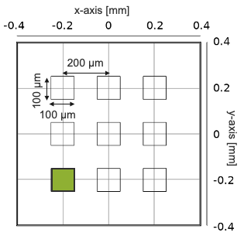
Signal formation in AC-Coupled LGAD
In collaboration with INFN Torino group of N. Cartiglia, we are currently looking at simulating the currents induced in the AC-Coupled Low Gain Avalanche Diode (LGAD) geometry.
When successfully benchmarked, it can be used to understand and explore novel readout designs.
M. Tornago, R. Arcidiacono, N. Cartiglia et al., Nucl. Instrum. Meth. A 1003 (2021).
See N. Cartiglia’s Friday VCI talk: “4d-tracking, LGADs, and fast timing detectors”.

Slide 17
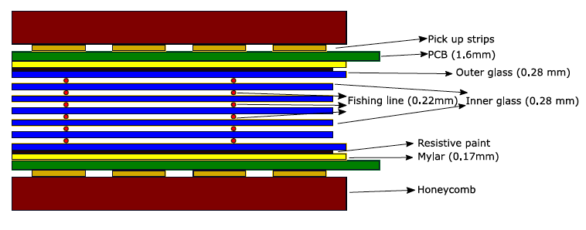
Some of the detectors containing resistive elements
We are working on extending the list of detectors geometries that contain resistive elements.
Spatial resolution study:
MicroCAT’s two-dimensional interpolating readout
μ-Resistive-WELL
Small-pad resistive Micromegas
Resistive-strip bulk Micromegas
AC-Coupled LGAD
Timing resolution study:
Multigap Resistive Plate Chambers (MRPC)
Resistive Picosec Micromegas Detector
Diamond3D sensor
AC-Coupled LGAD
M. Iodice et al., Nucl. Instrum. JINST 15 C09043 (2020).

Slide 18
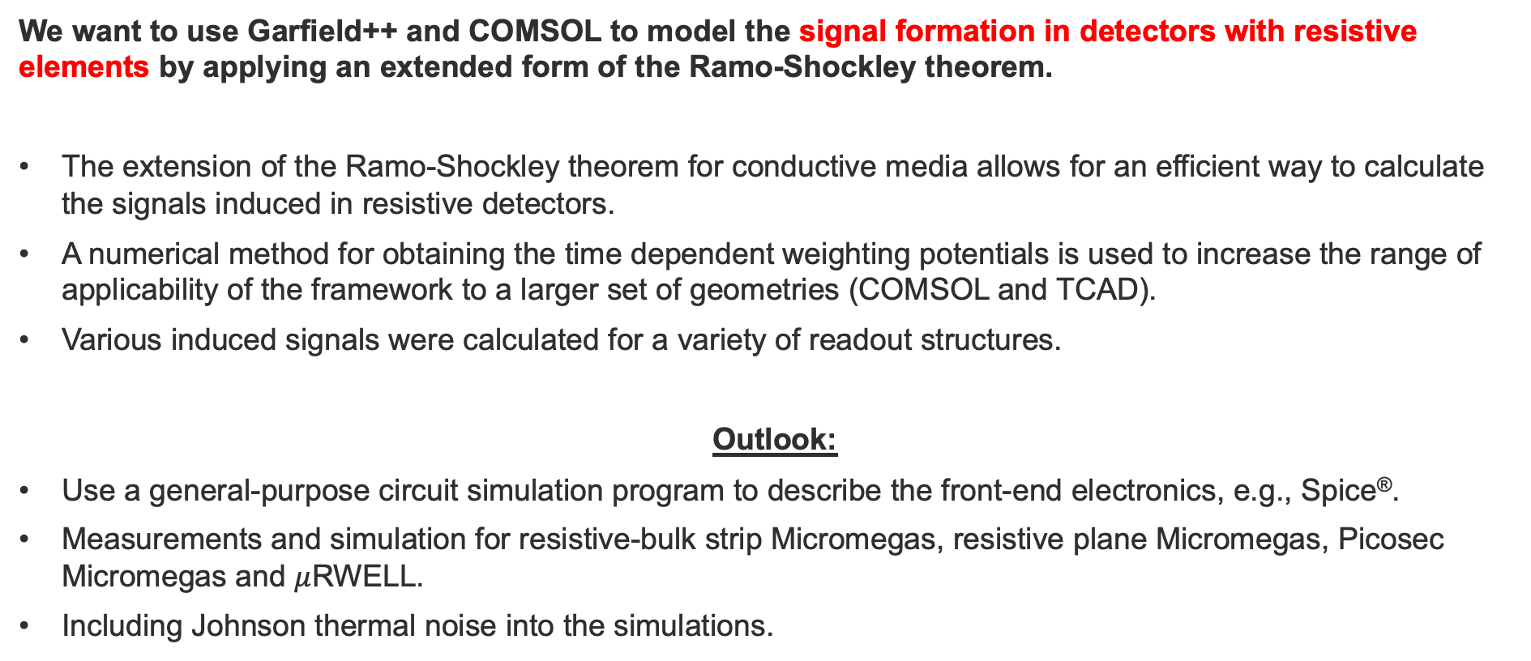
Summary
  We want to use Garfield++ and COMSOL to model the signal formation in detectors with resistive elements by applying an extended form of the Ramo-Shockley theorem.
  The extension of the Ramo-Shockley theorem for conductive media allows for an efficient way to calculate the signals induced in resistive detectors.
  A numerical method for obtaining the time dependent weighting potentials is used to increase the range of applicability of the framework to a larger set of geometries (COMSOL and TCAD).
  Various induced signals were calculated for a variety of readout structures.
  Outlook:
  Use a general-purpose circuit simulation program to describe the front-end electronics, e.g., Spice®.
  Measurements and simulation for resistive-bulk strip Micromegas, resistive plane Micromegas, Picosec Micromegas and $μ$RWELL.
  Including Johnson thermal noise into the simulations.
SPICE: http://bwrcs.eecs.berkeley.edu/Classes/IcBook/SPICE/

