Slide 1


Strategic R&D Programme on Technologies for future Experiments
EP R&D Days
20 and 21 June 2022
https://ep-rnd.web.cern.ch/

Slide 2
Purpose of the meeting
We are quite precisely at the midpoint of our programme
Take stock of status and achievements in all WPs
This time: include milestones and deliverables (defined in late 2018)
Very first ideas about the continuation of EP R&D. Strategy, topics, work plans, …
Keep bottom-up approach, i.e. proposals should come from WPs => Steering Committee will assess and comment => Presentation of new work plans in R&D Day 2022-2 (late 2022)
Aim for 1 year overlap (2024) to switch from EP R&D to EP R&D⁺⁺.
Details TBD.
EP R&D
Preparation & Approval Implementation (initial 5-yr programme & budget)
2018 2019 2020 2021 2022 2023 2024 2025 2026 …
EP R&D⁺⁺
Prepar-ation
Approval
Continuation …

Slide 3
Align with ECFA detector R&D Roadmap
Compare / align with ECFA detector R&D Roadmap
Vast majority of our activities should be ‘’thematically‘’ well-aligned with ECFA Roadmap. Some are - to a certain extent - CERN specific (magnets, cooling, optical links, ASIC platform, software)
Implementation of ECFA Roadmap is still being discussed. Aim for new Detector R&D Collaborations (DRDx).
Hope for a lighter model than initially conceived.
RD50 and RD51 may become nucleation points for Silicon and Gas detector DRDs (under discussion).
EP R&D
Preparation & Approval Implementation (initial 5-yr programme & budget)
2018 2019 2020 2021 2022 2023 2024 2025 2026 … …
Preparation
& Approval
Implemen-
tation ???
ECFA Roadmap
Gradual implementation

Slide 4
In view of the ECFA Roadmap …
What is the self-conception and modus operandi of EP R&D?
CERN established a Strategic R&D Programme on Technologies for Future Experiments, also referred to as EP R&D programme.
EP R&D is a set of technological detector R&D projects, approved and funded by the CERN Enlarged Directorate for the period 2020 – 2024. Similar R&D activities exist in other universities and national labs.
In EP R&D, Fellows and students are supervised profiting from small FTE-fractions of staff members who spend the vast majority of their time in LHC or support groups working towards the completion of the LHC phase-II upgrade. The involved resources are under the control of CERN.
In terms of the scientific programme EP R&D strives for alignment with the ECFA Roadmap. Wherever appropriate, the activities are carried out inside the RDxx (DRDx) collaborations. This is currently the case for RD50 and RD51.
C.J.

Slide 5
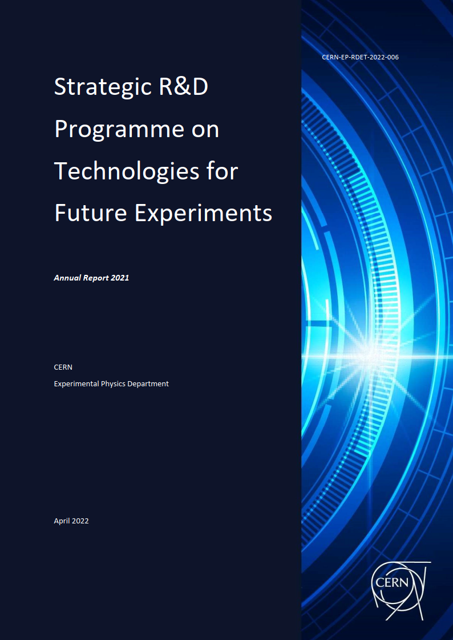
Annual report 2021
125 pages
194 co-authors => Many thanks to all contributors
My apologies for a few hick-ups with author list
A printed copy was given to each of the CERN directors

Slide 6
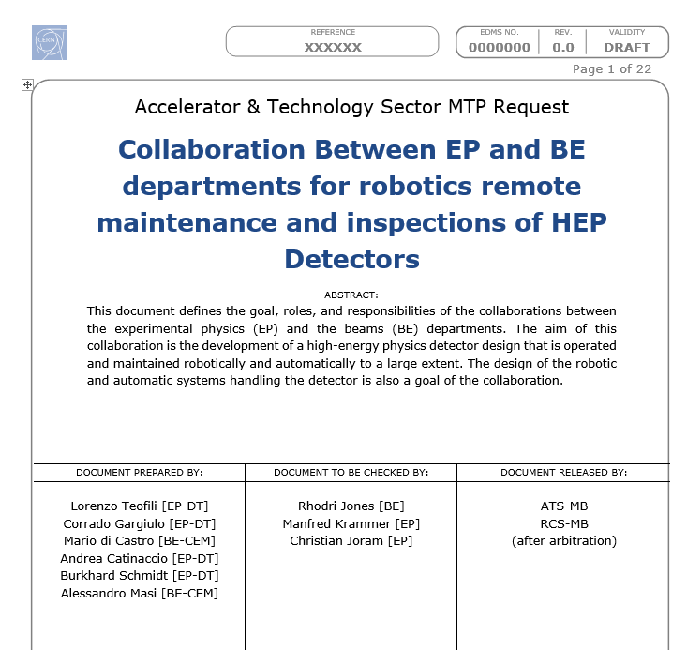
Uncertain news
Funding request for ‘’R&D on Remote Maintenance and Inspections of HEP Detectors’’ jointly with robotics activity in BE dept., directly submitted to directorate (MTP).
Thanks to Corrado Gargiulo and team for initiative and persistence.
Our robotics activity (WP4) could profit from an extra 1 MCHF funding (2023 and 2024).
EP R&D Steering Committee has approved 500 kCHF as fall back in case request doesn’t survive arbitration iterations.
Subject to final approval of CERN budget !!!

Slide 7
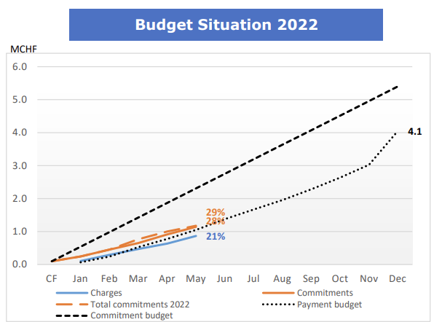
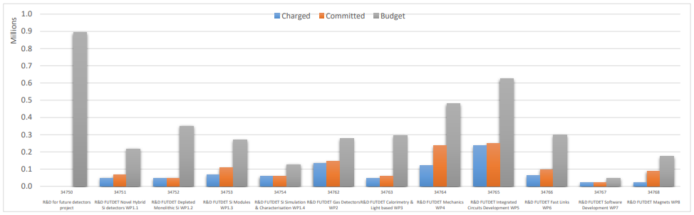
Budget and spending
2022 spending profile is somewhat flat
Please do great research, but also spend your money – for the foreseen purposes.
If you expect substantial (>20%) underspending, please let us know soon.

Slide 8

New CERN graduate program (becoming effective still in 2022.)
There will be just 3 categories of graduates
. Recruitment via job specific Vacancy Notice.
. Recruitment via job specific Vacancy Notice.
‘’Research’’ Fellows include also Applied Physicist and Engineers with a research oriented profile. Recruitment very similar to current fellow selection. PhD is a must.
No QUEST recruitment foreseen in autumn 2022
Perhaps only an old-style AFC for research physicists in autumn 2022. Under discussion.

Slide 9

Barbecue !!!
Please sign up for the EP R&D barbecue (today before 17:00)
It starts tomorrow, Tuesday, 18:00 at Prevessin BBQ site (next to B972)
Drinks (soft and alc.) and food (incl. vegetarian) will be provided
Participants are asked to contribute 10 CHF/EUR (on site)

