Slide 1

The Silicon Electron Multiplier Sensor
Victor Coco¹, Evangelos Leonidas Gkougkousis¹, Marius Mæhlum Halvorsen^{1,2}, Lucia Romano^{3, 4, 5}
¹CERN, ²University of Oslo, ³Paul Scherrer Institute, ⁴ETH Zürich, ⁵University of Catania

Slide 2
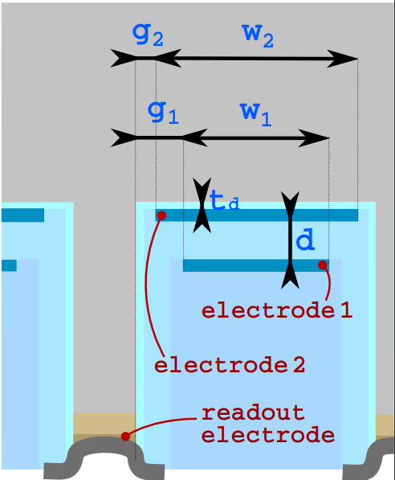
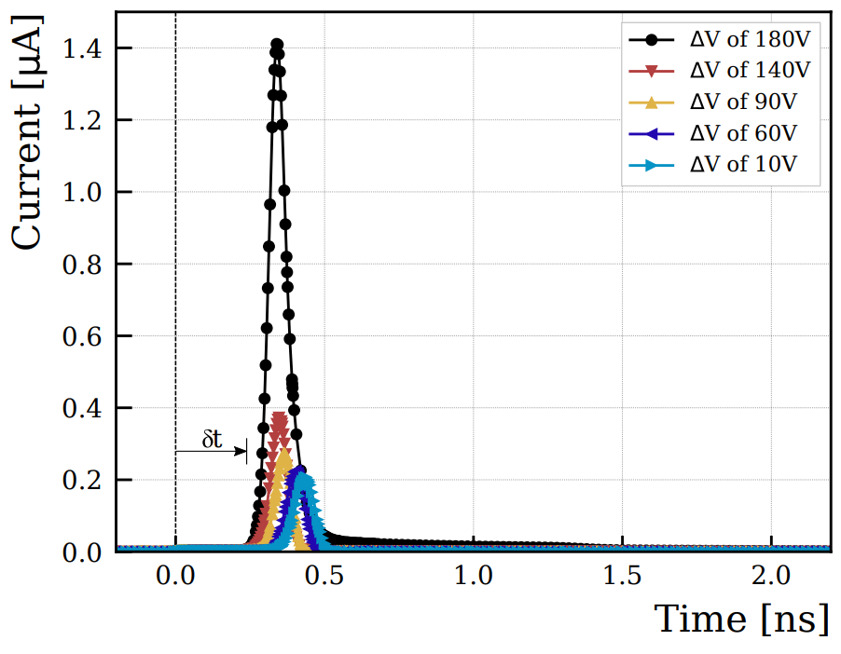
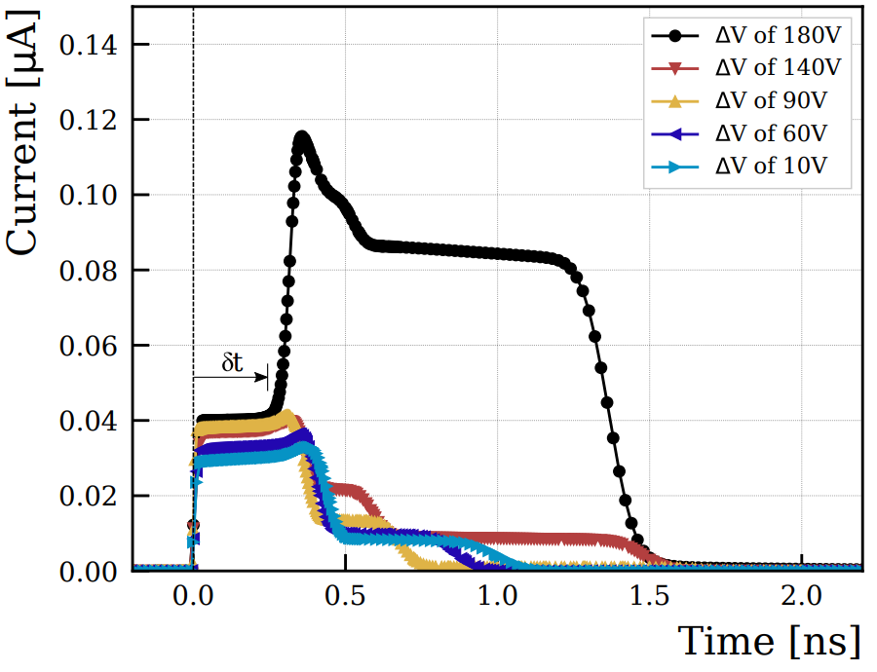
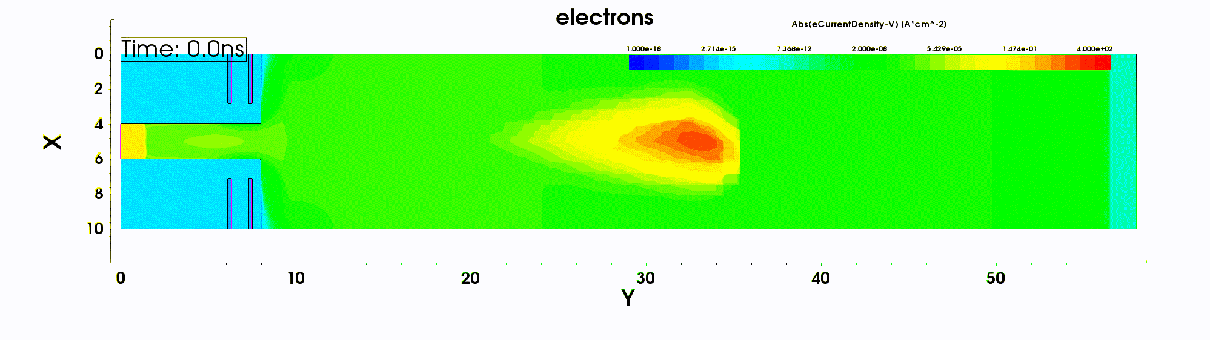
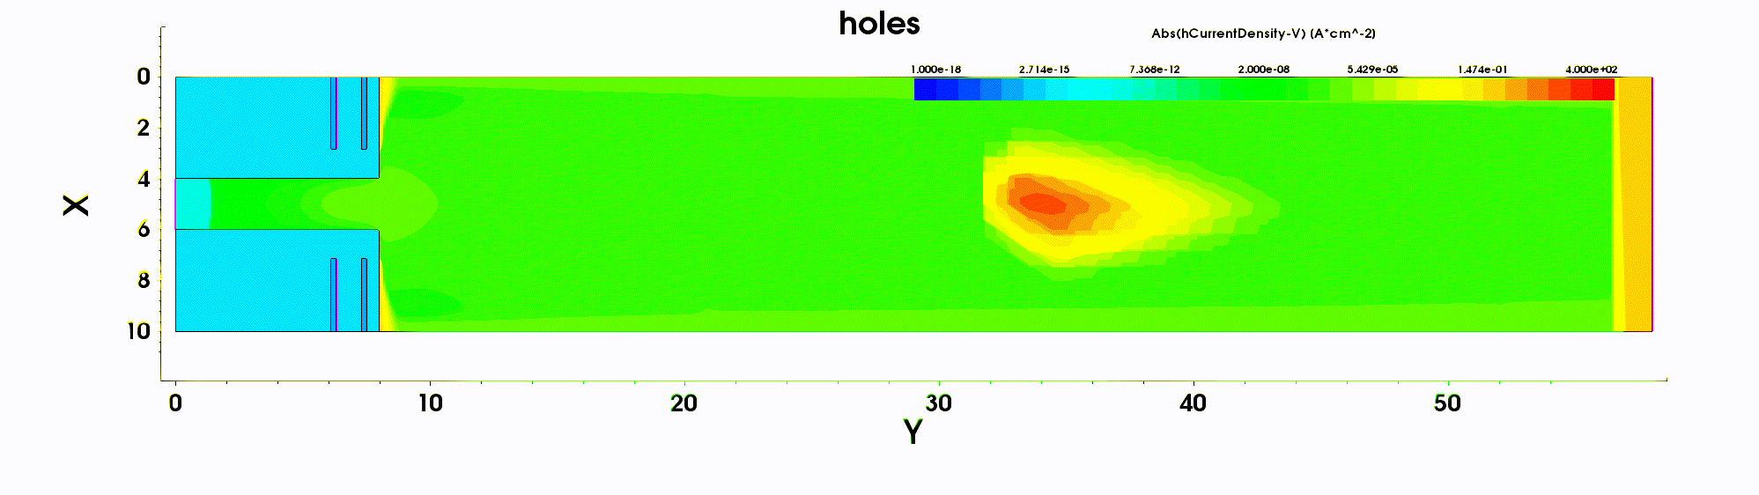
The Silicon Electron Multiplier Sensor
Make a radiation hard sensor with good timing capabilities
  Avoid doping dependent gain regions
Approach:
  Implement additional electrodes in sensor substrate to create high electric field regions to promote charge multiplication
Paper in review with NIM-A
  preprint on Arxiv: https://arxiv.org/abs/2203.01036
Demonstrator productions
  Metal assisted chemical etching
    With PSI
  Deep reactive ion etching
    With CNM

Slide 3

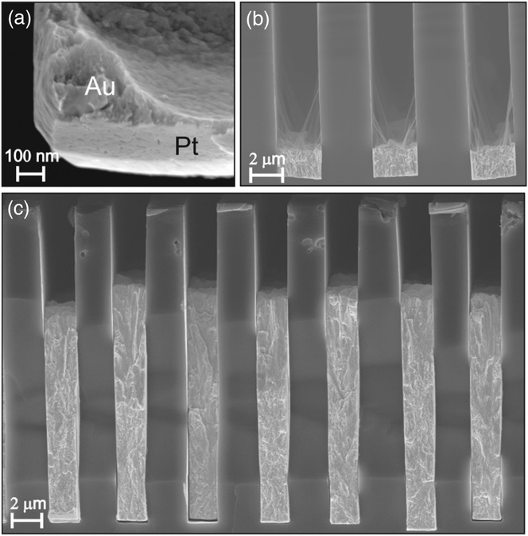
Fabrication: Metal Assisted Chemical Etching
On-going fabrication at PSI
Process developed at PSI by L. Romano^{1,2}.
  High aspect ratio grating fabrication for X-ray optics
  [L. Romano et al; Nanoscale Horizons 5(5) (2020) 869-879]
Metallic pattern used as etching catalyst for HF vapor.
Etching catalyst is also used as a multiplication electrode
  Suitable for single electrode geometries
Process not yet applied on active media
¹ETH Zurich, ²Paul Scherrer Institute
[L. Romano et al; AdEM 22 (2020) 2000258]

Slide 4
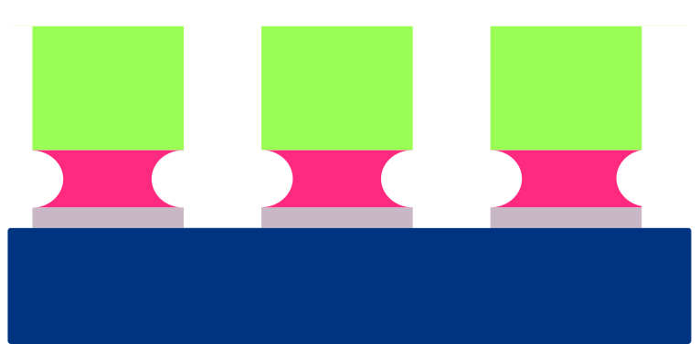


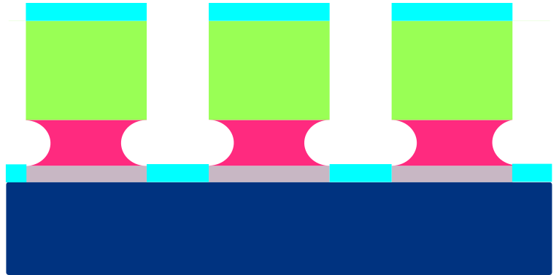



Process flow overview
coating
exposure + development
wafer
lift-off
Pt evaporation
etching
dewetting

Slide 5
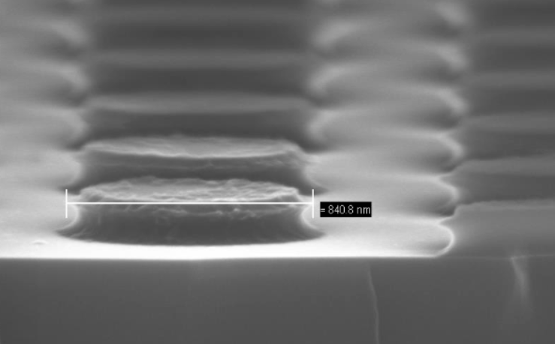
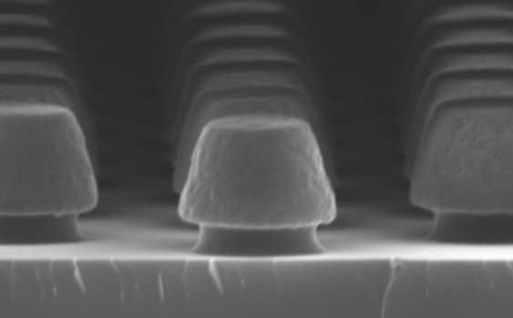
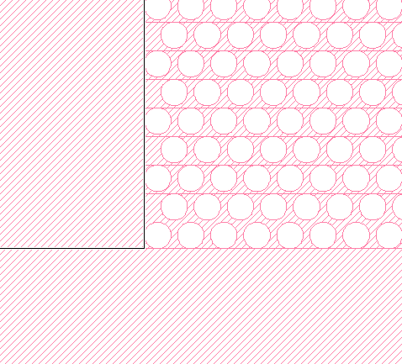
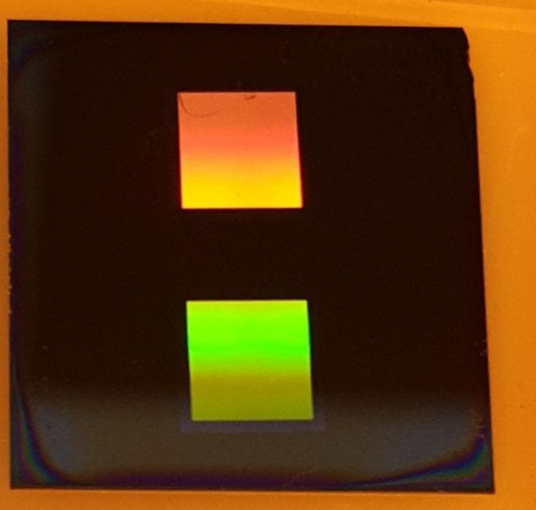
Process optimisation,
Coating and exposure
Optimise different photoresists
Pattern
  Hexagonal grid, circle radius of 500–600nm, pitch of 1.5μm,
Direct Write Laser system
  DWL66+ from Heidelberg Instruments
  HiRes Write mode, can write features >0.3μm
5mm
5mm
5mm

Slide 6
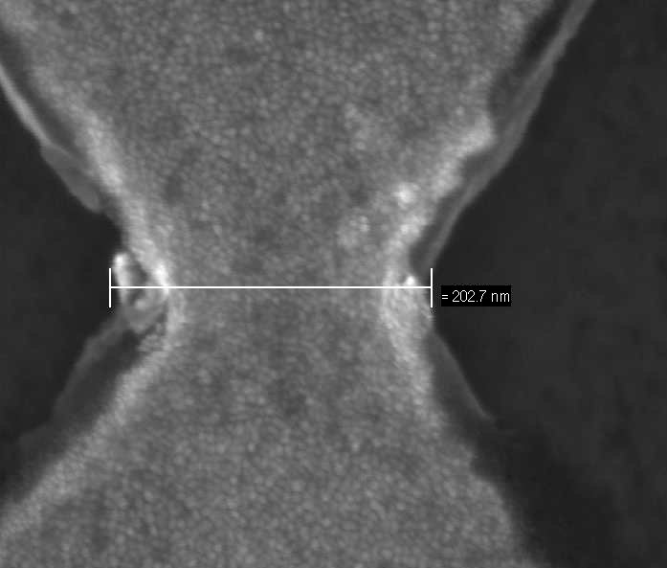
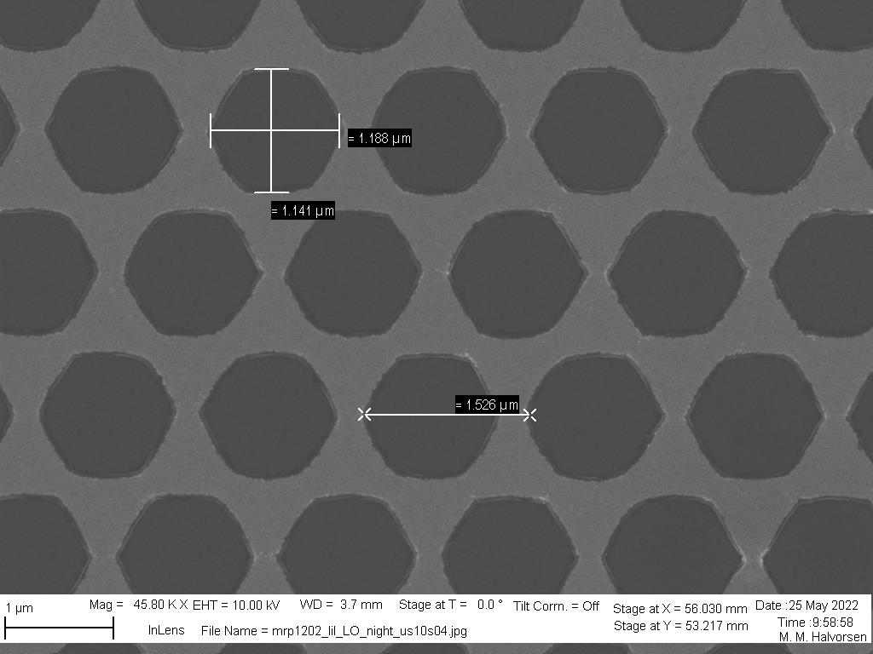
Platinum evaporation and lift-off
E-beam evaporator
  Pt deposition
Lift-off to remove excess photoresist and metal
Dewetting to create nano pores

Slide 7
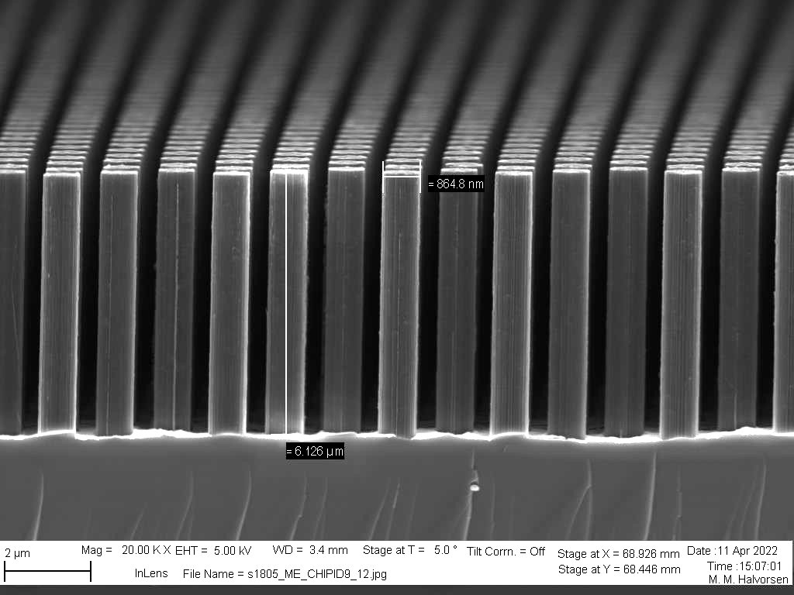
Etching
Remaining processing steps
On-going optimisation of etching parameters
  Temperature
  Time
  Distance from HF-liquid interface
Trench filling
Contact mentalisation

Slide 8
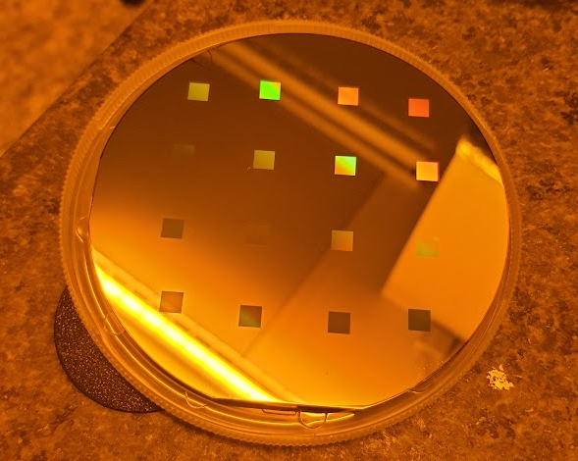
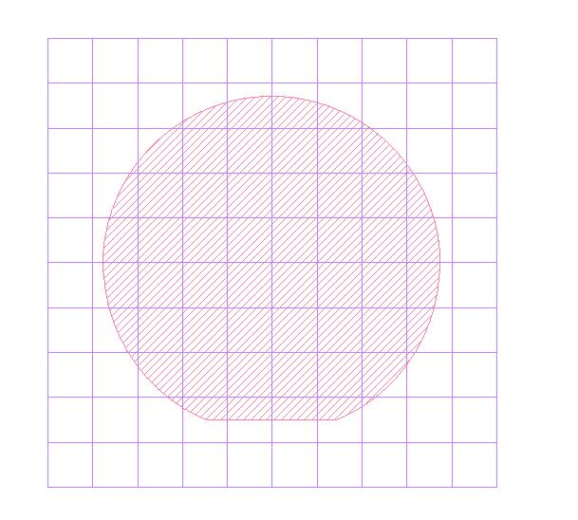
Upcoming steps
4” test wafer
High resistivity wafer procured from CNM
Process optimisation
  Etch rate comparison
Test several patterns
  Pad-, pixel- and strip-like geometries
First production to be completed after summer
6” high resistivity wafer
Green: 32
Orange: 20

Slide 9


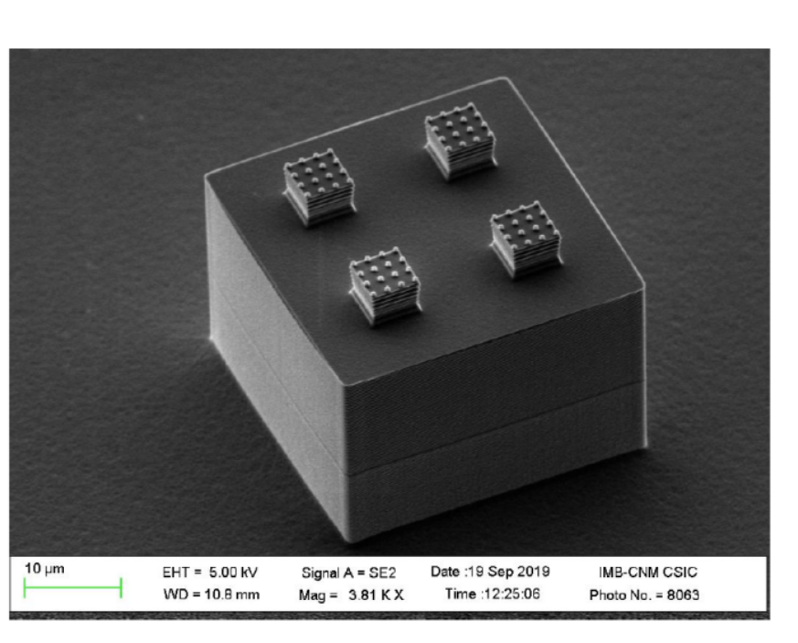
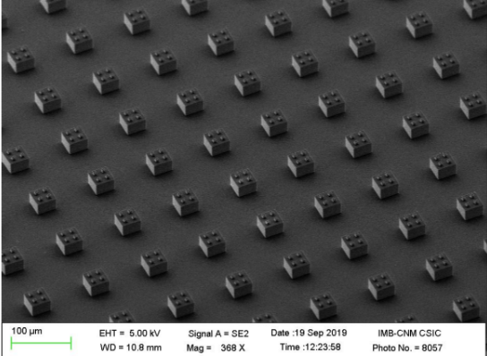
Fabrication using deep reactive ion etching
Project in cooperation with CNM.
Awarded AIDA innova blue sky R&D grant for a demonstrator production
Project has started
  First design proposal beginning of July
  Refining of simulations
  Post-doc starts this summer
  Production starts this autumn 2022
DRIE etching of pillars
  Deposit oxide and metal afterwards
Metal not in direct contact with the semiconductor
  Milder operation conditions for silicon
Process related constraints
Scalloping
[courtesy of CNM]

Slide 10
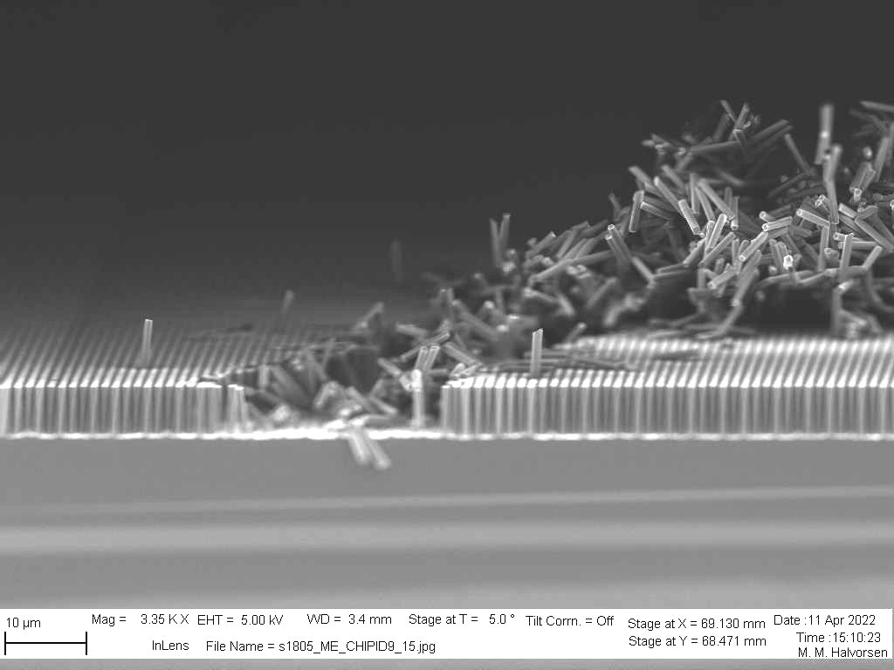
Conclusion
a dramatic paper cut
Two demonstrator productions are initiated
MacEtch fabrication is well advanced
Last process optimisation steps remains
Fabrication using DRIE is progressing
After productions:
Electrical characterisation

