Slide 1
28nm Analog front-end for hybrid sensors
Viros Sriskaran,
On behalf of the Picopix design team*
* CERN EP-ESE-ME, Geneva, Switzerland
* Nikhef, Amsterdam, the Netherlands

Slide 2
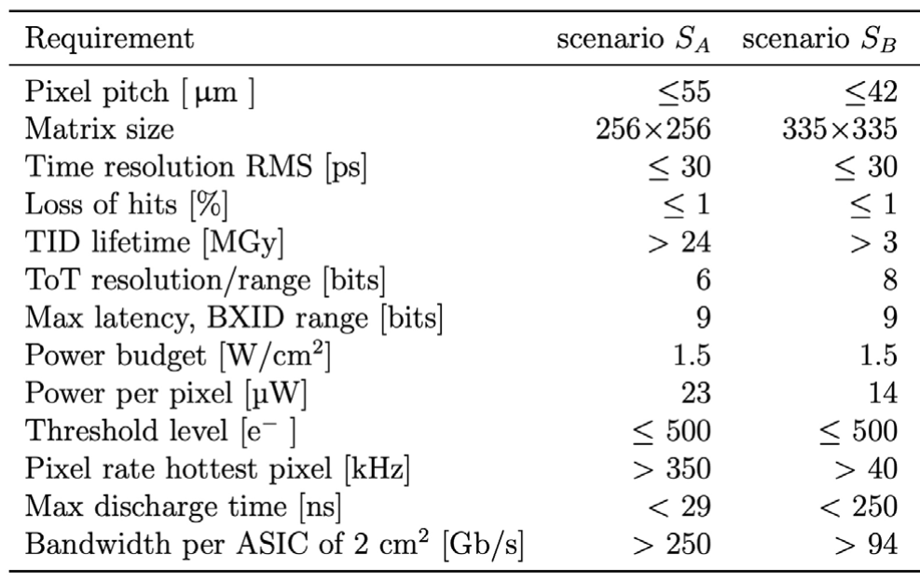
Requirements for PicoPix chip

Slide 3
PicoPix a demo chip for Velopix2
Designed as a “real” small scale prototype of the large Velopix2:
  Analog FE
  Local DCO
  Pixel data clustering
  Pixel readout
  SEE robust architecture
  Clock distribution using dDLL approach (as in Timepix4)
  High-speed links:
  On-chip Bandgap and biasing DACs
  UVM Functional verification
Slow Control protocol can be simplified → reused from Medipix4/Timepix4?
Why?
  Avoid to get false expectations on final design.
  If this design is successful the large scale chip should be simple and minimizes risk (time and money).
  PicoPix is a readout chip for fast timing and compatible with small pitch fast sensors.
Slide courtesy: X. Llopart.

Slide 4
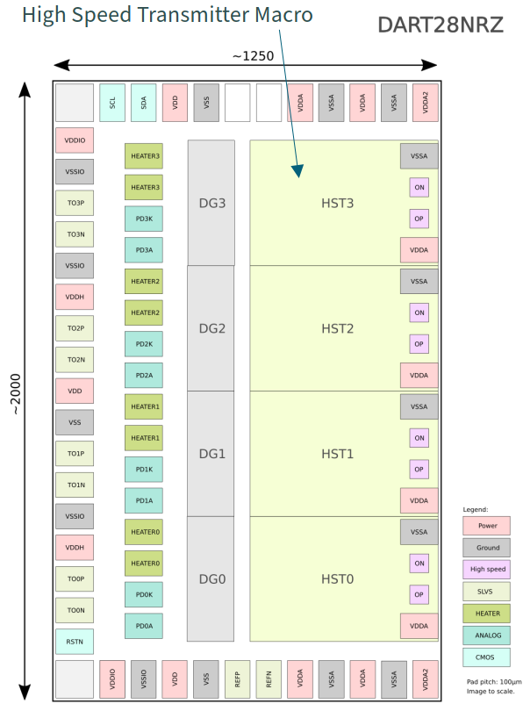
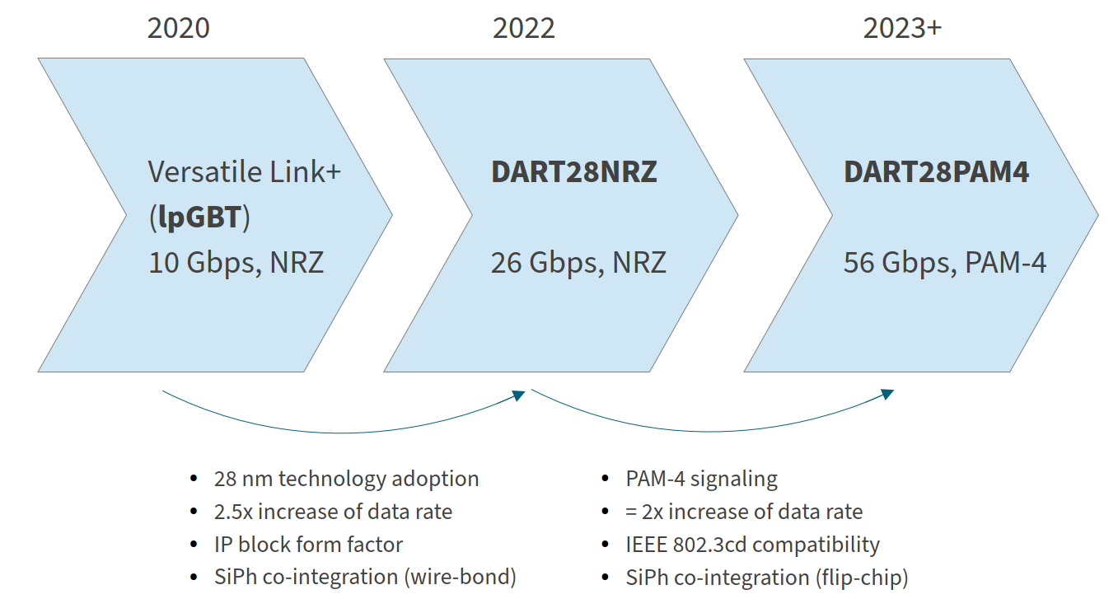
IP blocks and high speed links in 28nm
Close collaboration with EP R&D WP5
  IP blocks to be used for PicoPix ASIC.
  Adopting the technology (technology overview, designers guide).
  Documentation.
  Many thanks to R. Ballabriga, F. Bandi, M.Piller, S. Emiliani.
High speed links in 28nm in EP R&D WP6:
DART28 (S.Bieregel)
https://indico.cern.ch/event/1138500/

Slide 5
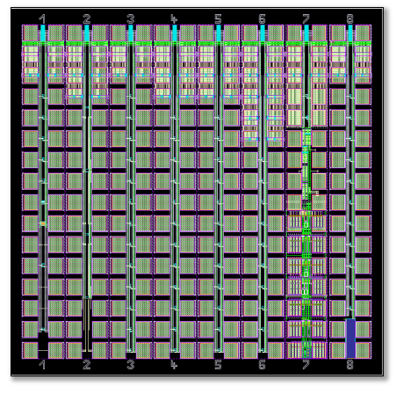
28nm TSMC HPC+ CMOS technology
Overview:
  Front-End Features:
    0.9V core transistors (thin oxide) and 1.8 I/O transistors (thick oxide)
    Triple well, Deep N-Well (to isolate P-Wells)
    Multiple Vt transistors (but only five different flavors in the same design: ulvt, lvt, reg, uhvt)
    Only vertical poly (PO) is allowed → No ELTs
  Back-End Features:
    9 copper layers plus last metal layer in AlCu pad
Radiation hardness:
  First indications shows that this technology is suitable for rad-hard designs
    But no ELTs are possible
  Tested up to 1 Grad with 30-50% Isat ON max degradation in core transistors
    Better than TSMC 65nm
  More results with the test chip
Slide courtesy: X. Llopart.
TID28

Slide 6
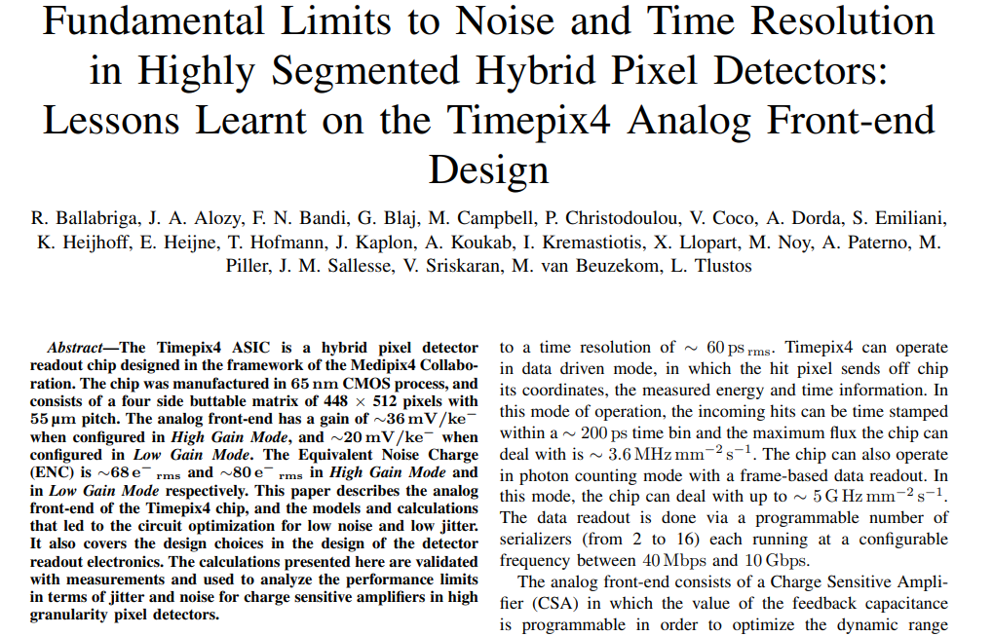
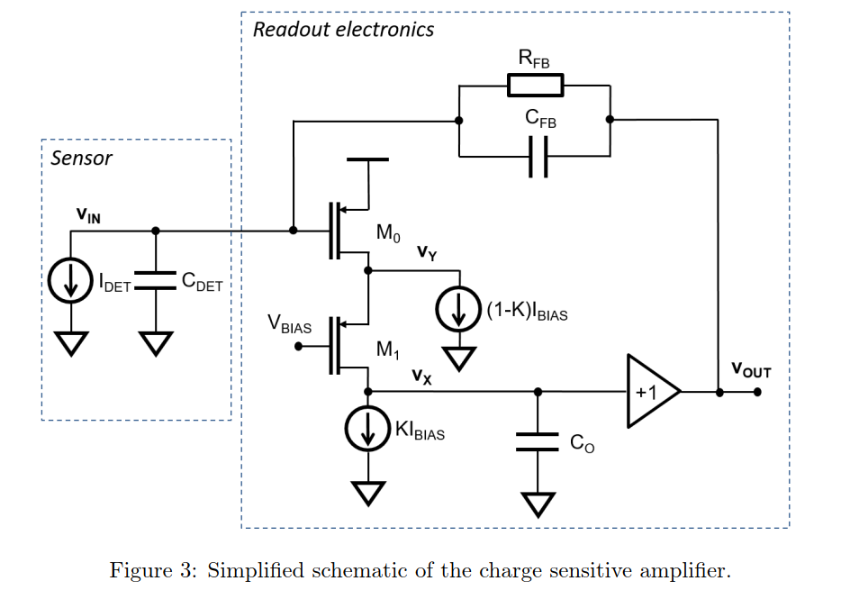
Fundamental limits to time resolution in analog front-end
Submitted to journal
Plot courtesy: R. Ballabriga.

Slide 7

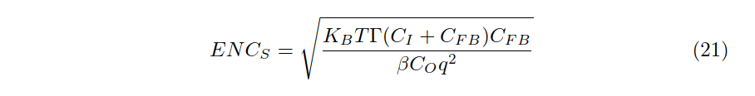
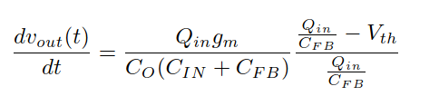
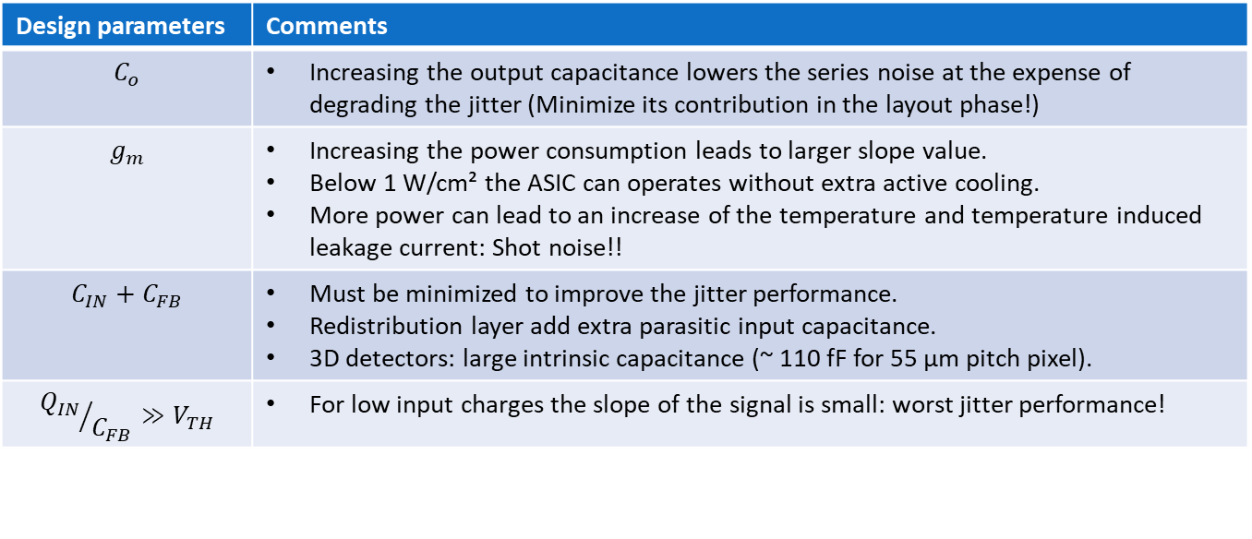
Fundamental limits to time resolution in analog front-end
Series noise (does not depend on gm!)
(scaling techno does not really help)
Slope
Design parameters | Comments
$$C_{o}$$ | Increasing the output capacitance lowers the series noise at the expense of degrading the jitter (Minimize its contribution in the layout phase!)
$$g_{m}$$ | Increasing the power consumption leads to larger slope value. Below 1 W/cm² the ASIC can operates without extra active cooling. More power can lead to an increase of the temperature and temperature induced leakage current: Shot noise!!
$$C_{IN}+C_{FB}$$ | Must be minimized to improve the jitter performance. Redistribution layer add extra parasitic input capacitance. 3D detectors: large intrinsic capacitance (~ 110 fF for 55 µm pitch pixel).
$${Q_{IN}}/{C_{FB}}≫V_{TH}$$ | For low input charges the slope of the signal is small: worst jitter performance!

Slide 8
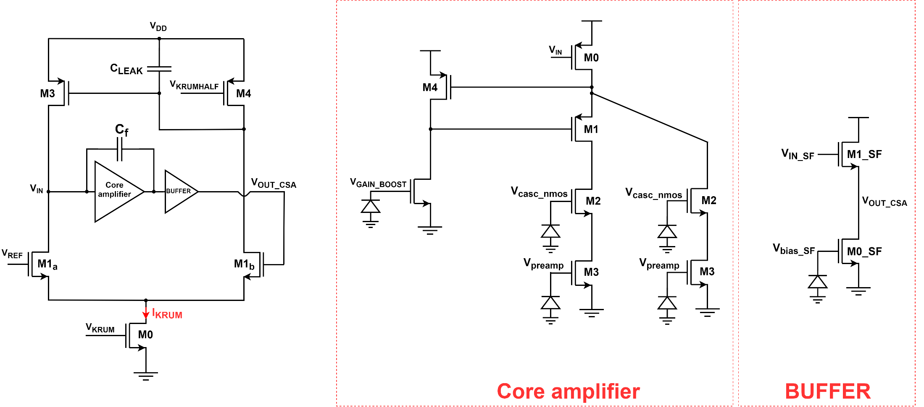
Analog front-end for PicoPix
Gain boosting
CSA based on Krummenacher scheme with a feedback capacitance of ~3 fF: DC leakage compensation and programmable discharge time.
Gain boosting to increase the DC gain of the core amplifier.

Slide 9
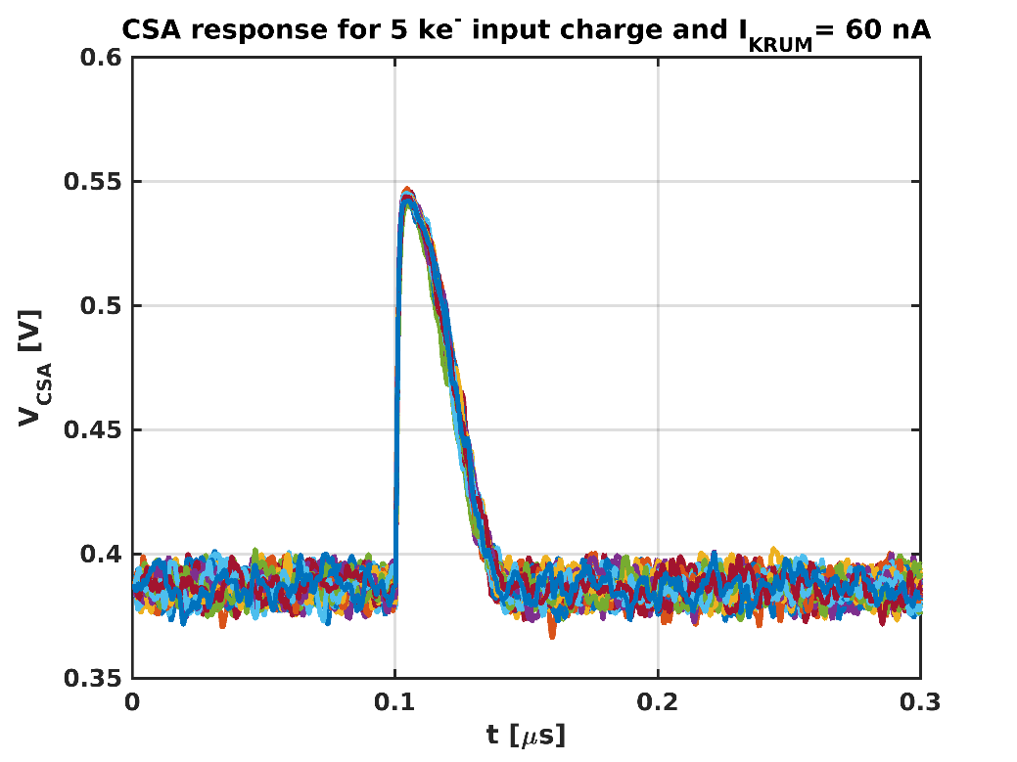
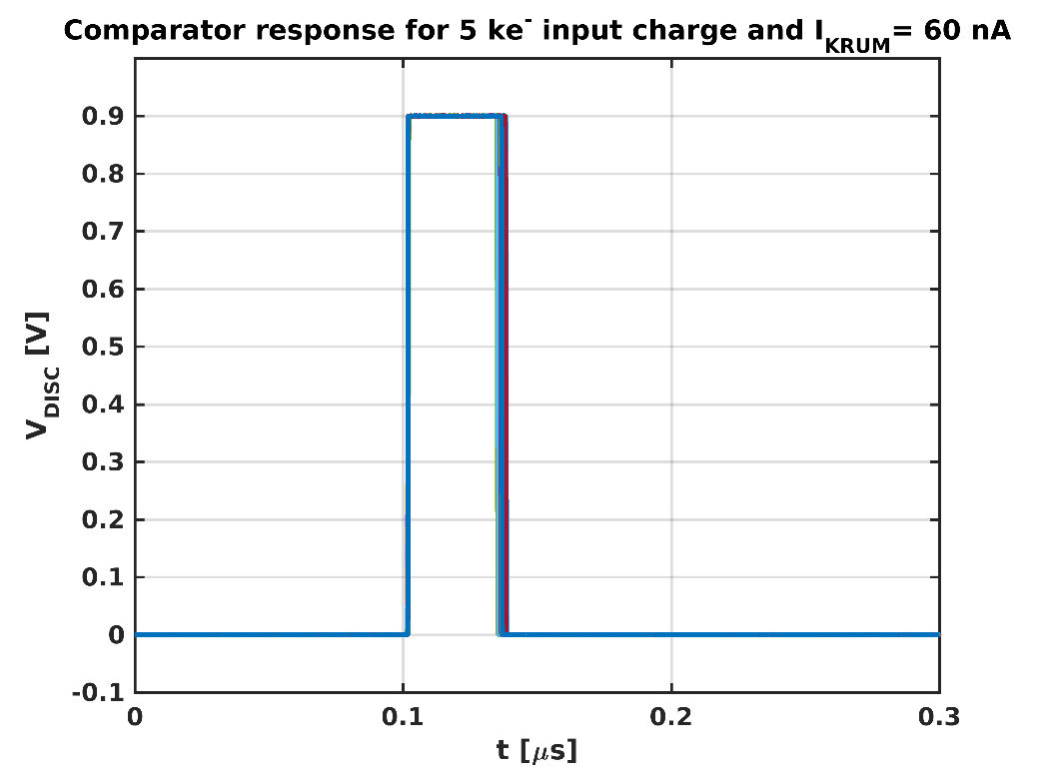
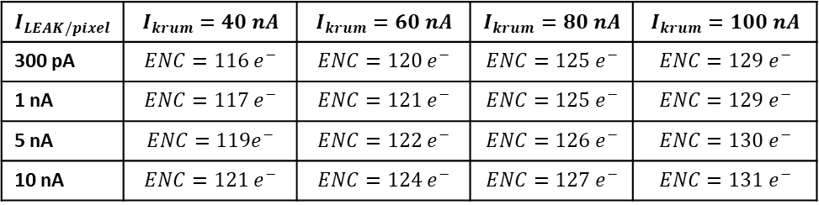
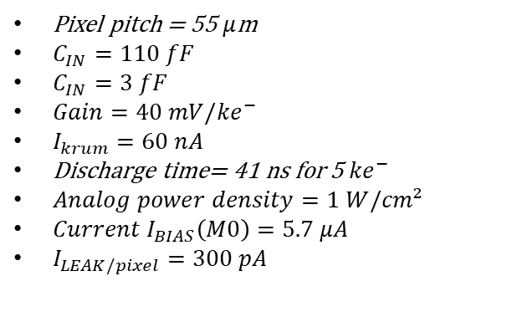
Analog front-end for PicoPix
$$I_{LEAK/pixel}$$ | $$I_{krum}=40 nA$$ | $$I_{krum}=60 nA$$ | $$I_{krum}=80 nA$$ | $$I_{krum}=100 nA$$
300 pA | $$ENC=116 e^{−}$$ | $$ENC=120 e^{−}$$ | $$ENC=125 e^{−}$$ | $$ENC=129 e^{−}$$
1 nA | $$ENC=117 e^{−}$$ | $$ENC=121 e^{−}$$ | $$ENC=125 e^{−}$$ | $$ENC=129 e^{−}$$
5 nA | $$ENC=119e^{−}$$ | $$ENC=122 e^{−}$$ | $$ENC=126 e^{−}$$ | $$ENC=130 e^{−}$$
10 nA | $$ENC=121 e^{−}$$ | $$ENC=124 e^{−}$$ | $$ENC=127 e^{−}$$ | $$ENC=131 e^{−}$$
Pixel pitch = 55 $μ$m
$C_{IN}=110 fF$
$C_{IN}=3 fF$
$Gain=40 mV/{ke}^{−}$
$I_{krum}=60 nA$
Discharge time= 41 ns for 5 ${ke}^{−}$
$Analog power density=1 W/cm²$
$Current I_{BIAS}\left(M0\right)=5.7 μA$
$I_{LEAK/pixel}=300 pA$
NB: 110 fF is the total pixel capacitance obtained with 3D-trench sensor.
DOI: 10.1088/1748-0221/15/09/P09029

Slide 10
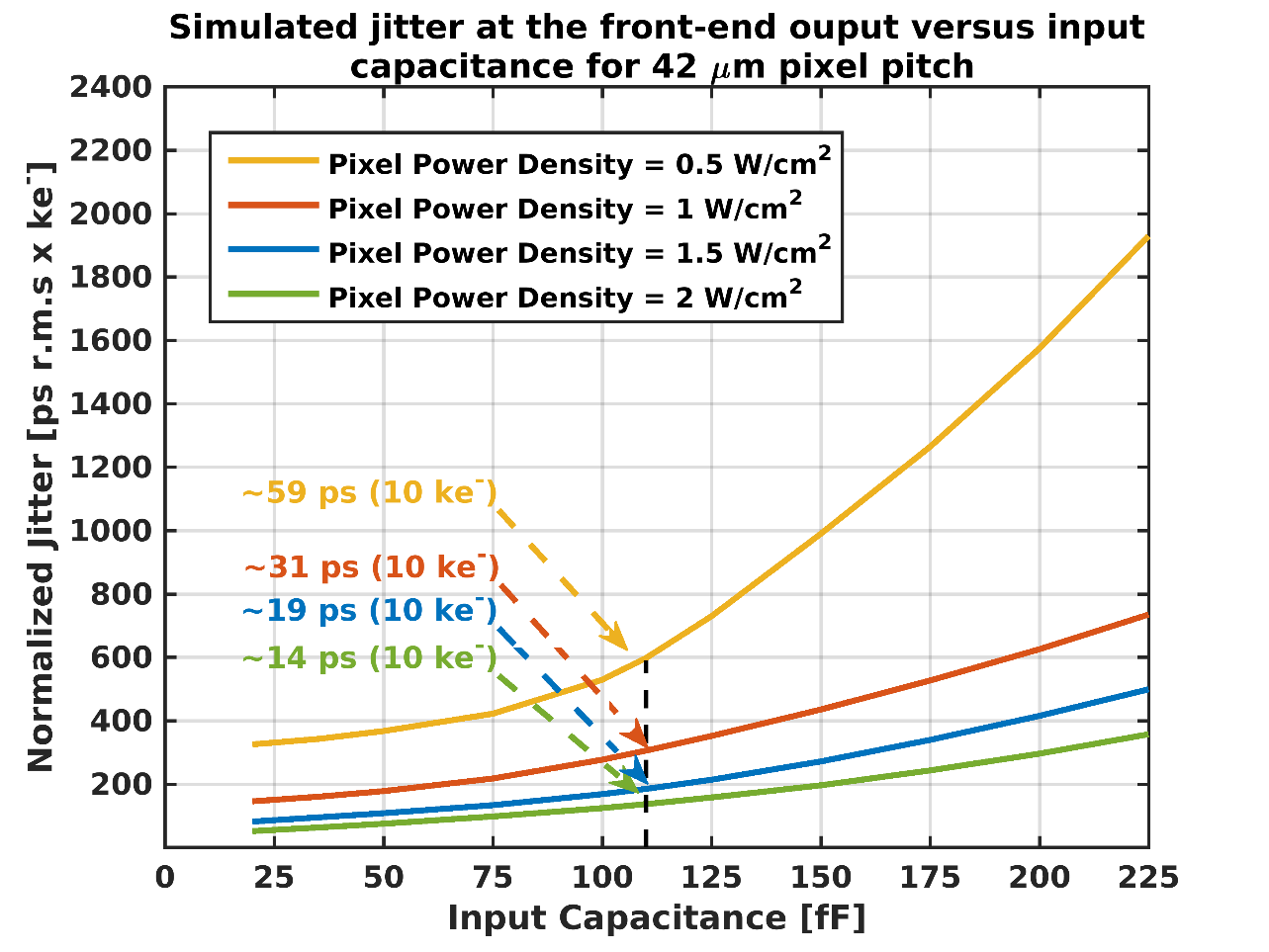
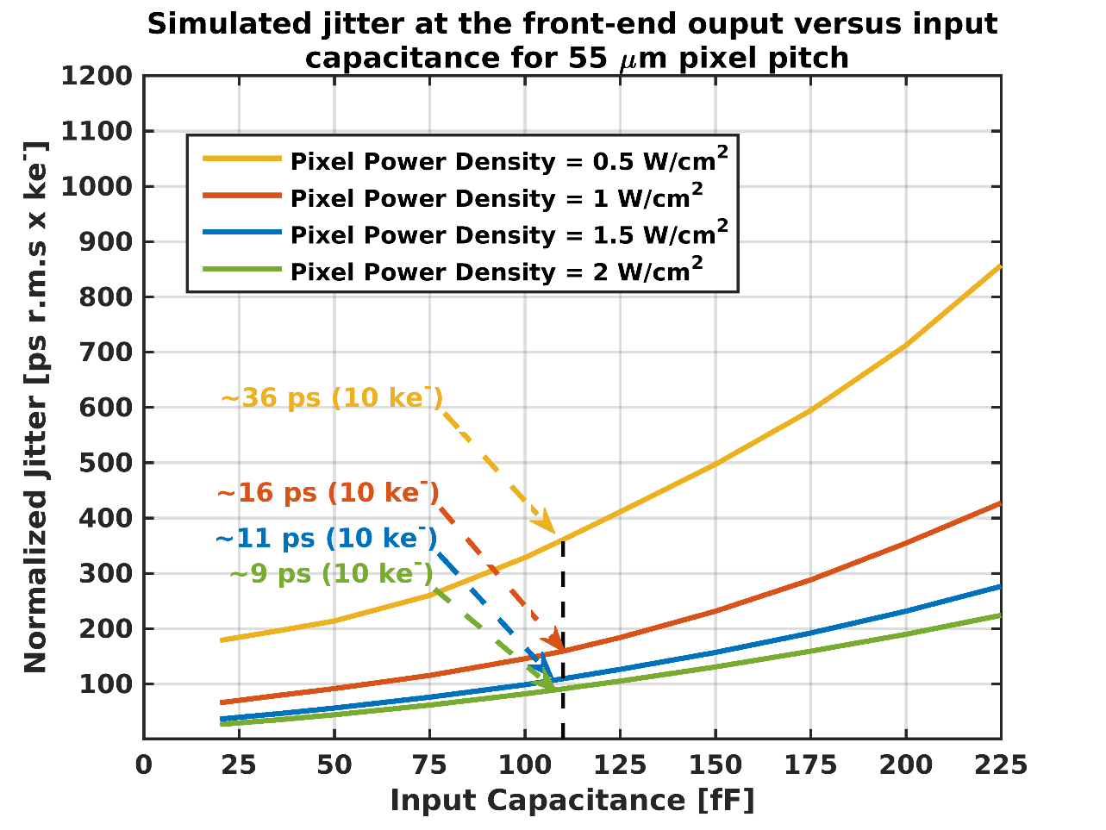
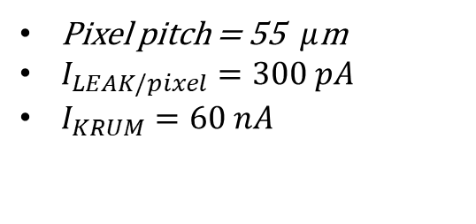
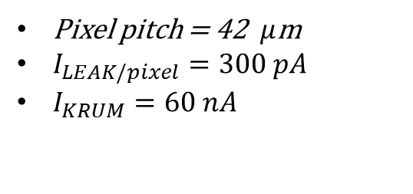
Simulated jitter at front-end output versus input capacitance
Pixel pitch = 42 $μ$m
$I_{LEAK/pixel}=300 pA$
$I_{KRUM}=60 nA$
Pixel pitch = 55 $μ$m
$I_{LEAK/pixel}=300 pA$
$I_{KRUM}=60 nA$
Simulation using schematic view!!
NB: 110 fF is the total pixel capacitance obtained with 3D-trench sensor.
DOI: 10.1088/1748-0221/15/09/P09029

Slide 11
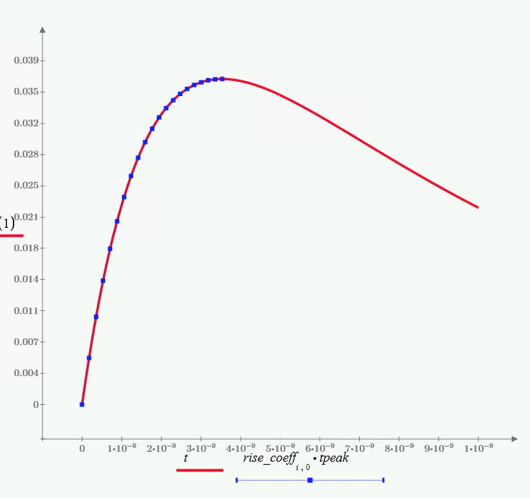
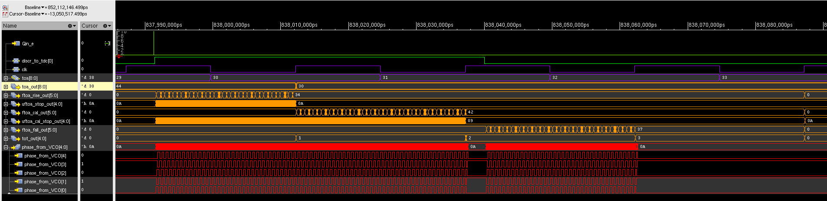
First RTL simulations
Modified pixel model (from Medipix4) represents more realistically the rise-time slope → critical to extract correct timing.
  Model includes analog pile-up.
  Fall time is a constant slope.
Used pixel model, new free-running DCO with calibration and Timepix4 adapted TDC logic.
  Peak time=3.2ns, ENC=100e-rms, constant fall time of 5ns/ke.
Simulation time of ~few seconds.
Rise Time mesurmement
DCO Calibration
mesurmement
Fall time
mesurmement
Slide courtesy: X. Llopart.

Slide 12
Comparison with Timepix4 and PicoPix
Penalty due to RDL in Timepix4
PicoPix
PicoPix
Slide courtesy: X. Llopart.

Slide 13
Thank you

Slide 14
Requirements
Technology:
    CMOS 28 nm – 9 metal
Analog supply voltage:
    900 mV
System configuration:
    Pixel pitch → 55 µm x 55 µm | 42 µm x 42 µm
Matrix pixel:
    Different options might be available
Polarity:
    Optimized for electron collection
Power consumption:
    Total power consumption less than 1 W/cm². If 50 % goes to the analog pixel and 50% to the digital pixel, the maximum current consumption per analog front-end is 16.8 µA for 55 µm pixel pitch and 9.8 µA for 42 µm pixel pitch.
Peaking time:
    < 10 ns
Minimum threshold:
    ~ 500 e- which is possible with ENC < 75 e- (depends on the input capacitance)
Number of thresholds:
    1
Tuning DAC dynamic range:
    5 bits

Slide 15
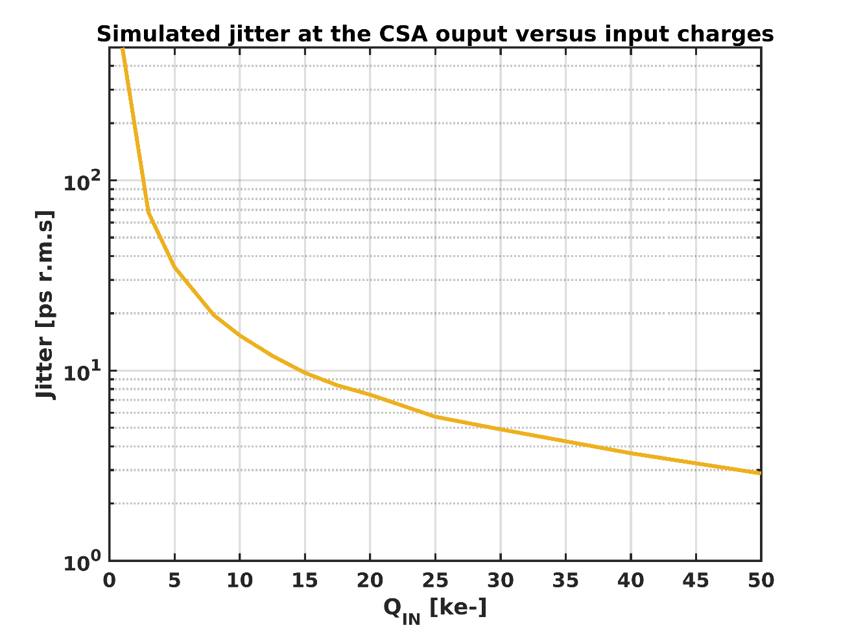
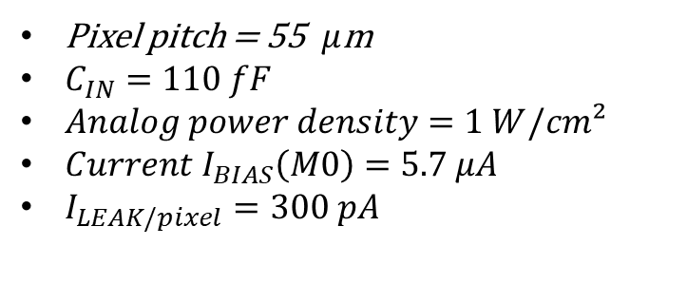
Simulated jitter at CSA output versus input charges
Pixel pitch = 55 $μ$m
$C_{IN}=110 fF$
$Analog power density=1 W/cm²$
$Current I_{BIAS}\left(M0\right)=5.7 μA$
$I_{LEAK/pixel}=300 pA$

Slide 16
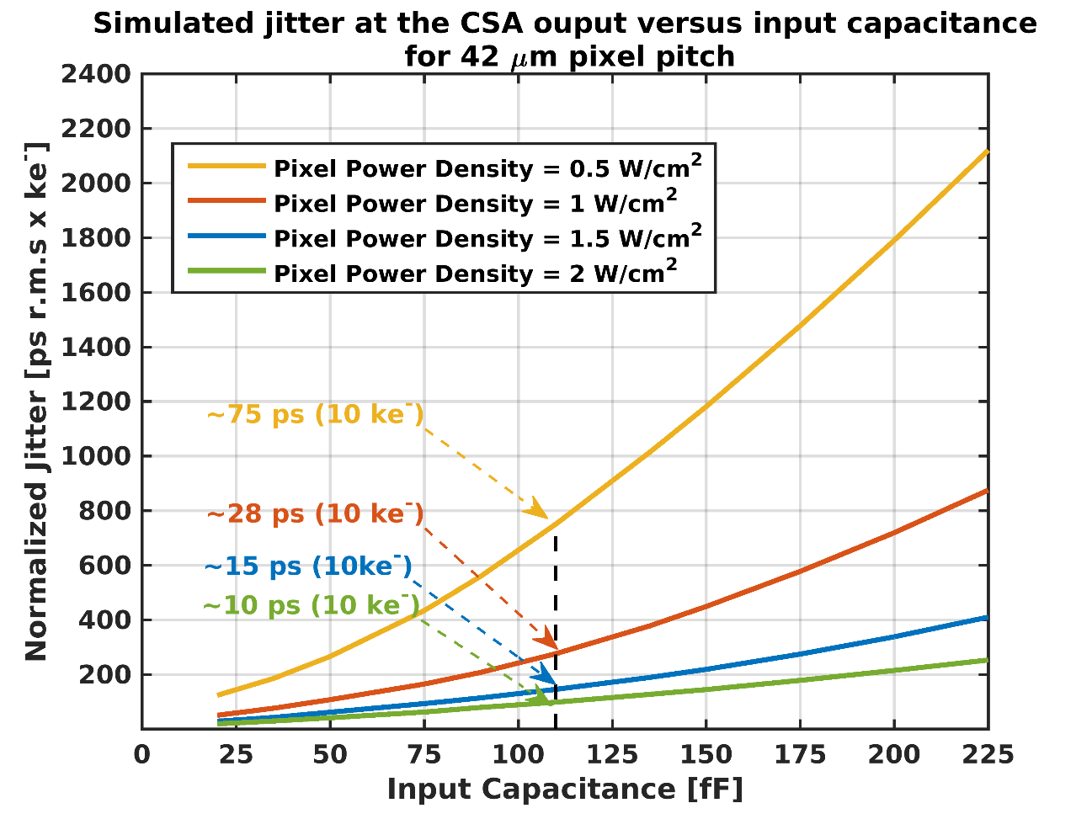
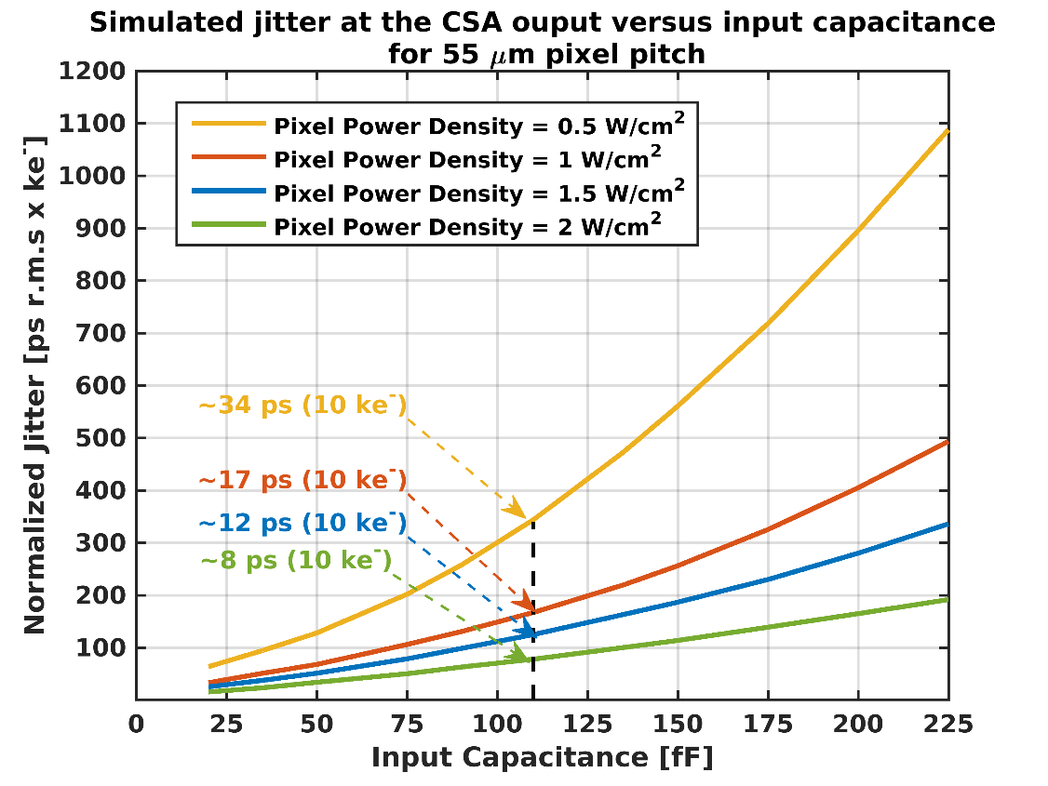
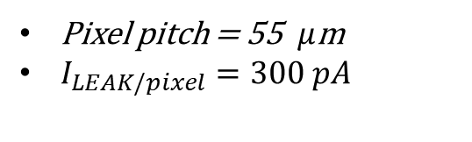
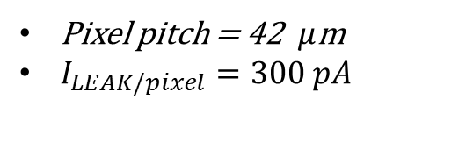
Simulated jitter at CSA output versus input capacitance
Pixel pitch = 42 $μ$m
$I_{LEAK/pixel}=300 pA$
Pixel pitch = 55 $μ$m
$I_{LEAK/pixel}=300 pA$
NB: 110 fF is the total pixel capacitance obtained with 3D-trench sensor.
DOI: 10.1088/1748-0221/15/09/P09029

Slide 17
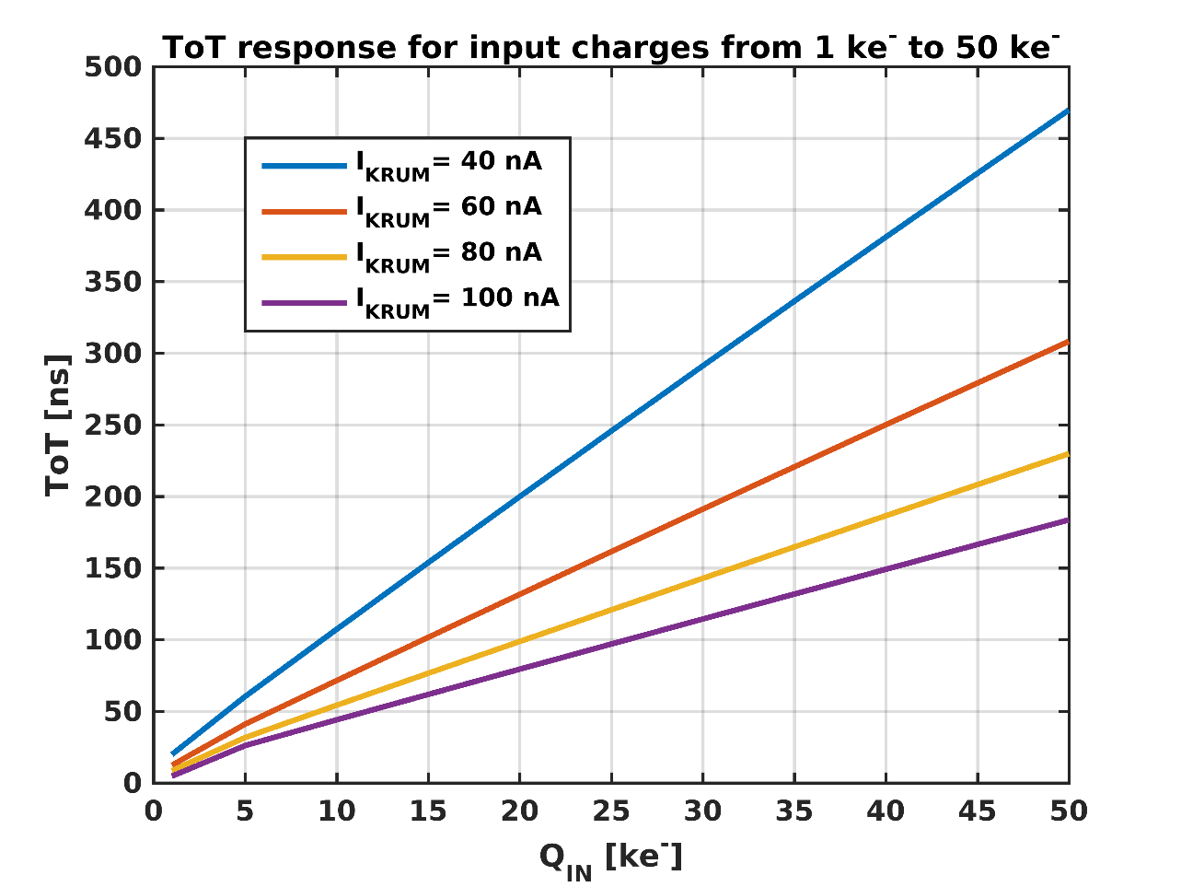
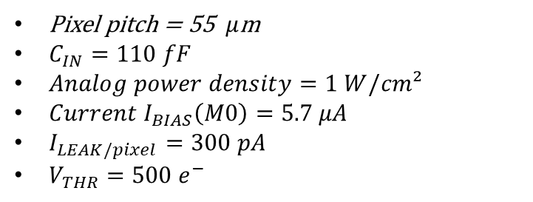
Simulated jitter at CSA output versus input charges
Pixel pitch = 55 $μ$m
$C_{IN}=110 fF$
$Analog power density=1 W/cm²$
$Current I_{BIAS}\left(M0\right)=5.7 μA$
$I_{LEAK/pixel}=300 pA$
$V_{THR}=500 e^{−}$
NB: 110 fF is the total pixel capacitance obtained with 3D-trench sensor.
DOI: 10.1088/1748-0221/15/09/P09029

Slide 18
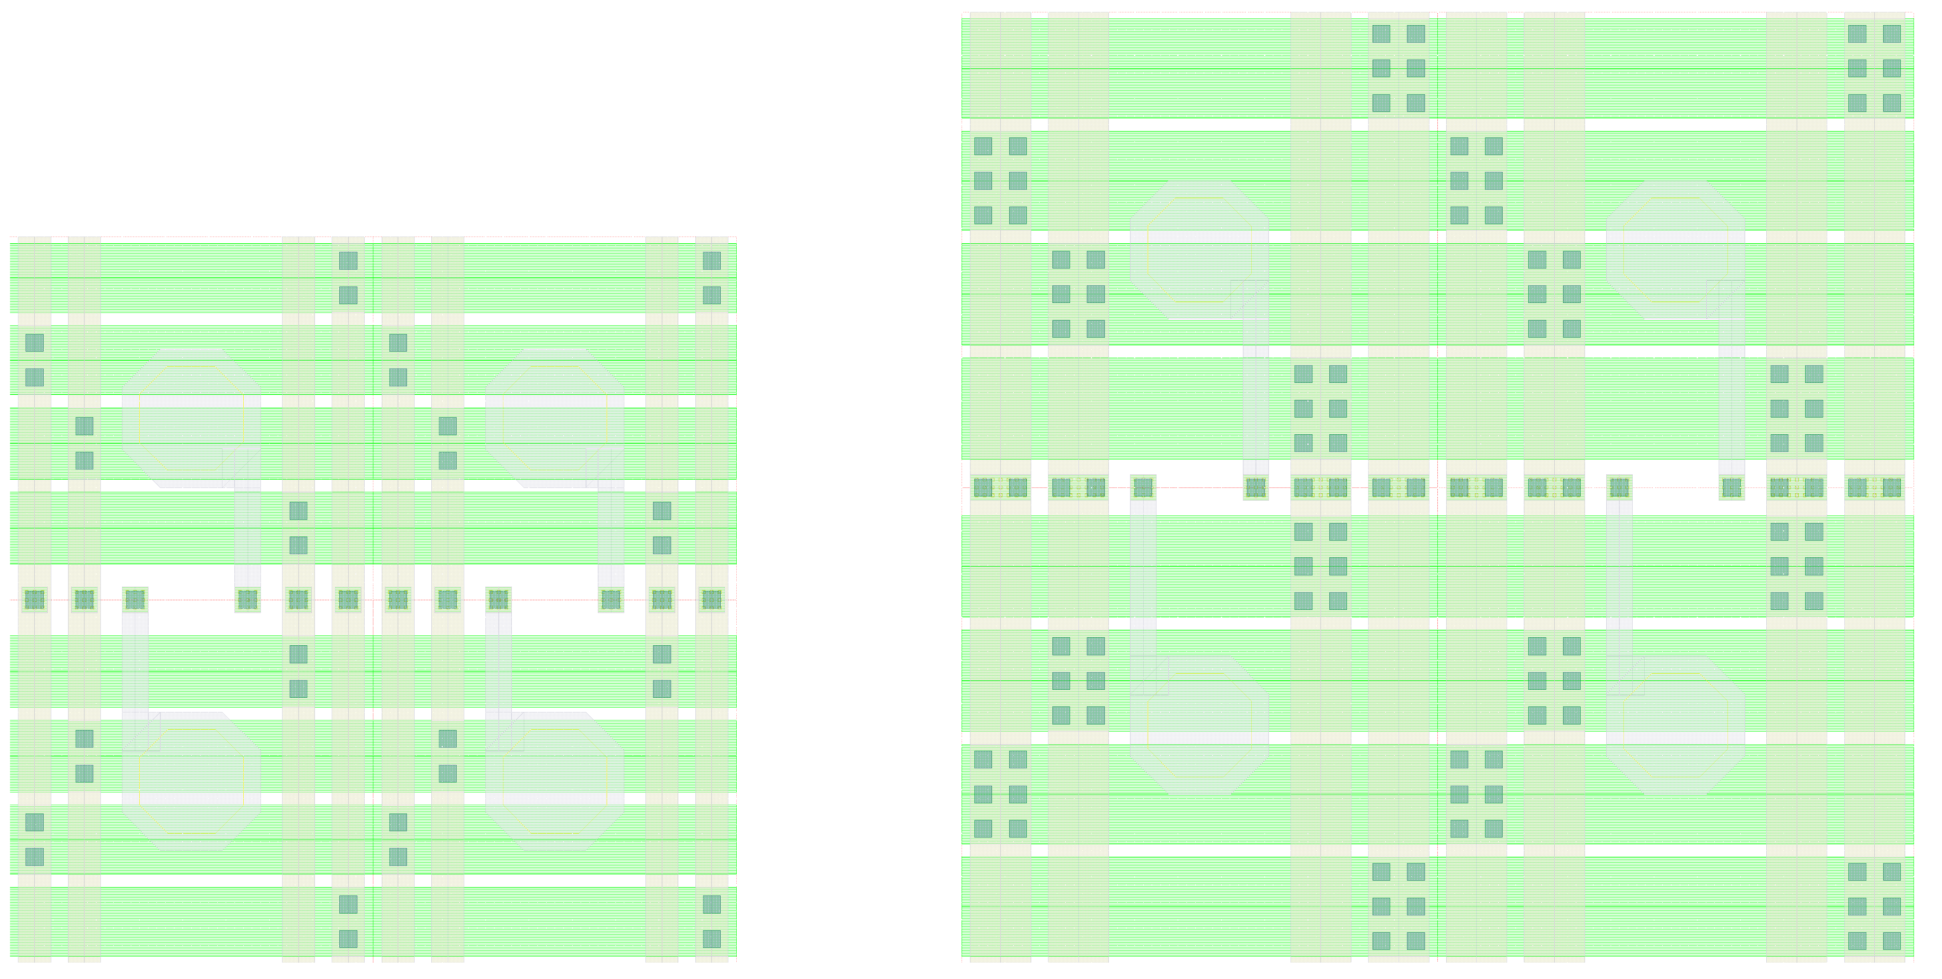
2x2 pixels floorplan
55 µm
42 µm
42 µm
55 µm
Pixel pitch | 42 µm | 55 µm
Pad opening | 16 µm | 16 µm
M9 width (horizontal power distribution) | 8.3 µm | 11.75 µm
AP width (vertical power distribution) | 3.75 µm | 7 µm
M8 width (vertical power distribution) | 3.75 µm | 7 µm

Slide 19
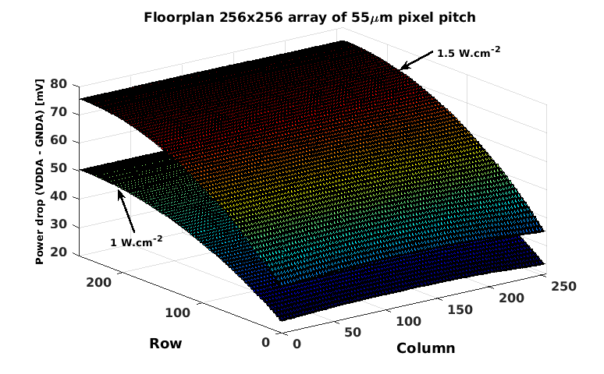
Power distribution scheme

Slide 20
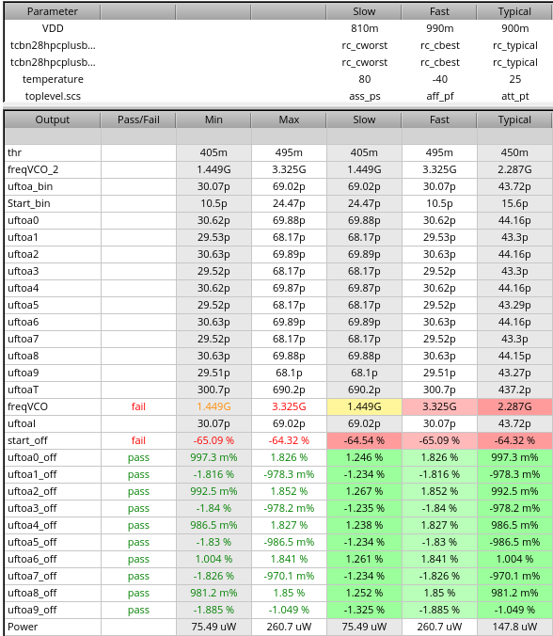
Free running on-pixel DCO?
Explored the idea of the on-pixel free-running DCO:
  With 3-4 bits oscillation control
  Using 7T cells with extracted parasitic
Advantages:
  No control voltage distributed along the column
  Top down mismatch due to radiation can be minimized
  Faster oscillation times and lower dynamic power → better time resolution
Disadvantages:
  Requires DCO calibration measurement → data bandwitdth!
 | freq | Phases | LSB | Area | power
Timepix4 | 640 MHz | 8 | 195ps | ~350µm² | ~500µW
Free-running DCO in 28nm | 1.5-2.5 GHz | 10 | 66-40ps | ~70µm² | ~150µW
Slide courtesy: X. Llopart.

