Slide 1

EP R&D on Experimental Technologies
WP8
Magnet Detector R&D
21st June 2022
Benoit CURE – EP/CMX

Slide 2

Content
1- WP8
  Scope
  People and Organisation
  Activities and results over 2020-2022
2- Detector R&D roadmap developed by the European Committee for
Future Accelerators (ECFA)
3- WP8 workplan for second half of R&D program
4- WP8 program extension request
B. CURE | EP - WP8 - Detector Magnet R&D

Slide 3
EP R&D WP8 Activities
WP8 on Magnet Detector R&D launched in 2020 with 3 major R&D areas (scope reduced compared to the initial plan to meet the available budget).
Scope for years 2020-2024
8.1 Advanced Magnet Powering
8.4 New 4-Tesla General Purpose Magnet Facility for Detector Testing
8.5 Innovation in Magnet Controls, Safety Systems & Instrumentation
8.2 Reinforced Super-Conductors and Cold Masses
8.3 Ultra-Light Cryostat Studies
……………….. On hold
………………………… Integrated into WP4
B. CURE | EP - WP8 - Detector Magnet R&D

Slide 4
WP8 organisation
Program started at the time of the Covid pandemic :
  Still possible to begin the activities with one fellow and one technical student, but it was a slow start due to Covid.
Over the Covid period, the works were adapted to the conditions:
  Prototyping delayed until access to CERN was granted, following CERN recommendations regarding on-site presence,
  First focusing more on studies, but with limited internet speed for remote connections.
We selected highly motivated candidates with excellent background in mechanical and electrical engineering, cryogenics, instrumentation.
  Candidates were selected to have complementary scientific backgrounds in the team, but few of the applicants had full university education in the field of superconductivity.
  The works were also adapted to enable the fellows & students to learn in this field.
B. CURE | EP - WP8 - Detector Magnet R&D

Slide 5
WP8 organisation – period 2020-2022
Members of the team:
Fellows: Shuvay Singh, Anna Vaskuri
Technical Students: Filip Malinowski, Michela Neroni, Weronika Głuchowska, Robert Jurco
Staff: Alexey Dudarev, Matthias Mentink, Nicola Pacifico, Benoit Cure
+ support from :
Atlas Magnet Team Fellow: Nikkie Deelen
Trainees: Tonke Boelens, Pieter Kruyt, Dennis Klaassen
B. CURE | EP - WP8 - Detector Magnet R&D

Slide 6
WP8 organisation
In the frame of our activities we have received the welcome (and appreciated) support from:
TE-CRG Cryolab for test facility design and testing (snubber, 5-T small coil),
EP-DT-DI magnet control section (b180 new test facility control system),
EP-DT-TP for contribution to instrumentation studies,
TE-VSC-SCC for material analysis,
EN-MME for material testing,
EN-EL for the electrical distribution of b180 new test facility,
ATLAS (and CMS) support team for technical activities.
Many thanks to them for their useful collaboration !
B. CURE | EP - WP8 - Detector Magnet R&D

Slide 7
WP 8.1 - Advanced Magnet Powering
Original workplan
Results
Activities 2020- mid 2022
Quench protection studies and modelling, applied to the 4-T magnet studies,
Snubber studies for implementation on Atlas Barrel Toroid,
Commissioning of CMS free wheel system,
Study of persistent mode current switch,
Study of flux pump.
Resources: (½ fellow + 1 technical student + trainee) / year over 2020-2022
Results 2020 – mid 2022:
Feasibility studies and reports : done (1-2-4-5)
Computational simulations: done (1-2-4-5)
Conceptual design reports based on simulation: done (2-4-5); construction of demonstrator models and testing : done (2), in progress (5)
Implementation and final testing campaign : done (2-3)
Scope for years 2020-2024
Magnet powering and protection
Free wheel systems and persistent mode current switch
Energy extraction studies and quench protection
Studies applied to WP8.4.
Resources: (½ fellow + 1 technical student) / year over 2020-2022
Deliverable 2020 – mid 2022:
Feasibility studies and reports.
Conceptual Design reports based on simulation, technical designs, construction of demonstrator models and testing.
B. CURE | EP - WP8 - Detector Magnet R&D

Slide 8
WP 8.4 - New 4-Tesla Magnet Facility
Original workplan
Results
Activities 2020- mid 2022
Definition of technical requirements,
Studies of magnet layout and stray field
Definition of conductor and cold mass
Study of cryogenics
Resources: ½ fellow (2020-22)+ 1 technical student (2021)
Results 2020 – mid 2022:
Magnet concepts: done, reported and published.
  Two options studied, Split coil solenoid and Dipole (Magnadon*).
  Conductor and winding defined: pancake winding of reinforced Al-stabilized NbTi conductor.
Magnet subsystem studies on:
  Inner cryogenics, powering system, yoke.
  In progress: cryostat, support system.
* discussed with MADMAX collaboration as potential application.
Scope for years 2020-2024
Conceptual design study of a 4-T magnet for a test beam facility
Resources: ½ fellow / year over 2020-2022
Deliverable 2020 – mid 2022:
Magnet design.
Magnet subsystem design (cryogenics, powering, cryostat, yoke, support system)
B. CURE | EP - WP8 - Detector Magnet R&D

Slide 9
WP 8.5 - Innovation in Magnet Controls, Safety Systems & Instrumentation
Original workplan
Results
Activities 2021 - mid 2022
New testing setups for HTS tape characterisations.
Assembly of a new low-T test bench facility with SC magnet for SC cable measurements and further prototype testing.
Scrutiny of emerging optical technologies in position measurement for potential application to fieldmapping.
Study of an innovative insulation system.
Resources: 1 fellow / year from Oct. 2021 + 1 TS (2022)
Results 2021 – mid 2022:
HTS studies: in progress
  Computational simulations,
  Construction of cable demonstrator models and testing.
Test bench facility installation : in good progress.
New magnet control system to be implemented on new test facility (with EP-DT magnet control team).
Report on optical technologies with discussion on applications and level of accuracy: done.
Scope for years 2020-2024
Quench protection in HTS: fast detection, sensitivity, low voltage;
Magnet controls : requirements, identification of future systems;
Instrumentation: magnetic measurement, interfaces CAN FD.
Applied to the 4-T magnet beam test facility to test and qualify these systems.
Resources: activity starting from mid 2021 with 1 fellow + 1 technical student
Deliverable mid 2021 – mid 2022:
Magnet control system needs.
Testing and reporting.
Simulation, prototyping with new instrumentation.
B. CURE | EP - WP8 - Detector Magnet R&D

Slide 10
The 2021 ECFA
Detector Research and Development Roadmap
Detector Research and Development Themes (DRDTs) identified in the Roadmap report.
DRDT 8.1: Develop Novel Magnet Systems
in Chapter 8 - Integration ; 8.3 - Key technologies
Integration (Task Force 8)
DRDT 8.1 - Develop novel magnet systems.
Magnet requirements are very speciﬁc to the design of the detector. Considering the very long lead time, generic R&D programmes must be established and maintained on dedicated conductors and prototyping to achieve the variety of magnet speciﬁcations.
B. CURE | EP - WP8 - Detector Magnet R&D

Slide 11
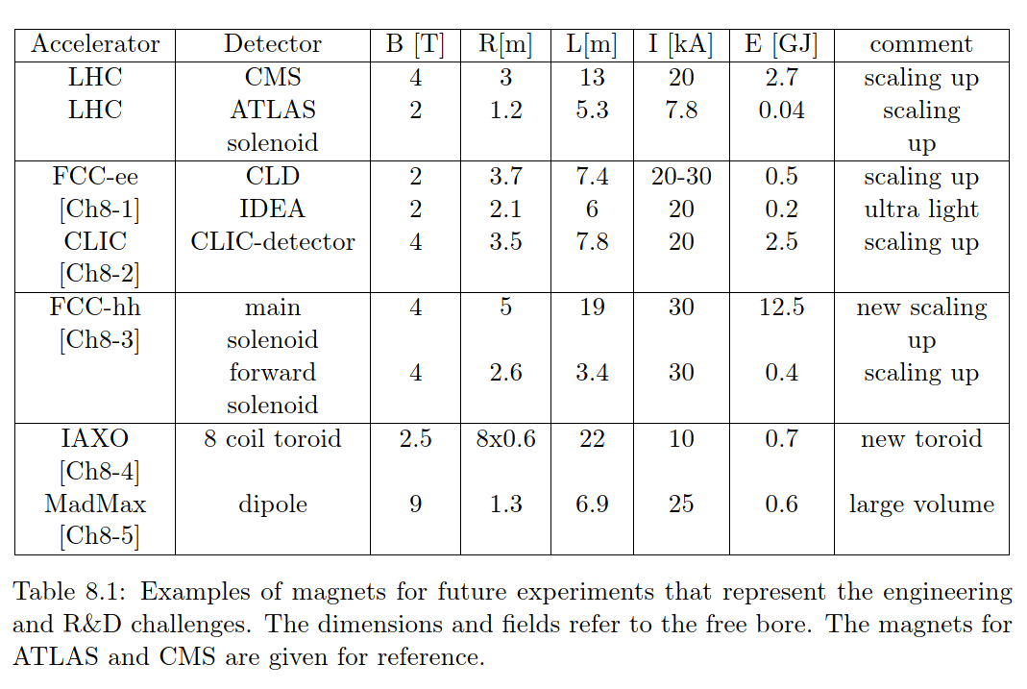
The 2021 ECFA
Detector Research and Development Roadmap
DRDT 8.1: Develop Novel Magnet Systems
Some examples of future magnet systems that represent the spectrum of engineering challenges and R&D needs for this topic :
reference
B. CURE | EP - WP8 - Detector Magnet R&D

Slide 12
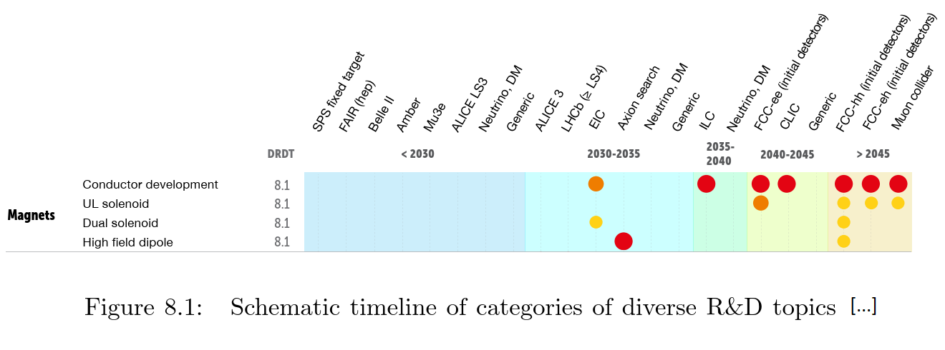
The 2021 ECFA
Detector Research and Development Roadmap
DRDT 8.1: Develop Novel Magnet Systems
Given the time required for procurement, conductor manufacturing, coil and detector assembly, the availability of the superconductor comes quite early in the project plans.
R&D on superconductors must be achieved well in advance of detector completion (minimum ~ 5 to 7 years).
B. CURE | EP - WP8 - Detector Magnet R&D

Slide 13
The 2021 ECFA
Detector Research and Development Roadmap
DRDT 8.1: Develop Novel Magnet Systems –
Summary of the key technologies needed, as listed in the ECFA report :
Magnets for collider experiments:
Development of next generation of Al-stabilized high-yield strength Rutherford cable superconductors and prototyping for 30-40 kA large coils placed behind calorimeters.
R&D on conductors and prototyping for thin conductors Al/Cu/NbTi for small coils placed in front of the calorimeters.
Long term: development of high temperature superconductors for coils and current leads.
R&D for assemblies with dual solenoids for magnetic shielding.
Magnet for non-collider experiments:
large volume magnets for axion searches […], and high field
Development of quench protection, energy extraction and high voltage designs for coils with high energy/mass ratios is also needed.
B. CURE | EP - WP8 - Detector Magnet R&D

Slide 14
WP8 workplan for second half of R&D program
Workplan to be continued according to the reduced initial scope.
WP 8.1 – Advanced Magnet Powering
  Continue on powering system demonstrators and testing.
WP 8.4 - New 4-Tesla Magnet Facility
  Plan to build a demonstrator coil including concepts with potential use for future magnets.
WP 8.5 - Innovation in Magnet Controls, Safety Systems & Instrumentation
  Implement a specific instrumentation and test system for HTS superconductor cables.
  Continue prototyping and testing of these HTS cables, including the use of a new insulation.
More details in the next presentation by Matthias Mentink
B. CURE | EP - WP8 - Detector Magnet R&D

Slide 15
WP8 request for R&D program extension from 2023 onwards
To keep plans of EP R&D WP8 in line with ECFA DRDT 8.1:
Enlarge the scope of activities on superconductor R&D, for period 2023-2027
Strong need identified for aluminum stabilized superconductor prototyping & pre-industrialization, for CERN programs and associated projects:
  BabyIaxo, Alice3, FCC-ee (ultra-thin and conventional), CLICdp, FCC-hh.
Request the EP R&D Committee to consider activating the WP8.2 on reinforced superconductors and cold masses from 2023 onwards, with resources to be defined.
B. CURE | EP - WP8 - Detector Magnet R&D

Slide 16
WP8 request for R&D program extension from 2023 onwards
WP 8.2 workplans reported earlier (blue report CERN-OPEN-2018-006)
Scope given: to identify and propose manufacturing routes, in view of producing sample lengths with industry that can be adapted for scaling up to production for future detector magnet conductors.
To be discussed in a specific meeting.
Initial workplan proposed:
B. CURE | EP - WP8 - Detector Magnet R&D

Slide 17
ep-rnd.web.cern.ch

