Slide 1

EP R&D WP8,
Future Plans
21st June 2022
M. Mentink (EP/ADO) on behalf of WP8

Slide 2
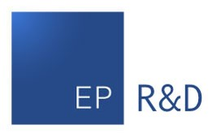
Where are we coming from?
Advanced Magnet Powering (Prioritized, in time for LS2)
CMS Free-wheeling diode for increased magnet availability: Completed
ATLAS Toroid Snubber for breaker arc suppression: Completed
Reinforced Super Conductors and Cold Masses (on hold)
(Limited effort) Cryogenic compatibility studies of 3D printed structures (cold masses, coil suspension, support structure): On-going
New 4 T General Purpose Magnet Facility for Detector Testing
Conceptual design study: Well-advanced (See talk Shuvay Singh)
Construction of cryogenic test station for conductor and coil demonstrator testing: Well-advanced
Aluminum-stabilized HTS demonstrator conductor for superconducting busbars and cooling-efficient high-temperature transparent superconducting magnets, including novel quench protection method for HTS-based coils, and towards coil design: On-going (See talk Anna Vaskuri)
Innovation in Magnet Controls, Safety & Instrumentation
Optical position measurement for high-resolution field mapping: On-going
Mosfet-based flux pump for current generation and cryogenic power savings: On-going
M. MENTINK | EP - WP8 - Detector Magnet R&D

Slide 3
Where do we want to go?
To develop the technology and expertise needed for superconducting detector magnet projects (NA 4T dipole, BabyIAXO, Alice-3, CLIC, FCC-ee, FCC-hh, …)
Challenges:
The typical development and construction time-line for a (very) large superconducting magnet is 10-20 years. For example, CMS solenoid, from CDR to TDR (core team of 20 persons): 3 years, from TDR to commissioning-on-surface: 10 years, so a long-term strategic view would be needed to ensure that the required superconducting detector magnets do not delay the projects → Long-term strategy should be formulated.
Superconducting detector magnets can last for decades (For example: ATLAS H8 Morpurgo Superconducting dipole since 70s) and expertise disappears over time → Training of the next generation of specialists is important, and cost-effective demonstrator studies can contribute towards this objective.
Conduction-cooled superconducting detector magnets require aluminum-stabilized Nb-Ti/Cu conductors, which are no longer commercially available → Investigate aluminum-stabilized conductor production for the purpose of enabling detector magnet projects.
M. MENTINK | EP - WP8 - Detector Magnet R&D

Slide 4
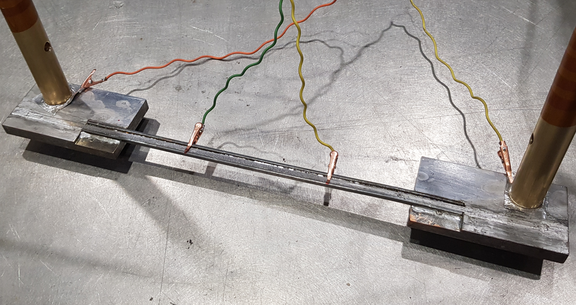
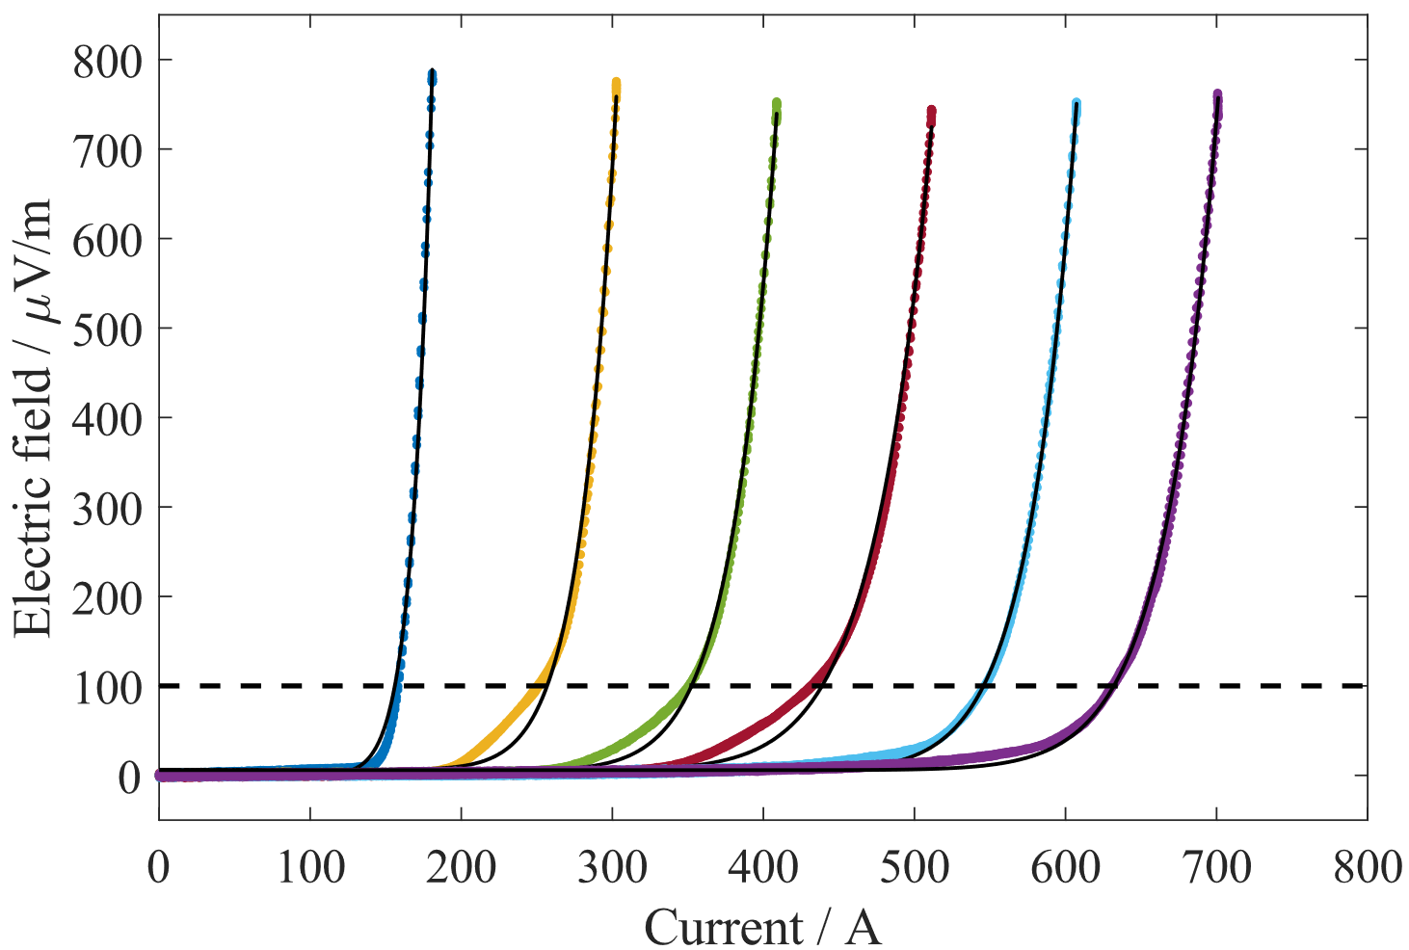
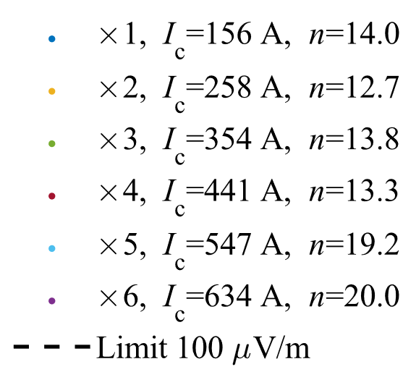
HTS-based aluminum-stabilized conductor technology
On-going: Study of aluminum-stabilized HTS-based conductors (see talk Anna Vaskuri)
Motivation: HTS-based conductors (ReBCO and Bi-2223) offer alternative to the superconducting detector magnet workhorse superconductor Nb-Ti
HTS is relatively expensive, but technological developments are on-going in recent years, whereas Nb-Ti was optimized some decades ago
In addition to increased field strengths, HTS allows operation at elevated temperatures, allowing substantial cryogenic cost savings and reduced energy consumption, which is compatible with the CERN objective of sustainable science.
HTS is expected to give enhanced particle transparency
Near-term use: Busbars, current leads
Long-term use: Superconducting coils
R&D challenges: Basic conductor technology investigation (on-going), commercial production of long lengths (long-term), quench detection and protection (on-going), coil winding (long-term)
→ Towards characterization at variable temperature and magnetic field, and then towards a conceptual coil design, including quench protection studies
Experimental HTS-based aluminum-stabilized conductor
Critical current measurements at 77 K
M. MENTINK | EP - WP8 - Detector Magnet R&D

Slide 5
North-Area 4 T dipole: Split-coil solenoid demonstrator (1/2)
Towards table-top demonstrator of a Nb-Ti/Cu split-coil solenoid
Motivation:
Conceptual design of North-Area 4 T dipole is well-advanced (see talk Shuvay Singh), but how to check aspects of the conceptual design and move beyond it?
Split-coil solenoid demonstrator, helps to test superconducting detector magnet concepts in a comprehensive (from coil winding to vacuum vessel) but cost-effective manner
To ensure that all the details that don’t appear in a conceptual design (current leads, joints, busbars, cryogenics, vacuum vessel etc.), are designed, implemented, and tested
To provide a training platform for the next generation of superconducting detector magnet experts
Step towards cost-effective intermediate-size superconducting detector magnets as needed by the CERN community, and would be useful for conductor and (small) detector component testing
This includes:
Coil winding
Current leads and busbars
Quench detection and protection
Cryogenics and thermal shield
Vacuum vessel
Mechanics
Testing
M. MENTINK | EP - WP8 - Detector Magnet R&D

Slide 6
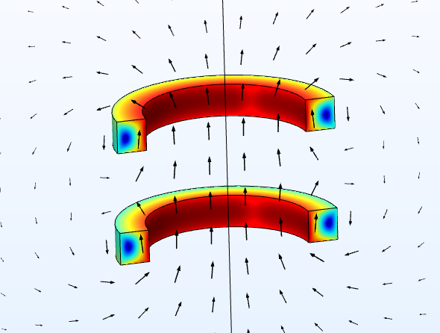
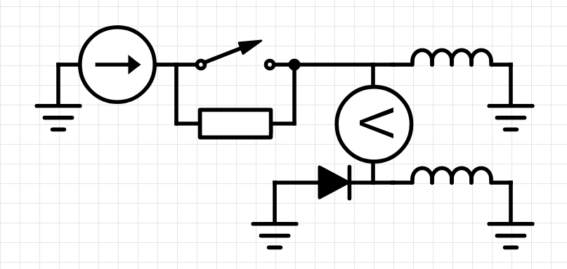
North-Area 4 T dipole: Split-coil solenoid demonstrator (2/2)
Specifics:
Coil winding (with EP-DT-EF support): Co-wound coils features insulated Nb-Ti/Cu and Cu conductors
Quench protection:
  Novel quench detection concept featuring intrinsically-optimal inductive balancing, for reduced quench detection complexity
  Novel quench protection concept featuring inductive energy transfer between coupled coils resulting in low voltages and very homogeneous quench behaviour
Cryogenics, thermal shield, current leads: Stand-alone cryogenics utilizing a cryo-cooler, with HTS-based current leads for thermal efficiency
Mechanics: Lorentz forces are mainly handled by conductor, with net forces between coils to be resolved by support structure
Vacuum vessel: Could make interesting test case for WP4 vacuum vessel technology, to be discussed
We aim to do this within existing EP R&D budget allocation
Nb-Ti/Cu coil
1 T
480 mm
1 T split-coil solenoid
Power supply
Quench detection
Nb-Ti/Cu coil
Fast dump switch
Co-wound copper coil
Proposed electrical circuit
M. MENTINK | EP - WP8 - Detector Magnet R&D

Slide 7
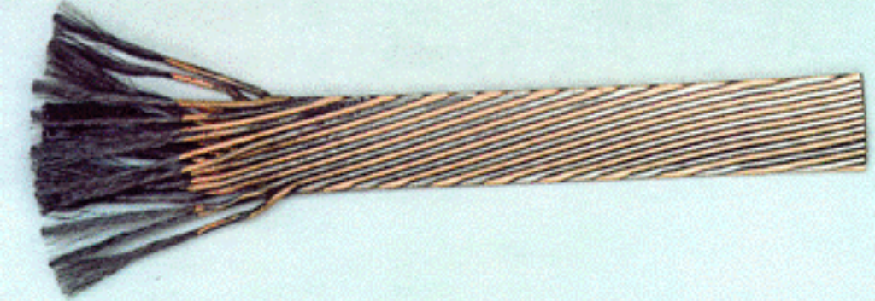
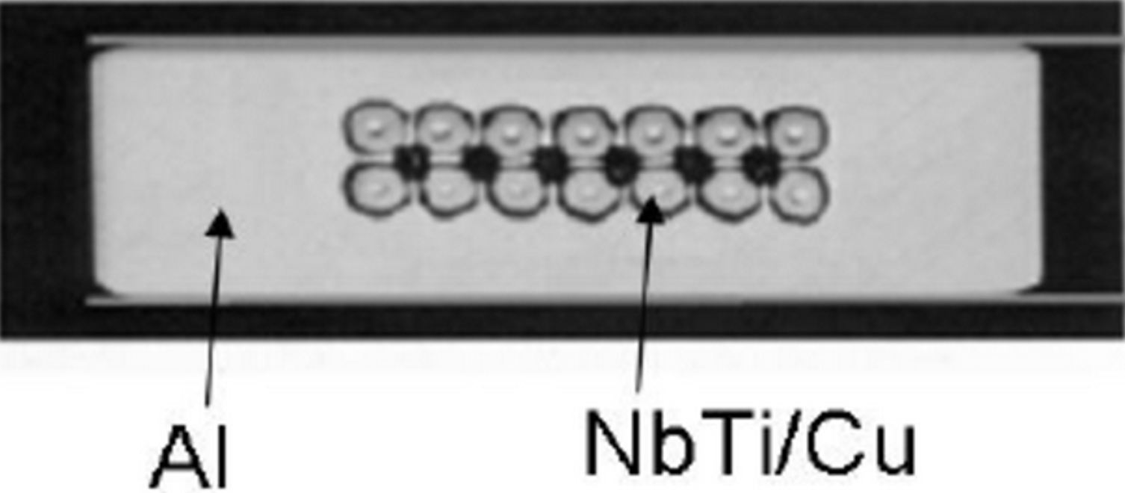
Aluminum-stabilized Nb-Ti/Cu conductor (1/2)
Challenge:
Similar to existing superconducting detector magnets (ATLAS, CMS, …), future superconducting detector magnets require aluminum-stabilized Nb-Ti/Cu conductors, which are presently no longer commercially available
Why not use individual Nb-Ti/Cu strands or accelerator magnet conductors instead?
  Superconducting detector magnets develop internal voltages during quench, voltage amplitude is inversely proportional to operating current, and, for insulation purposes, the maximum voltage is practically limited to < 1000 V → Large detector magnets require large operating currents, and so cabling of strands is unavoidable (→ Rutherford cables)
  Superconducting detector magnets are typically conduction-cooled, where aluminum ensures the thermal, electrical, and mechanical stability of the superconductor, temporarily carries the current during a quench, and provided needed heat capacity. Aluminum-stabilized conductors is a niche technology, and accelerator magnet technology (where conductor is in direct contact with helium and the stored magnetic energy is much smaller) does not work for superconducting detector magnets
Nb-Ti/Cu Rutherford cable
Rutherford cable encased in pure aluminum
M. MENTINK | EP - WP8 - Detector Magnet R&D

Slide 8
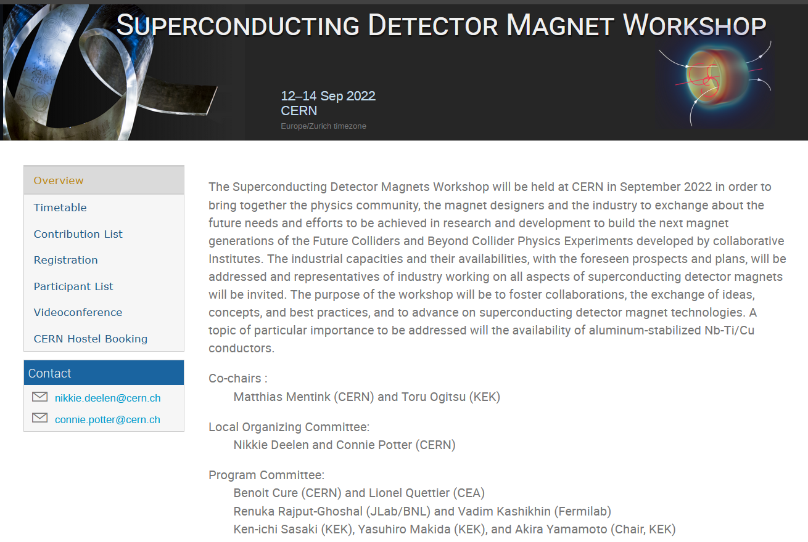
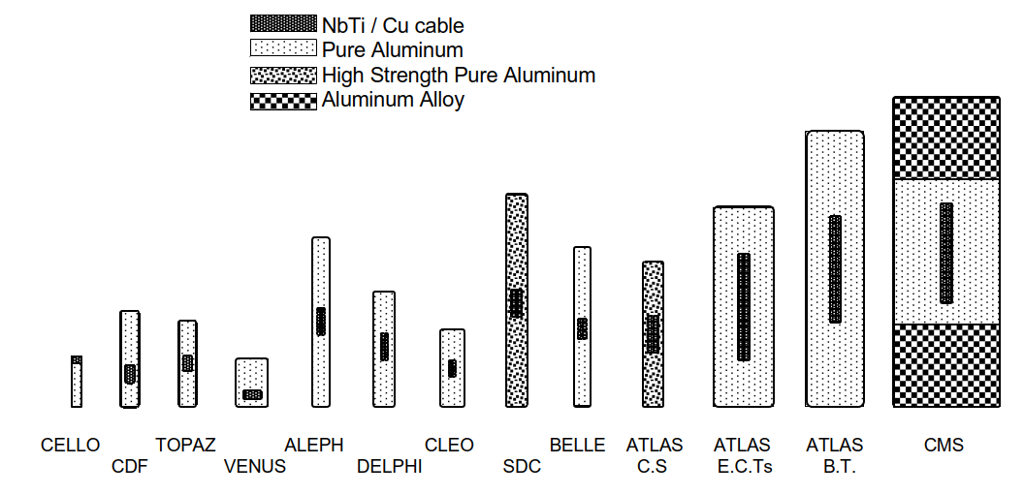
Aluminum-stabilized Nb-Ti/Cu conductor (2/2)
indico.cern.ch/e/sdmw
Aluminum-stabilized conductors used for various superconducting detector magnets
(Source: Snowmass white paper ’22)
Workshop on superconducting detector magnets, to be held later this year at CERN, with emphasis on aluminum-stabilized Nb-Ti/Cu conductor availability
To address lack of commercial availability, we are organizing a workshop together with KEK on superconducting detector magnets later this year at CERN with world-wide colleagues and industry
Must-have technology for present and future superconducting detector magnet projects (BabyIAXO, Alice-3, CLIC, FCC-ee, FCC-hh, …)
Request: To fund aluminum-stabilized Nb-Ti/Cu conductor development, as was originally foreseen (EP R&D WP8.2)
M. MENTINK | EP - WP8 - Detector Magnet R&D

Slide 9
Summary
Goal: To ensure we have technology and expertise needed to contribute to superconducting detector magnet projects
Aluminum-stabilized HTS-based conductor:
  Long-term alternative to traditional aluminum-stabilized Nb-Ti/Cu conductor with attractive features
  On-going: Short-length conductor development, towards testing at various temperature and field, addressing quench protection challenges, and towards conceptual design
Table-top Split-coil solenoid demonstrator:
  Comprehensive but cost-effective effort, for training the next generation of superconducting detector magnet experts
  Towards cost-effective intermediate-sized superconducting detector magnets as needed by the CERN community, and demonstrator itself is useful for testing conductors and small detector components
  Novel technologies (Quench detection and protection, current leads, cryogenics, vacuum vessel)
Aluminum-stabilized Nb-Ti/Cu conductor:
  Traditional workhorse conductor for superconducting detector magnets
  Must-have for present and future superconducting detector magnet projects, but no longer commercially available
  We request to fund WP8.2 aluminum-stabilized conductor development, as was originally foreseen, to address this issue
EP R&D WP8 benefits from the contributions of various colleagues at CERN. We thank everyone for their contributions!
M. MENTINK | EP - WP8 - Detector Magnet R&D

Slide 10
ep-rnd.web.cern.ch

Slide 11
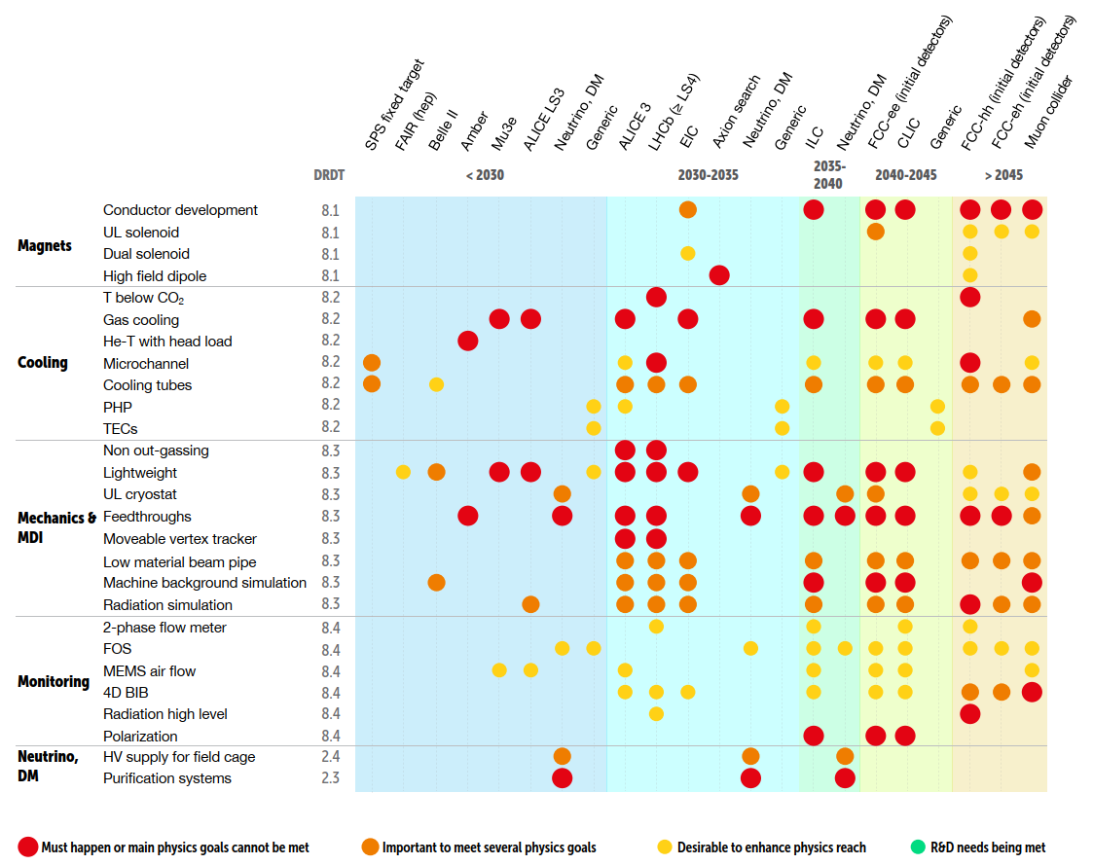
Back-up slide
DRDT 8.1 - Develop novel magnet systems.
Magnet requirements are very speciﬁc to the design of the detector. Considering the very long lead time, generic R&D programmes must be established and maintained on dedicated conductors and prototyping to achieve the variety of magnet speciﬁcations.
2021 ECFA Detector Research and Development Roadmap
M. MENTINK | EP - WP8 - Detector Magnet R&D

