Slide 1
EP R&D Day 2022
WP5.2 powering solutions
S. Michelis, G. Ripamonti, P. Antoszczuk, G. Bantemits, K. Khalife,
M. Balutto, L. Johansson , N. Galante
20/06/2022

Slide 2

Team players
Today working on the RD WP5.2:
  Stefano Michelis (Staff, DCDC project coordinator)
  Giacomo Ripamonti (Staff)
  Pablo Antoszczuk (WP5 Fellow)
  Georgios Bantemits (WP5 Fellow)
  Khalil Khalife (WP5 Internship from EPFL)
  Marco Adorno (Fellow, ASIC support team)
  Alessandro Caratelli (Staff, ASIC support team)
People that have contributed in the past:
  Mattia Balutto (WP5 Technical Student)
  Leo Johansson (WP5 Internship from EPFL)
  Nicolas Galante (WP5 Internship from EPFL)

Slide 3
Power management and distribution
Detector
(high radiation)
Low voltage
High current
Power supplies
DC-DC converters
High voltage
Low current

Slide 4



Power management ASICs: projects
Stage 1:
$$2.5V→1.2V$$
$$48V→12V$$
Stage 2:
Stage 3:
$$12V→2.5V$$
bPOL48V
POL buck converter
(0.35 µm HV-CMOS and GaN)
bPOL12V
bPOL2V5
linPOL48V
Linear regulator
(0.35 µm HV-CMOS)
rPOL48V
GaN-based switched-tank resonant converter
WP5 R&D
Developed in the past
WP5 R&D and now in production grade/in production
WP5 R&D and KT funds
Already developed outside WP5

Slide 5

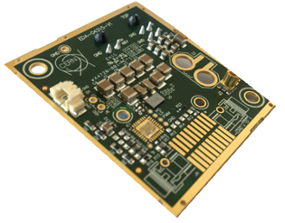
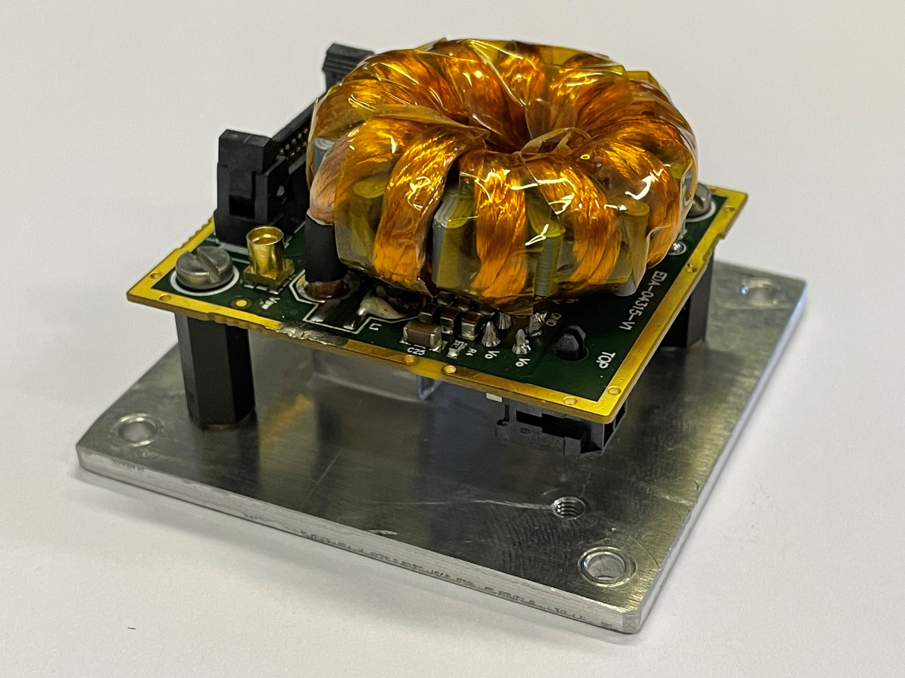
Stage1
bPOL48V: 48V-input buck DC-DC converter
bPOL48V is composed by:
a commercial Gallium Nitride (GaN) power stage EPC2152
a rad-hard controller designed by CERN (Si_Buck_Controller) in the
Silicon HV-CMOS OnSemi I3T80 technology
RD with WP5 of only 2.5 years. Already in production
Possible big customers:
  ATLAS Lar calorimeter
  Space industry
Success of this project due to:
  maturity of the EP-ESE-ME knowledge in High Voltage CMOS technology
  maturity of the GaN technology
  close collaboration with GaN manufacturer
specs | Vin max | 48V
 | Typ Vout | 12V
 | Iout max | 12A
Rad specs | TID max | 228 Mrad
 | SEE max | 88 MeV/(mg/cm²)
 | DD max | 4e14 n/cm2 2.23e14 p/cm2(30MeV)
Production | 26000 dies produced
NB
TID=Total Ionizing Dose
SEE= Single Event Effect
DD= Displacment Damage

Slide 6
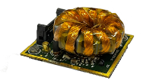
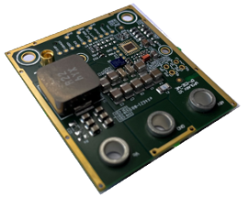
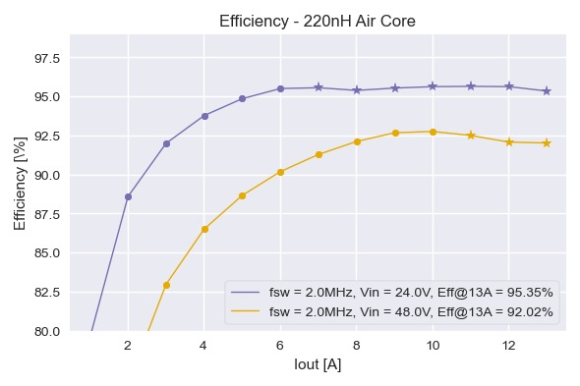
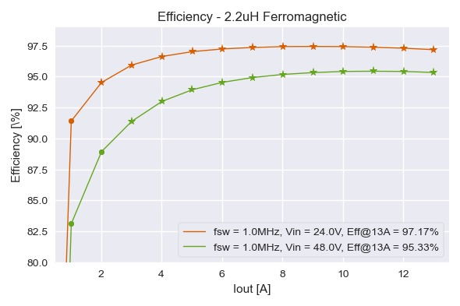
Stage1
bPOL48V: 48V-input buck DC-DC converter

Slide 7
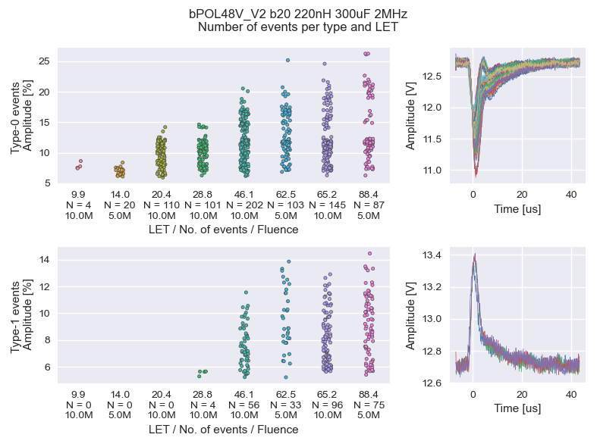
Stage1
bPOL48V: 48V-input buck DC-DC converter
TID (Total Ionizing Dose)
SEE (Single Event Effect)
Succesfully tested up to LET=88 MeV/(mg/cm²) (space grade)
Only fast transients seen (2-3us), no permanent damage or long-resets
For CERN applications LET=46 MeV/(mg/cm²) transients are less than 20% of Vout

Slide 8
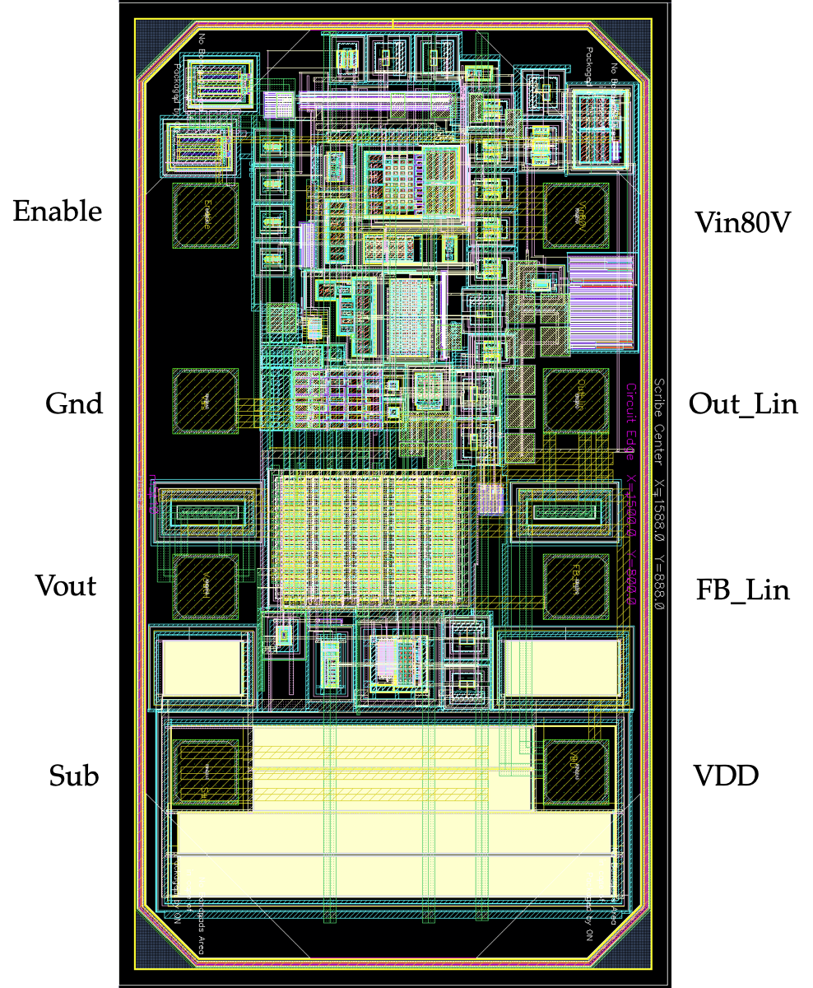
Stage1
linPOL48V: 48V-input linear regulator
LinPOL48V is a rad-hard linear regulator designed in the HV-CMOS OnSemi I3T80 technology,
available in DFN8 package
RD with WP5 of only 2.5 years. Already in production
specs | Vin max | 48V
 | Typ Vout | 12V
 | Iout max | 200mA
Rad specs | TID max | 700 Mrad
 | SEE max | 88 MeV/(mg/cm²)
 | DD max | 4e14 n/cm2 2.23e14 p/cm2(30MeV)
Production | 30000 dies produced
NB
TID=Total Ionizing Dose
SEE= Single Event Effect
DD= Displacment Damage

Slide 9
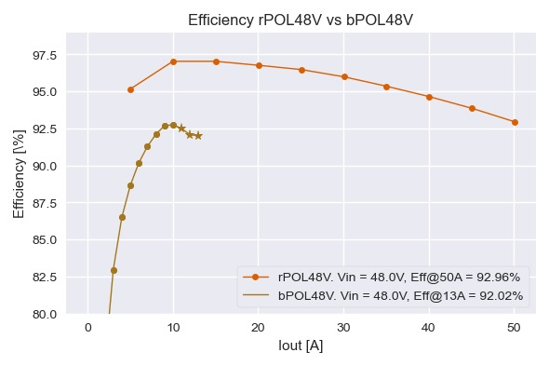
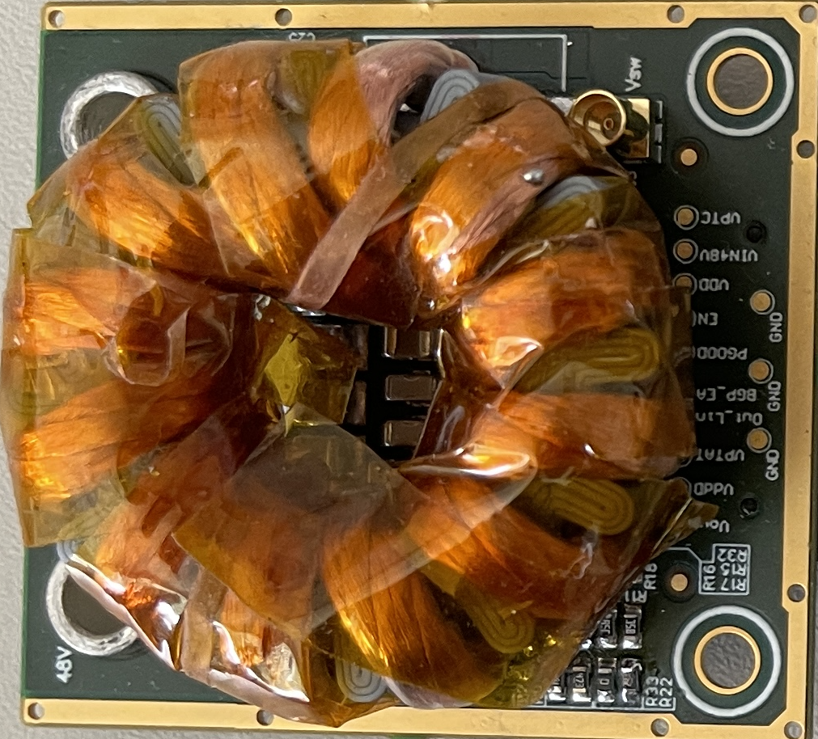
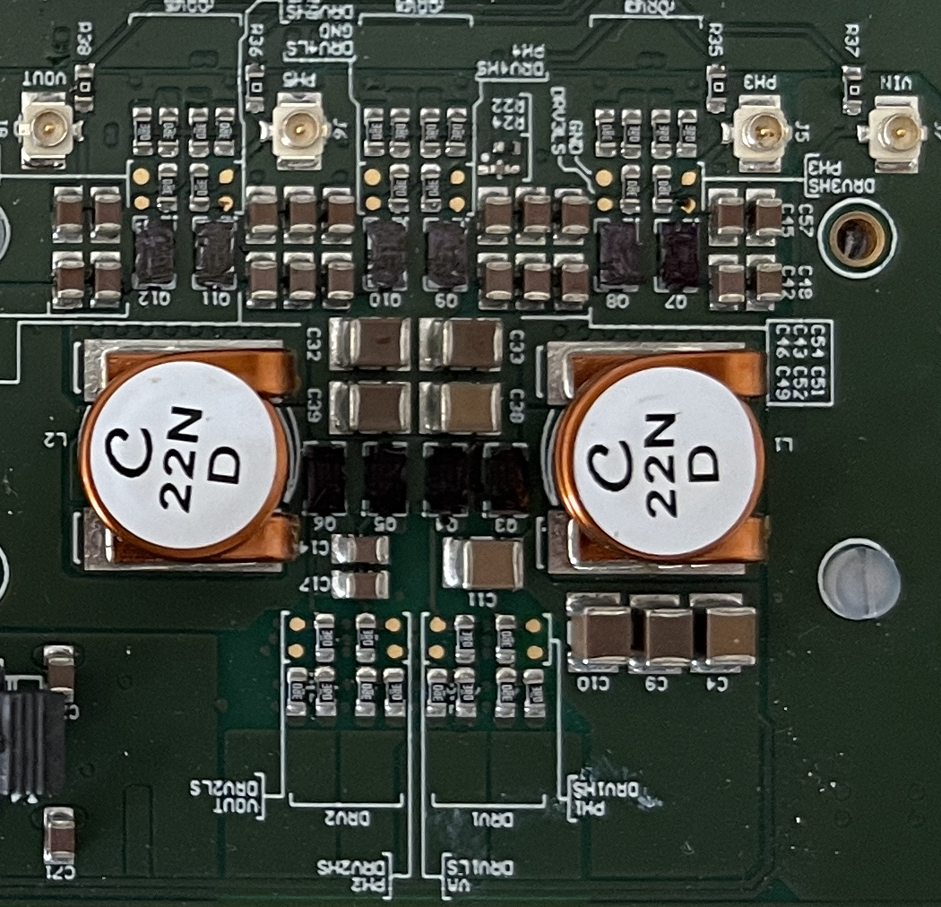
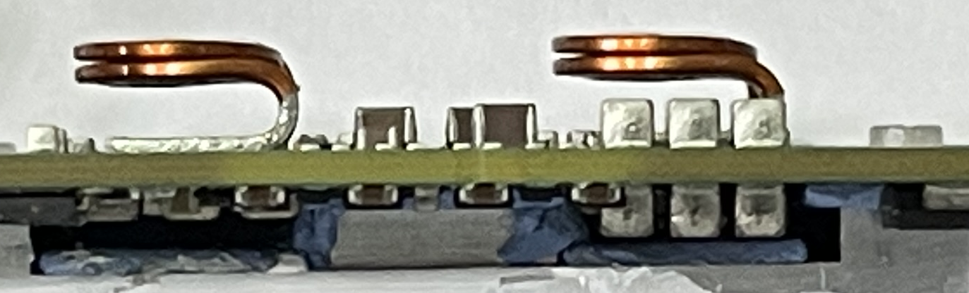
Stage1 R&D
rPOL48V: 48V-input Switched Tank Converter (STC)
rPOL48V is a WP5.2/KT-fund development in collaboration with University of Udine, aiming to a 50A very compact and efficient DCDC converter, fixed ratio 4. First prototype is built with commercial non-rad hard controller, as demonstrator
bPOL48V (buck) vs. rPOL48V (resonant)
production grade

Slide 10





What Next? Future development for long term R&D in WP5
Stage 1: $48V→12V$
Stage 2: $12V→2.5V$
Stage 3: $2.5V→1.2V$
Today:
  RD on bPOL48V finished,
  30 wafers produced
bPOL48V
(Si_buck_controller + EPC2152)
bPOL2V5
bPOL12V
  Si_Buck_Controller &
  linPOL48V Fab (I3T80) is closing
linPOL48V
rPOL48V
Future R&D:
  Not originally included in the WP5 RD program
Stage 1: $48V→5V$
Stage on FE-chip: $5V→0.9V$
  New HV Stage1 (HV CMOS technology and GaN)
  DCDC converter in 28nm TSMC
new bPOL48V
28nm DCDC+LDO

Slide 11
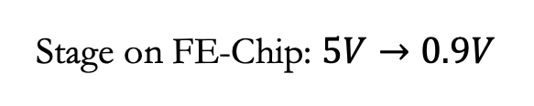

Future development for long term R&D in WP5
Stage 1: $48V→5V$
Stage on FE-Chip: $5V→0.9V$
New bPOL48V
(new controller)
Fully integrated DCDC in
28nm TSMC
All On-Chip (caps, inductor, 200MHz)
+ LDOs
We need to find a new suitable High Voltage technology and test it for radiation.
Full radiation caracterization takes at least 1 year
Design and production of test chips
Radiation testing:
  TID (Total Ionizing Dose)
  SEE (Single Event Effect)
  DD (Displacement Damage)
28nm TSMC technology already fully characterized for radiation

Slide 12
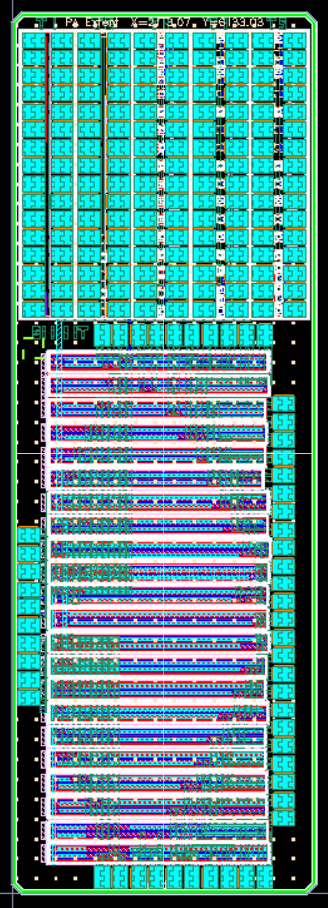
Future R&D
Stage 1: HV technology
OnSemi I4T radiation results
Transistor Voltage (V) | TID (total Ionizing dose) | SEE (Single Event Effect), mainly SEB (Single Event Burn-out) |  | DD (Displacement Damage)
1.8 | ok | ok |  | On-going in Irrad facility
3.3 | Leakage, very large Vth degradation | ok
15 | High leakage in NMOS | All NMOS suffers of SEB PMOS OK | SEB at 11V
30 | High leakage in NMOS |  | SEB at 20V
45 | High leakage in NMOS |  | SEB at 25V
70 | High leakage in NMOS |  | SEB at 30V
Work in progress to find an alternative for:
HV CMOS technology
OnSemi I4T: 2 testchips submitted in 2021 in I4T OnSemi technology. Outcome not very promising
OnSemi I3T80 in Gresham: Onsemi is moving the production to the US Fab. Testchips are being manufactured
ST 0.16 BCD SOI: we try to get the PDK and design testchips
GaN technology:
close collaboration with EPC
IMEC GaN 200V: testchips are in their way to CERN

Slide 13
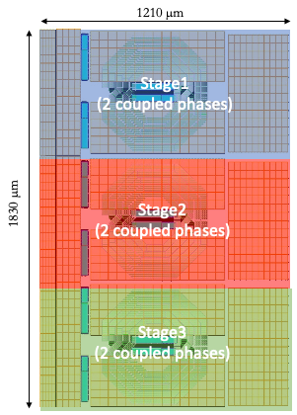
Future R&D
Stage On-Chip in 28nm technology 5V -> 0.9V
  Added value:
  precise power distribution on-chip
  possible to have different voltage domains from only one input voltage at 5V
  large reduction of input current (factor 4)
  radiation tolerance up to 1Grad
  fully integrated including all passive components, relaxing PCB design
  based on a resonant modular architecture
  Design started, submission of the first prototype in Nov 2022
  Linear regulator design is ongoing in collaboration with
  TU university of Graz

Slide 14
Summary
Name | Status | Availability | WP5 plan
bPOL48V | Fully tested Radiation tolerance OK TID, DD, SEE | Already produced 30 wafers available ~30k samples | Originally the only planned activity
linPOL48V | Fully tested Radiation tolerance OK TID, DD, SEE
rPOL48V | First prototype Tests ongoing Commercial drivers FPGA control Rad-hard controller being designed at CERN |  | Side development with also KT funds
Technology characterization | OnSemi I4T OnSemi I3T80 from Gresham Fab ST 0.16 BCD SOI IMEC GaN 200V |  | New WP5 R&D added
DCDC converter in 28nm | Design in progress
14

