Slide 1
End-cap yoke considerations and halo muon background
Burkhard Schmidt
07.12.2010

Slide 2
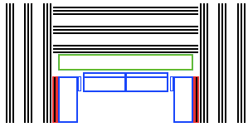
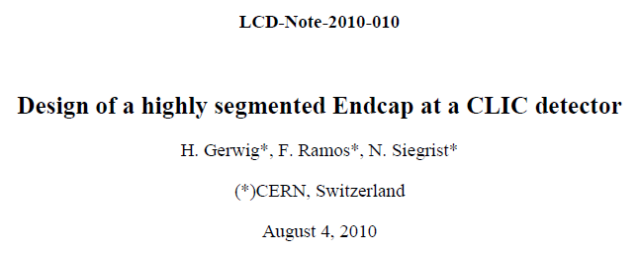
Muon system Layout
Detector Layout:
  3 tail-catcher layers in barrel, 3+1 in EC
  2 x3 additional layers interleaved by about 1m of absorber
  Granularity: about 3cm in both coordinates, matching the HCAL granularity.
Yoke design:
  Note summarizes the status of the work as of early summer.
  The design shown in the note is obsolete.
  Optimization is an iterative process
Not present as such in the present
design, but will be integrated in the EC

Slide 3
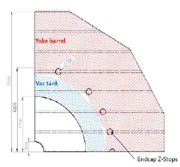
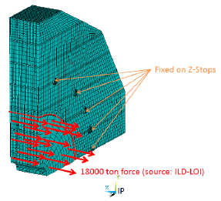
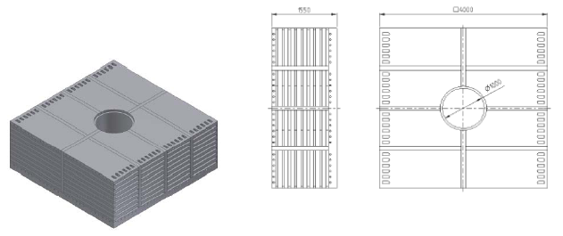
End-cap yoke design
Figures show the old design:
The present CLIC Muon system design has been discussed with Hubert and a new yoke layout is being worked on.
The presence of about 550mm steal blocks without gap is appreciated and simplifies the layout, as most of the stress can be taken by these steal blocks.
An effort is made to minimize the dead space (in the old design 6%) and to avoid ‘blind zones’ for (parallel) background muons.
In a 2nd step, look more closely at the technology implementation.

Slide 4
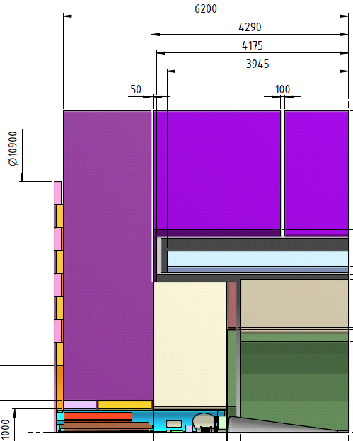
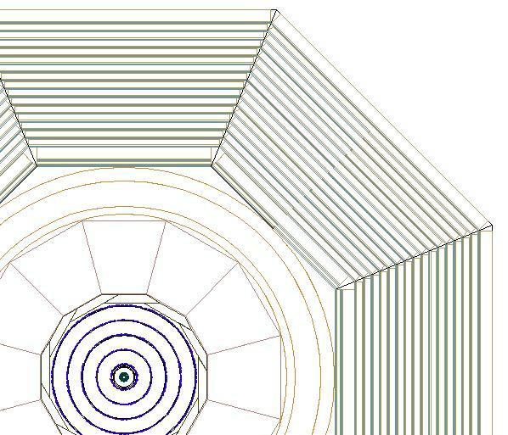
Technology Implementation
CLIC_ILD side view
CLIC_SiD front view
Strip length
  Barrel: ~3m along beam axis 3-4m across octant
  End-cap: Less intuitive. To be looked at with engineers . But strips not longer than ~3m

Slide 5
Halo Muon Background
Number assumed so far:
  Halo muons: ~10³ per bunch, 0.8muons/cm² close to the beamline
  too high !
Latest results of Lawrence Deacon et al.:
  Shown at IWLC October 2010:
  http://ilcagenda.linearcollider.org/getFile.py/access?contribId=259&sessionId=83&resId=0&materialId=slides&confId=4507
1.2E4 muons / train at exit of QF1, 10m upstream of IP, and within a 6m radius of the beam line (assuming 10⁻⁴ of beam hitting spoilers, based on ideal machine, so should be taken as a minimum value).
“Swapped” layout (Rogelio Tomas) – betatron before energy collimation – muon flux is decreased by a factor of 0.4 to 4.8E3 muons/train (presented at IPAC 2010). Modest reduction.

Slide 6
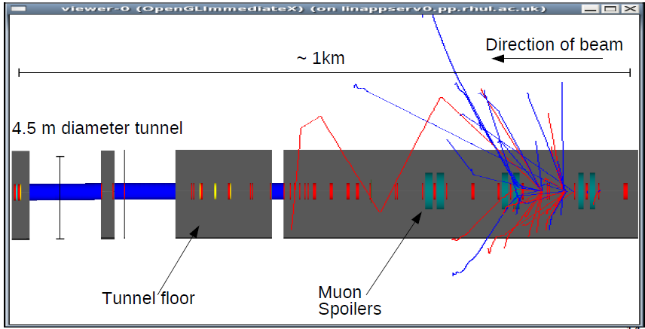
Geometry of cleaning section
1st attempt: The addition of these muon spoilers results in a factor ~0.1 reduction in muon flux to detector
2nd attempt: using a simple iterative process does the same with half the length of spoilers.
Trying to optimize further
Distribution files available at:
https://www.pp.rhul.ac.uk/twiki/bin/view/JAI/ClicMuon

Slide 7
Halo muon background
Next steps:
  Understand results from L. Deacon
  Develop an algorithm to identify halo muons from the geometry simulations by L. Deacon

