Slide 1
HRMT-56: Experimental Results on Irradiated Graphitic Materials for HED

Slide 2
Agenda
Irradiated Materials Overview
The HRMT-56 Experiment
Results Analysis
Conclusions

Slide 3
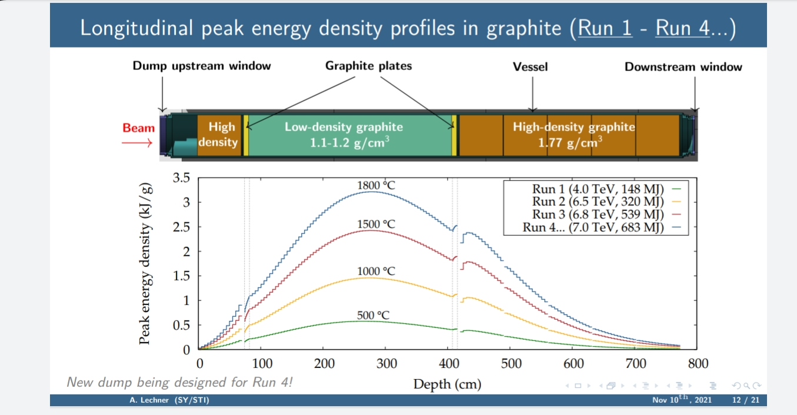
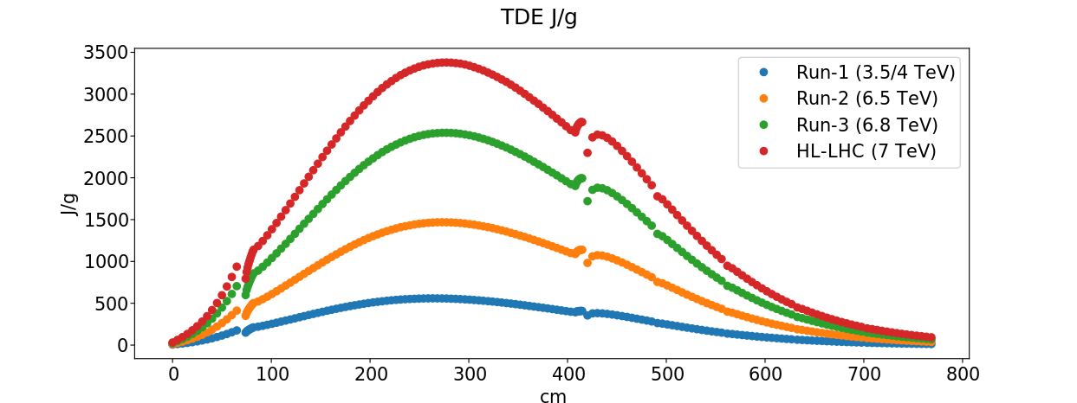
LHC TDE Configuration & Operational Runs
Courtesy of E.Farina & A.Lechner

Slide 4
Irradiated Materials Overview

Slide 5
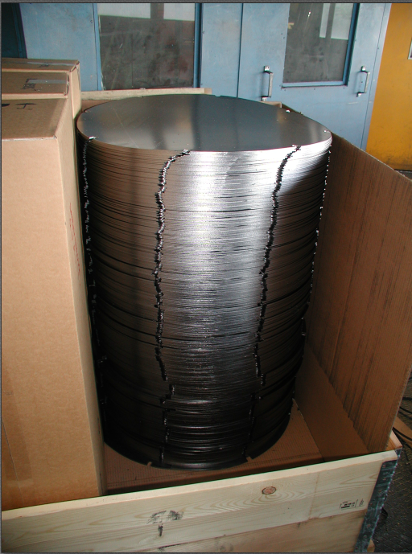
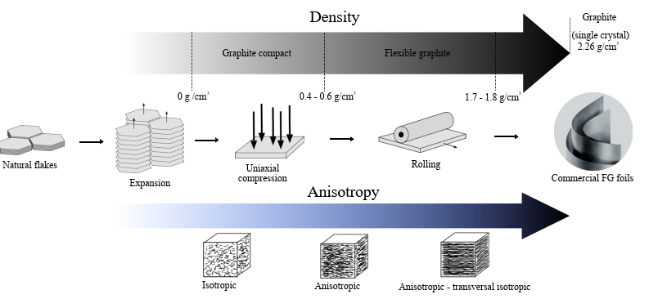
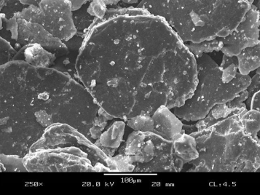
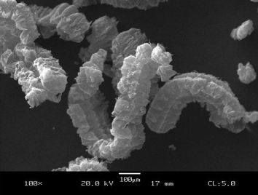
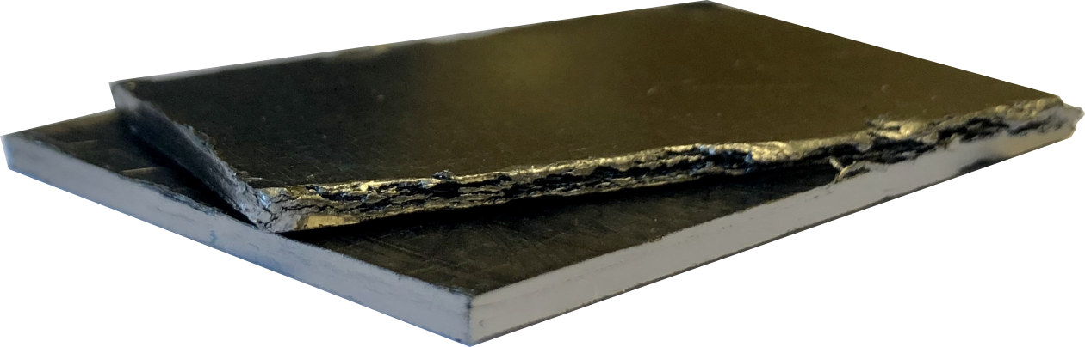
TDE Low-Density Core: Sigraflex®
~1630 sheets of Sigraflex®, 2 mm thick (L20012-C)
SIGRAFLEX
Sigraflex stack of sheets
Notes:
Add expanded graphite (reduced speech)

Slide 6
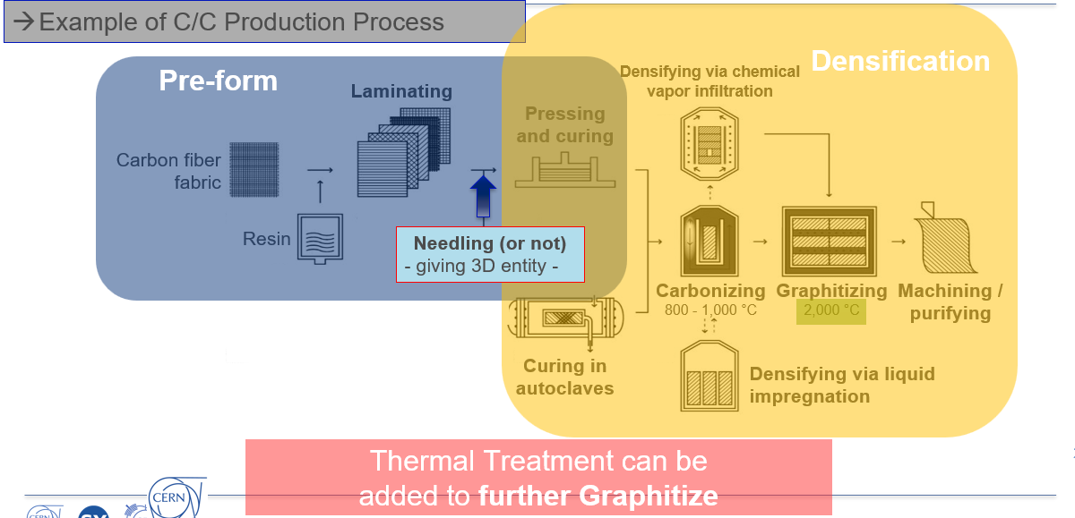
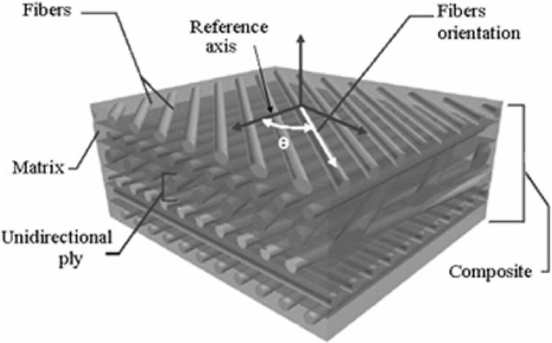
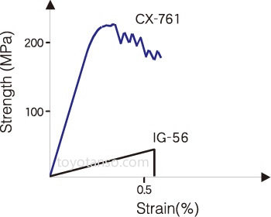
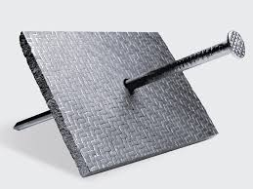
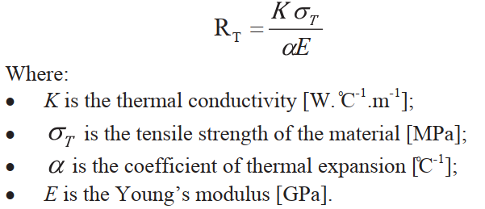
Alternative Options for HL-LHC Dump Core
Low-Density Carbon-based materials such as Graphite and Carbon-Carbon - C/C
C/Cs advantages:
+ Densities and properties can be “tailored”.
+ Hight R_{T} as of compared to Graphite (Better mechanical properties).
+ Non-fragile behaviour (also wrt crack propagation).
C/C
Graphite
Brittleness
- Adjustable mechanical and thermomechanical properties.
- 30 grades from 6 different EU producers under assessment.
- 3D Carbon/Carbon composites for beam intercepting devices at CERN (F.X.Nuiry et al.)
- Full Scale Proton Beam Impact Testing of new CERN Collimators and Validation of a Numerical Approach for Future Operation (M.Bergeret, F.X.Nuiry et al.)
Notes:
Consideration as the best alternative to compose the dump core

Slide 7
C/C Tailoring of Industrial grades
Density and HTHT influence mechanical and thermomechanical properties of grades
Higher density:
- Similar CTE
- Higher Thermal Conductivity
- Stronger (↑ σ_{T} ) but stiffer (↑ E)
(Relation depends on specs. For each material)
Higher T during HTHT:
- Stability to material throughout T span (Specially wrt CTE values)
- Increases Thermal Conductivity
- Increases mechanical properties (↑σ_{T} /E) but up to a limit related to Graphitization
Characterizations required as inputs for simulations

Slide 8
The HRMT-56 Experiment

Slide 9
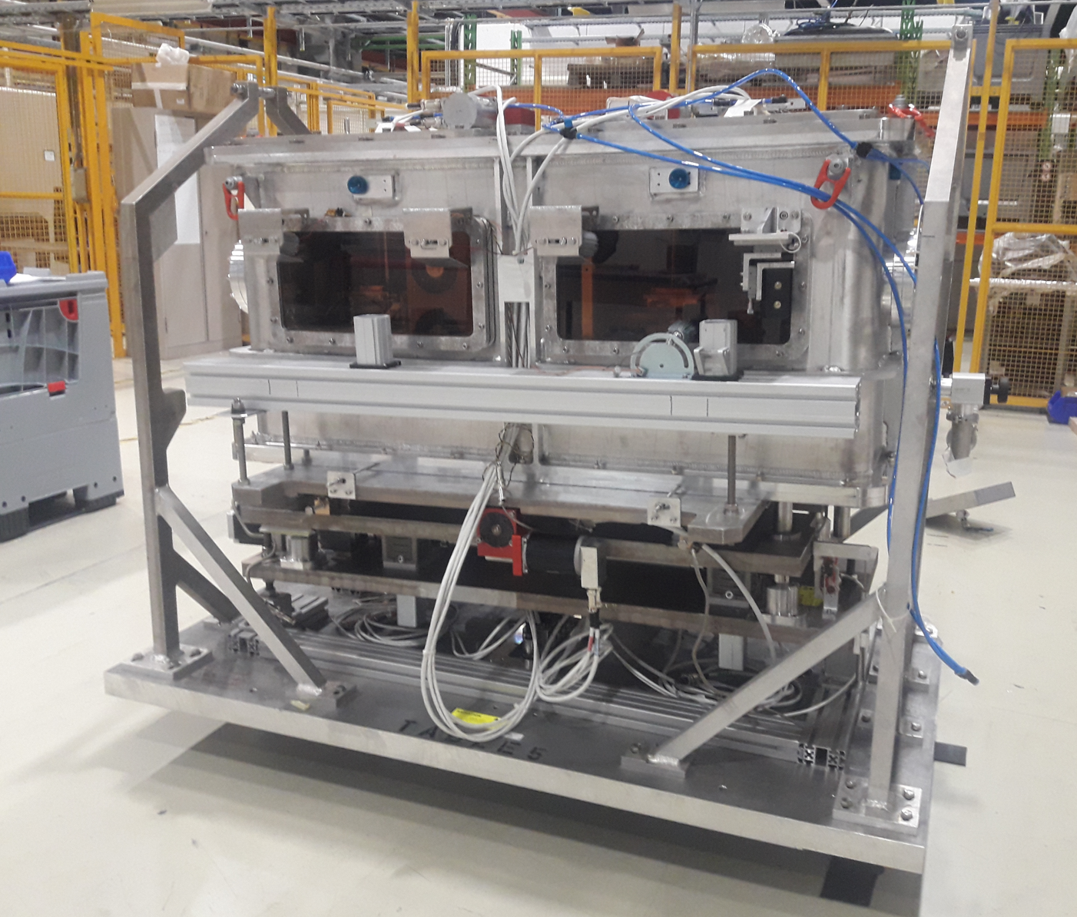
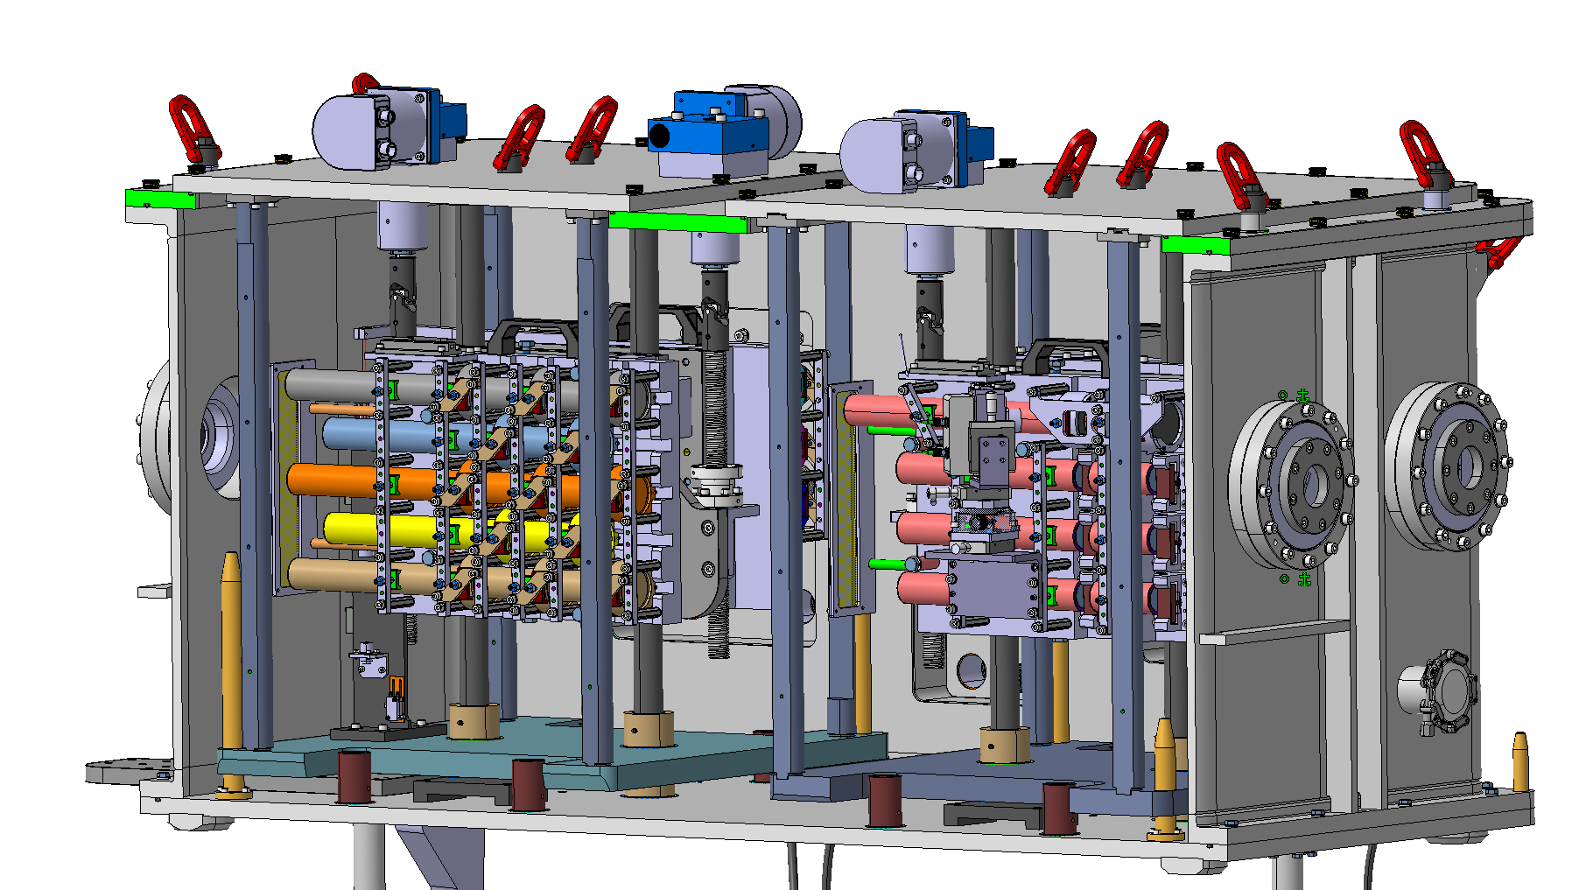
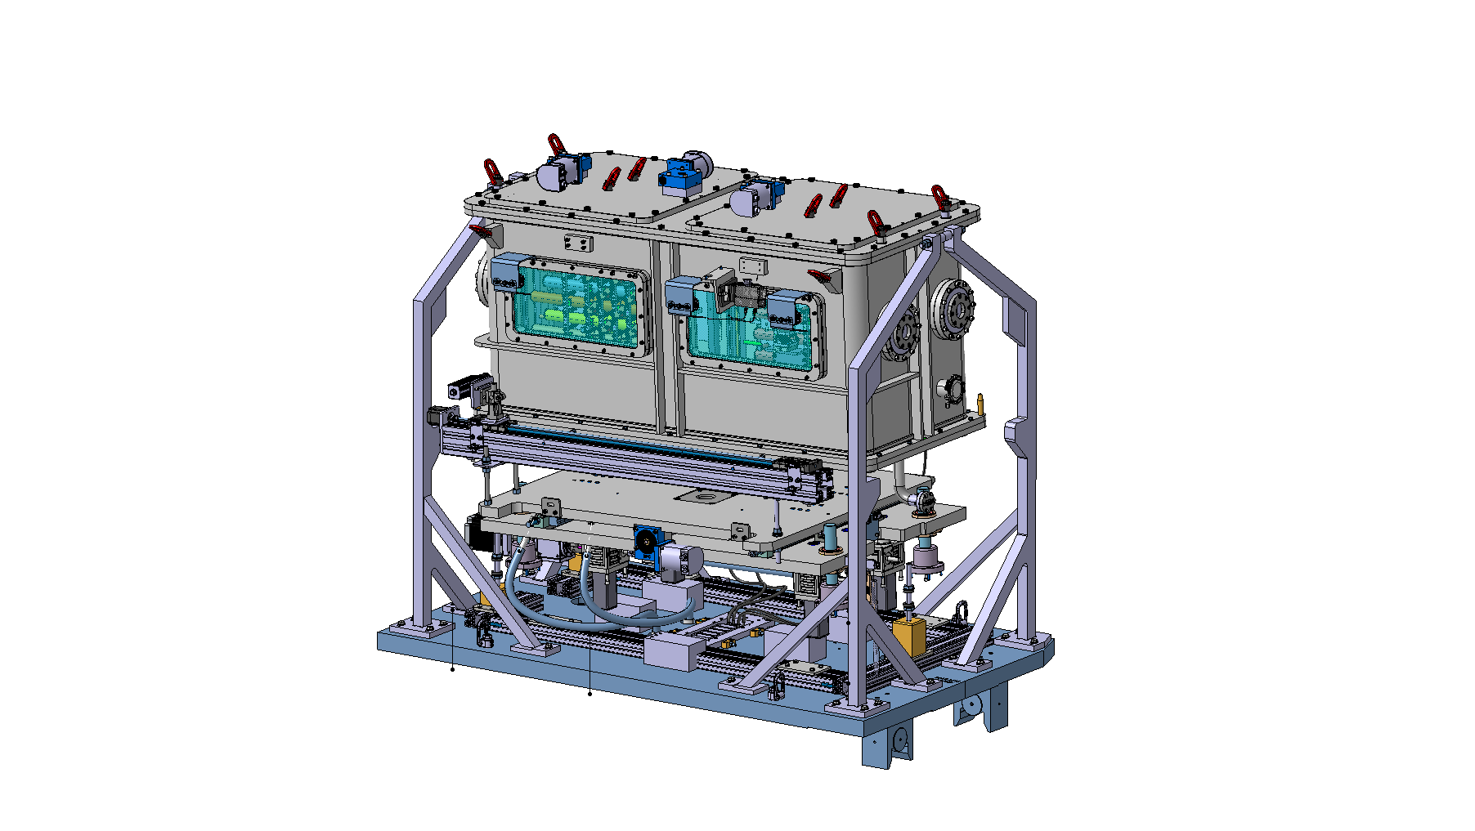
HiRadMat-56 [HED = High-Energy Dumps]
Beam gotten w44/21 (November 2021)
Complete Pulse List attained successfully – 77 pulses in total (~2,65x10¹⁵ protons)
Beam parameters:
440 GeV / 1.2e11 ppb
beam
HRMT-56 tank CAD model
HRMT-56 tank CAD model – cut view
Notes:
Add two/three legends
Add BEAM
4 TS
440GeV a 1.2e11 p+

Slide 10
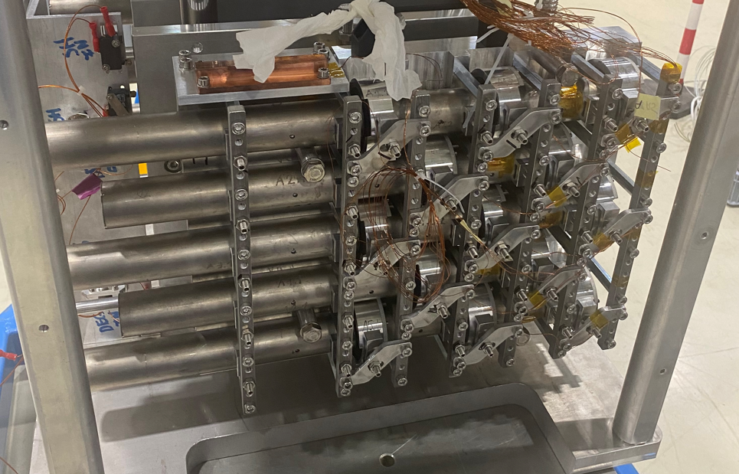
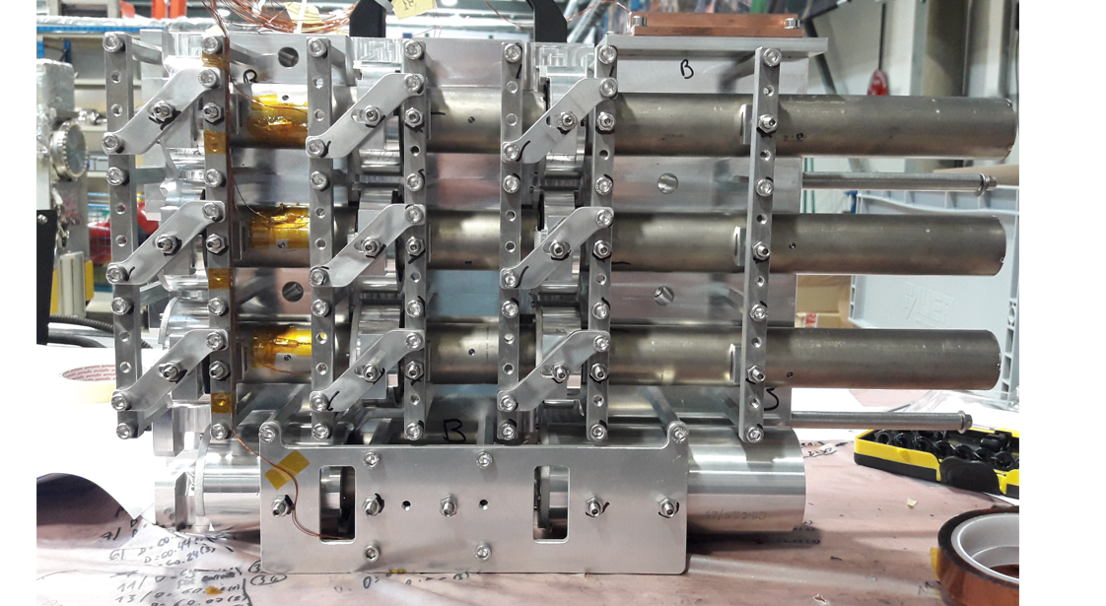
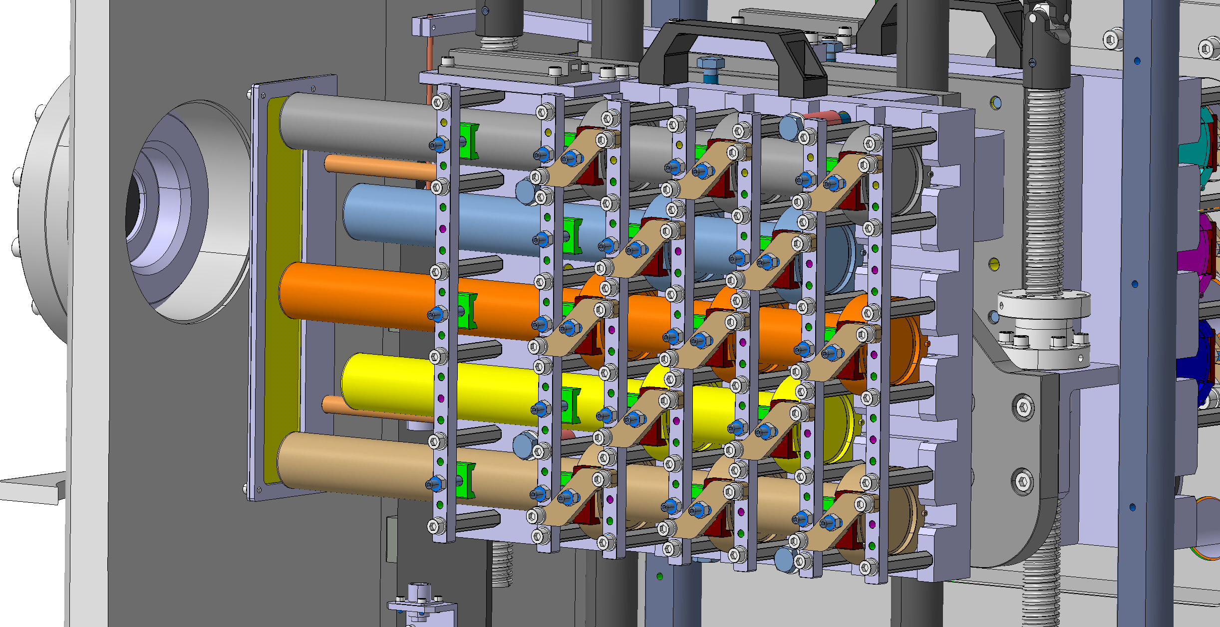
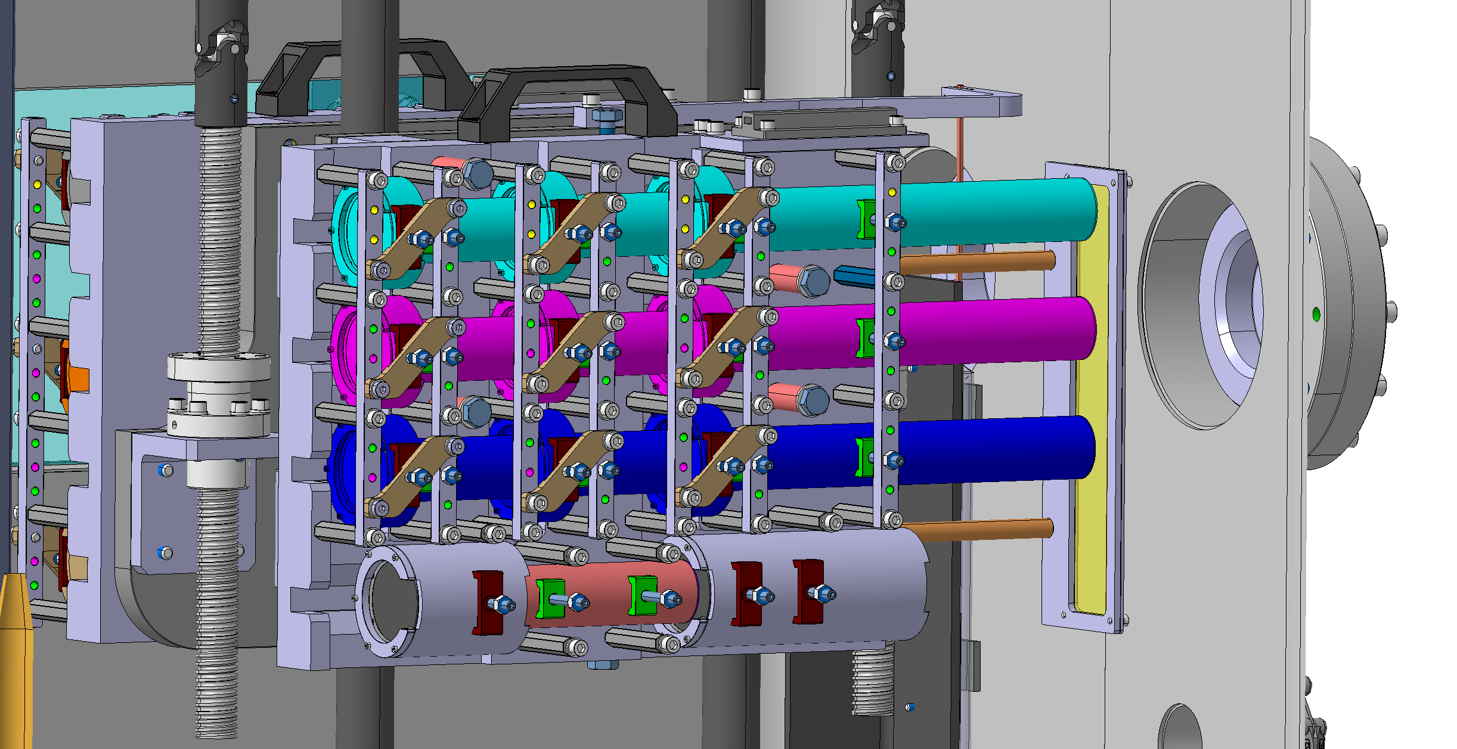
Target Station A & B: HL-LHC TDE
Target St.B | Number | Length | Instrumented
Total Targets | 9 | 20 mm | No
 | 2 | 150 mm & 75 mm | No
Total TiB₂ Diluters | Long = 3 | 250 mm | No
 | Inter. = 1 | 120 mm | Yes ([1x] PT100)
 | Short = 8 | 80 mm | Yes (3 → [1x] PT100)
Target St.A | Number | Length | Instrumented
Total Targets | 13 | 21 mm | No
Total TiB₂ Diluters | Long = 5 | 250 mm | No
 | Short = 8 | 80 mm | Yes (5 → [1x] PT100)
1
beam
beam
HL-LHC Beam Dump material targets (1)
HL-LHC Beam Dump material targets (2)

Slide 11
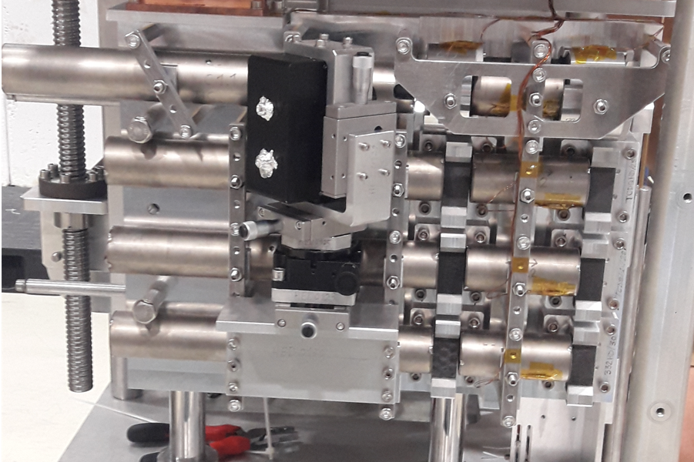
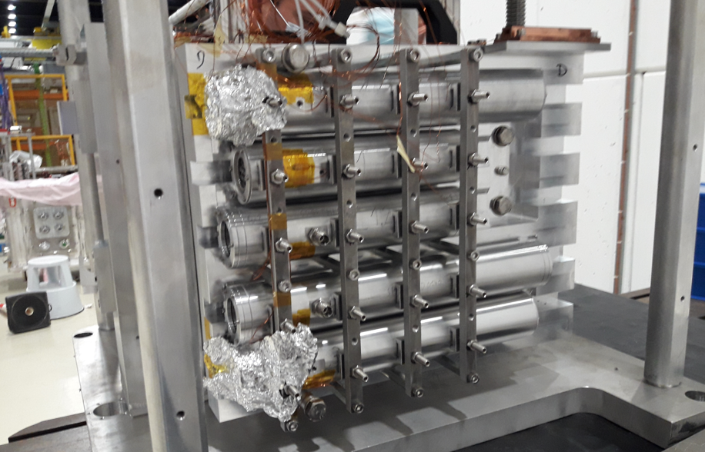
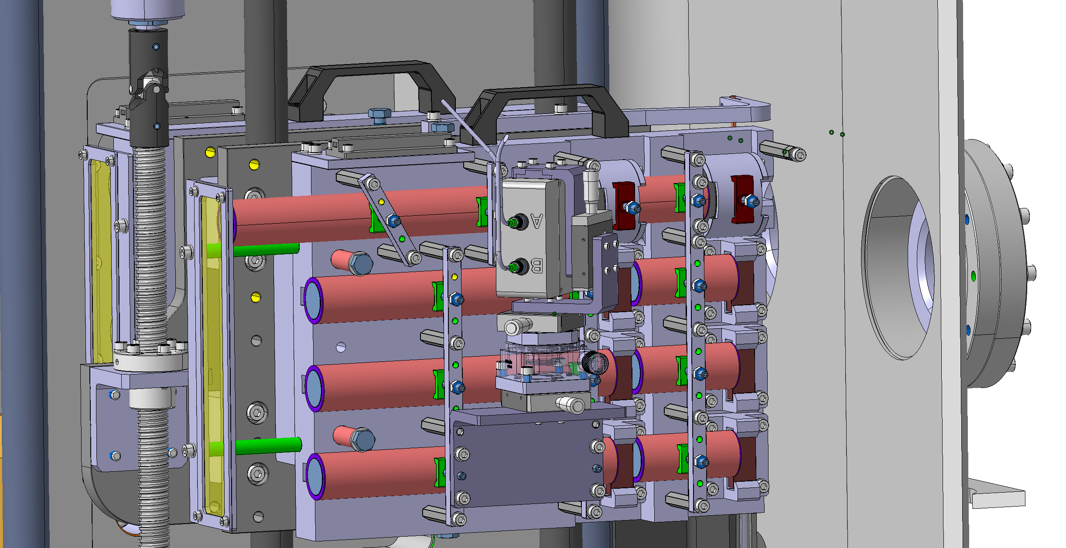
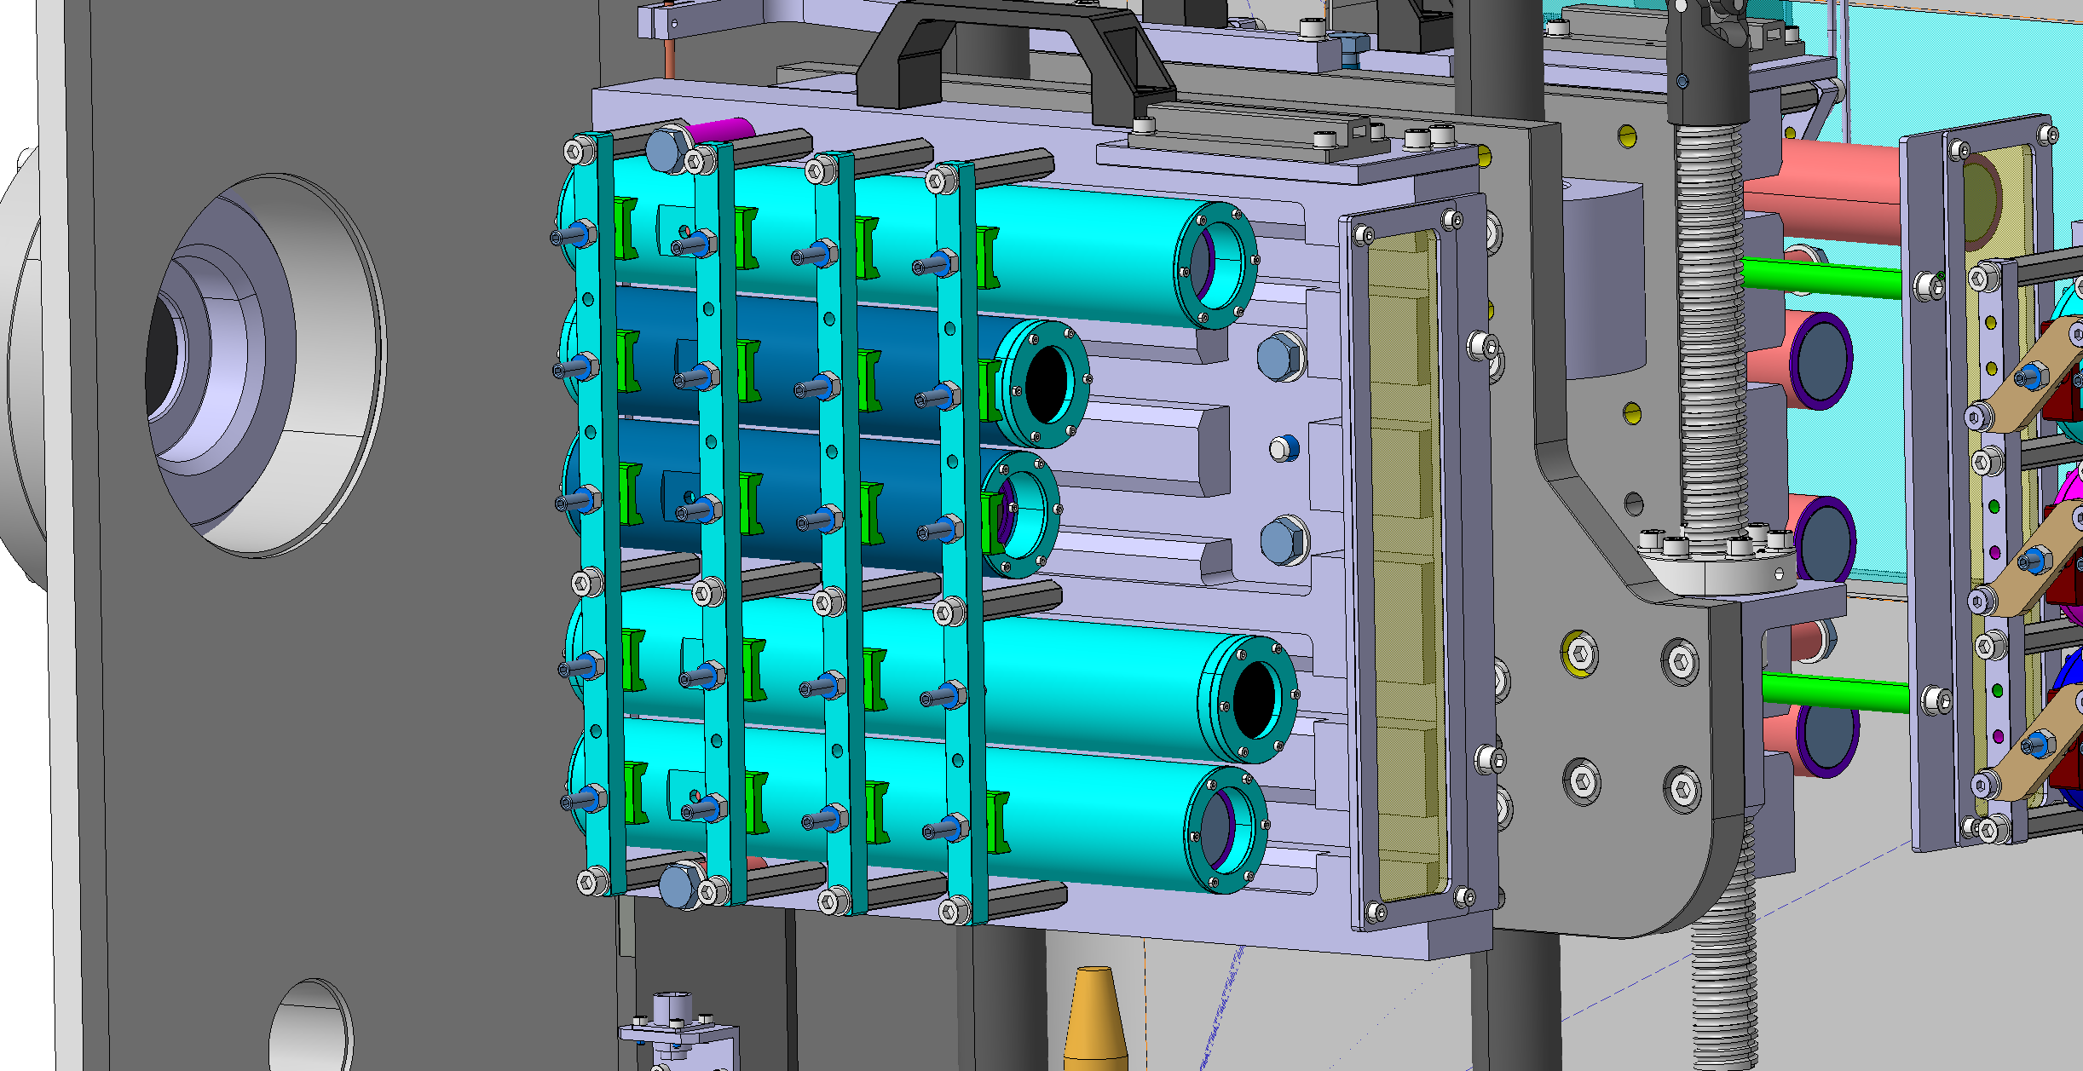
Target Stations C & D: FCC-ee + TCDQ/S & Sigraflex®
Target St.C | Mat. | Number | Length | Instrumented
Total Targets | C | 2 | 30 mm | Yes [x1] – LDV. Int
 |  | 6 | 20 mm | Yes [x3] - LDV. Ext
Total Diluters | TiC | Long = 1 | 300 mm | Yes ([1x] PT100)
 |  | Short = 1 | 60 mm | Yes ([1x] PT100)
Total Diluters | TiB₂ | Long = 3 | 250 mm | No
 |  | Short = 3 | 80 mm | Yes (3 → [1x] PT100)
Target St.D | Number | Length | Instrumented
Total Targets | 2 | 220 mm | Yes ([1x] PT100)
 | 3 | 320 mm | Yes ([1x] PT100)
beam
beam
FCC-ee & TCDQ/s material targets
LHC-TDE Sigraflex for Run3 targets

Slide 12
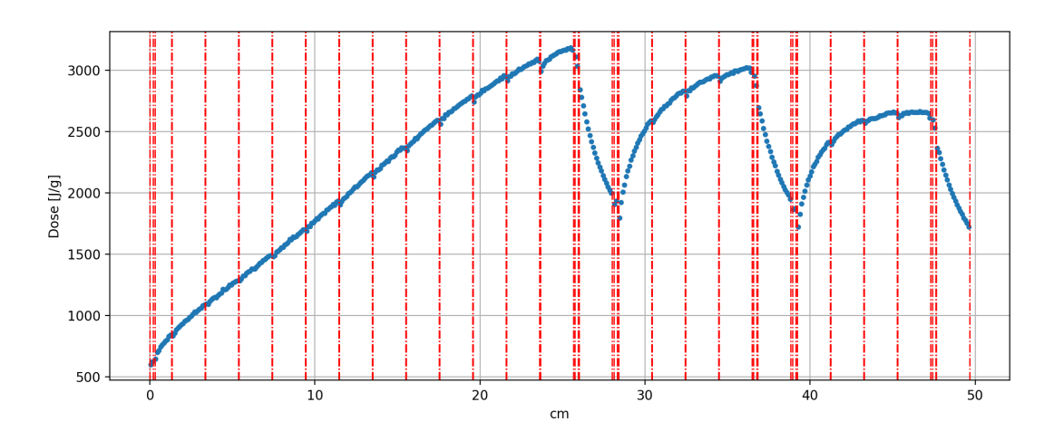
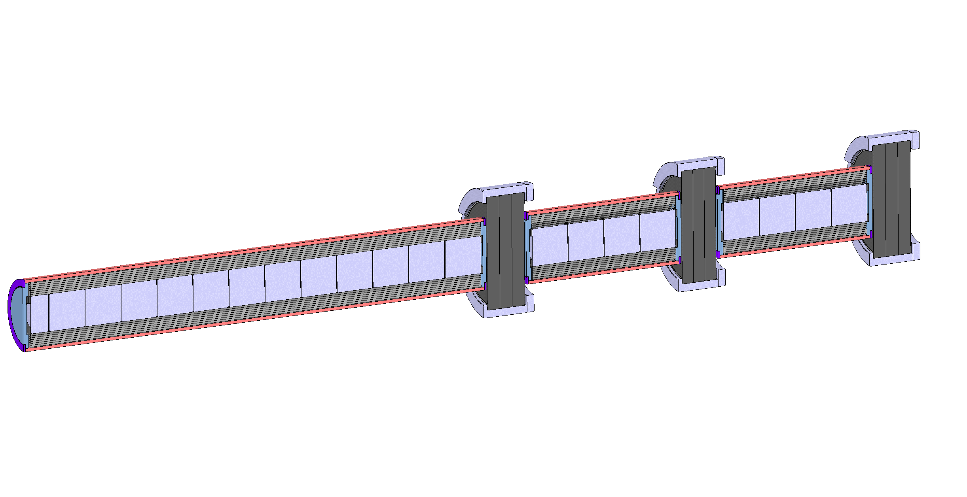
Target Station A & B: HL-LHC TDE
Peak Energy Density into target train (Courtesy of E.Farina & A.Lechner)
Targets
21 mm of C/C - Ø 60 mm
(3 slices)
1.7 g/cm³
Diluter up → 250 mm TiB2 Ø20mm / (20 mm slices)
1.5 g/cm³
1.1 g/cm³
Peak E dose = 2.32 kJ/g
beam
Peak E dose = 2.62 kJ/g
Peak E dose = 2.75 kJ/g
Example of Target Train for HRMT-56 beam impact
Diluters mid & down → 80 mm TiB2 Ø20mm / (20 mm slices)

Slide 13
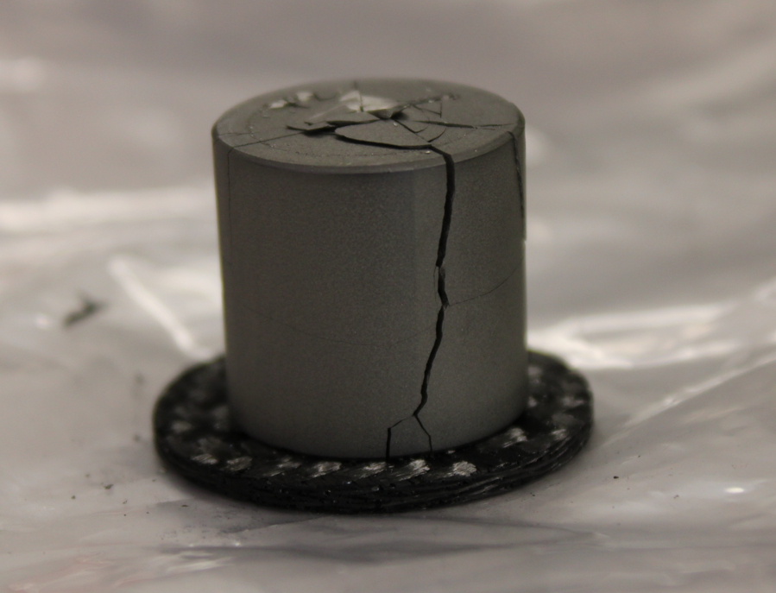
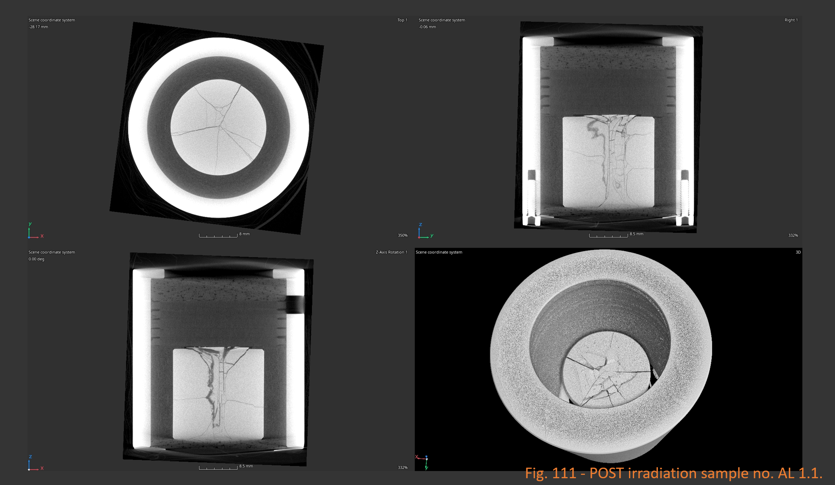
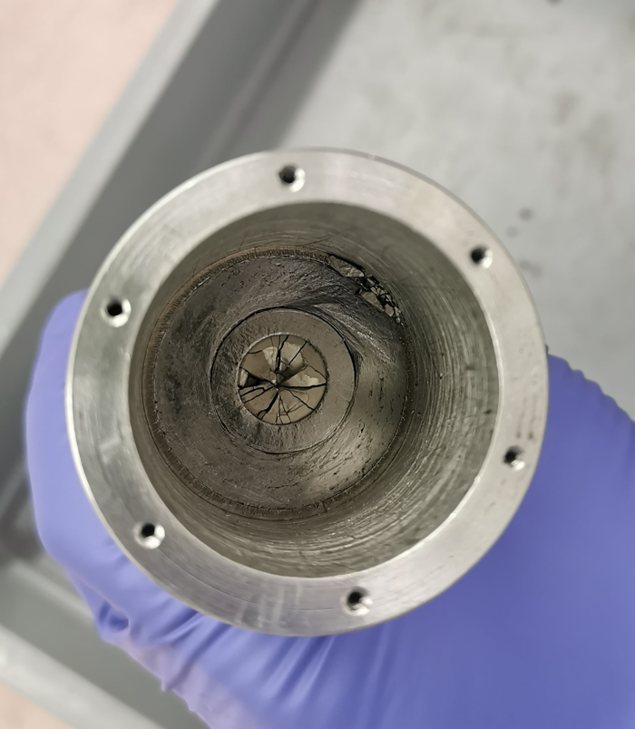
Diluters TiB₂

Slide 14
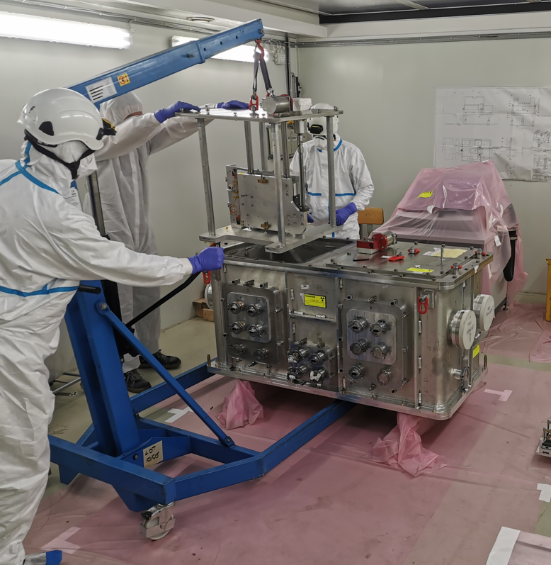
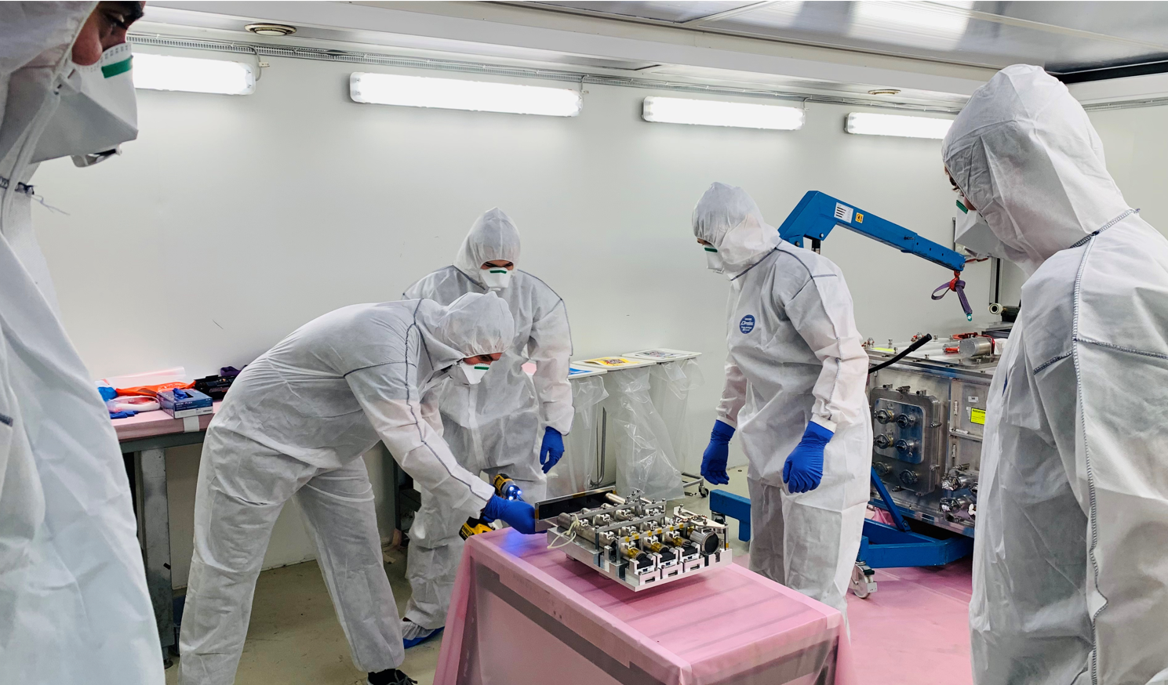

Slide 15
PIE - Results Analysis

Slide 16
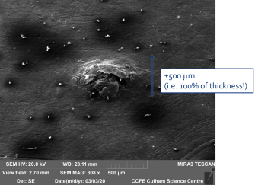
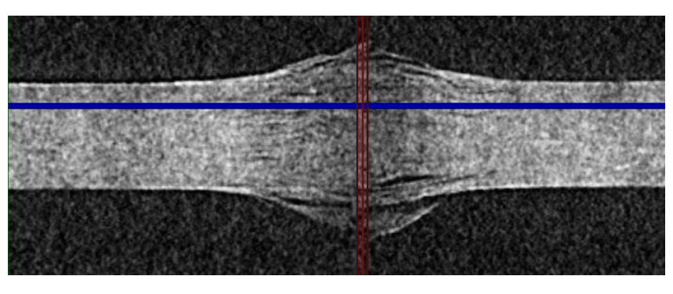
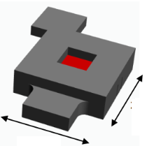
TDE Low-Density Core: Sigraflex®
HRMT- 43 (2018) test
u-CT scan
SEM
One single beam impact
One sheet
Sample was in Air
Sample was unconstrained
24 mm
beam
0.5 mm thickness
Energy deposited ~ 2.46 kJ/g (in 7.2 µs)
LHC Run3 peak energy density
- Delamination & flakes fracture within the bulk
Bump of over 200 µm of both sides (-> permanent damage)
Experimental conditions were not fully controlled
Investigation of SIGRAFLEX samples exposed in the HiRadMat facility: https://edms.cern.ch/document/2380563/1

Slide 17
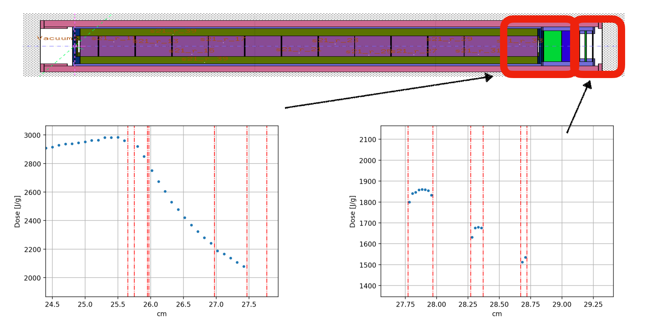
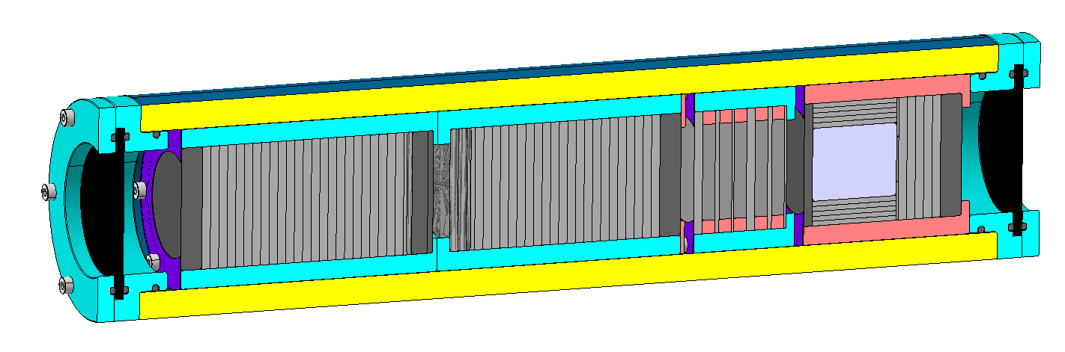
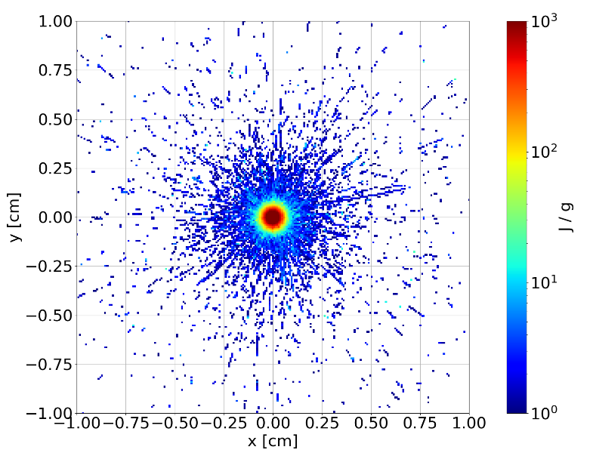
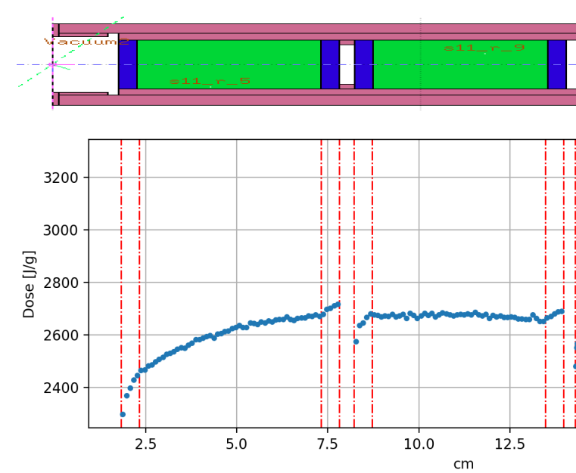
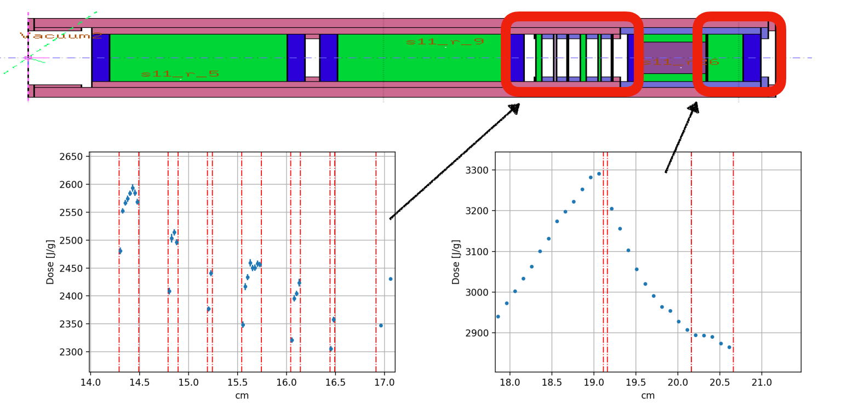
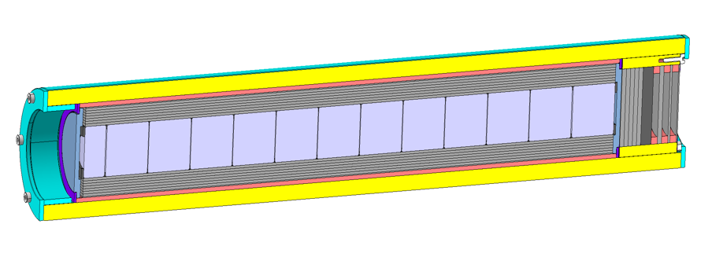
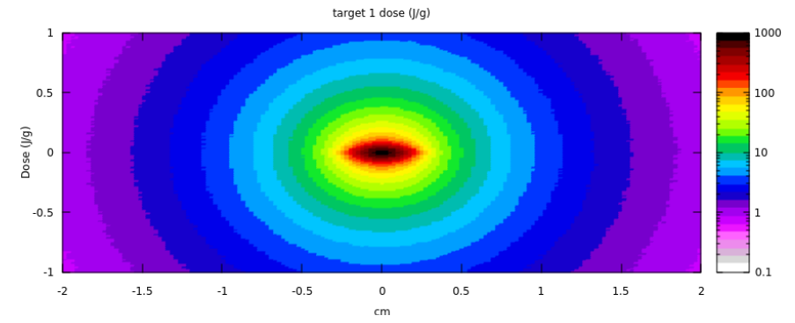
HRMT-56 [HED] – Sigraflex studies (N₂ and VACUUM)
Sigraflex 1.2 (= 1.1) Target
BEAM 1 =
0.25 x 0.25 mm
Diluter of TiB2: Ø20mm
Length 20 mm
Max. Peak E = 2.6 - 2.7 kJ/g
Constrained configuration - Uncompressed
1.2 g/cm3, t = 2 mm
50 mm
10 mm
50 mm
Constrained - Uncompressed
1.2 g/cm, t = 2mm
Constrained configuration – Compressed 5%
1.2 g/cm3, t = 2 mm
Free sheets:
t = 2/1/0.5 mm, 1.0 g/cm3
t = 2/1/0.5 mm, 1.2 g/cm3
Max. Peak E = 3.2 kJ/g
Max. Peak E = 2.7 kJ/g
Max. Peak E = 2.60 – 2.37 kJ/g
BEAM 2 =
1 x 0.34 mm
Max. Peak E = 1.85 – 1.5 kJ/g
Free sheets:
t = 2/1/0.5 mm, 1.2 g/cm3
Sigraflex 2.1 (= 2.2) Target
Diluter of TiB2: Ø20mm
Length 250 mm
Constrained - Uncompressed
1.2 g/cm, t = 2mm
Max. Peak E = 3 kJ/g

Slide 18
HRMT-56 Sigraflex ® targets type1 (N2 and VACUUM)
Sigraflex 1.2 (= 1.1) Target
Diluter of TiB2: Ø20mm
Length 20 mm
BEAM 1 =
0.25 x 0.25 mm
Max. Peak E = 2.6 - 2.7 kJ/g
Constrained configuration - Uncompressed
1.2 g/cm3, t = 2 mm
50 mm
10 mm
50 mm
Constrained - Uncompressed
1.2 g/cm, t = 2mm
Constrained configuration – Compressed 5%
1.2 g/cm3, t = 2 mm
Free sheets:
t = 2/1/0.5 mm, 1.0 g/cm3
t = 2/1/0.5 mm, 1.2 g/cm3
Max. Peak E = 3.2 kJ/g
Max. Peak E = 2.7 kJ/g
Max. Peak E = 2.60 – 2.37 kJ/g

Slide 19
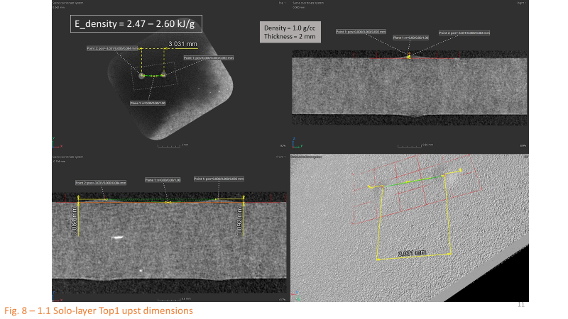
HRMT-56 [HED] – Sigraflex studies
SOLO layers (HRMT-56)
Layer Thickness / Multi-shot vs. Single shot effect in N2
2 mm thick
1 mm thick
0,5 mm thick
2 mm thick
1 mm thick
0,5 mm thick
Relation between layer thickness and damages observed
No clear sign of major effect related with multi-pulses events
x
Specimens much less affected than in HRMT-43
Damaged confined to entry/exit surfaces
Bulk intact

Slide 20
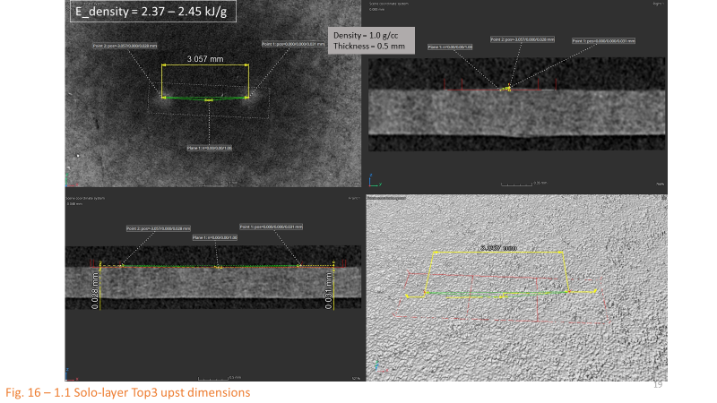
HRMT-56 [HED] – Sigraflex studies
SOLO layers (HRMT-56)
Layer Thickness / Response in N₂ vs. under Vacuum
2 mm thick
1 mm thick
0,5 mm thick
2 mm thick
1 mm thick
0,5 mm thick
Relation between layer thickness and damages observed
Samples irradiated in N2 more damaged than those under vacuum
Specimens much less affected than in HRMT-43
Damaged confined to entry/exit surfaces
Bulk intact

Slide 21
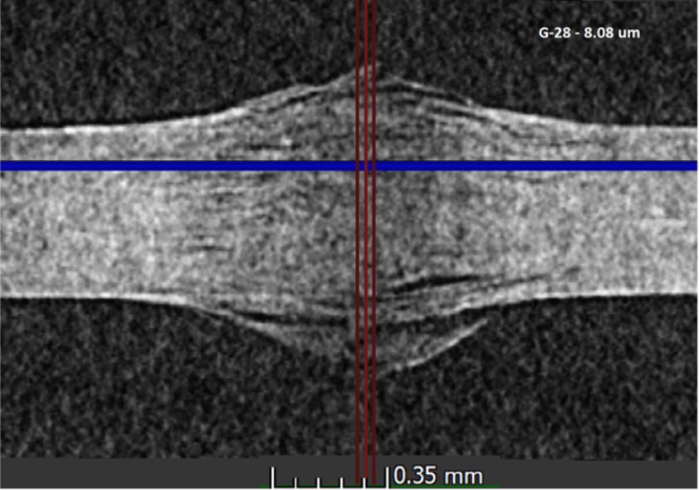
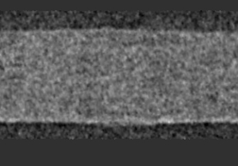
HRMT-56 [HED] – Sigraflex results
SOLO layers (HRMT-43 vs. HRMT-56)
 | HRMT-43 | HRMT-56
Material purity | TH/Z grade (C > 99.85%) – F05010TH | NH/C grade (C > 98%) – F05010C
Density | 1.0 g/cm³ | 1.0 g/cm³
Environment* | Air | Nitrogen (also under vacuum)
Beam Spot Size (σ_{x} , σ_{y}) | “0.25x0.25 mm” | 0.28x0.24 mm (SOLO layers)
Conditioning of Samples** | Workshop (“humid”) | N2 environment and Flushing (“dry”)
Sample thickness | 0.5 mm | 0.5 mm (also 1 mm and 2 mm)
Out of plane deformation | 200 – 250 ums | 20 – 30 ums
Radius of affected area | 0.8 mm | 0.28 mm
Beam Intensity // Peak Energy Density // Event type | G27-G28 ← 1.218e11 ppb, 288b // ̴ 2.47 kJ/g // (1 pulse event) | 1.208e11 ppb, 288b // ̴ 2.45 – 2.35 kJ/g (per pulse) // (3 pulses / 1 pulse)
2 mm thick
1 mm thick
0,5 mm thick
*TDE environment is N2 at slight overpressure to P_{a}.
**Sigraflex Dump conditioning is “somewhere between” dry and humid

Slide 22
HRMT-56 Sigraflex ® targets type2 (N2 and VACUUM)
Max. Peak E = 1.85 – 1.5 kJ/g
Free sheets:
t = 2/1/0.5 mm, 1.2 g/cm3
Sigraflex 2.1 (= 2.2) Target
Diluter of TiB2: Ø20mm
Length 250 mm
BEAM 2 =
1 x 0.34 mm
Constrained - Uncompressed
1.2 g/cm, t = 2mm
Max. Peak E = 2.8 kJ/g

Slide 23
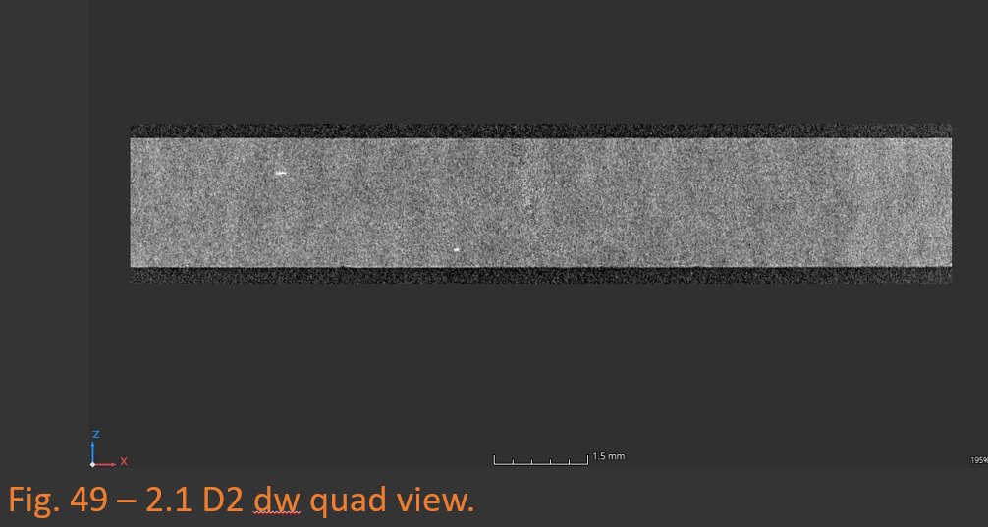
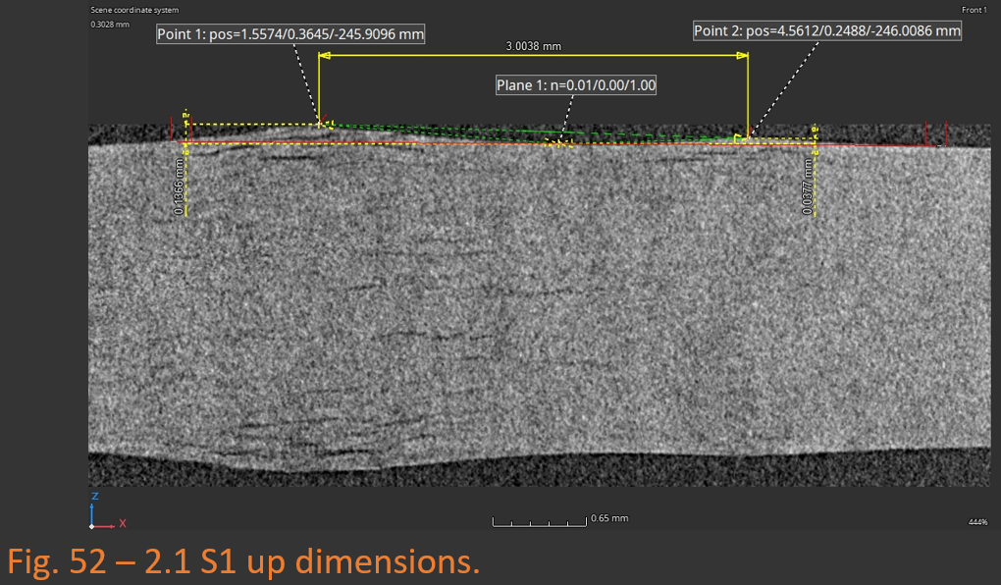
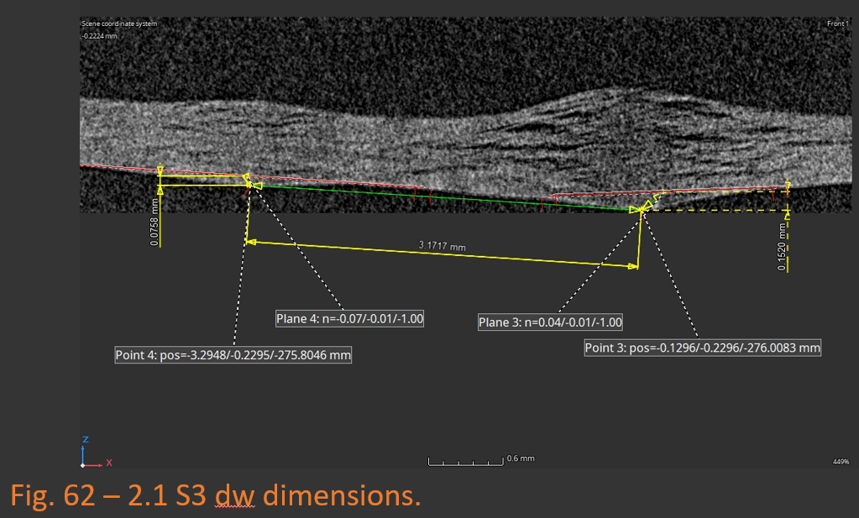
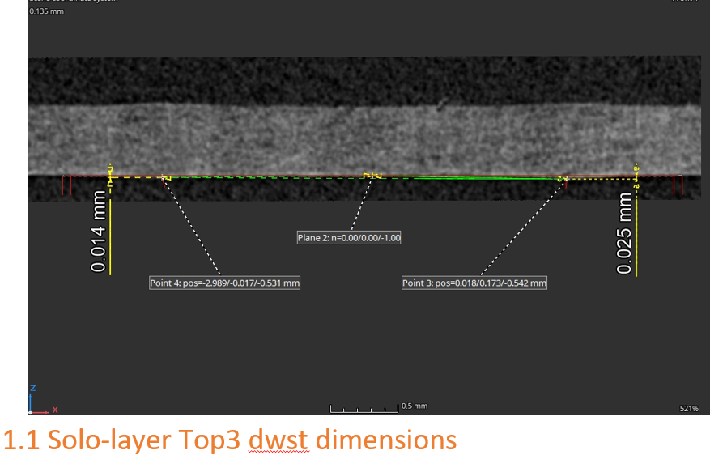
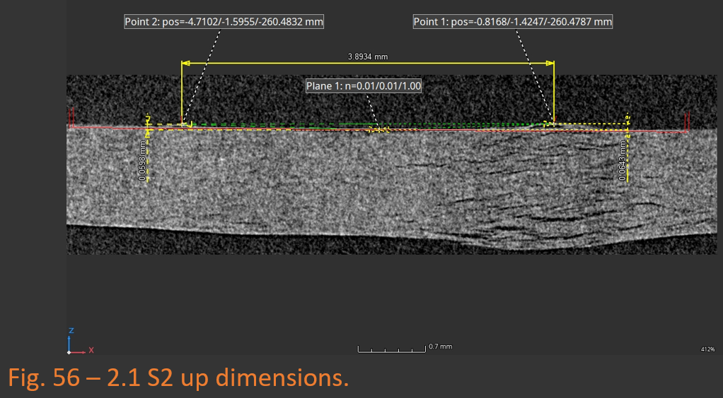
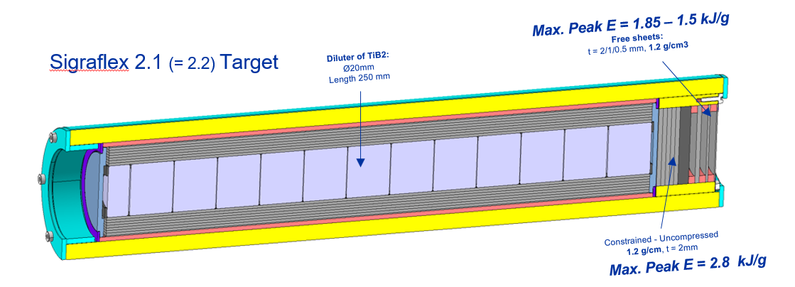
Asymmetric Beam in N₂ – Surface effects
SOLO layers (HRMT-56)
E_density = 1.6 – 1.7 kJ/g
E_density = 2.37 – 2.45 kJ/g
E_density = 1.8 – 1.85 kJ/g 0
E_density = 2.8 kJ/g
E_density = 1.5 – 1.55 kJ/g
Density = 1.0 g/cc
Thickness = 2 mm
N₂ / Asymmetric beam
Stacked
Density = 1.0 g/cc
Thickness = 1 mm
N₂ / Asymmetric beam
Density = 1.0 g/cc
Thickness = 0.5 mm
N₂ / Symmetric beam
Density = 1.0 g/cc
Thickness = 0.5 mm
N₂ / Asymmetric beam
Density = 1.0 g/cc
Thickness = 2 mm
N₂ / Asymmetric beam
SOLO layers in N2 + asymmetric beams → bulk delamination
Effect of thickness on extent of delamination
Recent results. On-going progress.

Slide 24



Asymmetric Beam in N₂ / Vacuum
E_density = 1.8 – 1.85 kJ/g 0
E_density = 1.8 – 1.85 kJ/g 0
E_density = 1.5 – 1.55 kJ/g
E_density = 1.6 – 1.7 kJ/g 0
E_density = 1.6 – 1.7 kJ/g
E_density = 1.5 – 1.55 kJ/g 0
Density = 1.0 g/cc
Thickness = 0.5 mm
N₂ / Asymmetric beam
Density = 1.0 g/cc
Thickness = 2 mm /
VAC / Asymmetric beam
Density = 1.0 g/cc
Thickness = 2 mm
N₂ / Asymmetric beam
Density = 1.0 g/cc
Thickness = 1 mm /
VAC / Asymmetric beam
Density = 1.0 g/cc
Thickness = 1 mm
N₂ / Asymmetric beam
Density = 1.0 g/cc
Thickness = 0,5 mm /
VAC / Asymmetric beam
N2 layers damaged in the bulk / Vacuum layers just superficial damage
Effect of thickness on extent of delamination
Recent results. On-going progress.

Slide 25





Results on Sigraflex® (HRMT-56)
STACKED layers
Conclusions STACKED layers in N2/Vacuum:
Practically no damage observed (coherent with LHC TDE Autopsy Results)
Compressed/Uncompressed results are very similar
- Vacuum samples “untouched”

Slide 26
Conclusions

Slide 27
Sigraflex® shows no damage up to 2.7 - 3.2 kJ/g when irradiated in N2 & Vacuum for 3 (or 1) shots and in STACKED configuration for any beam impact
  Run3 parameters are compatible with tested conditions for Sigraflex
  (doubt on what cumulative damages would appear after ‘00s shots at Run3 & beyond (HRMT-HED2 (2024))
  HRMT-56 SOLO layers results do not show bursting-out effect shown in HRMT-43 for symmetric beam impacts
  HRMT-56 SOLO layers show bursting-out effect for asymmetric beam impacts:
      No bulk effect on samples under Vacuum / Layers impacted in N2 show same extent of damage as those of HRMT-43
      Boundary conditions and environment play indeed a role in bursting out of plane – even more than peak energy density.
→ Technically going with stacked Sigraflex ® sheets is a valid choice for Run3
Alternatives based on CFC materials would be available and are performing well.
Full assessment of C-based materials under beam Impact (being) done (CC / C-SiC / Sigraflex / Graphite)

