Slide 1
Dielectric Resonator System Barcelona
CC-CC Transition Measurement
P. Krkotić & S. Calatroni
2-May-22

Slide 2
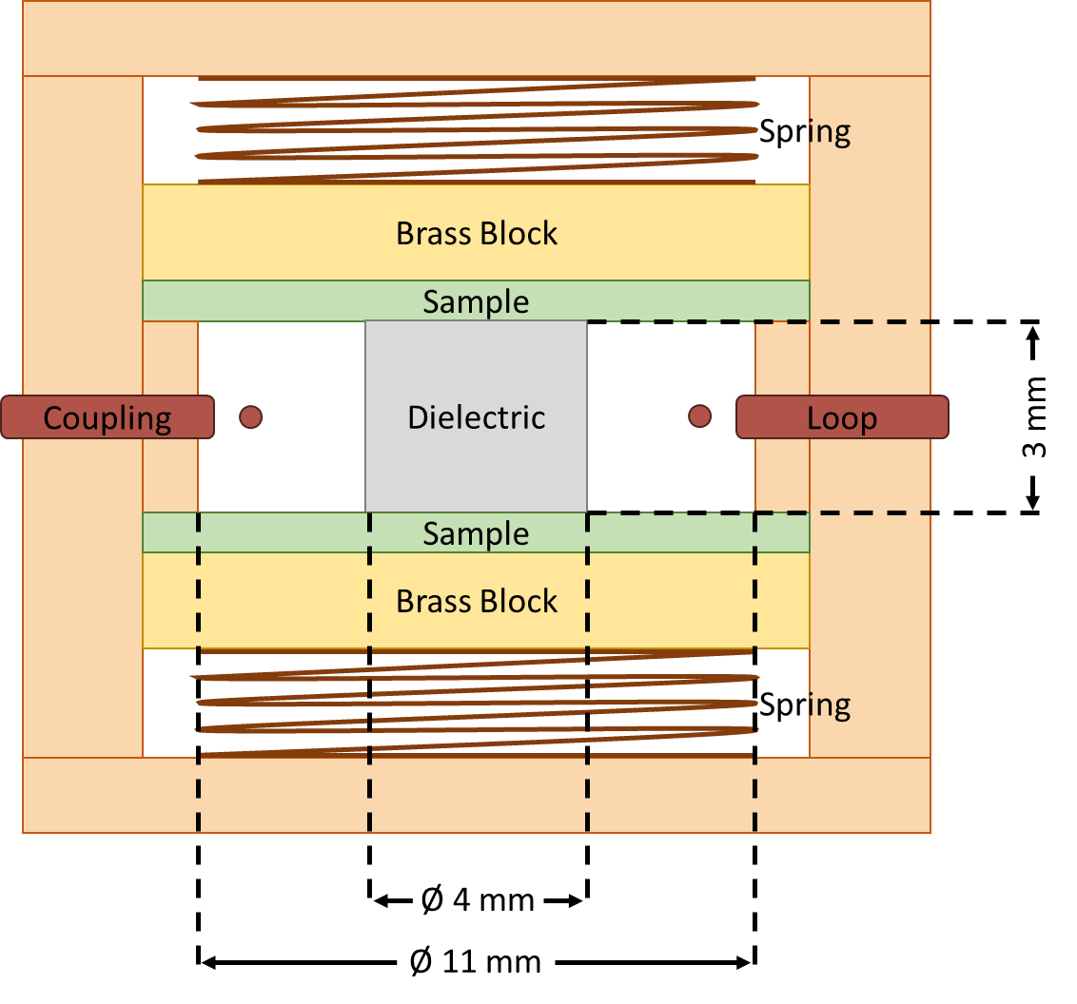


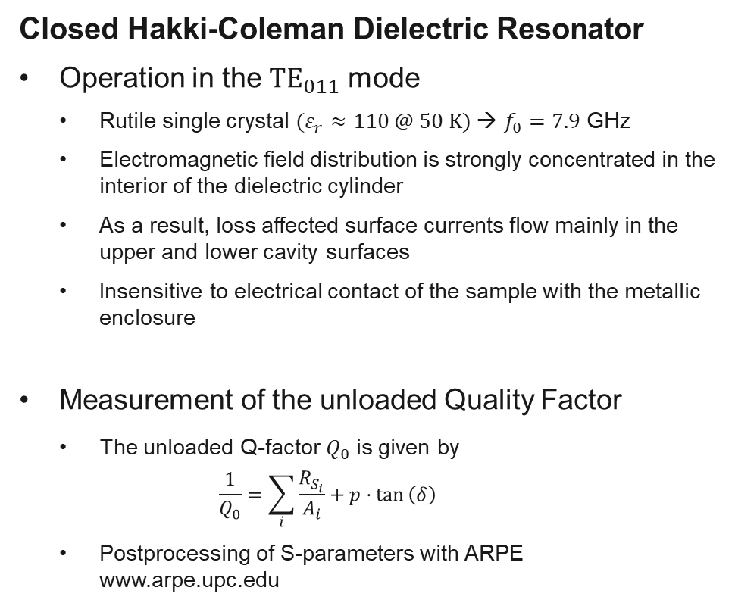
Dielectric Resonator
System Barcelona
Closed Hakki-Coleman Dielectric Resonator
  Operation in the ${TE}_{011}$ mode
    Rutile single crystal $(ε_{r}≈110 @ 50 K)$→ $f_{0}=7.9$ GHz
    Electromagnetic field distribution is strongly concentrated in the interior of the dielectric cylinder
    As a result, loss affected surface currents flow mainly in the upper and lower cavity surfaces
    Insensitive to electrical contact of the sample with the metallic enclosure
  Measurement of the unloaded Quality Factor
    The unloaded Q-factor $Q_{0}$ is given by
      $$\frac{1}{Q_{0}}=\sum_{i}{\frac{R_{S_{i}}}{A_{i}}+p⋅tan}\left(δ\right)$$
    Postprocessing of S-parameters with ARPE
    www.arpe.upc.edu
$R_{S_{i}}$= surface resistance
$A_{i}$ = geometry factor
$p$ = filling factor
$\tan\left(δ\right)$ = loss tangent

Slide 3
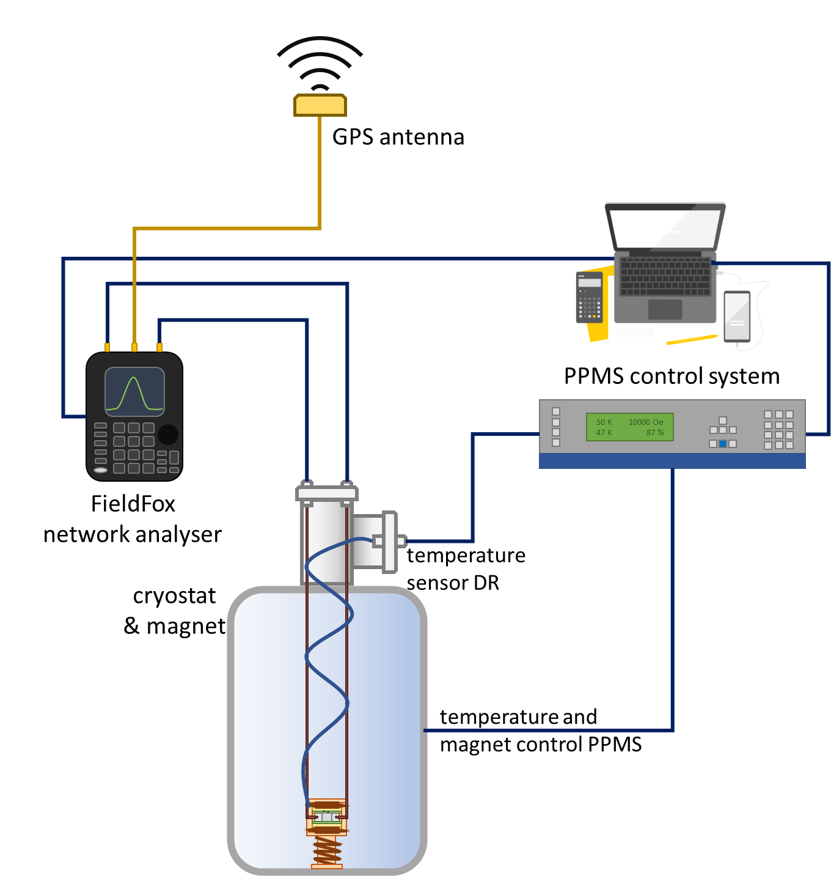
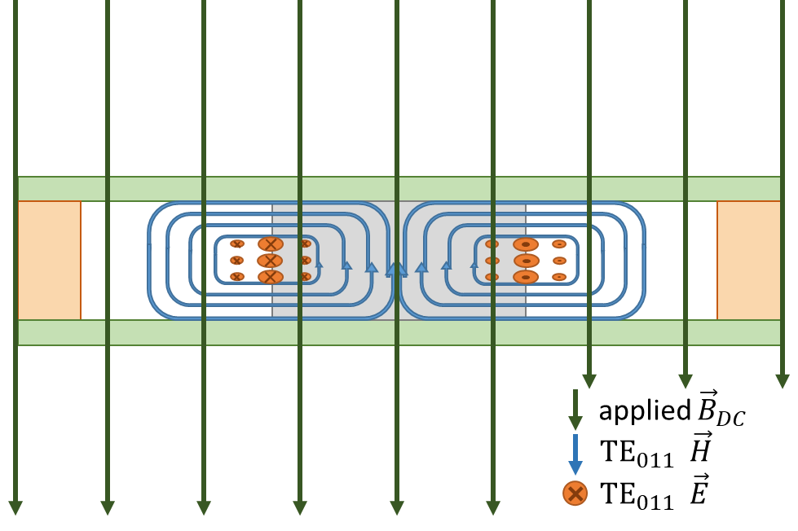


Dielectric Resonator
System Barcelona
Closed Hakki-Coleman Dielectric Resonator
  Operation in the ${TE}_{011}$ mode
    Rutile single crystal $(ε_{r}≈110 @ 50 K)$→ $f_{0}=7.9$ GHz
    Electromagnetic field distribution is strongly concentrated in the interior of the dielectric cylinder
    As a result, loss affected surface currents flow mainly in the upper and lower cavity surfaces
    Insensitive to electrical contact of the sample with the metallic enclosure
Closed Hakki-Coleman Dielectric Resonator
  Operation in the ${TE}_{011}$ mode
    Rutile single crystal $(ε_{r}≈110 @ 50 K)$→ $f_{0}=7.9$ GHz
    Electromagnetic field distribution is strongly concentrated in the interior of the dielectric cylinder
    As a result, loss affected surface currents flow mainly in the upper and lower cavity surfaces
    Insensitive to electrical contact of the sample with the metallic enclosure
  Measurement of the unloaded Quality Factor
    The unloaded Q-factor $Q_{0}$ is given by
      $$\frac{1}{Q_{0}}=\sum_{i}{\frac{R_{S_{i}}}{A_{i}}+p⋅tan}\left(δ\right)$$
    Postprocessing of S-parameters with ARPE
    www.arpe.upc.edu
$R_{S_{i}}$= surface resistance
$A_{i}$ = geometry factor
$p$ = filling factor
$\tan\left(δ\right)$ = loss tangent

Slide 4
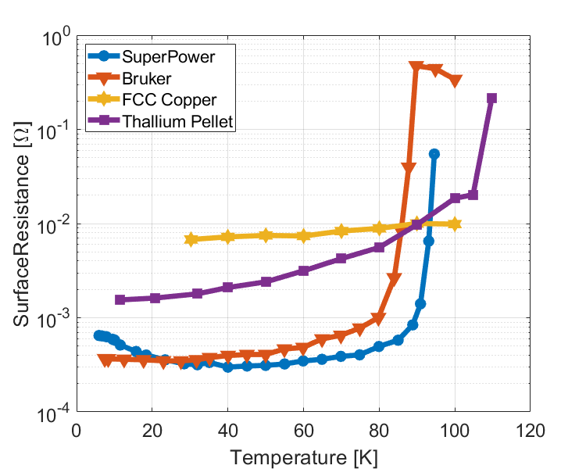
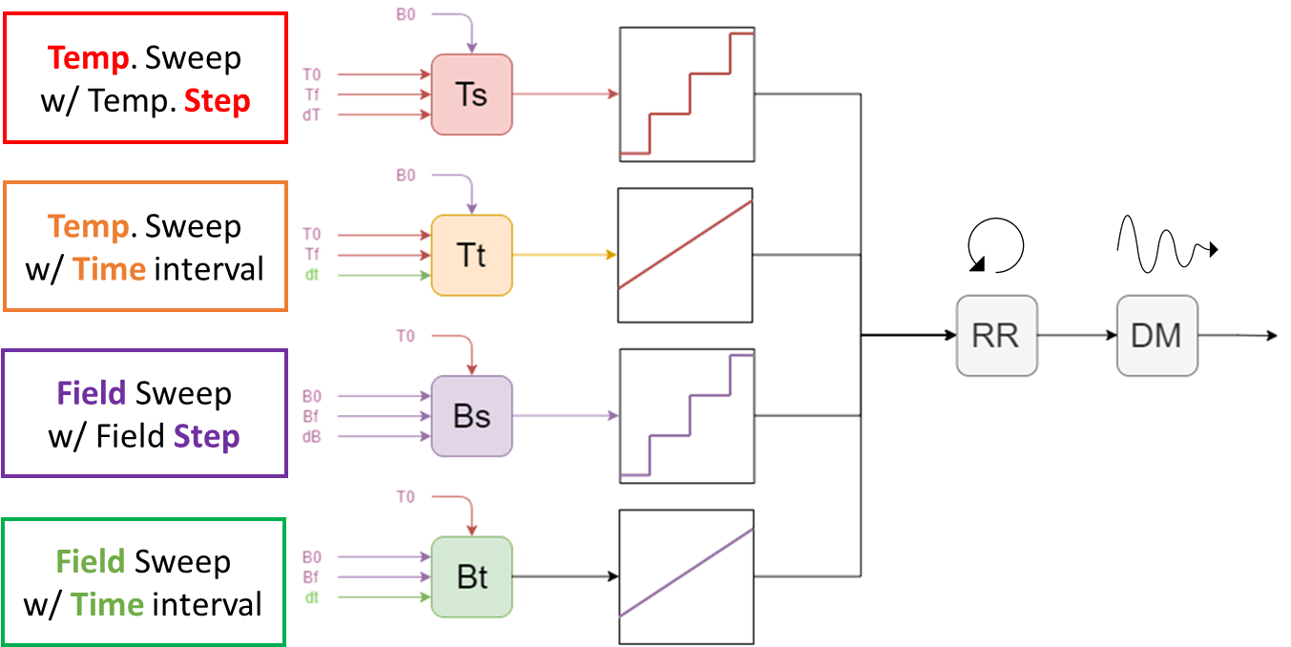
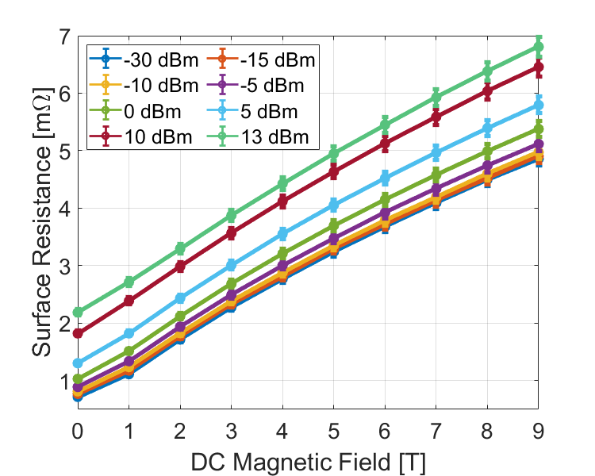

Dielectric Resonator
System Barcelona
Samples Characterisation
  Surface resistance as a function of
    Temperature
    DC magnetic field up to 9 T
    RF surface magnetic field strength (VNA output power +13 dbm)
By P.Krkotić and G.Telles

Slide 5
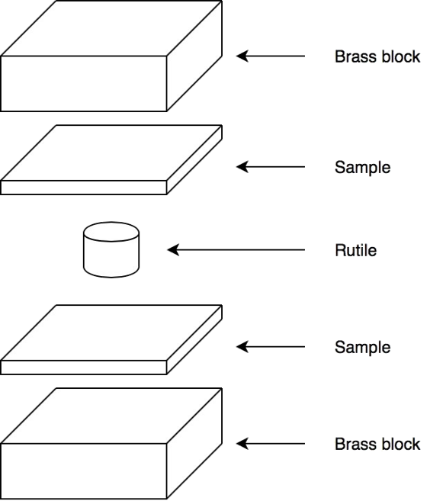
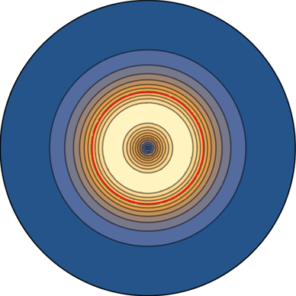
Dielectric Resonator
System Barcelona
CC-CC Transition Measurement
  Solder
  Delamination
  Cut
  Sample Manipulation for CC-CC transition testing

