Slide 1

Glyn Kirby , Ariel , Arnaud, Devide
4th May 2020

Slide 2
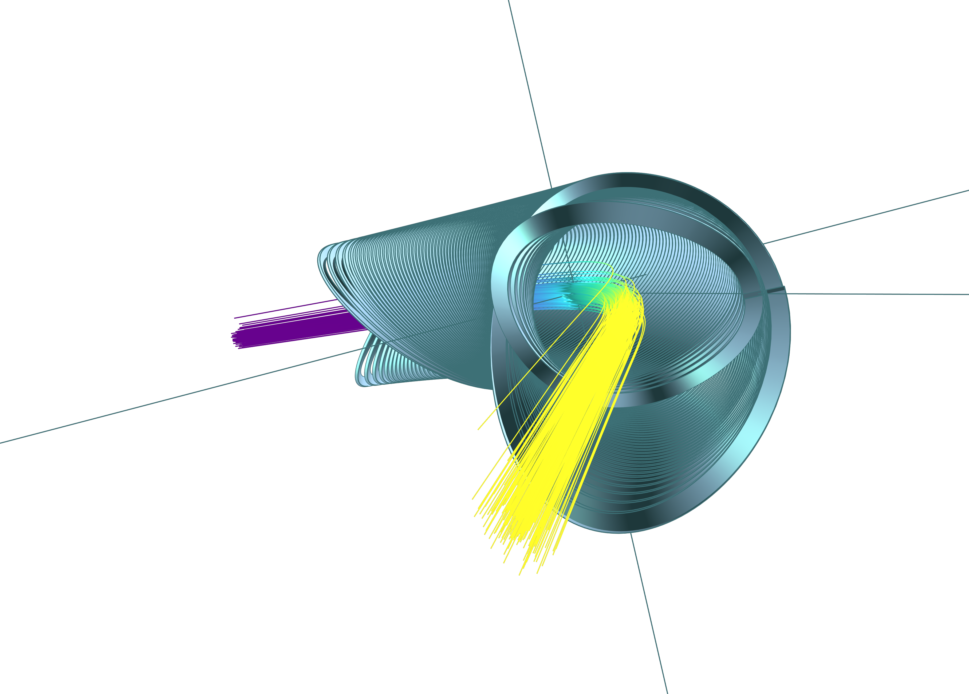
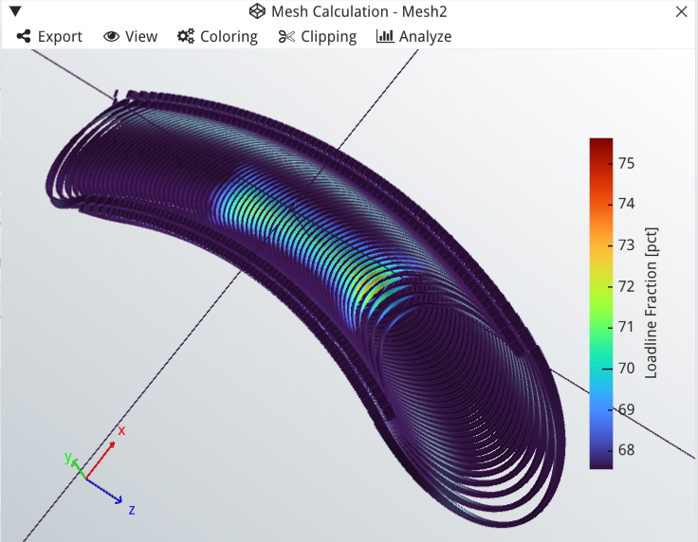
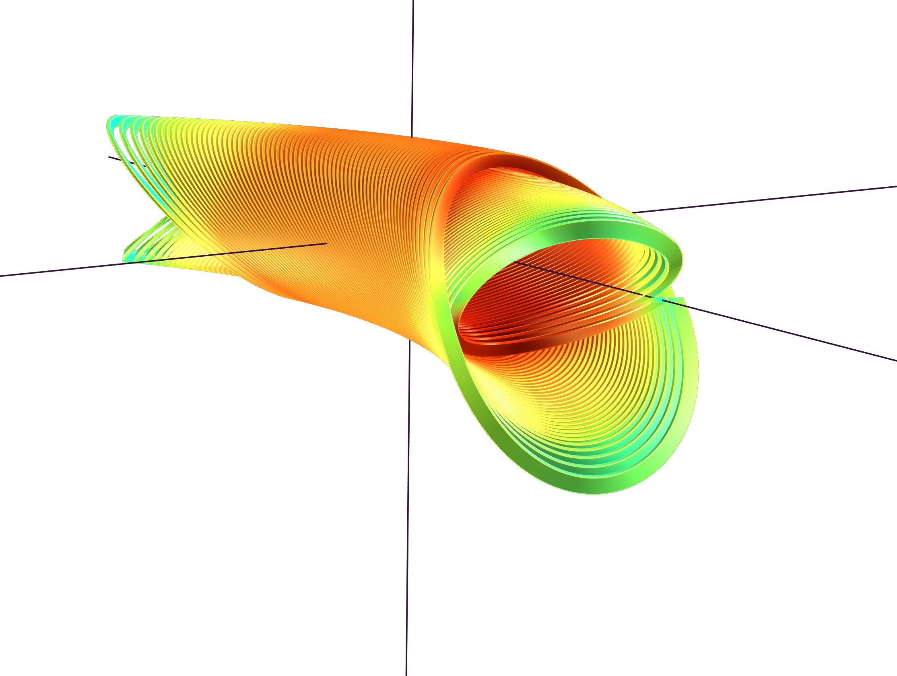
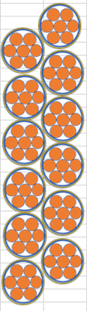
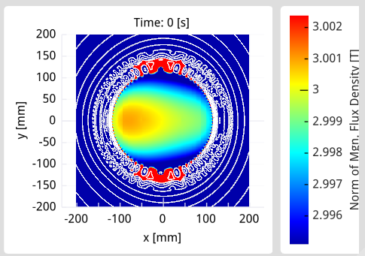
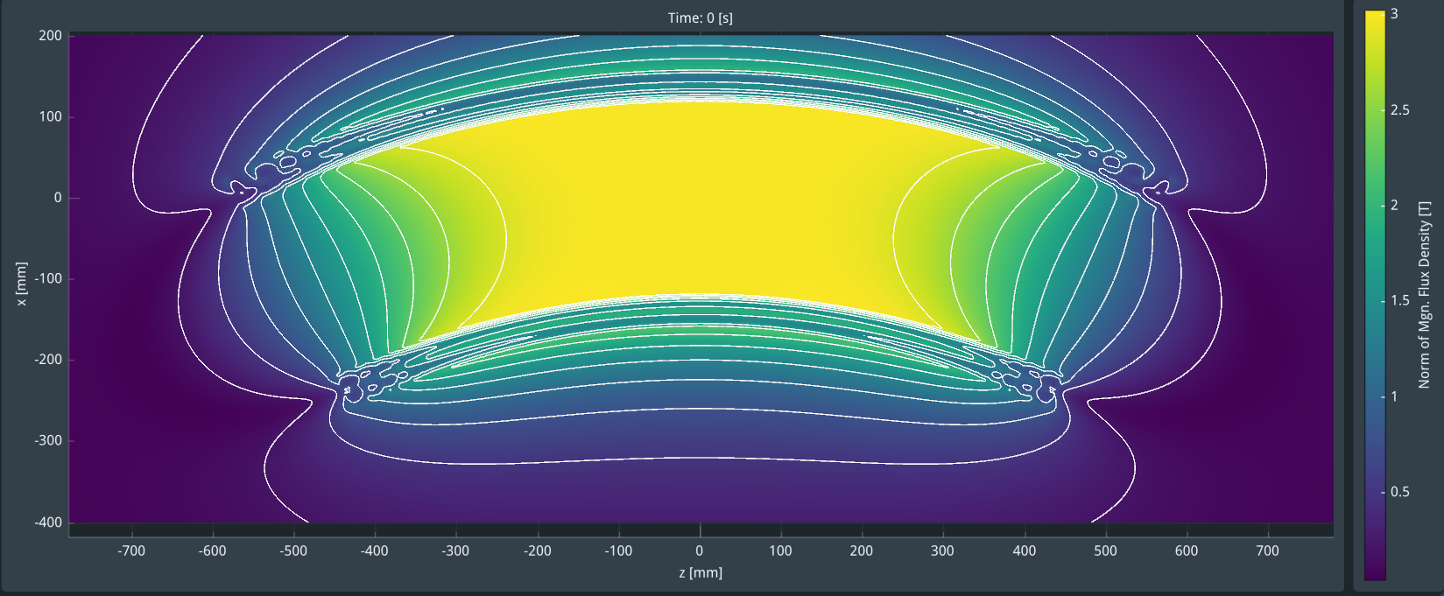
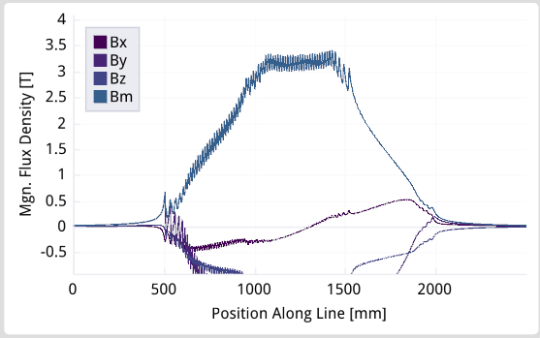
Base line design (no taper)
Central field : 3.000 T
Peak field inner/outer coils : 3.531 , 3.452 T
Load line Fraction inner/outer coils : 72.921% , 72.021%
Integral on 1m rad axis Tm : By -2.8, Bx -2.804 e-07, Bz 4.093 e-3
Errors: heavily curved magnet ( Beam tracking WG, I say more later)
Current : 218.372 A
Inductance : 13.172 H
7 strand insulated rope
Strand and cable for then magnet : ~15.59 km strand , ~2.22 km rope.
1m rad of curvature cold!!.
90 deg end to end angle at the outside of the magnet
Former : Spar 5 mm, min wall 0.5 mm
***Fine tuning in progress but this is very close ***

Slide 3
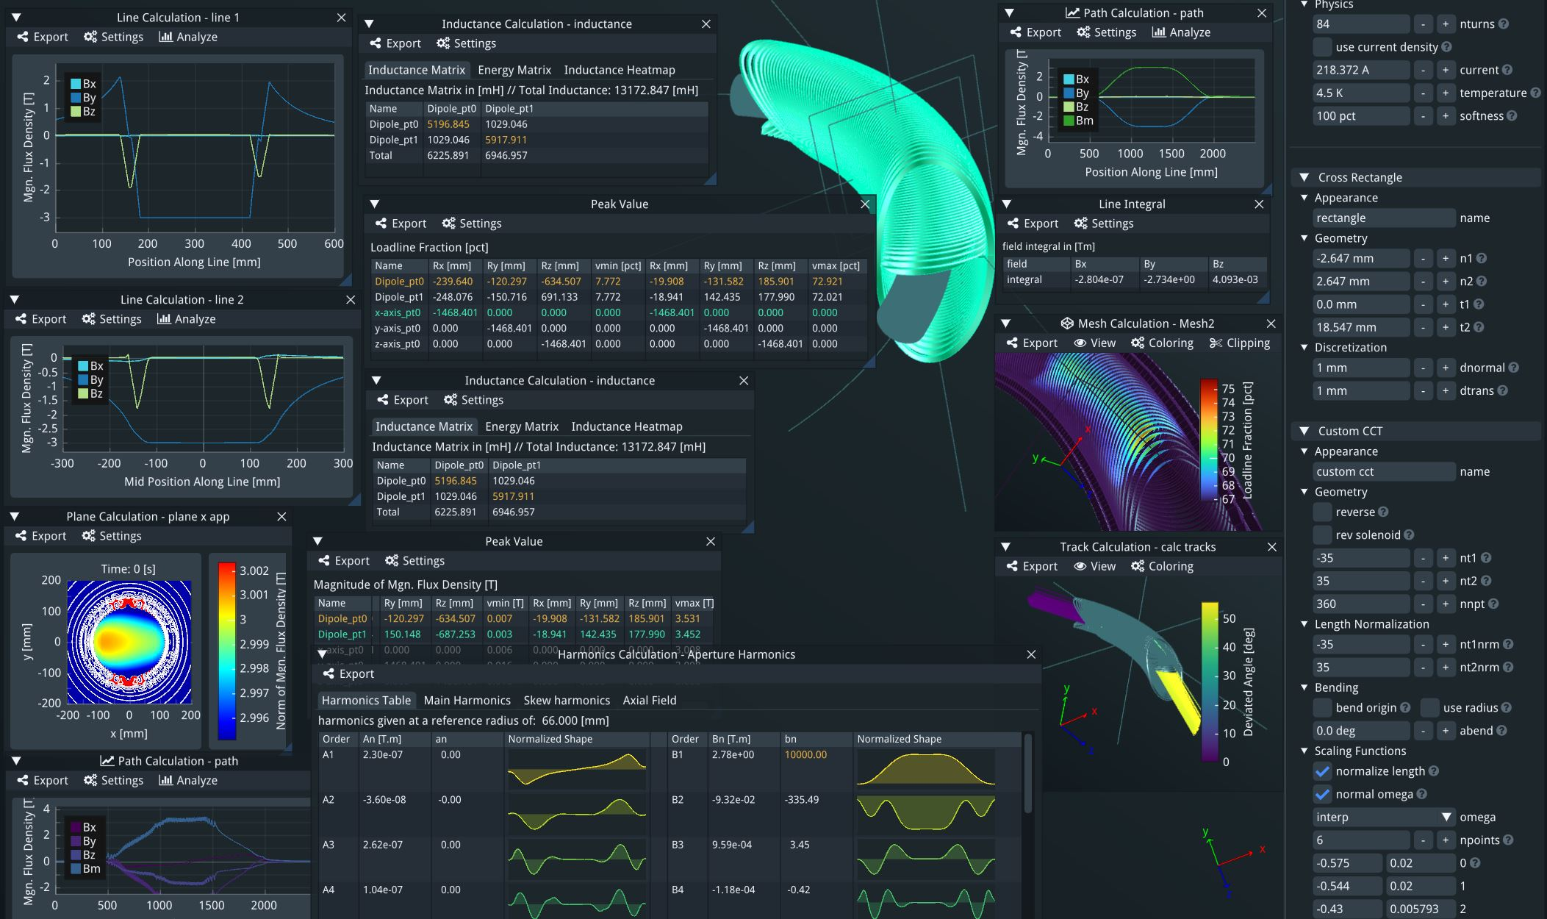

Slide 4
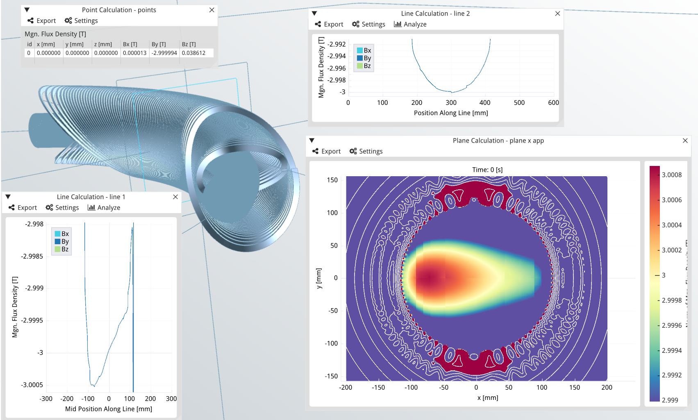
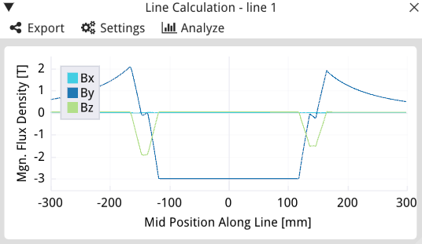
Flat dipole not the best
But one option
Combined Function correction
Dipole = 204 mm
Quad = 2.45 mm
Sextupole = 0.2 mm
Rad 118 mm
CF mm

Slide 5
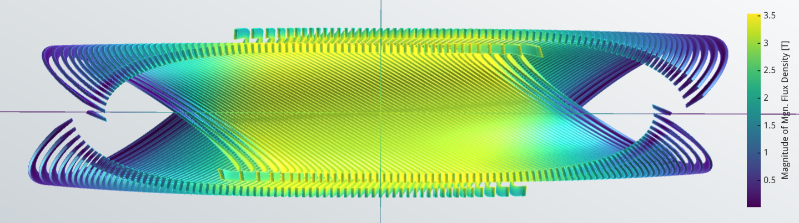
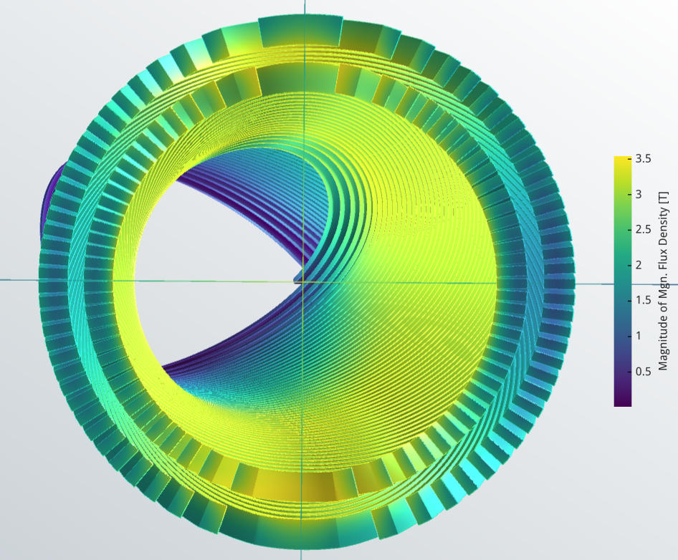
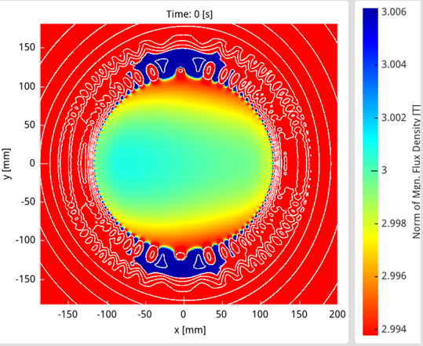
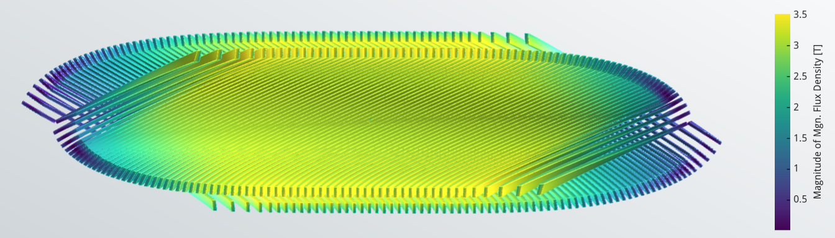
With clean dipole through aperture.

Slide 6
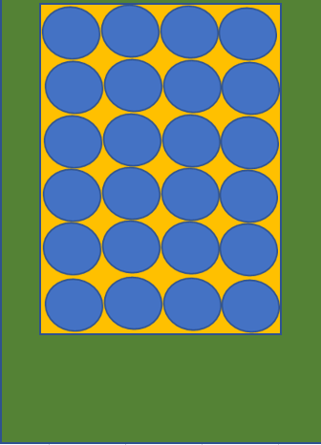

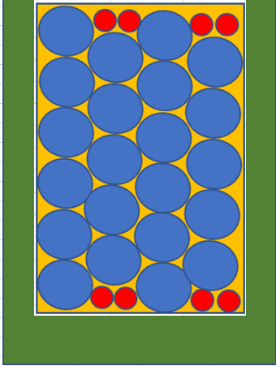
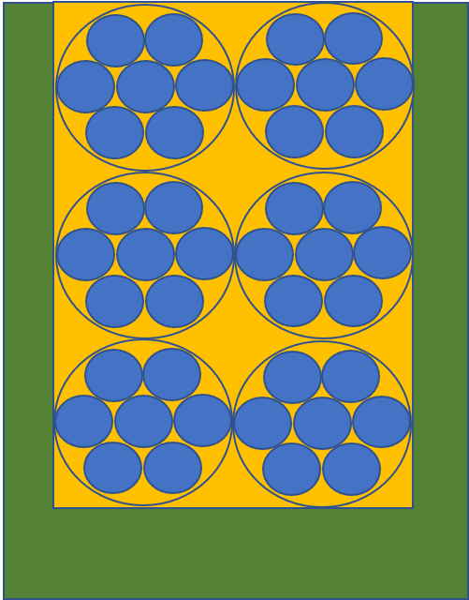
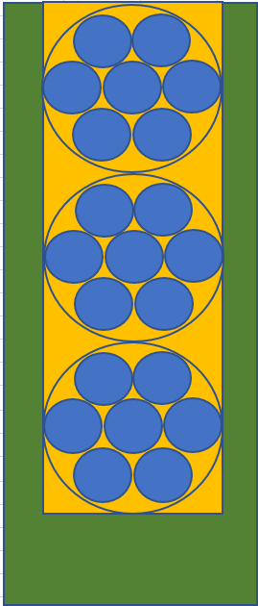
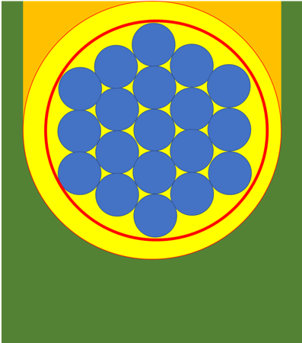
Channel layouts
Some channels with different packing lay out that have been looked at
6 x 7strand ropes 42 wires
~5 kA
Je 61.09 %
12 ropes
84 wires
118 A
Je 63%
3 x 7 strand ropes
21 wires ~ 5 kA
Je 61.09 %
19 strand rope
13.5 kA
Je < 59.6 %
24 wires
710 A
Je 78.54%
22 wires
710 A
Je 83.8%

Slide 7
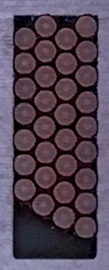
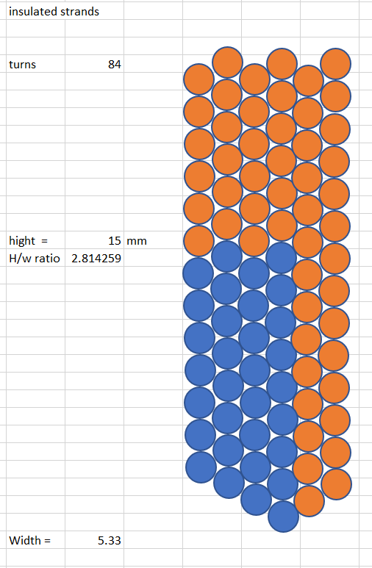
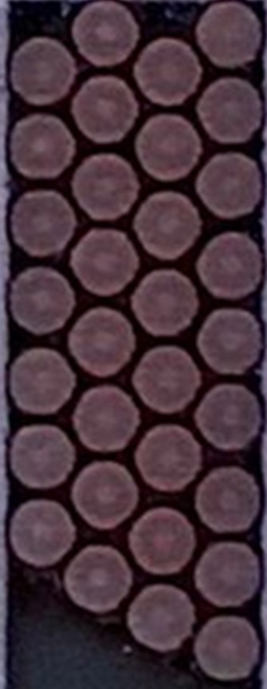
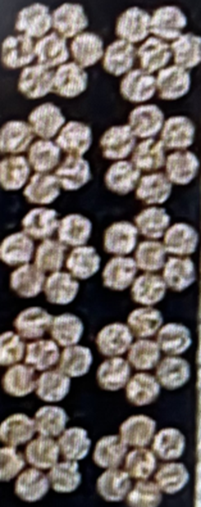
Log Stacking
Layout in channel | Je %
Log stacking | 83.8
Rectangular stacking | 78.45
7 strand rope | 61.09
19 strand rope | 59.6
Test channels 7 strand rope and 36 strand log stacking
Thanks to the Upsala team for the rope image
Fusillo 84 strand log stacking with chisel base to add stacking
Thanks to Ariel for the log stacking tests

Slide 8
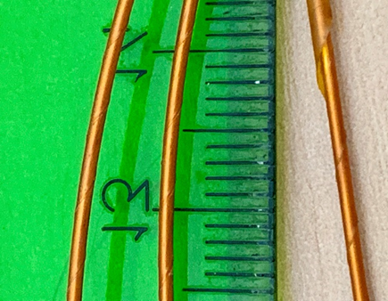
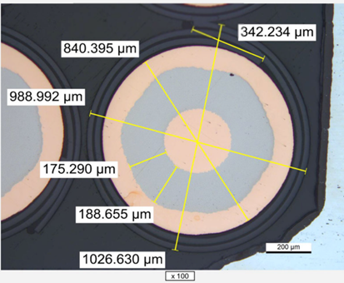
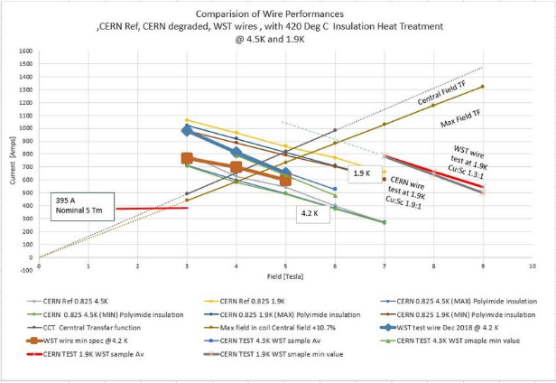
Wire insulation & Performance
Wire insulation is key!
55% overlap 2 layers + 3 layer spiraling spacer rib !
CERN 1.9:1 filaments 6 um
Prototype stock CERN wire
Magnet SS 55%
~ 4 mm pitch
11kV wire insulation!
Strong bond to wire!

Slide 9


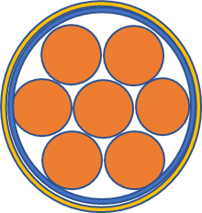
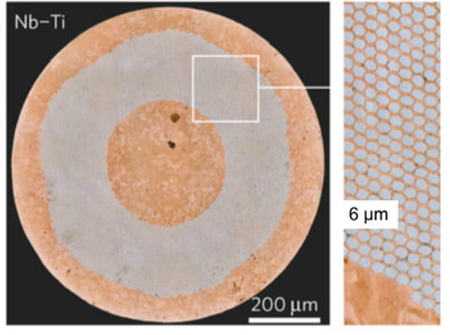

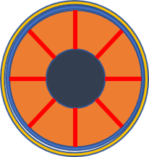

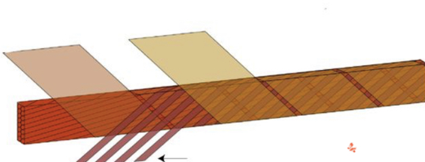
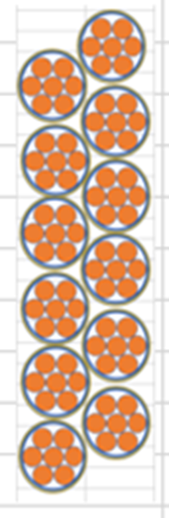
Conductors
compacted strands into a rope & then insulated
Non-Insulated strands
Insulated strands
New design of non insulated rope.
Heavily competed,
large strand !
Nice but ????????
7 insulated strands
82 insulated strands in channel, winding with rope may be an advantage.
Base line design today
6 Non insulator strands in rope with a Cu or Invar core, the core cannot have superconductor due to inductive current and joint problems.
But insulation may stop resin getting in so ?
Open insulation old idea.
Open insulation
14 ropes
1627 A, 0.4 H
12 ropes
249 A 14 H

Slide 10

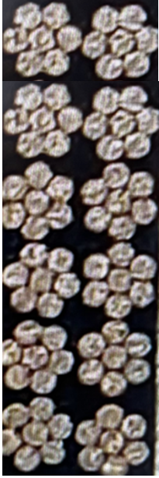

Log stacking v classical
12 – 7 strand ropes
We plan winding tests!
12 ropes
84 wires
118 A
Je 63%
6 x 7strand ropes 42 wires
~5 kA
Je 61.09 %

Slide 11
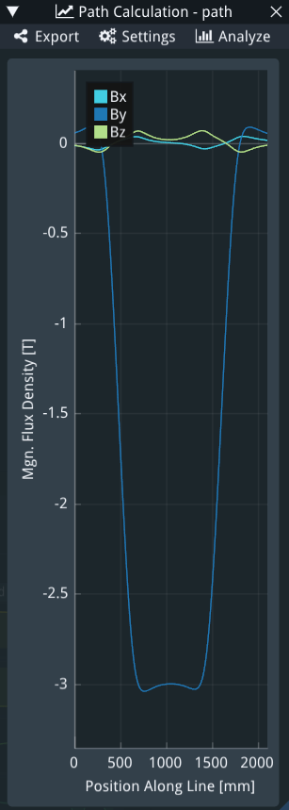
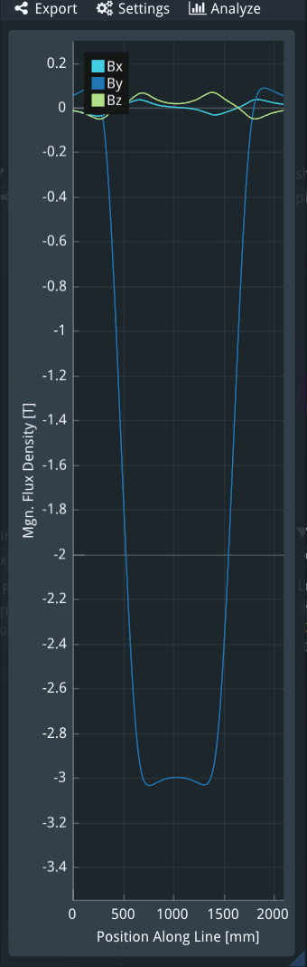
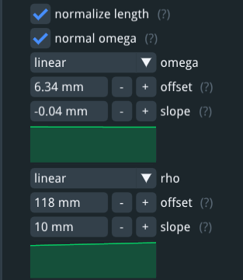
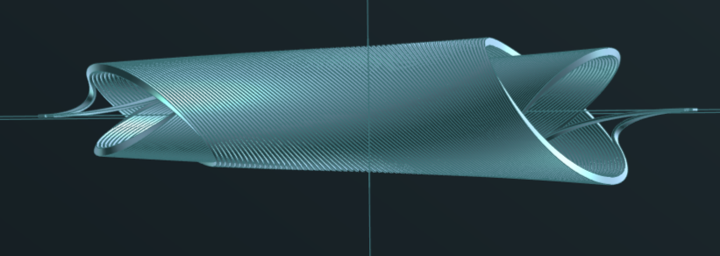
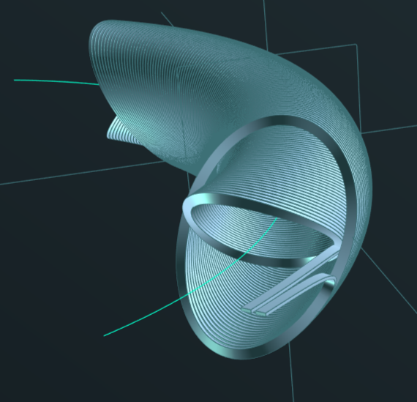
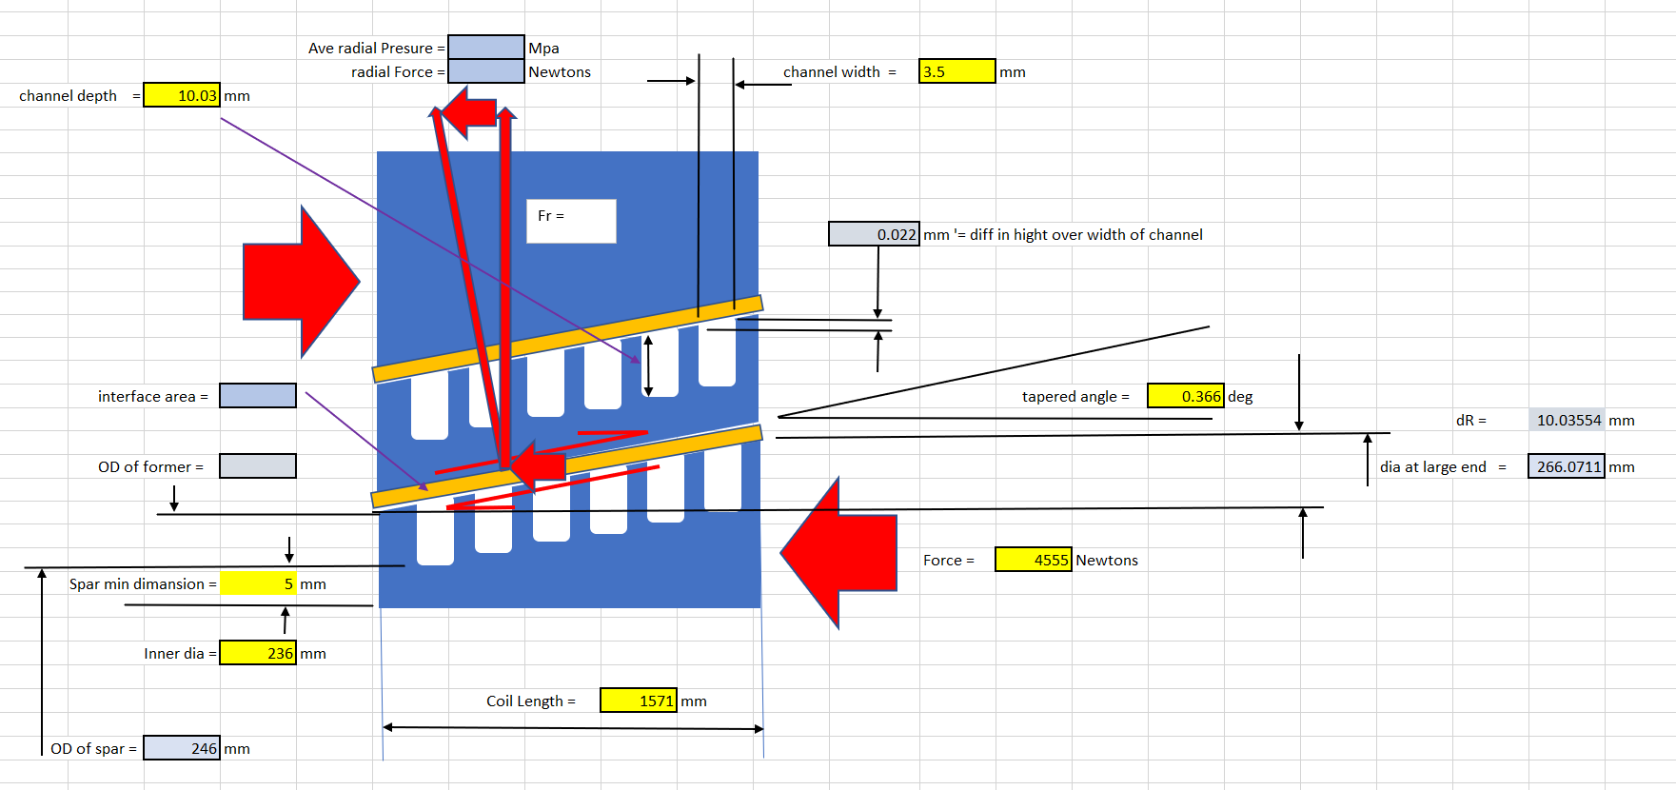
Tapered aperture & coil makes assembly easy!
And may give radial pre-stress option !?
10 mm taper on radius over 1.571m, 0.366 deg
0.022 mm step between channels
Axial to radial force magnification = x 156
Exaggerated view of taper
Not corrected for dia. change
After correction for dia. change

Slide 12
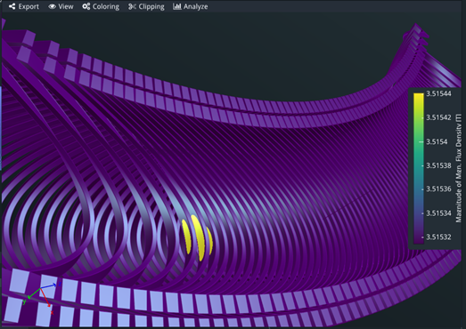
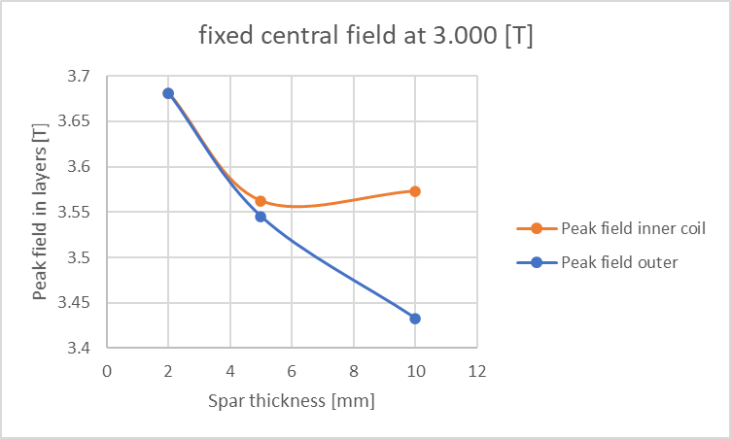
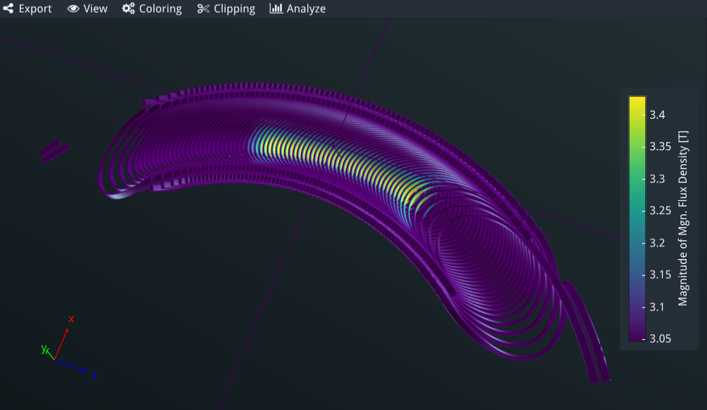
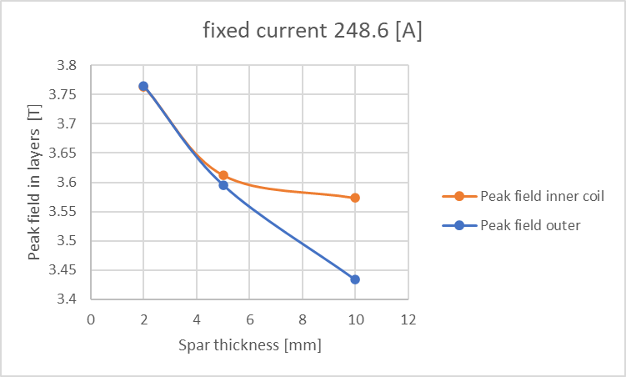
Peak field due to spar thickness or more precisely the gap between coils
Decreasing coil gap
Spar thickness
Peak field volume
As the SPAR reduces in thickness the layers get closer and at 5 mm (for this coil) both inner and outer coil peak field are equal further reduction in the gap increases peak field
In this image the peak field has started to be leveled away from the ends

Slide 13
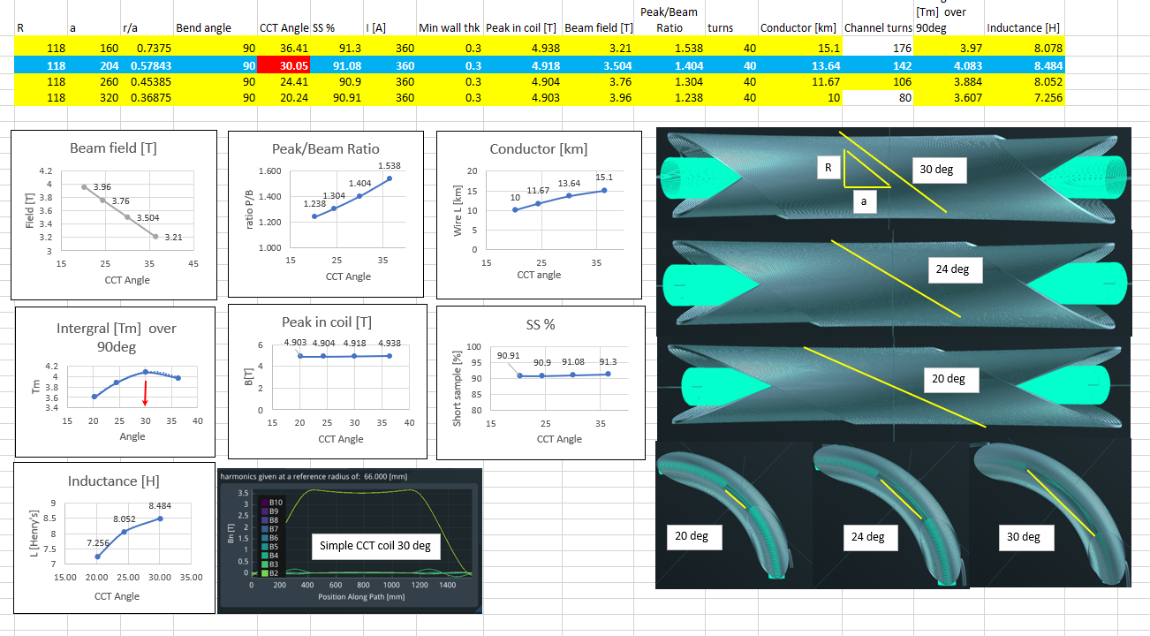
The basics of selecting the CCT angle

Slide 14
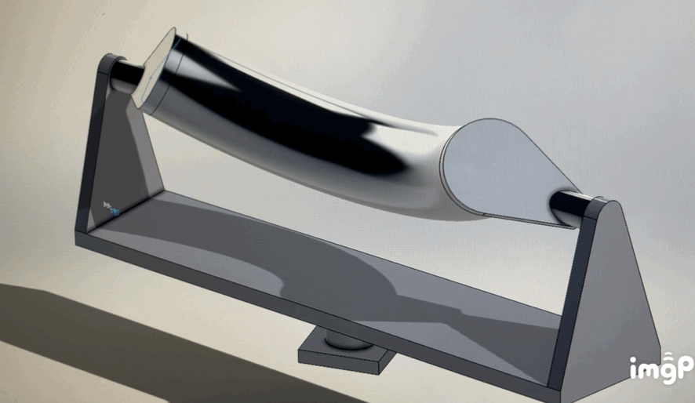
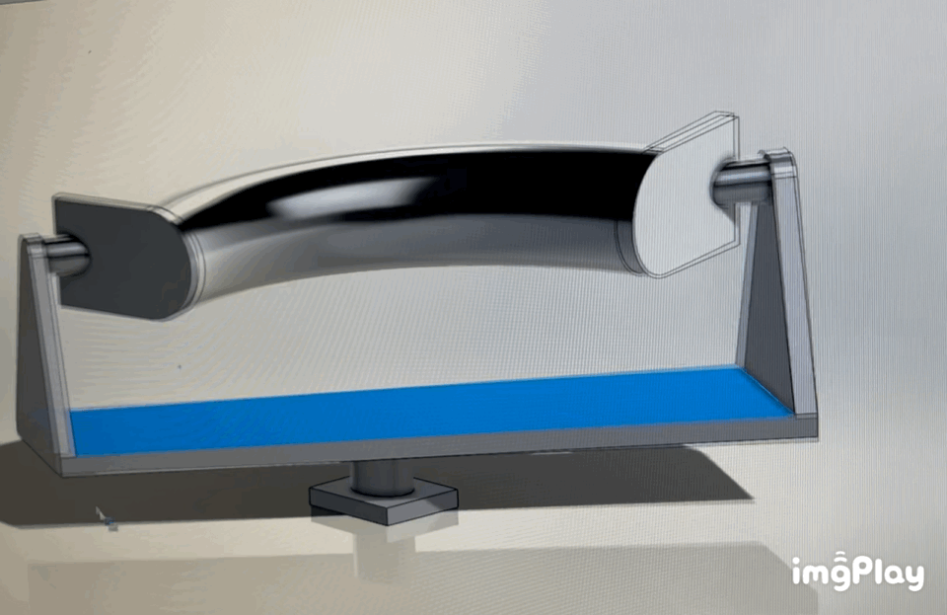
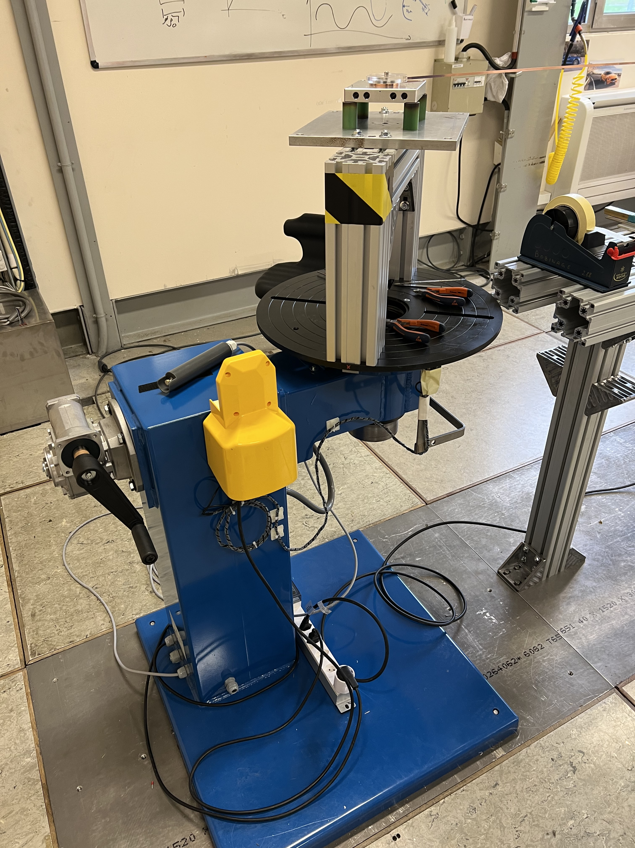
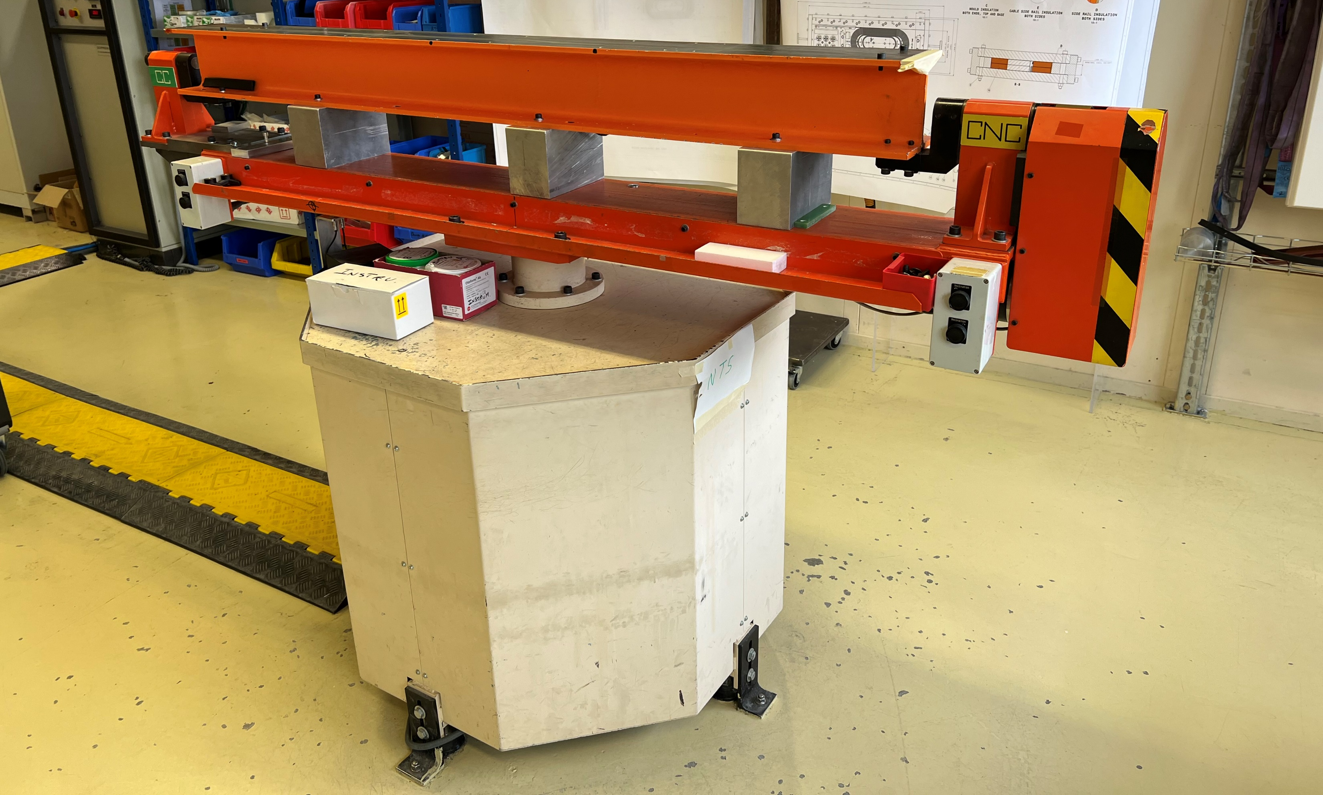
First look at winding table idea!
3 axis
2 axis
Vertical table in Bat 927
Need to add one stepper motor and control, identical to what we have just made for the hts winging tool in Bat 230.
Thanks to Oliver for the animated models

Slide 15
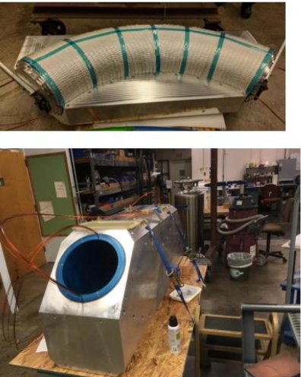
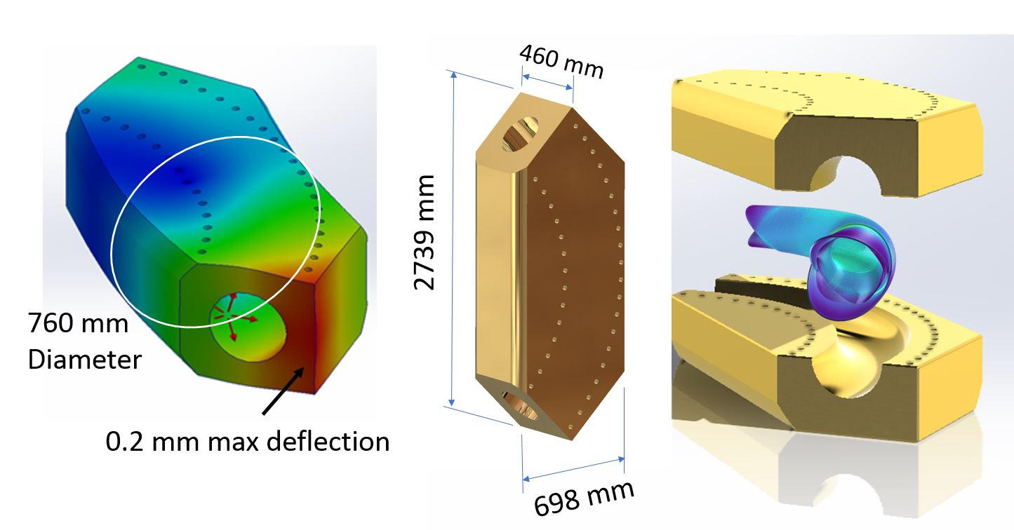
Solid Aluminum Support Design to fit into CERN Test Station
LBNL design.

Slide 16
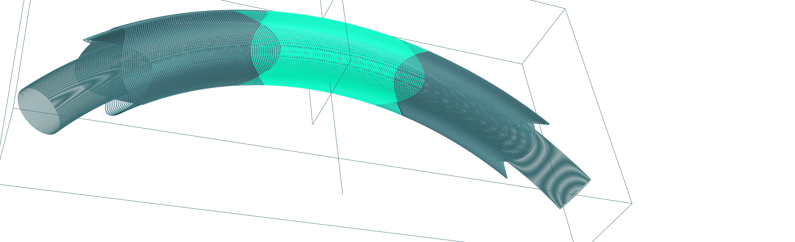

Added later by Spanish team

Slide 17


Beam tracking in 3 Tesala
Bean energy 1.3 GeV, particle rest mass 0.938 GeV, 3T central field, Beam > 50 deg

Slide 18





Beams like the Curved Corrected Harmonics

Slide 19
Thankyou

