Slide 2
WORKORDERS (WO) Proposal for IC Activities
TE-CRG-ML

Slide 3
WO Definitions
WO are the EAM objects used to manage any kind of interventions:
  from the definition of the task, the work preparation, the work execution up to the reporting and possibly billing of the executed work.
  They are linked to the equipment as they must be connected to the (assets or part) and/or positions but also to systems, sub-systems, components, or projects for building one of those.
  Interventions are actions or tasks linked to the above entities.

Slide 4
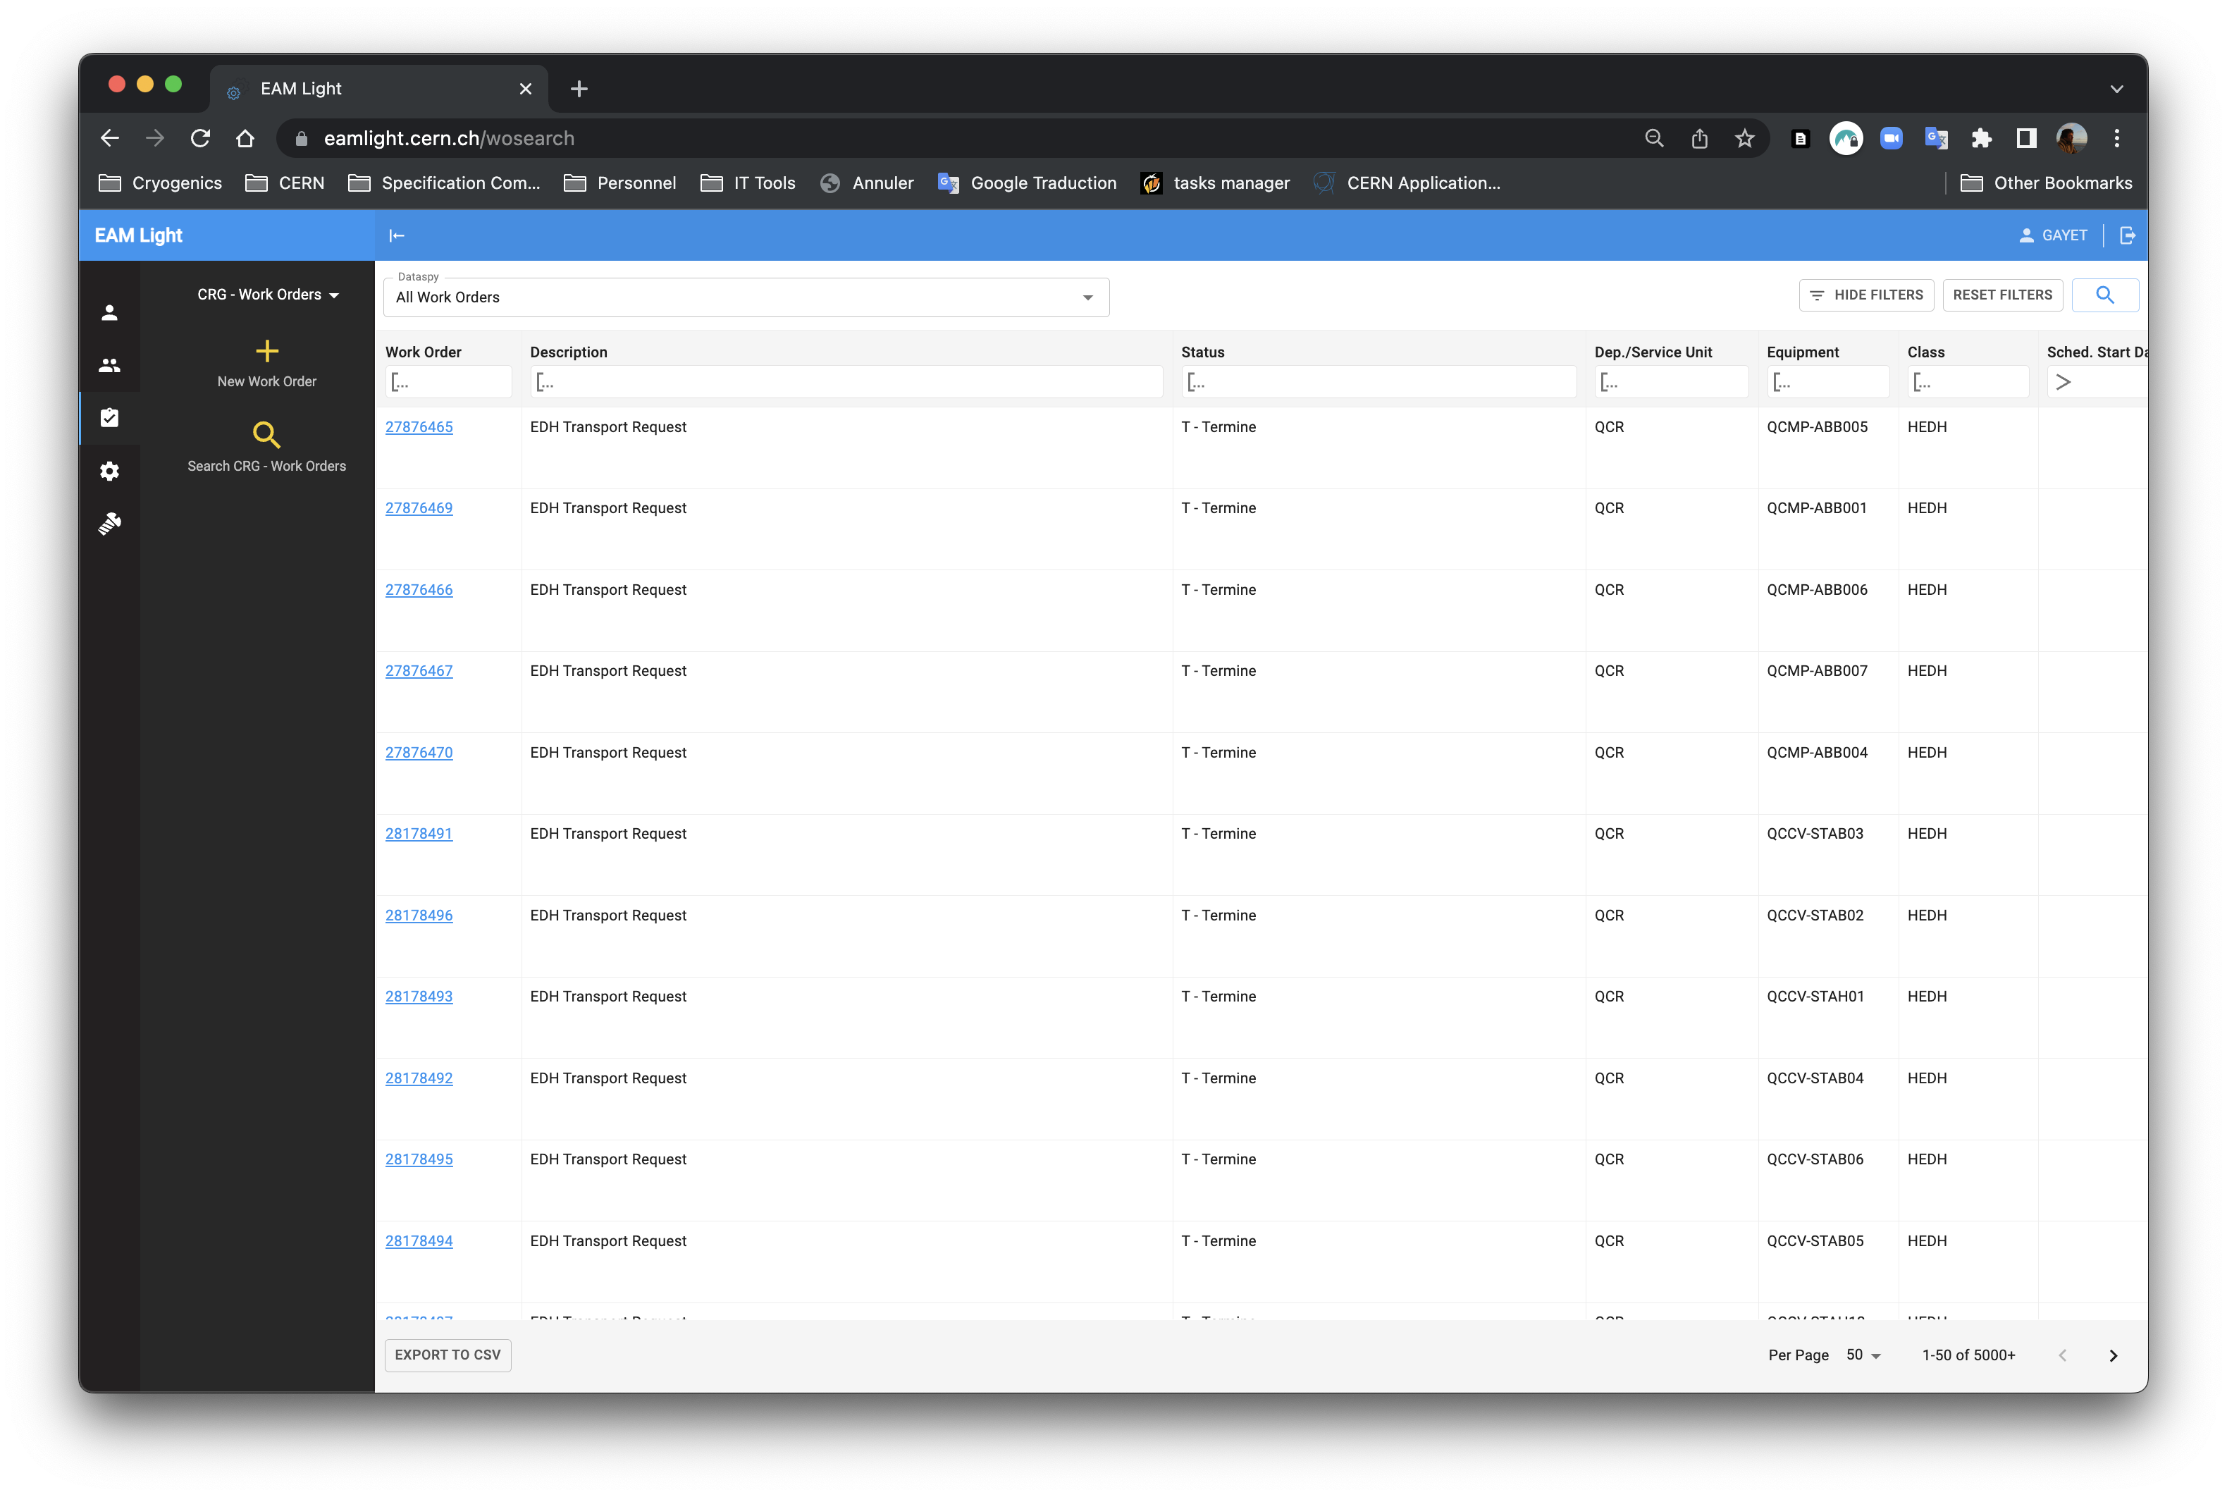
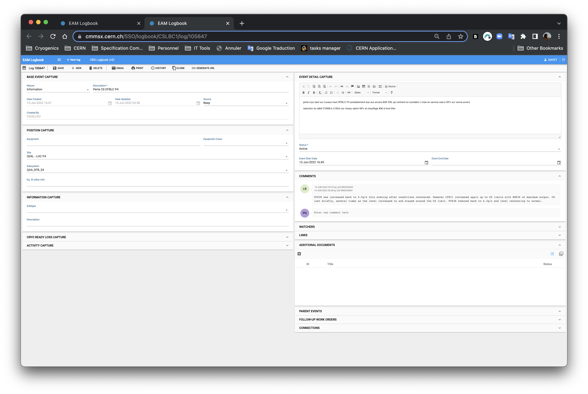
WO User Interface
2 Distinct Panels in EAM-light :
  one to list and retrieve the WO
  one to manage the WO
List & Retrieve
Manage

Slide 5
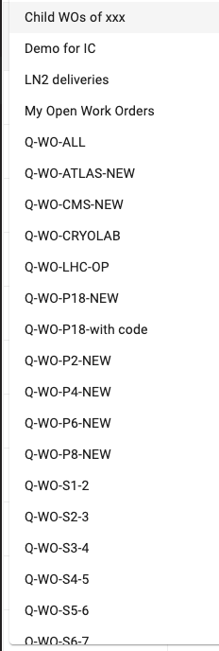
List & Retrieve WO
Columns with Filters to narrow the criteria
New WO creation
Predefined Data spies for common selection

Slide 6
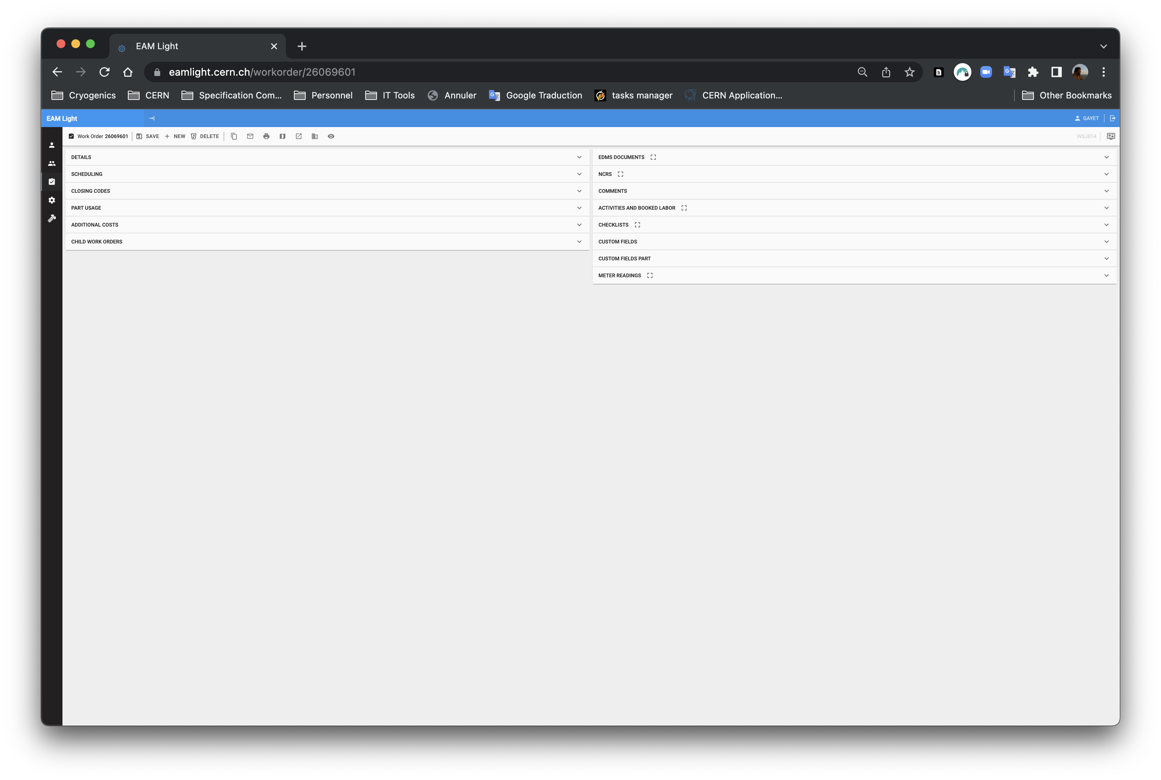
Manage WO
14 sub-panels to capture all details of the WO

Slide 7
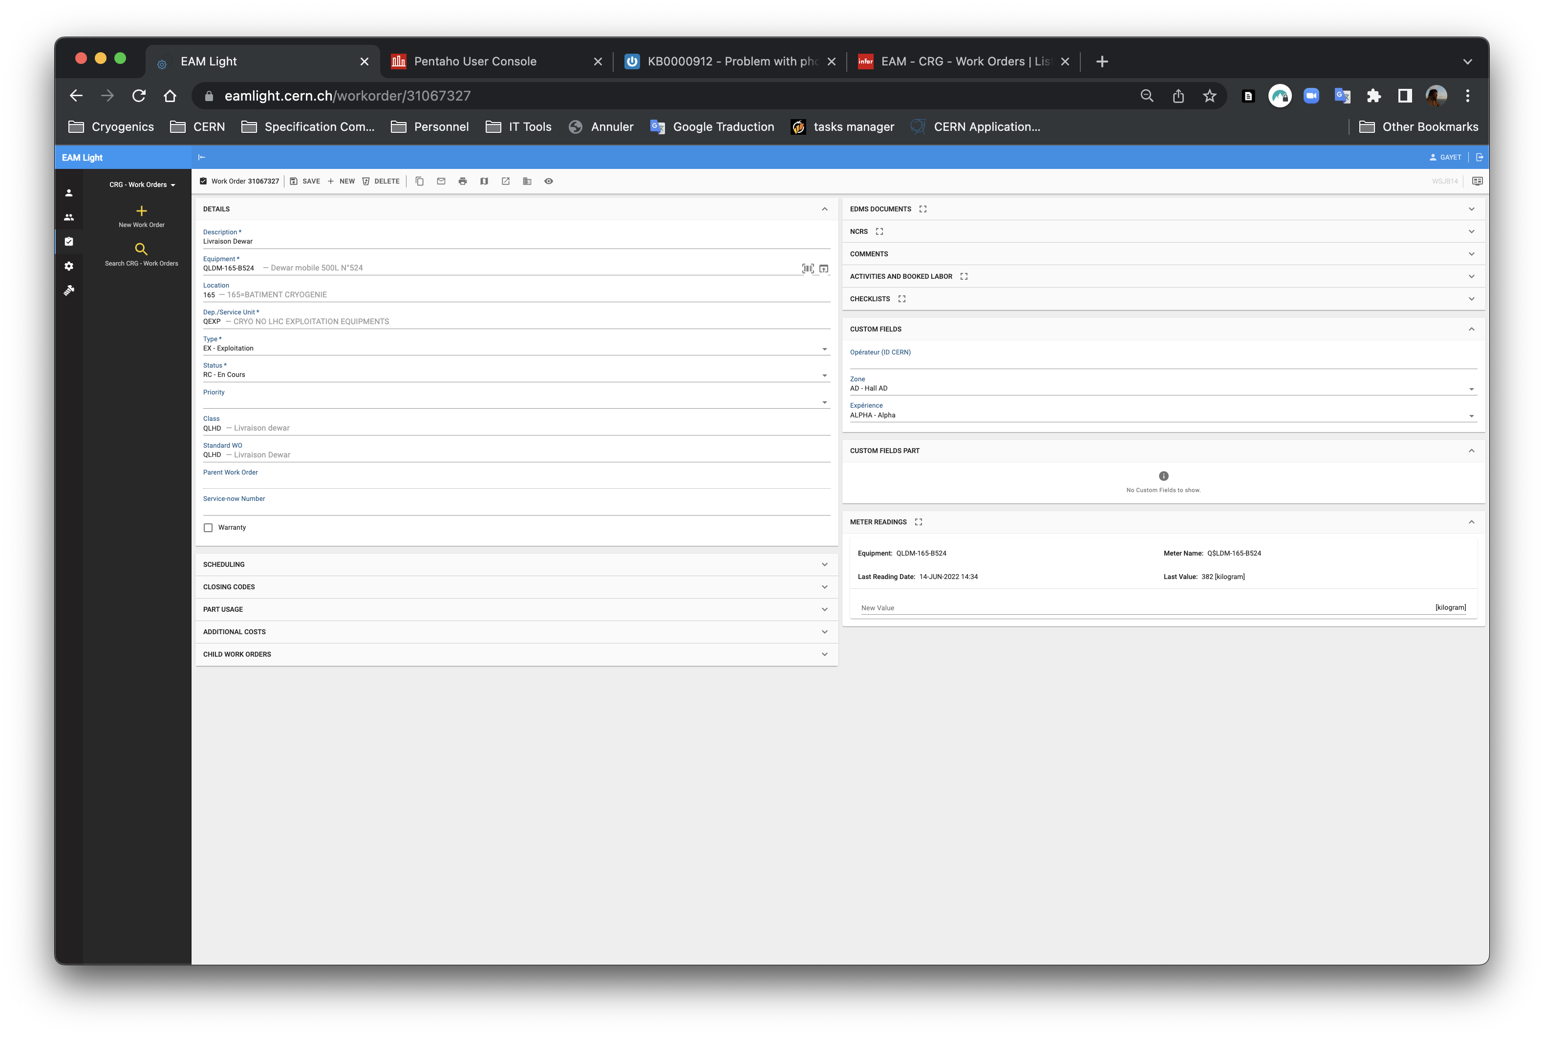
WO Specific for IC Activity Tracking
We have the possibility to create class of WO to capture specific information.
It is used for He or N2 gas deliveries
New fields can be captured
  Class of the WO
  Specific Fields

Slide 8
WO Specific for IC Activity Tracking
For Electrical or instrument related interventions it exists a list of Closing codes that can be used to class the problem, its origin, what was done to solve it.
It is used for He or N2 gas deliveries
New fields can be captured
  Class of the WO
  Specific Fields

Slide 9
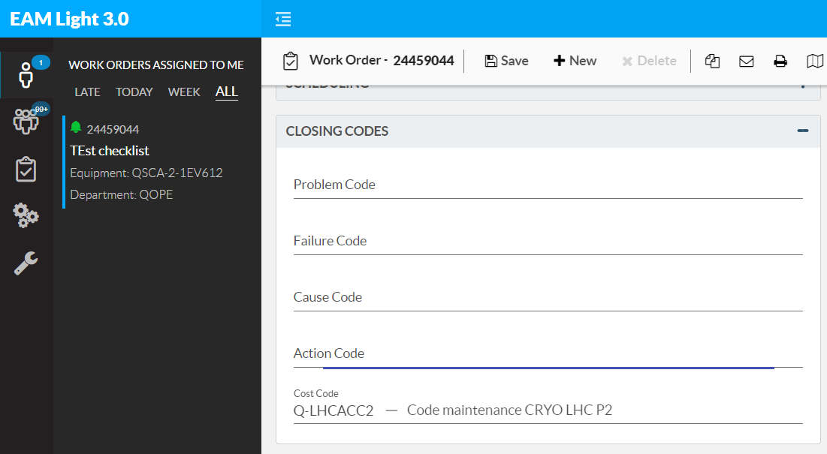
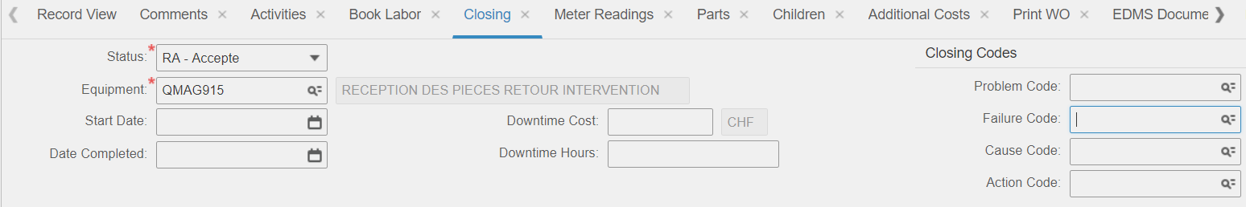
Closing codes in EAM
Problem = Identified effects
Failure = Technical reason
Cause = root cause
Action = measure taken to correct problem

Slide 10
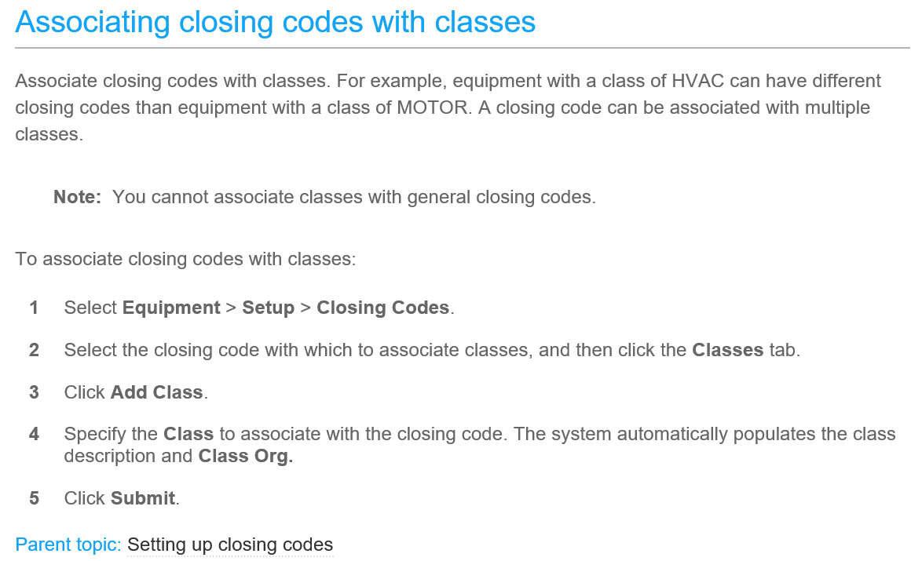
Classes similaires dans ISO 14224:2016
CO – Compresseurs
EM – Moteurs
GT – Turbines gaz
PU – Pompes
PI – Tuyauteries
VE – Appareils sous pression
TA – Réservoirs de stockage
FC – Convertisseurs de Fréquence
PC – Câbles électriques et bornes
PT – Transformateurs de puissance
CL – Unités logiques de commandes
VA – Vannes
Equipment of Interest

Slide 11
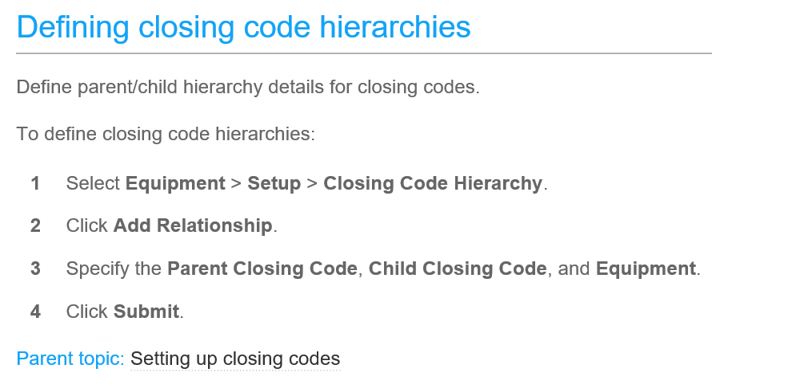

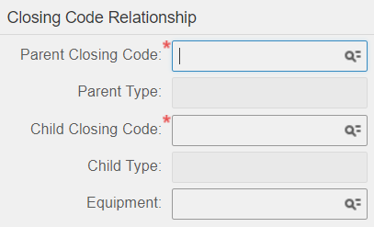
Power transmission
Coupling
Worn
Broken
Bolt
Guard
Mill
…
…
…
Aging
Improper installation
Lack of lubrication
Misaligned
Mechanical seizure
Misaligned
Set screw missing, loose
Shock loading
…
Q4T/QaT
Accouplement axial
Equipment
Problem
Failure
Cause
Action

Slide 12
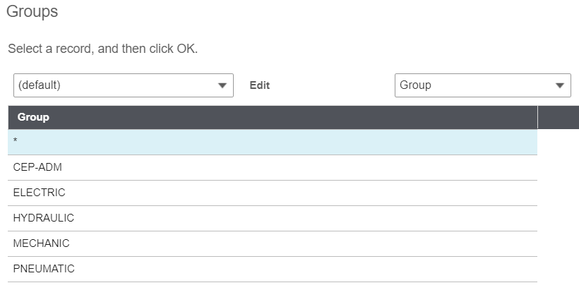
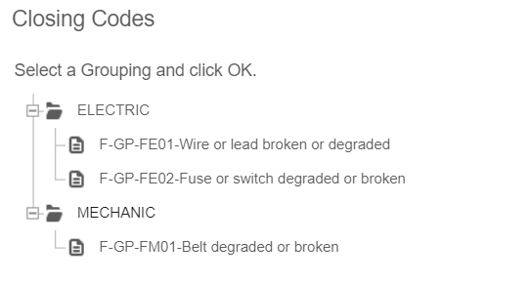
If this solution is fine for you :
  We need to define the needed Closing codes to cover your needs.
  Then Implement, test, update.

Slide 13
Solution for IC activity Tracking
I do not think that the logbook Itself is the good choice for your activity tracking.
However it can be the origin of failure detection to trigger actions that will be followed by a specific WO with proper Closing codes/Custom fields/Meters

