Slide 1
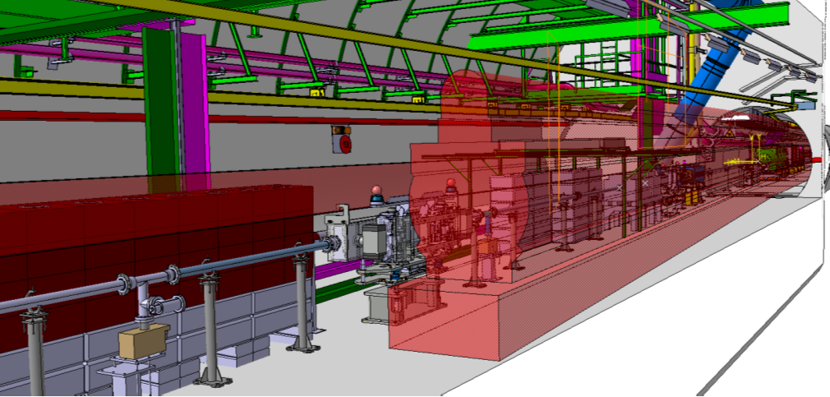
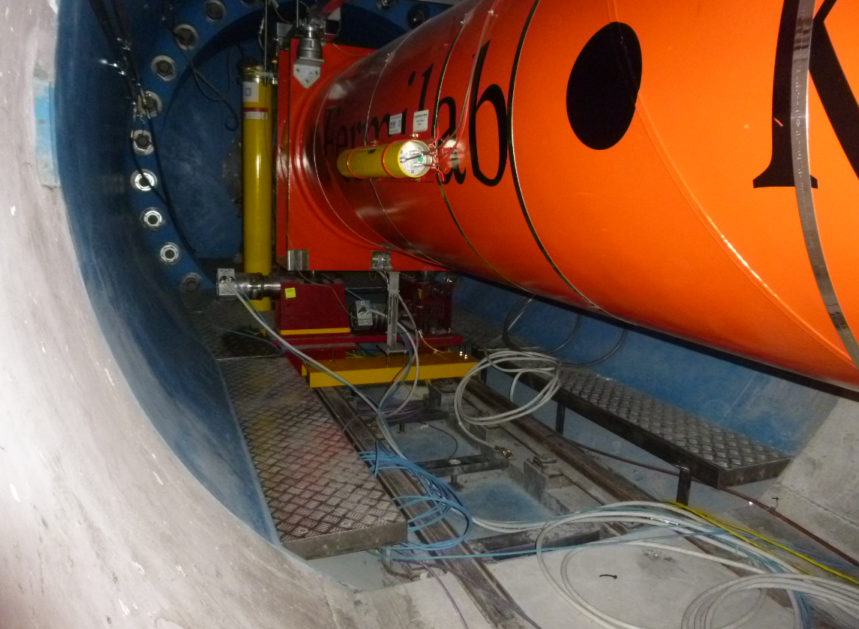
Revision of MCEW technical status and costing
J. Pedro Pinheiro de S., HL-LHC WP15
06/05/2022

Slide 2
Minor Civil Engineering Works (MCEW)
What are the MCEW? These are activities:
  Identified as required to ensure the compatibility between the HL-LHC machine (layout optics v1.6) and the existing LHC infrastructures.
  Also known as orphan activities since prior to its recent identification (starting in late 2020) and despite being necessary, the responsibility of each activity had not yet been formally assigned to any HL-LHC Work Package nor had budget been allocated for them by the HL-LHC Project Office.
  whose preliminary data were collected and produced in a collaboration established between the client WPs, the impacted WPs and WP15.
  centralized by WP15 in order to facilitate exchanges and formal approval procedures between the client WP and the impacted WPs, allowing its seamless incorporation in the LS3 schedule.
Notes:
What are the MCEW? These are activities:
Designed to ensure the compatibility between the HL-LHC machine (layout optics v1.6) and the existing LHC infrastructures.
Also known as orphan activities since prior to this study the responsibility of each activity had not yet been formally assigned to any HL-LHC Work Package nor had budget been allocated for them by the HL-LHC Project Office, despite its need.
whose preliminary data were collected and produced in a collaboration established between the client WP (the WPs whose machine components or activities were incompatible with the present configuration of the LHC infrastructures), the impacted WPs and WP15.
Although the impacted WPs had initially been foreseen as being exclusively by Site and Civil Engineering (hence the selected name), in view of the required nature of the works to be carried out on-site it has evolved to encompass EN-EL
centralized by WP15 in order to facilitate exchanges and formal approval procedures between the client WP and the impacted WPs.

Slide 3
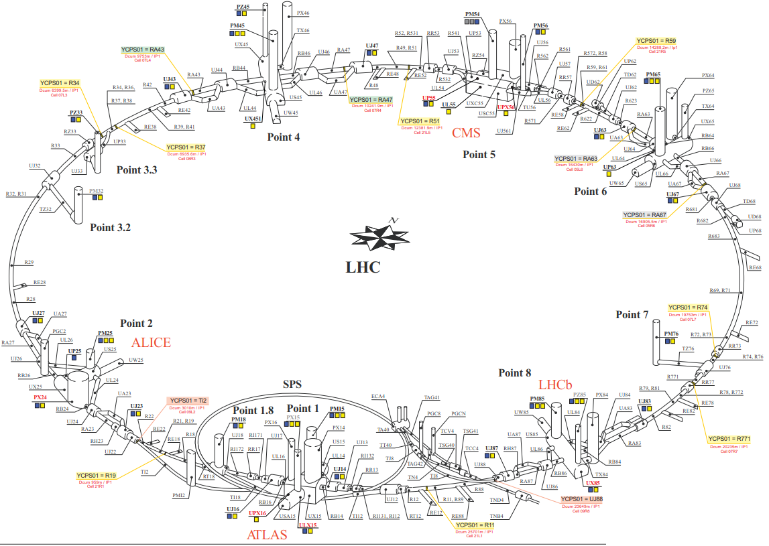
Overview of the regions where the MCEW will take place
MCEW – 2,3,4,5,7,8
P5
P2
P1
MCEW – 6
MCEW – 1,2,4,8

Slide 4
Overview of the followed process for the MCEW
Preliminary specification for each of the identified works are provided.
Pre-studies to identify missing information for the execution are started.
Initial budget estimations are performed.
Baseline are established and further studies on behalf of each group are conducted
1
2
Budget allocated by HL- Project and approved in EDMS
3
WP15
WP15
WPx
SCE
EN-EL
After Sep ’20 Before Feb ‘22
After Feb ‘22
4
Detailed scheduling studies are conducted
5
The works are executed according to the guidelines established in step 4
WP15
SCE
EN-EL
4
Detailed technical studies are conducted
  The supervision of the works and its underlying technical studies will have been fully conducted by CERN personnel, so the estimated cost does not cover neither them.
SCE
EN-EL
Finished
WPx
A given Work Package
Unfinished
Notes:
Add note of the approved EDMS documents with COSTS

Slide 5
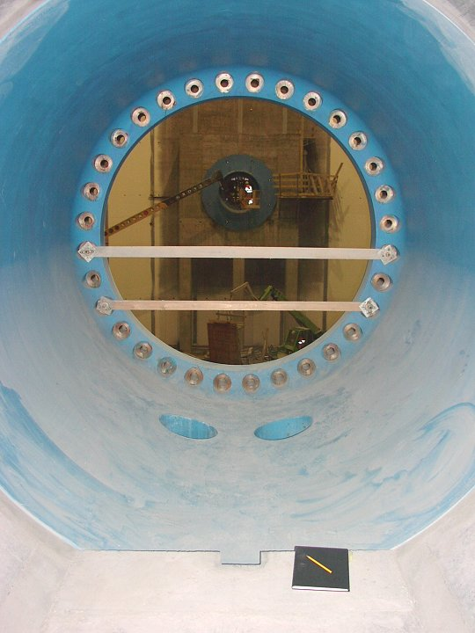
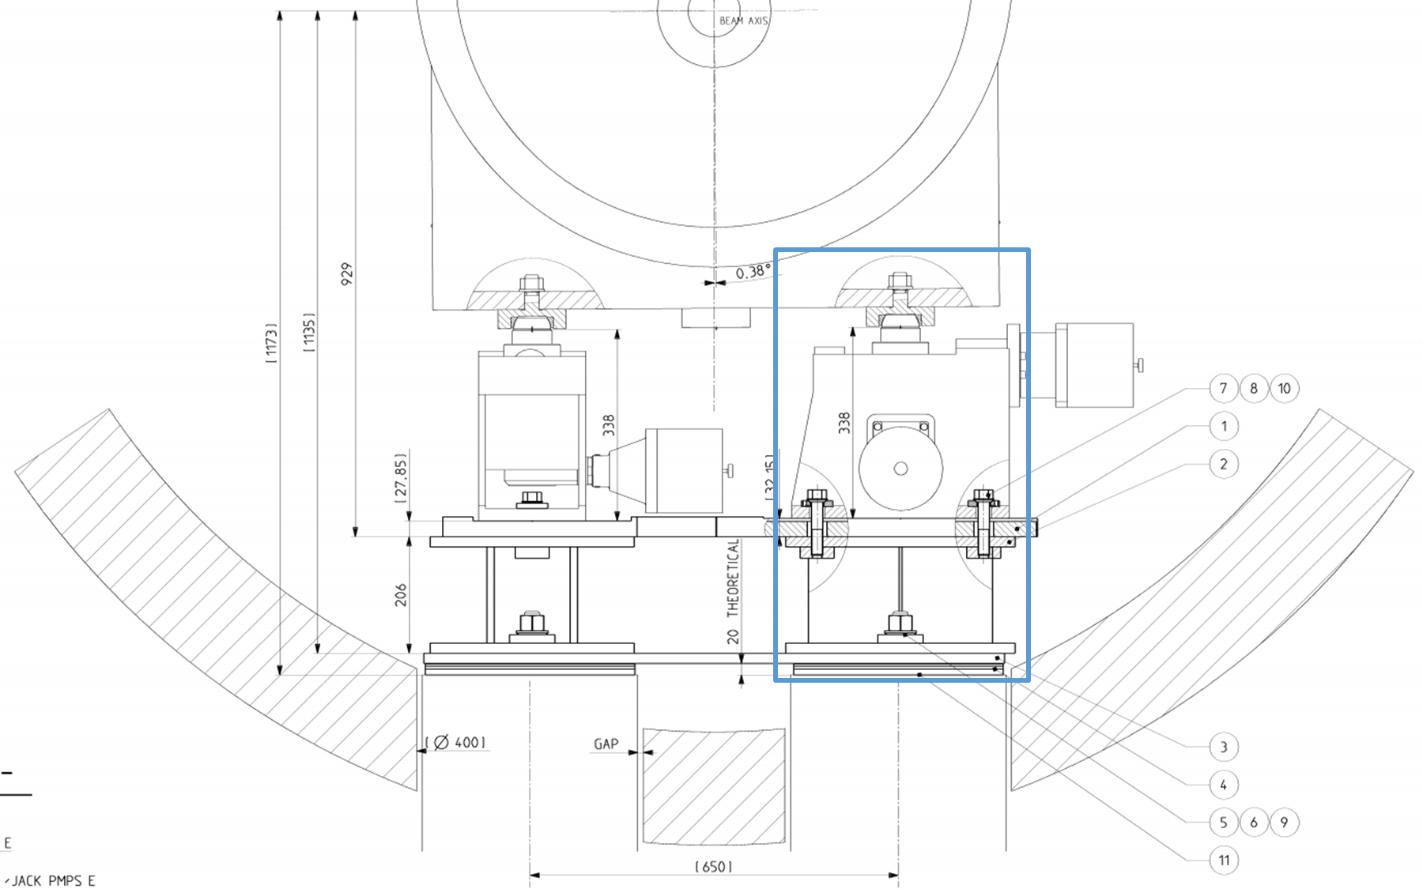
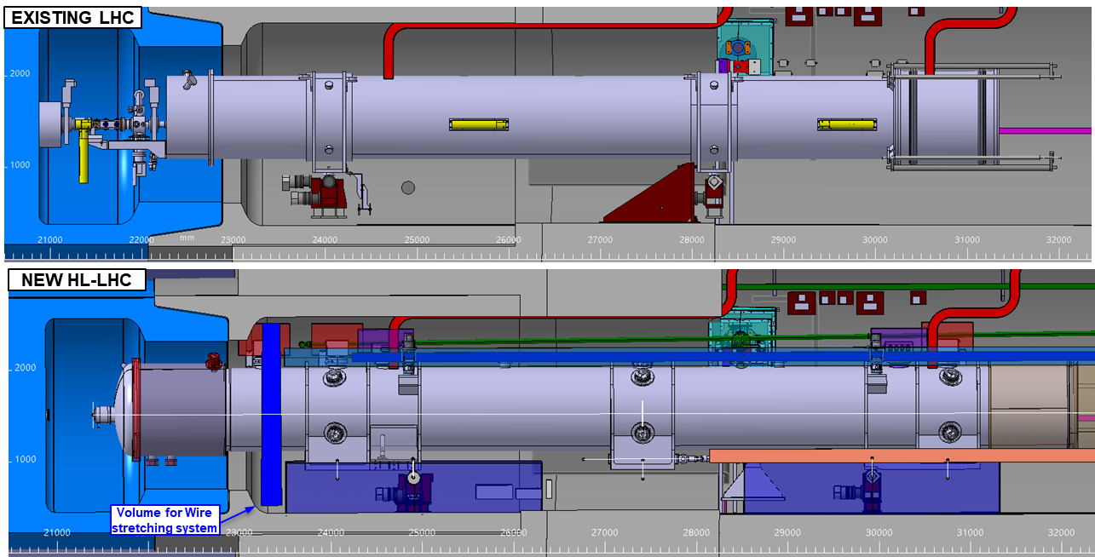
MCEW1 - PILLARS for the jacks of Q1 inside the nose iron shielding P1 (ATLAS)
Principle
The iron shieldings of P1R (RB16), P1L (RB14) that house a portion of the Q1 cryoassembly iron shieldings will be used to support the Q1 jacks in the HL-LHC configuration. Considering the jacks are positioned differently inside the iron shielding with respect to the LHC configuration (figure 3), new holes onto which these will be fixed on must be drilled during LS3.
The HL-LHC concrete pillars must be designed considering the axial (longitudinal and radial) and vertical loads following the design principles used for the LHC ones.
a series of compensation pieces intermediate the concrete pillars and the jacks, the efforts on the concrete pillars (and the fasteners embedded therein) are foreseen to follow the same guidelines as those used for the LHC jacks.

Slide 6
MCEW1 - PILLARS for the jacks of Q1 inside the nose iron shielding P1 (ATLAS)
Baseline
  Inside the Q1 nose shielding of IP1-R and IP1-L, 2 pillars will be created (amounting to a total of four).
  Dimensions of the pillars – diameter of 400mm and a height of 600mm.
  Thickness of the reinforcement steel rod – 200mm.
  The concrete pillars must not be solidary with the reinforcement steel rods.
  The anchor studs will be cut, whilst the concrete pillars will remain in place.
  No modification on the platform or on the present rails is foreseen, despite the need to take out the lateral access platforms for the drilling of the hole and the creation of the new pillars.
  The LSS1 and LSS5 regions of the LHC machine will have been fully taken out for the execution of the works
  The guiding rail will be longitudinally positioned 350 mm away from the pillars.
Caveats
  A study to validate the dimensions of the pillars is ongoing.
  The fixation of the lateral access platforms must be checked on site (welded or bolted?)
  The position of the pillars must be controlled with respect to the rails and must therefore be checked on site.
Minor Civil Engineering Work overview | Location | Stakeholder | Estimated cost (CHF)
MCEW1 - PILLARS FOR THE JACKS OF Q1 INSIDE THE NOSE IRON SHIELDING | IP1 |  | 21,000 (SCE)
WP3
WP15.4
Notes:
Andreas comment on the second wire coming in there will be at least one base plates for the reference pillars to be welded (as in the LHC) to the iron nose shielding. The old pillars will surely be removed, regardless of the selected means of installation of the new ones (already encompassed in the dismantling exercise).
Another relevant point is that for safety reasons enlarging the platforms towards the center of the iron shielding and extending the platforms outside the shielding along the portion of the tunnel vault where the curvature is the same, would be beneficial.

Slide 7
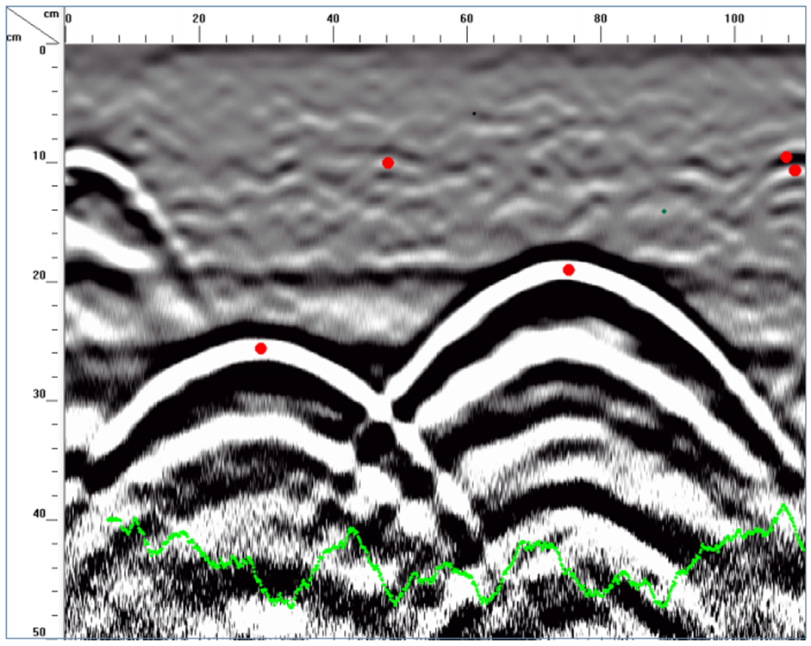
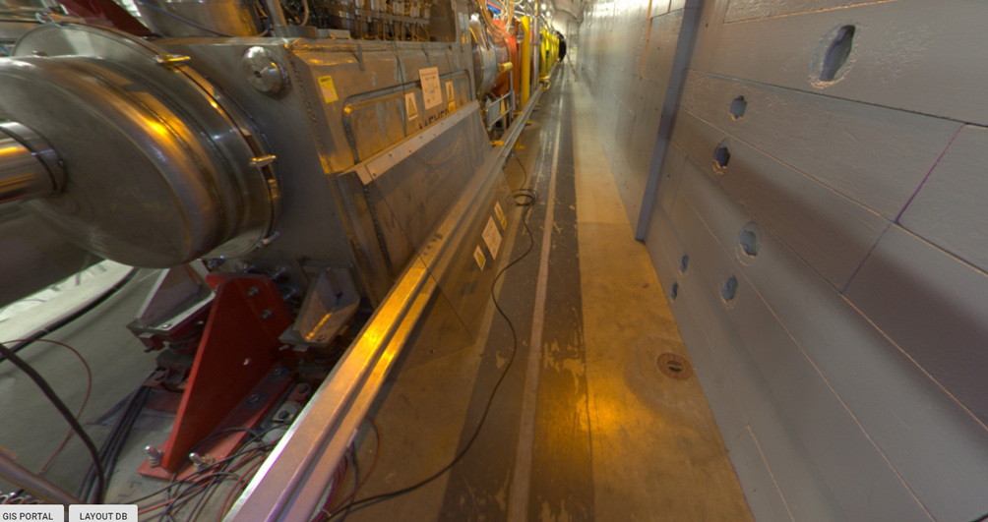
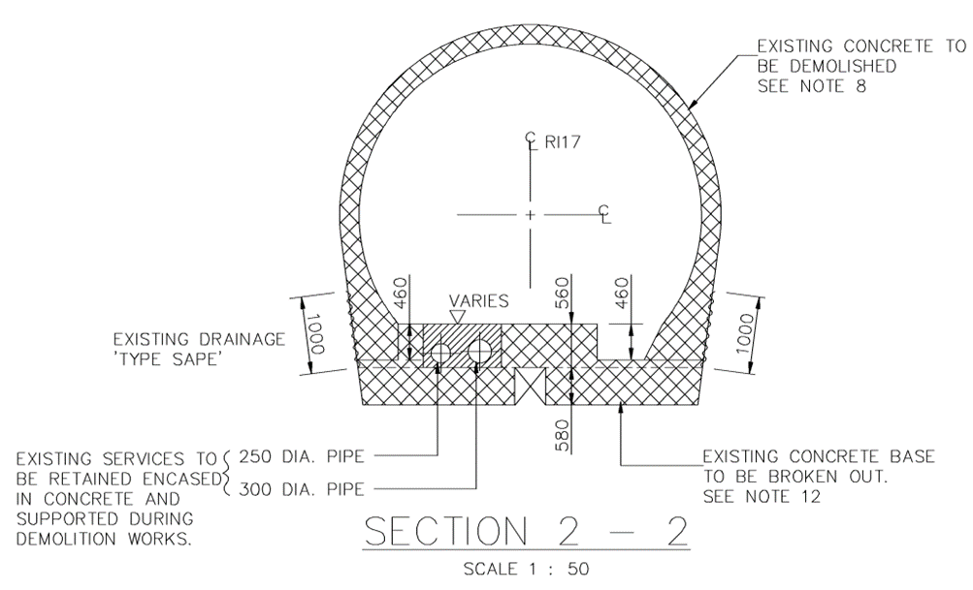
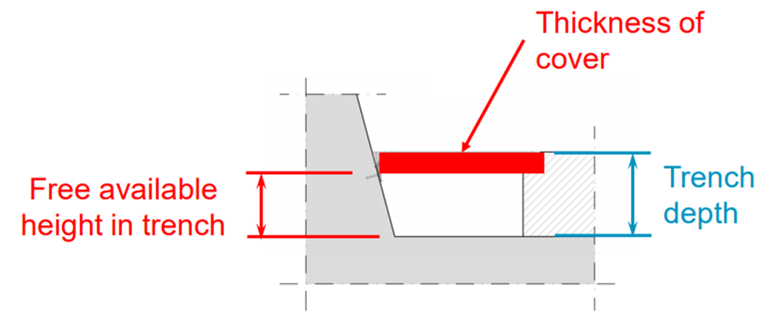
MCEW2 – PREPARATION OF TRENCHES FOR DEEP SURVEY REFERENCE INSTRUMENTATION (ATLAS AND CMS)
Principle
The deep survey references in the LHC tunnel are presently positioned are deemed “hot” areas in FLUKA simulations provided by the RP team, so to limit the exposure of workers to radiation, it was agreed to limit the access to these areas. It was proposed that these deep references would be permanently instrumented to provide a continuous reference for the vertical alignment activities in this area.
A connection between the HLS (on the exterior or cryogenic line side of the machine) and the deep references (on the transport or interior side of the machine) would be made using trenches that will be excavated by SCE. They would then be protected from impacts by covers.
Minor Civil Engineering Work overview | Location | Stakeholder | Estimated cost (CHF)
MCEW2 - PREPARATION OF TRENCHES FOR DEEP SURVEY REFERENCE INSTRUMENTATION | IP1/IP5 |  | 28,000 (SCE)
WP15.4
Notes:
Mention Raul’s detailed report and the scanning of the pipes

Slide 8
MCEW2 – PREPARATION OF TRENCHES FOR DEEP SURVEY REFERENCE INSTRUMENTATION (ATLAS AND CMS)
Baseline
  Trench with a width of 300mm – to be confirmed.
  Trench with a variable length – in P1 at 375cm and in P5 at 120cm.
  The depth of the high-pressure water pipes are 20cm and the advisable depth of the trenches are 15cm. With a cover of 3cm one gets 12cm leftover depth.
  Travelable covers are to be foreseen (Anticorodal type covers of 30mm thickness, considering a load arising from a 21 Ton cryostat).
Caveats
  The dimensions of the equipment making the link between the HLS and the GITLs must be designed according to these constraints.
Minor Civil Engineering Work overview | Location | Stakeholder | Estimated cost (CHF)
MCEW2 - PREPARATION OF TRENCHES FOR DEEP SURVEY REFERENCE INSTRUMENTATION | IP1/IP5 |  | 28,000 (SCE)
WP15.4
Notes:
Mention Raul’s detailed report and the scanning of the pipes

Slide 9
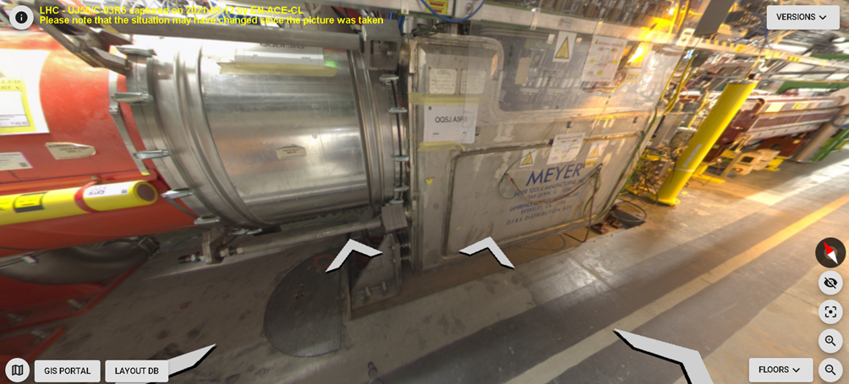
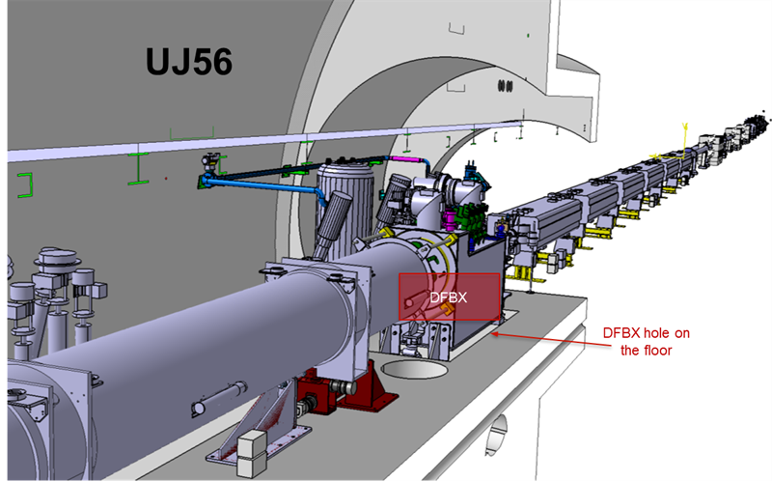
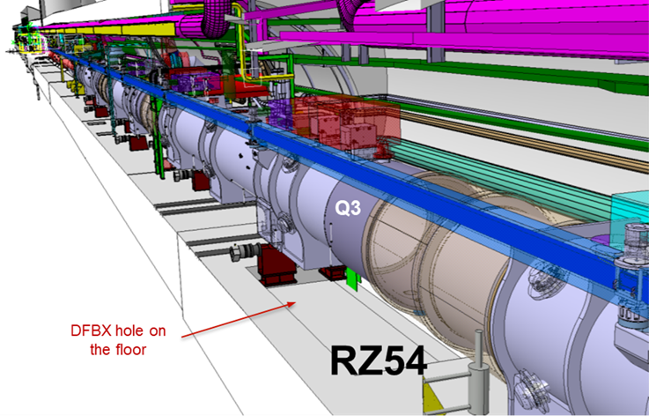
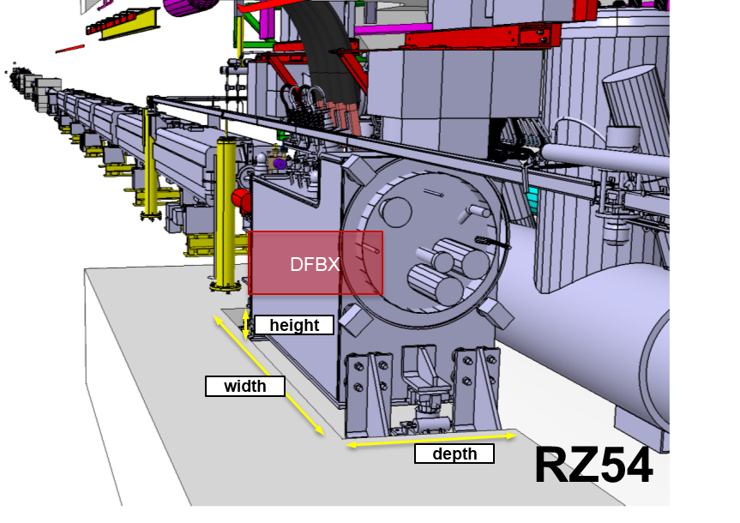
MCEW3 - FILLING OF THE DFBX RESERVATIONS
Principle
In the new HL-LHC configuration, the reservations trenches in P5L (RZ54,, figure 1) and P5R (UJ56, figure 4) presently used for the DFBX installation will no longer be required.
The trench must be filled to their full extent - according to the dimensions in the below table and be able to withstand the same loads of the LHC floor that is nearby.

Slide 10
MCEW3 - FILLING OF THE DFBX RESERVATIONS
Baseline
  The new portion of concrete ground will have to be capable of withstanding the same loads as the surrounding regions.
  Provision of tools and materials will be provided by the transport service of CERN and are therefore not covered by the estimated cost.
  The LSS1 and LSS5 regions of the LHC machine will have been fully taken out for the execution of the works
Caveats
  The slab must be reinforced with a web of wired mesh and cannot be attached to the existing one.
Minor Civil Engineering Work overview | Location | Stakeholder | Estimated cost (CHF)
MCEW3 - FILLING OF THE DFBX RESERVATIONS | IP5 |  | 13,000 (SCE)
WP3
EN-ACE

Slide 11
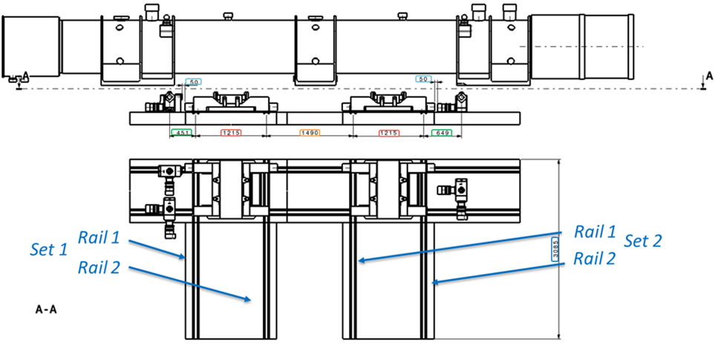
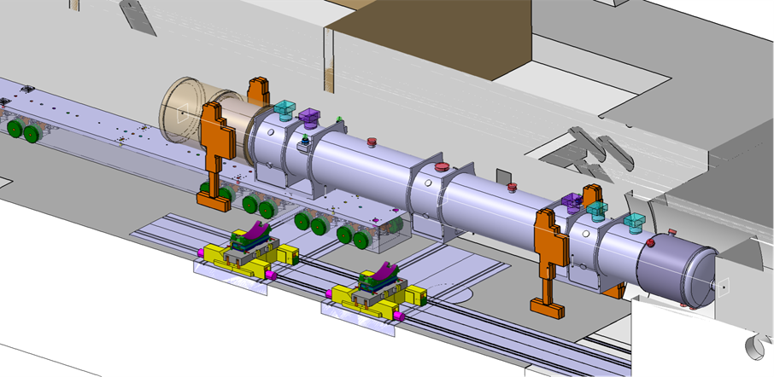
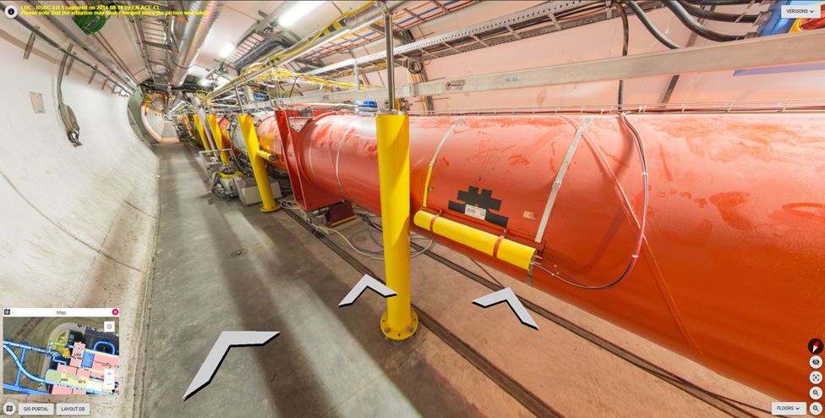
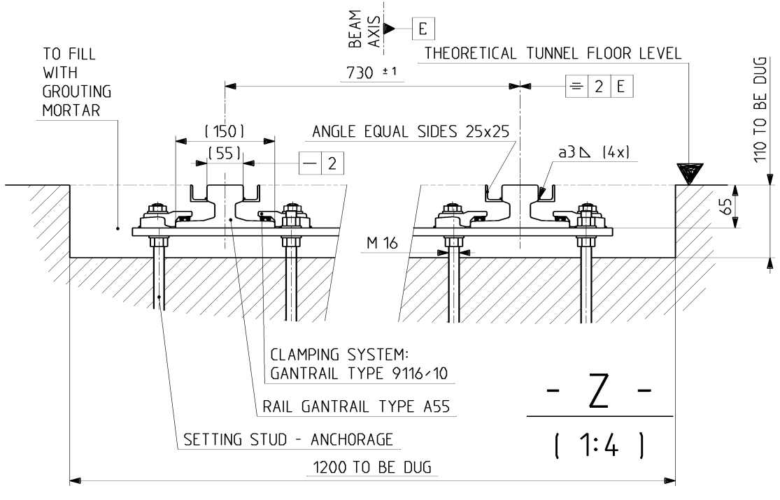
MCEW4 - RAILS INSTALLATION IN THE IT REGION
Principle
For the HL-LHC magnet installation new ITMB bogies that allow both the lateral transfer of the magnets and the insertion in the IPs “nose” areas will be used.
The rails for the longitudinal transfer already exist in the LHC tunnel. However, for the transversal transfer, two pairs of transversal rails shall be installed perpendicular to the longitudinal ones, below and in front of the Q2A magnet in the HL-LHC configuration, requiring, as such, junction pieces to interface the new transversal rails with the existing longitudinal ones.
Both the transversal rails and the junction piece shall be ordered from the catalogue of a specialized company in rails. In addition, longitudinal rails will equally be required to replace the portion of the existing obsolete ones. It is the responsibility of EN-HE to provide such pieces, and the responsibility of SCE to perform their installation.

Slide 12
MCEW4 - RAILS INSTALLATION IN THE IT REGION
Baseline
  The rails will be already assembled by pairs with the linking transversal elements. A large slab reservation for a pair of rails of 1400mm width and 110mm height must be foreseen.
  The length of the transversal rails is of 3100mm.
  The rails, X-shaped connection pieces and fixations will be supplied by EN-HE (and therefore the estimated cost does not account for them).
  The LSS1 and LSS5 regions of the LHC machine will have been fully taken out for the execution of the works
Caveats
  The reservations themselves will consist of:
    2 of 3200x1750mm
    1 of 1400x1400mm
  The maximum depth of the to be installed rails is of 15cm, to account for the pipes running underneath.
  The portion of the longitudinal rails between the transversal ones must be displaced.
Minor Civil Engineering Work overview | Location | Stakeholder | Estimated cost (CHF)
MCEW4 - RAILS INSTALLATION IN THE IT REGION | IP1/IP5 |  | 128,000 (SCE)
WP3
WP15.5

Slide 13
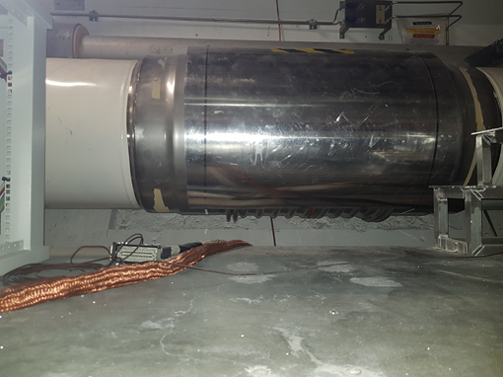
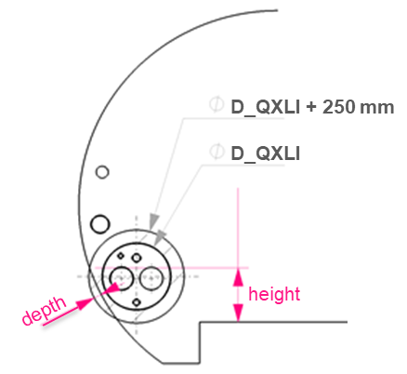
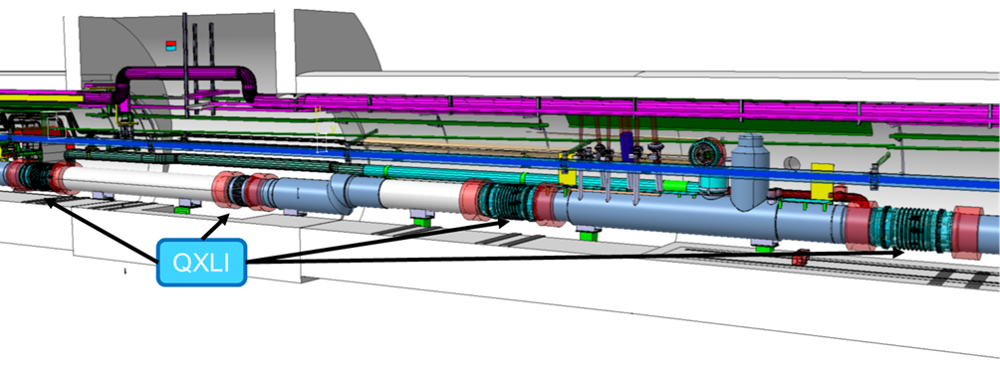
MCEW5 - VAULT GRINDING FOR THE HL-LHC CRYOGENIC LINE
Principle
The present state of the tunnel vault does not allow this margin of manoeuvre to carry out this type of works (which roughly amount to an additional 250mm to the diameter of the cryogenic line itself).
Considering that it was not deemed feasible to displace the QXL itself without incurring into design changes, it was decided to make space along the tunnel vault by grinding it at specified locations (creating pockets).
This type of localized intervention was also done at the time of the installation of the LHC.
A study was conducted by SCE to assess the capacity of having the tunnel vault having these changes, to which it was positive.

Slide 14
MCEW5 - VAULT GRINDING FOR THE HL-LHC CRYOGENIC LINE
Baseline
  The LSS1 and LSS5 regions of the LHC machine will have been fully taken out for the execution of the works
  The required clearance space around the QXL interconnections is of a diameter of 1300 mm + radius of 250 mm = circa 1800mm
  The required grinded pockets range from a minimum length of 550mm to 3935mm, amounting to a total span of circa 49m. The minimum depth is 16mm to 75mm.
  A budget was allocated for analysing the maximum grinding depth (a study led by Raul Fernandez from SCE).
  Concrete reinforcements were not included in the estimated cost.
Caveats
  A web of anti-cracking wire mesh exists at a depth of 5cm in regions of the LHC tunnel.
Minor Civil Engineering Work overview | Location | Stakeholder | Estimated cost (CHF)
MCEW5 - VAULT GRINDING FOR THE HL-LHC CRYOGENIC LINE | IP5 |  | 100,000 (SCE)
WP9

Slide 15
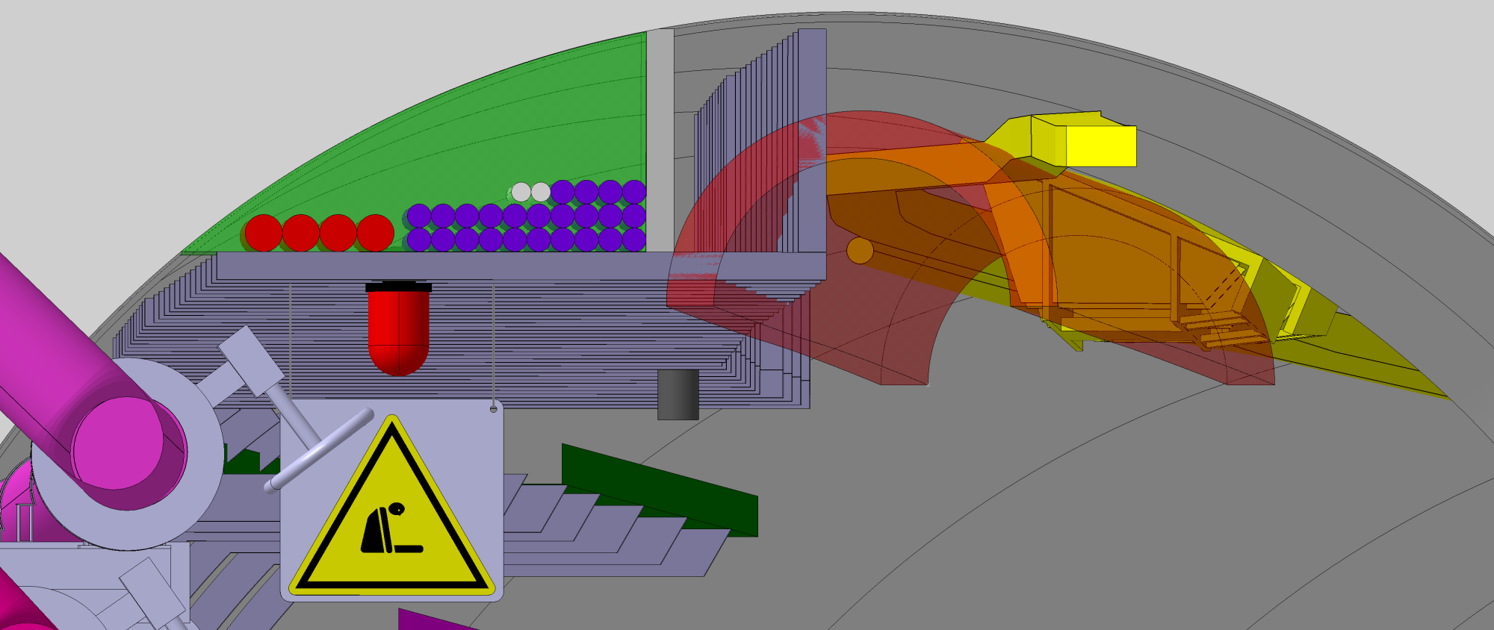
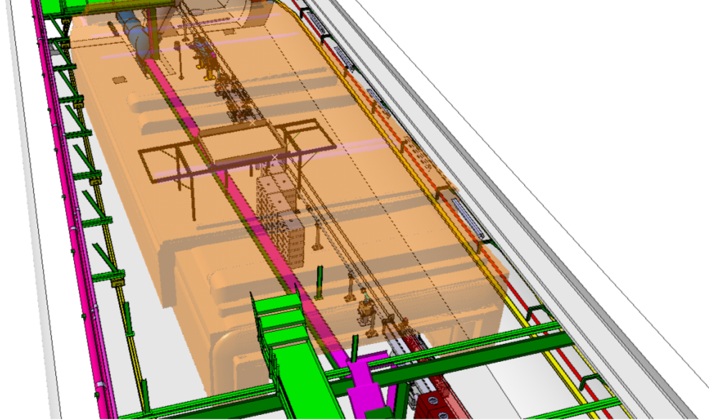
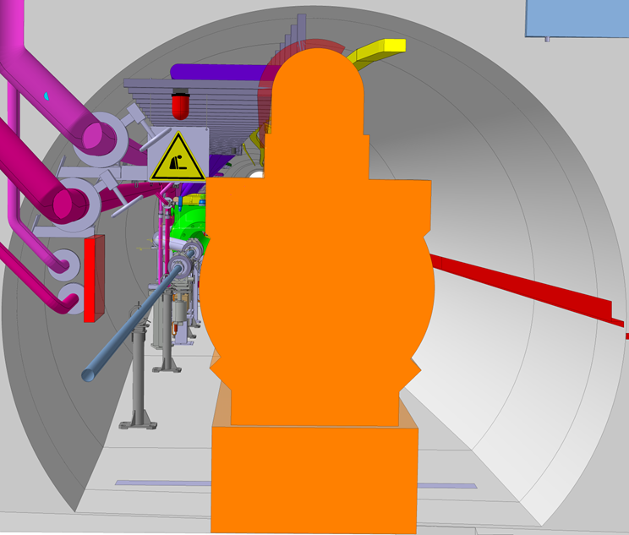
MCEW6 - MODIFICATIONS OF INFRA-STRUCTURES FOR THE TRANSPORT OF HL-LHC D2 IN THE TI2-UJ22 REGION (P2)
Principle
EN-HE produced a sweeping volume to simulate the traversed regions of the tunnels during the handling of the HL-D2 cryostat, one for each of the activities mentioned in section 3.3, depicting both required configurations of the HL-LHC D2, i.e. with the jumpers oriented in both directions, as mentioned above. Neither models that originally given by EN-HE contain any margins.
The clash with the transport volume starting from the first cable tray support (S0 at 0m) to the eleventh cable tray support (S2 at 5m) involves the modification of these structures and the reconfiguration of the cables themselves.
An inspection to the tunnel in December 2021 was done by EN-EL and HL-WP15 in order to identify the determining aspects of a cables configuration which would be compatible with that of the supports.

Slide 16
MCEW6 - MODIFICATIONS OF INFRA-STRUCTURES FOR THE TRANSPORT OF HL-LHC D2 IN THE TI2-UJ22 REGION (P2)
Baseline
  The changes will be permanent.
Minor Civil Engineering Work overview | Location | Stakeholder | Estimated cost (CHF)
MCEW6 - MODIFICATIONS OF INFRA-STRUCTURES FOR THE TRANSPORT OF HL-LHC D2 IN THE TI2-UJ22 REGION (P2) | IP2 |  | 7,000 (SCE) + 30,000 (EN-EL)
EN-EL
WP15.5

Slide 17
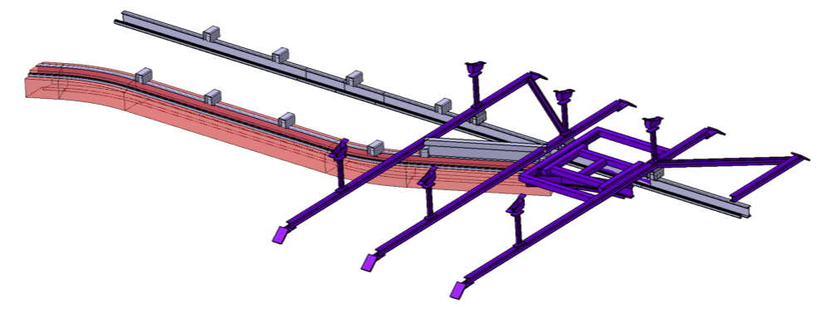
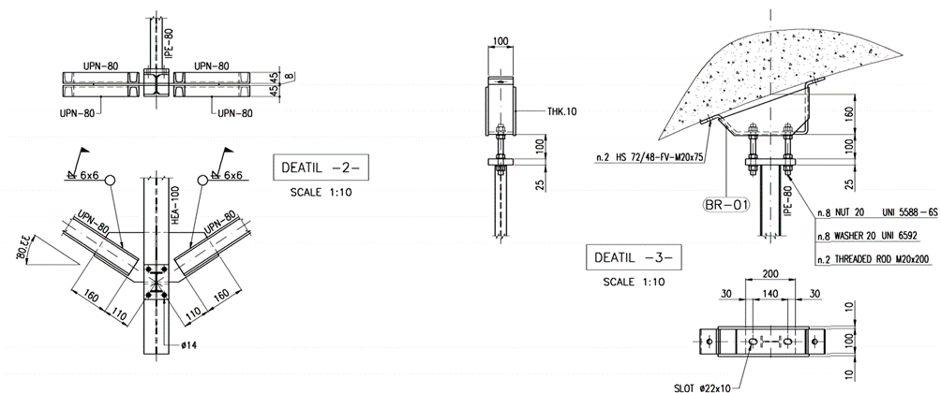
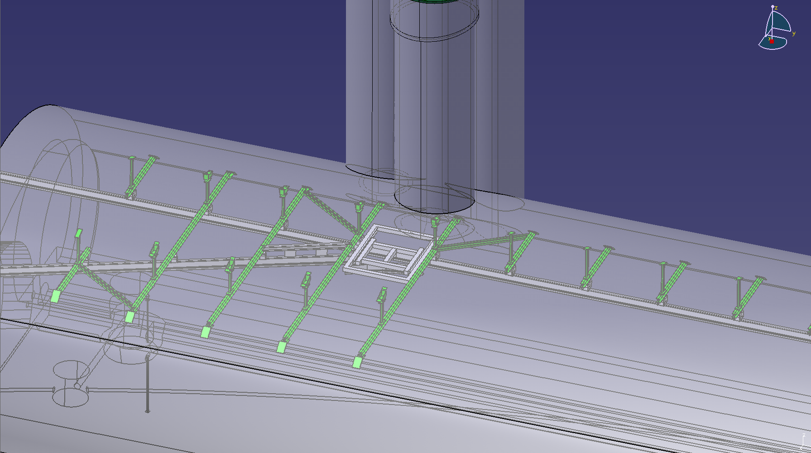
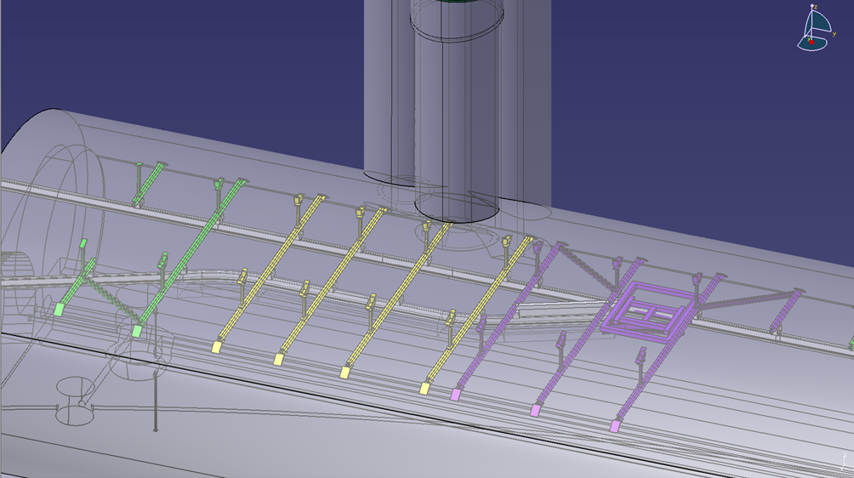
MCEW7 - MODIFICATION OF METALLIC FRAME (UJ57)

Slide 18
MCEW7 - MODIFICATION OF METALLIC FRAME (UJ57)
Baseline
  The load capacity of the monorail is 1 ton/linear meter.
  The LSS1 and LSS5 regions of the LHC machine will have been fully taken out during the execution of the works – rendering the LHC tunnel clear for the execution of the works
  A protection SAS is not deemed necessary.
  The supports to be dismounted are bolted and dismountable
  The fixation and adaptation of the monorail will be done by EN-HE.
  The maintenance and storage of the metallic frames will be carried out in collaboration with EN-HE.
  The services provided by EN-HE are not covered in the estimated cost.
  A budget for the computation of the fixations on the vault is included.
Caveats
  The fixation of a support of the metallic frame (as proposed by WP15 and EN-HE) falls under the opening of the core. SCE therefore proposed to replace it by two supports on each core side.
  The supports section was identified as being HEA100 (17.1 kg/linear meter) of a length of 6.2m.
  The study of the precise support positions is to be concluded.
  The phase for the removal and storing of the monorail could be prior to the removal of the frame and its supports.
  A storage unit for the stocking of the portion of the metallic frame to be kept and the machinery to remove it must be selected.
Minor Civil Engineering Work overview | Location | Stakeholder | Estimated cost (CHF)
MCEW7 - MODIFICATION OF METALLIC FRAME (UJ57) | IP5 |  | 41,000 (SCE)
WP6A
WP15.5

Slide 19
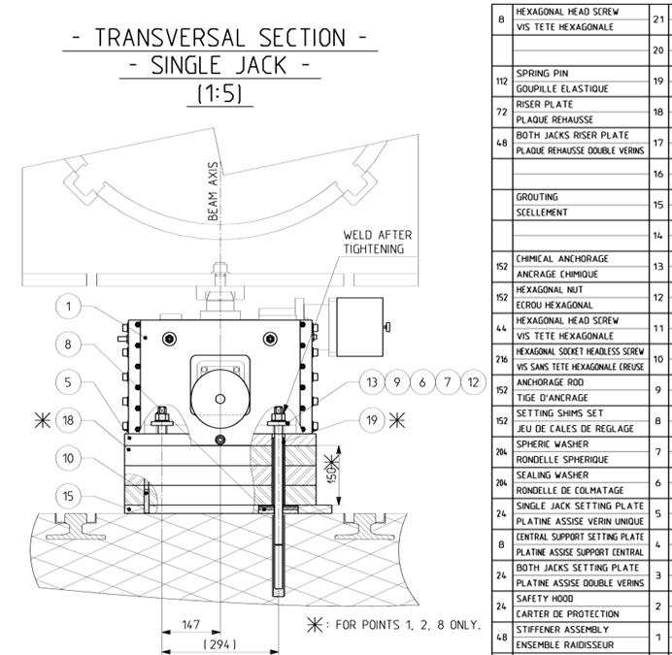
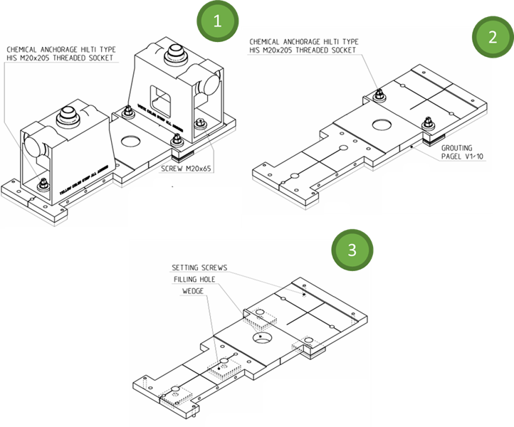
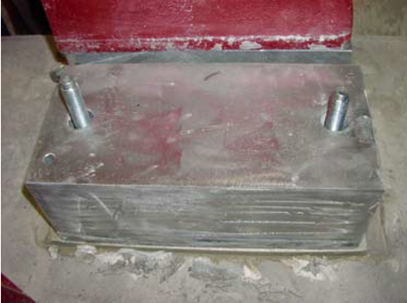
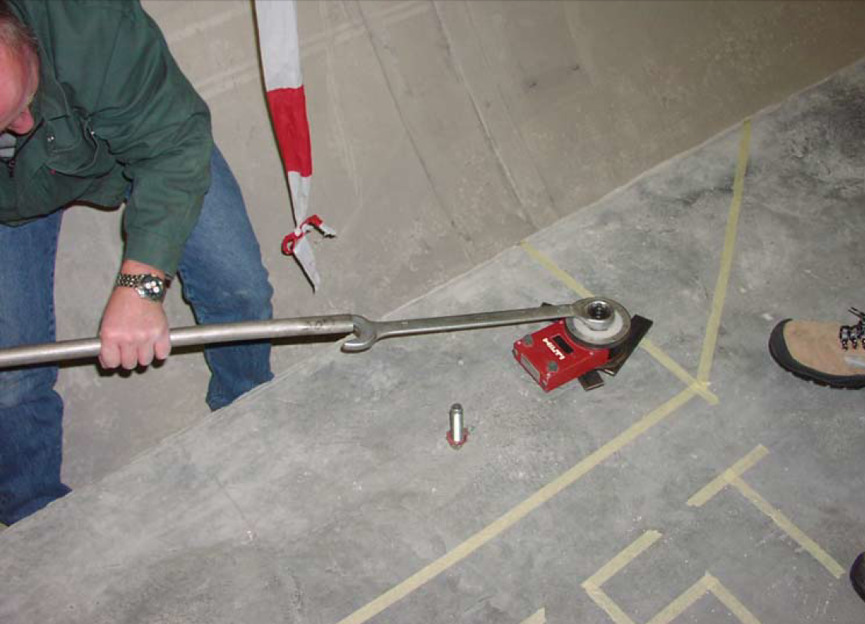
MCEW8 - GROUND PREPARATION FOR LONG STRAIGHT SECTION COMPONENTS SUPPORTS

Slide 20
MCEW8 - GROUND PREPARATION FOR LONG STRAIGHT SECTION COMPONENTS SUPPORTS
Baseline
  The LSS1 and LSS5 regions of the LHC machine will have been fully taken out in during the execution of the works – rendering the LHC tunnel clear for the execution of the works
  The foreseen quantities of the jacks and its supports are about 12-13 per IP side.
  The surface to be demolished and reset is of 0.5m x 1m = 0.5m^2.
Minor Civil Engineering Work overview | Location | Stakeholder | Estimated cost (CHF)
MCEW8 - GROUND PREPARATION FOR LONG STRAIGHT SECTION COMPONENTS SUPPORTS | IP1/IP5 |  | 62,000 (EN-ACE)
WP15.4
EN-ACE

