Slide 1

Brain storming HL-LHC valves in Q4
G.Bregliozzi, R. De Maria

Slide 2
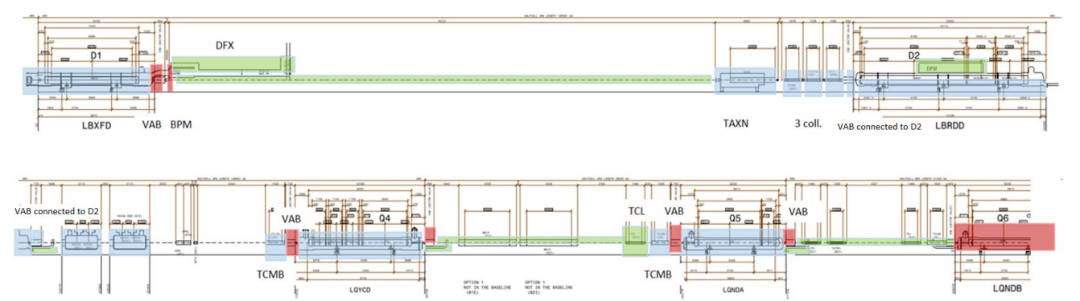
VACUUM SECTOR VALVE location
Alignment during YETS & LS
FRAS
Static
D1
D2
Valve D1
Valve D2
CRAB
Q4
Q5
Q6
Valve D2
Valve CRAB
Valves Q4
Valves Q5
Valve Q6

Slide 3
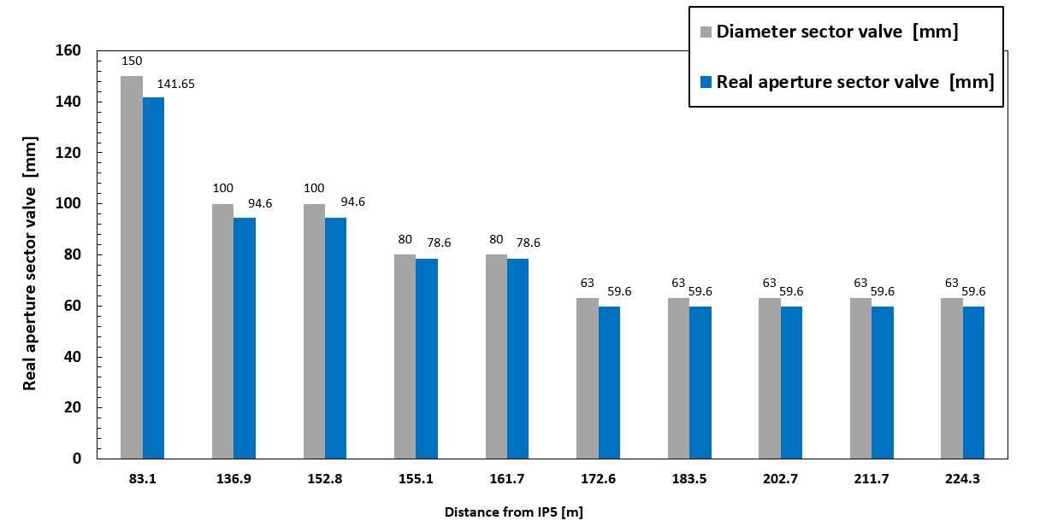
Sector valves apertures
D1
ID 150
D2
ID 100
CRAB
ID 80
Q4 – Q5 – Q6
ID 63

Slide 4
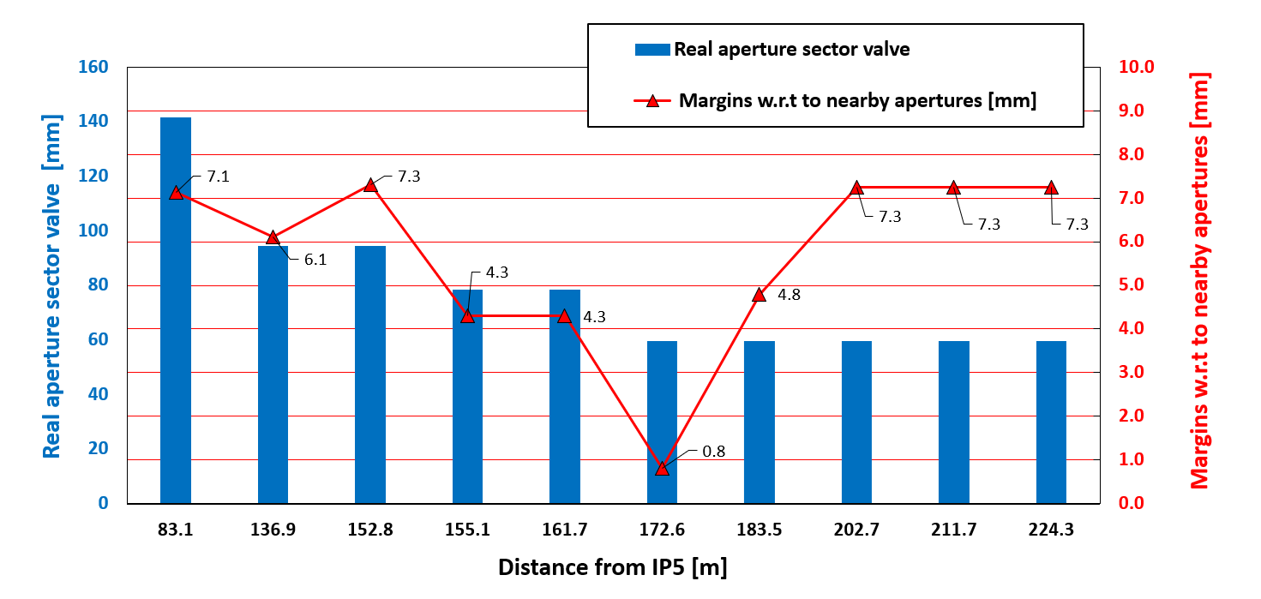
Available margins
Margins calculated by WP2, thanks to R. De Maria
D1
ID 150
D2
ID 100
CRAB
ID 80
Q4 – Q5 – Q6
ID 63

Slide 5
Detailed calculations
 | VABCKNAF | VABCDDAE | VABCEEAK | CRAB1 | CRAB2 | VABCBMAB | VABCBMAC | VABCBMAB | VABCBMAC | VABTB
Diameter sector valve [mm] | 150 | 100 | 100 | 80 | 80 | 63 | 63 | 63 | 63 | 63
Minimum Aperture due RF fingers | 145.1 | 96 | 96 | 80 | 80 | 63 | 63 | 63 | 63 | 63
Concentricity Flanges [mm] | 0.25 | 0.2 | 0.2 | 0.2 | 0.2 | 0.2 | 0.2 | 0.2 | 0.2 | 0.2
Circularity [mm] | 0.2 | 0.2 | 0.2 | 0.2 | 0.2 | 0.2 | 0.2 | 0.2 | 0.2 | 0.2
VSC Alignment margin [mm] | 1 | 1 | 1 | 1 | 1 | 1 | 1 | 1 | 1 | 1
FRAS | 2 | 0 | 0 | 0 | 0 | 2 | 2 | 2 | 2 | 2
Aperture separation [mm] | 0 | 184.0 | 194 | 194 | 194 | 194 | 194 | 194 | 194 | 194
Final Aperture | 141.65 | 94.6 | 94.6 | 78.6 | 78.6 | 59.6 | 59.6 | 59.6 | 59.6 | 59.6
DCUM % IP5 (mm) | 83118 | 136870 | 152772 | 155062 | 161655 | 172586 | 183474 | 202742 | 211695 | 224251
Position | D1 | D2 | D2 | CRAB1 | CRAB2 | Q4 | Q4 | Q5 | Q5 | Q6
Nearby apertures [mm] | 119 | 80 | 80 | 70 | 70 | 58 | 50 | 45.1 | 45.1 | 45.1
Beam separation [mm] | 16.8 | 178.3 | 194.0 | 194.0 | 194.0 | 194.0 | 194.0 | 194.0 | 194.0 | 194.0
Offset beam – aperture [mm] | 8.4 | 2.9 | 0 | 0 | 0 | 0 | 0 | 0 | 0 | 0
Margins w.r.t to nearby apertures [mm] | 7.1 | 5.9 | 7.3 | 4.3 | 4.3 | 0.8 | 4.8 | 7.3 | 7.3 | 7.3
The margin in Q4 is not a strong limitation, but it is not ideal because it will likely requires more re-alignments and extra care compared to the other valves.

Slide 6
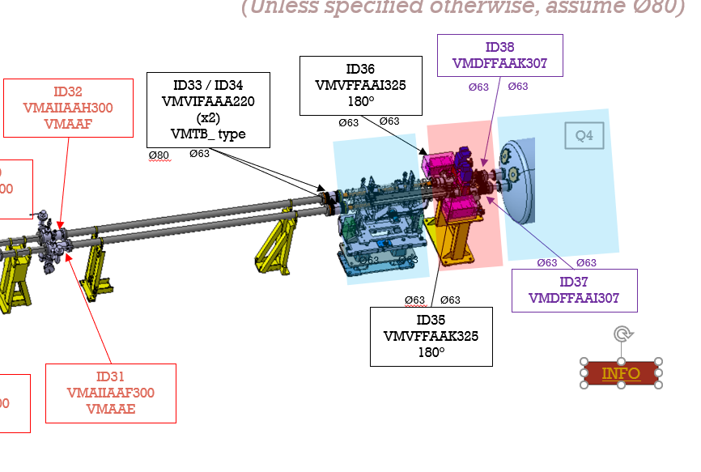

(Unless specified otherwise, assume Ø80)
CRAB-Q4
Color code:
DRF
LRM (VMTIA type bellow with standard or improved RF bridge)
RF (standard bellow and RF bridge)
Remote Alignment
Alignment during YETS / LS
Any improvement on the aperture
should not increase impedance (no DN100)
should not increase peak dose in MCBY (no increased distance with Q4)
In addition WP5 is considering TCLMB aperture reduction due to peak dose to MCBYs concerns

Slide 7
Potential options
Mask
Valve
Q4
Today: Valves manually aligned;
2 flexible bellows, 2 platforms needed;
small aperture margins in the valves
Fras
Fras
Valves aligned once;
1 flexible bellow, 2 platforms needed;
? kCHF
1)
Valves aligned once;
1 flexible bellow, 2 platforms needed
? kCHF
2)
3)
Valves and TCLMB aligned once
No flexible bellow, 1 platforms needed
? kCHF

