Slide 1



LPG sensor technology for environmental monitoring: from the laboratory to the detector
EP-DT Training seminar
Lorenzo Scherino
May 11, 2022

Slide 2
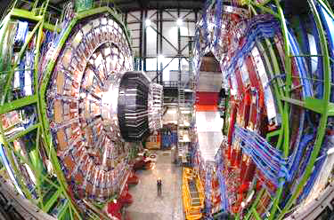
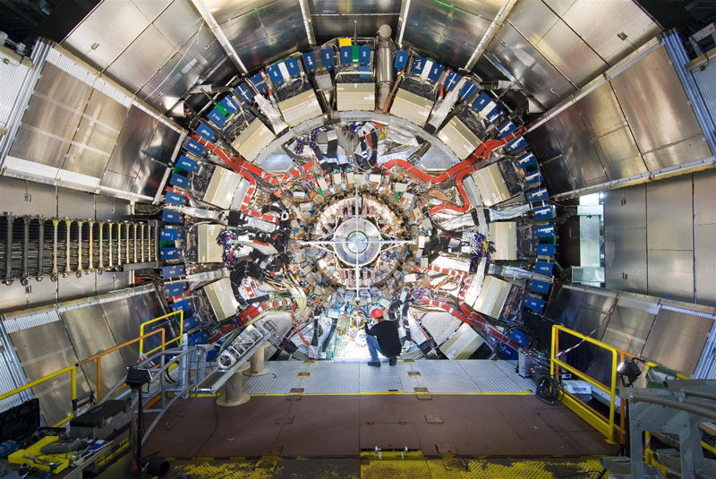
Relative Humidity (RH) Monitoring at CERN
The heart of the experiments
(ATLAS and CMS) is the Tracker
Silicon sensors measure position
of particles
Radiations cause heat generation
Cooling system is needed
The tracker and its services have
to be kept dry to avoid condensation
A CONTINUOUS THERMAL AND HYGROMETRIC
CONTROL OF THE ENVIRONMENT IS MANDATORY!

Slide 3
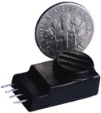
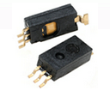
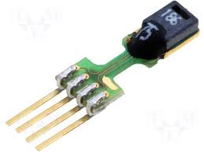
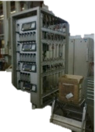
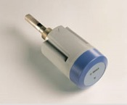
Currently at CERN for RH monitoring
1) Different types of miniaturized sensors (standard capacitive)
PRECON
HS2000
HONEYWELL
HIH4030
SENSIRION
SHT75
NO-ONE satisfies CERN requirements:
Not radiation hard
“Dead” at absorbed radiation doses ≤ 10 kGy
2) Remote air sniffers
Measurements with lab instrument on air samples transferred over long distance
- No distributed sensing
- Only time-averaged measurements provided
Sniffer rack in remote laboratory
Vaisala DRYCAP Dewpoint Transmitter DMT242
3) Fiber Optic Relative Humidity Sensors (FOS-RH) based on Fiber Bragg Grating technology
They offers several advantages for significant metrological improvement

Slide 4
Fiber Optic Sensors
For a large number of environmental monitoring and industrial applications fiber-optic sensor technology offers several advantages for significant metrological improvement through:
High sensitivity
Immunity to electromagnetic interference
Possibility to work in harsh environments
Versatility
Absence of electronic circuitry in the measurement area

Slide 5
Three generations of fibre-optics based environmental sensors (thermo-hygrometric FOS)
1st generation based on Fiber Bragg Grating (FBG) technology:
- Investigations from 2011
- R&D completed
2nd generation based on Long Period Grating (LPG) technology:
- Investigations from late 2013
- Prototype installation in ATLAS ID in March 2019
- R&D still on-going (completion target 2022)
- Target complete installation in ATLAS ITk in 2024
3rd generation based on distributed sensing:
- Investigations from 2017
- R&D on-going
EP-DT seminar held by T. Neves (https://indico.cern.ch/event/1017585/)

Slide 6
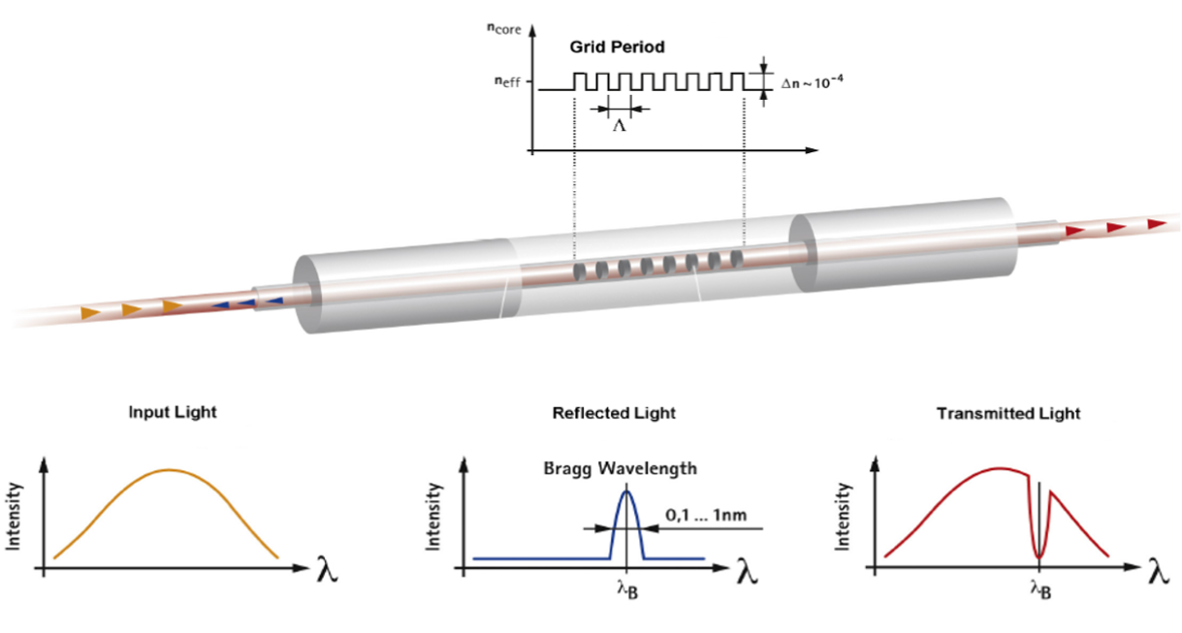
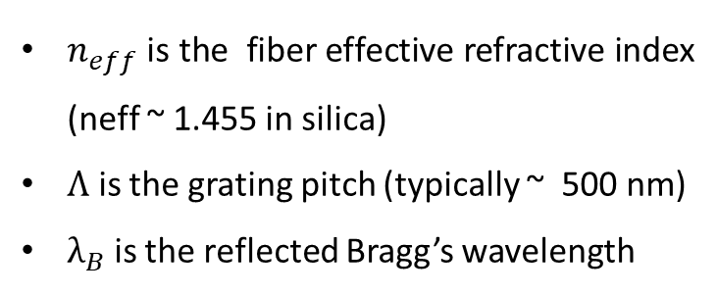
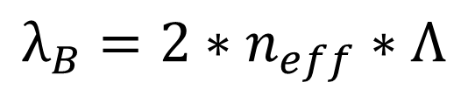
Fiber Bragg Gratings
FBGs are devices where is realized a permanent photo-induced periodic modulation of the refractive index of the fibre core.
When the light guided within the core hits on this periodic microstucture one specific wavelength gets reflected and all other wavelengths of the guided broadband light can pass unperturbed.
$$λ_{B}=2∗n_{eff}∗Λ$$
$n_{eff}$ is the fiber effective refractive index (neff ~ 1.455 in silica)
$Λ$ is the grating pitch (typically ~ 500 nm)
$λ_{B}$ is the reflected Bragg’s wavelength
Strain changes
Temperature changes

Slide 7
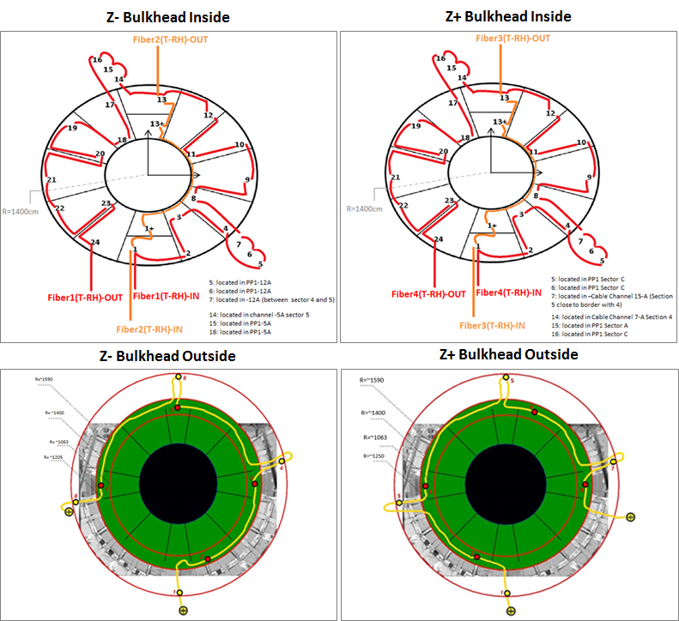
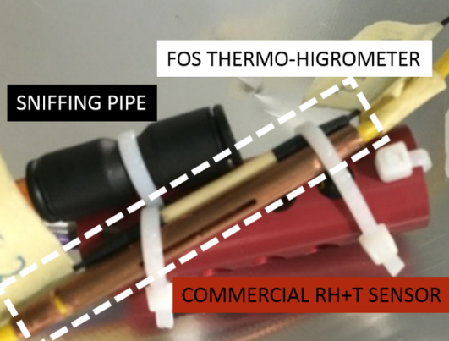
First generation: FBG-based RH sensors
Fiber optic RH sensor based on polyimide-coated Fiber Bragg Grating (FBG)
Water molecules absorbed by the hygroscopic coating
Strain induced
on the FBG
Coating expansion (“Swelling effect”)
Bragg
wavelength
shift (Δλ_{B})
72 FBGs- based thermo-hygrometers installed in CMS Tracker
RH operating range: [0, 100] %RH
T operating range: [-15, 30] °C
Radiation tolerant
G. M. Berruti et al, Sensors and Actuators B: Chemical, 177, (2013)
G. M. Berruti et al, IEEE Photonics Journal, 6(6), (2014)
G. M. Berruti et al, Jinst, 11, (2016)
Notes:
Even thought the results was very good and promising

Slide 8

Issues to be improved
Low RH Sensitivity
( S_{RH}~ 1.0 ÷ 2.0 pm/%RH in [-15, 30]°C)
High Cross Sensitivity
( S_{T} ~ 10 pm/°C in [0, 100] %RH)
Very precise T compensation needed to
decouple the RH and T effects from the
sensors measurements
E.g. S_{T} / S_{RH} =10 %RH/°C means that an T_{error} ≈±1°C
corresponds to RH_{error} ≈±10 %RH
Low accuracy below RH=±5%
Coating adhesion affecting the performances
Aging typical of polymers
ISSUE TO BE IMPROVED WITH
COATED FBGs:
Development of a second generation of FOS:
Long Period Grating (LPG) based sensors for Relative Humidity monitoring

Slide 9
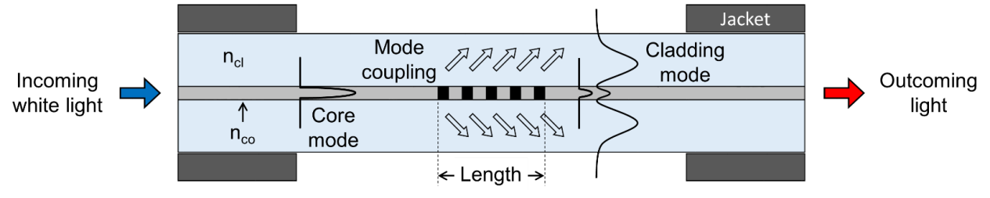

LPG principle of operation
Long Period Fiber Gratings (LPGs) are in fiber photonic devices realized by creating a periodic refractive index modulation of the core of a single-mode optical fiber along a small portion of its length.
LPGs act coupling the fundamental guided core mode to discrete forward propagating cladding modes, and to each of them at a distinct wavelength where the so-called phase matching condition is satisfied:
= grating period ~ hundreds of μm
n_{eff,core} = effective refractive index (RI) of the fiber core
n^{i}_{eff,clad} = effective RI of the i^{th} cladding mode
λ_{res,i} = resonance wavelength of the i^{th} cladding mode
$$λres,i = (neff,co – nieff,cl) × Λ$$

Slide 10
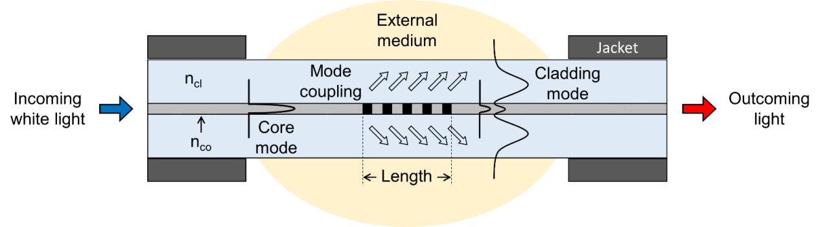

LPG principle of operation
Long Period Fiber Gratings (LPGs) are in fiber photonic devices realized by creating a periodic refractive index modulation of the core of a single-mode optical fiber along a small portion of its length.
LPGs act coupling the fundamental guided core mode to discrete forward propagating cladding modes, and to each of them at a distinct wavelength where the so-called phase matching condition is satisfied:
= grating period ~ hundreds of μm
n_{eff,core} = effective refractive index (RI) of the fiber core
n^{i}_{eff,clad} = effective RI of the i^{th} cladding mode
λ_{res,i} = resonance wavelength of the i^{th} cladding mode
$$λres,i = (neff,co – nieff,cl) × Λ$$

Slide 11
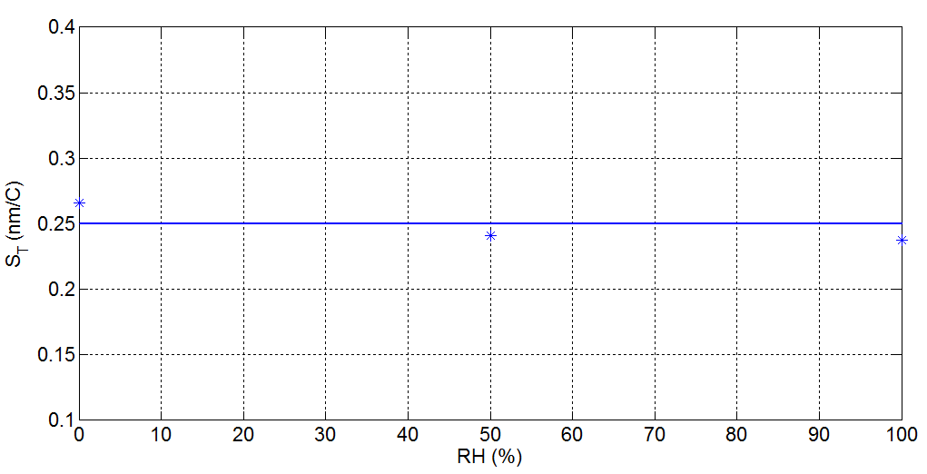

LPG as RH sensor
Moisture absorbtion/desorption by the coating
Spectral variation of attenuation bands
Modification of coating RI
Integration of nano-scale TiO₂ overlays
RH sensitivity Curve
T sensitivity Curve
S_{RH} = 1,4 ÷ 0,11 nm/%RH,
up to 3 orders of magnitude higher than the sensitivity of the 1st RH sensors!!!
S_{T_mean}≈ 0.250 ± 0.015 nm/°C in [0-100] %RH
If no compensation is applied, a T reading error of ± 1 °C corresponds to:
7-10 %RH error for coated FBG based RH sensors
0.2÷2 %RH error for coated LPG based RH sensors
M. Consales et al, Optics Letters 39(14), (2014)

Slide 12
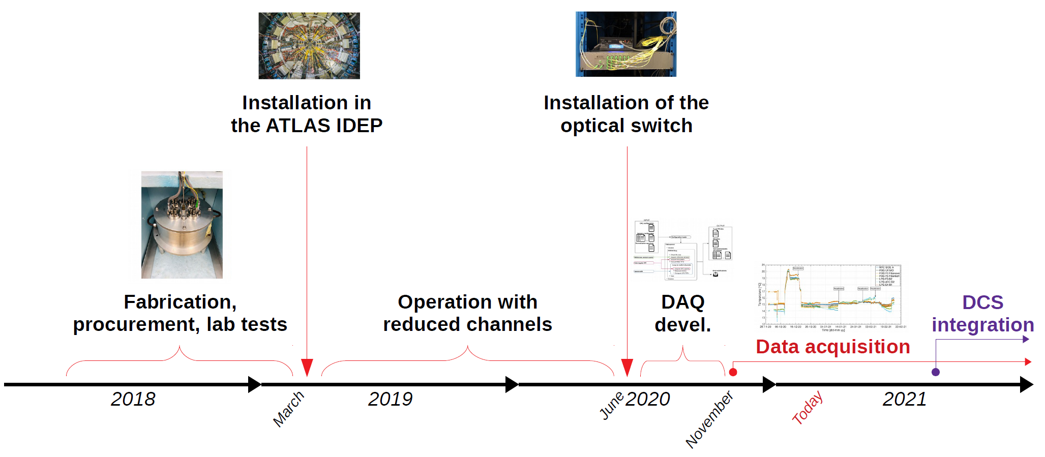
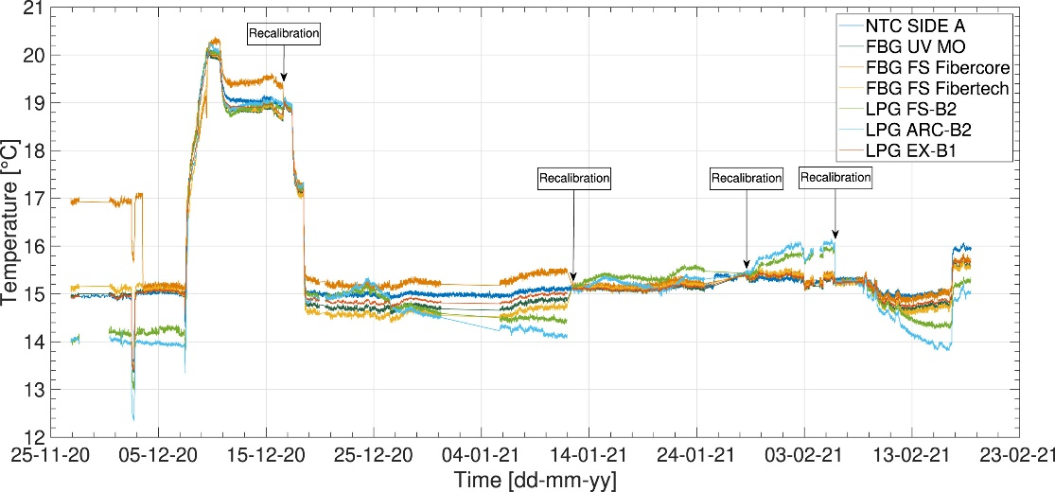
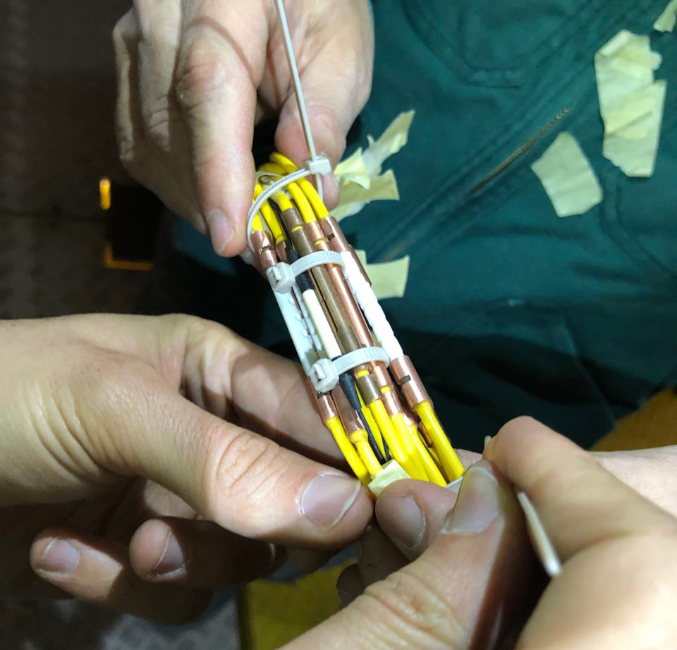
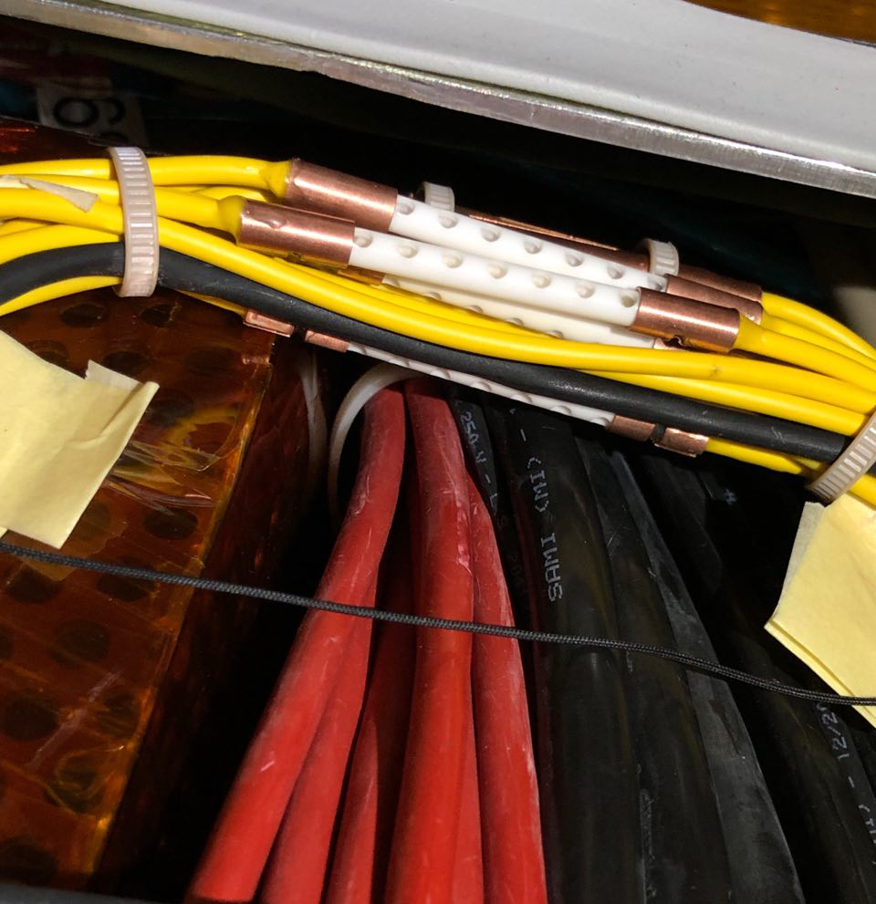
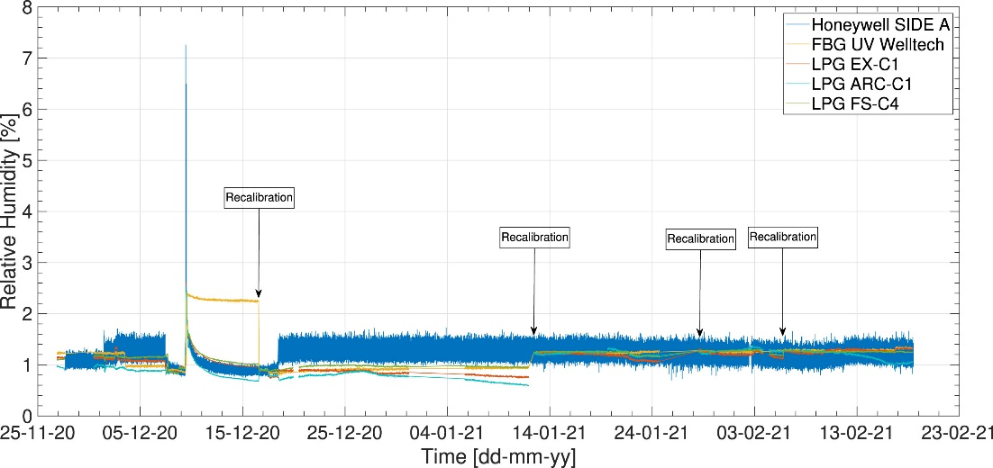
First infield application: LPGs + FBGs in ATLAS ID
A prototyping network of 12 LPGs + 7 FBGs installed in 2019
Scherino, L., et al. "Fiber optic sensors in the ATLAS Inner Detector." Nuclear Instruments and Methods in Physics Research Section A: Accelerators, Spectrometers, Detectors and Associated Equipment 1029 (2022): 166470.
Notes:
Even thought the results was very good and promising

Slide 13
Barriers to overcome
    Performance assessment: calibration and testing setup
    Development of the package for LPGs
    Multiplexing assessment
    Response to radiation

Slide 14
Barriers to overcome
    Performance assessment: calibration and testing setup
    Development of the package for LPGs
    Multiplexing assessment
    Response to radiation

Slide 15
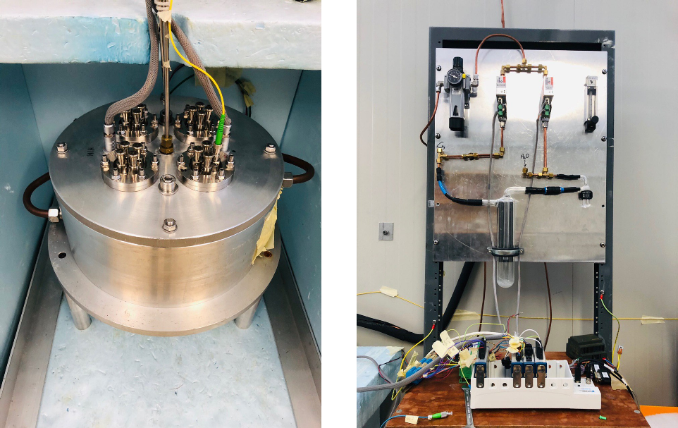
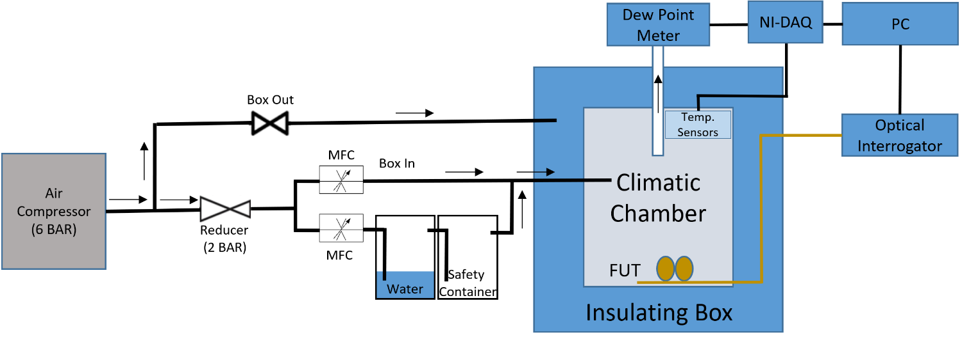
Calibration and testing setup
Upgrade of the existing climatic chamber:
High-vacuum feedthroughs connectors for both optical fibers and copper wires:
  No leaks in the system;
Precise control of RH (from 0.04% up to 90% of RH)
with a resolution of ~0.1% RH;
Large range of temperature (-30;+50 °C);
  DP lower than -60°C at all the temperatures.

Slide 16
Barriers to overcome
    Performance assessment: calibration and testing setup
    Development of the package for LPGs
    Multiplexing assessment
    Response to radiation

Slide 17
New package development
In harsh environments it is mandatory to use a package in order to preserve the integrity of the sensor.
High death rate of sensors during installation in the package developed in the past.
The package developed in the past could had some issues at low temperatures (around -10°C). The thermal expansion/contraction of the material induces an extra stress effect on the sensor itself, causing a wrong response of the sensor.

Slide 18
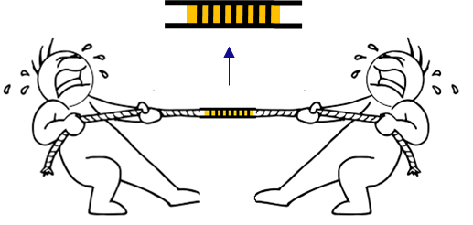
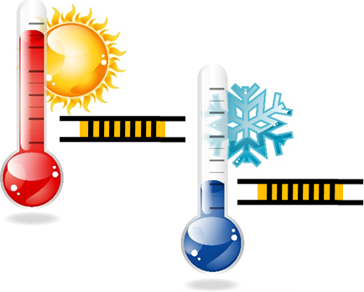
FBG and LPG packaging differences
Bare sensors: both FBG and LPG are sensitive to STRAIN and TEMPERATURE (different sensing mechanism)
FBG: strain-free mounting
LPG: pre-strained mounting
“clamping” points
When correctly “clamped” the LPG feels both its own local strain AND packaging deformations
When correctly “clamped” the FBG only feels its own local strain

Slide 19
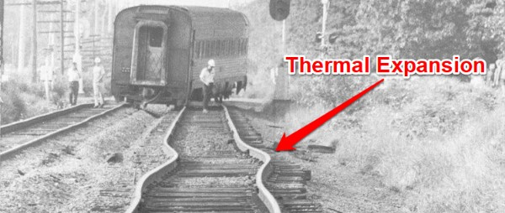
The importance of the package
L₀
L₀(1+αΔ)
If the CTE of the package is high compared to the CTE of the fibre, non-predictable abnormal behaviour may occur!!! The thermal expansion/contraction of the material induces an extra stress effect on the sensor itself, causing a wrong response of the sensor.

Slide 20
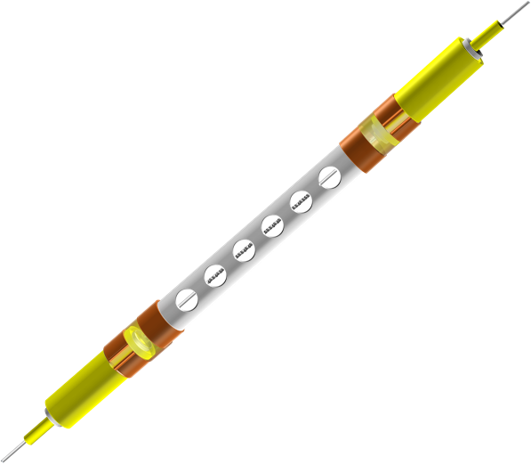
First machining solution used in ATLAS ID
Based on ceramic tube with copper extremities. It was discovered that this solution could present problems of distortion caused by the materials (copper) and the imperfect axial symmetry of the sensor within the package. Moreover this effect is amplified if the sensor is sensitive to polarization (see figure below).

Slide 21
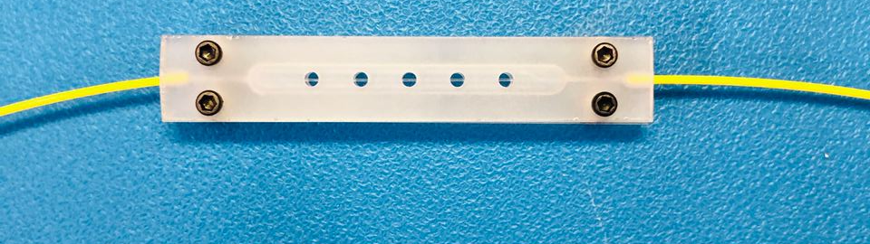
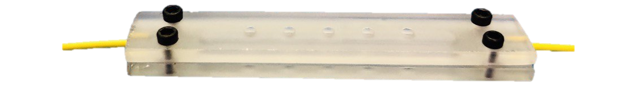
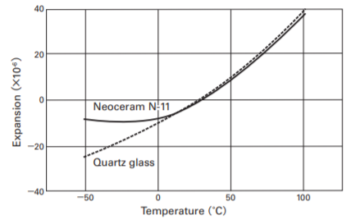
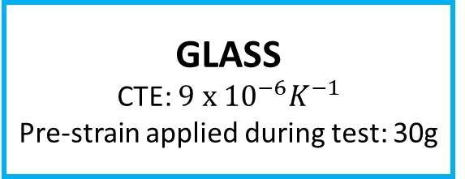
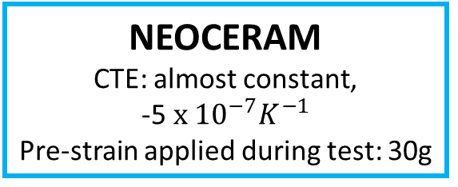
Final machining solution
50 mm
9 mm
~4/5 mm
We realize this package in two different materials
Thermal expansion
GLASS
CTE: $9 x {10}^{−6}K^{−1}$
Pre-strain applied during test: 30g
NEOCERAM
CTE: almost constant,
-5$x {10}^{−7}K^{−1}$
Pre-strain applied during test: 30g

Slide 22
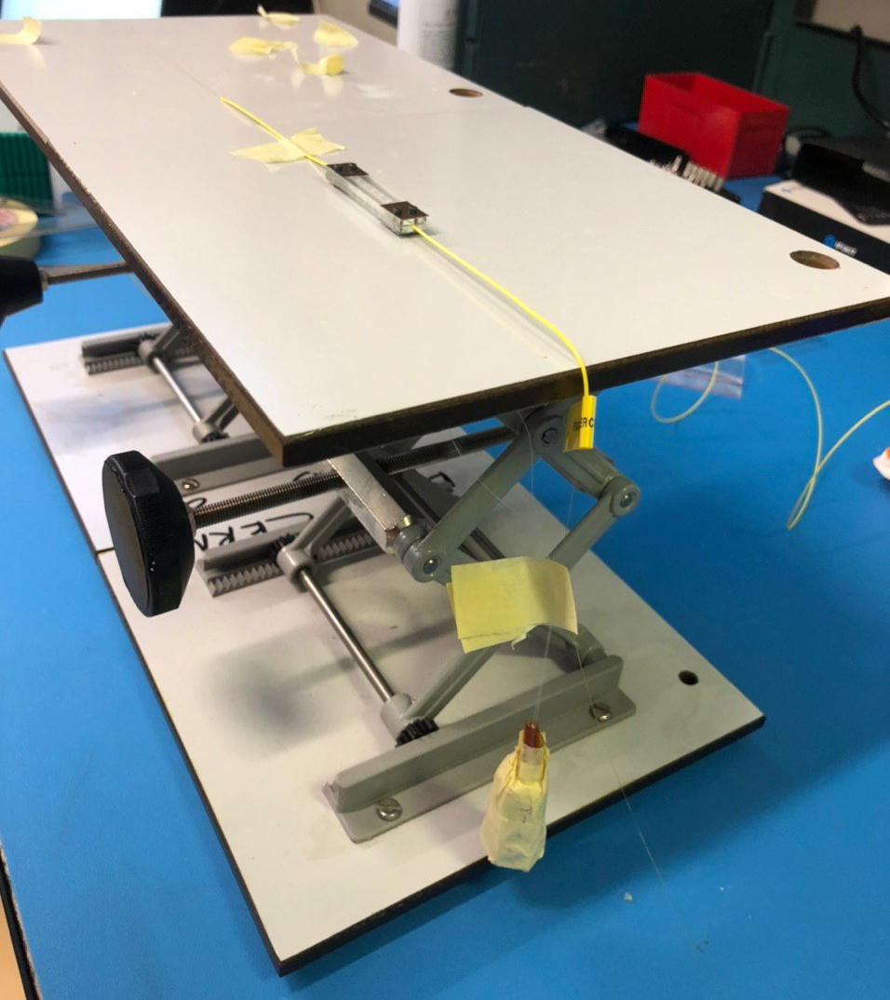
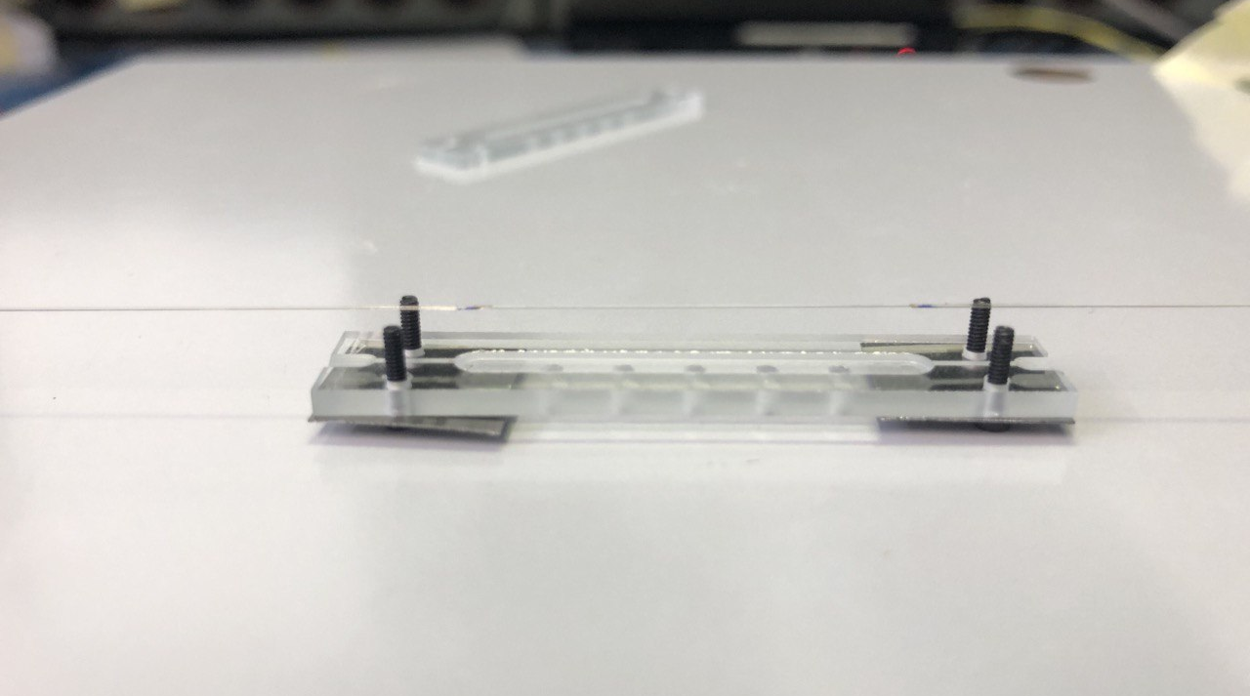
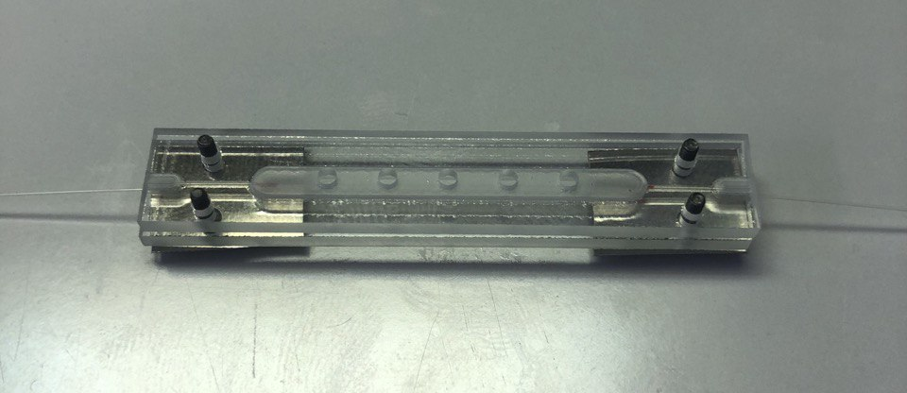
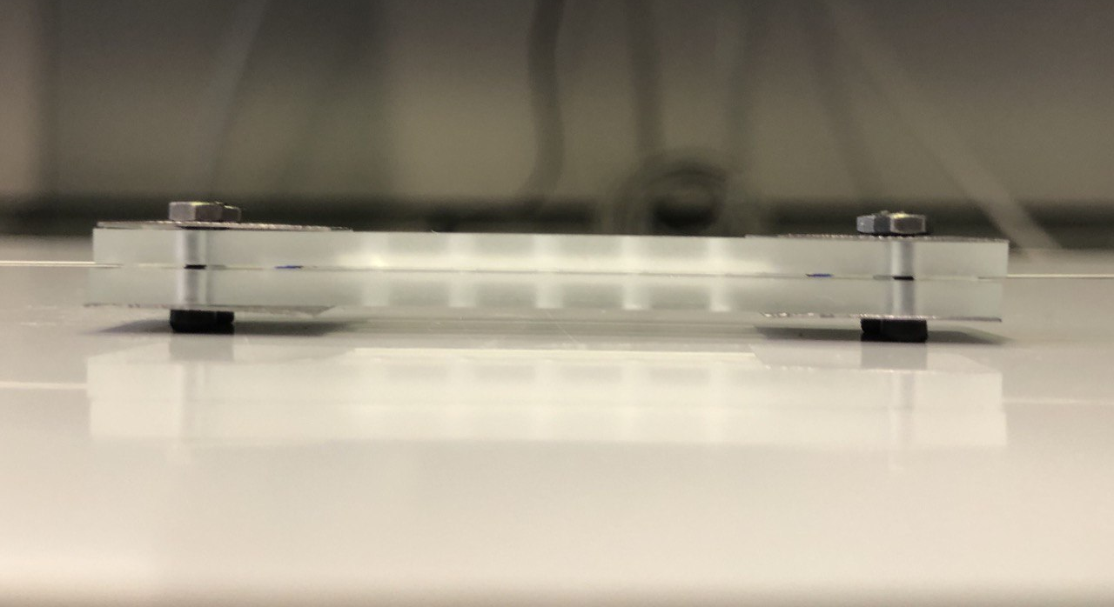
Test of the solution
~30 g pre-strain
Weight
30 g
 | T Sensitivity [pm/°C]
Without package (stress free) | 8.78
Glass package | 16.74
Neoceram package | 6.48
Notes:
FBG pre-stressed in order to make the sensors sensitive to the variations induced by the package itself

Slide 23
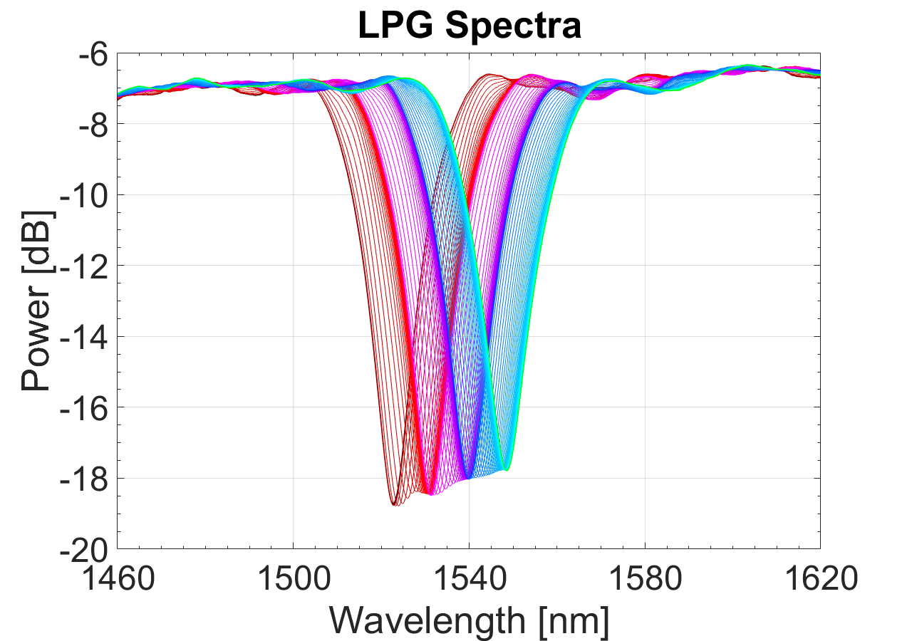
Test with an LPG in the Neoceram package
S_{T} = -0.590 nm/°C

Slide 24
Barriers to overcome
    Performance assessment: calibration and testing setup
    Development of the package for LPGs
    Multiplexing assessment
    Response to radiation

Slide 25
LPG multiplexing
One of the main problems regarding LPG-based technology is the level of multiplexing, mainly due to limitations in term of available bandwidth compared to the FBGs.

Slide 26
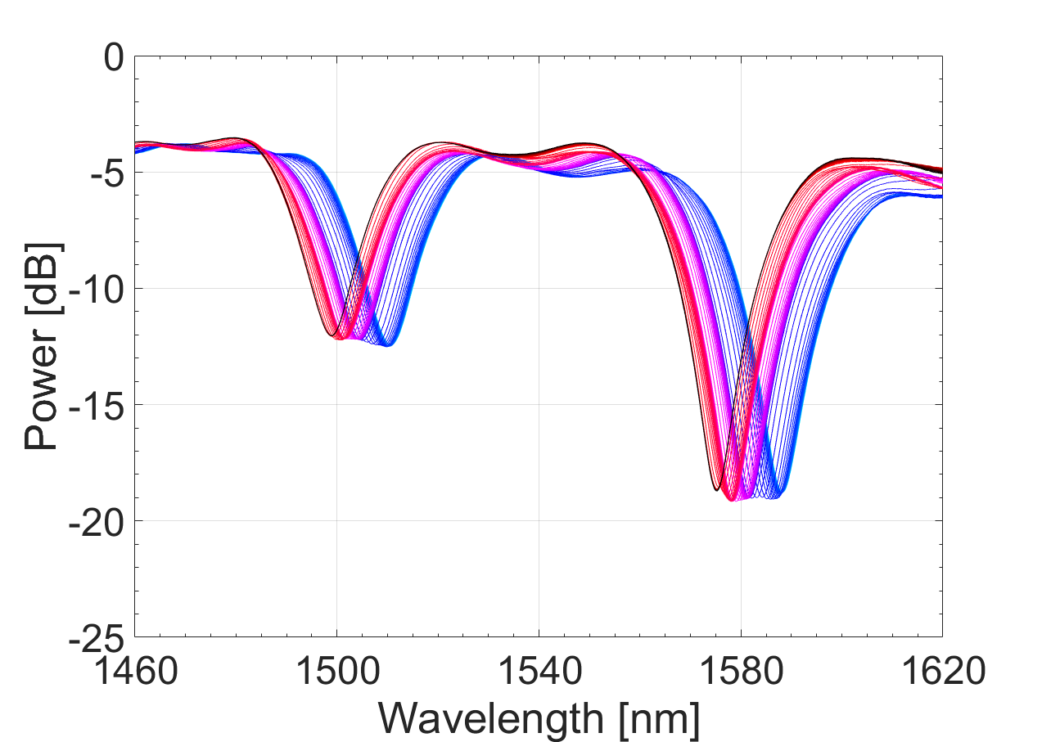
LPG multiplexing
The wavelength shift produced by LPGs in relation to T/RH variations are much bigger than those produced by FBGs (more sensitive):
It is important to avoid overlap between two LPGs in array.
ΔT=20°C

Slide 27

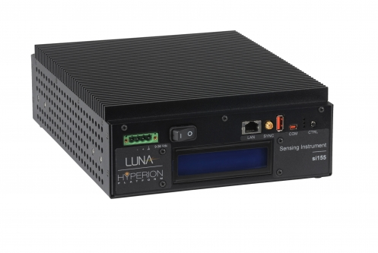
Base solution
LPG Array 1
LPG Array 2
Hyperion si155:
Wavelength range: 1460-1620 nm
Number of channels: 4
Wavelength accuracy: 1 pm
Cost: ~25000 CHF

Slide 28
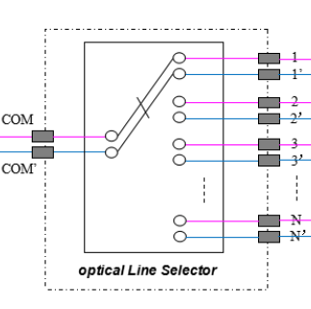

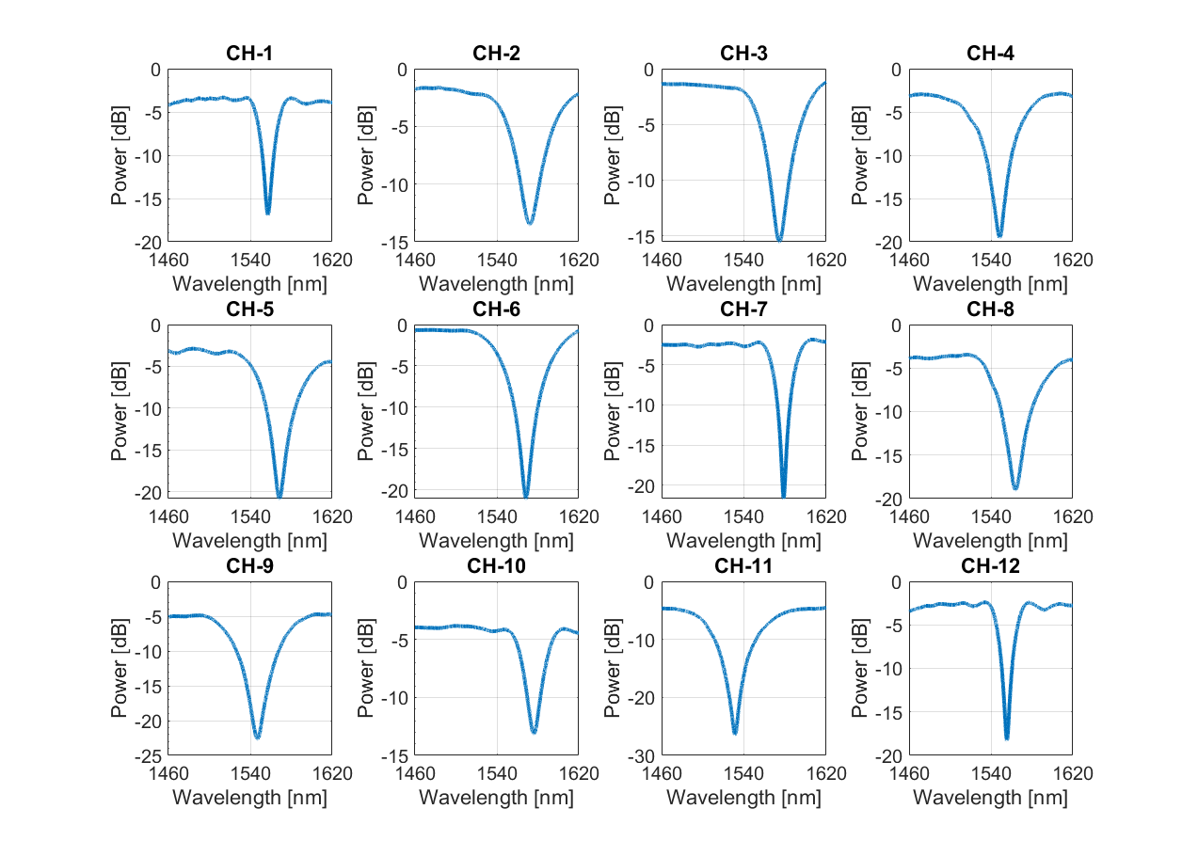
Proposed solution
Hyperion si155:
Wavelength range: 1460-1620 nm
Number of channels: 4
Wavelength accuracy: 1 pm
Cost: ~25000 CHF
Self-align dual 1x12 switch :
Operative range: 1460-1620 nm
Fiber: SMF-28 fiber
Connectors: FC/APC on each port
Cost: ~2800 CHF

Slide 29
Barriers to overcome
    Performance assessment: calibration and testing setup
    Development of the package for LPGs
    Multiplexing assessment
    Response to radiation

Slide 30
Main objective
Even thought in literature there are few studies about LPGs under radiation, there are a lot of parameters (fabrication, fiber, ...) that might affect their response to radiation.
For this reason it is fundamental to study the response of our FOS based on LPG platform to different radioactive sources. 3 campaigns have been planned:
  Neutrons irradiation campaign
  Protons irradiation campaign
  Gamma irradiation campaign (planned)

Slide 31

Typical setup
Control room
Irradiation room
xx

Slide 32
Neutron irradiation campaign
TRIGA reactor, Jožef Stefan Institute (JSI), Ljubljana (SL)

Slide 33
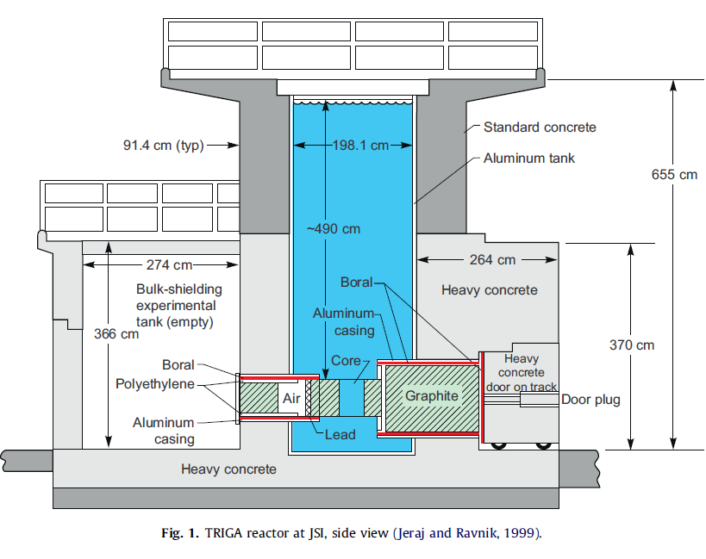
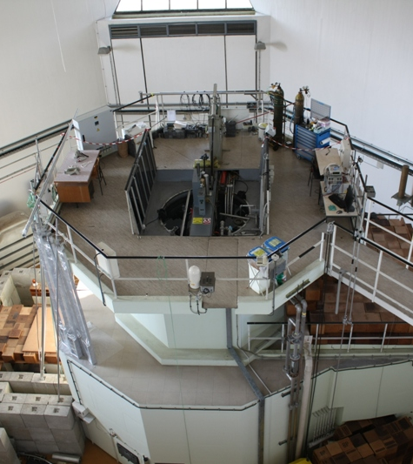
Reactor view (I)
Notes:
From the platform you can arrive to the core

Slide 34
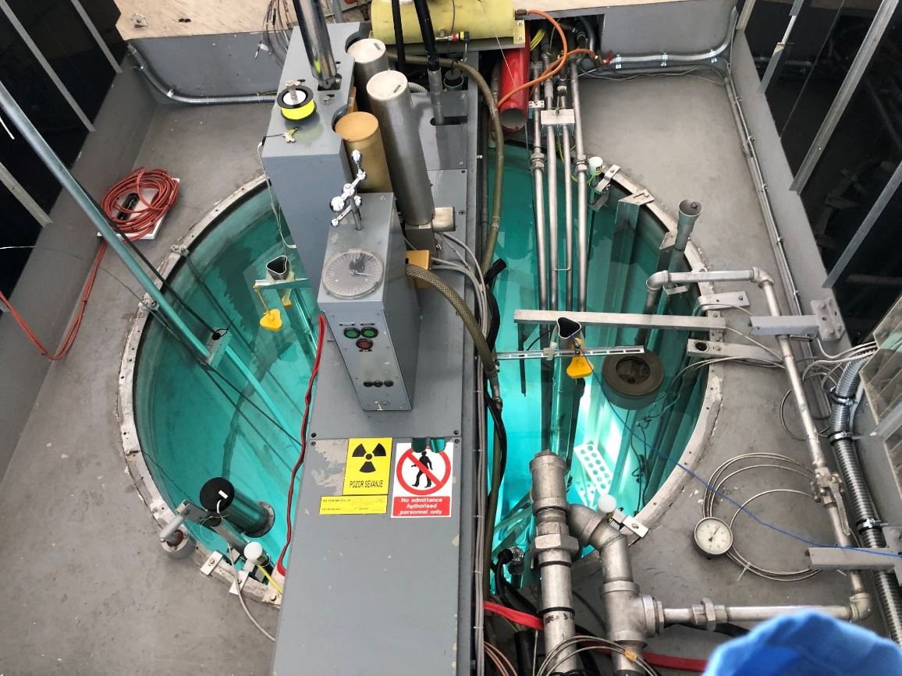
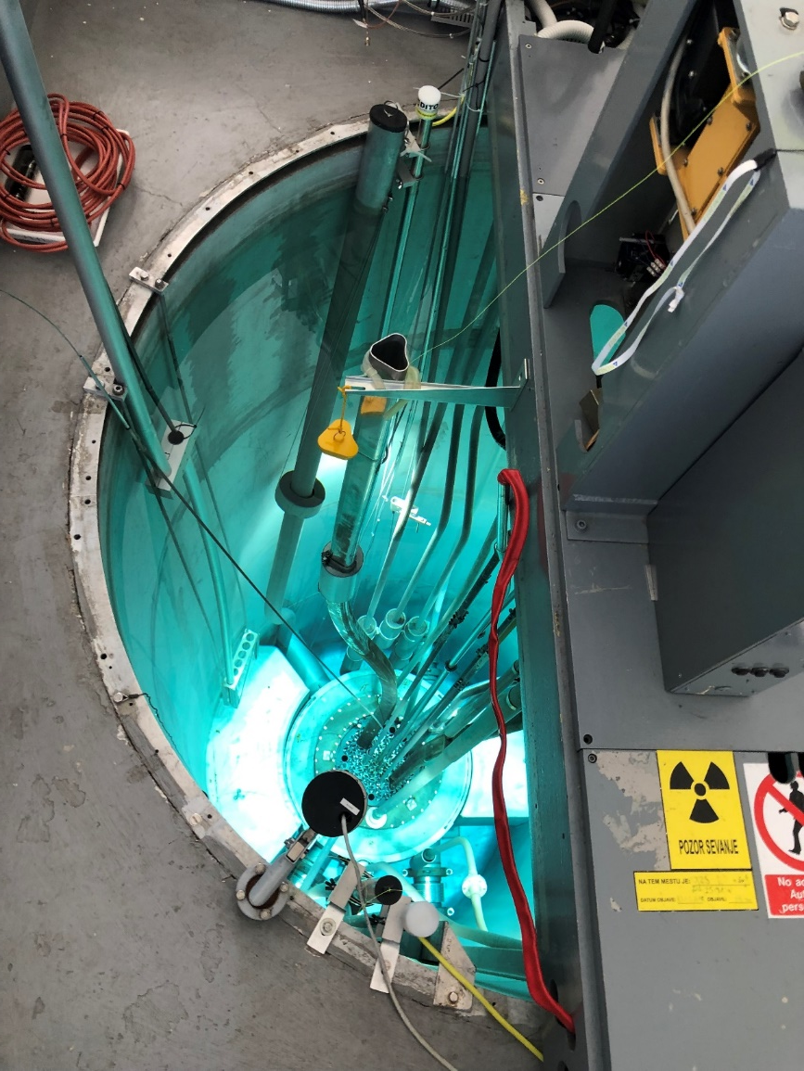
Reactor view (II)
Irradiation channel TiC

Slide 35
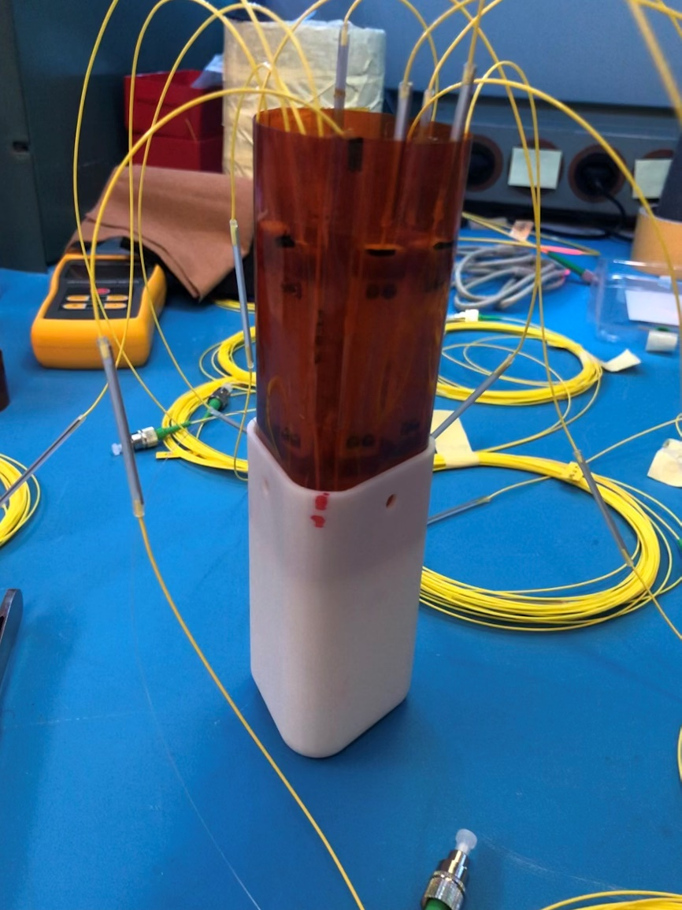
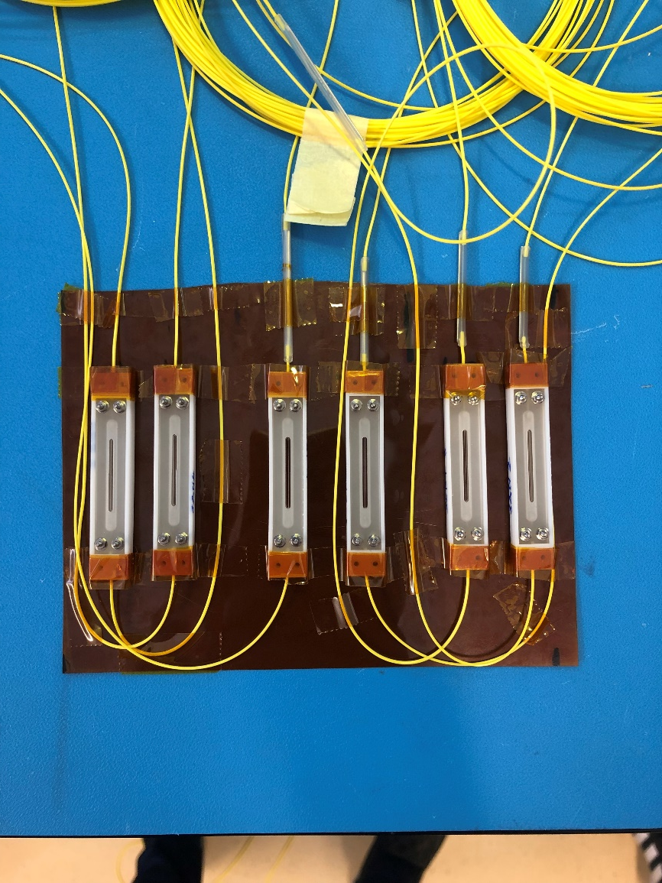
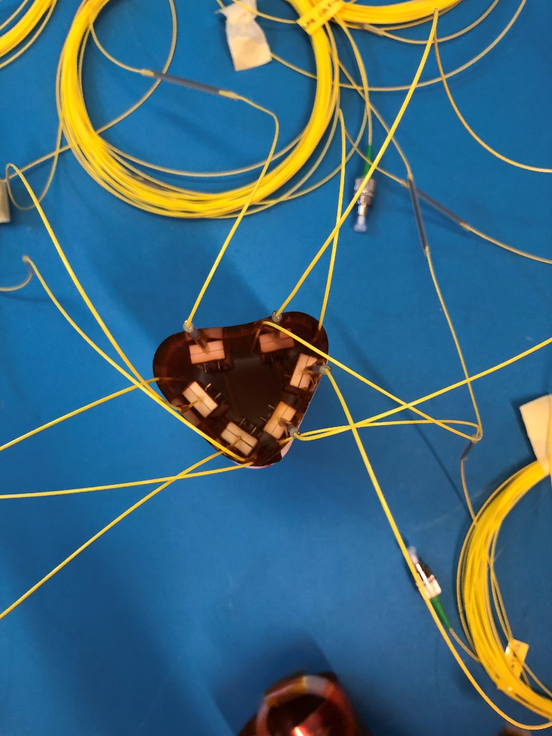
LPG preparation in EP-DT lab

Slide 36
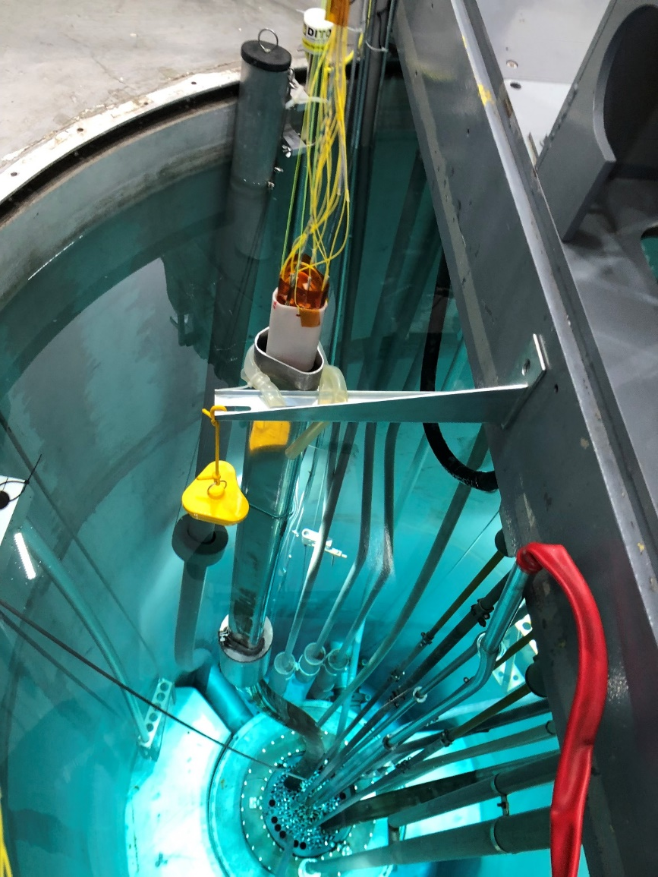
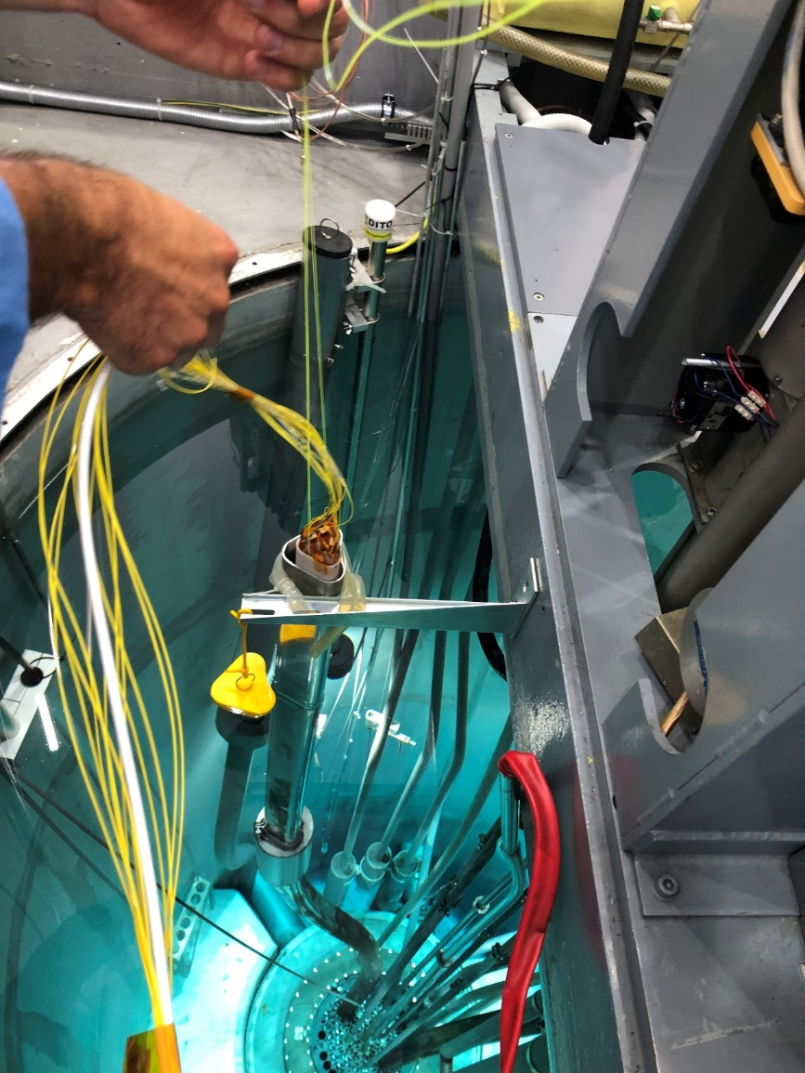
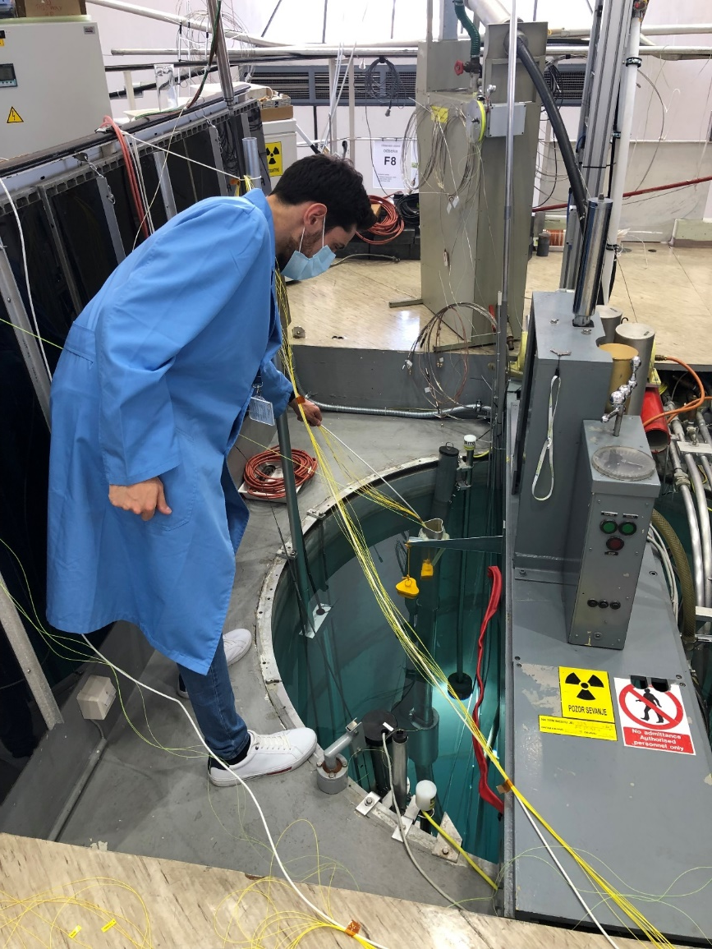
First run of irradiation: LPG insertion

Slide 37
Irradiation conditions
The sensors were exposed to:
Irradiation time: ~80 min
Flux in the irradiation channel (@P=65 kW): 1e12 n/cm2/s
Cumulative fluence: ~4.8e15 #n/cm2
All data have been acquired real time using the LUNA Hyperion and the optical switch.
In both runs there were also a PT100 and a HIH4000 inside the container near the sensors, in order to acquire the T variations during the irradiation and the RH before the irradiation (no rad-tolerant).

Slide 38

Response to neutron radiation
Notes:
We tested different LPGs, fabricated with different parameters. The 4,5,6, are in agreement beetween them

Slide 39
Proton irradiation campaign
IRRAD, CERN

Slide 40


Setup
Control room
Irradiation room

Slide 41


Details of the setup

Slide 42
Irradiation conditions
The sensors were exposed to:
Cumulative fluence: 4.2230e+15 p/cm2
Calculated Total Ionising Dose*: 1.152 MGy
Irradiation time: about 5 days
*Dose [Gy] = 1.602 × 10-10 × (dE/dx)min [MeV-cm2/g] × Φp[cm-2]
where Φp is the proton fluence [cm-2] and (dE/dx)min is the energy lost by a particle due to collisions with a given material over the distance x traveled [MeV-cm2/g]
[https://ps-irrad.web.cern.ch/assets/doc/info/atomic%20and%20nuclear%20properties%20of%20materials.pdf]
For our samples, we referred to the value corresponding to SiO2.

Slide 43

Response to proton radiation

Slide 44

Simulations
In order to validate the experimental data it is possible to perform numerical simulations to assess which parameters are most affected by the type of radiation:
Fabrication parameters (grating period, length of the sensor, …);
Fiber parameters (refractive index of the core and the cladding, …);
Very good agreement between experimental and simulated data.

Slide 45


ATLAS ITk
Volume | FOS devices (LPG+FBGs)
Strip EC | 6
Strip Barrel | 6
Pixel Inner | 8
Pixel Outer | 12
OSV | 18
LPG (T/RH)
FBG (T)
Radiation dose estimated and compensated from RADMON readings

Slide 46


Improvement: direct measurement of dose
%
:
+
+
:
+
We tested several types of rad-hard FBGs, which demonstrate the insensitivity of the sensors to radiation
:
Notes:
3 equations in 3 unknowns

Slide 47
Schematic of the package
LPG
courtesy of J. Noel
Commercial fiber 250 µm (125 µm the fiber + 125 µm the acrylate coating)
Uncoated fiber
LPG sensor
The maximum space to allocate the LPG is around 33 mm. The package has been designed in such a way that this combination of diameters allows the correct clamping of the sensor without unexpected breakage of the fiber at the fixing points.

Slide 48
Main objective
FBG
FBG
courtesy of J. Noel
Commercial fiber 250 µm (125 µm the fiber + 125 µm the acrylate coating)
Uncoated fiber
FBG sensor
The objective is to understand the feasibility of splicing two FBGs in a space that does not exceed the 33 mm imposed by the package designed for the LPGs.

Slide 49
Splicing step: results
Notes:
Then the study is feasible

Slide 50
Final device

Slide 51


Connection
3 signals from each point of ITk: $\left\{\begin{aligned}T [°C] \\ RH [\%] \\ TID [Gy]\end{aligned}\right.$

Slide 52
Finals steps
T and RH test of the final device (LPG + 2xFBGs) in EP-DT climatic chamber (ongoing).
Thermal cycling (down to -40°C) EP-DT QART lab of:
  LPG + FBGs in the final package;
  Sensirion SHT31-ARP-B;
  HIH4000+PT100.
New radiation campaign planned:
  New proton radiation at IRRAD;
  Within the year, gamma radiation campaign
Complete the T/RH/TID model
Technology transfer to Johannesburg group (ATLAS)

Slide 53
Finals steps
T and RH test of the final device (LPG + 2xFBGs) in EP-DT climatic chamber (ongoing).
Thermal cycling (down to -40°C) EP-DT QART lab of:
  LPG + FBGs in the final package;
  Sensirion SHT31-ARP-B;
  HIH4000+PT100.
New radiation campaign planned:
  New proton radiation at IRRAD;
  Within the year, gamma radiation campaign
Complete the T/RH/TID model
Technology transfer to Johannesburg group (ATLAS)
THANKS FOR YOUR ATTENTION!

Slide 54
BACKUP

Slide 55





Strain and Temperature FBG-based sensors
Strain changes:
S_{ε}≈ 1 pm/με
ε
- Λ via direct deformation
- n_{eff} via elasto-optic effect
Temperature Changes:
S_{T}≈10 pm/°C
Λ via thermal expansion
- n_{eff} via thermo-optic effect
T
For strain measurements, discrimination between temperature and strain needed:
(T-Compensation technique)

Slide 56
Fabrication (UV methods): Point to Point Technique
The writing technique based on UV exposure according to the point-by-point method consists of exposing a co-doped B-Ge fibre to a laser source (λ = 248 nm), thus introducing an increase in the refractive index of the core.

Slide 57
Different types of fabrication of LPGs used in ATLAS ID

Slide 58
RH-LPG calibration

Slide 59




Example: FOS on the Strip
Courtesy of J. Tarrant

Slide 60



Radiation Environment Expectations for the ITk Detector
Expected fluence after 3000fb-1 for the extended@4 layout.

Slide 61
T conditions Neutron irradiation
1st run, LPG
2nd run, FBG
Outside the reactor
Out of the core,
but inside the reactor
Out of the core,
but inside the reactor

Slide 62
RH conditions Neutron irradiation
1st run (LPGs)
2nd run (FBGs)

