Slide 1
Conceptual layout drawings of the CLIC vertex detector
and
First engineering studies of a pixel access/insertion mechanism

Slide 2
Aim of the meeting
Kick-off meeting to start design and engineering of the CLIC vertex detector.
Short-term aims:
  Produce conceptual drawings for the CLIC-ILD and CLIC_SiD vertex detectors
  Conceptual study to provide access to the CLIC vertex detector, including possibility to replace it in a typical winter shut-down
Further remarks:
  Provide material for the CLIC conceptual design report (material due for ~end-May 2011)
  The conceptual design report is just a start; it does not require great details.
  Propose to start working on the CLIC-ILD version

Slide 3
Contacts

Slide 4
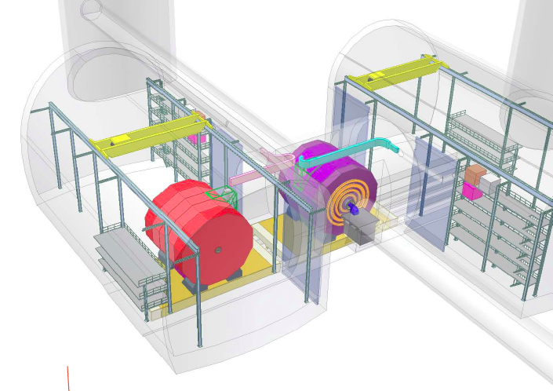
CLIC_ILD and CLIC-SID in push-pull

Slide 5
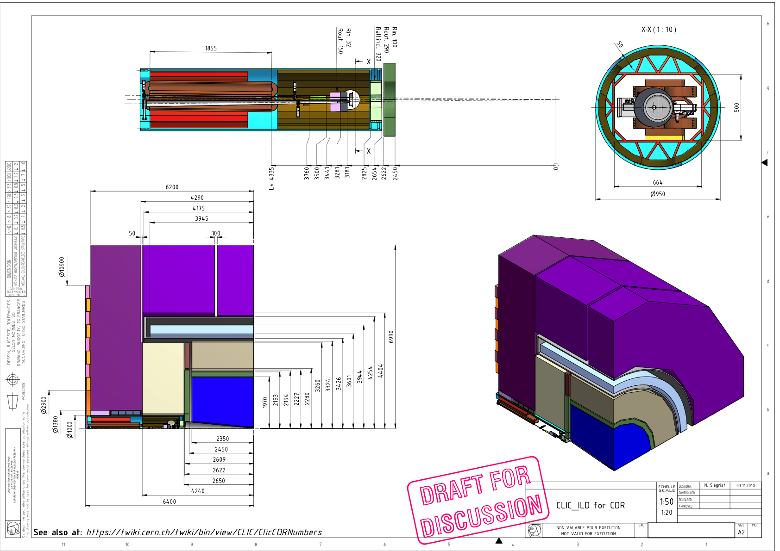
CLIC_ILD

Slide 6
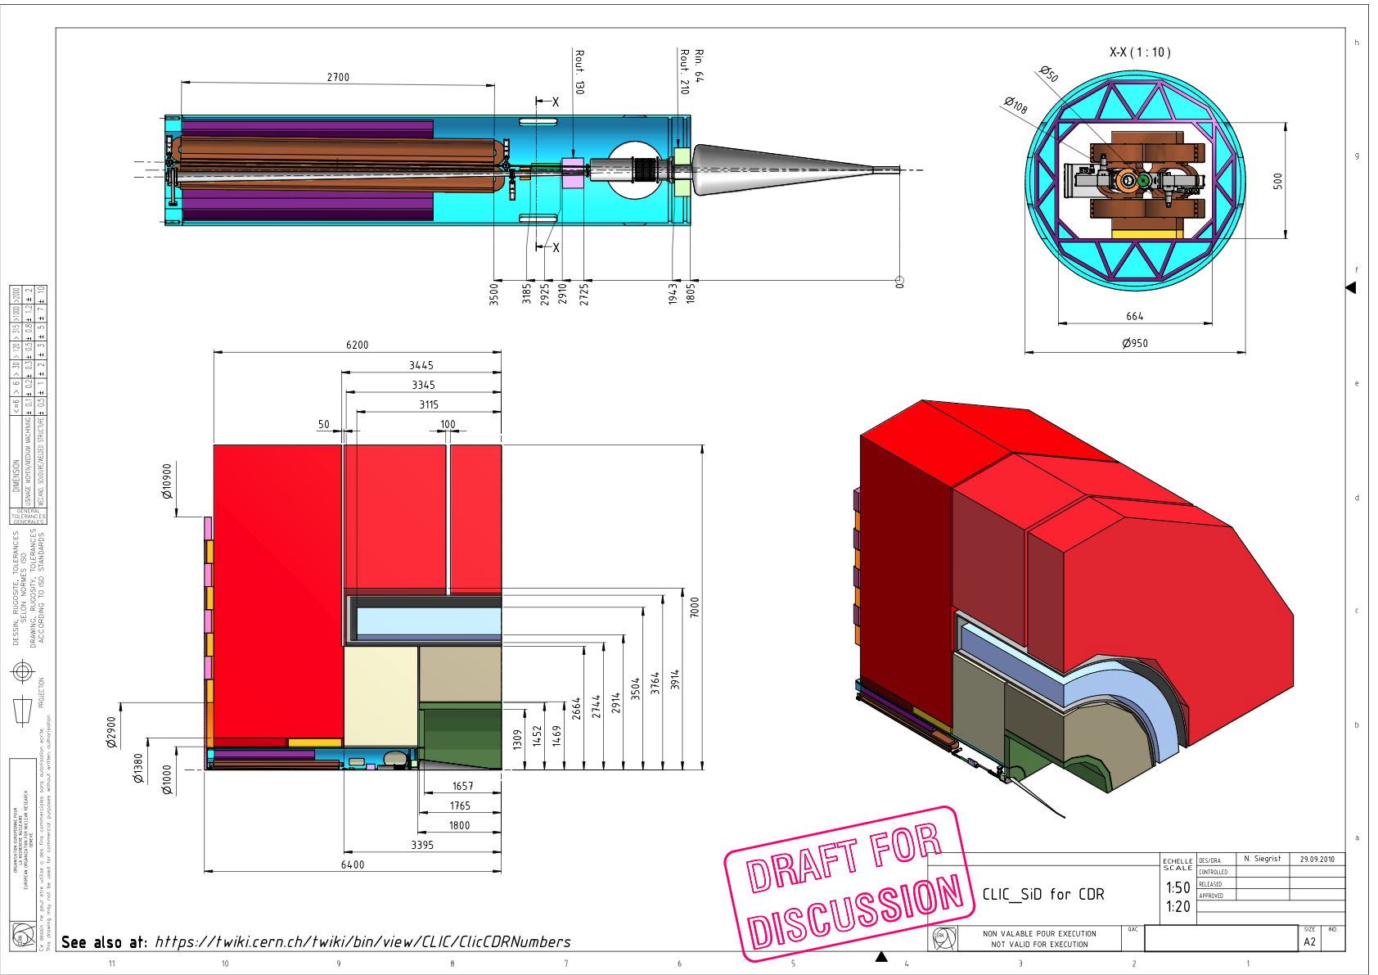
CLIC_SiD

Slide 7
CLIC Outer tracking layout
CLIC_ILD
CLIC_SiD
B=4 T
Time projection chamber (TPC):
  224 layers, σ_{Rφ}~100 μm per layer
Outer silicon-strip envelope:
  SET: 2 stereo cylinder layers, σ_{Rφ}=7 μm; σ_{z}=50 μm
  ETD: triple-layer disk, σ_{Rφ}~σ_{R}~7 μm
Inner silicon-strip envelope:
  SIT: 2 stereo cylinder layers, σ_{Rφ}=7 μm; σ_{z}=50 μm
Forward silicon-strip tracking:
  FTD: 5 stereo disk layers, σ_{Rφ}=7 μm; σ_{z}=50 μm
B=5 T
Outer Tracker Barrel (TRB):
  5 single cylinder layers, σ_{Rφ}=14 μm
Forward Tracker (TRF):
  4 single disk layers, σ_{Rφ}=14 μm
Outer tracker can be moved in z, to allow for service access to vertex region

Slide 8
CLIC zoom into vertex region
CLIC_ILD
CLIC_ILD
0.6 mm Be beampipe at R=30 mm
3 double layers of pixel cylinders
3 double layers of pixel disks
20 μm pixels, analog readout, σ_{sp}=2.8 μm
X=0.18% X0 / double layer
(2 x 50 μm Si + 134 μm Carbon Support)
0.74m² surface, 1.84G Pixel
CLIC_SiD
0.5 mm Be beampipe at R_{i}=25 mm
5 single layers of barrel pixel cylinders
7 single layers of forward pixel disks
20 μm pixels, binary (analog) r/o,
σ_{sp}=5.8 μm (3 μm)
X=0.12% X0 / single layer
(50 μm Si + 130 μm Carbon Support)
1.1m² surface, 2.77G Pixel
Vertex region
(for material scan)
CLIC_SiD
Vertex region
(for material scan)
Dominik has a list of all dimensions

Slide 9
CLIC material budget in vertex region
Good agreement between material descriptions in fast and full simulation
Remaining differences understood to be caused by the effect of more detailed modeling of detector and readout elements in the full simulations
(e.g. planar modules as opposed to ideal cylinders and disks)
30-70% more material in the vertex region of CLIC_SiD:
    ~doubled support due to the single layers
    One more pixel disk
    More material in outer support shell that had been designed with push-pull option in mind (included in these plots, though it does not affect the performance of the VTX detector itself!)

Slide 10
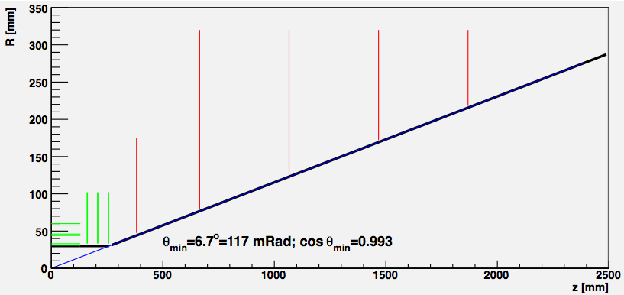
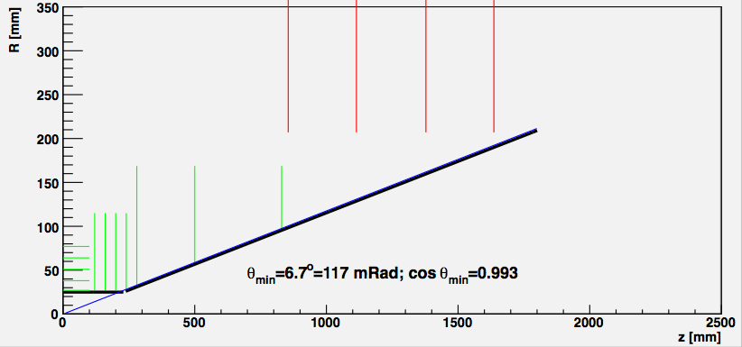
CLIC beam pipe and forward region
CLIC_ILD
Similarly optimized forward design for both concepts:
Closest possible distance to IP given the constraints from backgrounds and magnetic fields
Moved conical part out in z as far as possible, given the constraints from
  direct pair- background hits
  Forward-calorimeter acceptance
Final forward acceptance is very similar for both concepts
(Almost) projective geometry of conical part
Conical part used as shielding against backscatters (equivalent to 4 mm steel)
CLIC_SiD

Slide 11
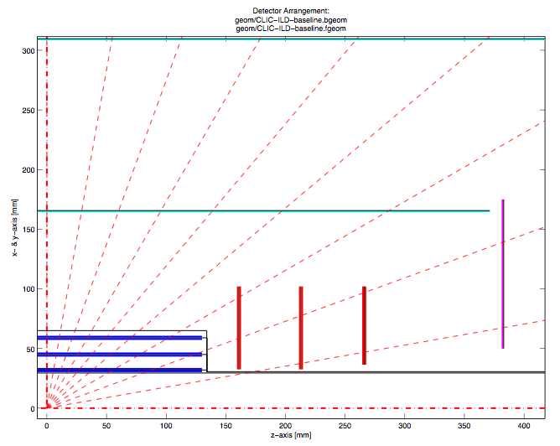
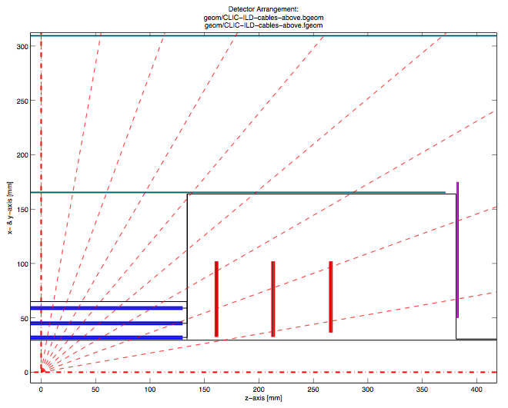
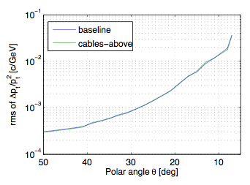
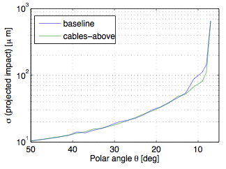
Cable Routing Options (ILD)
Cables along beam pipe
Cables above pixel disks
(difficult to implement in Mokka)
p=3 GeV
p=3 GeV
Routing cables above FTD Pixel Disks improves IP resolution in this region

Slide 12
Summary: vertex-detector parameters
Parameter | CLIC-ILD | CLIC-SiD
Magnetic field | 4 T | 5 T
Beam pipe (central region) | 0.6 mm Beryllium, R=30 mm | 0.5 mm Beryllium, R=25 mm
Barrel pixel layers | 3 double layers 31 mm < R < 60 mm | 5 single layers 27 mm < R < 77 mm
Forward pixel disks | 3 double layers 160 mm < z < 257 mm | 7 single layers 120 < z < 830 mm
Layer thickness | 0.18% X0 / double layer | 0.12% X0 / single layer
Pixel size | 20 μm pitch, 50 μm silicon depth
Total area | 0.74 m² | 1.11 m²
Total number of pixels | 1.84G | 2.77G
Readout | analog, σ_{SP}~3 μm
projected IP resolution (90º) | σ_{Rφ}=1.5 μm + 20 μm GeV / p_{T} | similar, t.b.c.
Power consumption target (air cooling; power pulsing) | < 100 mW/cm² (<0.4 μW/pixel)
Background occupancy (ee) | ~0.01 hits / mm² / ns (innermost layers)
Radiation (pairs+γγ→hadr.) | NIEL: ~10¹⁰ n_{eq} cm⁻² y⁻¹ ; TID: ~100 Gy y⁻¹

Slide 13
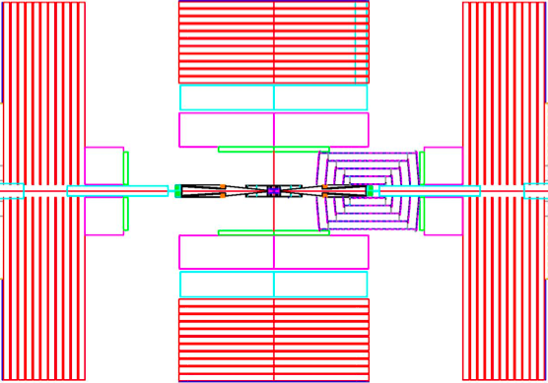
Access to CLIC pixel detector
As CLIC will run at several energies, pixel detector needs to be replaced
No radiation issues => replacement in 1 winter shut-down is OK
Current ILC detectors have not foreseen suitable access
Need for a basic insertion concept at an early stage
  Will undoubtedly influence overall pixel detector layout
    May influence layout/acceptance of pixel and tracker systems
    We need to know impact on amount of material
  Influence vibration/alignment?
  Impact in layout of cooling+services
  Will influence vacuum scheme and
  experiment’s opening scenarios
  Suspension of beam pipe
  Influence on requirements for cavern
ILC_SiD access to vertex detector

Slide 14
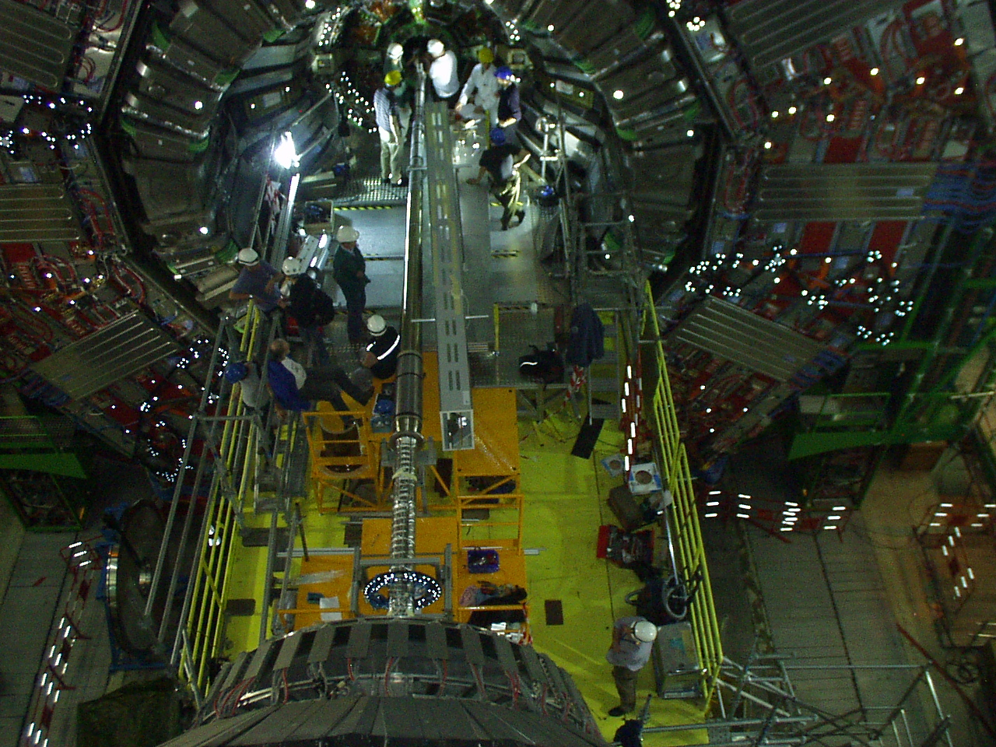
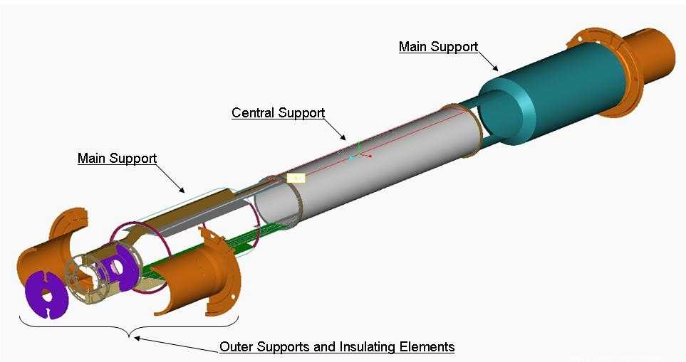
CMS pixel insertion
See slides of Paolo Petagna: http://indico.cern.ch/conferenceDisplay.py?confId=97318

Slide 15
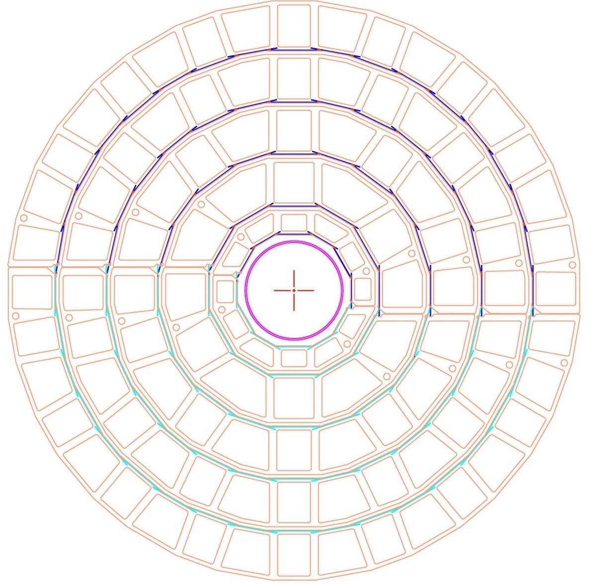
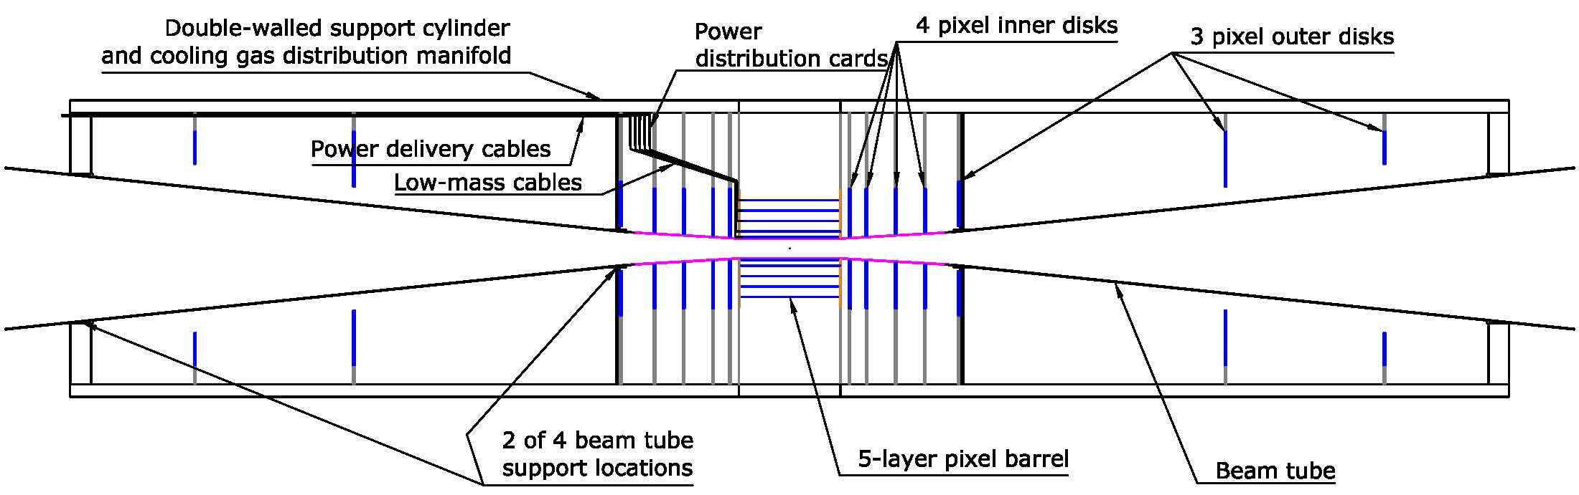
Example of ILC_SiD studies
Bill Cooper’s studies:
http://indico.cern.ch/conferenceDisplay.py?confId=91525
Vertex barrel end view

Slide 16
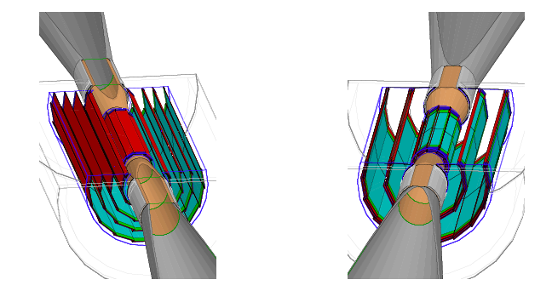
Example of ILC_ILD studies
5 single layers
3 double layers

Slide 17
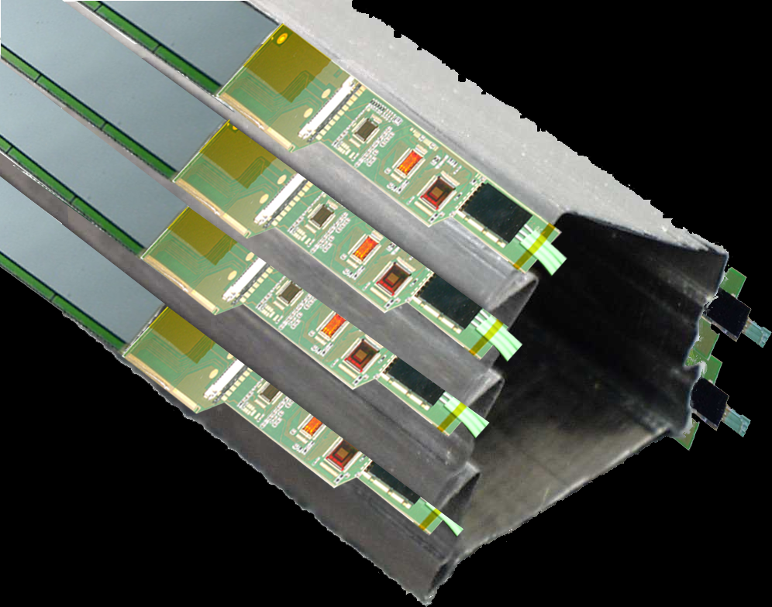
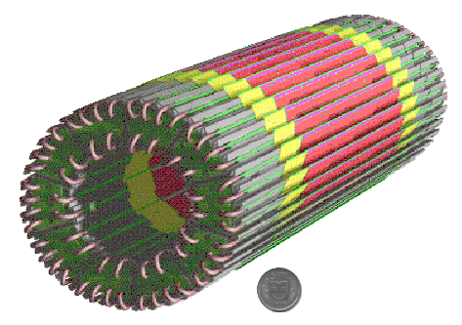
Example of ALICE pixel detector

Slide 19
Material budget of one ALICE SPD layer
Comparison with STAR pixel detector

Slide 20
Additional information
Drawings for the CLIC accelerator CDR document:
\\cernhomeN.cern.ch\N\nsiegris\Public\Views_for_CDR
Parameters drawings CLIC_SiD & CLIC_ILD:\\cernhomeN.cern.ch\N\nsiegris\Public\CLIC_SiD-&-CLIC_ILD_PARAMETERS
CLIC Detector layouts in EDMS: https://edms.cern.ch/nav/P:CERN-0000079435:V0/P:CERN-0000079528:V0/TAB3
CLIC CDR WG-4 meetings on vertex-detector technology:
http://indico.cern.ch/categoryDisplay.py?categId=2843
CLIC CDR WG-5 meetings on engineering & layout:
http://indico.cern.ch/categoryDisplay.py?categId=2844
H. Gerwig’s talk on CLIC Machine-Detector-Interface at ECFA workshop:
http://ilcagenda.linearcollider.org/getFile.py/access?contribId=229&sessionId=83&resId=0&materialId=slides&confId=4507

Slide 21
Additional information
Ingrid Gregor’s talk on PLUME (0.16% X0 per double layer) at ECFA workshop:
http://ilcagenda.linearcollider.org/getFile.py/access?contribId=518&sessionId=82&resId=0&materialId=slides&confId=4507
ILC-ILD LOI: http://www.ilcild.org/documents/ild-letter-of-intent
ILC-SiD LOI: http://lcdev.kek.jp/IDAG/SiDLoI.pdf

Slide 22
THANK YOU

Slide 24
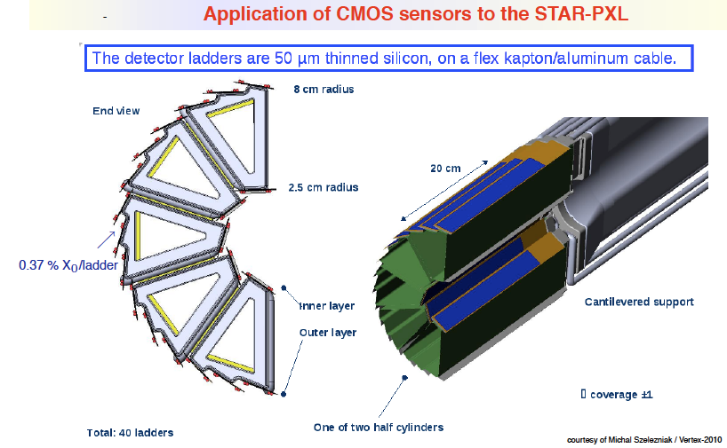
Example of the STAR pixel detector

