Slide 1
Xsuite development status
G. Iadarola and R. De Maria
Contributions to development and testing by:
A. Abramov, F. Asvesta, H. Bartosik, P. Belanger, X. Buffat, M. Boucard, F. Carlier, D. Demetriadou, D. Di Croce, P. Hermes, S. Kostoglou, A. Fornara, P. Kicsini, E. Lamb, A. Latina, C. E. Montanari, K. Paraschou, A. Poyet, T. Pugnat, V. Rodin, M. Schwinzerl, G. Simon, G. Sterbini, F. Van der Veken, M. Zampetakis
Many thanks to:
M. Giovannozzi, T. Persson, T. Pieloni, G. Rumolo, Y. Papaphilippou, S. Redaelli, R. Tomas
https://xsuite.readthedocs.io/en/latest/

Slide 2
Outline
Introduction
Recent developments, tests and applications
  Benchmark and performance on single-particle tracking
  First Dynamic Aperture studies
  Xpart package
  Twiss functionality
  Import of deferred expressions (Xdeps)
  Synchrotron radiation
  Tests on low energy machines
  Collimation studies
  Strong-strong beam beam
  Beamstrahlung
  BB Wire compensator
  Intra-beam scattering
  Electron cloud
  Tracker functionalities
  Xsequence
  Job management tools
  BOINC

Slide 3
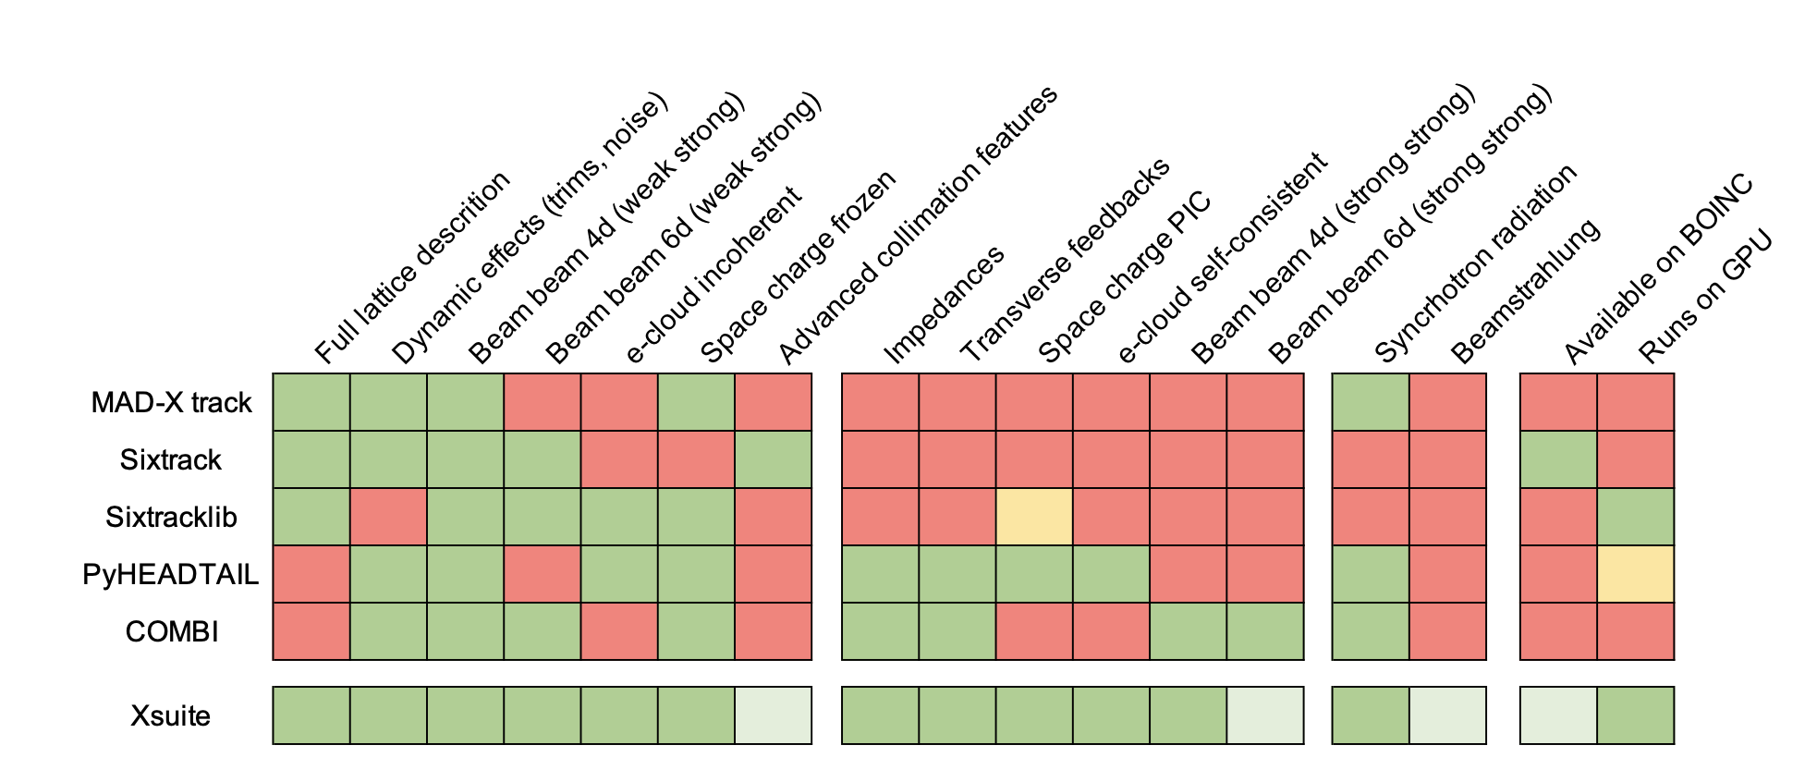
Introduction
Project launched to rationalize and modernize software for multiparticle simulations
Moved from a heterogenous range of programs each with limited capabilities to an integrated modular toolkit (Xsuite)
  Covering with a single toolkit of injectors, LHC, HL-LHC and design studies (e.g. PBC, FCC hh & ee)
  Exploitation of modern computing platforms (e.g. GPUs) for a wide range of applications
  Strong simplification of development and maintenance process (removes several duplications)
Available
In development
Not available
Experimental

Slide 4
Development phases
The development was divided in two phases:
Phase 1 (mostly done by R. De Maria and G. Iadarola):
  Identification of suitable technologies (cffi, cupy, pyopencl)
  Design of low-level infrastructure, including memory management and CPU/GPU code specialization
  Development of core functionalities for single-particle tracking (for LHC/HL-LHC at first, largely based on Sixtracklib) and particle-in-cell
  Concluded with successful comparison of results and performance vs SixTrack
Phase 2 (involving many more people across the group)
  Development of more advanced and team-specific features
  Populate documentation and automatic test suite
  Test and exploitation of Xsuite in real-life studies. Provided vital information for:
    Identification and correction of bugs and issues
    Improvement of user experience, software interface, performance, etc.
Q1 2021
-
Q2 2021
Q3 2021
-
present
4

Slide 5
Outline
Introduction
Recent developments, tests and applications
  Benchmark and performance on single-particle tracking
  First Dynamic Aperture studies
  Xpart package
  Twiss functionality
  Import of deferred expressions (Xdeps)
  Synchrotron radiation
  Tests on low energy machines
  Collimation studies
  Strong-strong beam beam
  Beamstrahlung
  BB Wire compensator
  Intra-beam scattering
  Electron cloud
  Tracker functionalities
  Xsequence
  Job management tools
  BOINC

Slide 6
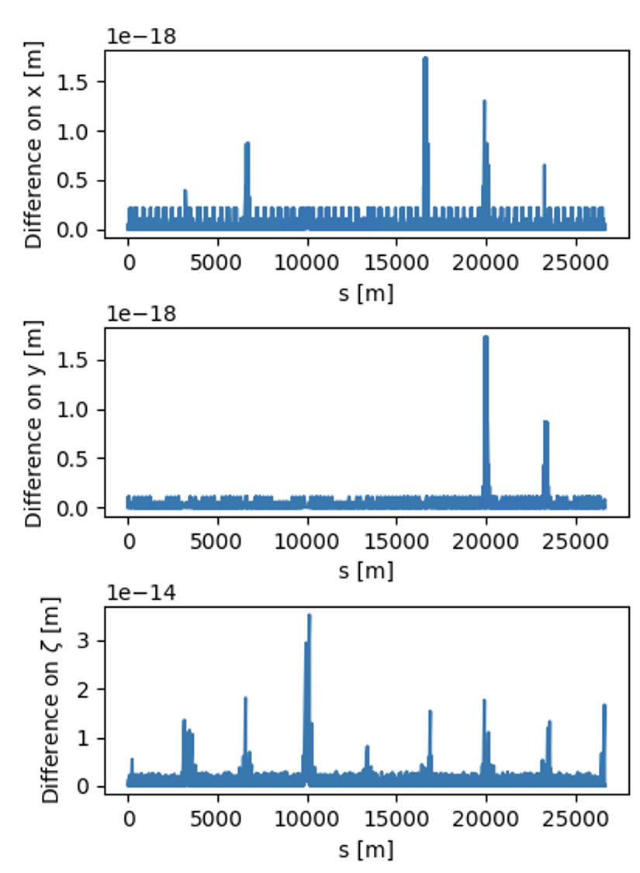
Single-particle tracking – benchmarks and performance
Based on past work from M. Schwinzerl
Single-particle tracking has been successfully benchmarked against SixTrack
  → Checks performed for protons and ions
Computation time very similar to Sixtrack on CPU and to sixtracklib on GPU
Platform | Computing time
CPU | 190 (μs/part./turn)
GPU (Titan V, cupy) | 0.80 (μs/part./turn)
GPU (Titan V, pyopencl) | 0.85 (μs/part./turn)
(*) tests made on ABP GPU server
6

Slide 7
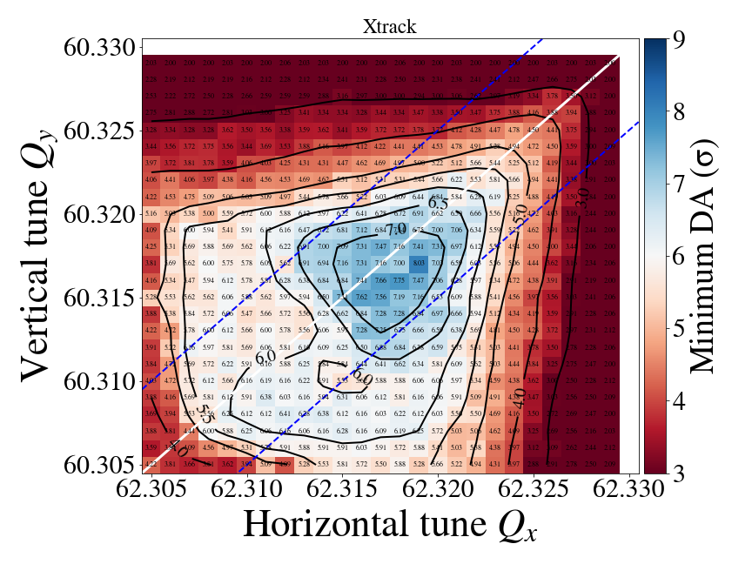
HL-LHC Dynamic Aperture scan
G. Sterbini, S. Kostoglou
First DA studies with Xsuite. Package used in combination with other Pythonic tools:
Pymask used to prepare the machine configurations
Job management using a new Python package (TreeMaker)
Dynamic Aperture computation in Python using Pandas
Parameters of pilot study
Full HL-LHC lattice (20k elements)
Weak strong Beam-beam
N. tune configurations = 625
N. tracked particles/conf. = 1780
N. turns = 10⁶
N. jobs = ~10'000
Comp. time ~48h on INFN- CNAF cluster
7

Slide 8
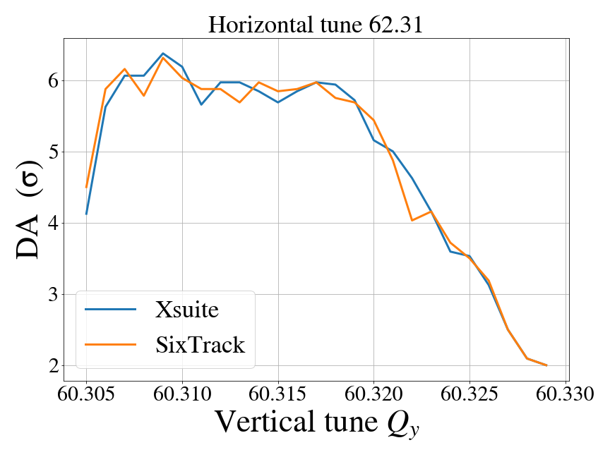
HL-LHC Dynamic Aperture scan
G. Sterbini, S. Kostoglou
First DA studies with Xsuite. Package used in combination with other Pythonic tools:
Pymask used to prepare the machine configurations
Job management using a new Python package (TreeMaker)
Dynamic Aperture computation in Python using Pandas
Parameters of pilot study
Full HL-LHC lattice (20k elements)
Weak strong Beam-beam
N. tune configurations = 625
N. tracked particles/conf. = 1780
N. turns = 10⁶
N. jobs = ~10'000
Comp. time ~48h on INFN- CNAF cluster
Benchmarked against SixTrack
8

Slide 9
Advanced studies on Dynamic Aperture evaluations
C. E. Montanari, F. Van der Veken, A. Bazzani, M. Giovannozzi, G. Turchetti
Testing predictive capacity on chaotic behaviors with different dynamic indicators:
  Classical indicators from accelerator community (e.g. Fast Lyapunov Indicator) and more exotic indicators used in cosmology and astrophysics (e.g. Reverse Error Method, Smallest Alignment Index, Global Alignment Index)
Use of machine learning for smart sampling of the phase space
Xsuite instrumental for these studies since it provides:
Easy configuration of custom "ghost particles" used as probes for the dynamic indicators
Easy implementation of unphysical actions, e.g. displacement renormalization every n turn
Fast parallel tracking on large amounts of particles on GPU
Comparison of dynamic indicators (HL-LHC)
Smart sampling with ML

Slide 10
Outline
Introduction
Recent developments, tests and applications
  Benchmark and performance on single-particle tracking
  First Dynamic Aperture studies
  Xpart package
  Twiss functionality
  Import of deferred expressions (Xdeps)
  Synchrotron radiation
  Tests on low energy machines
  Collimation studies
  Strong-strong beam beam
  Beamstrahlung
  BB Wire compensator
  Intra-beam scattering
  Electron cloud
  Tracker functionalities
  Xsequence
  Job management tools
  BOINC

Slide 11
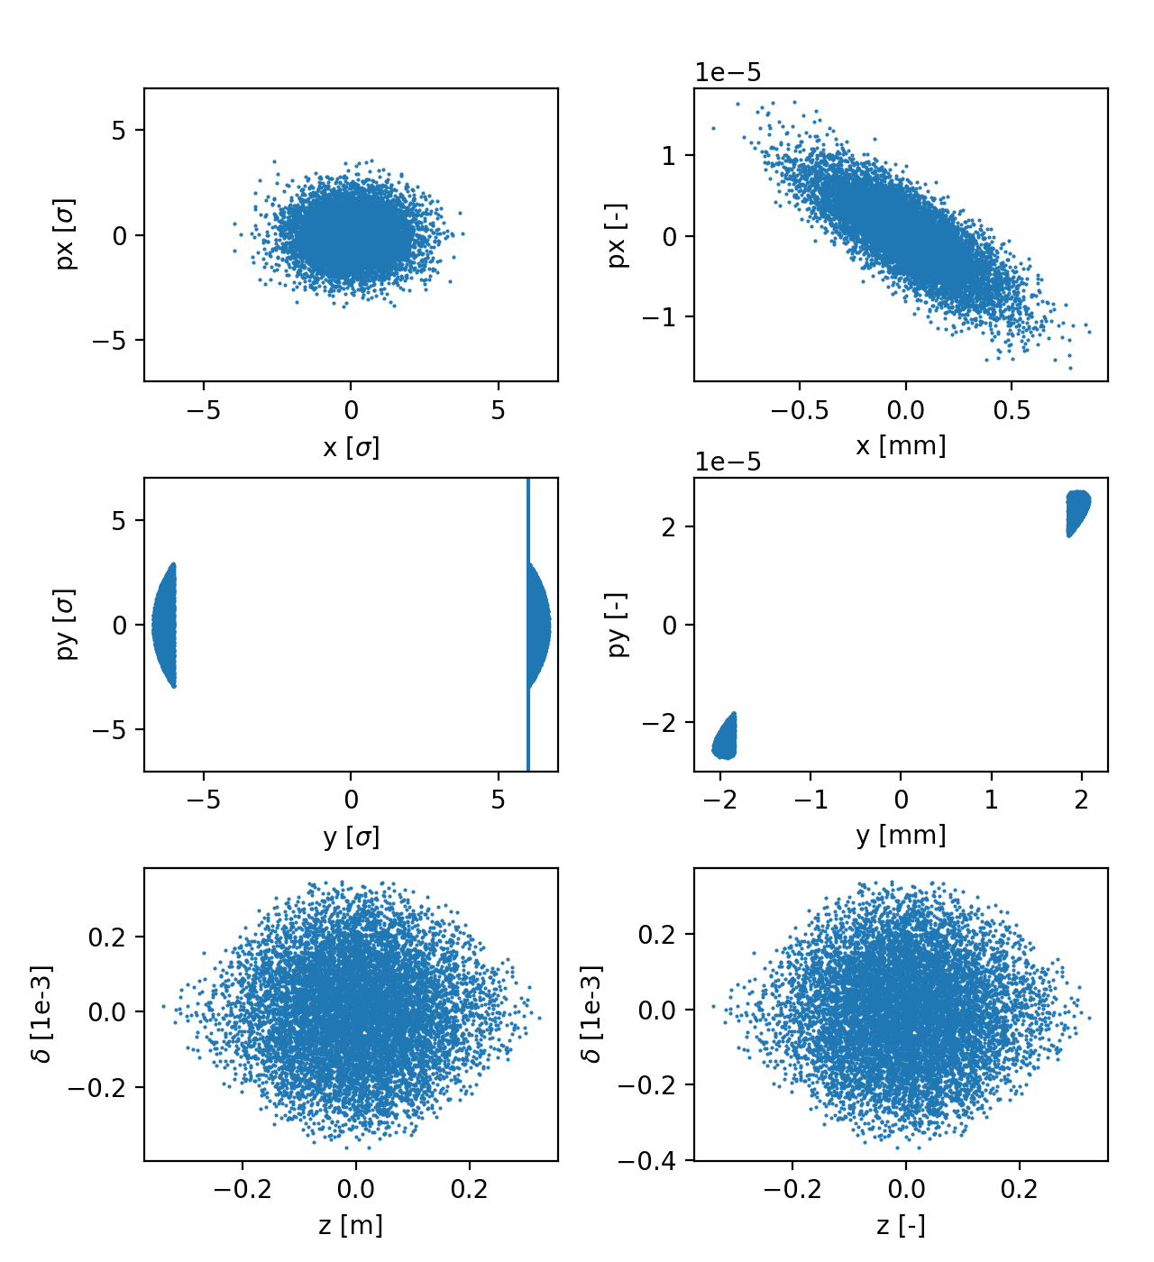
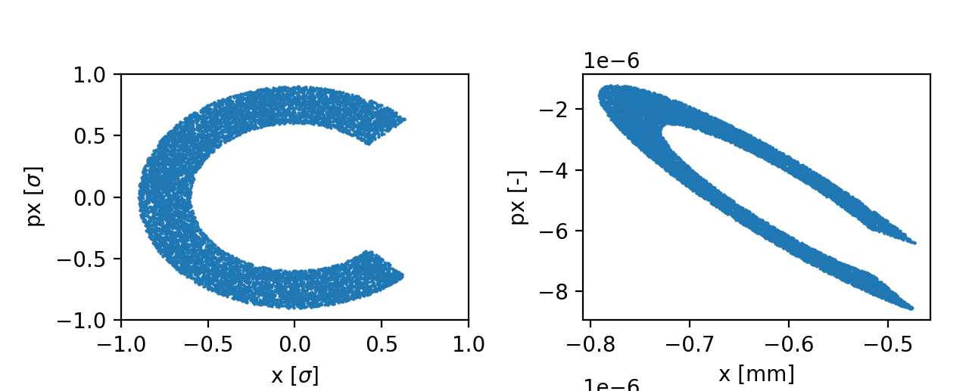
Xpart
The Xpart package provides tools to generate particles distribution:
Generate different particle distributions in the normalized transverse phase space (Gaussian, pencil, halo, polar grid)
Generate longitudinal coordinates matched to the RF bucket (ported from PyHEADTAIL)
Transform from normalized to physical coordinates using the 6D linear normal form of the the lattice (computed with finite differences) and center on the closed orbit (reused PySixtrack code by K. Paraschou)
Gaussian distribution
(Cut) Halo distribution
Normalized
Physical
Physical
Normalized
Pencil distribution
Normalized
Physical

Slide 12
Outline
Introduction
Recent developments, tests and applications
  Benchmark and performance on single-particle tracking
  First Dynamic Aperture studies
  Xpart package
  Twiss functionality
  Import of deferred expressions (Xdeps)
  Synchrotron radiation
  Tests on low energy machines
  Collimation studies
  Strong-strong beam beam
  Beamstrahlung
  BB Wire compensator
  Intra-beam scattering
  Electron cloud
  Tracker functionalities
  Xsequence
  Job management tools
  BOINC

Slide 13
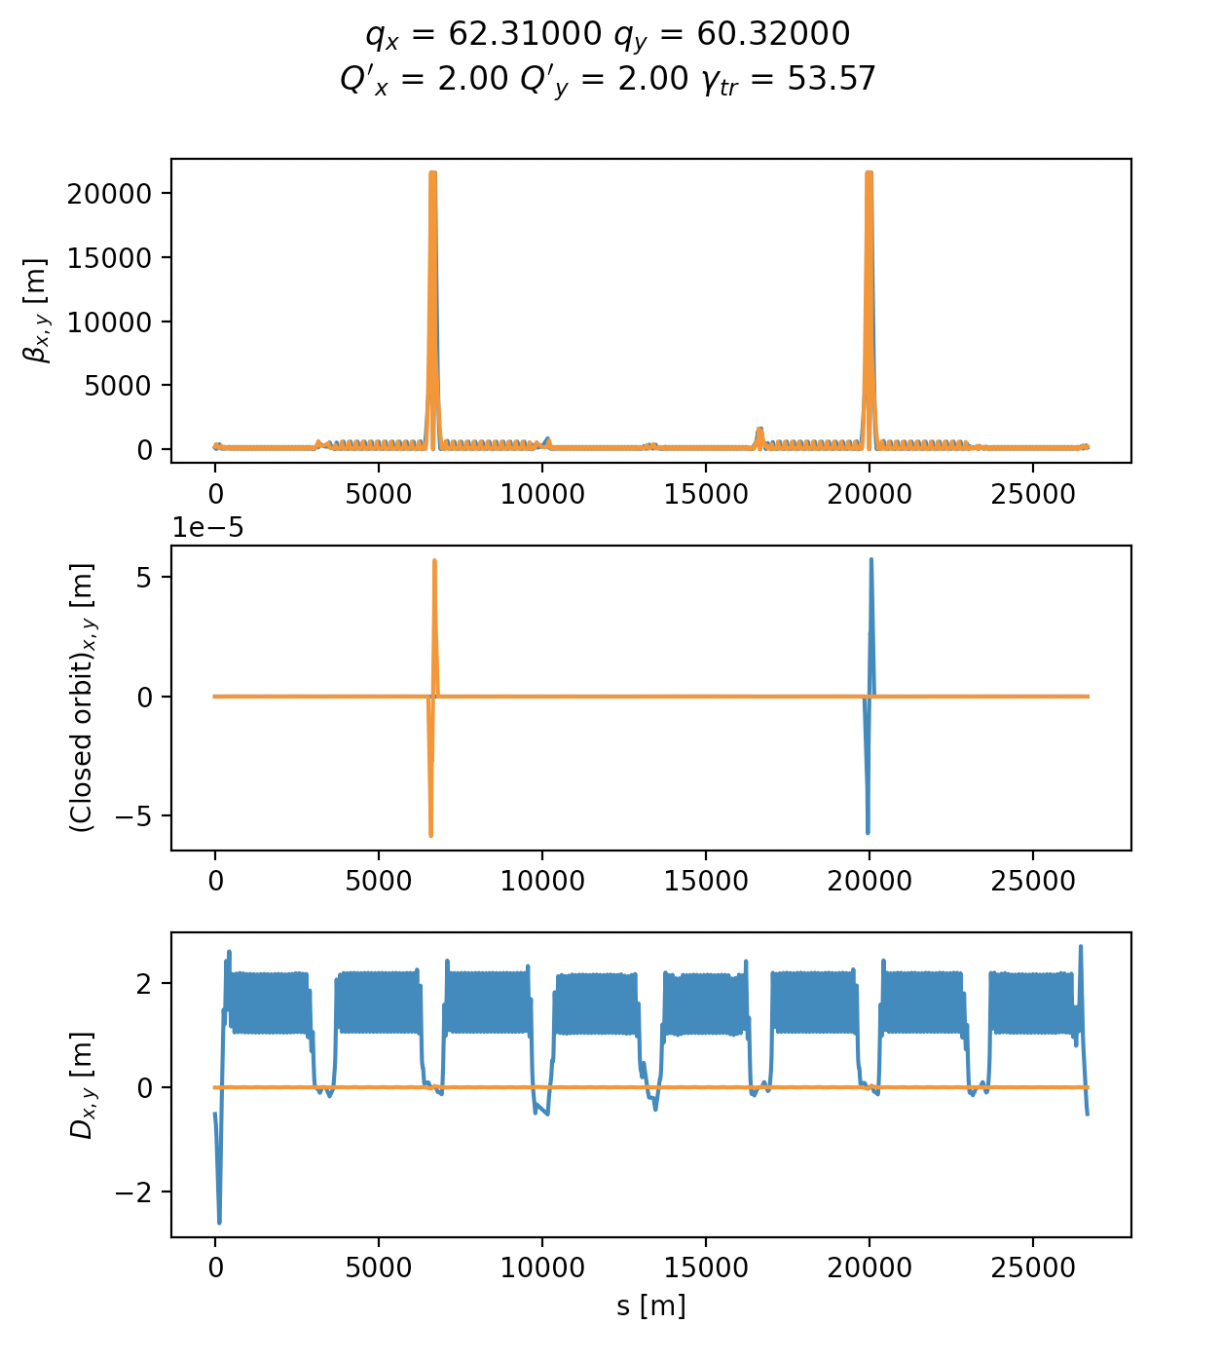
Twiss
A twiss method was introduced in Xtrack to compute closed orbit, linear optics and other parameters.
How it works:
Searches 6D closed orbit using scipy fsolve on one-turn map
Computes first order one-turn matrix using finite differences around the closed orbit
Diagonalization, identification and sorting of the eigenmodes (from Kostas)
Track particles associated to the eigenvectors around the machine
Compute twiss parameters from the eigenvalues/eigenvectors
Repeat off momentum for chromaticity
Tested for HL-LHC, PSB, ELENA, Elettra, CLIC-DR, FCC-ee → found to be very accurate

Slide 14
Twiss
Proved very useful to check/debug machine model before tracking (easy way of explicitly checking stability and main parameters of the lattice)
Provides:
name and s positions of the elements
Closed orbit: x, px, y, py, zeta, delta, ptau
Twiss parameters: betx, bety, alfx, alfy, gamx, gamy
Dispersion dx, dpx, dy, dpy
Phase advance: mux, muy
Tunes and chromaticities: qx, qy, dqx, dqy
Longitudinal params: qs, slip_factor, momentum_compaction_factor
One-turn matrix: R_matrix
Particle on CO: particle_on_co
Optionally can provide all parameters at s locations defined by the used (no need to install markers)

Slide 15
Outline
Introduction
Recent developments, tests and applications
  Benchmark and performance on single-particle tracking
  First Dynamic Aperture studies
  Xpart package
  Twiss functionality
  Import of deferred expressions (Xdeps)
  Synchrotron radiation
  Tests on low energy machines
  Collimation studies
  Strong-strong beam beam
  Beamstrahlung
  BB Wire compensator
  Intra-beam scattering
  Electron cloud
  Tracker functionalities
  Xsequence
  Job management tools
  BOINC

Slide 16
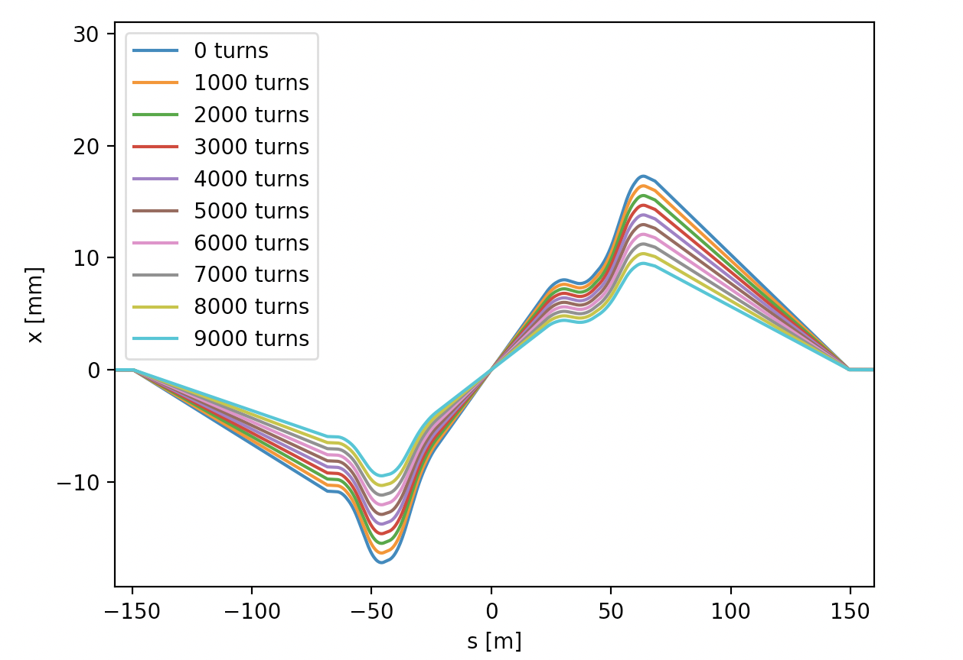
Xdeps
The Xdeps package can be used to import deferred expression from MAD-X model to Xsuite simulations.
Knobs imported from MAD-X can be easily changed before the simulations (configure the machine) or during the simulation to model transients, ripples, noise
# Simulate change of crossing angle from 300 urad
# to 25 urad in 10000 turns
num_turns = 10000
phi_table = np.linspace(150, 300, 10000)
for i_turn in range(num_turns):
tracker.vars['on_x1'] = phi_table[i_turn]
tracker.vars['on_x5'] = phi_table[i_turn]
tracker.track(particles)

Slide 17
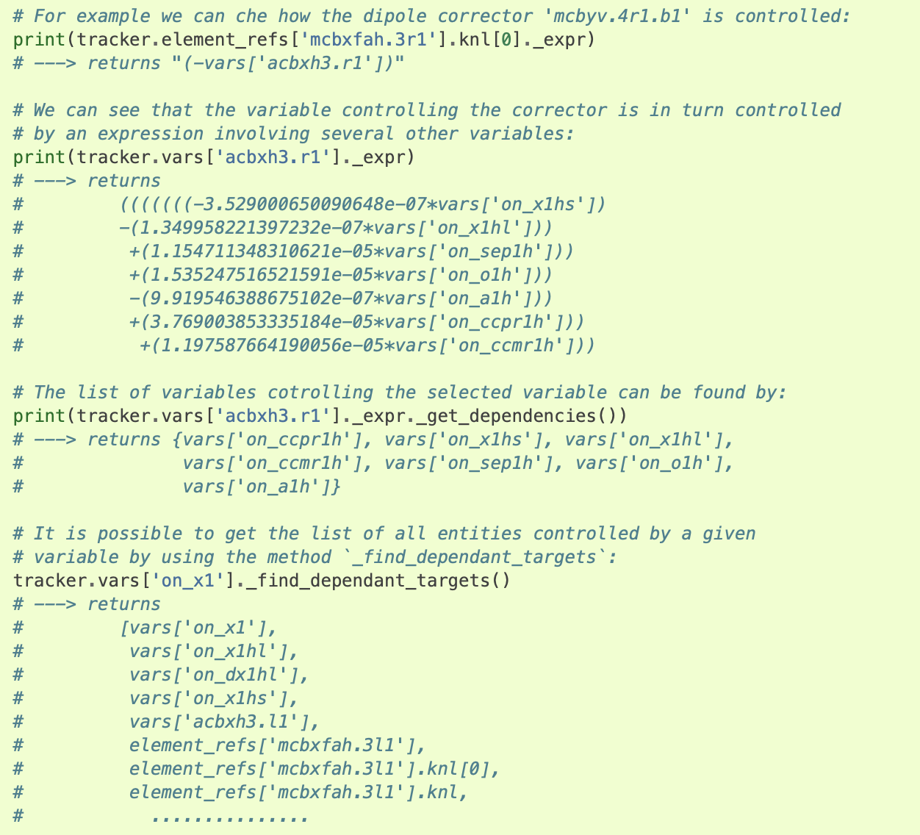
Xdeps
The package provides tools to analyze dependencies introduced by deferred expressions:

Slide 18
Outline
Introduction
Recent developments, tests and applications
  Benchmark and performance on single-particle tracking
  First Dynamic Aperture studies
  Xpart package
  Twiss functionality
  Import of deferred expressions (Xdeps)
  Synchrotron radiation
  Tests on low energy machines
  Collimation studies
  Strong-strong beam beam
  Beamstrahlung
  BB Wire compensator
  Intra-beam scattering
  Electron cloud
  Tracker functionalities
  Xsequence
  Job management tools
  BOINC

Slide 19
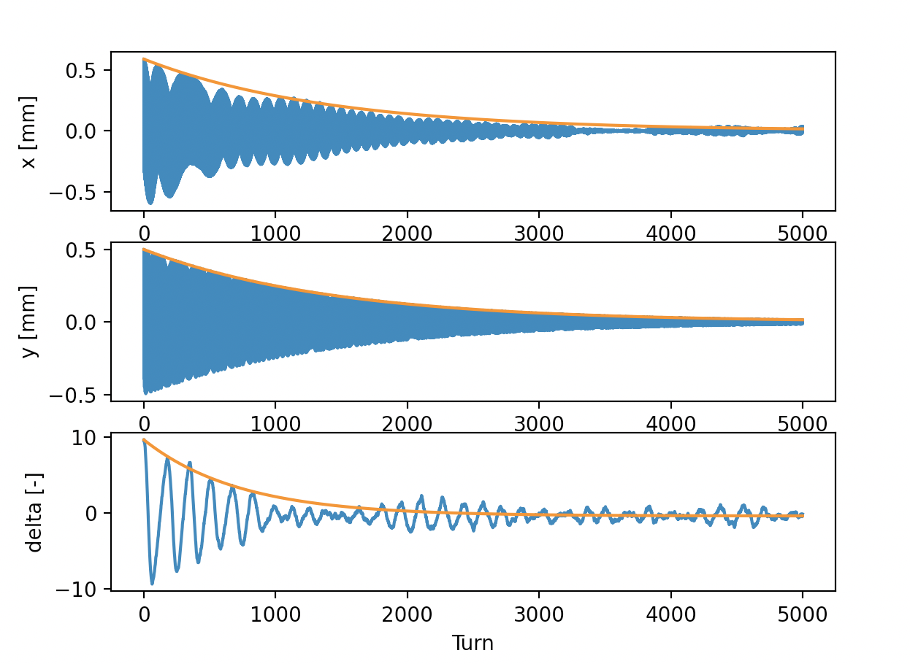

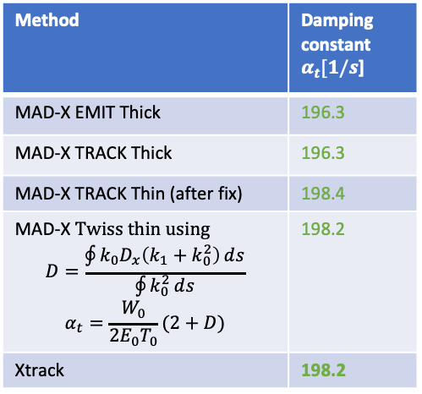
Synchrotron radiation
A. Abramov, A. Latina, A. Poyet, G. Simon, M. Zampetakis
Synchrotron radiation emission introduced for thin magnetic elements (no solenoid yet), largely based on MAD-X and PLACET implementations. User can choose between:
Mean power emission (no quantum effects) → only damping
Quantum description (emission of individual photons) → damping + excitation
Xtrack twiss computes energy loss (from particles on closed orbit) and damping constants (from matrix eigenvalues) → checked against MAD-X
Xsuite tracking Xsuite twiss
Method | Damping constant $α_{t}[1/s$]
MAD-X EMIT Thick | 196.3
MAD-X TRACK Thick | 196.3
MAD-X TRACK Thin (after fix) | 198.4
MAD-X Twiss thin using $$D=\frac{\oint{k_{0}D_{x}\left(k_{1}+k_{0}^{2}\right)}ⅆs}{\oint{k_{0}^{2}}ⅆs}$$ $$α_{t}=\frac{W_{0}}{2E_{0}T_{0}}(2+D)$$ | 198.2
Xtrack | 198.2
Study supported by

Slide 20
Synchrotron radiation
A. Abramov, A. Latina, A. Poyet, G. Simon, M. Zampetakis
Tested in extreme configuration of FCC-ee (tt mode, 175 GeV)
~2% energy loss, tapered lattice
Excellent agreement vs MAD-X on closed orbit and linear optics
Full ring
Zoom

Slide 21
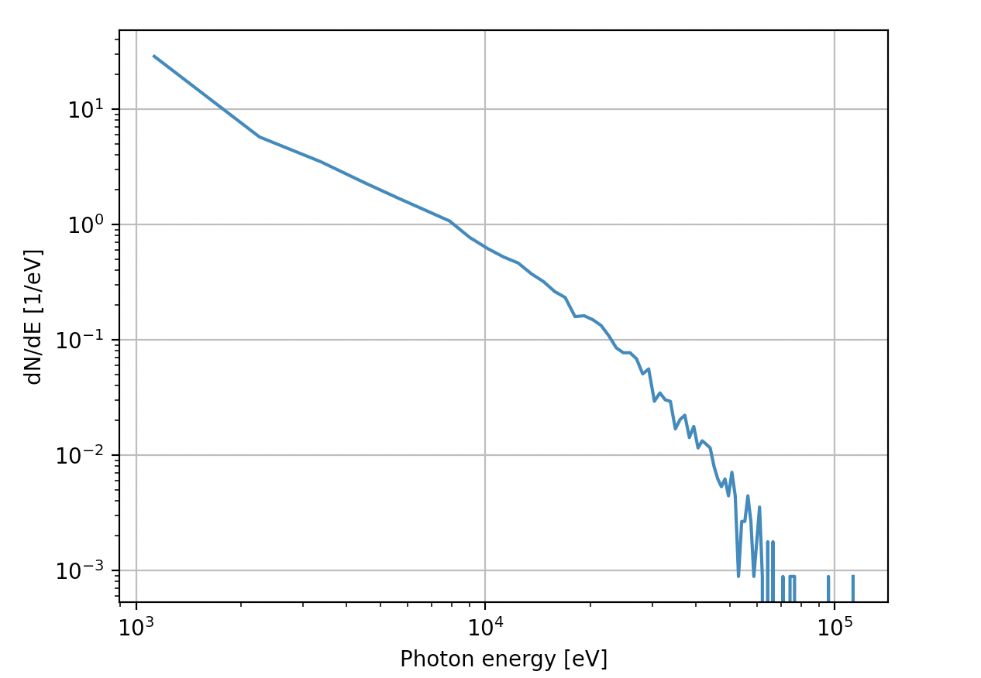
Synchrotron radiation
A. Abramov, A. Latina, A. Poyet, G. Simon, M. Zampetakis
Very recently we introduced capability to record the energy of each emitted photon
spectrum to be chacked against analytic formula (Guillaume)

Slide 22
Outline
Introduction
Recent developments, tests and applications
  Benchmark and performance on single-particle tracking
  First Dynamic Aperture studies
  Xpart package
  Twiss functionality
  Import of deferred expressions (Xdeps)
  Synchrotron radiation
  Tests on low energy machines
  Collimation studies
  Strong-strong beam beam
  Beamstrahlung
  BB Wire compensator
  Intra-beam scattering
  Electron cloud
  Tracker functionalities
  Xsequence
  Job management tools
  BOINC

Slide 23
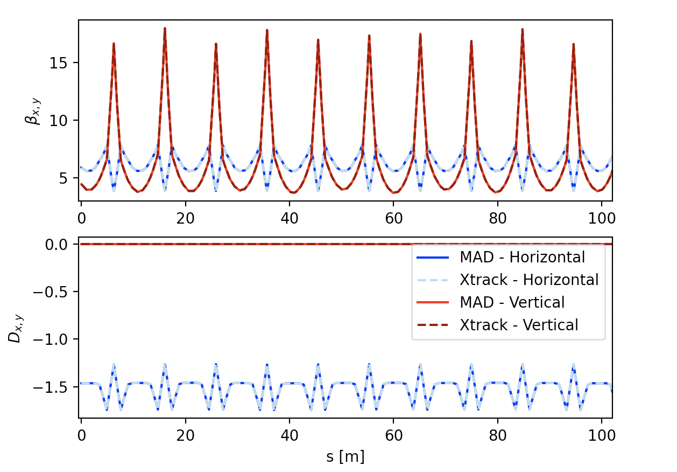
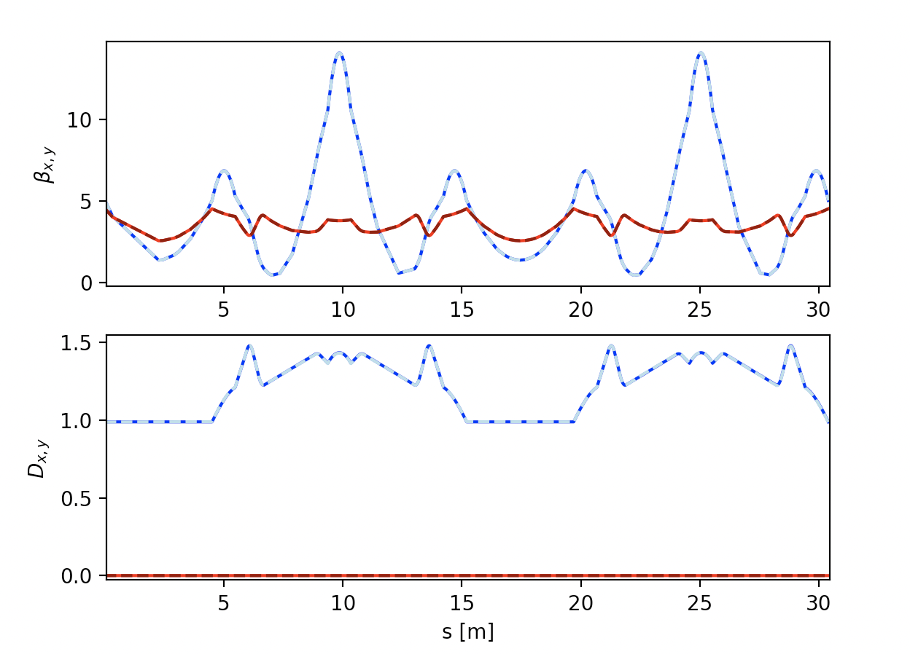
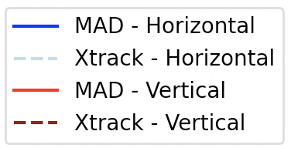
Low energy accelerator tests: PSB and ELENA
F. Asvesta, V. Rodin
Xsuite track and twiss tested also for low energy machines → check that effect or relativistic beta is correctly modelled
PSB
Protons, E_{kin} = 160 MeV, β = 0.520
ELENA
Antiprotons, E_{kin} = 100 keV, β = 0.0146
MAD-X: Qx = 4.15000000 Qy = 4.51000000
Xsuite: Qx = 4.15000002 Qy = 4.50999998
MAD-X: Q'x = -3.5533572 Q'y = -7.1875114
Xsuite: Q'x = -3.5532929 Q'y = -7.1875384
MAD-X: alpha_p = 0.0590347
Xsuite: alpha_p = 0.0590353
MAD-X: Qx = 2.45400000 Qy = 1.41600000
Xsuite: Qx = 2.45403134 Qy = 1.41600000
MAD-X: Q'x = -3.5579063 Q'y = -0.9370119
Xsuite: Q'x = -3.5563392 Q'y = -0.9366512
MAD-X: alpha_p = 0.2512849
Xsuite: alpha_p = 0.2515006

Slide 24
Outline
Introduction
Recent developments, tests and applications
  Benchmark and performance on single-particle tracking
  First Dynamic Aperture studies
  Xpart package
  Twiss functionality
  Import of deferred expressions (Xdeps)
  Synchrotron radiation
  Tests on low energy machines
  Collimation studies
  Strong-strong beam beam
  Beamstrahlung
  BB Wire compensator
  Intra-beam scattering
  Electron cloud
  Tracker functionalities
  Xsequence
  Job management tools
  BOINC

Slide 25
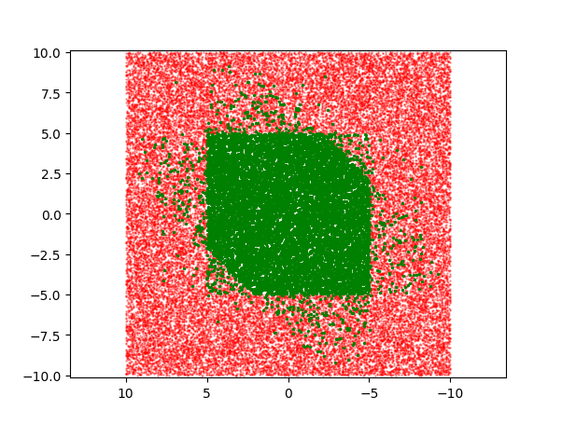
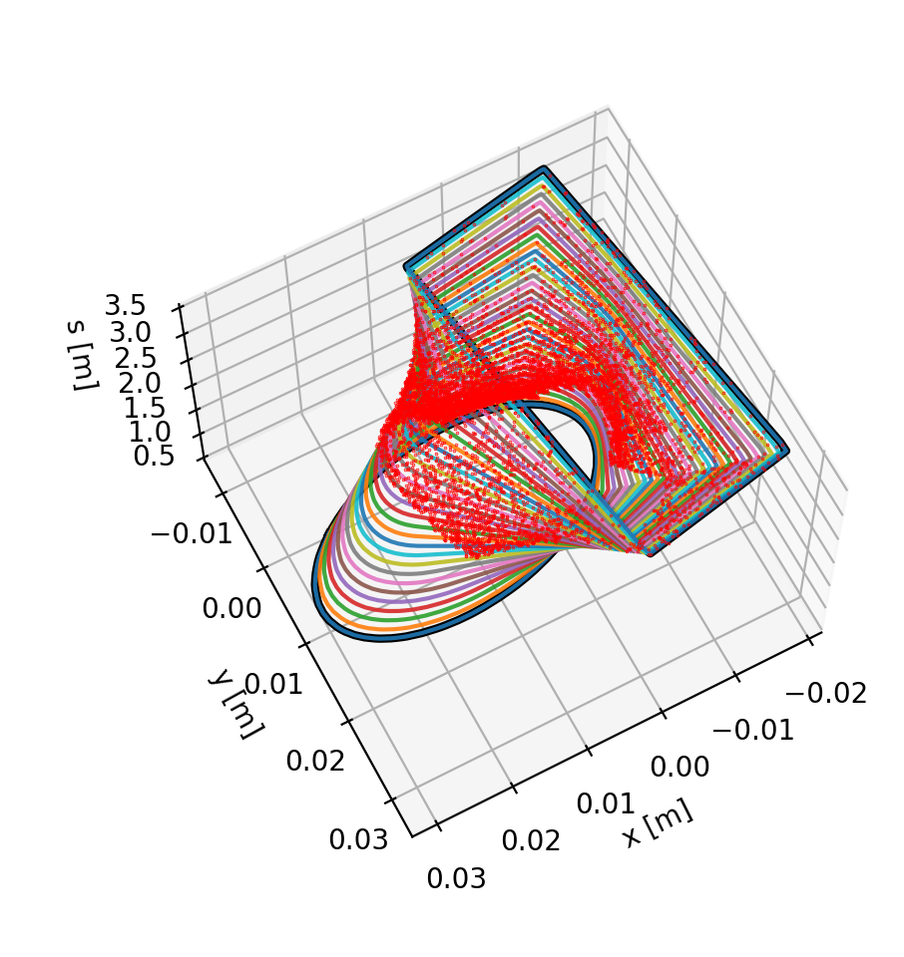
Collimation simulations
A. Abramov , D. Demetriadou, F. Van Der Veken
Xcoll - K2 simulation
(LHC primary collimators)
The Xcoll package is being developed to manage and simulate collimators within an Xsuite beamline.
It installs collimators in an Xsuite beamlines
It configures the collimator gaps based settings in sigmas provided by the user (uses beam sizes from Xsuite twiss)
It runs different engines simulating particle-matter interaction inside collimator jaw
  K2: ported from Sixtrack, being translated in python (almost done)
  Geant4-BDSIM: tested in full loss-map studies for HL-LHC and FCC-ee (developed in dedicated package, still to be be integrated in Xcoll)
  FLUKA: coupling still to be ported from Sixtrack
Collimation studies also require precise localization of particles lost in the aperture
Dediicated module implemented in Xtrack that automatically generates smooth transitions between apeture markers and backtracks particles to identify the exact location of losses
y [σ]
x [σ]
Loss Location Refinement
Xtrack

Slide 26
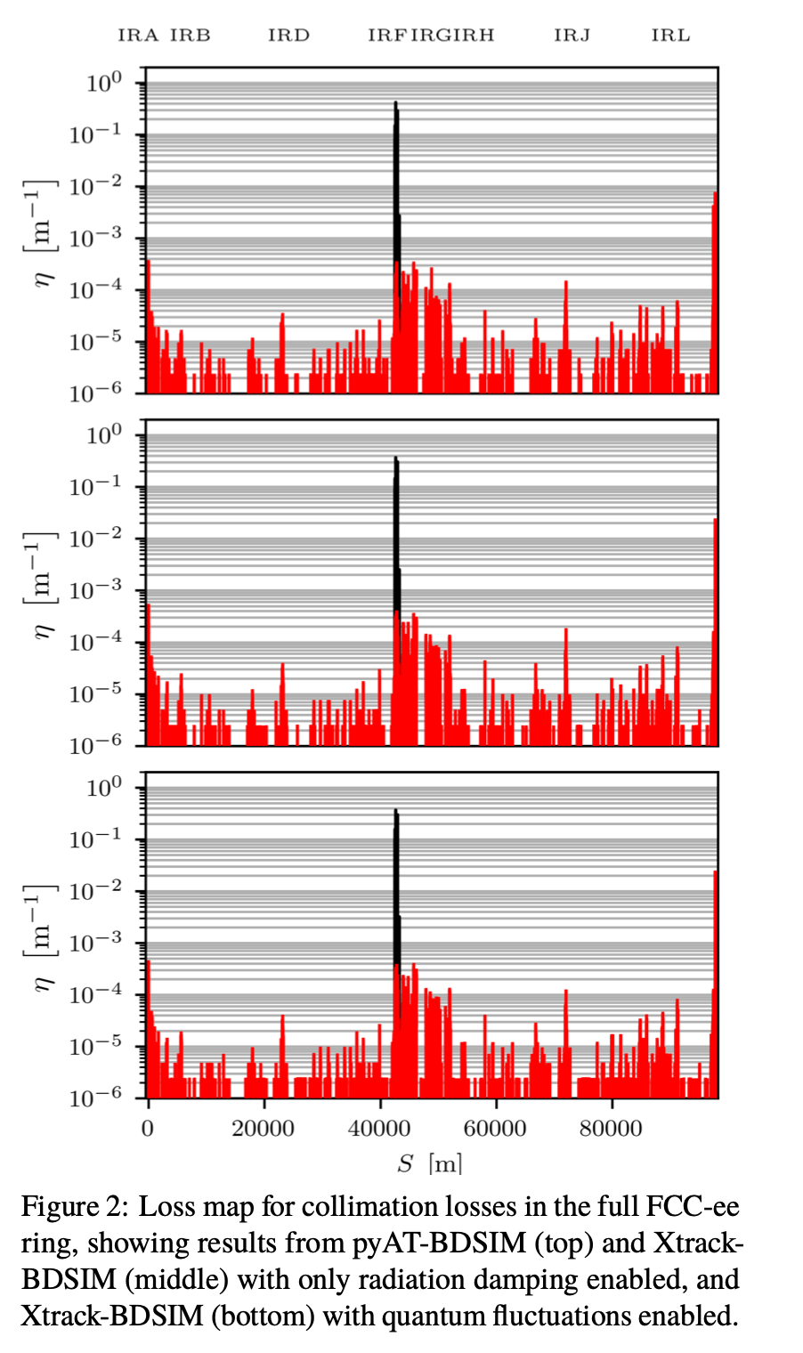
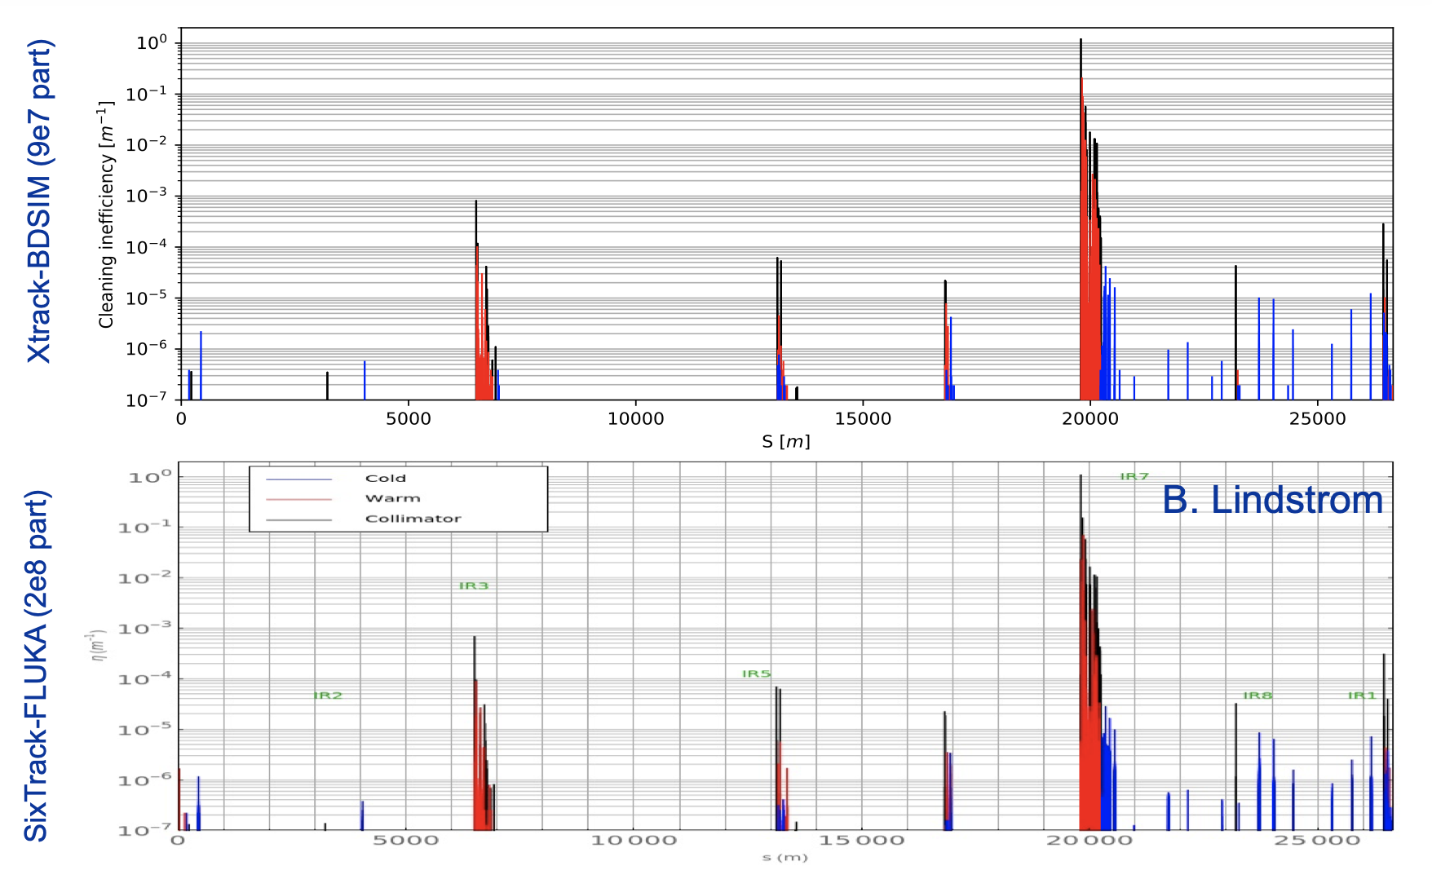
Collimation simulations
A. Abramov , D. Demetriadou, F. Van Der Veken
First loss-map simulations conducted with Xsuite + BDSIM/Geant4 for HL-LHC and FCC-ee
FCC-ee
HL-LHC
PyAT-BDSIM
Xsuite-BDSIM
(quantum OFF)
Xsuite-BDSIM
(quantum ON)
For more details: https://indico.cern.ch/event/112293/

Slide 27
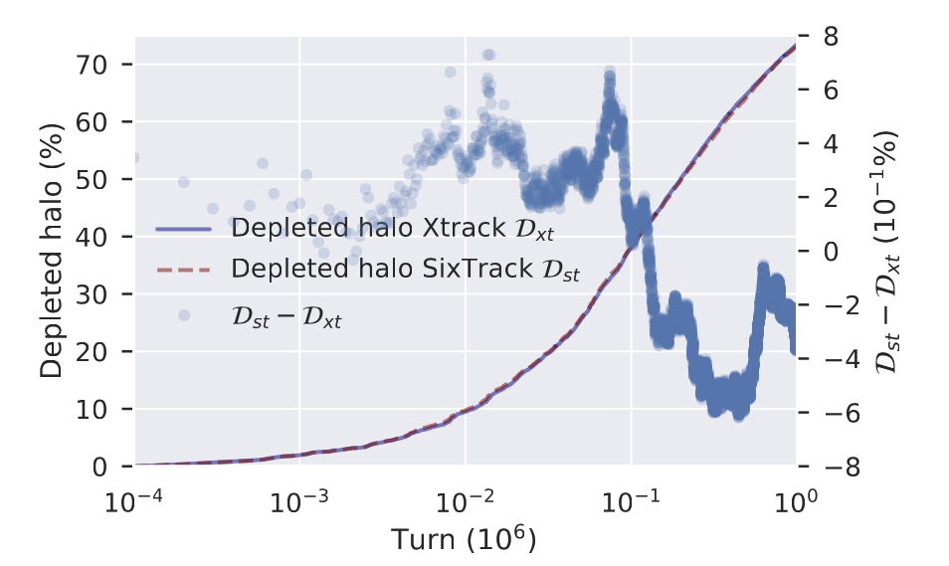
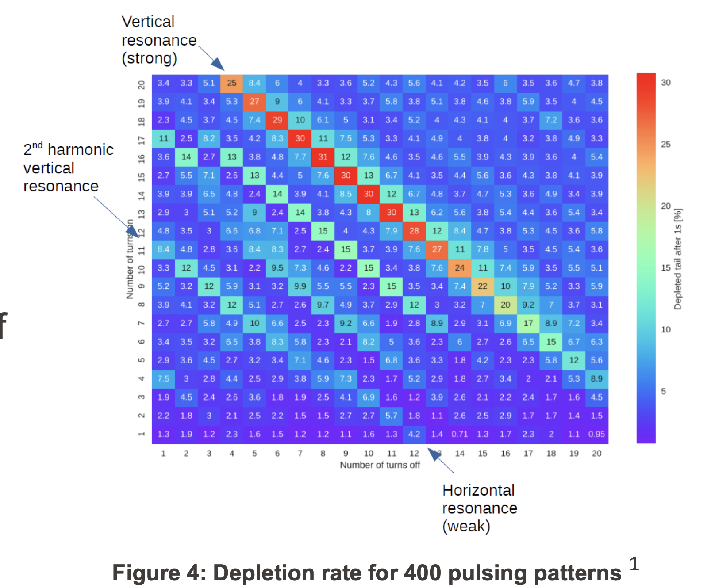
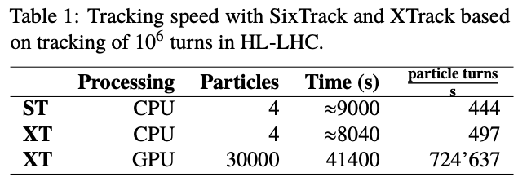
Electron lens studies
M. Boucard, P. Hermes
Xsuite is being extensively used to study halo cleaning with hollow electron lenses
Thoroughly benchmarked against SixTrack
Profiting from use of GPUs to simulate many particles and long timescales
Profiting of Xsuite capability to dynamically change the pulse strength directly in the GPU memory
Xsuite to be used as baseline tool for production runs from now on. Developing more complex modelling of the HEL (e.g. non-ideal electron distributions)
Benchmark against Sixtrack
Pulsing pattern optimization

Slide 28
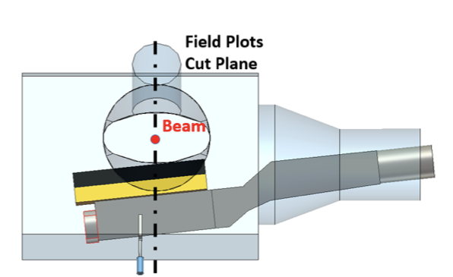
Loss pattern generated by the PS internal dump
T. Pugnat, M. Giovannozzi
Study the behavior of beam and secondary particles in the PS as the internal dump moves inside the chamber to stop the beam
Requires simulating a beam/matter interaction with a moving object
  The dump speed is very slow compared to the beam speed → 10k turns before completely stopping the beam
From JACoW-IPAC2018-THPAF052
28

Slide 29
Outline
Introduction
Recent developments, tests and applications
  Benchmark and performance on single-particle tracking
  First Dynamic Aperture studies
  Xpart package
  Twiss functionality
  Import of deferred expressions (Xdeps)
  Synchrotron radiation
  Tests on low energy machines
  Collimation studies
  Strong-strong beam beam
  Beamstrahlung
  BB Wire compensator
  Intra-beam scattering
  Electron cloud
  Tracker functionalities
  Xsequence
  Job management tools
  BOINC

Slide 30

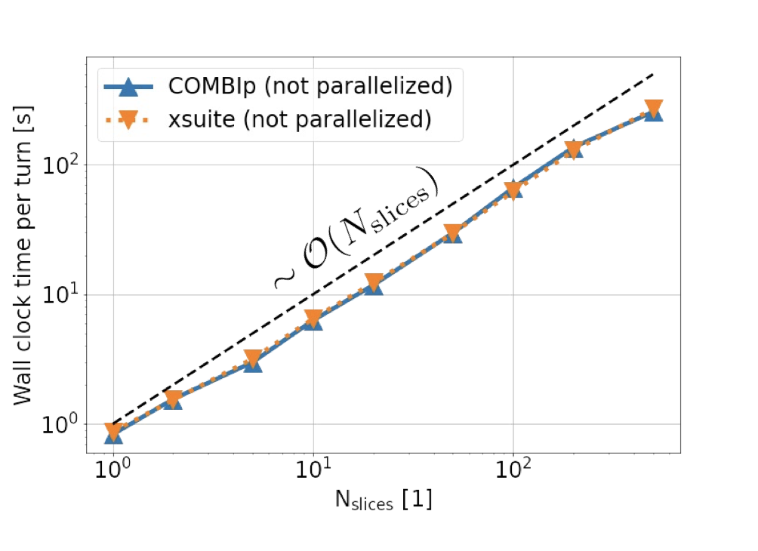
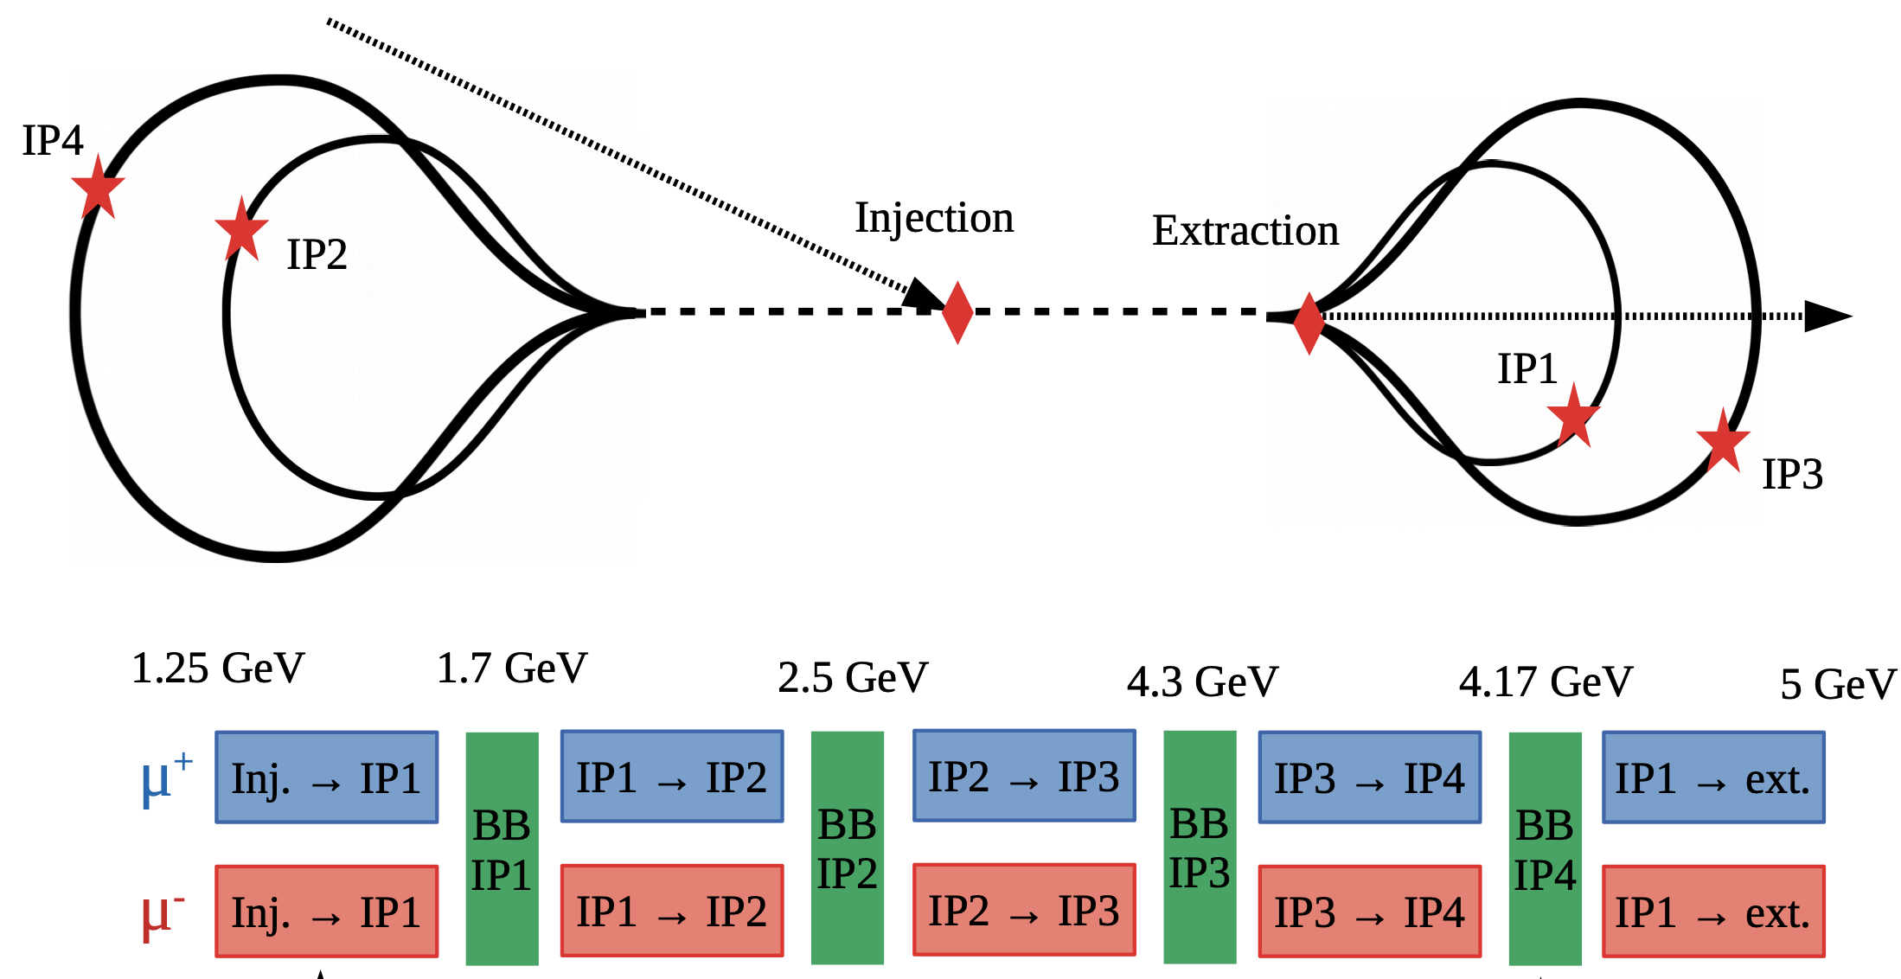
Strong-strong beam beam
X. Buffat, P. Kicsini
Xsuite used to simulate strong-strong beam beam effects (so far done with COMBI)
Additional package (PyPLINE) provides multi-node parallelization on top of xsuite in order to simulate many bunches on different nodes
Used in production studies on CERN HPC cluster (~500 CPU cores/simulation)
  Studies on crab-cavity feedback and crab-cavity noise for HL-LHC
So far only 2D Gaussian model used for strong-strong studies
  Development ongoing to extend to 6D modelling and Particle In Cell
Xsuite used for first studies on beam-beam effects in recirculating linac for muon collider

Slide 31
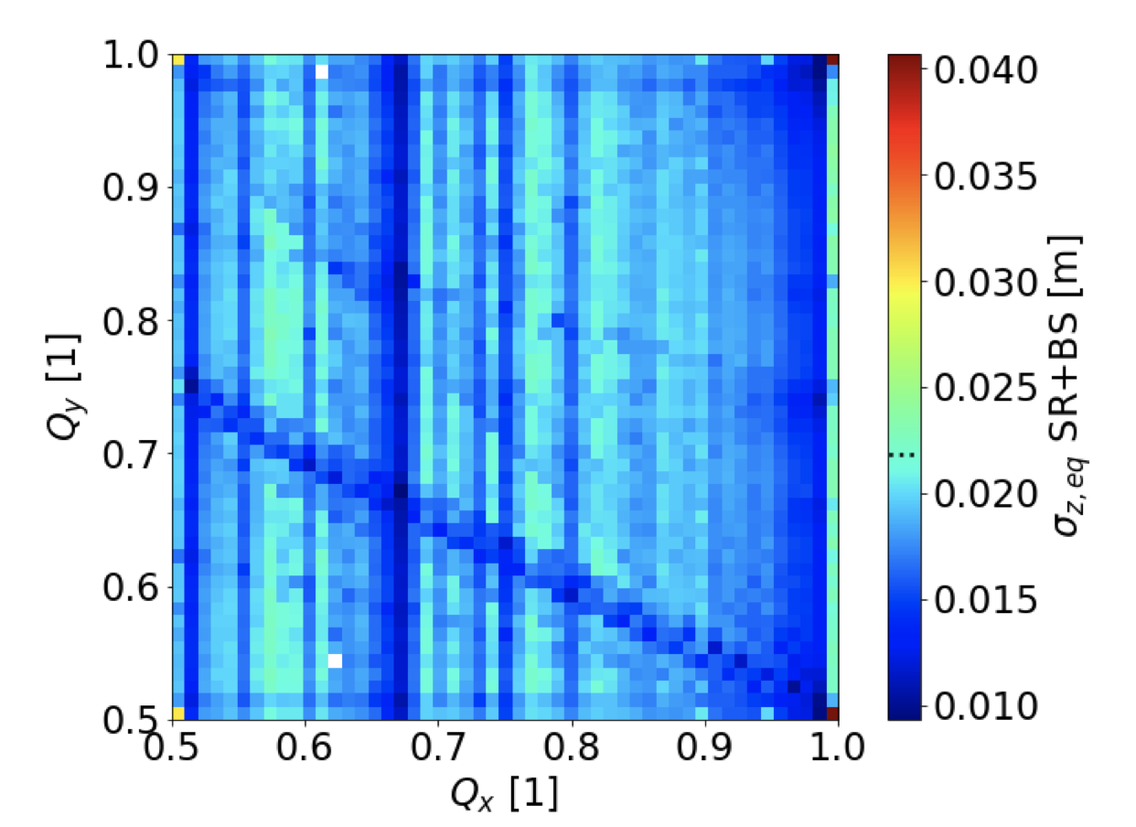
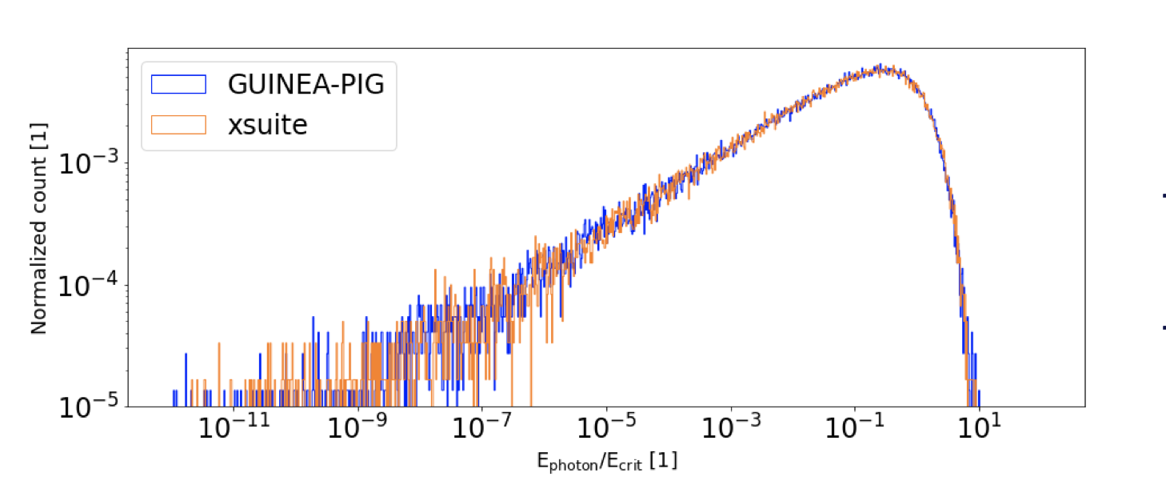
Beamstrahlung
X. Buffat, P. Kicsini
Beamstrahlung effect has being implemented and is presently being tested
First pilot studies for FCC-ee including are ongoing including:
  Synchrotron radiation
  Weak-strong beam beam
  Beamstrahlung
https://indico.cern.ch/event/1160125/

Slide 32

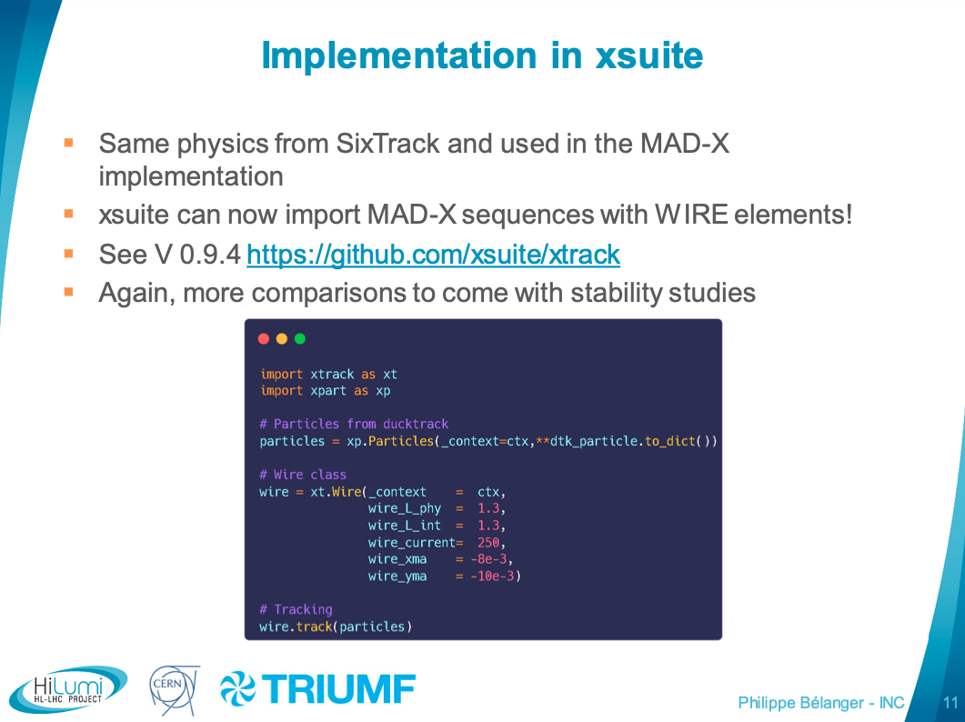
Beam-beam compensator (wire)
P. Belanger, G. Sterbini
For more info: https://indico.cern.ch/event/1135861

Slide 33
Outline
Introduction
Recent developments, tests and applications
  Benchmark and performance on single-particle tracking
  First Dynamic Aperture studies
  Xpart package
  Twiss functionality
  Import of deferred expressions (Xdeps)
  Synchrotron radiation
  Tests on low energy machines
  Collimation studies
  Strong-strong beam beam
  Beamstrahlung
  BB Wire compensator
  Intra-beam scattering
  Electron cloud
  Tracker functionalities
  Xsequence
  Job management tools
  BOINC

Slide 34
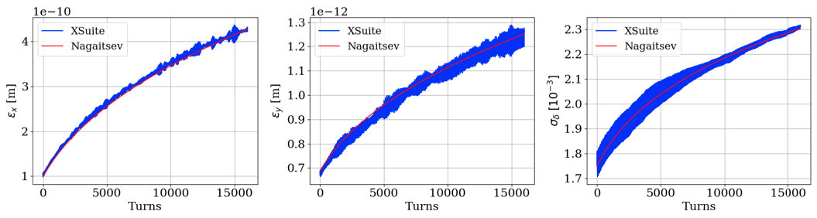
Intra Beam Scattering
M. Zampetakis, F. Antoniou
Two approaches are being implemented to model Intra Beam Scatterin (IBS):
Simplified kick (applicable above transition) → Tested for the CLIC Damping rings
Kinetic theory (required below transition) → developed using PyORBIT, will soon be ported to Xsuite
For more info: https://indico.cern.ch/event/1130602/

Slide 35
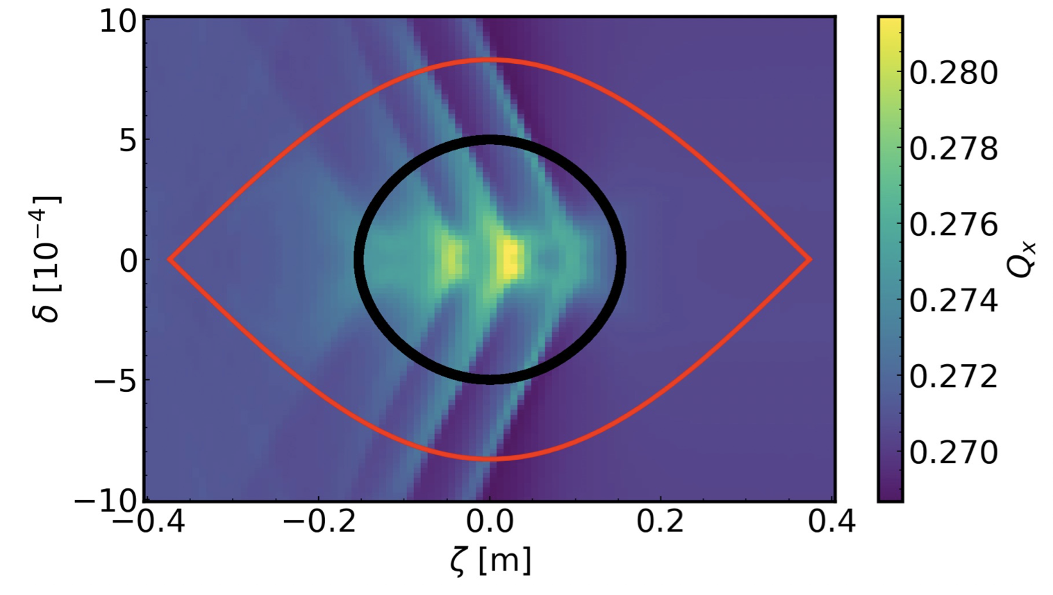
e-cloud
K. Paraschou
Beam element for the simulation of incoherent e-cloud effects recently ported from sixtracklib
Non-linear forces from arbitrarily complex e-cloud are applied throught a tricubic interpolation scheme, which preserves the symplecticity of the map
Possiblity to track particles while freezeing the synchrotron motion (offered by Xsuite) has been used to study the detuning intriduced by the e-cloud as a function of the longitudianal coordinates
For more info: https://indico.cern.ch/event/1151340

Slide 36
Outline
Introduction
Recent developments, tests and applications
  Benchmark and performance on single-particle tracking
  First Dynamic Aperture studies
  Xpart package
  Twiss functionality
  Import of deferred expressions (Xdeps)
  Synchrotron radiation
  Tests on low energy machines
  Collimation studies
  Strong-strong beam beam
  Beamstrahlung
  BB Wire compensator
  Intra-beam scattering
  Electron cloud
  Tracker functionalities
  Xsequence
  Job management tools
  BOINC

Slide 37
Advanced functionalities in xsuite.Tracker
The Tracker object takes care of managing the simulation. Recently added features:
Start/stop at any element in the lattice (implemented by F. Van Der Veken)
Handling of single-particle and collective elements (including PyHEADTAIL elements) in the same beam line
Managing data logging from elements (e.g. emitted photons, collimator touches)
Automatic transfer to CPU for elements not supporting GPU
GPU
Lattice
SP
GPU
Space charge
CC
CC
Space charge
GPU
GPU
Lattice
SP
SP
Lattice
GPU
GPU
Space charge
CC
CC
Space charge
GPU
CPU
Impedance
Damper
CPU
SP = Single particle
CC = Collective
CC, PyHEADTAIL
CC, PyHEADTAIL

Slide 38
Outline
Introduction
Recent developments, tests and applications
  Benchmark and performance on single-particle tracking
  First Dynamic Aperture studies
  Xpart package
  Twiss functionality
  Import of deferred expressions (Xdeps)
  Synchrotron radiation
  Tests on low energy machines
  Collimation studies
  Strong-strong beam beam
  Beamstrahlung
  BB Wire compensator
  Intra-beam scattering
  Electron cloud
  Tracker functionalities
  Xsequence
  Job management tools
  BOINC

Slide 39
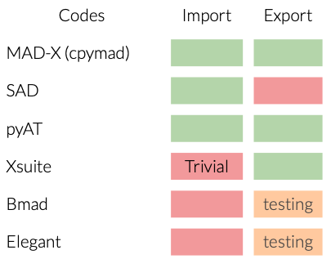
Xsequence
F. Carlier
Xsequence package being developed in the framework of FCC-ee in order to:
Simplify lattice conversions to the different codes of interest
Offer an expandable platform for users to contribute tools for specific conversions
Simplify the creation of models for the large simulation campaigns by controlling errors and tuning knobs
Ensure model consistency between platforms for comparative simulations
Development status
For more details: https://indico.cern.ch/event/1085318/
39

Slide 40
Outline
Introduction
Recent developments, tests and applications
  Benchmark and performance on single-particle tracking
  First Dynamic Aperture studies
  Xpart package
  Twiss functionality
  Import of deferred expressions (Xdeps)
  Synchrotron radiation
  Tests on low energy machines
  Collimation studies
  Strong-strong beam beam
  Beamstrahlung
  BB Wire compensator
  Intra-beam scattering
  Electron cloud
  Tracker functionalities
  Xsequence
  Job management tools
  BOINC

Slide 41
Tools to submit and manage large sets of jobs
F. Soubelet & OMC team, G. Sterbini, F. Van Der Veken
Ongoing efforts toward pythonic tools to generate and manage large sets jobs:
PyLHCSubmitter
  Template files with suitable placeholders
  Allows htcondor submission from python
tree_maker
  Based on yaml configuration files (easy to import in python) → Templates are valid simulations (useful for debug)
  Aims at supporting different computing infrastructures (local, LSF, HTCondor tested)
  Can monitor job status (pending/running/finished)
  Can handle dependencies among jobs (e.g. launch tracking jobs when result from mask job is available) → anytree package used in the background
Xdyna
  Focused on large dynamic aperture studies
  Uses database instead of multiple i/o files
  Implements file locking for filesystems not supporting exclusive access (e.g. AFS)
Overlap among projects is minimal → will work on maximizing syngergies

Slide 42
BOINC
D. Di Croce, F. Van Der Veken
Work is ongoing in collaboration with the EPFL-LPAP team to deploy Xsuite on BOINC (volunteer computing)
Running Xsuite through its python interface would be quite cumbersome on BOINC (would require using containers or virtual machines which might limit attractiveness for volunteers) → prefer to deploy a conventional binary executable
Used the Xsuite python interface to automatically generate a header-only library ("xtrack.h") from which a stand-alone executable ("xtrack.exe") is easily built
  Checkpointing functionality has been implemented (suspend/resume)
  Executable made compatible with Windows (used by many volunteers)
It is impractical to use the real system for development → Test environments have been prepared to:
  Test the Xsuite application in the same environment used by the volunteers (BOINC client)
  Test the entire workflow, including the part running on the BOINC server, from the job submission to the retrieval of the results (dummy BOINC server prepared for these tests)
First tests with Xtrack in the BOINC client are starting now
Aiming at first runs on CENT-IT BOINC server and LHC@home volunteers by end 2022

Slide 43
Summary
Engagement of many developers and users allowed great progress in the development, testing and improvement of Xsuite (big thanks!!!)
  We are getting there… ☺
Available
In development
Not available
Experimental

Slide 44
Thanks for your attention!

Slide 45
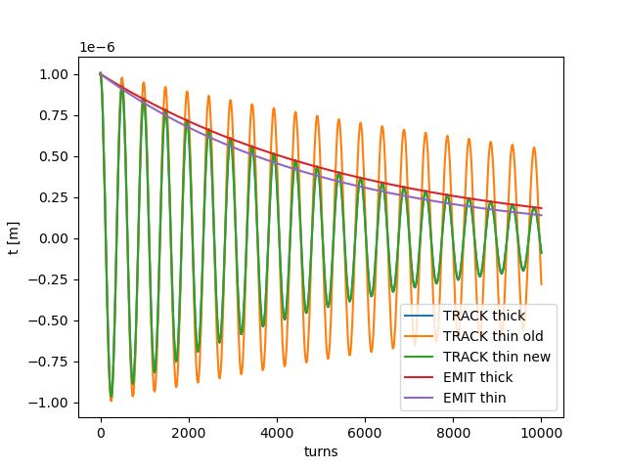
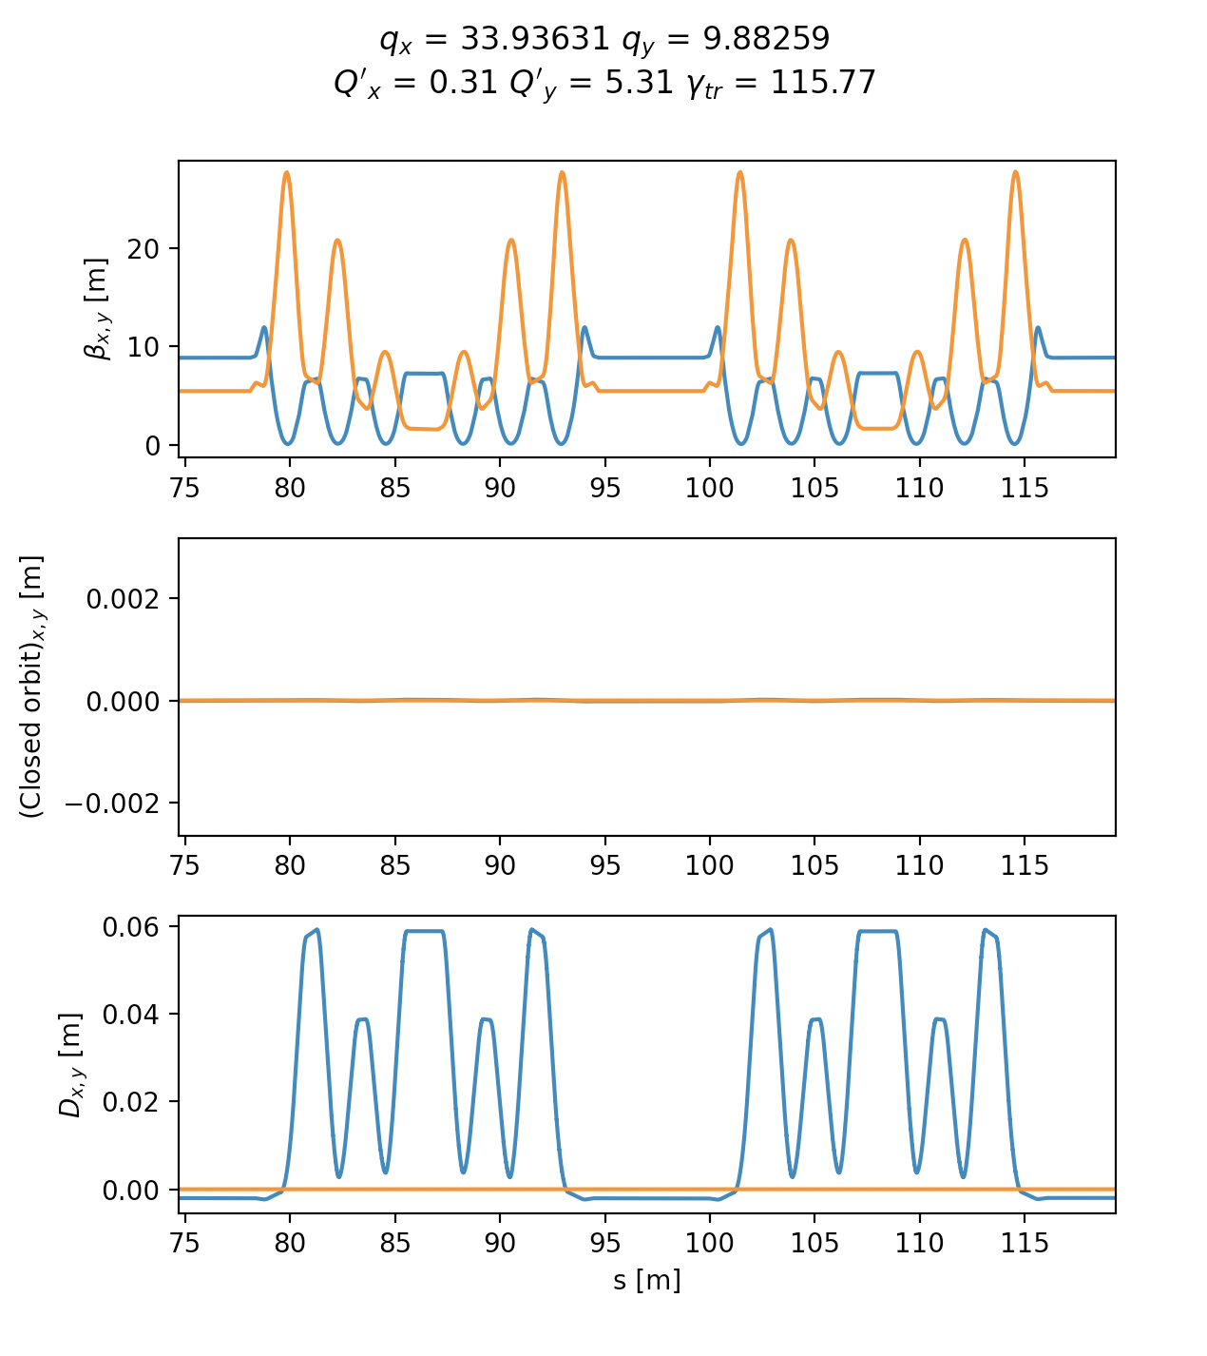
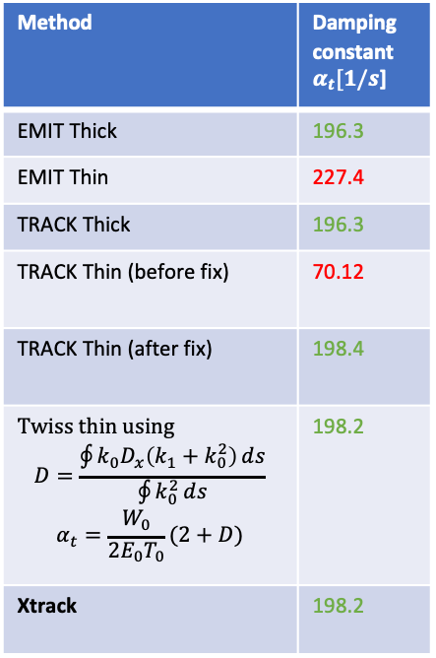

Synchrotron radiation
Method | Damping constant $α_{t}[1/s$]
EMIT Thick | 196.3
EMIT Thin | 227.4
TRACK Thick | 196.3
TRACK Thin (before fix) | 70.12
TRACK Thin (after fix) | 198.4
Twiss thin using $$D=\frac{\oint{k_{0}D_{x}\left(k_{1}+k_{0}^{2}\right)}ⅆs}{\oint{k_{0}^{2}}ⅆs}$$ $$α_{t}=\frac{W_{0}}{2E_{0}T_{0}}(2+D)$$ | 198.2
Xtrack | 198.2
Axel, Guillarme
$$t[turns]=t_{0}e^{−α_{t}{ T}_{0} turns}$$

Slide 46
Incomplete todo list…
Integration with PyHEADTAIL
Ions and fragments
Two beams setup, mask
Review beam-beam interface (needs clean up and proper integration of strong-strong cases)
Missing to get rid of COMBI
  6D beam-beam, Peter is working in it
  Lumi calculation (being developed now)
SR photon spectrum check
Ions and ion fragments

Slide 47
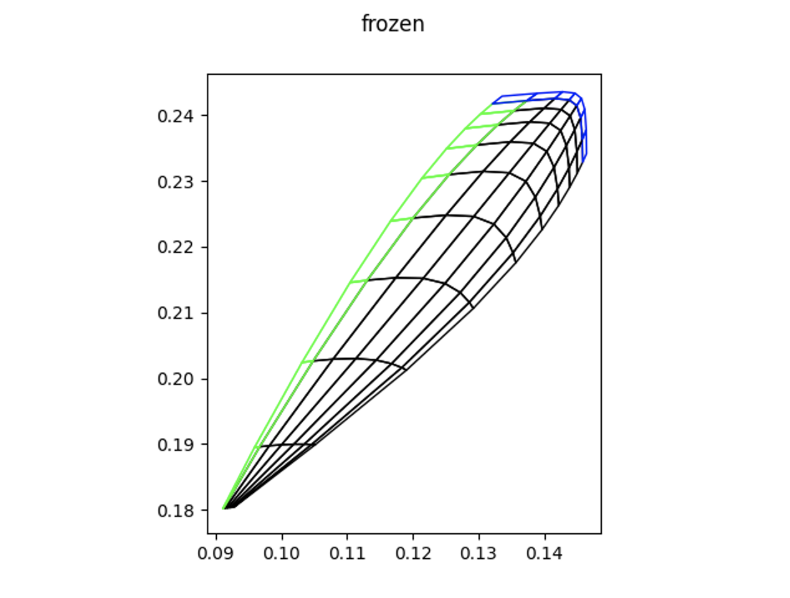
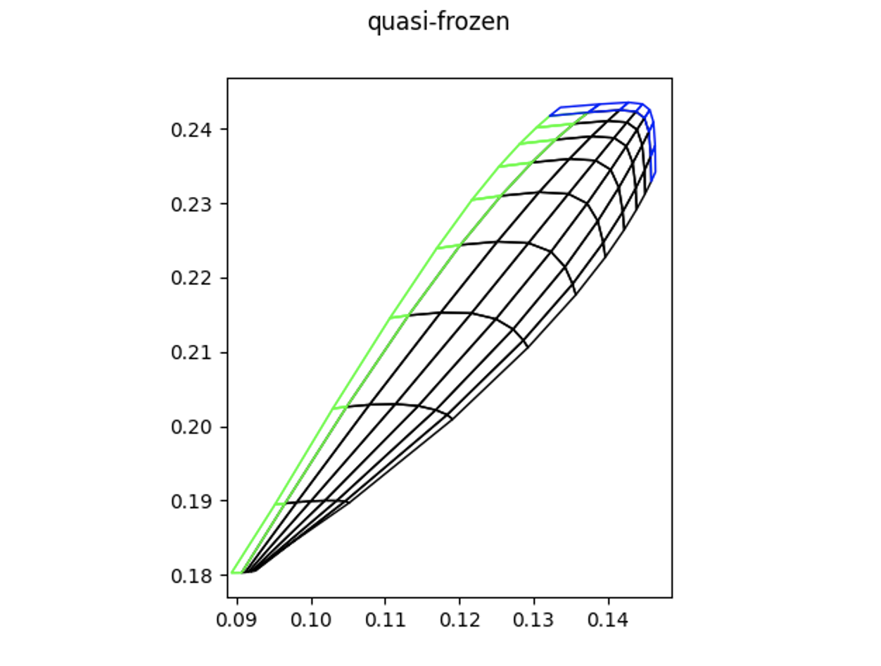
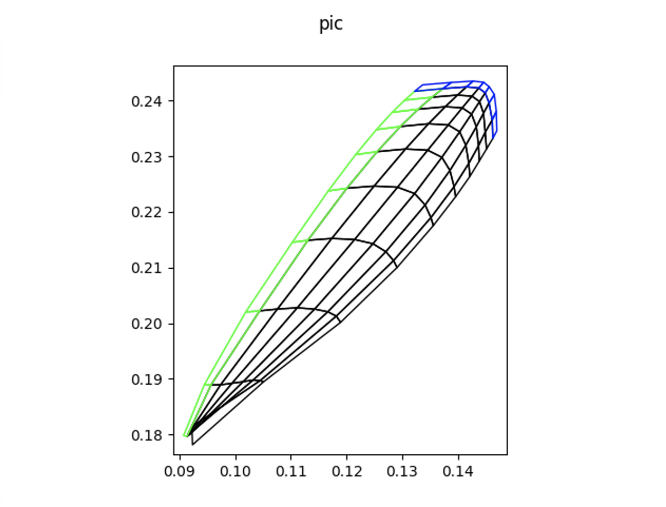
Space-charge – benchmarks and performance
Xsuite allows different kinds of space-charge simulations (frozen, quasi-frozen, Particle In Cell - switching from one to the other is straightforward)
Tested in the realistic case of the full SPS lattice with 540 space-charge interactions
Example of application where the usage of GPUs is practically mandatory
10⁶ particles
32 turns
Comp. time:
CPU 24 h
GPU 9 min
Vertical tune
Horizontal tune
Horizontal tune
Horizontal tune

