Slide 1
MAD-X status: May 2022
R. De Maria for the MAD-X team
Thanks to Laurent Deniau, Ghislain Roy, Guillaume Simon, Tobias Persson, Joshua Dilly, Gianni Iadarola, Leon Van Riesen-Haupt, Scot Berg, T. Glasse, Tessa Charles, Jacqueline Keintzel‎, A. Latina

Slide 2
MAD-X Status 2022-04-27
Last release: MAD-X 5.08.01, cpymad v1.9.3 (Versioning scheme: major.minor.bugfix)
Issues: 37 Open (bug: 19, documentation: 8, enhancement: 10)
  PTC related: bug: 1, documentation:2, enchantment: 1
Pull requests: 2 , Active branches: 1
Failing tests: from 0 to 13 depending on the compiler/OS

Slide 3
Simplification of issue labelling
Issues that can be closed by a pull request or a “closing” label:
  bug: the behaviour is not documented and should be fixed in the code.
  documentation: the behaviour is not documented and should be fixed in the documentation.
  enhancement: the behaviour should be changed in the code sometime
Closing labels:
  notanissue: it is not an issue for us
  wontfix: it is an issue, but cannot be addressed in a foreseeable future
Information labels:
PTC: related to PTC or MAD-X PTC interface
Other issue types made sense but deleted in Github to simplify the management:
Invalid or duplicated issues will be deleted
Questions or information issues would be converted in “discussions” since it is now available in GitHub.

Slide 4
Activity: 2022 Jan - May
Closed issues:
Arctan2 function in MAD-X enhancement wontfix#1097 by rdemaria was closed 33 minutes ago
Inconsistent treatment of +- enhancement wontfix#1092 by bjlindst was closed 33 minutes ago
One-turn map R symplectic deviation: 0.152312E-11 warning notanissue#1089 by zhuruihu was closed on Mar 16
Misalignment of thin dipole (multipole) enhancement wontfix#872 by tpersson was closed on Apr 4
Proposal for tests and changes in the MADX code enhancement wontfix#172 by coldfix was closed on Apr 4
Add2expr creates a working, illegal expression bug wontfix#1103 by mihofer was closed on May 4

Slide 5
Activity: 2022 Jan - May
Closed Pull Request:
Fix potential buffer overrun when node_name calls stoupper #1108 by jsberg-bnl
WIP: Stabilize tests #1107 by rdemaria
Clean tspa io and some fixes #1095 by ldeniau
Userguide: Additional info about bv flag#1088
Small typo in the manual #1086 by tpersson was merged on Mar 23
version bump #1083 by rdemaria was merged on Feb 25
fix rad damping multipole #1079 by rdemaria was merged on Feb 25
Fixes to exact drift when pt is large and beta << 1 #1077 by tpersson was merged on Feb 25
Fixes a bug in the dqmin calculation. #1075 by tpersson was merged on Feb 2
Allows disabling the scaling of TWISS in PTC by default but possible to activate it. #1073 by tpersson was merged on Feb 25
Fixing of lxplus tests2022 #1071 by tpersson was merged on Jan 12
Fix in Dynap and some lxplus tests #1070 by tpersson was merged on Jan 12
For the release. #1069 by tpersson was merged on Jan 12
Fix nmul and some tests #1068 by tpersson was merged on Jan 10

Slide 6
MAD-X to do for next bugfix release
Preserve ordering of thin elements placed in the same location in a sequence enhancement#1055 opened on Nov 26, 2021 by rdemaria 5.07.02
twiss energy loss does not take the gamma of the closed orbit correctly into accout. bug#1098 opened 20 days ago by rdemaria 5.07.02
Add reference on W documentation#1096 opened 26 days ago by rdemaria 5.07.02
Issue #866 persists in MAD-X 5.08.01 bug#1087 opened on Mar 9 by roman-martin 5.07.02
test failures, probably roundoff, Arch Linux (gcc-11.2/glibc-2.35) bug#1085 opened on Mar 1 by jsberg-bnl 5.07.02
Should be done within 2022

Slide 7
MAD-X to do for next minor release
Urgent fixes FCC related:
issue with radiation of multipoles in track and emit bug#1082 opened on Feb 25 by rdemaria 5.08
adding ktap on additional elements enhancement#1081 opened on Feb 22 by rdemaria 5.08
equilibrium emittance for tilted solenoid bug#1101 opened Apr 27 by rdemaria 5.08
Synchrotron integrals:
synchrotron radiation integrals zero with thin sequence bug#1074 opened on Jan 21 by skostogl 5.08
Synchrotron radiation integrals with dipoles tilted by 90 degrees bug#1011 opened on Apr 30, 2021 by kandre2 5.08
Tracking issues
Enable sextupole elements in tracking enhancement#1054 opened on Nov 26, 2021 by rdemaria 5.08
Track substracted wrong close orbit for other observer points then the start bug#948 opened on Aug 20, 2020 by tpersson 5.08
Aperture and layout modelling
Consider to add or replace an alternative octagon shape definition enhancement#1056 opened on Nov 26, 2021 by rdemaria 5.08
Intentional misalignment enhancement#953 opened on Sep 20, 2020 by tpersson 5.08
Other issues:
[MAKETHIN] Using K0L (when defined) over ANGLE when MAKEDIPEDGE = TRUE bug#1076 opened on Jan 31 by GuillaumeRD 5.08
Bug in aperture definition of aper_vx bug#1080 opened on Feb 11 by roman-martin 5.08
Documentation
User's Guide issue bug documentation#1037 opened on Oct 27, 2021 by ChristopheLannoy 5.08
end markers from makethin in User's guide documentation#1017 opened on May 19, 2021 by bjlindst 5.08
Loss of higher orders in twiss by kill fringe bug#961 opened on Oct 16, 2020 by HelmutCERN 5.08
angle option in multipole not documented and new proposal documentation enhancement
Undocumented quadrupole fringe option documentation PTC#738 opened on Feb 27, 2019 by bogomyag
PTC_TWISS dispersion values don't change depending on TIME flag documentation PTC#728 opened on Feb 14, 2019 by rdemaria
Some could be done in 2022, prioritization needed!!!

Slide 8
Recent developments

Slide 9
References
MAD8 Physics guide: https://cern.ch/mad8/doc/phys_guide.pdf
Still most complete reference. Unpublished, some typos
We are in the process of correcting typos and re-release for MAD-X
For radiationeffects:
J. Jowett Introductory statistical mechanics for electron storage rings
https://doi.org/10.1063/1.36374

Slide 10
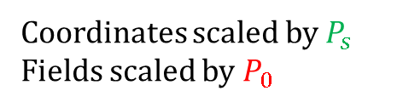
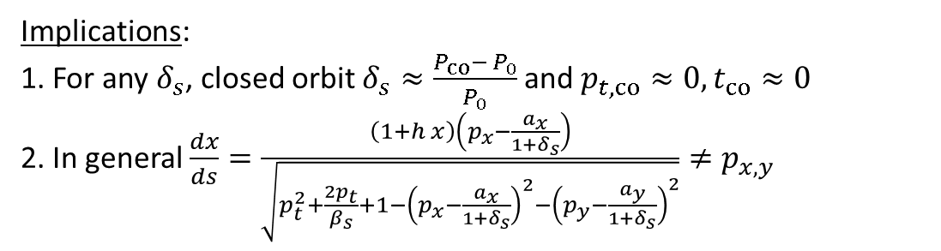
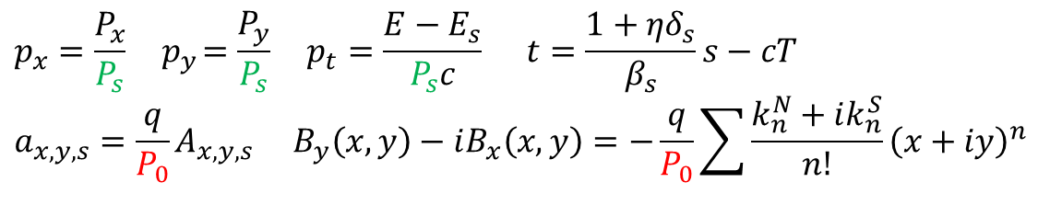

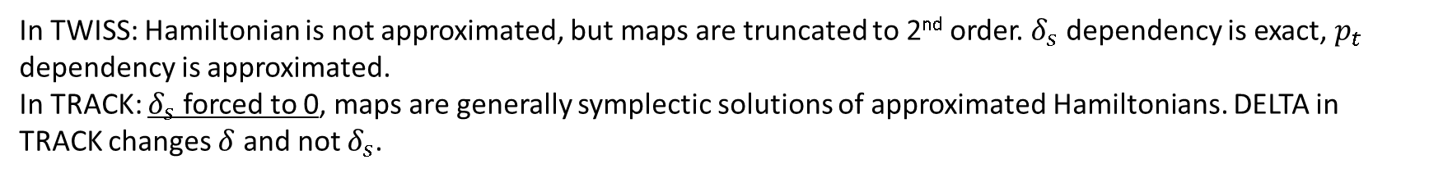
MAD-X variables
DELTA in TWISS command
Physical coordinates: $X, Y, Z, T,P_{x},P_{y},P,E, A_{x},A_{y},A_{s}$, $P_{s}={m_{0}cβ}_{s}γ_{s}=P_{0}(1+δ_{s})$
PC in BEAM command
$$p_{x}=\frac{P_{x}}{P_{s}}{ p}_{y}=\frac{P_{y}}{P_{s}} p_{t}=\frac{E−E_{s}}{P_{s}c} t=\frac{1+{ηδ}_{s}}{β_{s}}s−cT$$
$$a_{x,y,s}={\frac{q}{P_{0}}A}_{x,y,s} B_{y}\left(x,y\right)−iB_{x}\left(x,y\right)=−\frac{q}{P_{0}}\sum{\frac{k_{n}^{N}+ik_{n}^{S}}{n!}{\left(x+iy\right)}^{n}}$$
Coordinates scaled by $P_{s}$
Fields scaled by $P_{0}$
Implications:
1. For any $δ_{s}$, closed orbit $δ_{s}≈\frac{{P_{co}− P}_{0}}{P_{0}}$ and $p_{t,co}≈0, t_{co}≈0$
2. In general $\frac{dx}{ds}=\frac{\left(1+h x\right)\left(p_{x}−\frac{a_{x}}{1+δ_{s}}\right)}{\sqrt{p_{t}^{2}+\frac{2p_{t}}{β_{s}}+1−{\left(p_{x}−\frac{a_{x}}{1+δ_{s}}\right)}^{2}−{\left(p_{y}−\frac{a_{y}}{1+δ_{s}}\right)}^{2}}}≠p_{x,y}$
good to keep approximations in $p_{t}$, $t$ small
Careful when using $p_{x}$,${ p}_{y}$ inside dipoles and solenoids
In TWISS: Hamiltonian is not approximated, but maps are truncated to 2nd order.${ δ}_{s}$dependency is exact, $p_{t}$ dependency is approximated.
In TRACK: $δ_{s}$ forced to 0, maps are generally symplectic solutions of approximated Hamiltonians. DELTA in TRACK changes $δ$ and not $δ_{s}$.

Slide 11
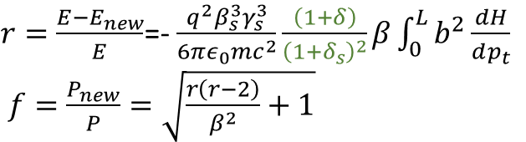

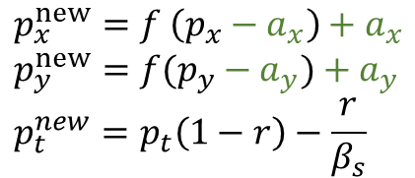

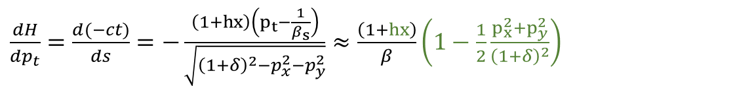

Radiation effect: average power loss
Bp=(sqrt(|B|^2-|B x’e|^2)) ~ Bs x’ (px-ax)/1+delta
Bp=(sqrt(|B|^2-|B.ex x’|^2)) ~ Bs y’
$$−\frac{dE}{dT}=\frac{q^{2}}{6πε_{0}m^{2}c^{3}}\frac{dP^{μ}}{dτ}\frac{dP_{μ}}{dτ}=\frac{2}{3}\frac{r_{q}}{m_{0}c}\frac{dP^{μ}}{dτ}\frac{dP_{μ}}{dτ}$$
For magnetic
fields
$\frac{dP^{μ}}{dτ}\frac{dP_{μ}}{dτ}={\left(qγβcB_{⊥}\right)}^{2}={\left(\frac{PP_{0}b}{m}\right)}^{2}$ where $b=\frac{q}{P_{0}}B_{⊥}$
$$−\frac{dE}{dT}=\frac{q^{2}P_{0}^{2}P^{2}}{6πε_{0}m^{4}c^{3}}b^{2}$$
$$\frac{dp_{t}}{ds}=−\frac{dE}{dT}\frac{dt}{ds}\frac{1}{P_{s}c}=\frac{q^{2}P_{s}^{3}}{6πε_{0}m^{4}c^{5}}\frac{{\left(1+δ\right)}^{2}}{{\left(1+δ_{s}\right)}^{2}}b^{2}\frac{dH}{dp_{t}}=\frac{q^{2}β_{s}^{3}γ_{s}^{3}}{6πε_{0}mc^{2}}\frac{{\left(1+δ\right)}^{2}}{{\left(1+δ_{s}\right)}^{2}}b^{2}\frac{dH}{dp_{t}}$$
In dipoles for instance
$\frac{dH}{dp_{t}}=\frac{d(−ct)}{ds}=−\frac{\left(1+hx\right)\left(p_{t}−\frac{1}{β_{s}}\right)}{\sqrt{{\left(1+δ\right)}^{2}−p_{x}^{2}−p_{y}^{2}}}≈\frac{\left(1+hx\right)}{β}\left(1−\frac{1}{2}\frac{p_{x}^{2}+p_{y}^{2}}{{\left(1+δ\right)}^{2}}\right)$
Sometimes missing in the code
The energy is lost in the direction of the momentum of particle and not the canonical momentum:
In MAD-X we calculate
$r=\frac{{E−E}_{new}}{E}$=- $\frac{q^{2}β_{s}^{3}γ_{s}^{3}}{6πε_{0}mc^{2}}\frac{\left(1+δ\right)}{{\left(1+δ_{s}\right)}^{2}}β\int_{0}^{L}{b^{2}\frac{dH}{dp_{t}}}$
$f=\frac{P_{new}}{P}=\sqrt{\frac{r\left(r−2\right)}{β^{2}}+1}$
$p_{x}^{new}=f \left(p_{x}−a_{x}\right)+a_{x}$
$$p_{y}^{new}=f(p_{y}−a_{y})+a_{y}$$
$$p_{t}^{new}=p_{t}\left(1−r\right)−\frac{r}{β_{s}}$$

Slide 12
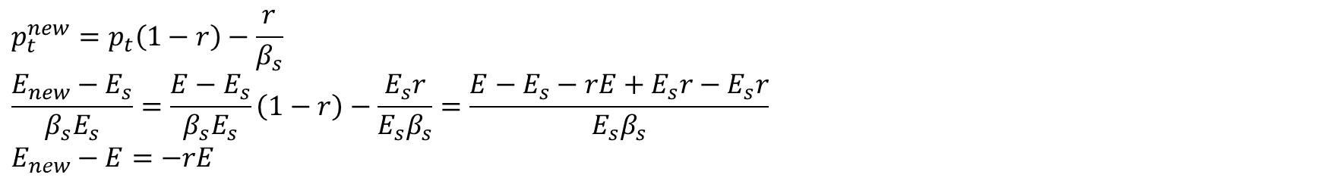
MAD-X: useful relations
$$p_{t}^{new}=p_{t}\left(1−r\right)−\frac{r}{β_{s}}$$
$$\frac{E_{new}−E_{s}}{β_{s}E_{s}}=\frac{E−E_{s}}{β_{s}E_{s}}\left(1−r\right)−\frac{E_{s}r}{{E_{s}β}_{s}}=\frac{E−E_{s}−rE+E_{s}r−E_{s}r}{{E_{s}β}_{s}}$$
$$E_{new}−E=−rE$$
$f=\sqrt{\frac{r\left(r−2\right)}{β^{2}}+1}=$ $\sqrt{\frac{\left(E−E_{new}\right)(−E−E_{new}) }{{E^{2}β}^{2}}+1}=\frac{\sqrt{E_{new}^{2}−E^{2}+{Pc}^{2}}}{Pc}=\frac{P_{new}}{P}$

Slide 13
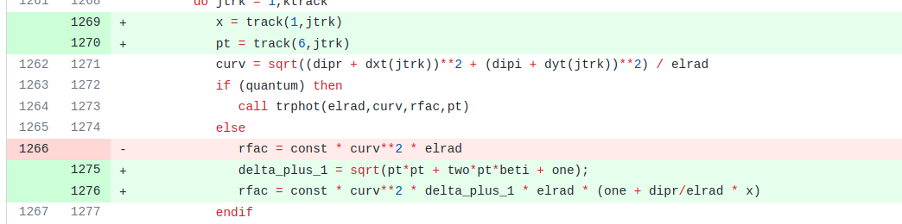
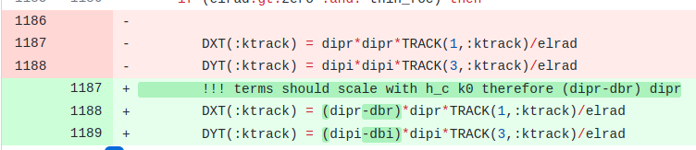

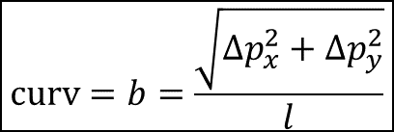
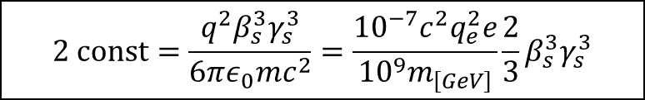

Fixes in track
$\frac{1}{4πε_{0}}=1.00000000055(15) {10}^{−7}c^{2}$(since 2019)
https://github.com/MethodicalAcceleratorDesign/MAD-X/pull/1079
$$2 const=\frac{q^{2}β_{s}^{3}γ_{s}^{3}}{6πε_{0}mc^{2}}=\frac{{10}^{−7}c^{2}q_{e}^{2}e}{{10}^{9}m_{\left[GeV\right]}}\frac{2}{3}β_{s}^{3}γ_{s}^{3}$$
arad=ten_m_16*charge*charge*get_variable("qelect")*clight*clight/mass;
$$curv=b=\frac{\sqrt{Δp_{x}^{2}+Δp_{y}^{2}}}{l}$$
Missing $\left(1+δ\right)\left(1+hx\right)$ dependence
Not directly related to radiation damping but still need fix when k0l different from angle

Slide 14
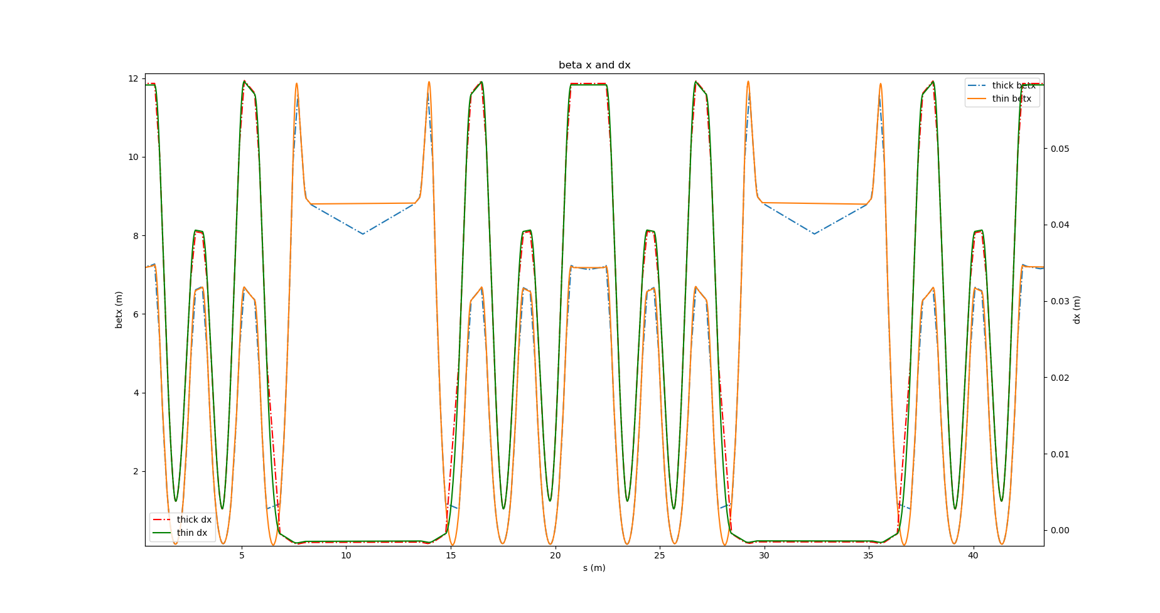
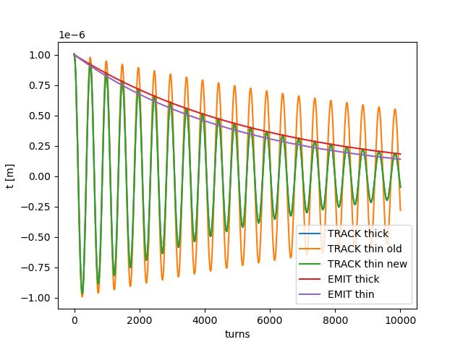
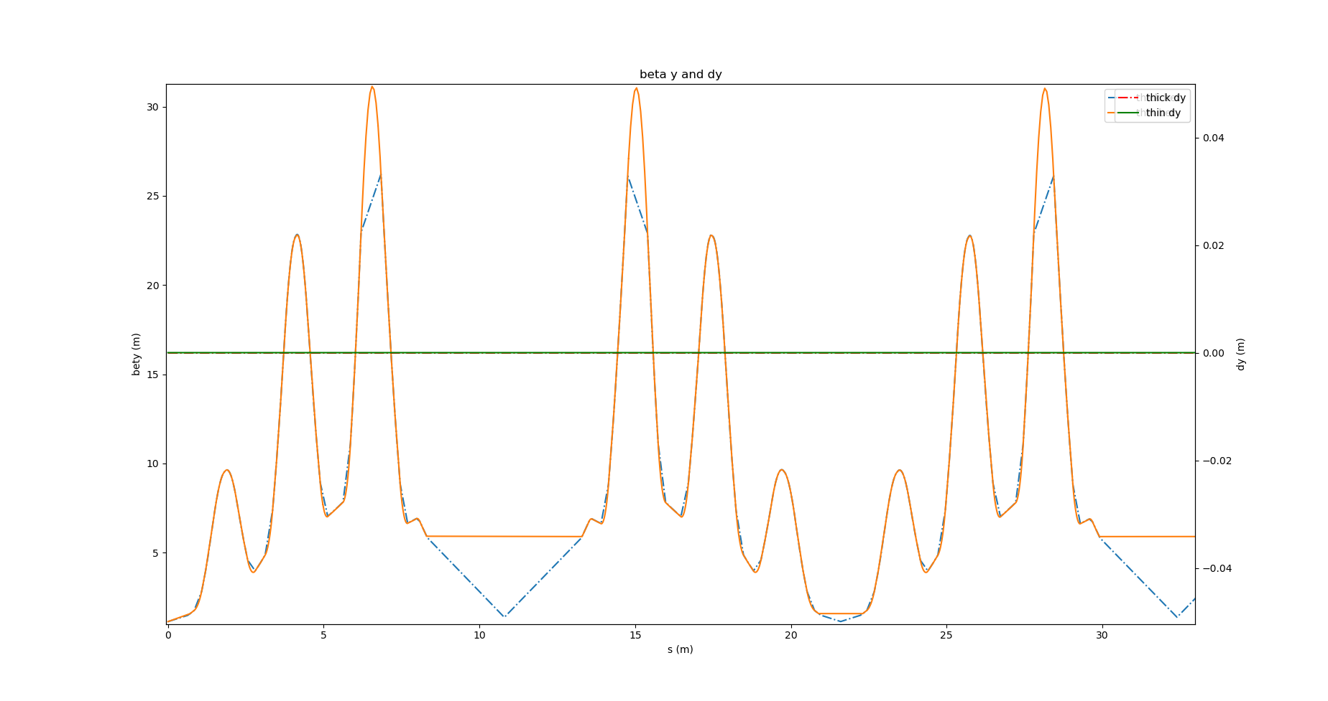
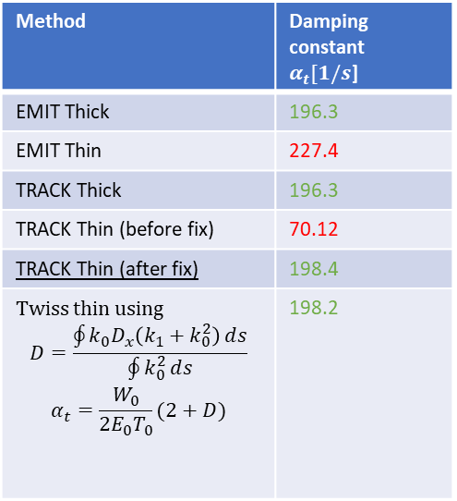

Damping times of Electra lattice
Taking Electra lattice as an example of small lattice with few cavities
Method | Damping constant $α_{t}[1/s$]
EMIT Thick | 196.3
EMIT Thin | 227.4
TRACK Thick | 196.3
TRACK Thin (before fix) | 70.12
TRACK Thin (after fix) | 198.4
Twiss thin using $$D=\frac{\oint{k_{0}D_{x}\left(k_{1}+k_{0}^{2}\right)}ⅆs}{\oint{k_{0}^{2}}ⅆs}$$ $$α_{t}=\frac{W_{0}}{2E_{0}T_{0}}(2+D)$$ | 198.2
$$t[turns]=t_{0}e^{−α_{t}{ T}_{0} turns}$$
NB. EMIT thick and thin gives the same T₀ and W₀

Slide 15
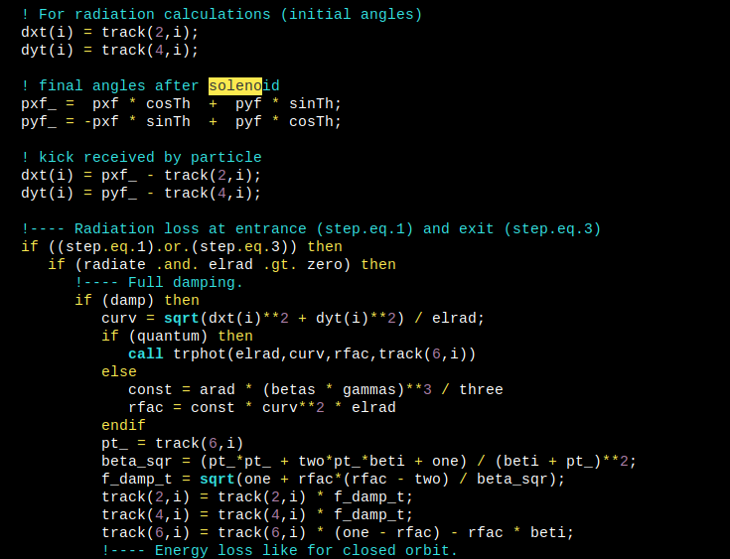














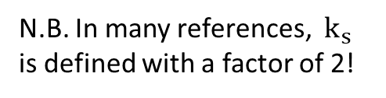
Solenoid
Track
N.B. In many references, $k_{s}$ is defined with a factor of 2!
$$A_{x}=−\frac{1}{2}B_{s}y A_{y}=\frac{1}{2}B_{s}\text{x}$$
Exit Fringe
$$Δx^{′}=−\frac{k_{s}}{2}y Δp_{x}=0$$
$$Δy=\frac{k_{s}}{2}x Δp_{y}=0$$
Entry Fringe
$$Δx^{′}=\frac{k_{s}}{2}y Δp_{x}=0$$
$$Δy=−\frac{k_{s}}{2}x Δp_{y}=0$$
$B_{x}=−\frac{B_{s}x}{2Δs}$
$B_{y}=−\frac{B_{s}y}{2Δs}$
$B_{x}=\frac{B_{s}x}{2Δs}$
$B_{y}=\frac{B_{s}y}{2Δs}$
$k_{s}=\frac{qB_{s}}{P_{0}}$
$$Δs$$
$$B_{s}$$
$$x^{′}$$
$$B_{s}$$
$$x^{′}\left(s\right)=\frac{p_{x}−a_{x}}{1+δ}$$
$$y^{′}\left(s\right)=\frac{p_{y}−a_{y}}{1+δ}$$
$$B_{⊥}$$
$$B_{∥}$$
EMIT

Slide 16
Back-up

Slide 17
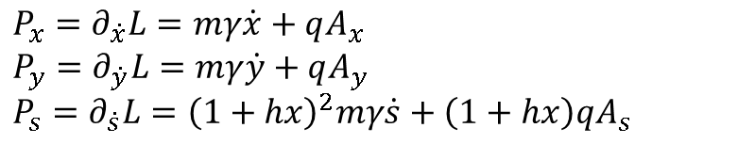
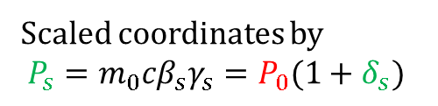



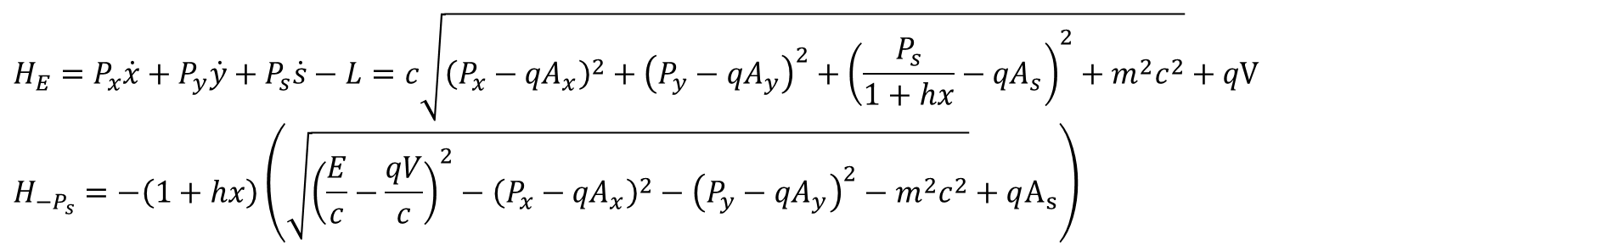
Variables and Hamiltonian
$$L=−\frac{mc^{2}}{γ}+q\dot{R}∙A−qV$$
$$R\left(s\right)=R_{0}\left(s\right)+x\left(s\right)e_{x}\left(s\right)+y\left(s\right)e_{y}\left(s\right)$$
For piecewise constant curvatures!
$$P_{x}=∂_{\dot{x}}L=mγ\dot{x}+qA_{x}$$
$$P_{y}=∂_{\dot{y}}L=mγ\dot{y}+qA_{y}$$
$$P_{s}=∂_{\dot{s}}L={\left(1+hx\right)}^{2}mγ\dot{s}+\left(1+hx\right)qA_{s}$$
$$\dot{R}=\dot{s}\left(1+hx\right)e_{s}+\dot{x}e_{x}+\dot{y}e_{y}$$
$$H_{E}=P_{x}\dot{x}+P_{y}\dot{y}+P_{s}\dot{s}−L=c\sqrt{{\left(P_{x}−{qA}_{x}\right)}^{2}+{\left(P_{y}−{qA}_{y}\right)}^{2}+{{\left(\frac{P_{s}}{1+hx}−{qA}_{s}\right)}^{2}+m}^{2}c^{2}}+qV$$
$$H_{{−P}_{s}}=−\left(1+hx\right)\left(\sqrt{{\left(\frac{E}{c}−\frac{qV}{c}\right)}^{2}−{\left(P_{x}−{qA}_{x}\right)}^{2}−{\left(P_{y}−{qA}_{y}\right)}^{2}−m^{2}c^{2}}+qA_{s}\right)$$
Scaled coordinates by
$P_{s}={m_{0}cβ}_{s}γ_{s}=P_{0}(1+δ_{s})$
$$p_{x}=\frac{P_{x}}{P_{s}}{ p}_{y}=\frac{P_{y}}{P_{s}} p_{t}=\frac{E−E_{s}}{P_{s}c} t=\frac{1+{ηδ}_{s}}{β_{s}}s−cT { a}_{x,y,s}={\frac{q}{P_{0}}A}_{x,y,s}$$
$$H=\frac{1+{ηδ}_{s}}{β_{s}}p_{t}−\left(1+hx\right)\sqrt{p_{t}^{2}−\frac{2p_{t}}{β_{s}}+1 −{\left(p_{x}−\frac{a_{x}}{1+δ_{s}}\right)}^{2}−{\left(p_{y}−\frac{a_{y}}{1+δ_{s}}\right)}^{2}}−\frac{\left(1+hx\right)a_{s}}{1+δ_{s}}$$

Slide 18
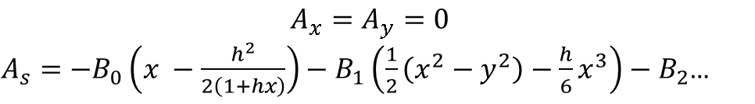
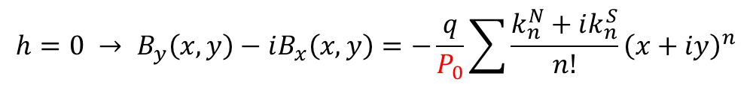
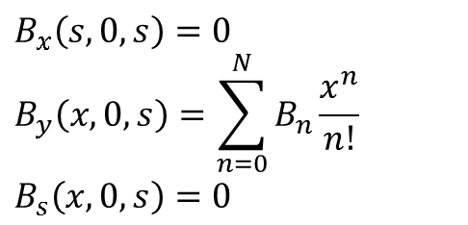
Magnetostatic
$$B_{x}\left(s,0,s\right)=0$$
$$B_{y}\left(x,0,s\right)=\sum_{n=0}^{N}{B_{n}\frac{x^{n}}{n!} }$$
$$B_{s}\left(x,0,s\right)=0$$
$$A_{x}=A_{y}=0$$
$A_{s}=−B_{0}\left(x −\frac{h^{2}}{2\left(1+hx\right)}\right)−B_{1}\left(\frac{1}{2}\left(x^{2}−y^{2}\right)−\frac{h}{6}x^{3}\right)−B_{2}$…
$$h=0 → B_{y}\left(x,y\right)−iB_{x}\left(x,y\right)=−\frac{q}{P_{0}}\sum{\frac{k_{n}^{N}+ik_{n}^{S}}{n!}{\left(x+iy\right)}^{n}}$$

Slide 19
Follow-up
Fix multipoles in EMIT
Test random fluctuations with multipoles and equilibrium emittances
Test tapering with multipoles (waiting for Ghislain to push implementations)
Test solenoid
Collect field map and implement sequence with slicing

Slide 20
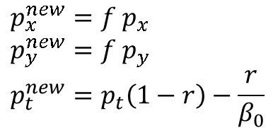
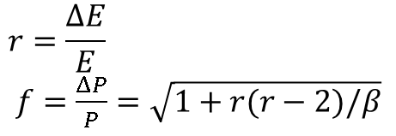
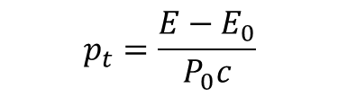



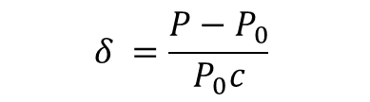
Multipole maps
General equation for average energy loss
$$−\frac{dE}{dt}=\frac{2}{3}\frac{r_{e}}{m_{0}c}\frac{dP^{μ}}{dτ}\frac{dP_{μ}}{dτ}$$
$$r_{e}=\frac{e^{2}}{m_{0}c^{2}}$$
with
With $\frac{dP_{μ}}{dτ}=γe\left(0,v×B\right)=\frac{e}{m_{0}c}(0,P×B)$ we get$−\frac{dE}{dt}=\frac{2}{3}\frac{{e^{2}r}_{e}P^{2}}{{\left(m_{0}c\right)}^{3}}B^{2}$
Integrating on the integration length $l(1+hx )$with the integrated multipole kick $Δp=\sqrt{Δp_{x}^{2}+Δp_{y}^{2}}$ we get:
$$−ΔE=\frac{2}{3}\frac{{e^{2}r}_{e}P^{2}P_{0}^{2}}{{\left(m_{0}c\right)}^{3}}{\left(\frac{Δp}{l}\right)}^{2}\frac{l\left(1+hx\right)}{βc}=\frac{2}{3}\frac{{e^{2}r}_{e}E P_{0}^{3}\left(1+δ\right)}{c{\left(m_{0}c\right)}^{3}}{\left(\frac{Δp}{l}\right)}^{2}l\left(1+hx\right)$$
$$δ =\frac{P−P_{0}}{P_{0}c}$$
$$p_{t}=\frac{E−E_{0}}{P_{0}c}$$
$$p_{x}=\frac{P_{x}}{P_{0}} p_{x}=\frac{P_{y}}{P_{0}}$$
with
$$r=\frac{ΔE}{E}$$
$f=\frac{ΔP}{P}=\sqrt{1+r(r−2)/β}$
$$p_{x}^{new}=f p_{x}$$
$$p_{y}^{new}=f p_{y}$$
$$p_{t}^{new}=p_{t}\left(1−r\right)−\frac{r}{β_{0}}$$
Assuming
then

