Slide 1

MTF for HL-LHC
Hector Garcia Gavela on behalf of the Quality team and WP4
HL-LHC Procurement, Baseline Documentation, Quality & Risk Office

Slide 2
Outline
Item vs Asset;
MIP and MTF;
MTF: Assets, Assemblies and Steps;
Manufacturing Documents;
Handling Nonconformities.

Slide 3
MTF
MTF (Equipment management Folder formerly Manufacturing and Testing Folder) is the dedicated tool for the follow-up of Production/QC activities and the storage of documentation during this phase of the project (All the Manufacturing & Test data).
MTF is an integral part of EDMS. Documents uploaded to MTF will became EDMS doc, documents already in EDMS can be attached to MTF.
Handling and storage of manufacturing and test data (including nonconformities) of the equipment.
MIP (Manufacturing & Inspection Plan) is the main input in order to build the MTF of the equipment.

Slide 4
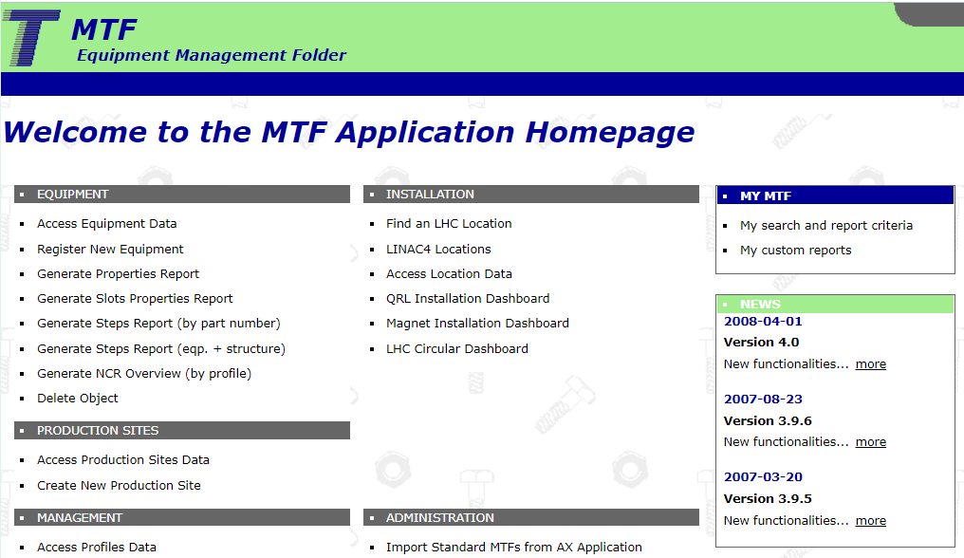
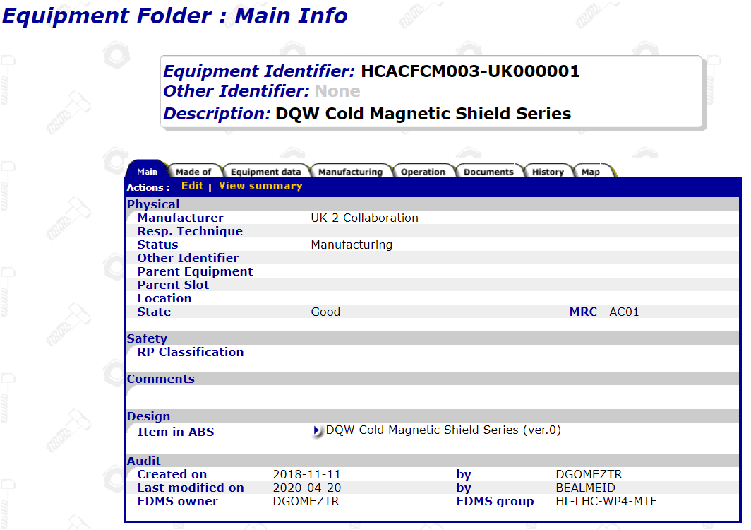
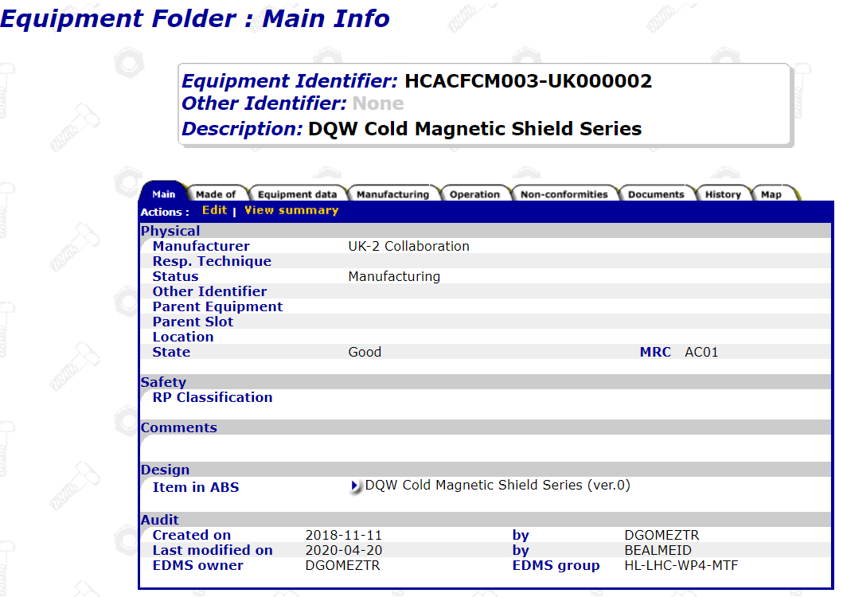
MTF
Link to MTF -
https://edms5.cern.ch/pls/asbuilt/mtf.home?cookie=25019603

Slide 5
Outline
EDMS and MTF;
Item vs Asset;
MIP and MTF;
MTF: Assets, Assemblies and Steps;
Manufacturing Documents;
Handling Nonconformities.

Slide 6




Item vs Asset
Item
The concept;
Associated with technical specifications, drawings, conceptual specification, manufacturing procedures, test procedures;
Everything needed before production.
Asset
The real thing;
Associated with all the manufacturing documentation (e. g. Metrological Reports, Material Certificates, Welds inspection …);
Manufacturing Records.
One item can have one or more assets!

Slide 7
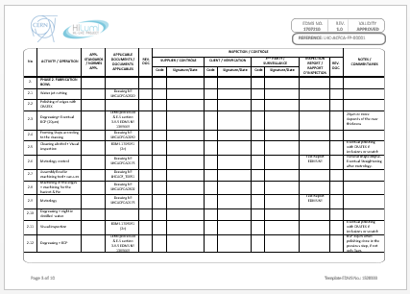
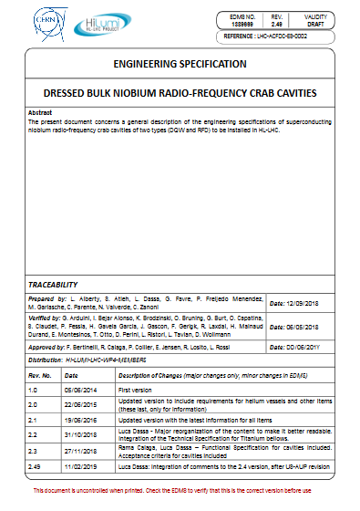
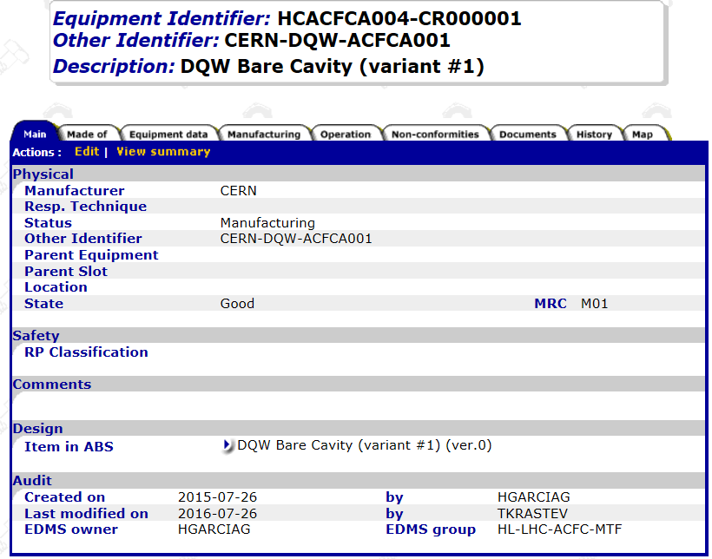
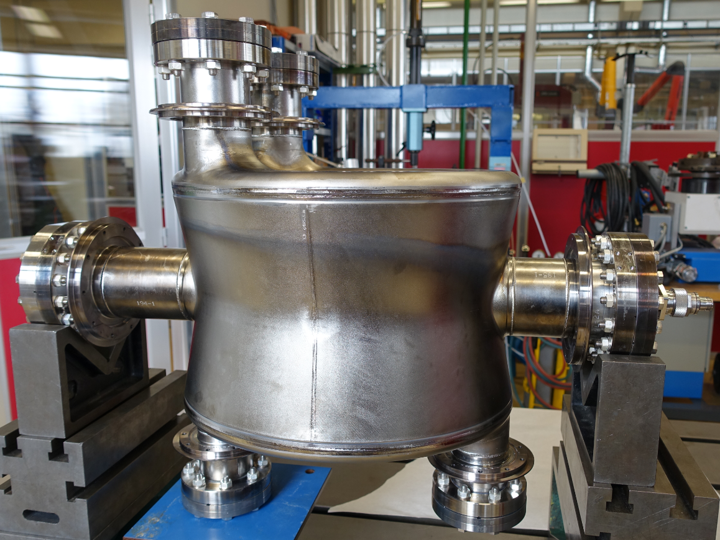
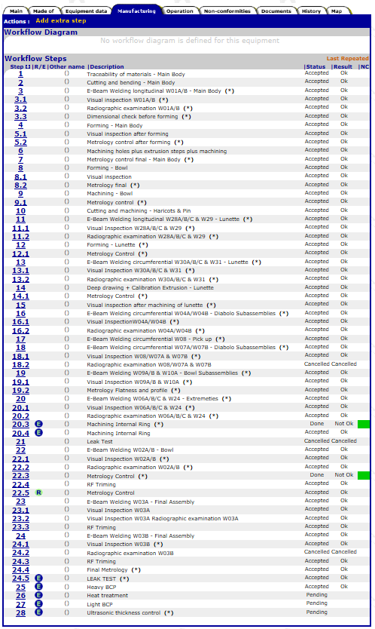
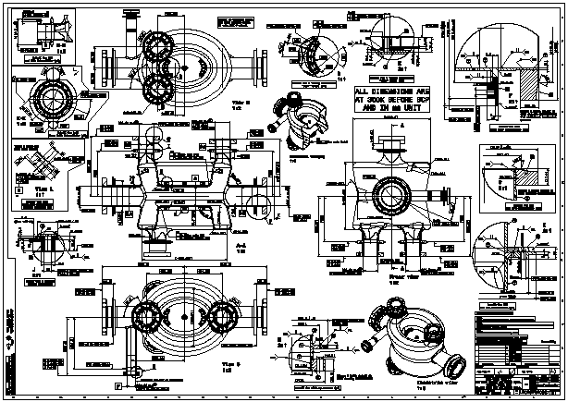
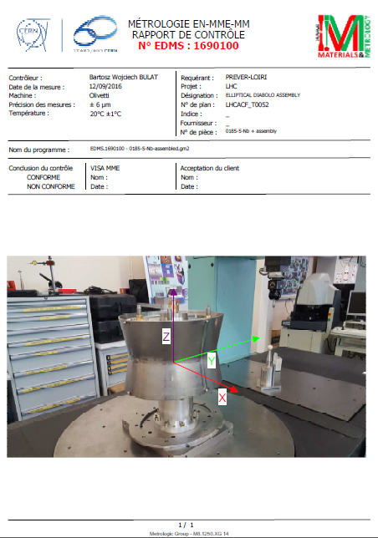
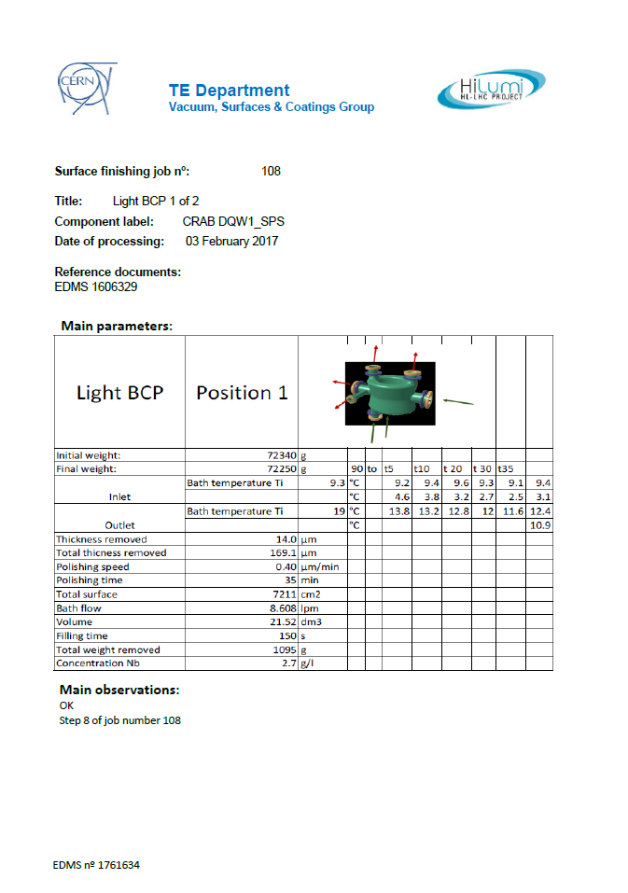
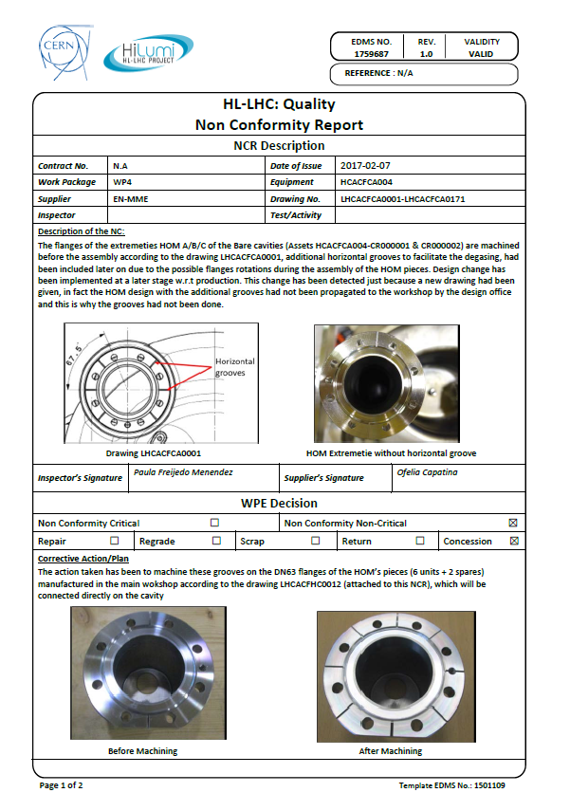
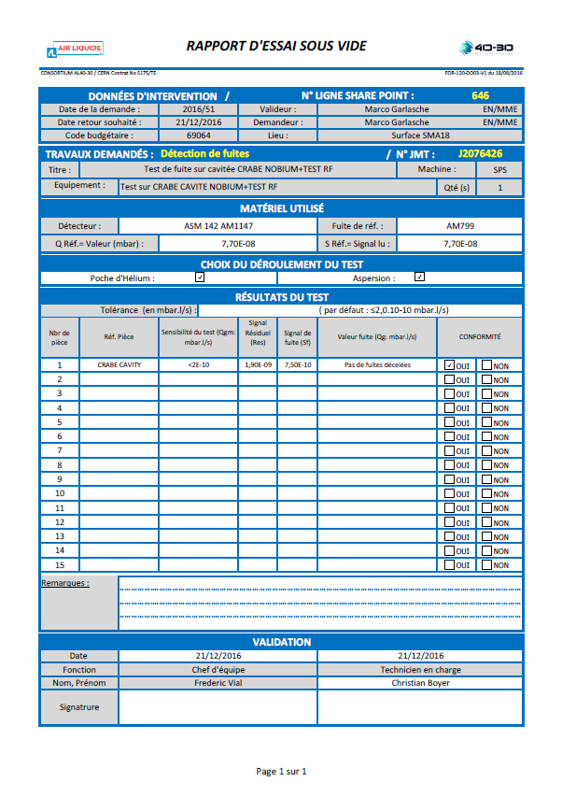
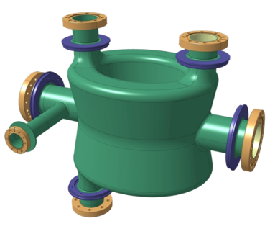
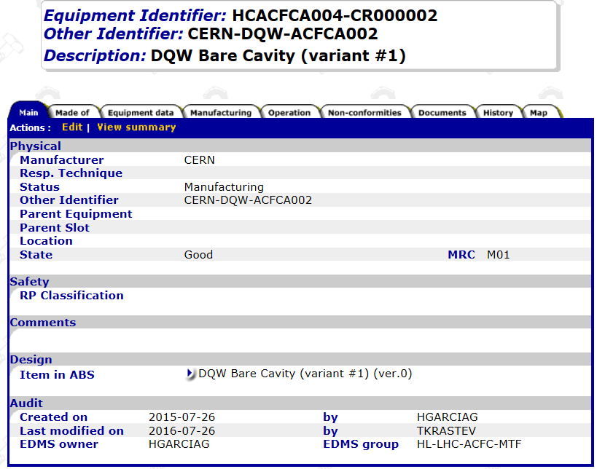
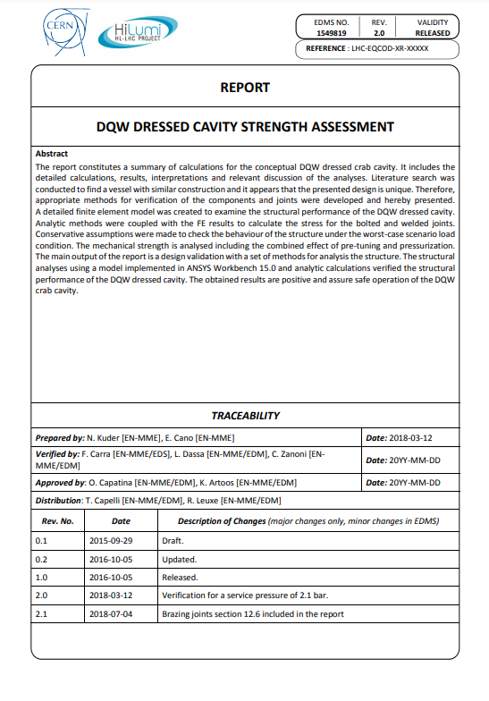
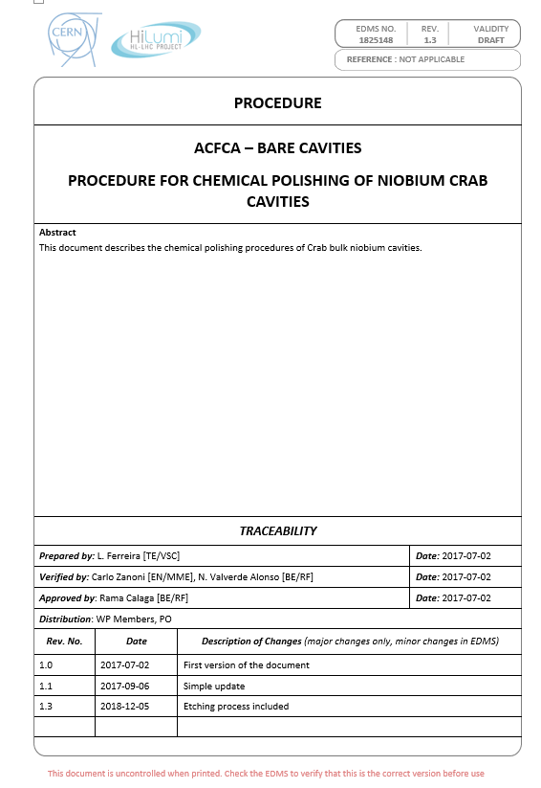
MIP as the basis of MTF Set up
ITEM
ASSET (S)

Slide 8
Outline
EDMS and MTF;
Item vs Asset;
MIP and MTF;
MTF Assets and Assemblies, Steps;
Manufacturing Documents;
Handling Nonconformities.
Notes:
Talking now about the relation between MIP and MTF

Slide 9
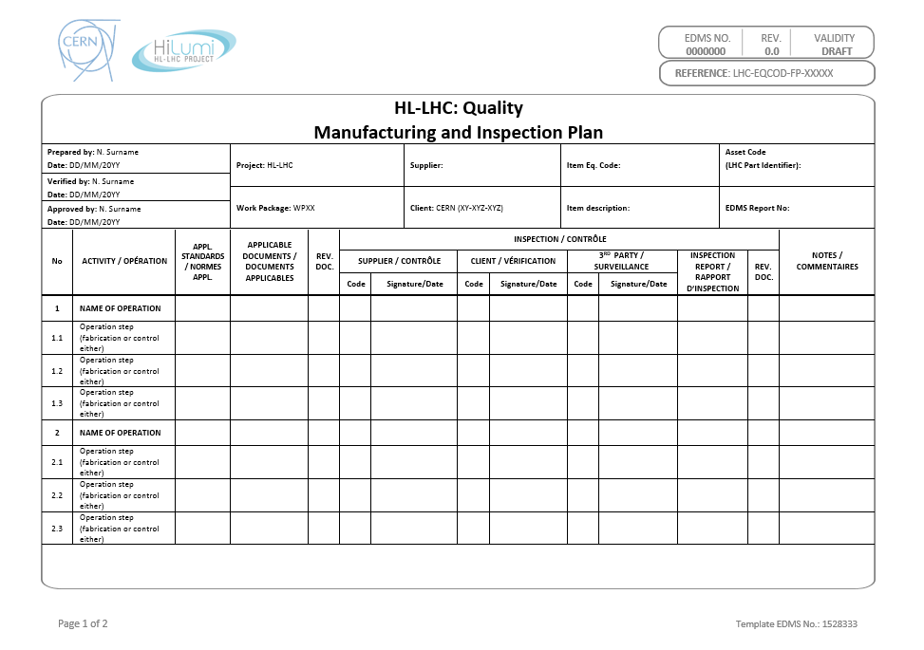
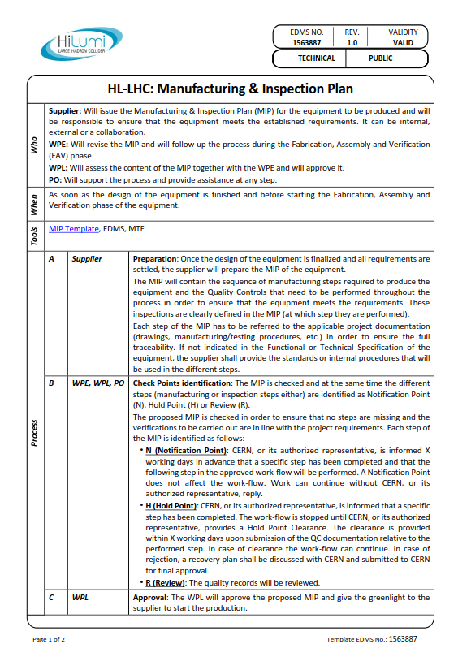
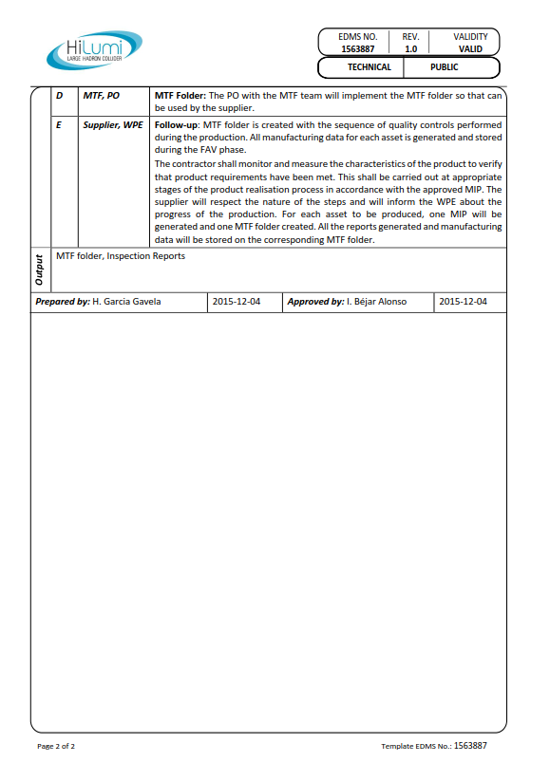
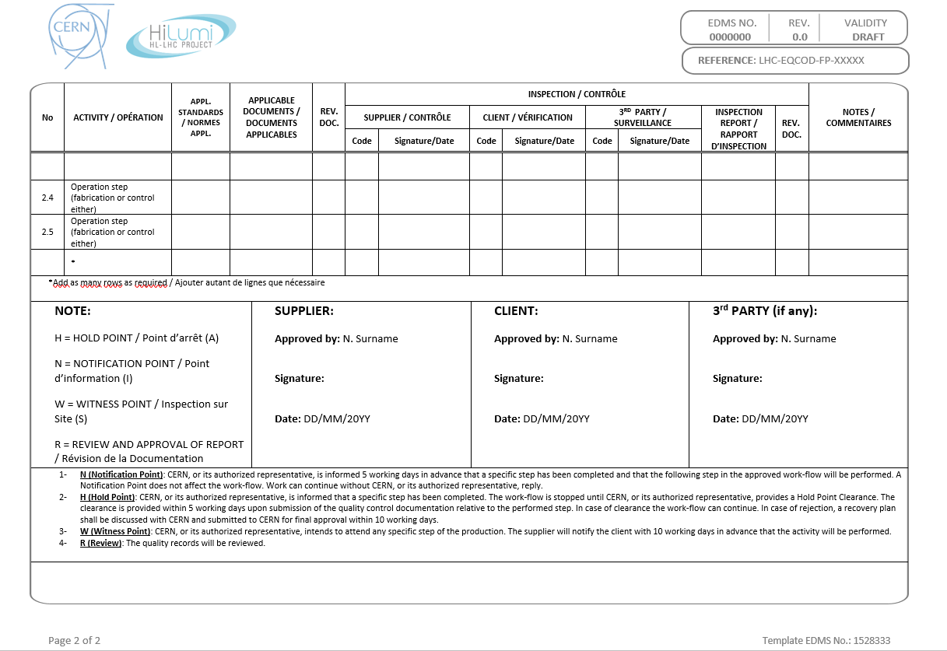
Manufacturing Inspection Plan - MIP
Manufacturing and Inspection Plan
PROCEDURE: 1563887
TEMPLATE: 1528333

Slide 10
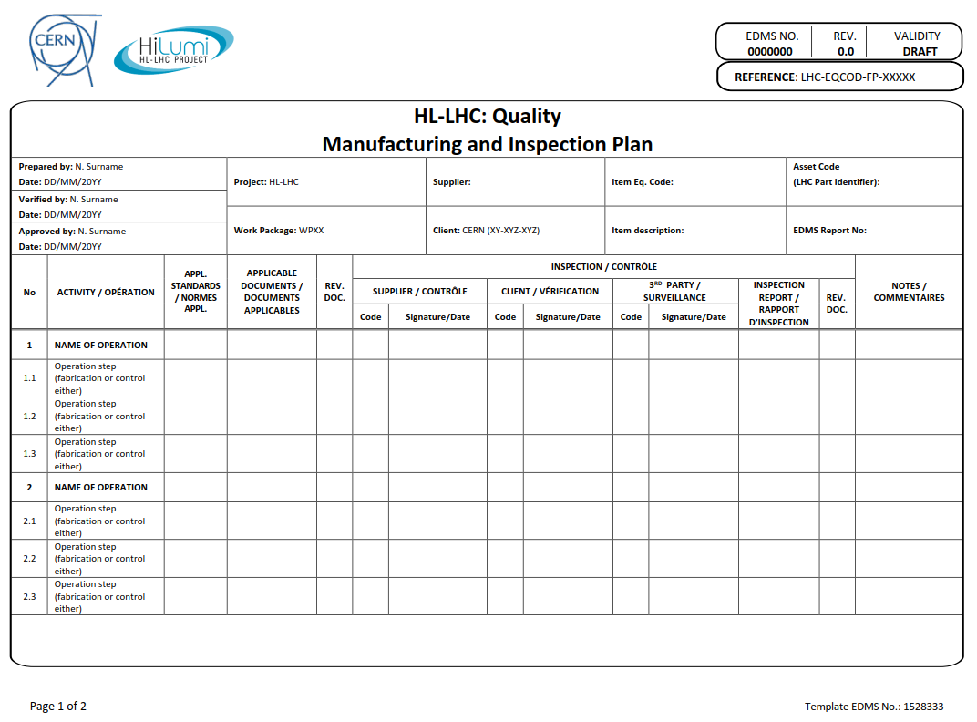
Manufacturing Inspection Plan - MIP
Verification and approval following HL-LHC documentation approval process.
Sequence of required steps to manufacture the equipment (both fabrication and QC activities).
Applicable documentation which supports the related activity such as drawings, procedures, standards, guidelines, acceptance criteria, checklists, etc.
Codification of the activity by the client (see next slide)

Slide 11
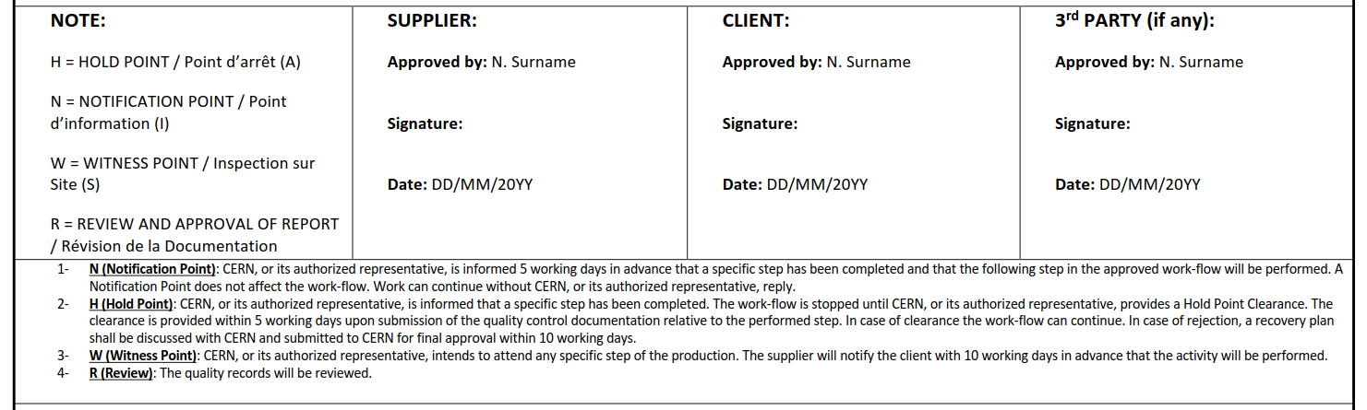
Manufacturing Inspection Plan - MIP
The different activities will be categorized by the client during the verification and approval process. The assigned categories shall be respected along the process (N, H, W, R or a combination of those).
We can set these categories on MTF. Since parallel activities are not allowed in the platform, it is not recommended to stop the workflow. Therefore, we can at least indicate the activity code in the name of the activity as per the MIP.

Slide 12
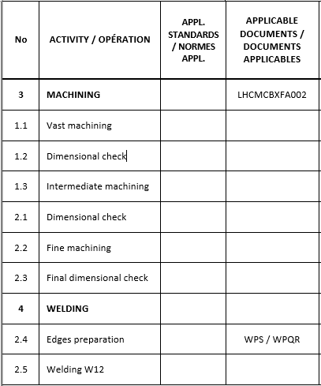

Manufacturing Inspection Plan - MIP
MTF shall be the Electronic MIP (e-MIP). We will extract from the MIP those steps that are relevant for the production and will have documentation associated to build the MTF.
There is no stopper to have the full MIP on MTF, however from practical point of view it is highly recommended to have a MTF Workflow more simplified (easier management).
Intermediate steps are fully necessary to check that requirements are being met but we can just leave the final step, which confirms that requirements are achieved.
Example:
MTF
MIP

Slide 13
Outline
EDMS and MTF;
Item vs Asset;
MIP and MTF;
MTF: Assets, Assemblies, Steps;
Manufacturing Documents;
Handling Nonconformities.

Slide 14
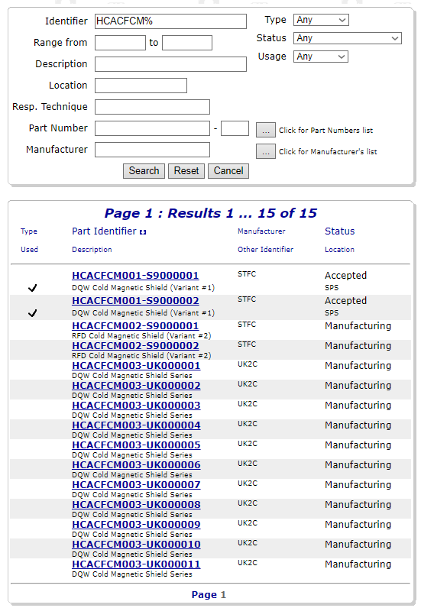
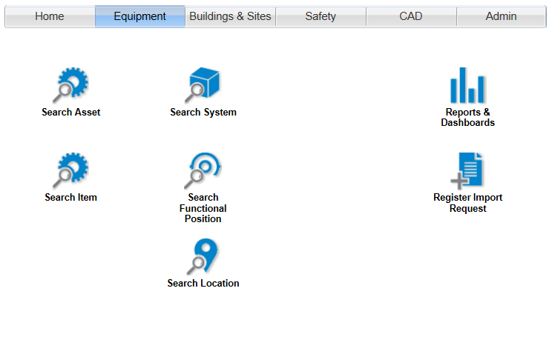
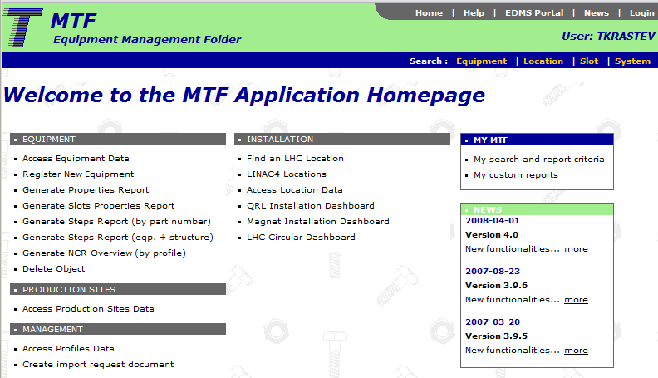
Access to MTF
We may access to the MTF of each asset through EDMS, Equipment Search (1), or directly from MTF Application Homepage (2).
1
2

Slide 15

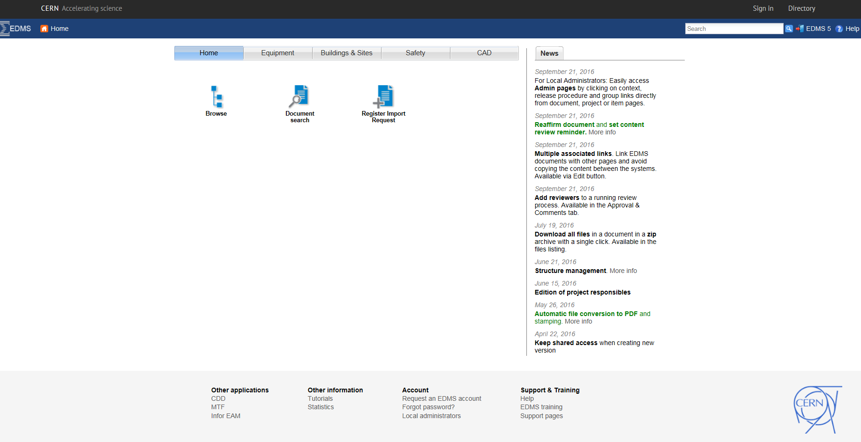
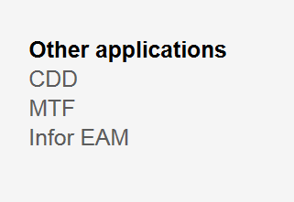
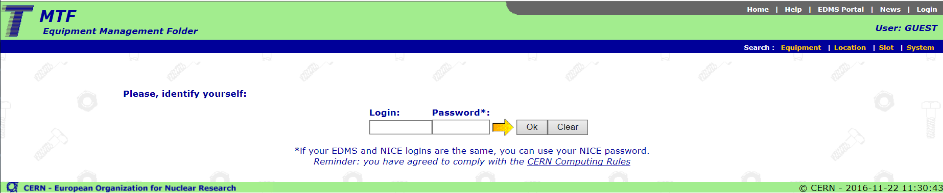
Access to MTF
From EDMS - https://edms.cern.ch/ui/#!master/portal/tab?home
From MTF - https://edms5.cern.ch/asbuilt/plsql/mtf.home?cookie=15935572
MTF can be only used with a CERN Nice Account
Externals to apply for one!

Slide 16
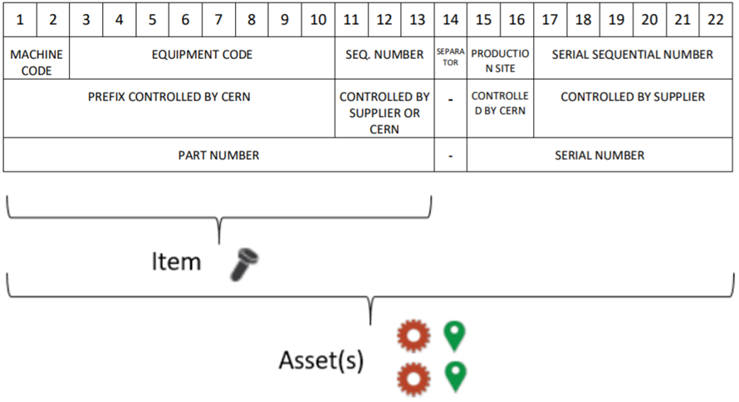
Access to MTF
Items/Assets?
We can see the number of assets (physical entity/ies produced from one design) that belong to an item (conceptual entity).
How we may see the assets?
We introduce the name of the item and therefore we will see the number of assets that will be manufactured from this item.

Slide 17
MTF Assets
Each asset will have its Manufacturing and Testing Folder (MTF), where all documentation/data generated during the FAV & Installation will be stored.
If you have the access rights, you can use the ‘Edit’ button to change the status, manufacturer, state and other information about equipment.

Slide 18
Main information of the asset
Main information of the asset may be found in this tab:
Manufacturer of the equipment
Current Status
Current Location
State
RP Classification
Access rights
Etc.

Slide 19
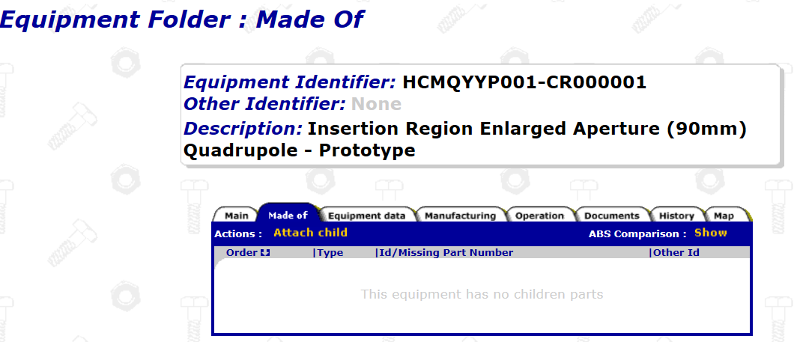
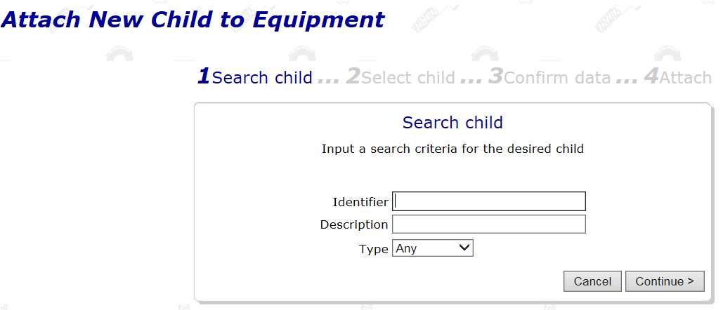
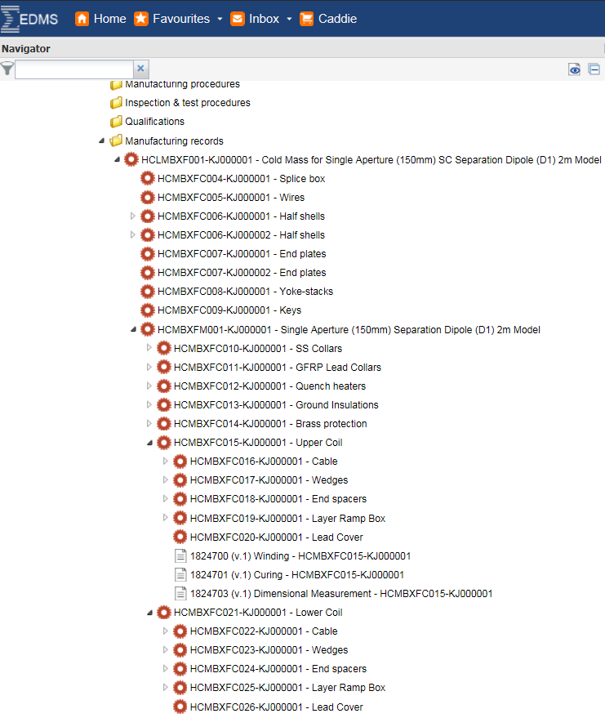
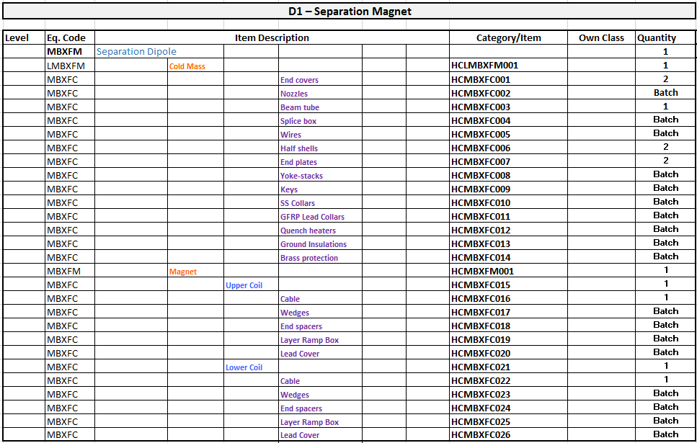
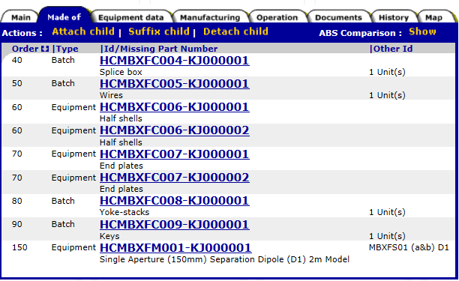
Assembly Breakdown Structure
Assembly Breakdown Structure (ABS)
ABS allows to keep traceability of the components that are used to build the equipment (these components to have their MTF as well)
We just have to attach the ‘child’ (component) that have been previously set up within the system

Slide 20
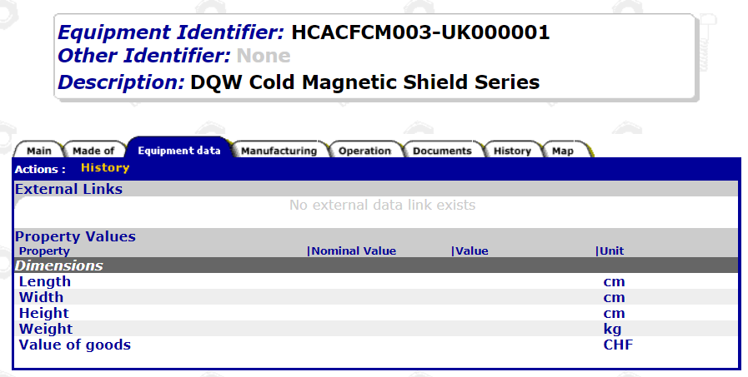
Main information of the equipment
This option will allow us to set the main parameters (nominal values) that will be checked during production (dimensions, mechanical properties, electrical values, magnetic checks, etc.). During the inspection the actual values shall be added (more for performance point of view).

Slide 21
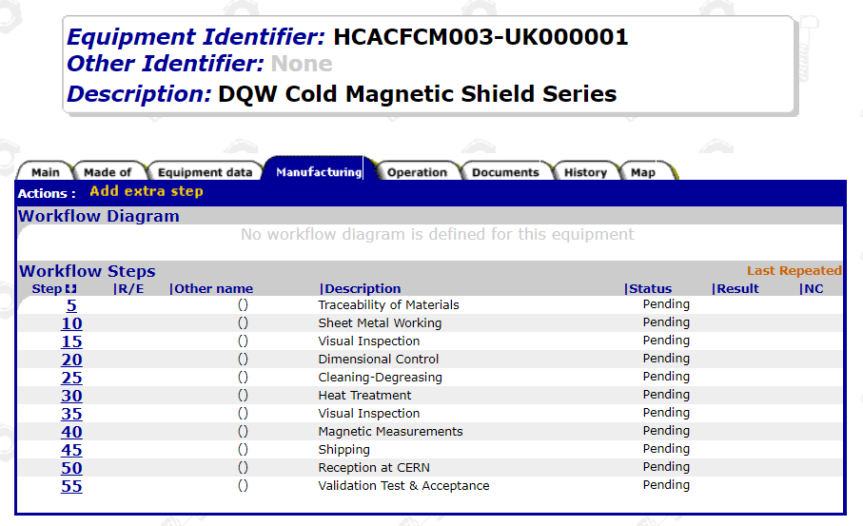
Manufacturing Workflow
Before starting the production, productions steps (manufacturing and QC) to be settled (MIP):
Implementation on MTF;
Feed MTF folder of each asset during the production.

Slide 22
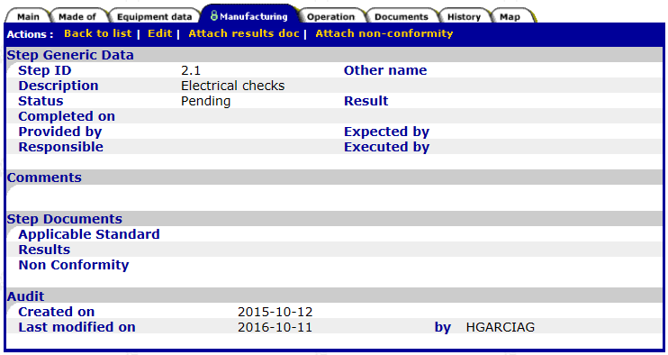
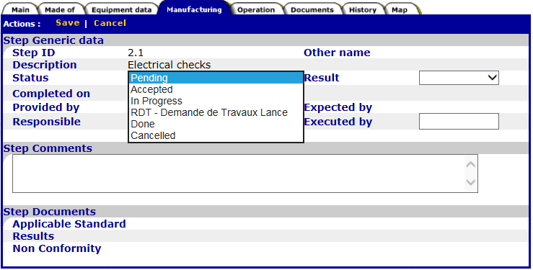
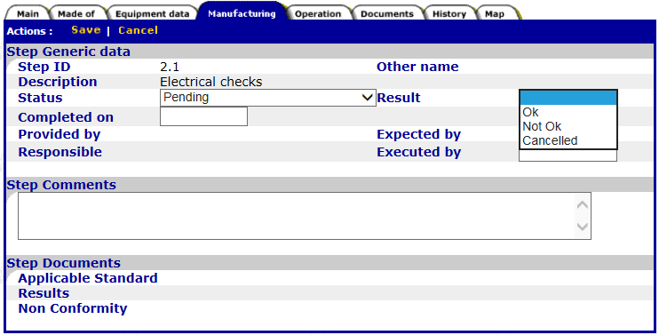
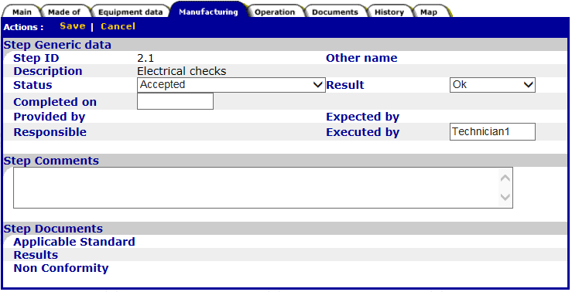
Approval of fabrication steps
Each step to be approved upon completion. We click in the Workflow Step number and then we EDIT to give the acceptance of the step and results OK (if the step would not have been accepted, then in results we select Not OK)
1
2
3
4
Once we finish, do not forget to save!!!!

Slide 23
Outline
EDMS and MTF;
Item vs Asset;
MIP and MTF;
MTF: Assets, Assemblies, Steps;
Manufacturing Documents;
Handling Nonconformities.

Slide 24
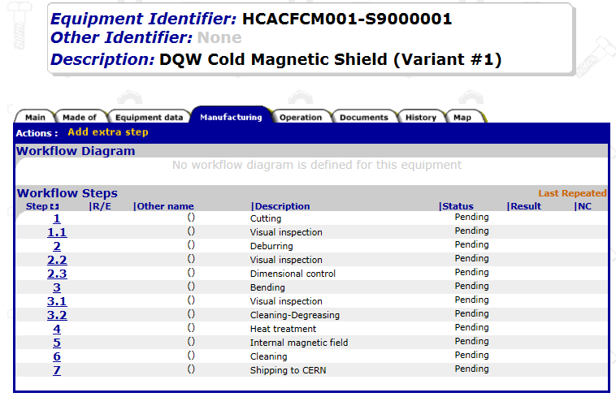
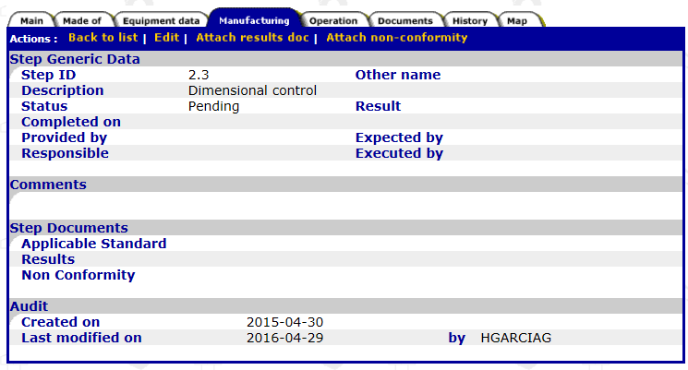
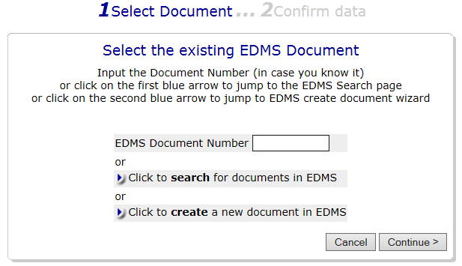
Manufacturing Documentation
Reports and documents related to each step to be attached in the MTF folder of each asset. Documents can be previously uploaded on EDMS or can be attached directly in MTF (if so, EDMS document is created automatically).
The step is approved and the report with results is attached.
If the step is not approved and a Non Conformity is opened, we can also attach it.
Document to attach from EDMS or directly on the step (it will be then automatically created on EDMS).
The document associated to this step of the asset is attached in MTF.
This process is to be repeated for each asset.

Slide 25
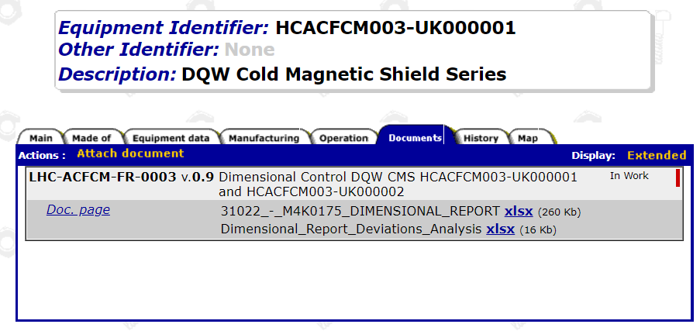
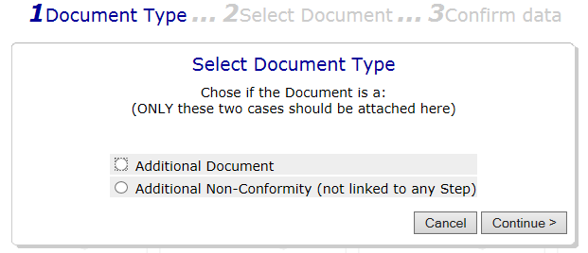
Other documents to be attached
Any other document can be attached to the MTF of the asset:
Material certificates
Manufacturing drawings
MIP
Welding maps
Etc.

Slide 26
Outline
EDMS and MTF;
Item vs Asset;
MIP and MTF;
MTF: Assets, Assemblies, Steps;
Manufacturing Documents;
Handling Nonconformities.

Slide 27
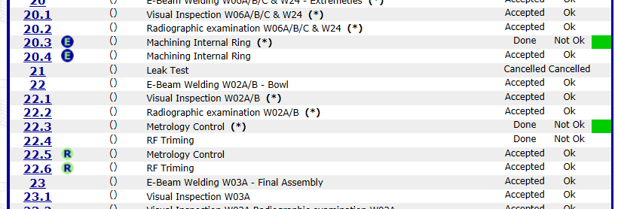
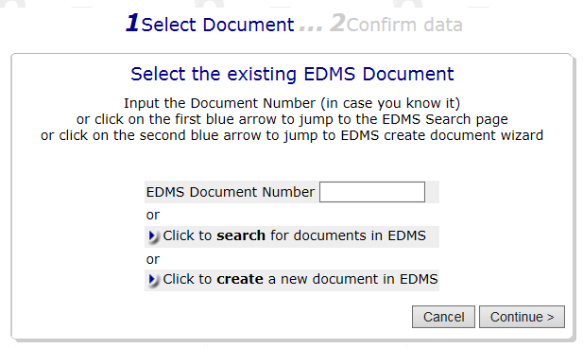
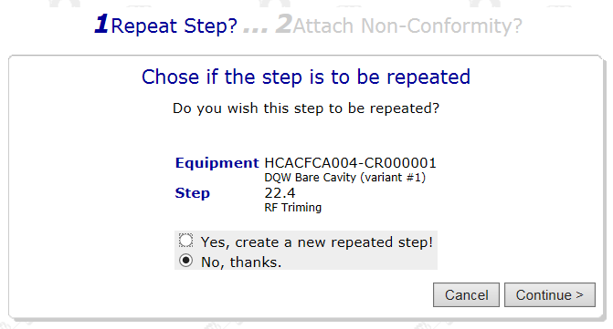
Handling of Nonconformities
A nonconformity is a non-fulfillment of a requirements. If during an inspection a deviation is found, then there is a Nonconformity to be issued.
HL-LHC Non-conformities Process – 2149457 It explains how a NC has to be launched and handled
The step subjected to a Nonconformity shall be repeated (unless we accept the non-conformity as it is) and a new extra step is added to the manufacturing workflow.

Slide 28


Handling of Nonconformities
Non-Conformity Report (NCR)
EDMS 1501109 template
Non-Conformity via EDMS
Criticality assessed based on the impact matrix in EDMS 1863763
Non-conformities Process for collaborations – EDMS 2149457
EDMS document Type – Quality Non-conformity. Decision integrated within the template
Decision about Non Conformity
Terminology according to ISO 9000
Notes:
Repair: Action on a nonconforming product in order to make it acceptable for the intended use
Regrade: Alteration of the grade of a nonconforming product in order to make it conform to requirements differing from the initial ones
Scrap: Action on a nonconforming product to preclude its originally intended use (Recycling, destruction).
Return: Action on a nonconforming product to send back to the supplier’s facilities
Concession: Permission to use or release a product that does not conform to specified requirements (Use as it is)

Slide 29
Conclusions
Manufacturing Records (Material Certificates, Quality Control Records, Test Records, Vérifications, etc.) are to be stored in MTF (integral part of EDMS)
The tool is also granting the traceability of the assemblies (what goes where)
Each asset represents the produced entities and they are individually traced

Slide 30
Thanks
Questions?

