Slide 1
HL Quality Plan and EDMS Insights
H. Garcia Gavela, V. Guillen Humbria, L. Quain Solis
CERN – 6th May 2022 – EDMS 2607473

Slide 2
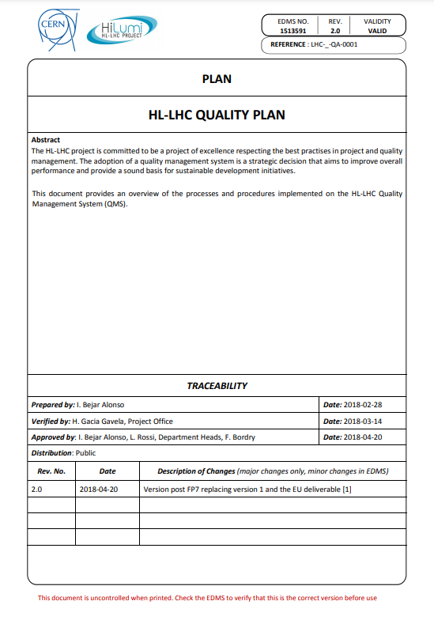
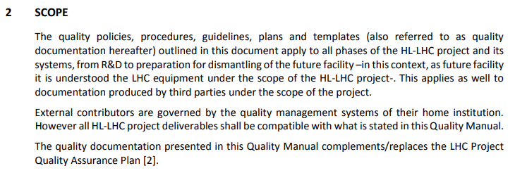
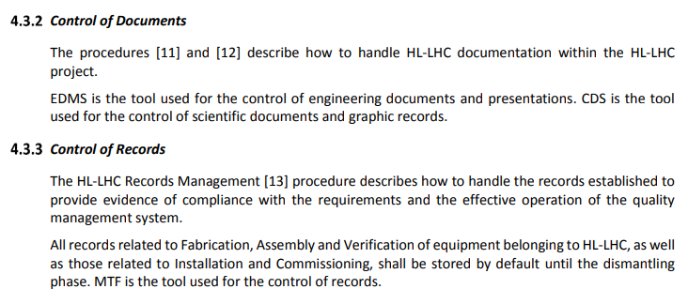
HL-LHC Quality Plan
HL-LHC Quality Plan: https://edms.cern.ch/document/1513591

Slide 3
How – CERN Tools integrated and supported
SmarTeam/CATIA
Used to extract BOMs and check some assemblies by the QA
CDD
Used for all internal drawings and for drawing control
MTF/Infor
Used for upload and control of external drawings (collaborations and companies) w/ LHC Stamp, by import
Used for assets (equipment or batch) and EDMS documents links
EDMS
Used for items
Used for storage, approval, traceability and management of documentation (engineering, manufacturing, installation,..)
Used thoroughly by the designers that make the 3D and 2D models
Used to access CDD as the drawings are also EDMS documents
Used for equipment production follow-up and their traceability
Used for storage (KIOSK)
Used for Layout links
Used to structure the Project in the different folders following the PBS [Configuration]
Used for manufacturing data storage
Used to access assets linked to an item

Slide 4
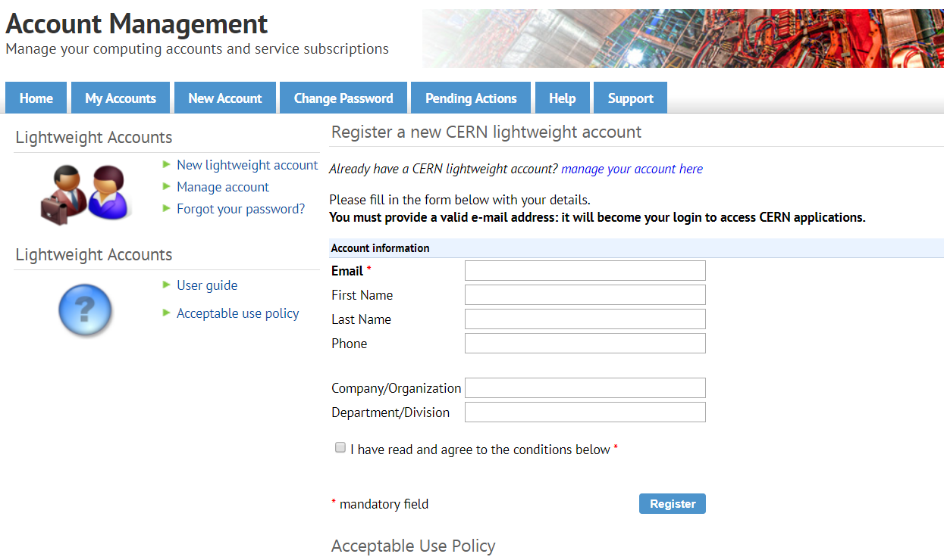
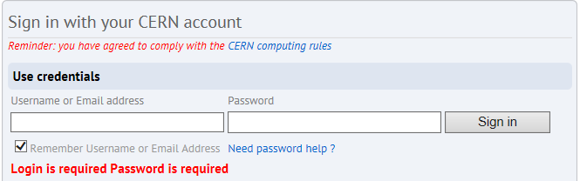

EDMS – Requirements to access
CERN Lightweight account is required (Link to create one) to access to EDMS (Engineering & Equipment Data Management Service)Engineering & Equipment Data Management Service
1. Follow the link to register your account
2. Go to EDMS and Log in with this account
3. You will then have access to the Documentation of the Project
Notes:
Ultimate : the pink box must substitute/overlap the blue one

Slide 5
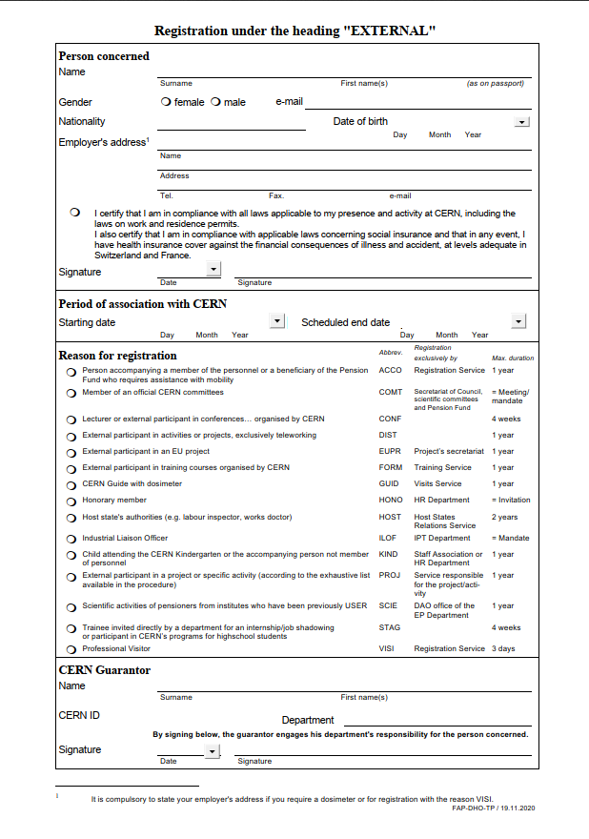
EDMS – Requirements to access
If you are going to use MTF (Equipment Management Folder), then a CERN Nice Account is required
Please contact HL-LHC.Secretariat@cern.ch
(Michela Lancellotti) in order to proceed
She will send you the details, the application form
to be filled in and the documentation to be provided
Notes:
Ultimate : the pink box must substitute/overlap the blue one

Slide 6
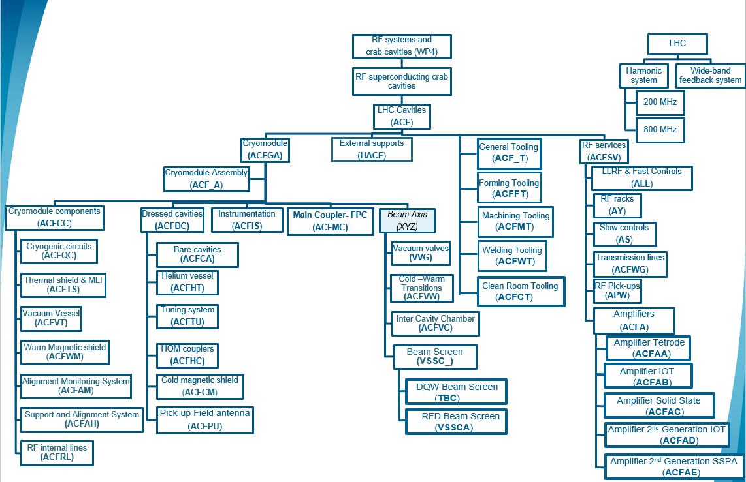
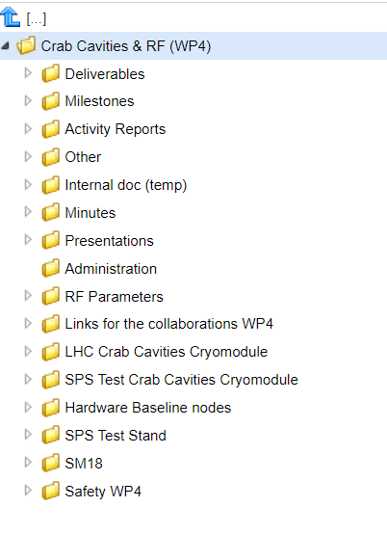
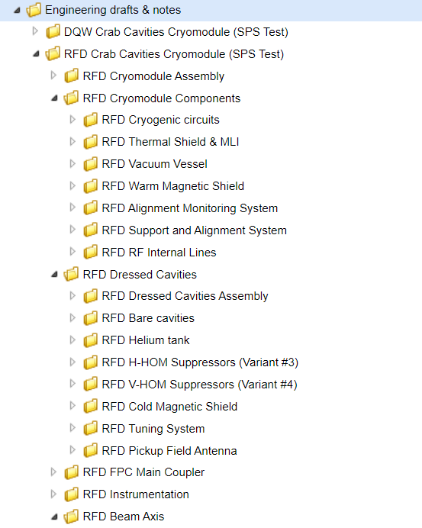
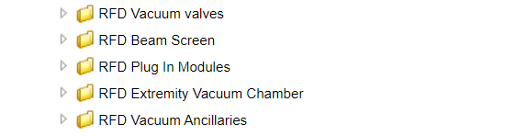
From system architecture to EDMS Structure

Slide 7
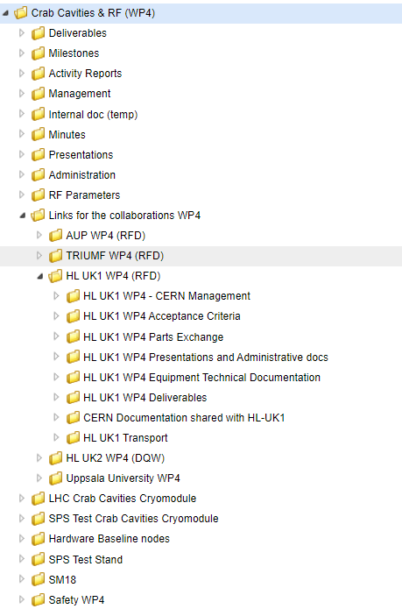
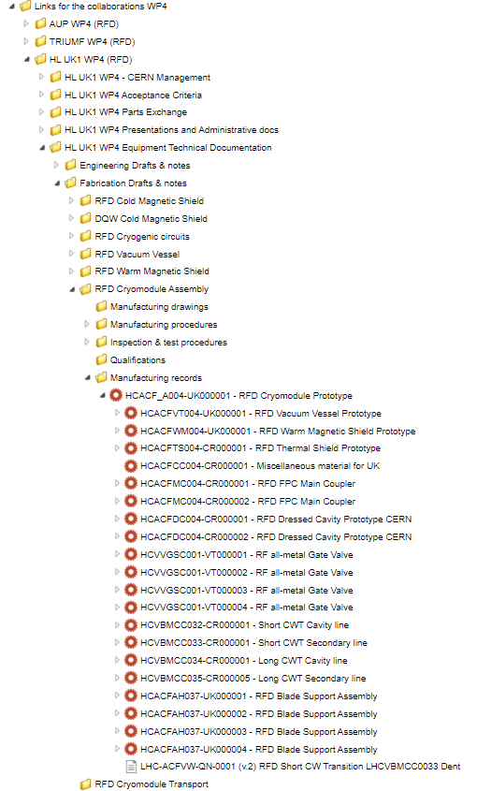
Specific Nodes for Collaborations
Dedicated node for each Collaboration within the main WP4 Structure
To access to CERN tools, colleagues from Collaborations need to set a lightweight account (only for EDMS access) or Nice Account (EDMS and MTF access required)
All members of HL will have the rights to create/edit documents in EDMS (under the corresponding Context)

Slide 8
Documentation - Key concepts
Baseline / Non Baseline
In my Work package / In several Work packages
Confidential (Cost, Resources, …)
Storage
Visibility
Approval

Slide 9
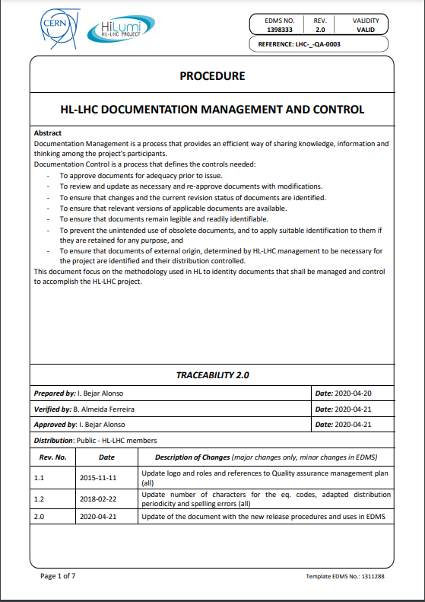

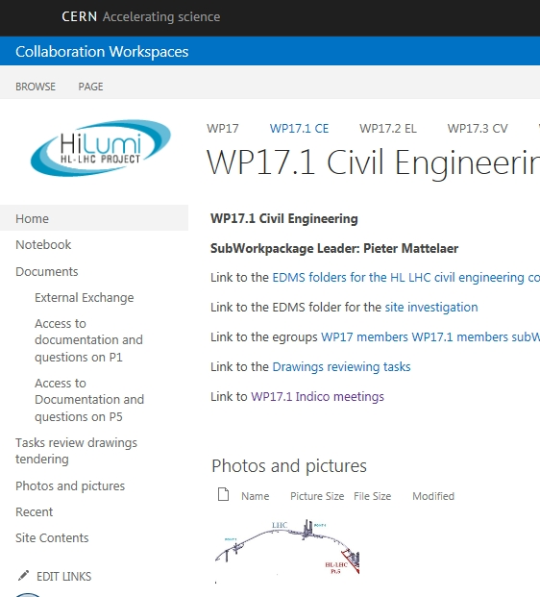
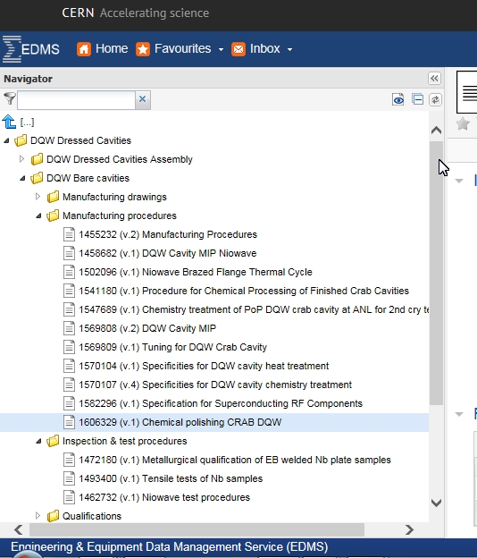
Documentation in one page (EDMS 1398333)
Non Baseline
Documents required for the well functioning of the project but
which storage will not be critical after commissioning
Baseline
Documents that will have to be stored and updated until the dismantling of the LHC
Concerning one Workpackage
Concerning more than one Workpackage or the project
Peer review process is generally managed by the author
Do not require special labelling
Stored in SharePoint or EDMS requiring approval process
Shall be peer reviewed by a group of people knowledgeable
on the subject and those
Shall be peer reviewed by a group of people knowledgeable
on the subject and those interfacing with the system /process described in the document.
Approved by the Project Office or by the Project Leader
Requires labelling
Can be prepared using the SharePoint but is stored in EDMS
interfacing with the system /process described in the document.
Approved by the WPL
Requires labelling
Can be prepared using the SharePoint but is stored in EDMS
Commercial documents are always baseline
While technical documents are all open to all the members of the project, Commercial, financial and HR documents are limited to the WPLs, DWPLs and PO

Slide 10
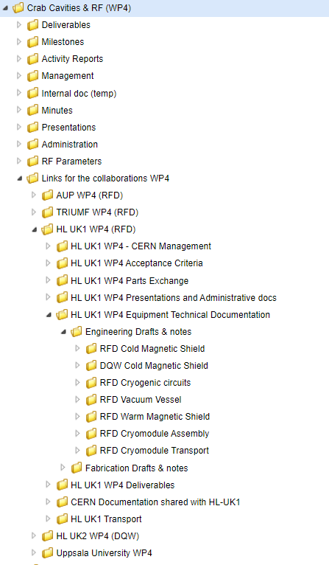

EDMS Engineering node
Documentation during this phase
Specifications
Drawings
Calculations
Simulations
Engineering notes
Bill of Materials, List of Materials

Slide 11

EDMS Fabrication, Assembly, Verification node
Documentation during this phase
Manufacturing Procedures
Test Procedures
Assembly Procedures
Manufacturing and Inspection Plans
Qualifications
Manufacturing Records – MTF

Slide 12
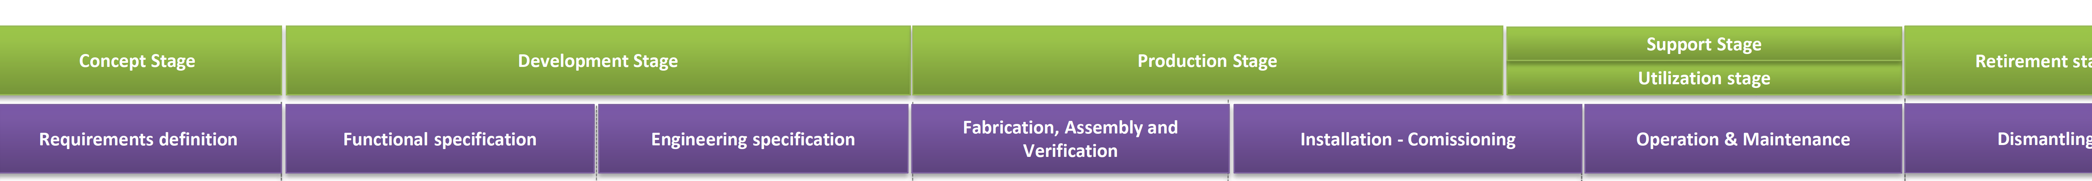
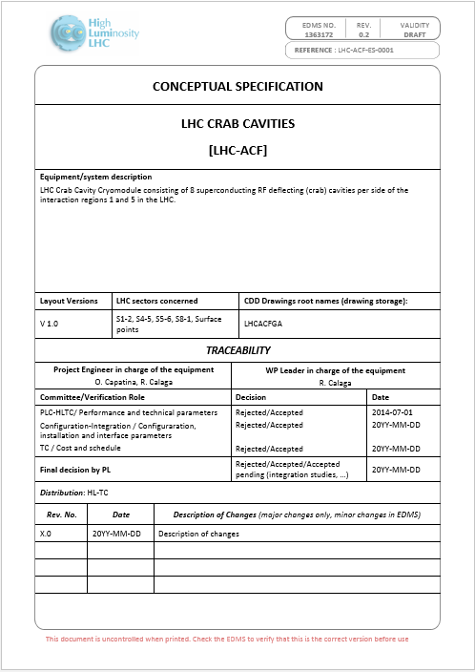
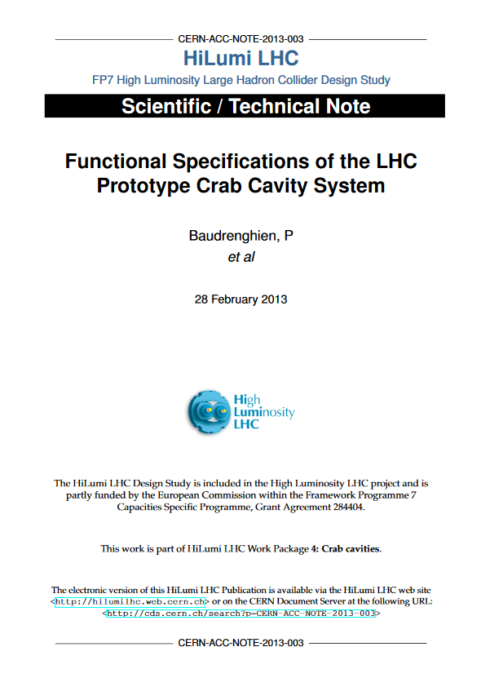
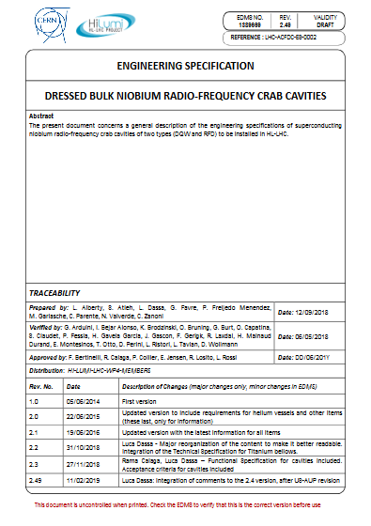
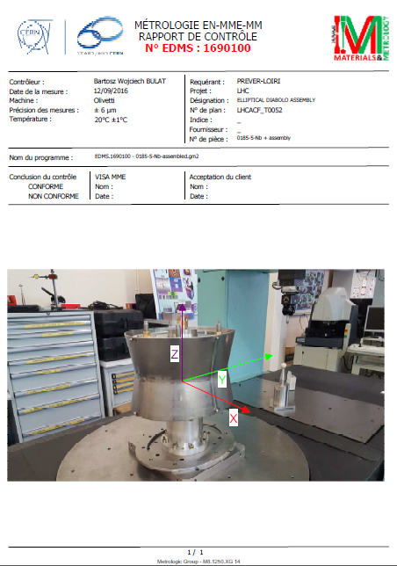
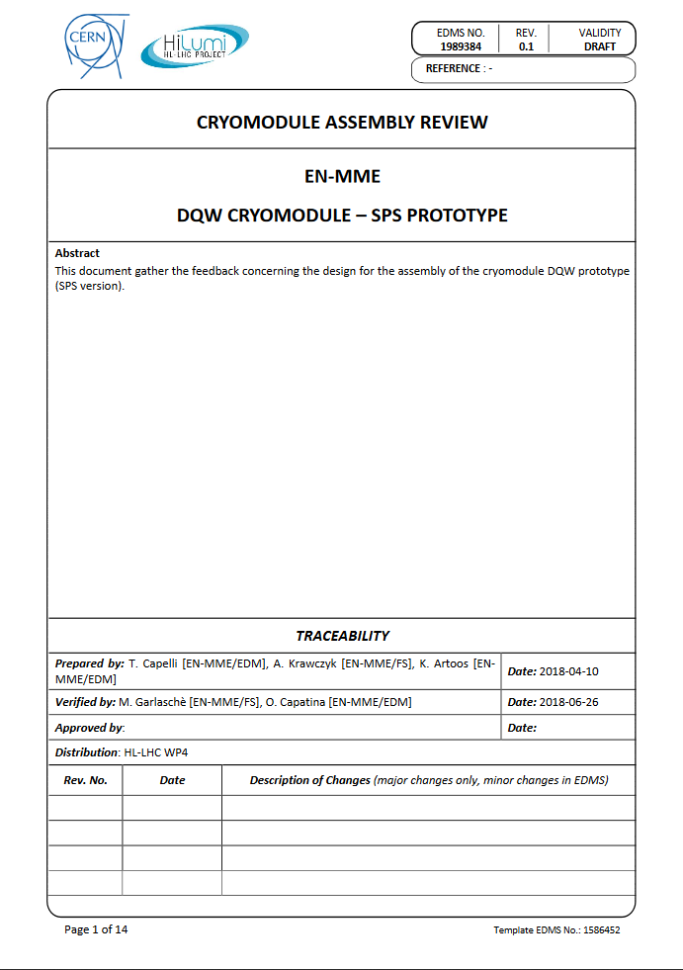
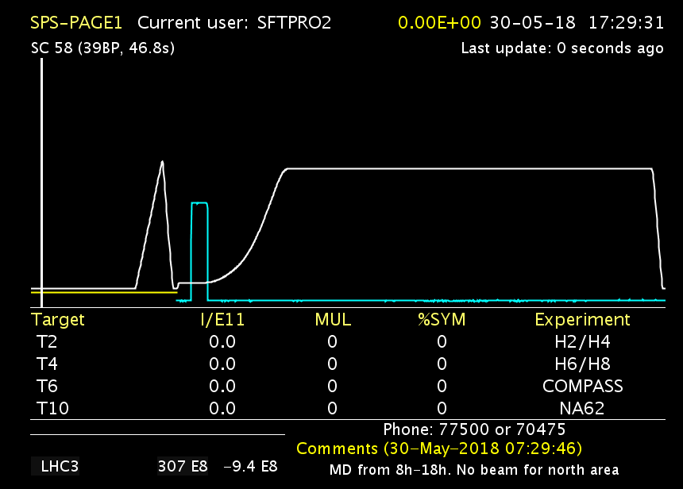

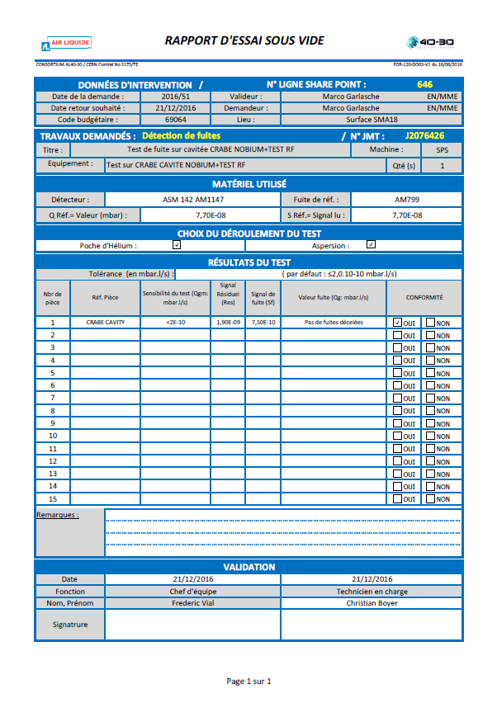
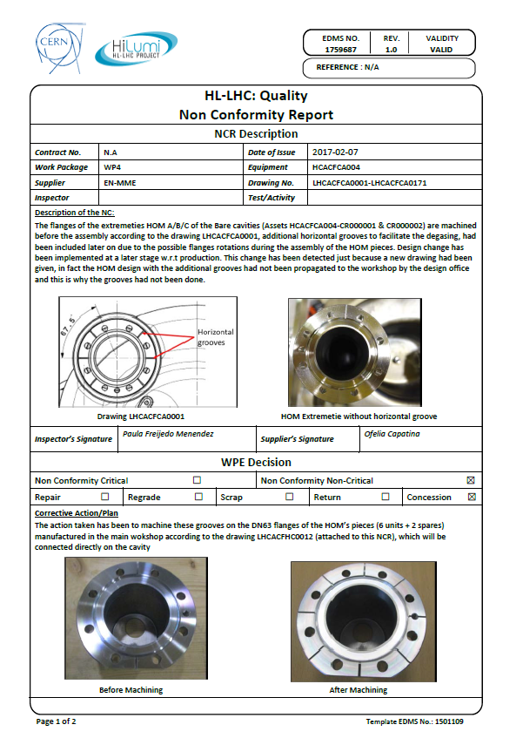
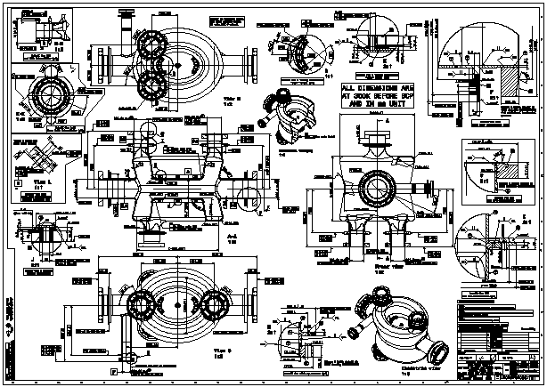
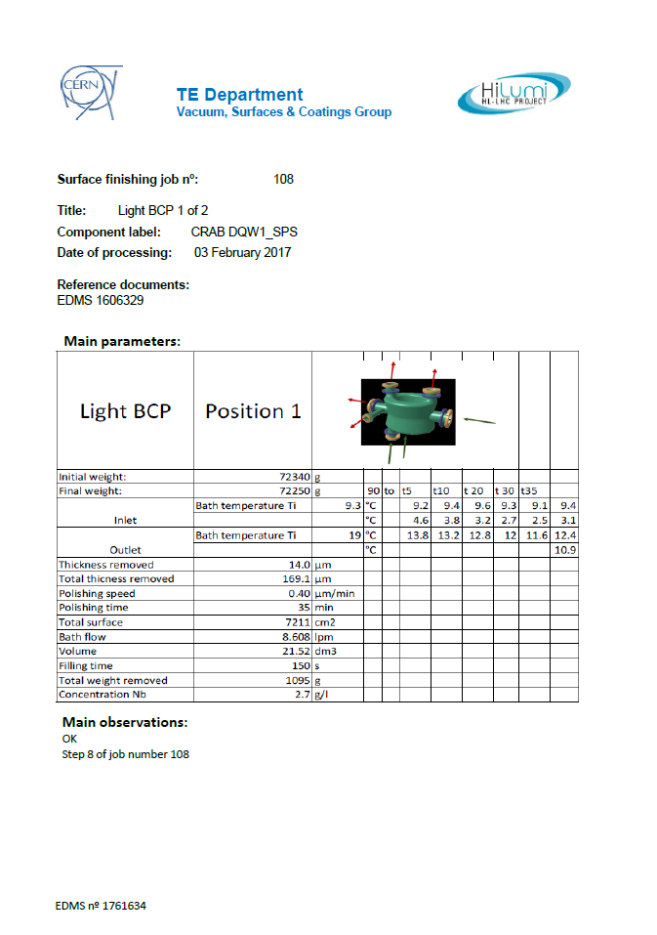
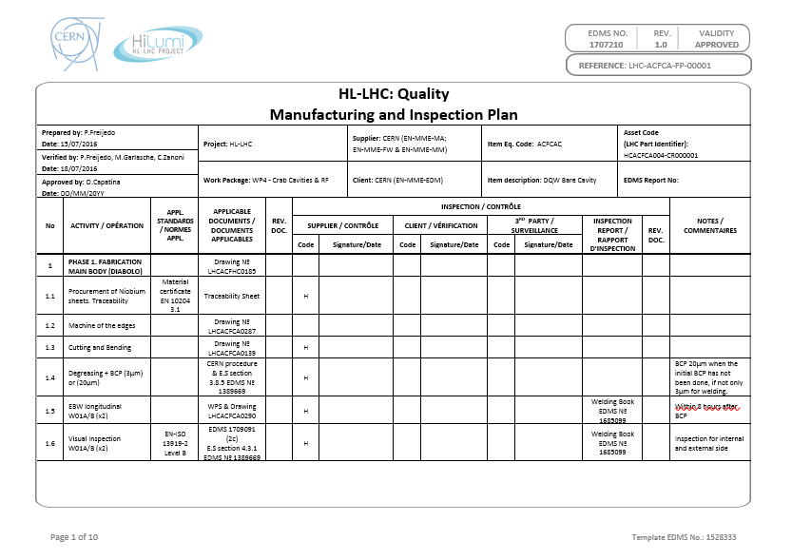
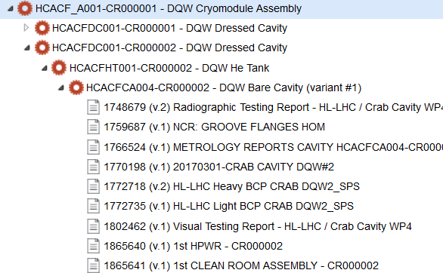
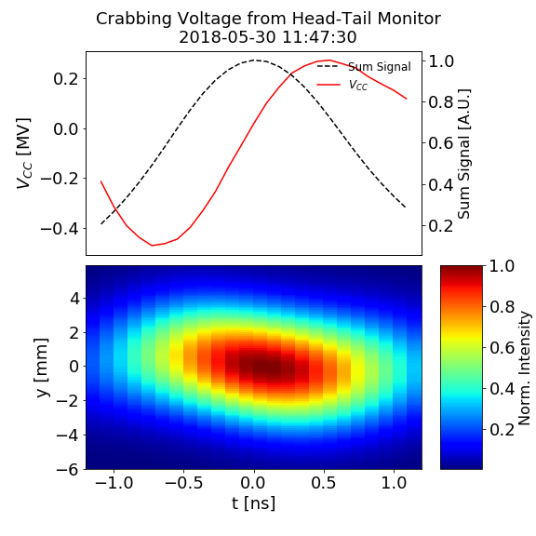
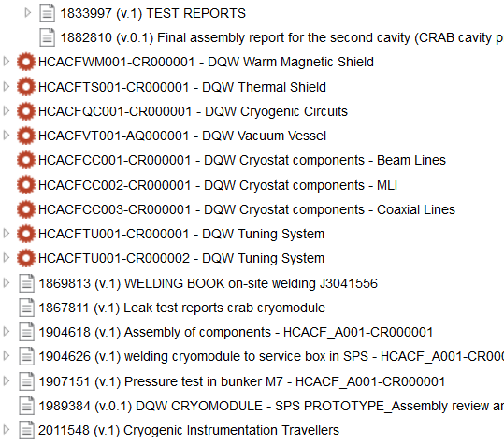
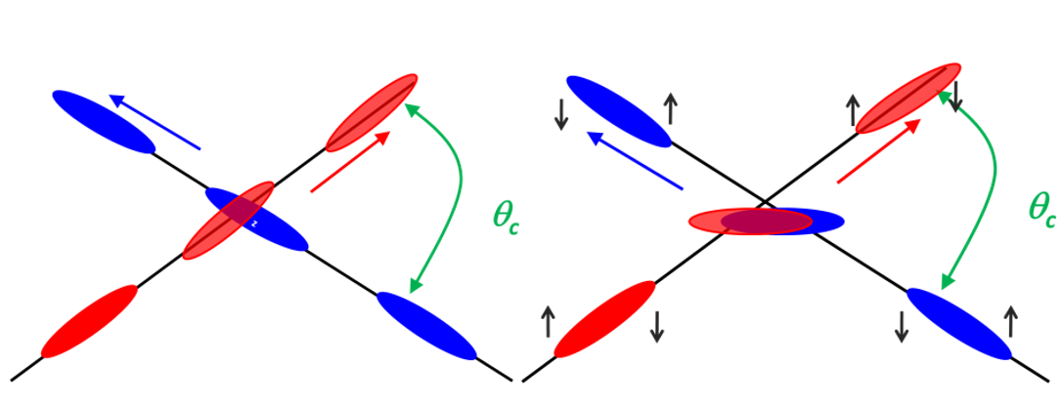
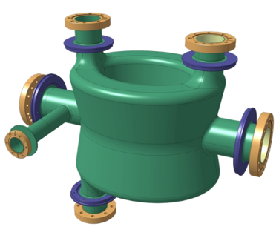
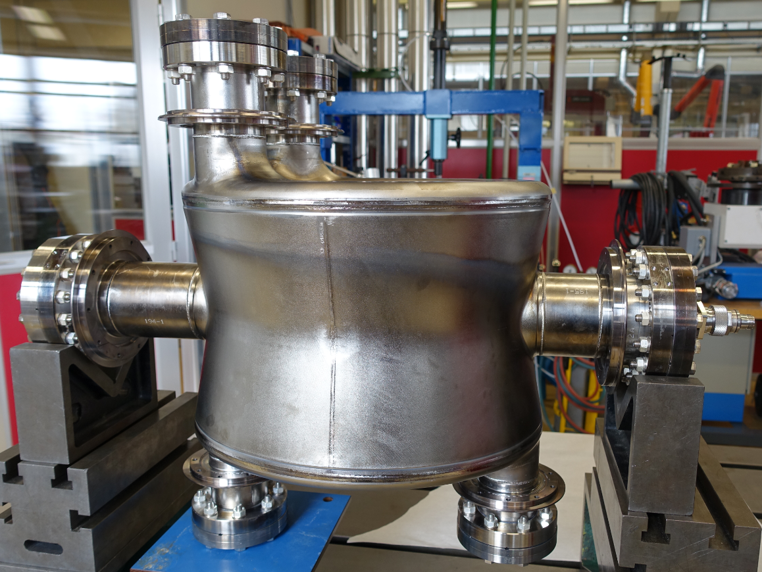
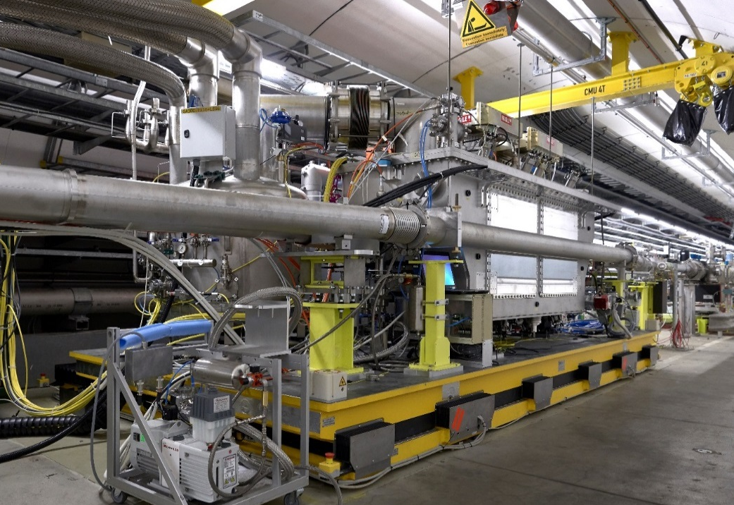
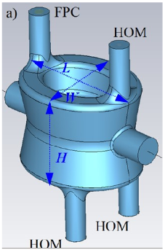
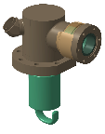
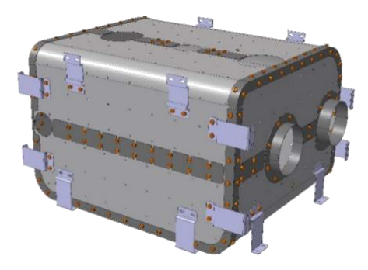
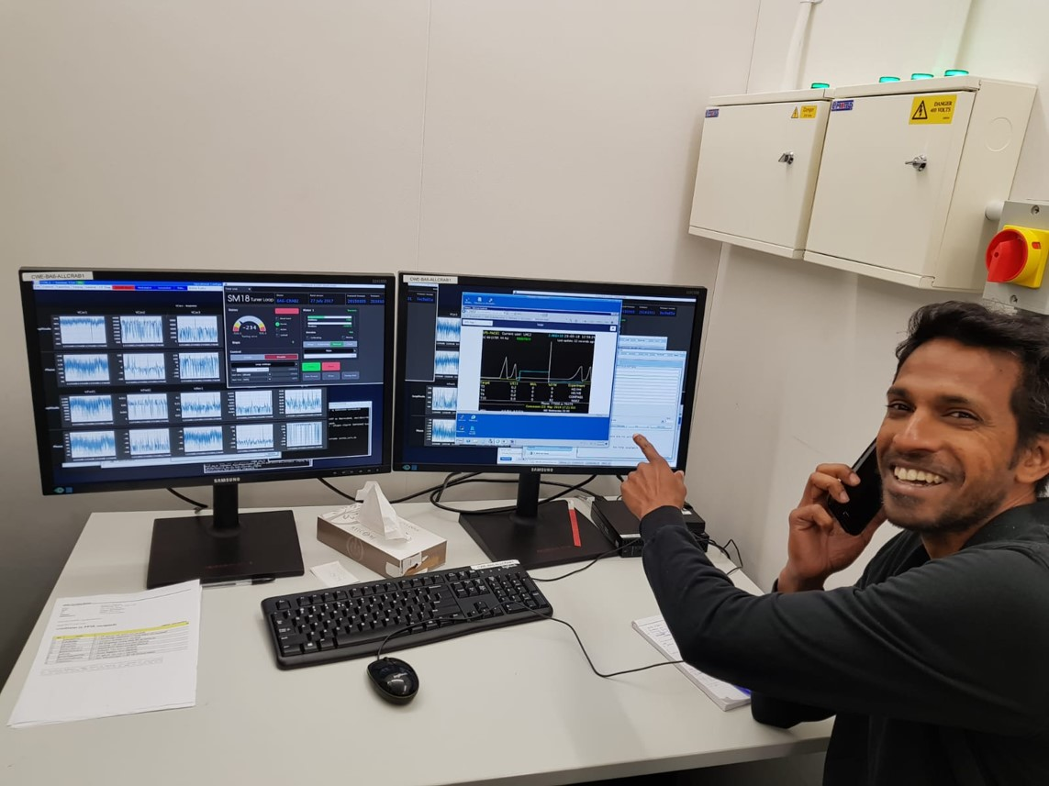
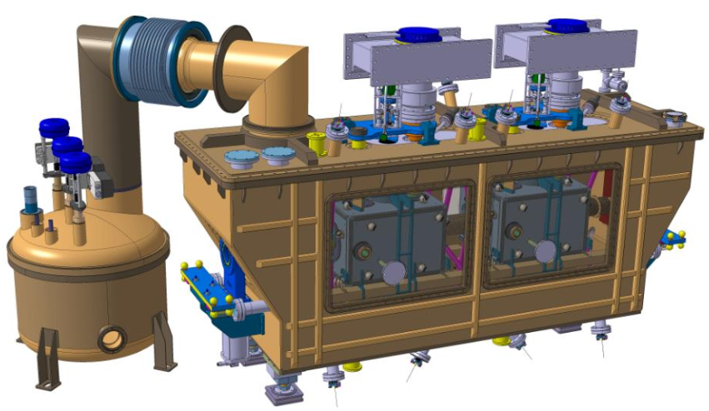
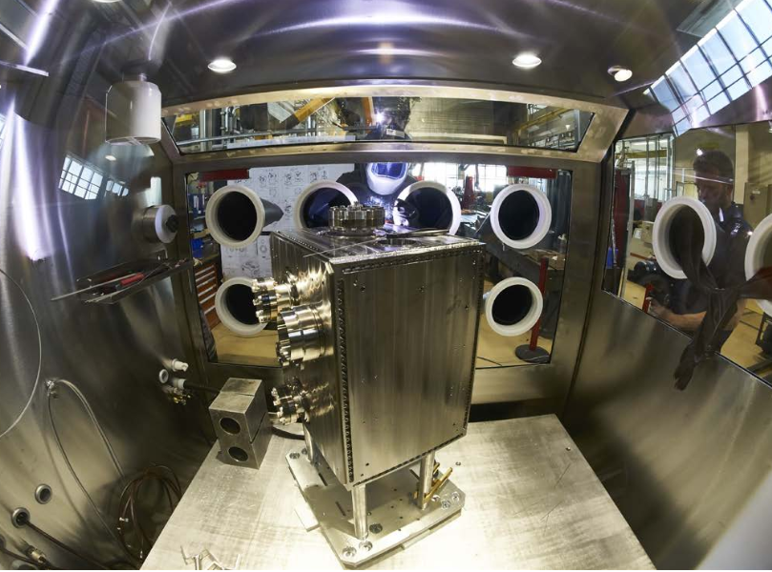
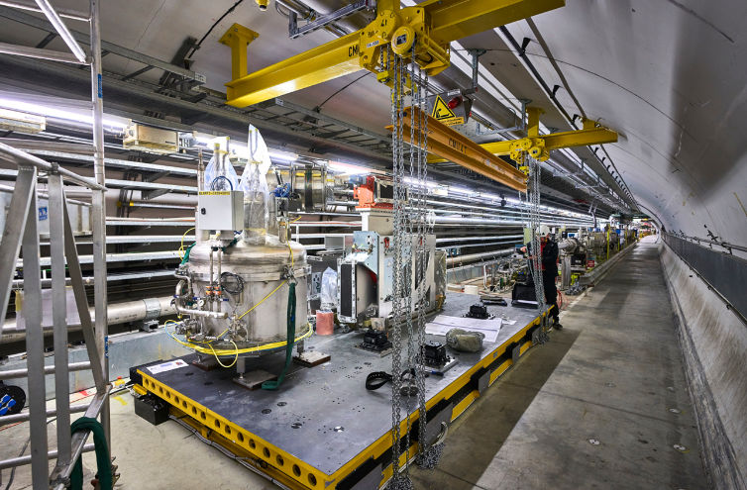
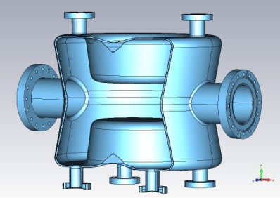
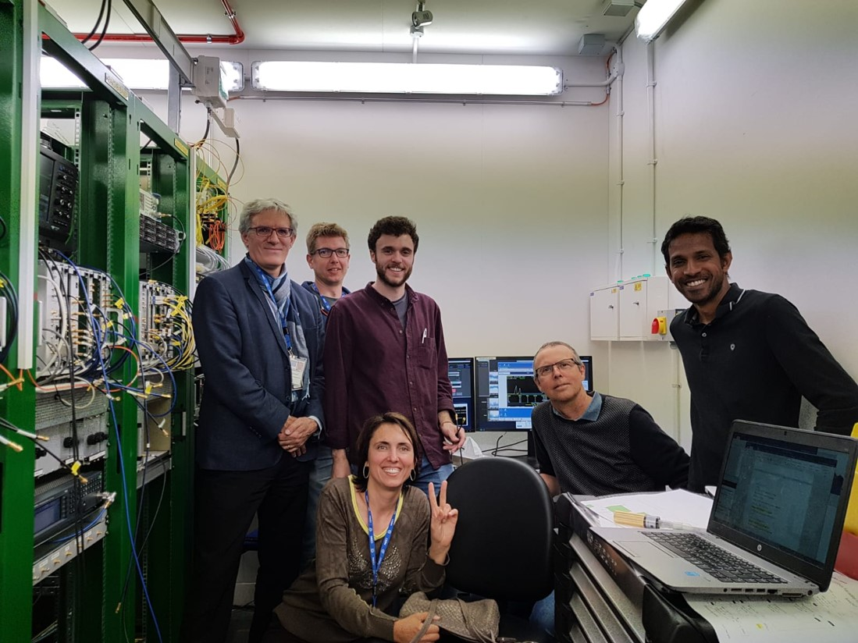
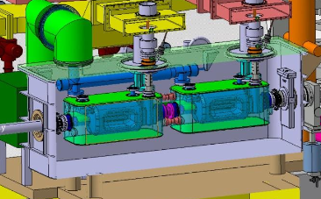
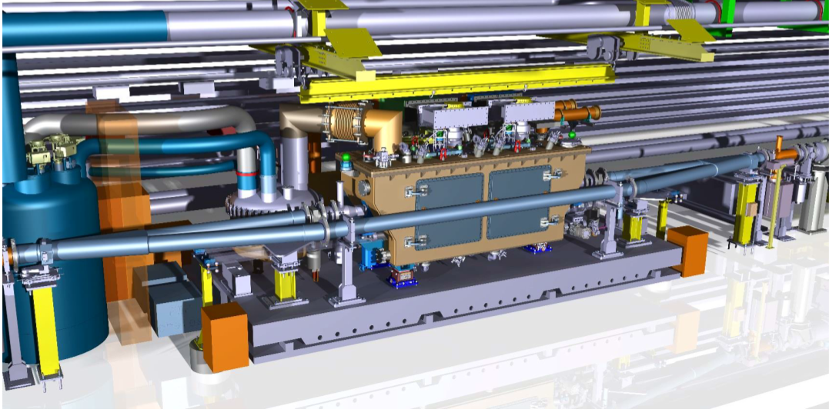
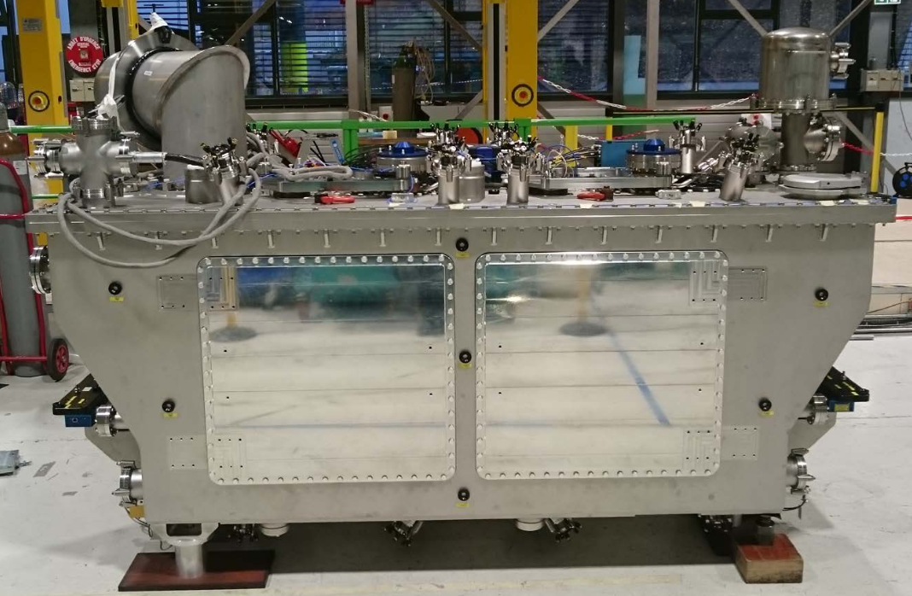
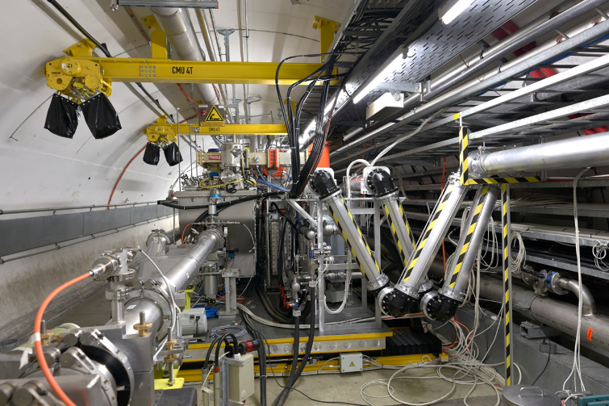
CC for SPS – The full HL-LHC life-cycle
MTF

Slide 13
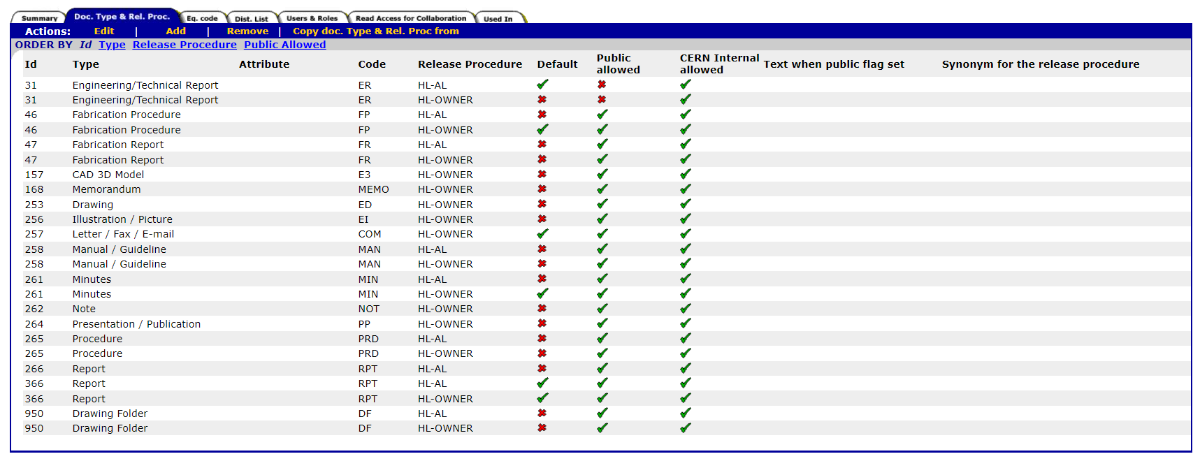
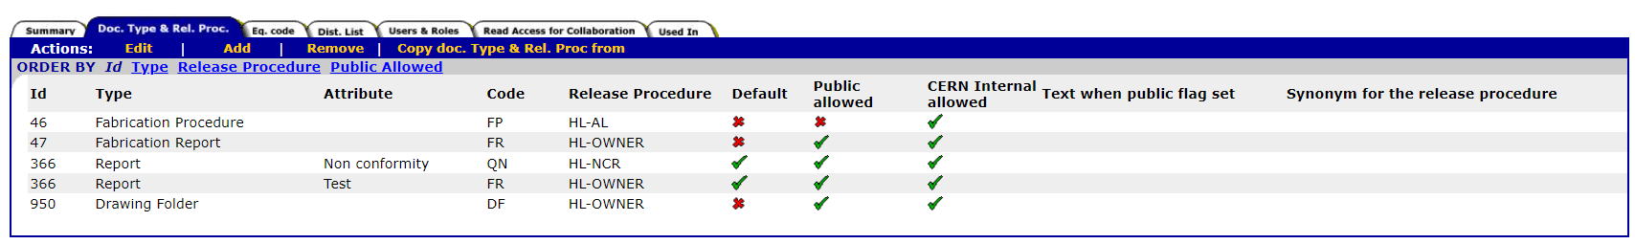
EDMS Release Procedures
EDMS Documents issued by the Collaboration will be issued under the Context: HL-LHC-WPX-UK
MTF Documents issued by the Collaboration will be issued under the Context: HL-LHC-WPX-UK-MTF

Slide 14

EDMS Release Procedures

Slide 15

EDMS Release Procedures

Slide 16

EDMS Release Procedures

Slide 17
HL-LHC Changes Traceability
Document | Purpose | Reference | EDMS Docs
ECR: Engineering Change Request | Modification of the current Project Baseline: There is a modification on the scope defined in the technical baseline (TDR) The maximum time allocated in the Master Schedule for one of the phases is not going to be respected. There is a need of extra funds to pay for an object that was in the baseline and can not be funded by internal reorganization of the budget for the same equipment. If the modification affects the present LHC machine an ECR is submitted using the normal LHC ECR circuit | TDR – Scope Baseline PBS – Project Breakdown Structure Master Schedule – Schedule Baseline MTP – Cost Baseline | Process 2429904 Template HL-LHC ECRs 1508429 Template LHC ECRs Link
DMR: Decision Management Reports | Trace managerial decisions without modifying the Project Baseline. Formalize a technical decision between several options or sharing of managerial decisions Internal re-scheduling w/o affecting the baseline Revaluation of the cost |  | Template 1501719
Deviation Requests | Request to do something different from an established requirement for a limited number of components, for a brief period, or for a specific use (The specifications nevertheless remain unchanged) | Engineering Specifications Design/Manufacturing files Technical Specifications | Process 1506723 Template 1506726
Safety Request | In case the deviation concerns exclusively a safety requirement. If so, it is not necessary to create a deviation request on the top of the Safety request. | Safety Requirements Technical Specifications Engineering Specifications | Template 1770077
Nonconformity | Non fulfilment of an established requirement (they are more production oriented) | Engineering Specifications Design/Manufacturing files Technical Specifications | Process 1499015 Template 1501109

Slide 18


Manufacturing Records in MTF
MTF is an integral part of EDMS.
This tool is used to store the manufacturing data during production and grant traceability (what goes where)
Workflow (more or less complex) shall be integrated following the Manufacturing & Inspection Plan (MIP)
Manufacturing reports shall be provided to CERN along the production (including Nonconformities)
For reference – MTF Training given in June 2020 to the UK Colleagues: https://edms.cern.ch/document/2385803/1.0

Slide 19
(Some) Conclusions
Everybody should feel responsible for Quality and not just the people that are more devoted to this activity
Documentation is a key part of any project
  It provides provision of objective evidence;
  It proves the conformity of the requirements established by a customer;
  It enables repeatability and traceability of the work done
HL-LHC is an upgrade of an existing machine (LHC). Existing rules are to be followed Pragmatic Approach with our Collaborations
HL-LHC tried to implement an industrial approach within the boundary conditions of the Research centers: Traceability, documentation, control of changes etc. are ‘a must’ for any project at large scale
Important to keep traceability (what goes where) along the full life-cycle
The correct use of EDMS/MTF is of paramount importance in order to store, handle and retrieve information in later stages
Standardization for all the CERN members and Collaborations
Continuous improvement as a quality principle

Slide 20

Thank you for your attention

