Slide 1
HL-LHC Quality - Introduction
H. Garcia Gavela, V. Guillen Humbria, L. Quain Solis

Slide 2
Introduction and Goals
Meet the relevant people (HL-UK Quality Team and HL-LHC Quality Office)
Start getting used of processes and main tools used for HL-LHC Project
Touch base with key concepts related to Quality and documentation
Where to find information

Slide 3



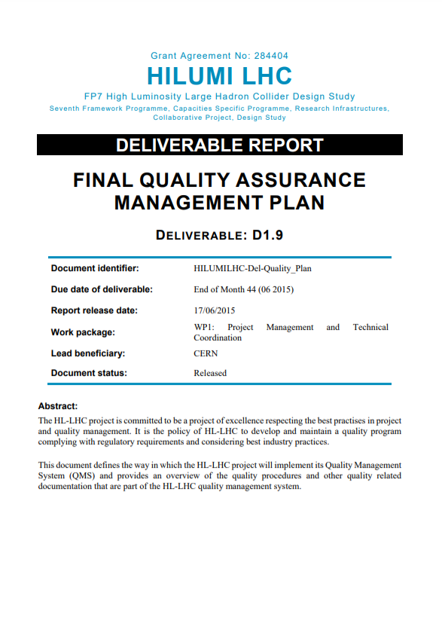
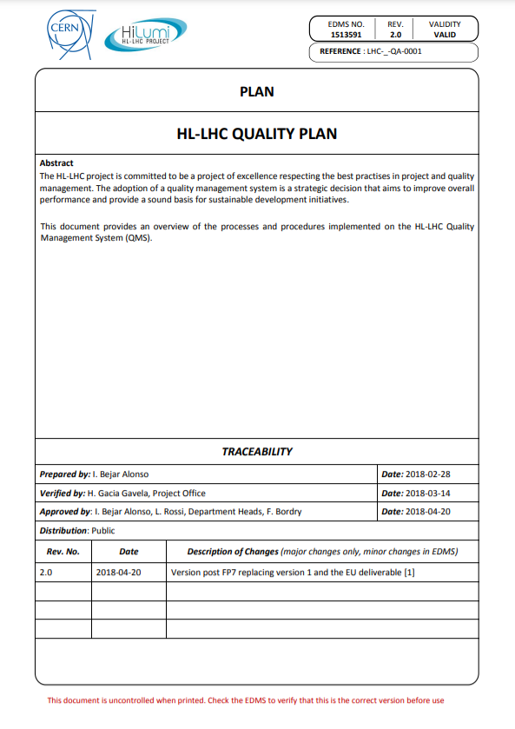

HL-LHC Quality Office
HL-LHC approved by CERN Council
HL-LHC Design Study
HL-LHC Project
Quality tasks within the TCO (Technical Coordination Office)
Quality tasks within the HL-LHC Quality Office
Technical Coordination Office
Configuration, Quality, Risk & Sourcing Office is created within the HL-LHC Project Office
EDMS 1518495
EDMS 1518495

Slide 4
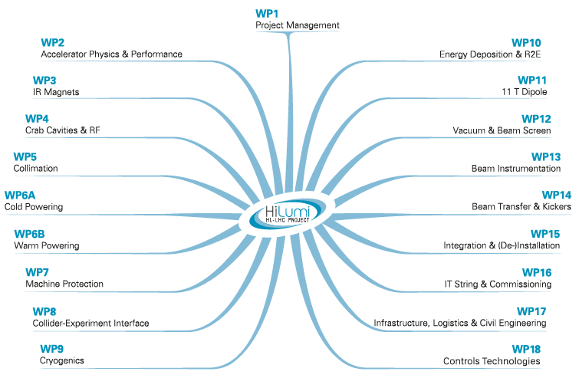
HL-LHC Project
HL WPs in which HL-UK is involved

Slide 5
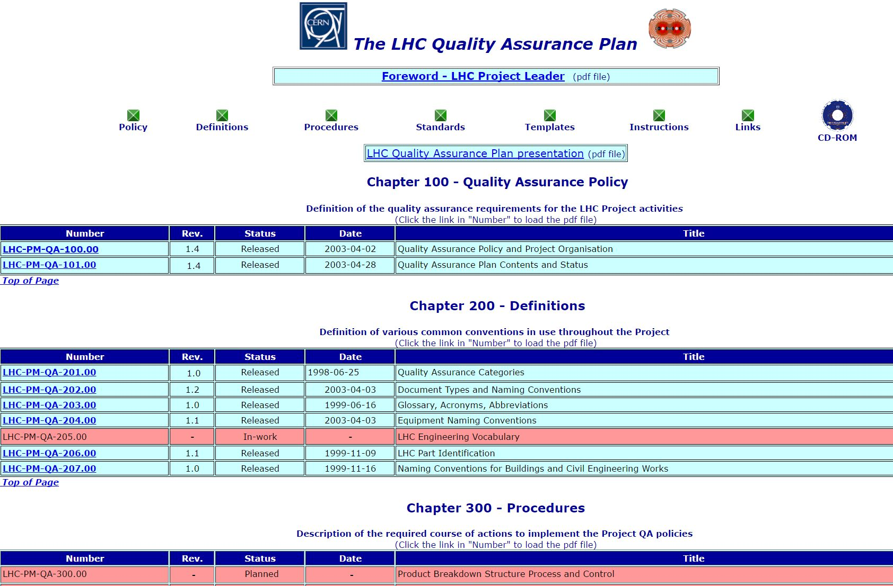
HL-LHC is an upgrade of an existing machine

Slide 6
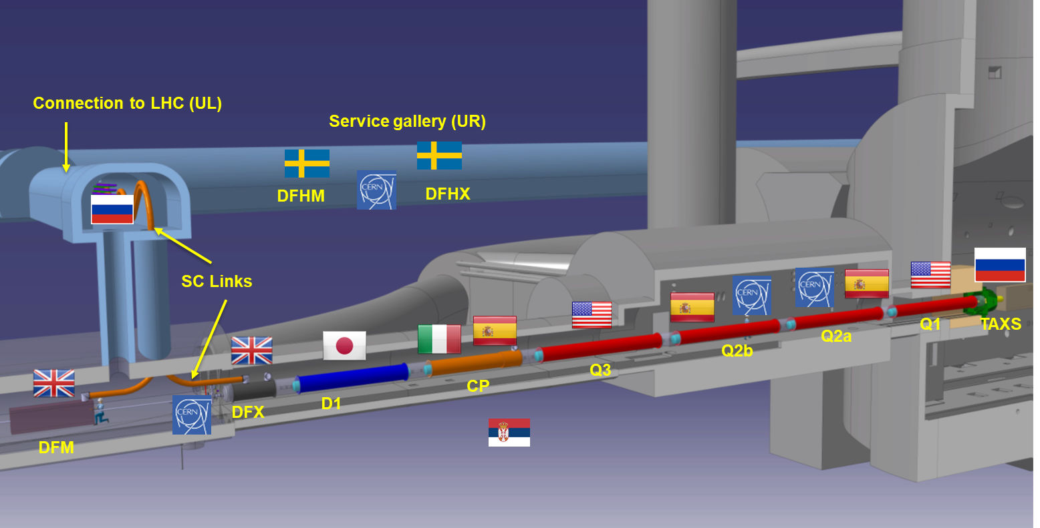
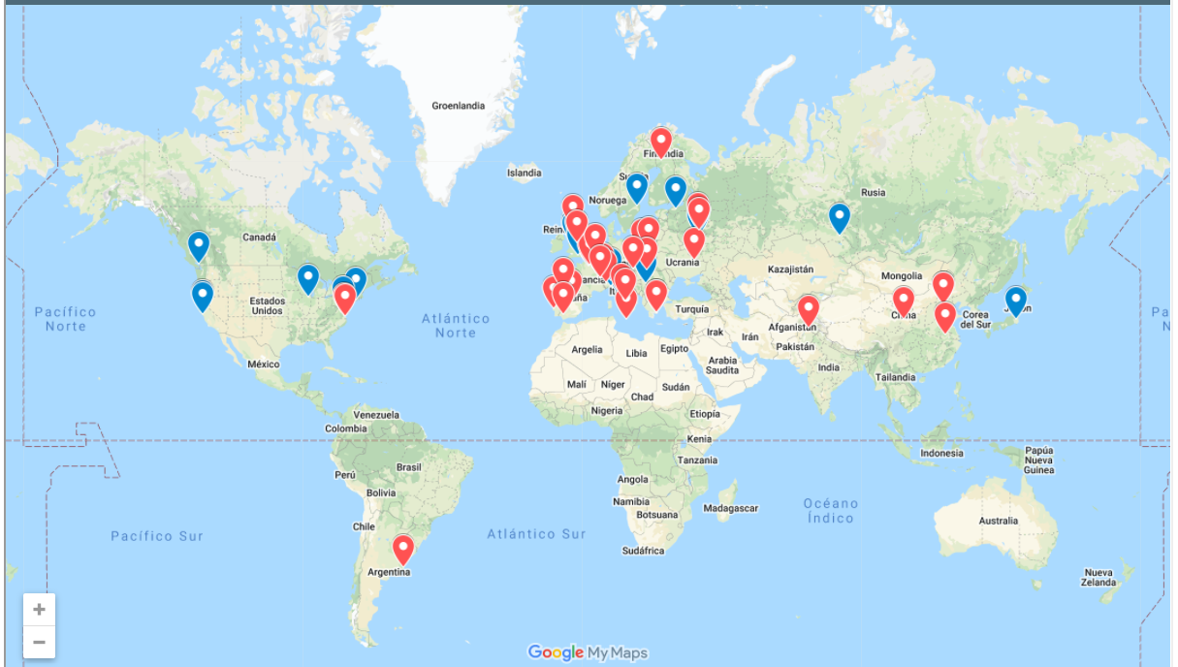
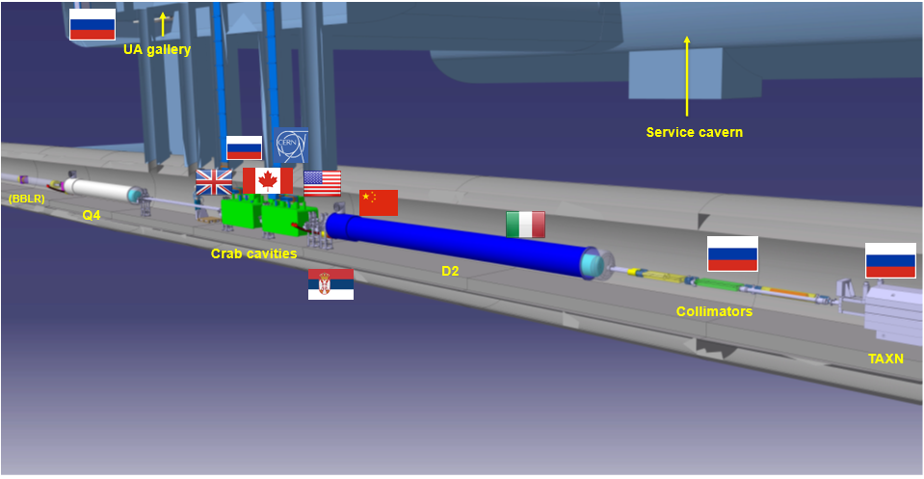
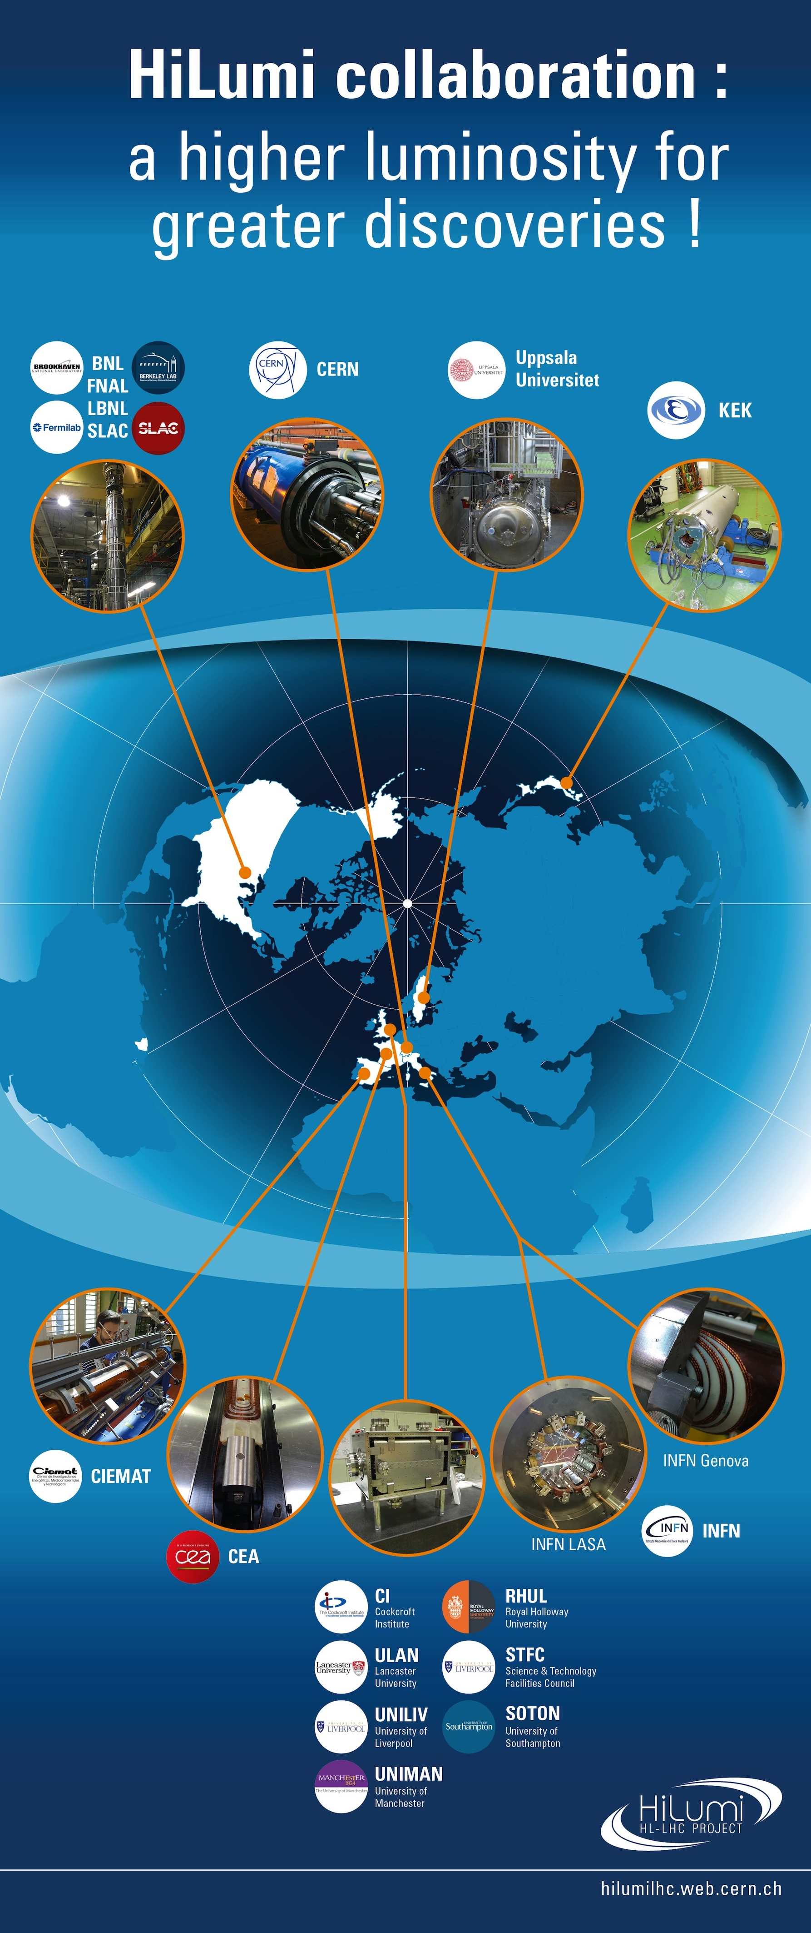
HL-LHC a truly collaboration project
We must integrate more than 20 different “ways” to work
6

Slide 7
Pragmatic approach
External contributors are governed by the quality management plans of their home institute, however all HL-LHC deliverables shall be compatible with the HL-LHC Quality plan
Hardware baseline documentation stored in EDMS
Fabrication records in MTF
Project information accessible to all “Hilumiers”
Corporate image when representing the project

Slide 8
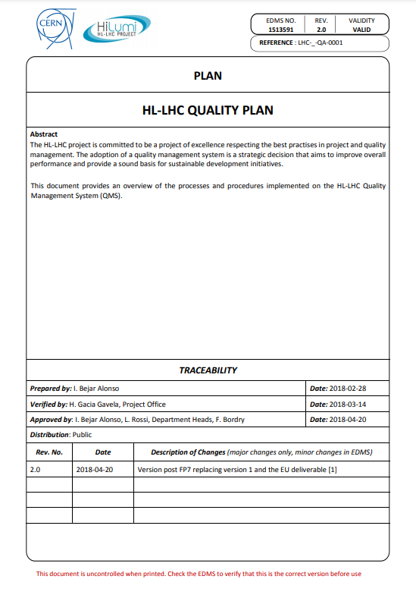
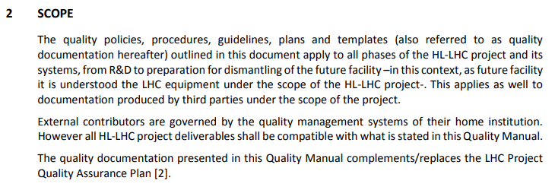
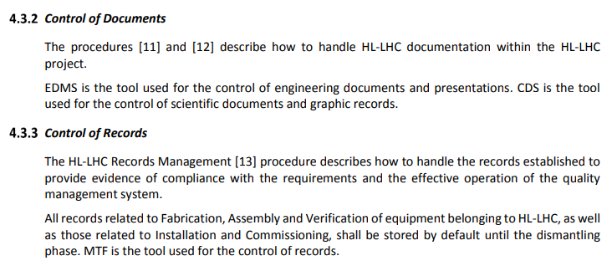
HL-LHC Quality Plan
HL-LHC Quality Plan: https://edms.cern.ch/document/1513591

Slide 9
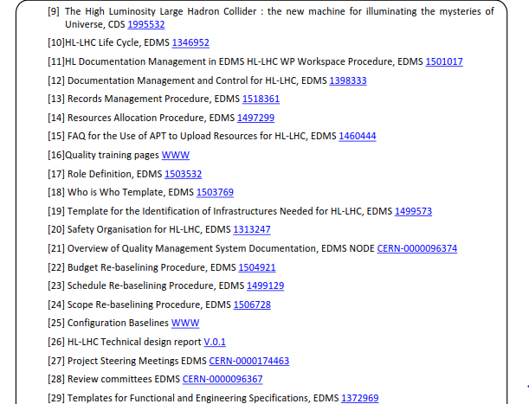
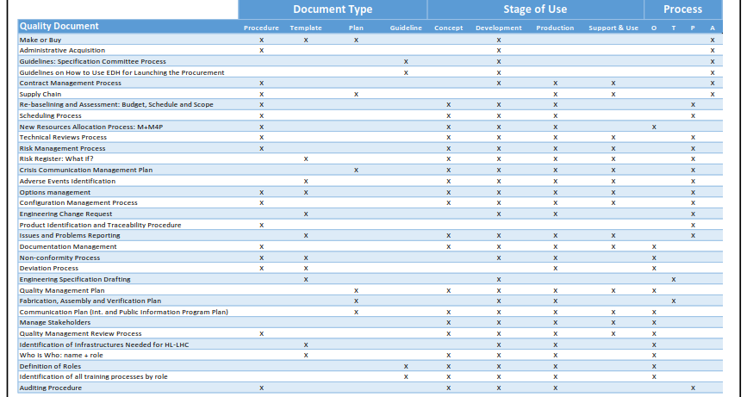
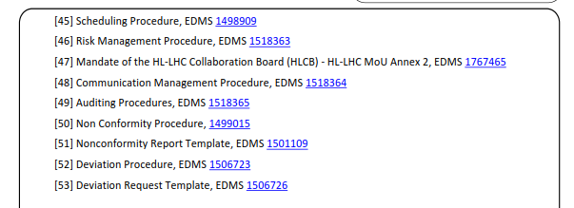
All processes documented

Slide 10
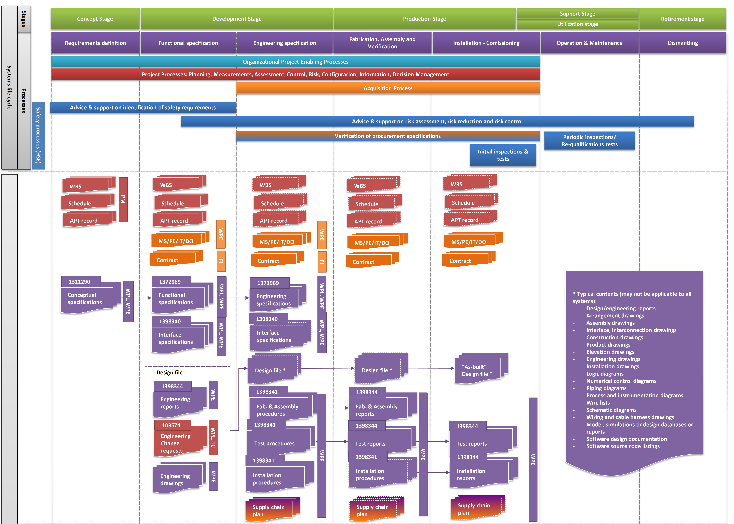
Long term documentation (1/2)
EDMS #1361462
From system requirements to technical solutions and products
Project management
Acquisition
Technical
Safety

Slide 11
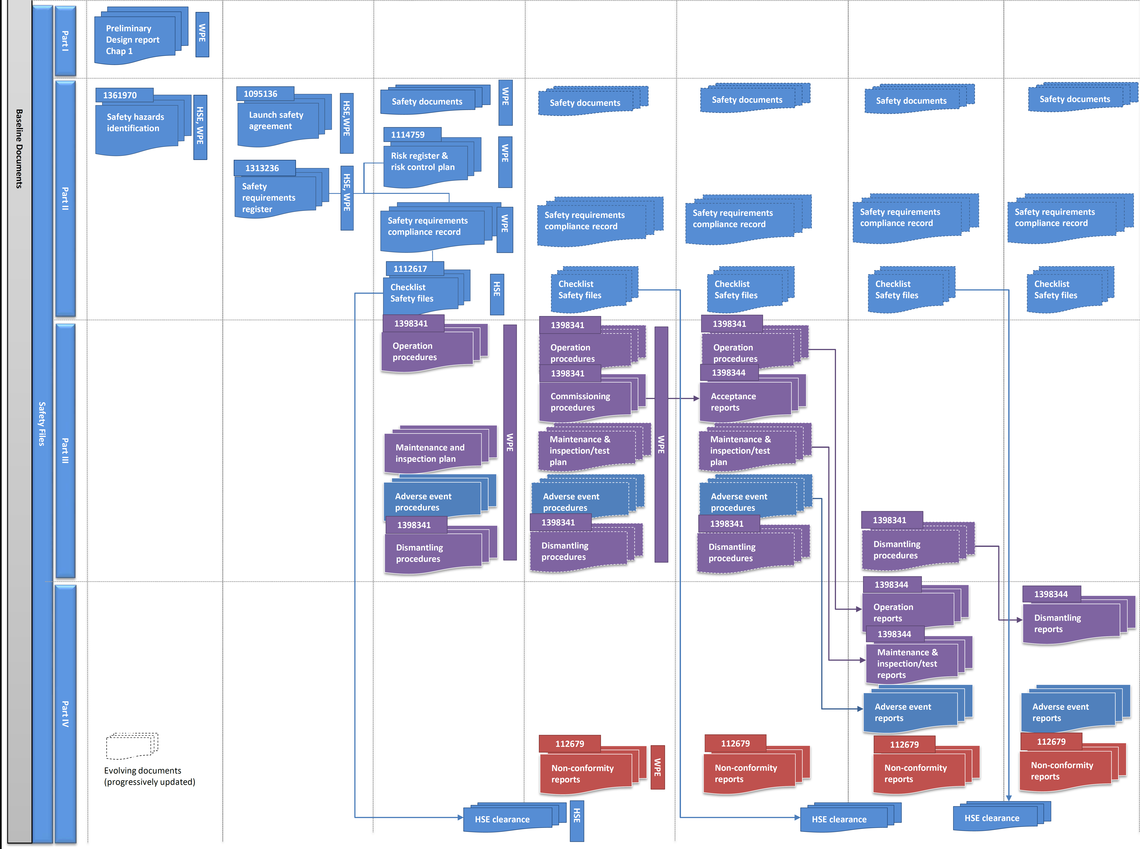
Long term documentation (2/2)
EDMS #1361462
Safety File
Links to already
existing documentation
will be made,
whenever required
Project management
Acquisition
Technical
Safety

Slide 12
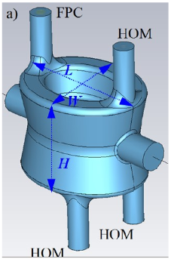
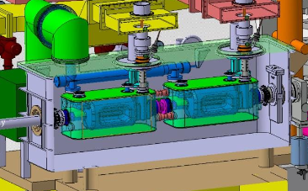
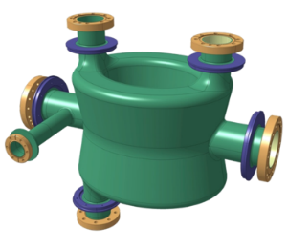
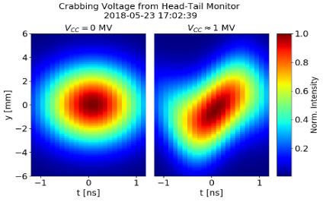
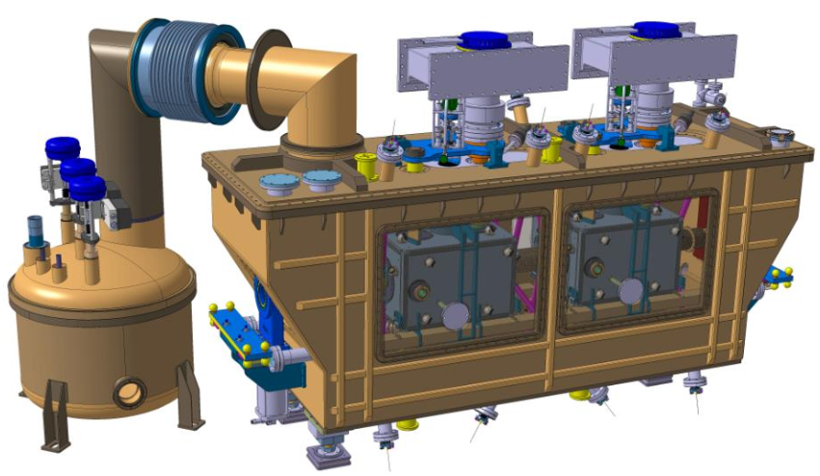
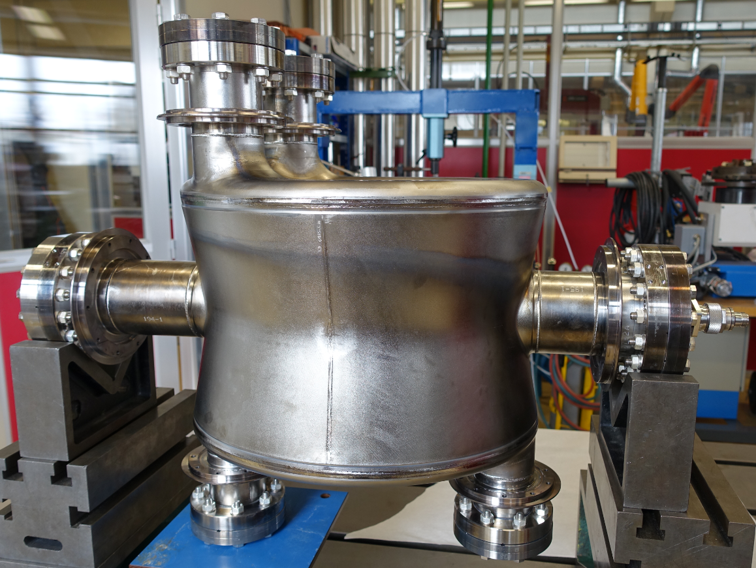
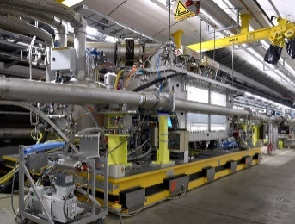
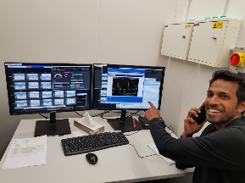
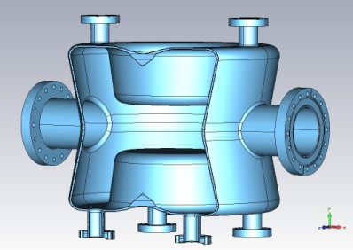
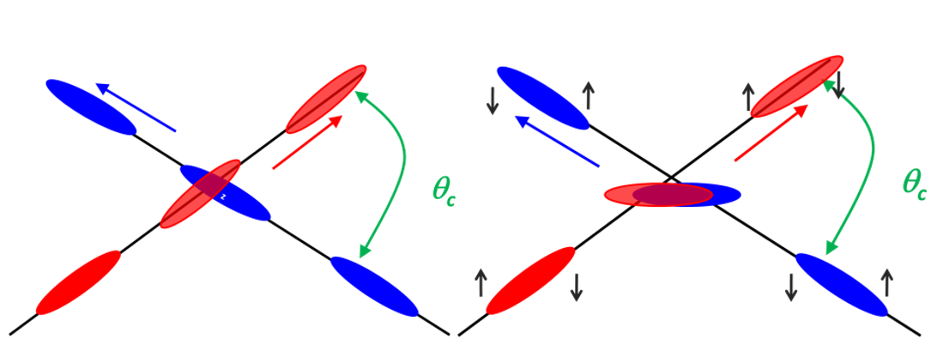
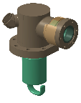
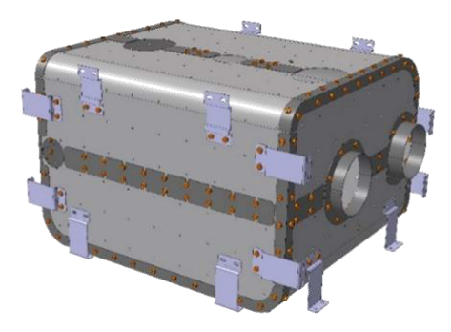
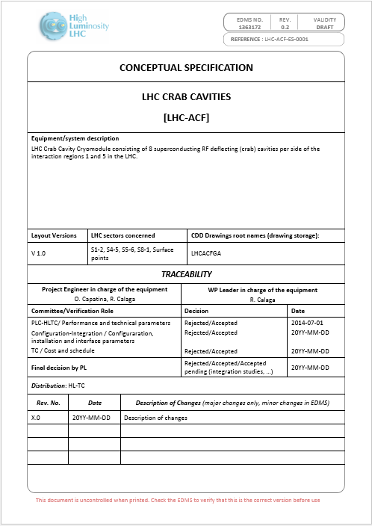
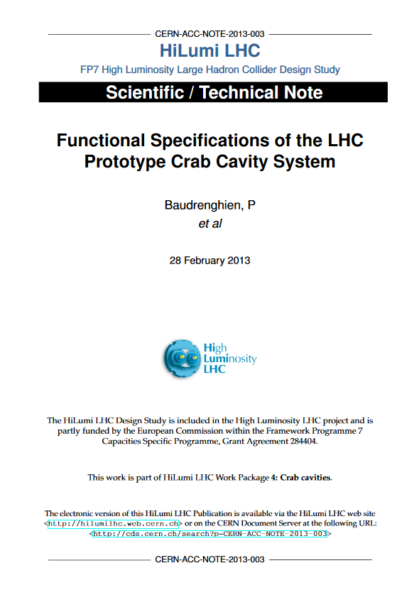
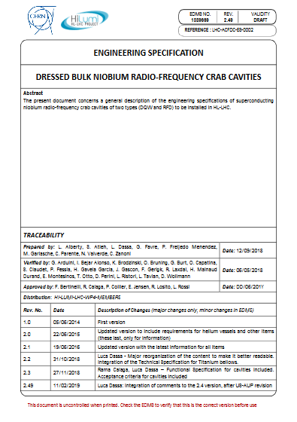
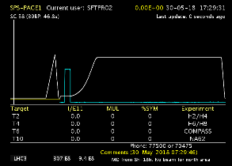
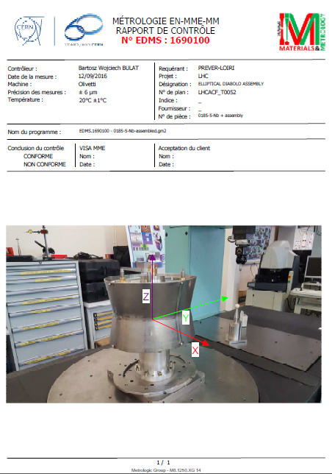
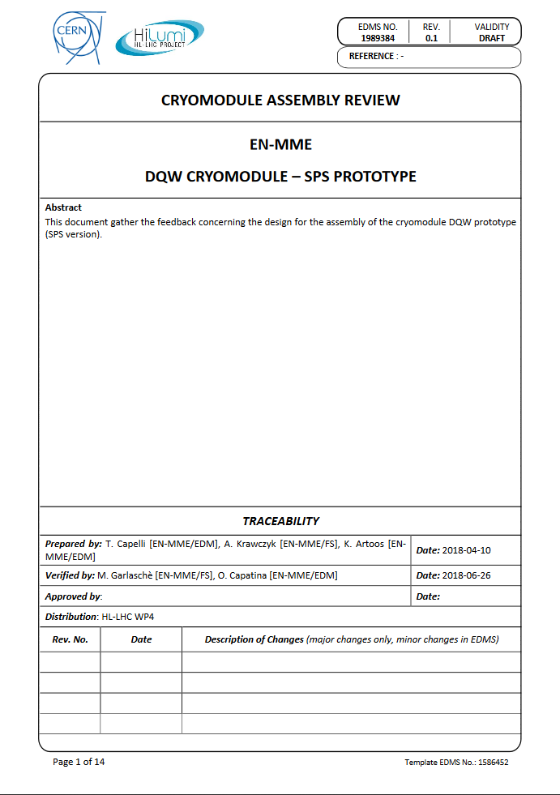
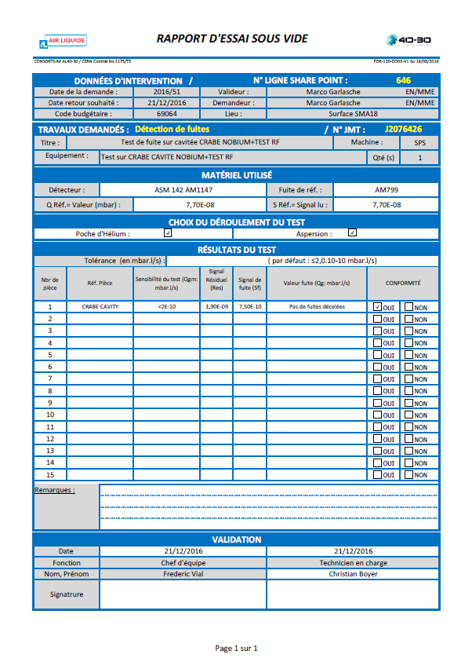
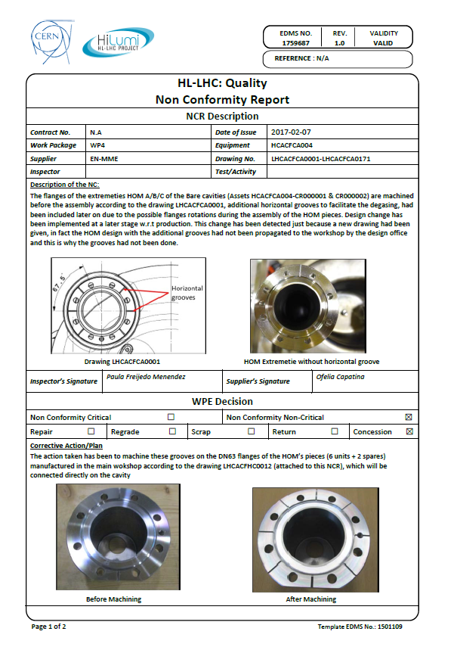
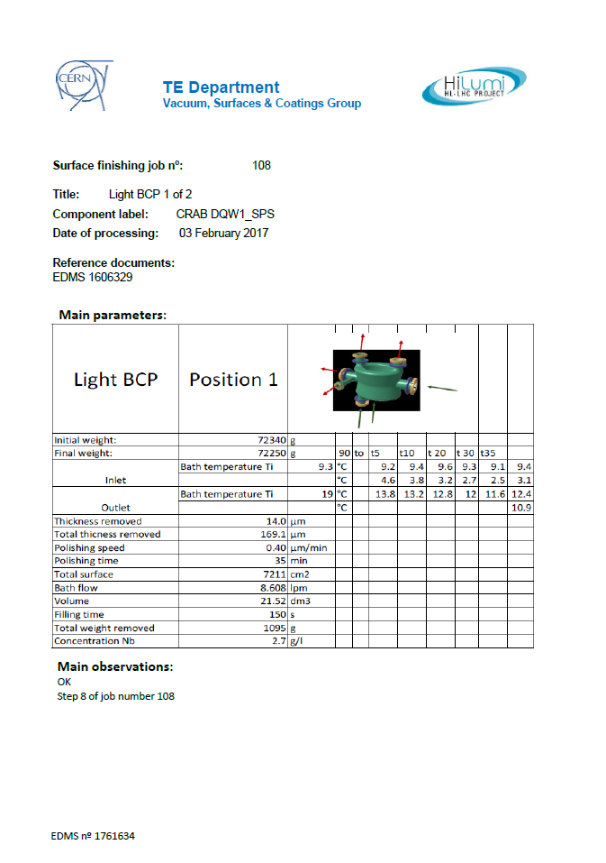
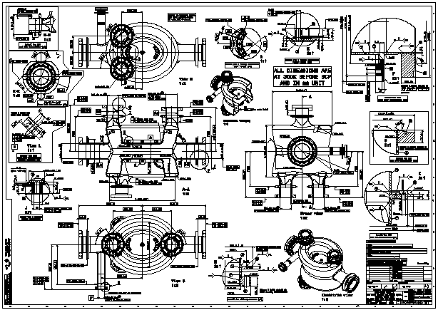
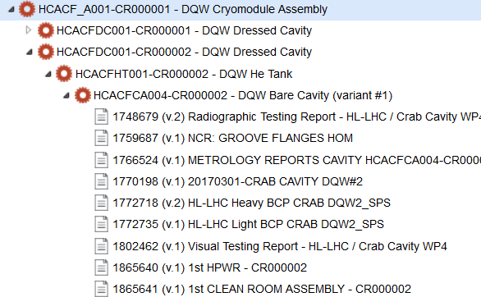

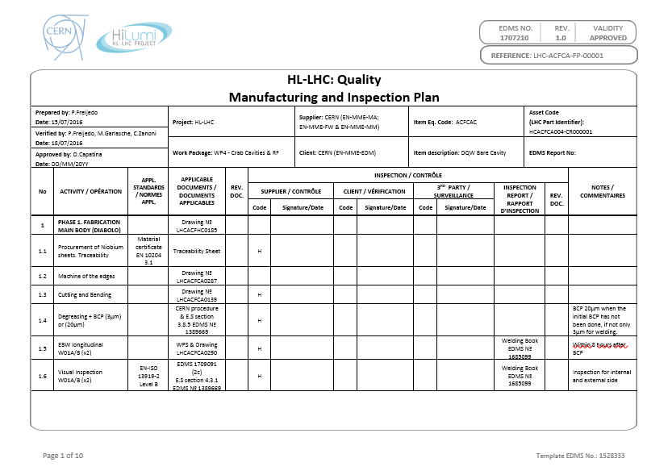
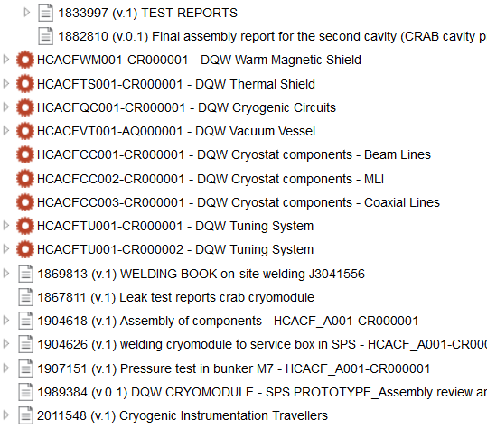
When – The full HL-LHC life-cycle
From Systems Requirements to Technical Solutions & Products

Slide 13
Summary
HL-LHC is an upgrade of an existing machine (LHC). Existing rules are to be followed – Pragmatic Approach with our Collaborations
Documentation is a key part of any project
  It provides provision of objective evidence;
  It proves the conformity of the requirements established by a customer;
  It enables repeatability and traceability of the work done
  Important to keep traceability (what goes where) along the full
  life-cycle
  Fabrication reports to be provided on time and not at the very end of the project
  Report of Nonconformities upon occurrence (lessons learned and avoid recurrence in order to optimize the production)
  More dedicated sessions can be organized to see the tools and some processes in a more exhaustive way

Slide 14
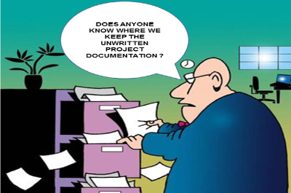
What use to happen at the end of the projects
other

Slide 15
Thank you for your attention

Slide 16
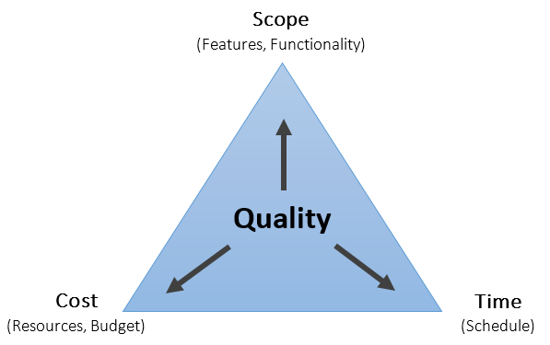
Why the office was created
SUPPORT: Rules without support are just papers
OPTIMIZATION: Engineers had to concentrate on the technical solutions
HARMONIZATION: We have 20 institutes working for the project and tens of CERN groups
RULES: The LHC quality plan was obsolete

