Slide 1
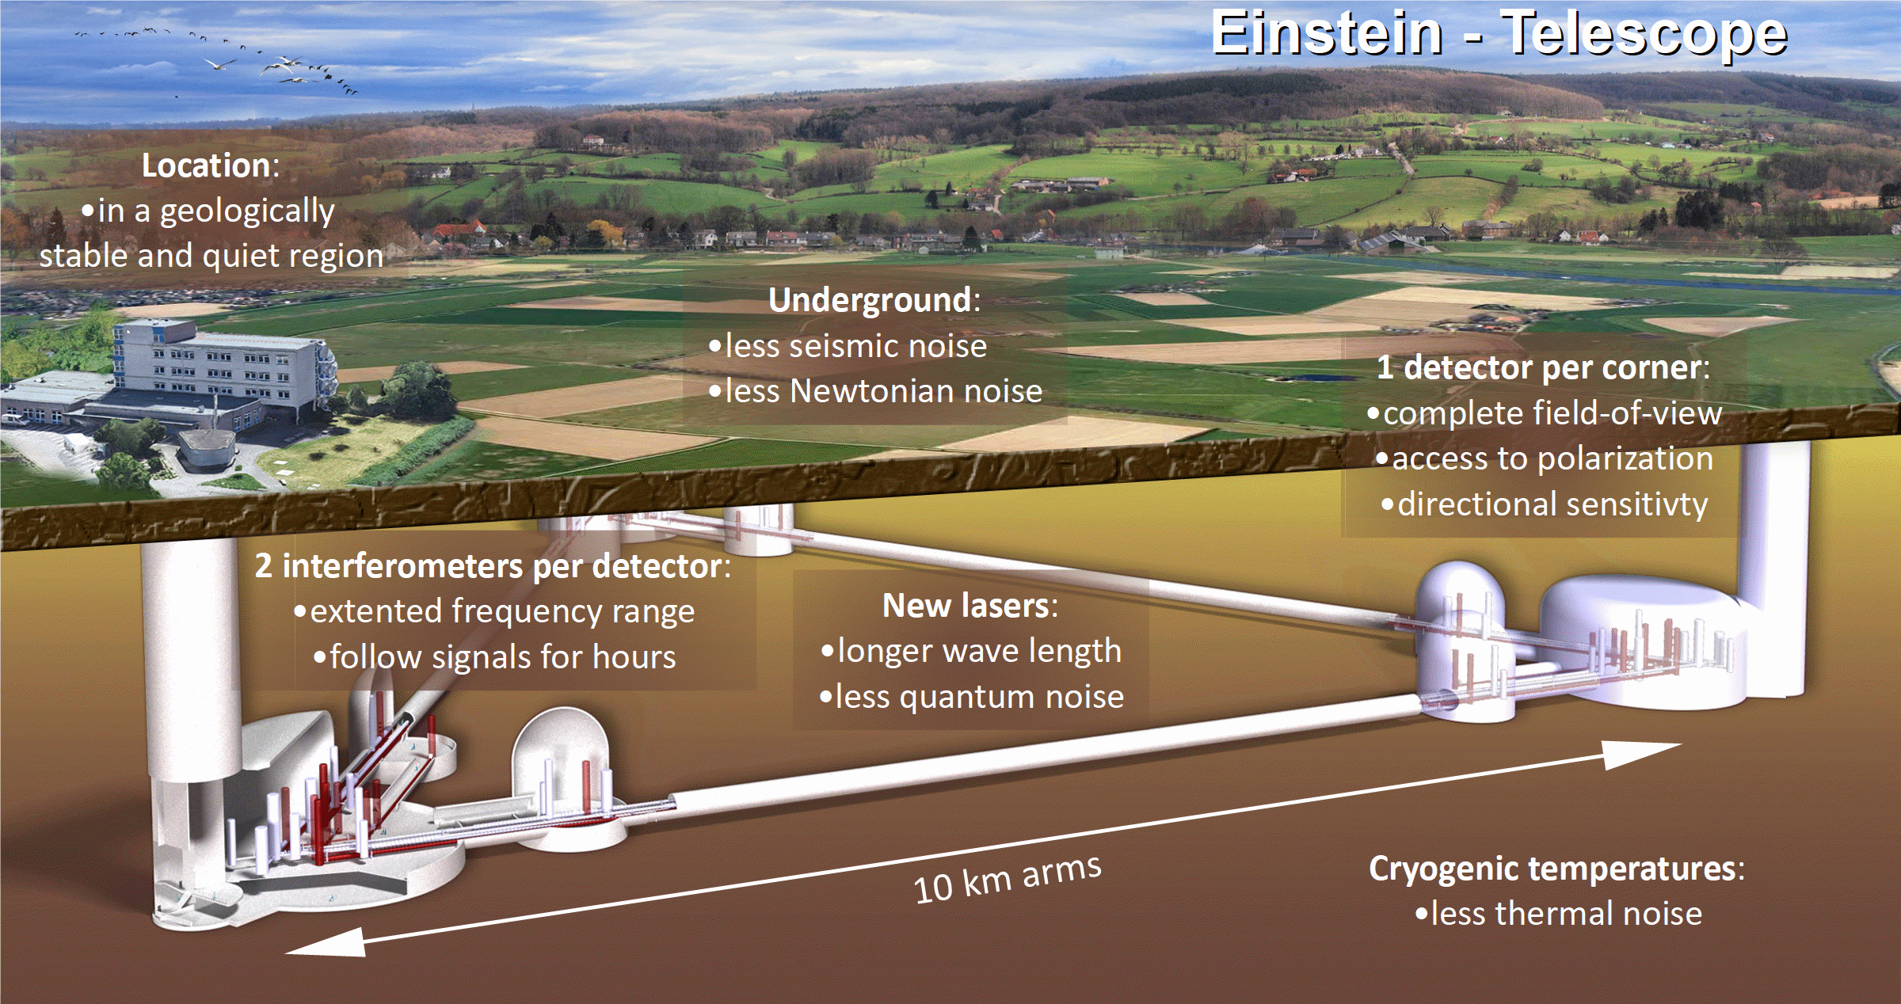

Slide 2
ET Vacuum
12 x 10 km arms @ room temperature + cryogenic endstations (mirrors)
Largest UHV system ever built
Fluctuations in gas density → fluctuation in the index of reflection → noise
Vacuum 10⁻¹¹ mbar (cost 450 Mio. €)
Technological developments for better vacuum and lower cost
  New materials
  Coatings
  Distributed pumping
  New concepts for pipes
  New production technologies
  Better design tools

Slide 3
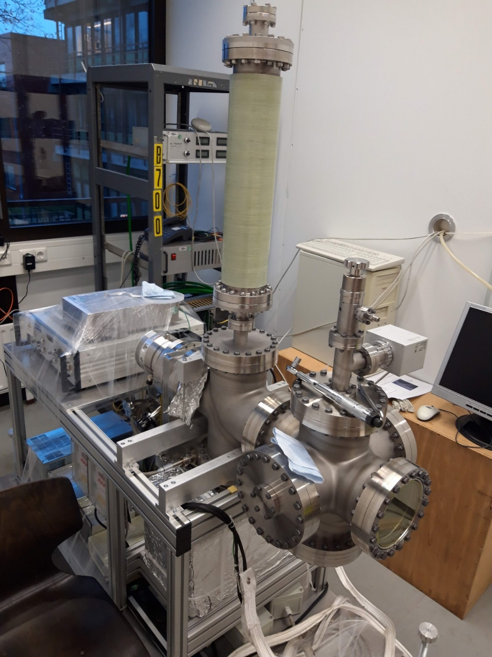
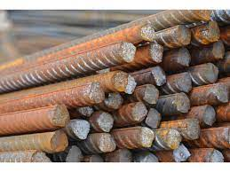
New UHV Technologies
Composite pipe
continious production
mild steel

