Slide 1
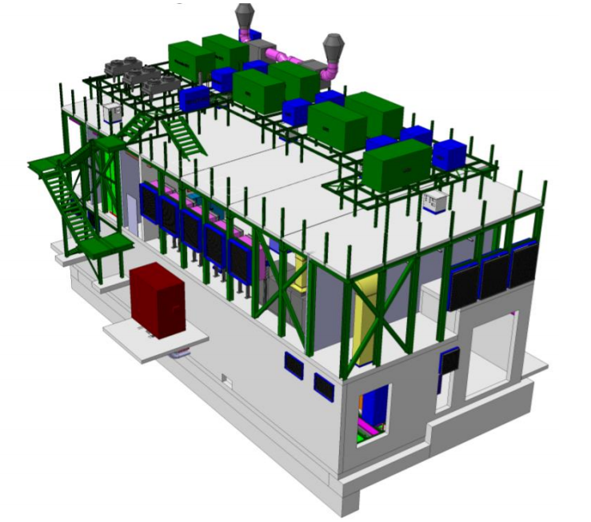


SXSN1 and CO2 Process
24/05/2022
Gerardo Velazquez Gutierrez (CERN)

Slide 2
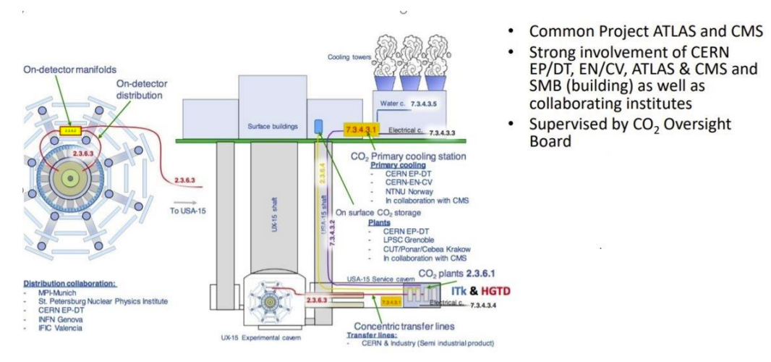
Introduction to the CO2 2PACL
A building is needed to host the primary cooling equipment
Courtesy of Martin Aleksa
Gerardo Velazquez Gutierrez (CERN)

Slide 3
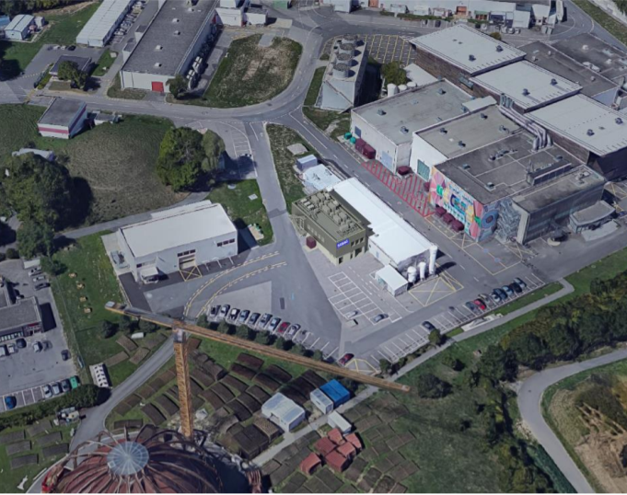
The SXSN1 building
  The SXSN1 building:
    Footprint: ~ 310 m2
    2 floors:
      Ground floor: machinery room and electrical room.
      First floor: UPS and battery room, storage area and services room.
      Roof: cooling equipment and solar panels.
Gerardo Velazquez Gutierrez (CERN)

Slide 4
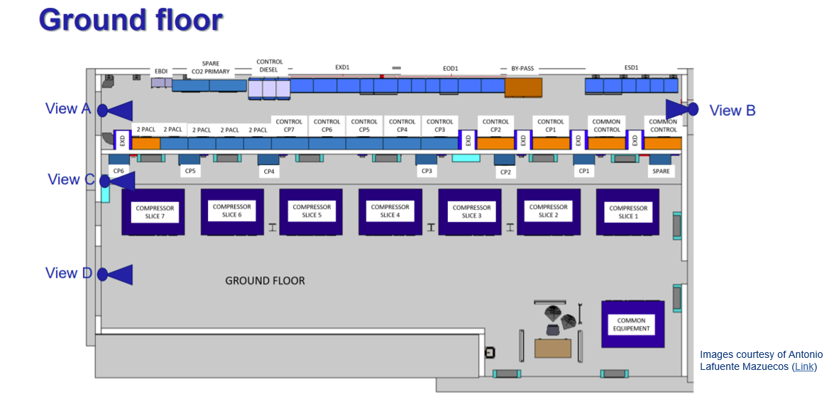
The SXSN1 building: Design
Gerardo Velazquez Gutierrez (CERN)

Slide 5
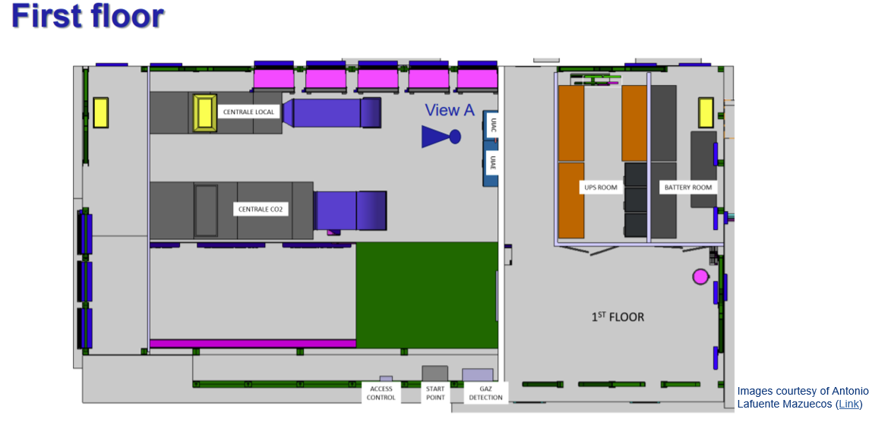
The SXSN1 building: Design
Gerardo Velazquez Gutierrez (CERN)

Slide 6
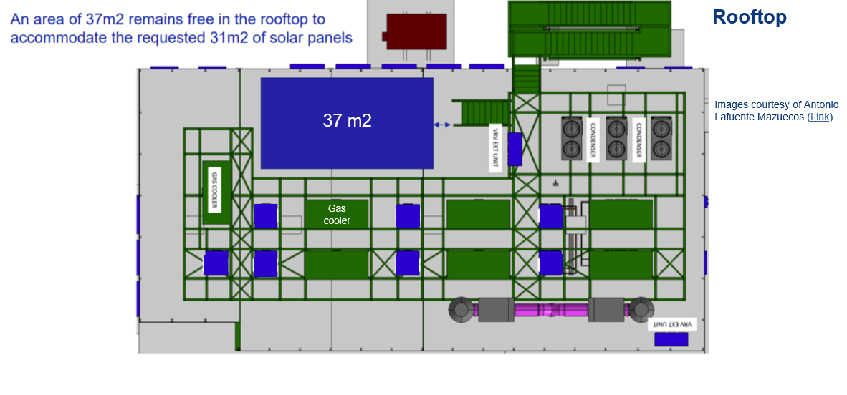
The SXSN1 building: Design
Gerardo Velazquez Gutierrez (CERN)

Slide 7
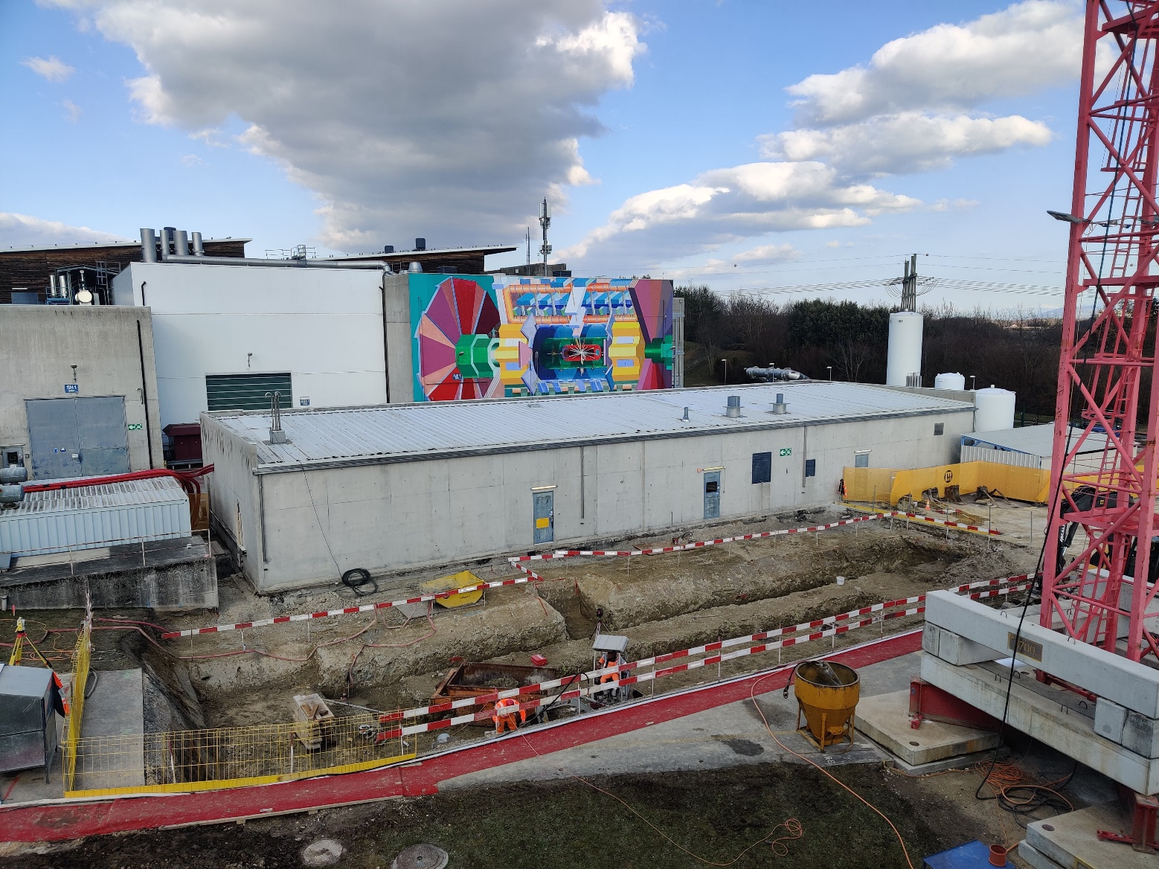
The SXSN1 building: Construction
January 2022: Excavation works
Gerardo Velazquez Gutierrez (CERN)

Slide 8
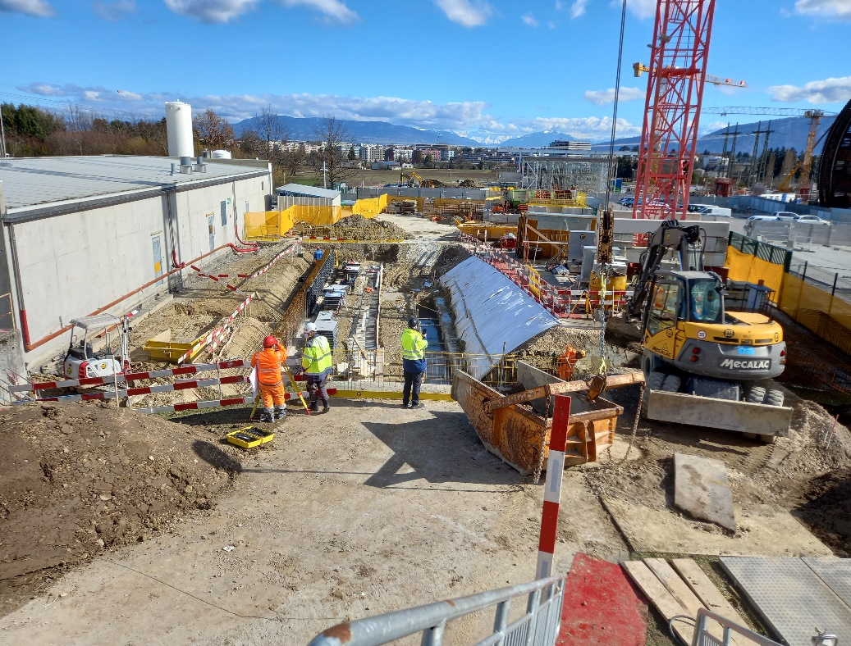
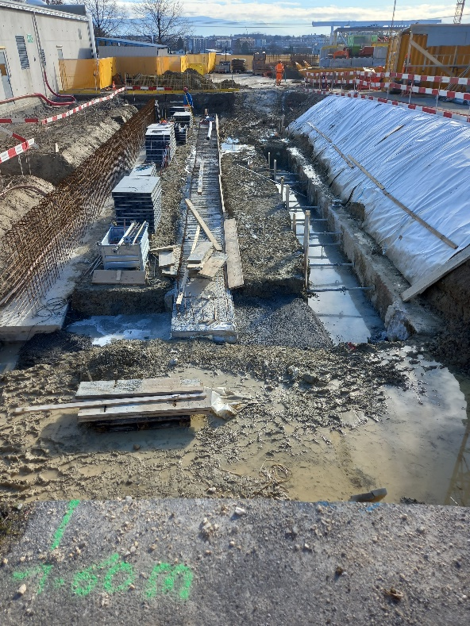
The SXSN1 building: Construction
February 2022: First concrete works
Gerardo Velazquez Gutierrez (CERN)

Slide 9
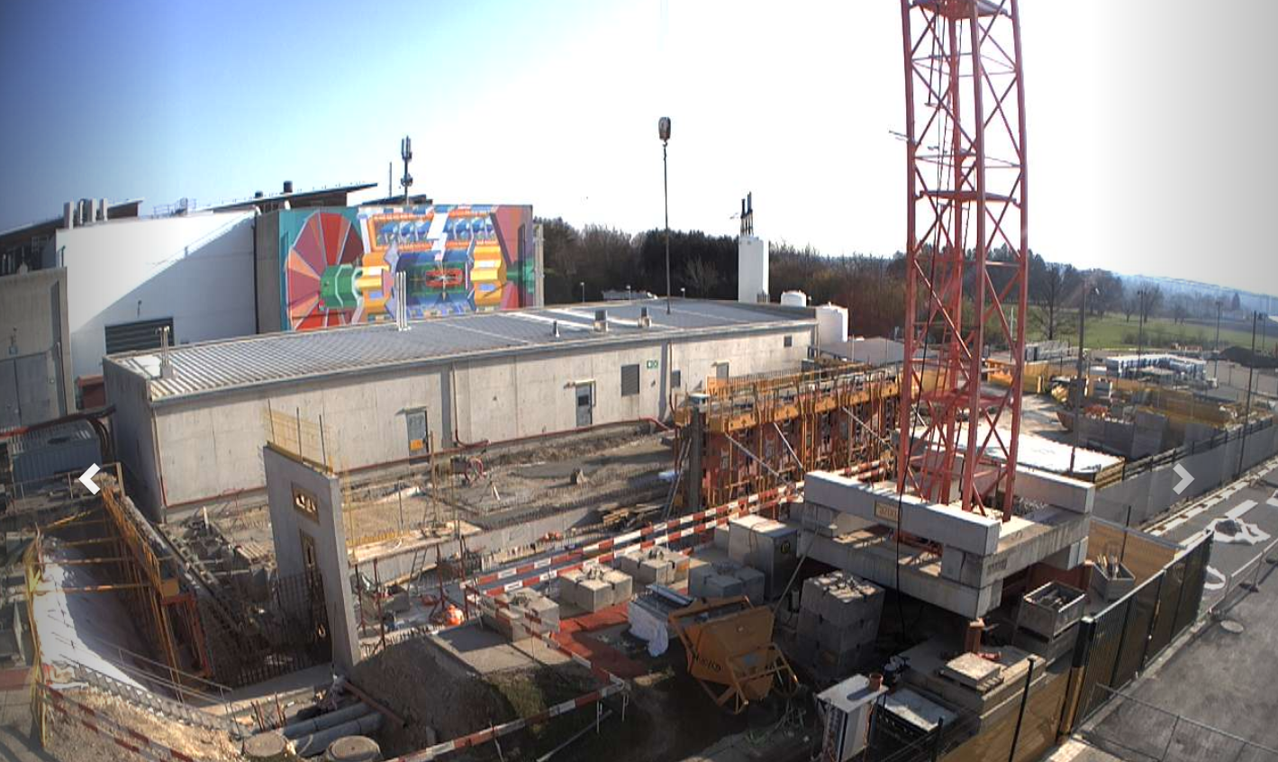
The SXSN1 building: Construction
March 2022: First walls
Gerardo Velazquez Gutierrez (CERN)

Slide 10
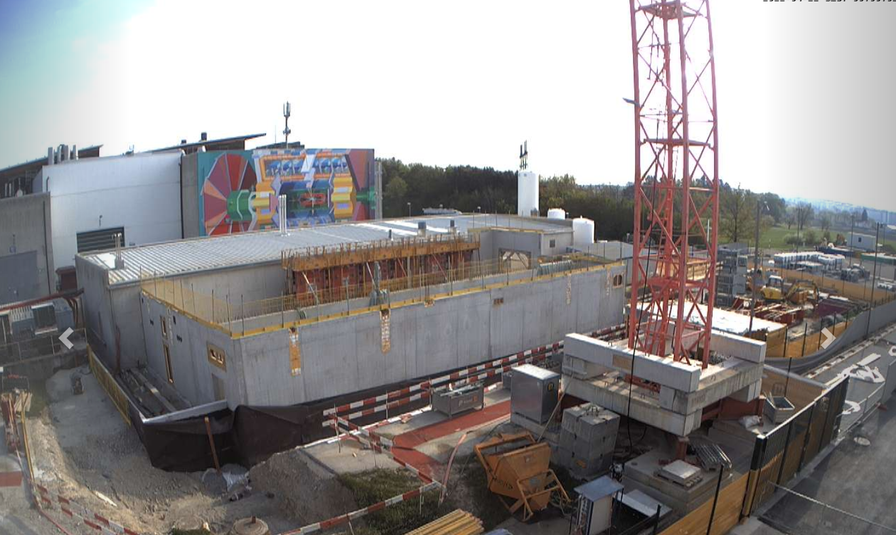
The SXSN1 building: Construction
April 2022: Ground floor almost completed
Gerardo Velazquez Gutierrez (CERN)

Slide 11
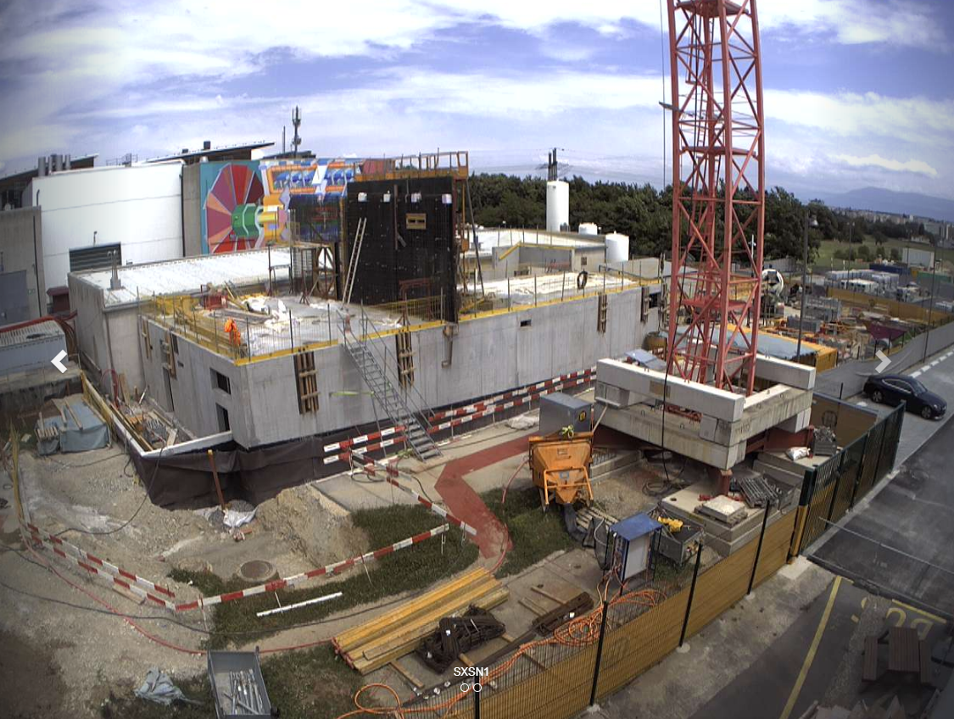
The SXSN1 building: Construction
Today: First floor on going
Gerardo Velazquez Gutierrez (CERN)

Slide 12
The SXSN1 building: Planning
2022
2023
2024
2025
LS3
Civil engineering
Building infrastructure
EL for R744
EN-CV R744
EP-DT 2PACL
SXSN1
SXNS1 – USA15 connection
ATLAS
Early installation
USA15
Remaining operation and installation
Mezzanine USA15 CV Room
See Raphael’s presentation
Pipping shaft
Gerardo Velazquez Gutierrez (CERN)

Slide 13
The SXSN1 building: Summary
Civil engineering planning: Being kept by the contractor → Construction finished by Q4 – 2022
Infrastructure planning: Q1 and Q2 2023
            Services design already completed → procurement phase on going
Integration of the equipment → Completed
            Project meeting each two weeks to revise conflicts or changes (due to the better definition coming from the design phase)
Overall → The project is progressing well but still a lot to come.
Gerardo Velazquez Gutierrez (CERN)

Slide 14
Cooling and Electrical Upgrade
Gerardo Velazquez Gutierrez (CERN)

Slide 15
Infrastructure upgrade: Power requirements
Power needs for ATLAS Phase-II defined and compiled in EDMS 2594736 → 5MVA additional power needs, increases expected for:
• Upgraded ATLAS detectors & new trigger electronics
• CO2 Cooling
• TDAQ farm
WPs are being worked out together with EN-EL
Previous presentations in the AUW on the topic by Martin Aleksa, Lukasz Zwalinksi and Gerardo Velazquez can be found in Link 1, Link 2 and Link 3
Gerardo Velazquez Gutierrez (CERN)

Slide 16
Power overview
When talking about detector and associated rack infrastructure powering during Run2, ATLAS was consuming:
  Normal → ~ 770 kVA
  BC → ~ 1500 kVA
  UPS → ~ 561 kVA
  Diesel → ~ 100 kVA
~ 3000 kVA (primary cooling and general infrastructure not accounted here)
For Phase II upgrade, the following loads have been requested by the detectors
  Normal → ~ 3700 kVA
  BC → ~ 3100 kVA
  UPS → ~ 990 kVA
  Diesel → ~ 140 kVA
~ 7800 kVA (primary cooling and general infrastructure not accounted here)
The numbers cover what will remain + the upgrade
There is no room in the existing infrastructure to cope with the requested load → Upgrade needed
Gerardo Velazquez Gutierrez (CERN)

Slide 17
Power overview vs work packages
  The upgrade of the different networks is covered by the following so-called work packages:
  Normal → ~ 3700 kVA
  BC → ~ 3100 kVA
  UPS → ~ 990 kVA
  Diesel → ~ 140 kVA
2PACL – CO2
2PACL – CO2
UPS consolidation
TDAQ containers
Minor modifications not detailed in this presentation
SXSN1
ATCA area USA15
TDAQ SDX1
UPS consolidation
SXSN1
Not easy to set up the scope of each WP as most of them are interrelated.
Gerardo Velazquez Gutierrez (CERN)

Slide 18
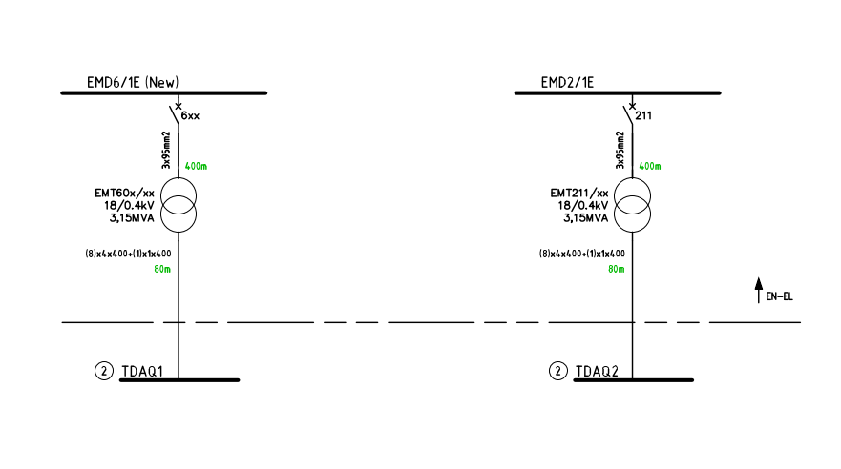
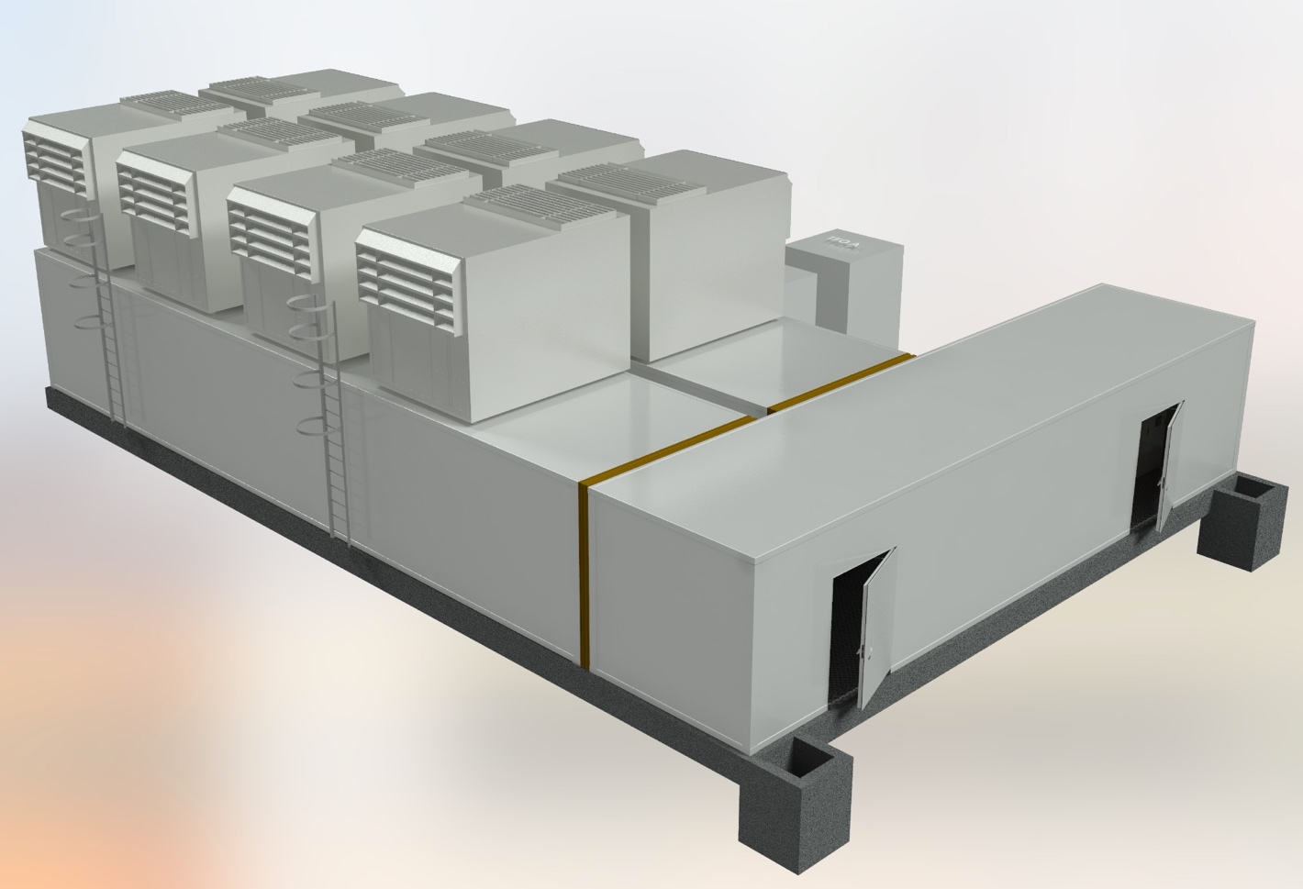
Normal network – TDAQ containers:
    1200 kVA TDAQ area →
    Two options selected (cost decision)
    Upgrade needed:
      1 (2) x 18 kVA feeders
      1 (2) x 3.15 MVA transformers
      Cabling
Extra feature
Works at the end of LS3:
Optimization based on the containers tendering
Baseline
Possible ATLAS implementation
Gerardo Velazquez Gutierrez (CERN)

Slide 19
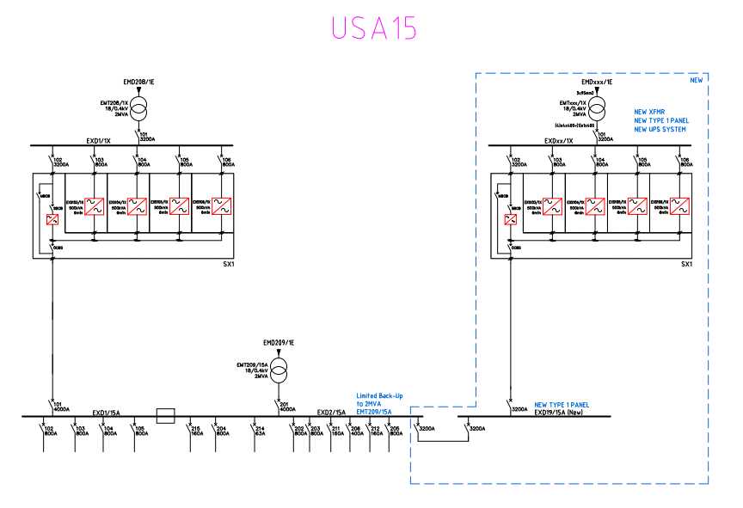
BC network – USA15: New ATCA area
  BC ~ 3100 kVA → 500 kVA US15 (existing network sufficient) + 2600 kVA USA15 (new network needed)
The existing network will be replicated: Baseline frozen
1 x 15 kV feeder
1 transformer
4 x 500 kVA UPS
Switchboards and cabling to racks
Works in LS3 in USA15 and prior to LS3 in SX1
Optimization: number of UPS may decrease based on the power evolution
Gerardo Velazquez Gutierrez (CERN)

Slide 20
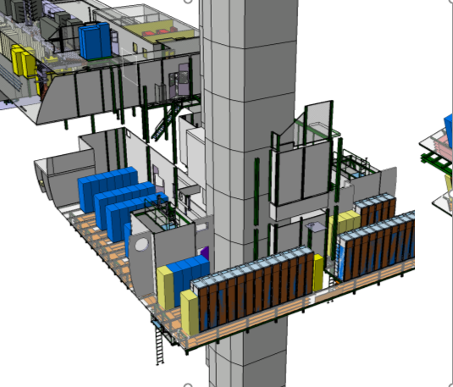
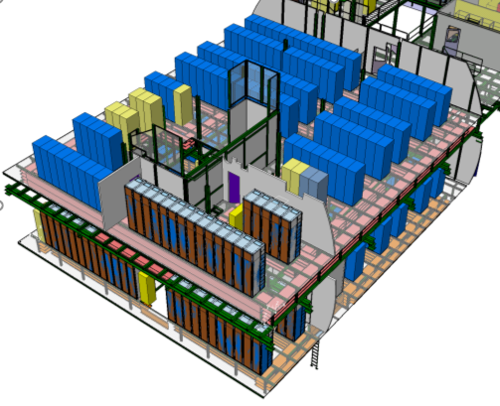
BC network – USA15: New ATCA area
New ATCA racks
Noise walls
Level 1
Level 2
Images courtesy of Kostas Iakovidis
Gerardo Velazquez Gutierrez (CERN)

Slide 21
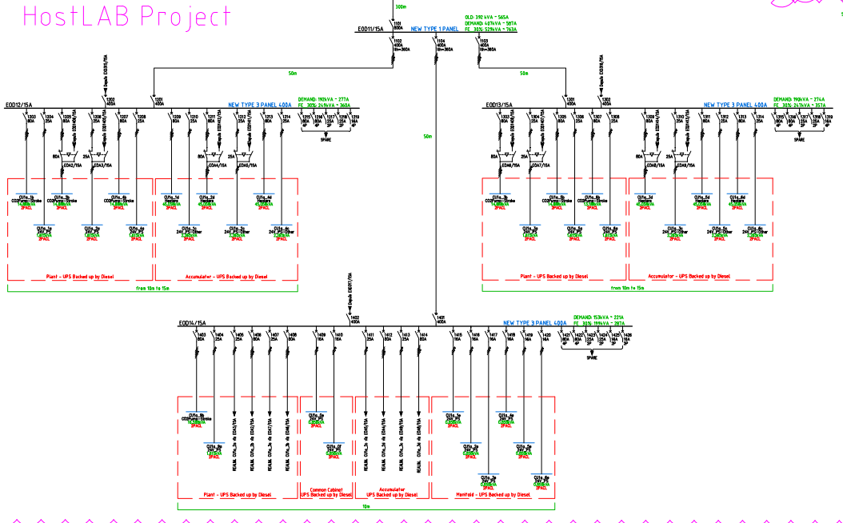
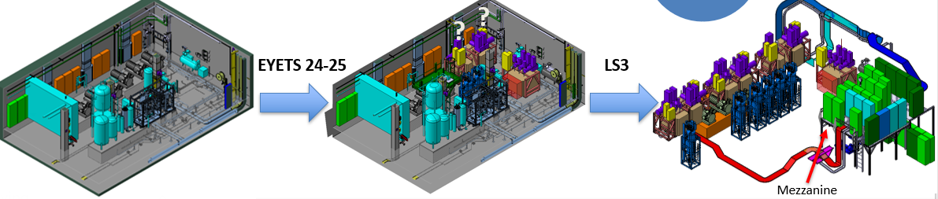
UPS network – SDX1+ SXSN1:
USA15:
  4 new switchboards for 2PACL loads
  Existing infrastructure to be used for rack room loads (minor modifications)
Baseline frozen
Planning 2PACL:
  Early installation being decided
  LS3
Planning rack room: LS3
Gerardo Velazquez Gutierrez (CERN)

Slide 22
Overall status and summary:
TDAQ containers and SDX1: scope identified, and baseline agreed. Granularity to racks to come with the TDAQ power evolution.
BC USA15: scope identified, and baseline agreed. Granularity and optimizations to come with the power updates by the systems
UPS USA15:
  2PACL: design completed, and baseline fixed (3D integration being adjusted) →Early installation (if approved)
  USA15 racks: : scope identified, and baseline agreed. Granularity to come during Run3
WP have been worked out together with EN-EL and they will be reviewed in a Cost and Schedule Review on June 17, 2022. Cost are covered jointly by CERN (Hostlab Phase II) and ATLAS Collaboration funds.
Very challenging project → Run 4 load will be 2,5 times the Run 3 one. Almost duplicating the existing infrastructure is needed
A lot of design work to come during Run 3
Installation works during LS3 will take place all along ATLAS
Gerardo Velazquez Gutierrez (CERN)

Slide 23
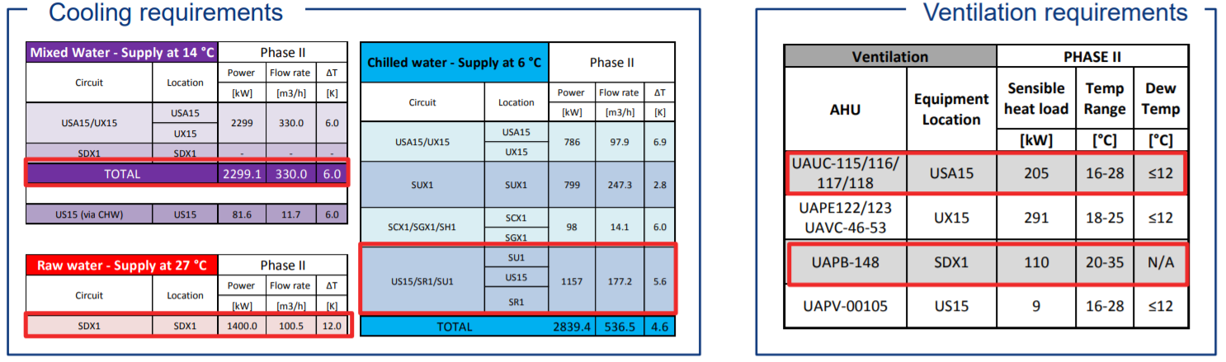
Infrastructure Upgrade: Cooling requirements
Courtesy of F. Dragoni
Cooling requirements for mixed water have increased in USA → Main reason for SU1/SUX1 upgrade
Gerardo Velazquez Gutierrez (CERN)

Slide 24
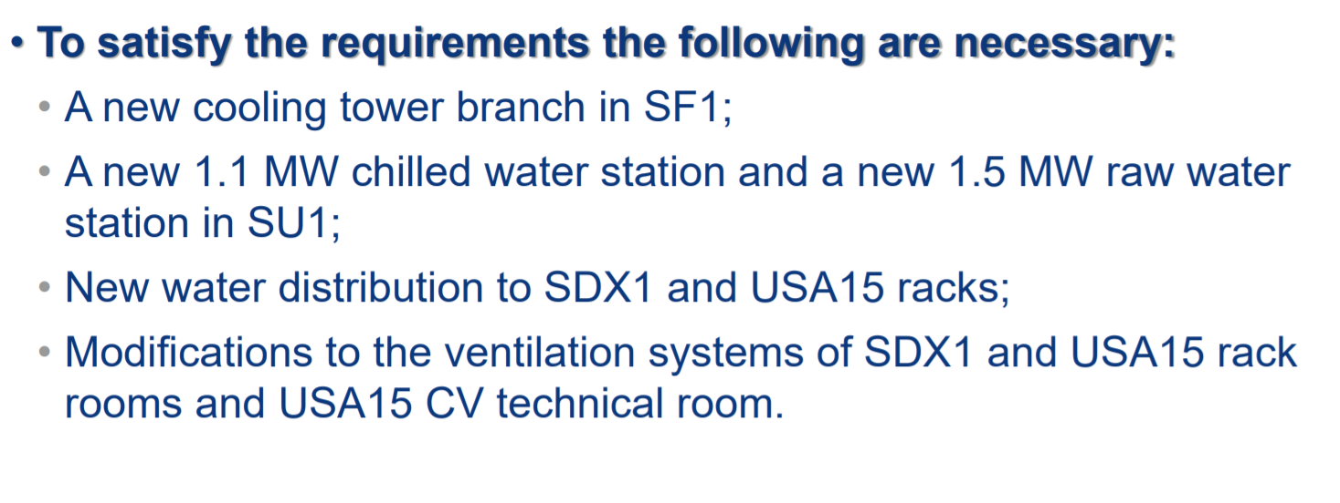
Infrastructure Upgrade: Cooling
Courtesy of F. Dragoni
Gerardo Velazquez Gutierrez (CERN)

Slide 25
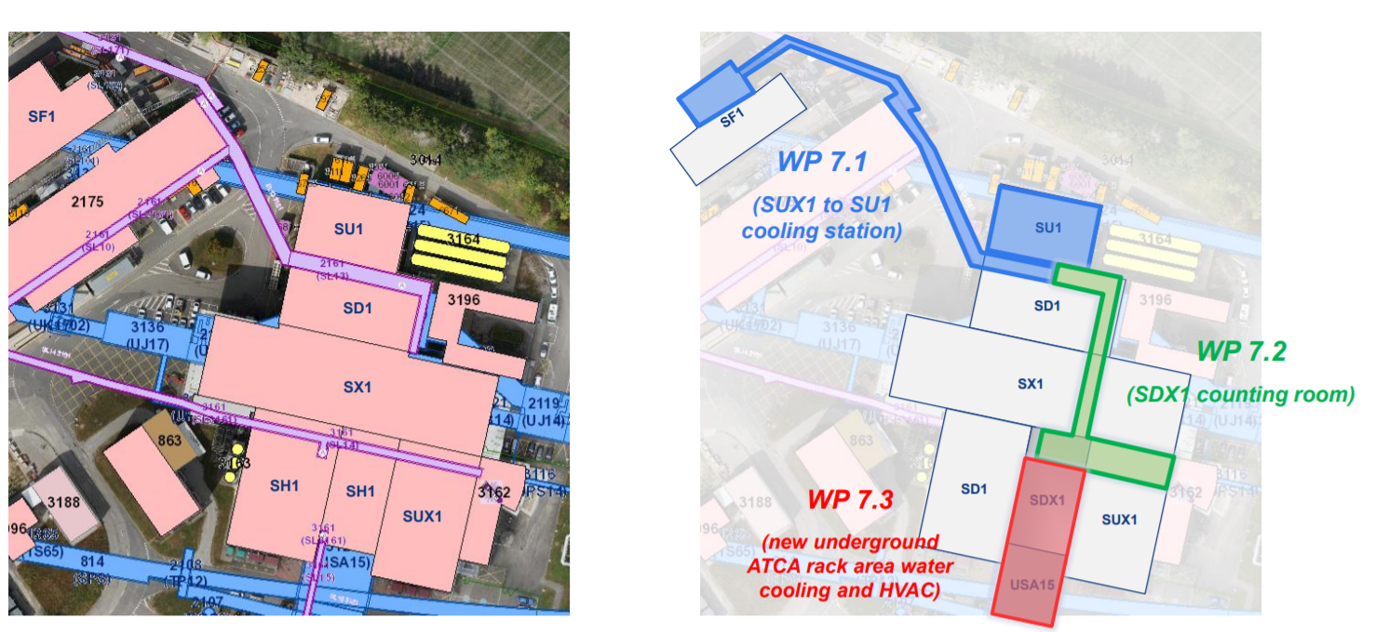
Infrastructure Upgrade: Cooling
*Works organized in 3 work packages (WP)
Courtesy of F. Dragoni
Gerardo Velazquez Gutierrez (CERN)

Slide 26
Infrastructure Upgrade: Cooling status
Cooling needs already defined and compiled in EDMS 2612278.
Detailed engineering almost completed.
SU1 consolidation contract being awarded → First Works staring on the YETS22-23
WP have been worked out together with EN-CV. Cost are covered jointly by CERN (Hostlab Phase II) and ATLAS Collaboration funds.
Gerardo Velazquez Gutierrez (CERN)

Slide 27
Q&A?
Gerardo Velazquez Gutierrez (CERN)

