Slide 1
Atlas TC meeting
Engineering activities
2022/05/24
Raphael Vuillermet
2022/05/24

Slide 2
Overview
Engineering efforts that are currently ongoing to prepare LS3
Muon
CO2 project
  Test
  Infrastructure
USA15 rack room re-organization
LS3 Services
Buildings layout
  B191 : SW decommissioning
  B180 : ITK mock-up
ATLAS movement
Conclusion

Slide 3
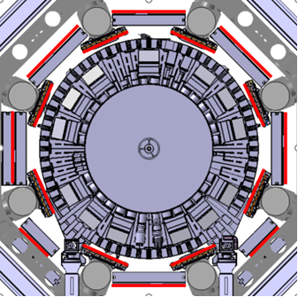
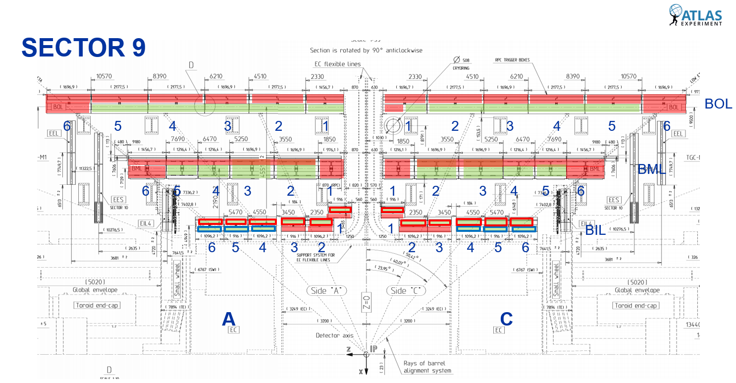
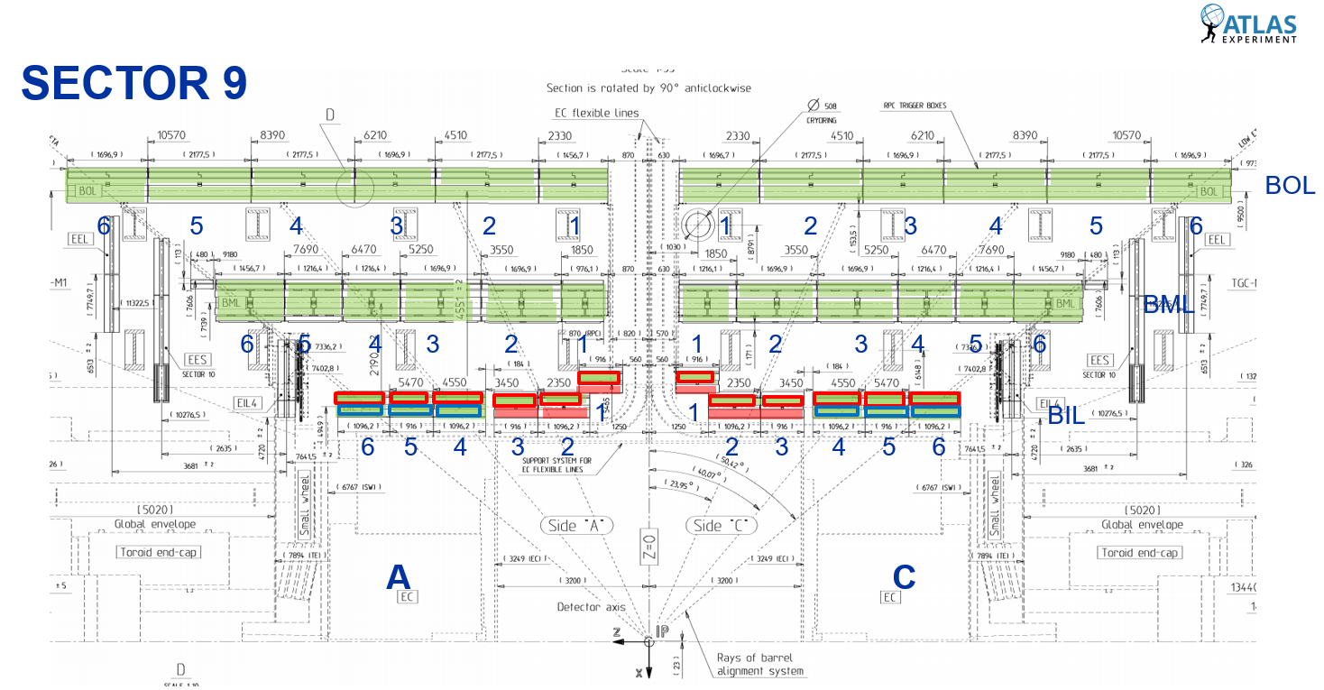
1- Muon
BI Project and Mezzanine Cards Replacement
Courtesy of Lorenzo & Tatiana
Work done in LS2
Installation of BIS78 as a Pilot Project
Replacement of the last 2 chambers of each small sector
BIS78 replaced the old BIS7 and BIS8 - 8 chambers have been installed on Side A
BIL
BIS
Installation of a new layer of RPC trigger chambers in the Barrel Inner muon layer ( BIS, BIL, BIM, BIR)
BIM/BIR
Plans for LS3
Replacement of mezzanine cards for all MDT chambers
Current BIS will be replaced by new chambers (sMDT + RPC) - 112 chambers to be replaced
New BIL RPC will be installed on top of existing BIL MDT - ≈180 new chambers to be installed
Mezzanine cards of all MDT chambers will have to be replaced (BI-BM-BO-EI-EE-EM-EO).
Many chambers are currently not reachable: study to provide access to all of them
Access maps of Sector 9 as an example – Before and after designing access

Slide 4
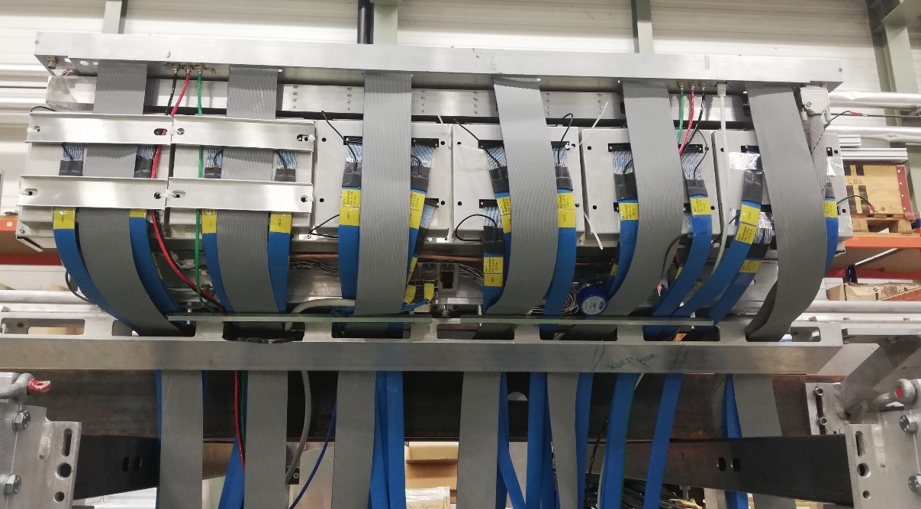
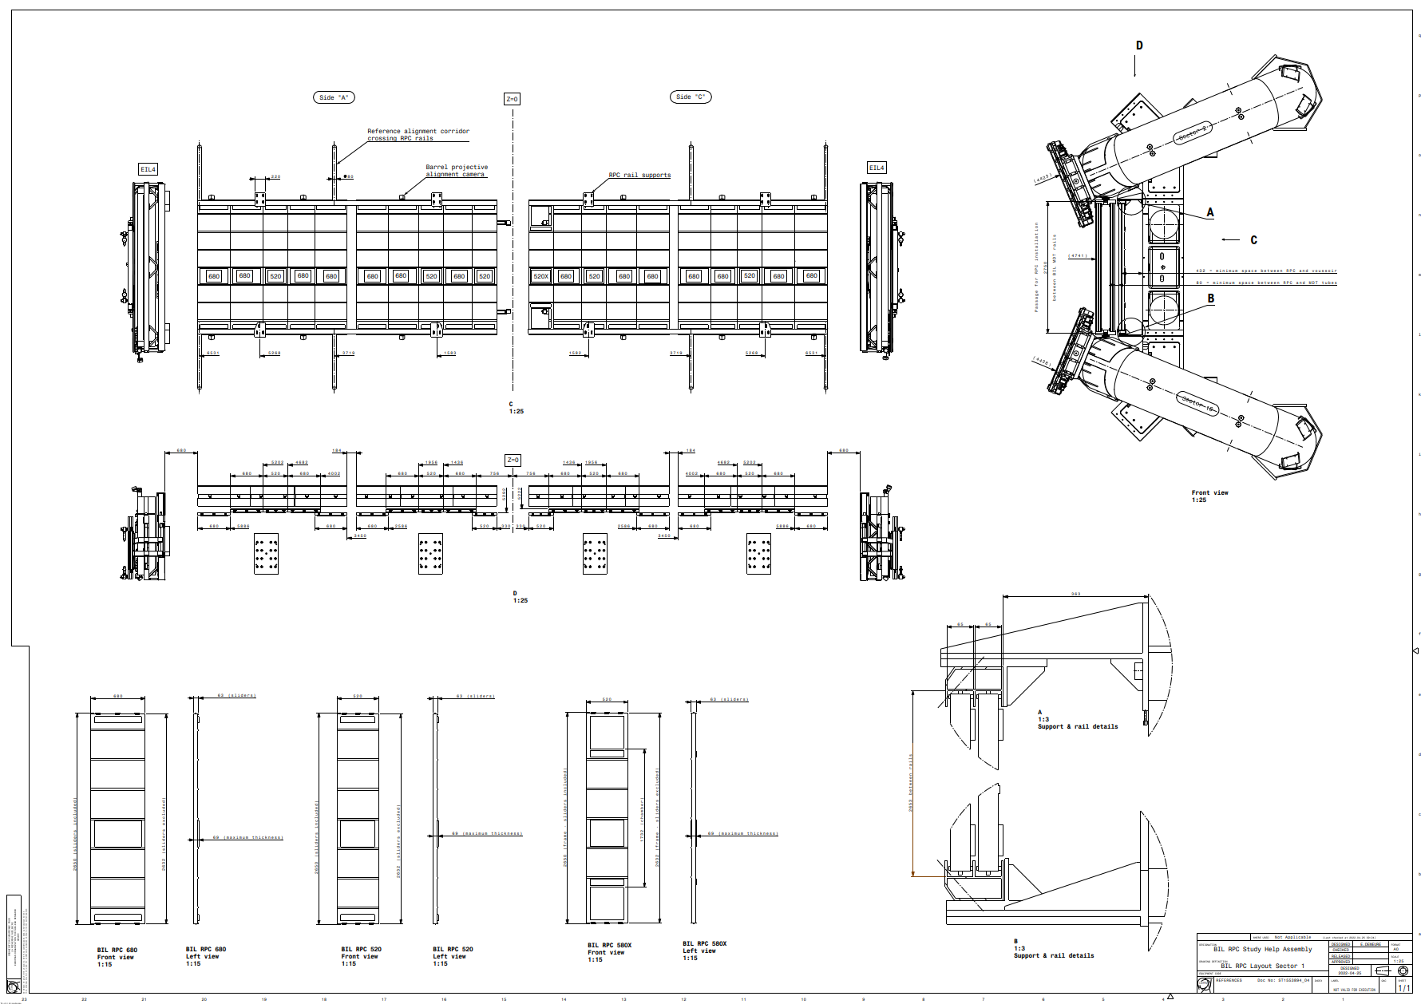
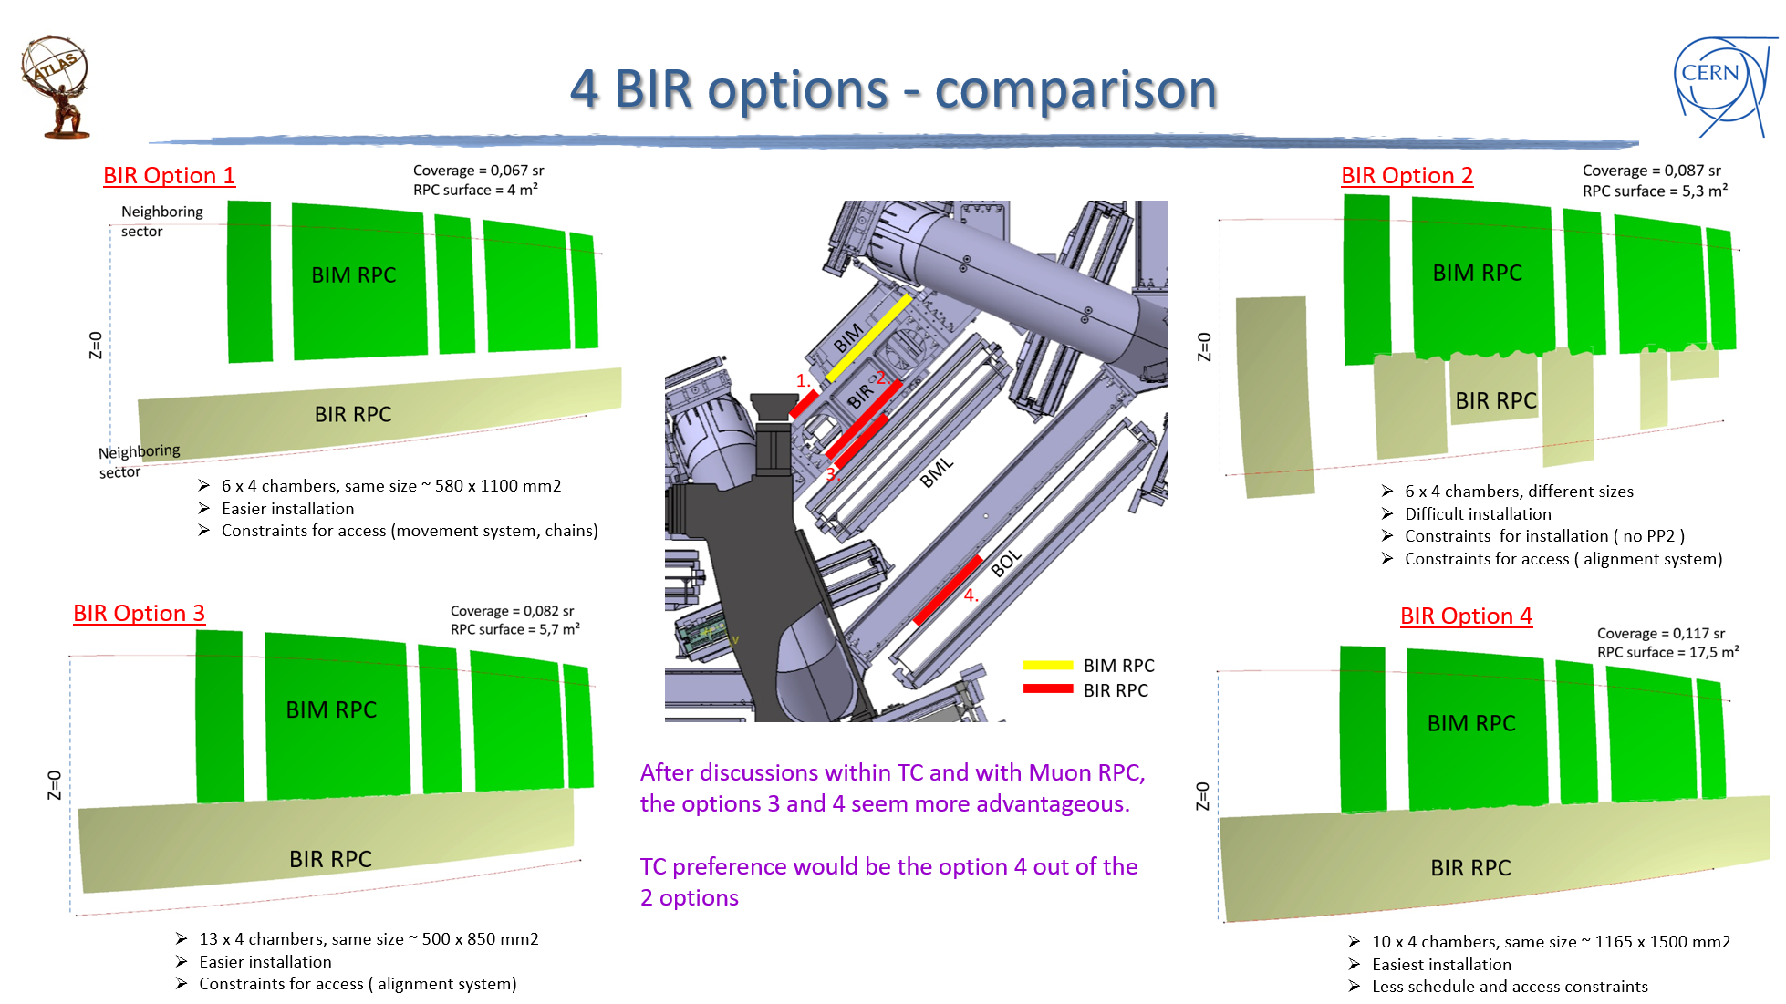
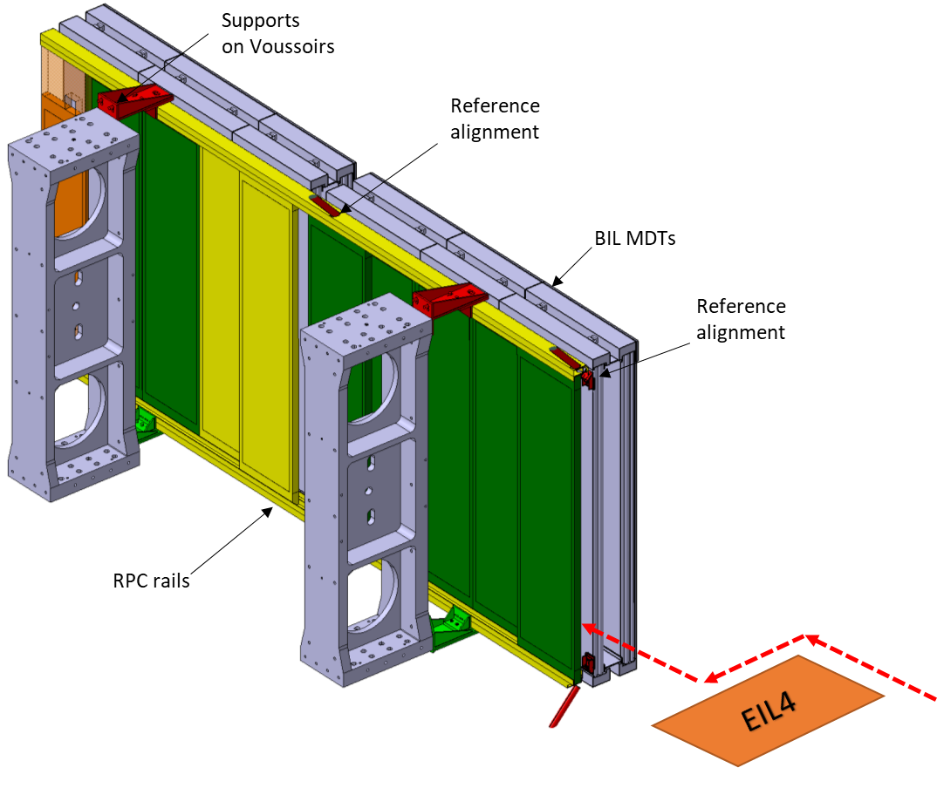
BIS 1-6 (Alexandre, Lorenzo, Tatiana)
Follow-up of BIS1-6 design, tests, and FDR
Definition of installation toolings and support frames, rail junction in Z0, movement system, rail reinforcements
BIL/BIM/BIR RPC (Edouard, Lorenzo, Tatiana)
Follow-up BIL RPC design, tests and FDR
Define BIL RPC final layout in 3D and produce detailed 2D drawings for all sectors
Design BIL RPC support structures (rails, brackets)
Propose and validate solutions for special cases (BIL RPC sectors 7,9,13)
Study BIM/BIR installation scenarios and layouts
BIS1 service routing test in BB5
BIL RPC: installation path and rails

Slide 5
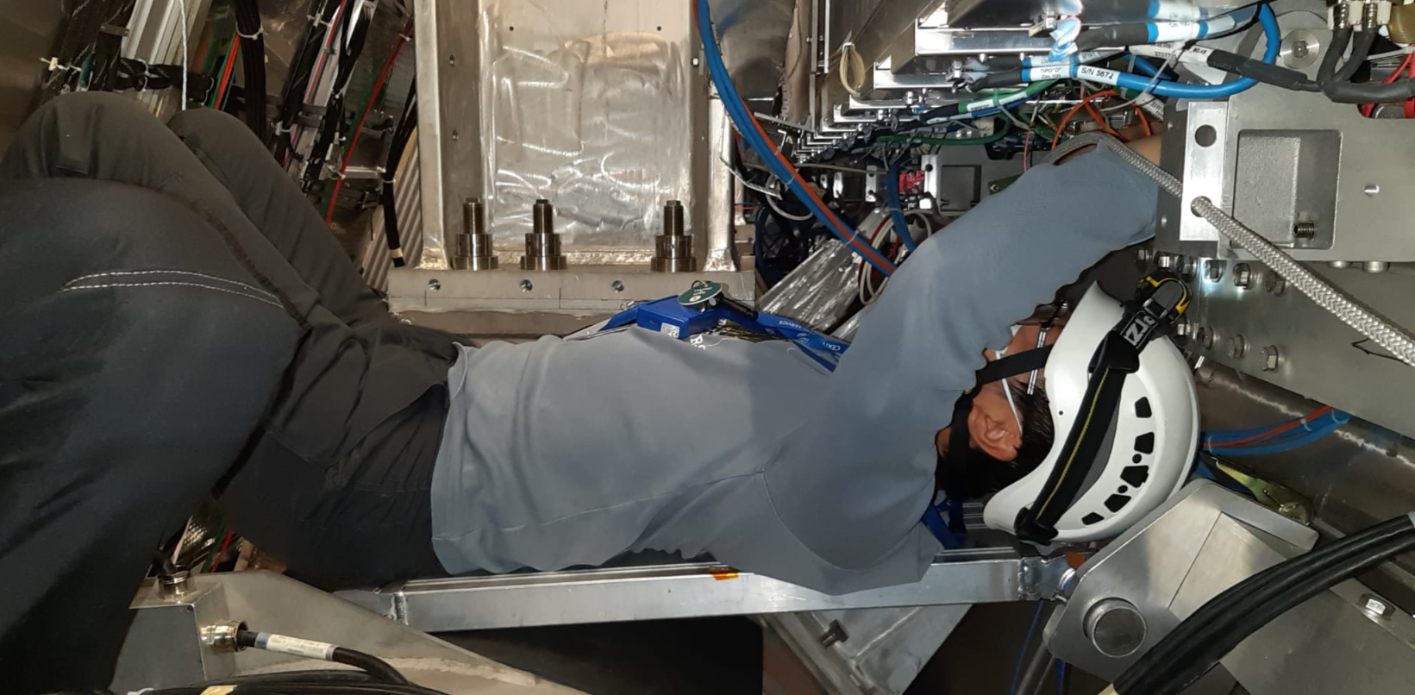
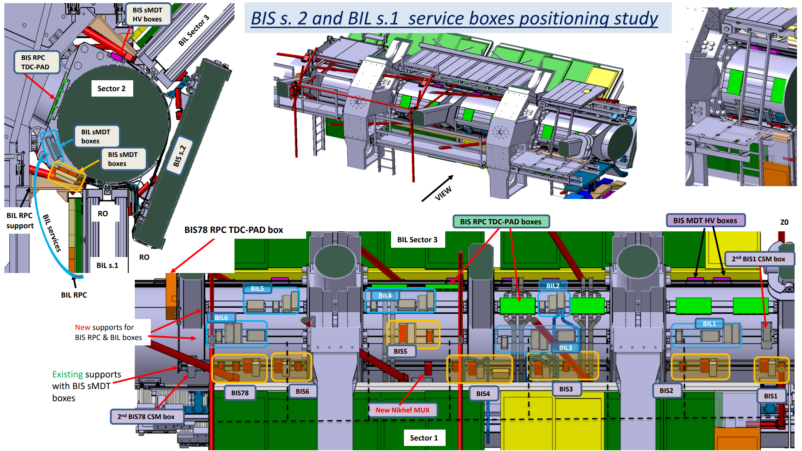
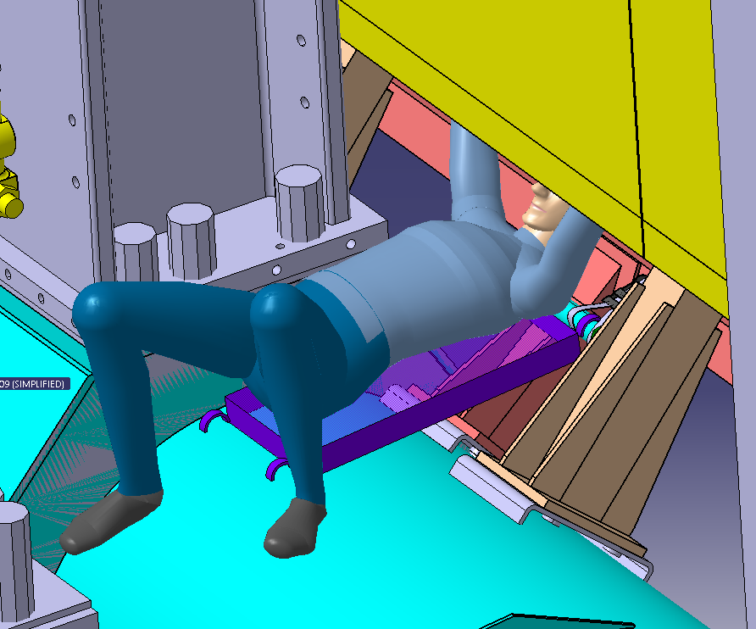
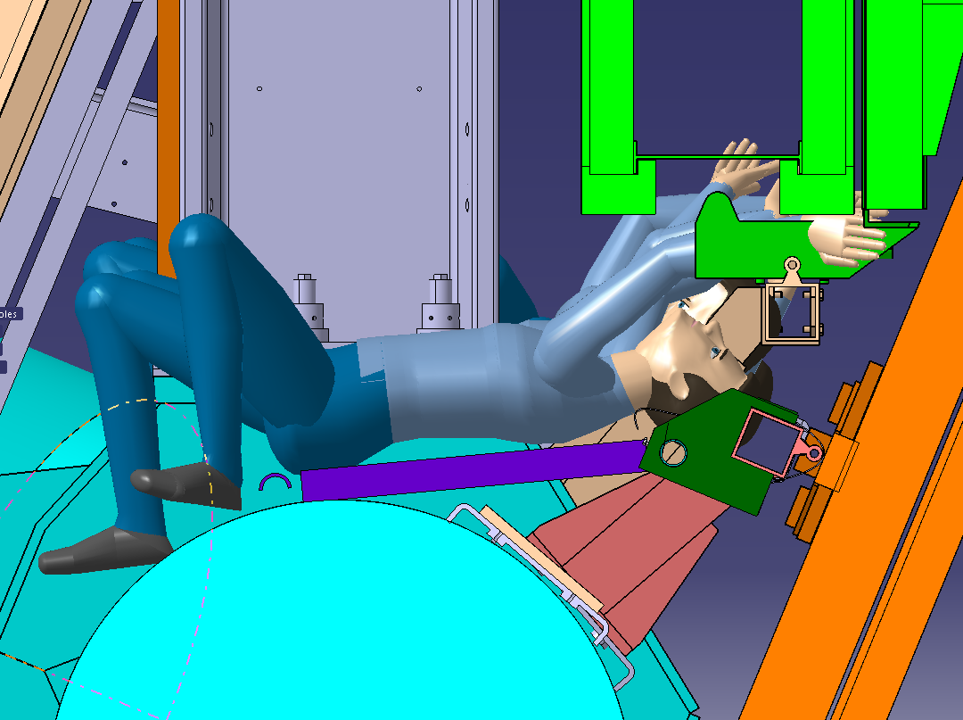
Access (Albert, Lorenzo, Tatiana)
  Continue design of access means for Barrel chambers mezzanine card replacement: BI-BM-BO chambers
  Continue design of access means for Forward chambers mezzanine card replacement: EIL4-EO-EE chambers
  Study access and propose solutions for BIS1-6 installation and connection
Services (Alexandre, Lorenzo, Tatiana)
  Define the service routing + electronic boxes positioning + mock-up
  Study and integration of Gas manifolds for RPC
Example of access studies in Sector 9

Slide 6
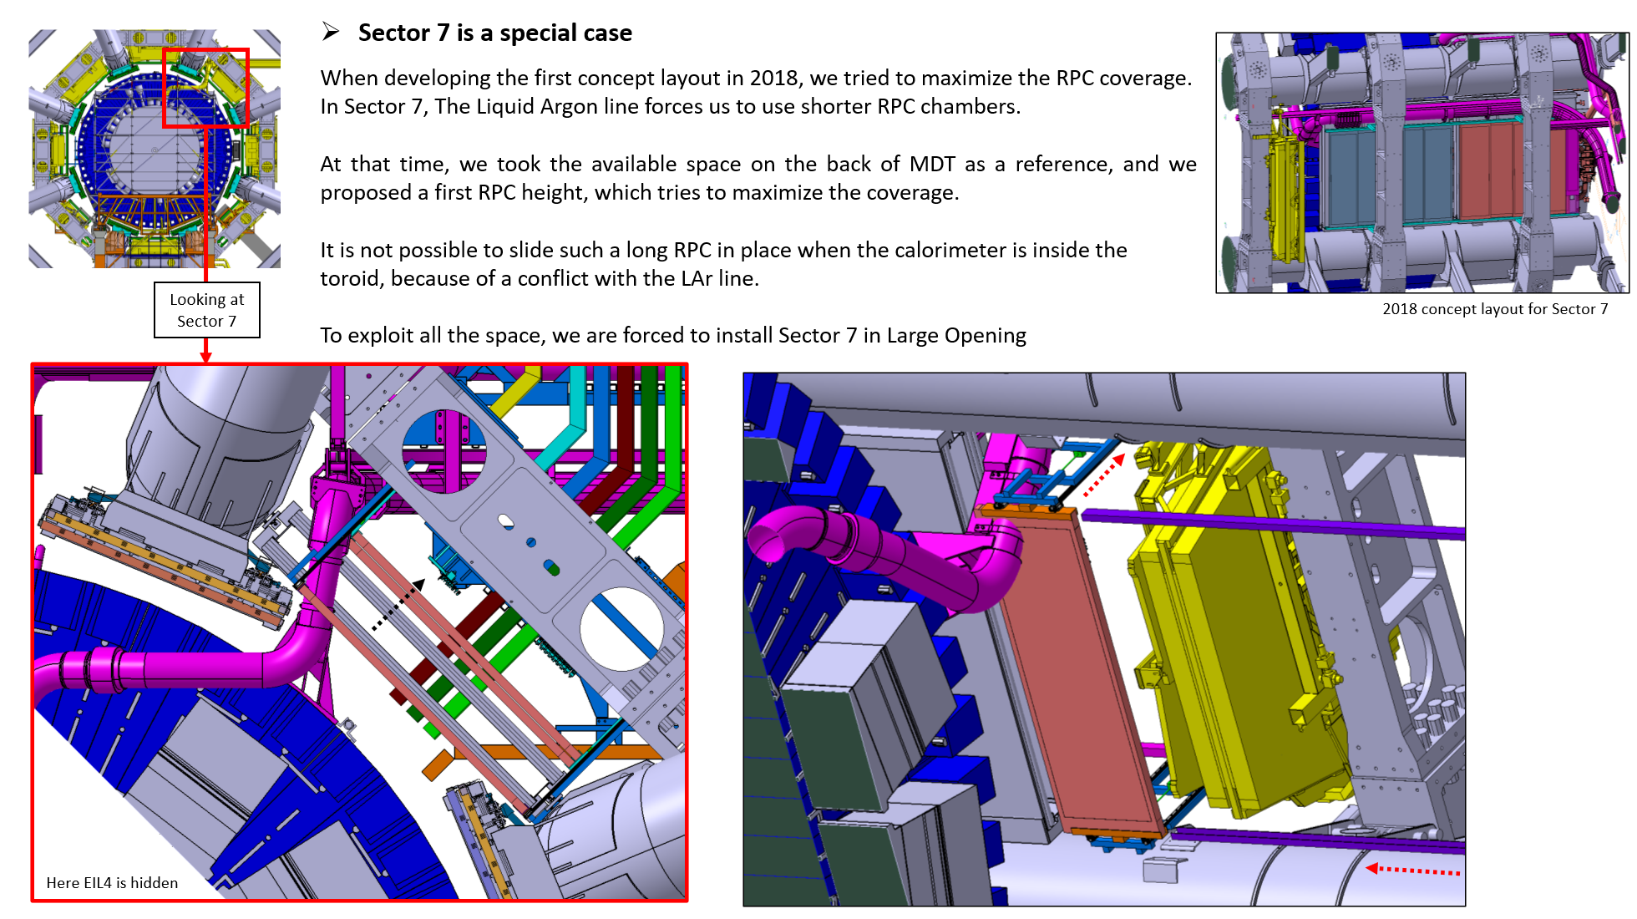
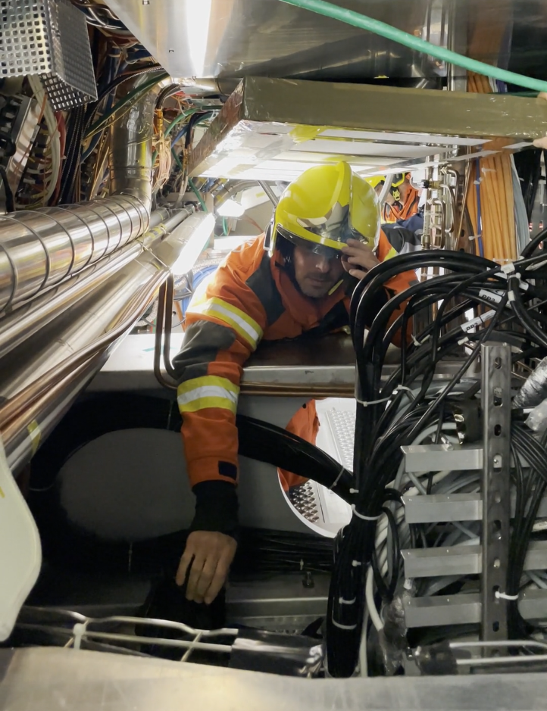
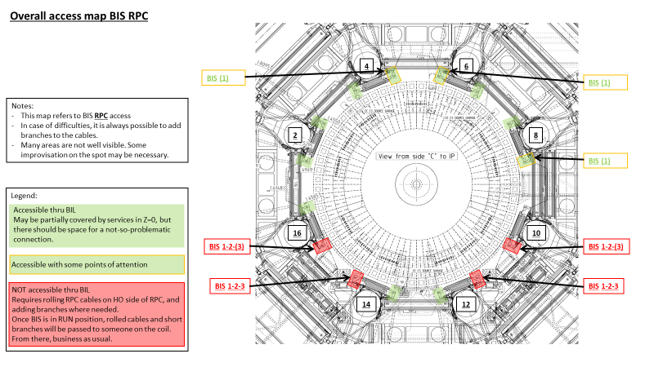
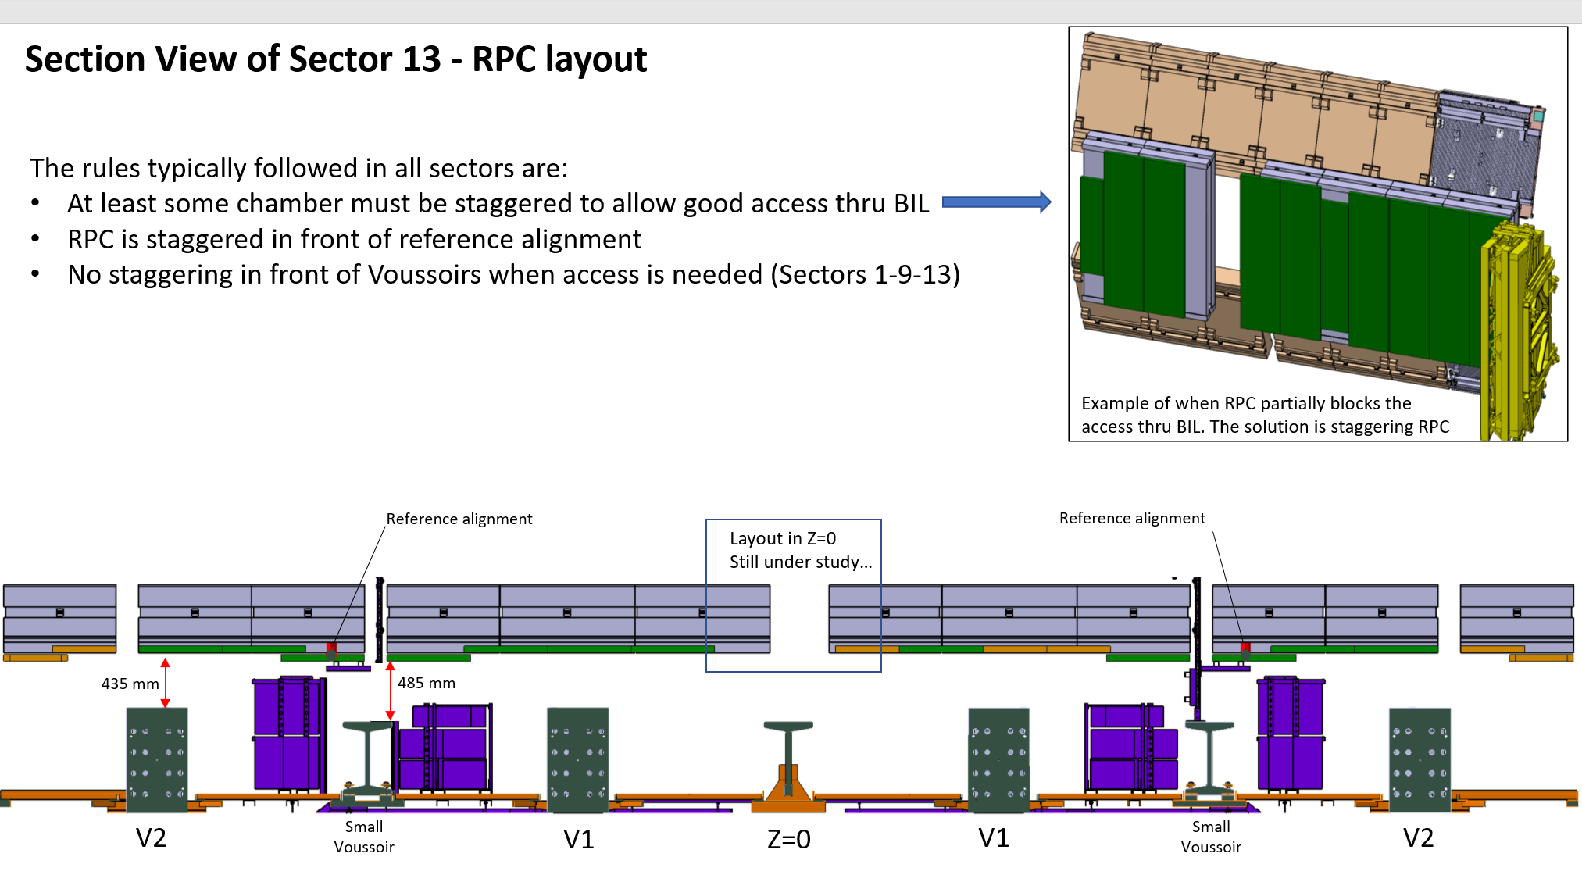
Installation and schedule (Lorenzo, Tatiana, Michel)
  Inventory of installation constraints
  Preparation of installation procedure for BIS/BIL RPC/EIL4 sTGC chambers
  Build up the installation schedule, and follow up with systems to validate the sequence of operations
Installation constraints in Sector 7
Access constraints map for RPC connection
Access test with Fire Brigade in Sector 13 to clarify access needs
Access constraints in Sector 13

Slide 7
2- CO2 project for Run 4 …
Context:
  For Run 4, a new cooling system based on CO2 will be installed in ATLAS infrastructure for ITK and HGTD.
  This system will replace the evaporative cooling system and thermosiphon for better thermal performances and for environmental reasons
  ATLAS infrastructures impacted :
    Surface building
      SXSN1 : primary cooling system (R744) (Gerardo)
      B180 : Baby-Demo for qualification of ITK system and HGTD commissioning (Martin D., Claudio)
      SR1 : Demo inheritance for qualification and commissioning of ITK (Martin D., Claudio)
    Underground
      PX15 and USA15 for the primary cooling and CO2 storage (EN-CV)
      USA15-CV with the installation of the CO2 compressors & accumulators, control & power cabinets (Raphael)
      USA15 (services) with the installation of the electrical switch board (Gerardo)
      ULX16 and UX15 with the installation of the Main Transfer Lines (MTL) (Martin D.)
      Toroid with the installation of the MTL and manifold boxes (Martin D.)

Slide 8
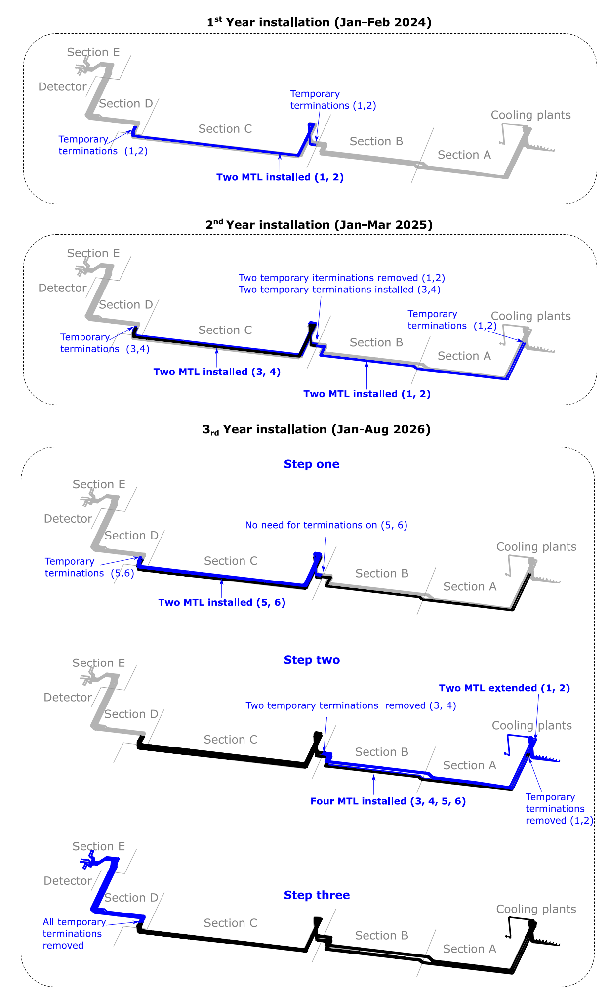
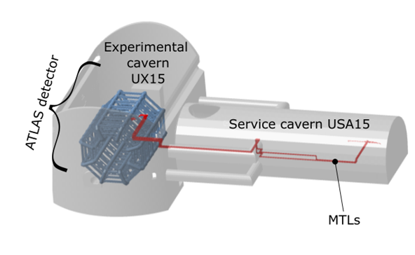
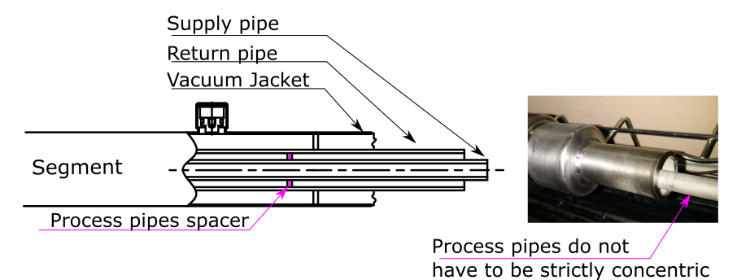
2.1 - CO2 project, tests and development
Courtesy of Martin D.
Main CO2 Transfer line specifications
CO₂ Cooling system
  Design and Integration of manifold Boxes in Toroid area (Martin D., Martin S., Jan)
  Tendering of the Main transfer lines (MTL) (6x120m from CV room to Toroid) (Martin D.)
  Component testing (Bartosz, Dominik, Martin D.)
CO₂ and Monophase cooling systems for SR1
  Design and planning of piping and cooling systems for SR1 (Sven, Martin D.)
  Integration of 2PACL + accumulators + piping connection (Martin D., Jamie, Abdou)
  Tendering of the CO₂ transfer line (Martin D.)
  Tendering of the CO₂ distribution racks (Martin D.)
  Pipe installation (Anastasios)

Slide 9
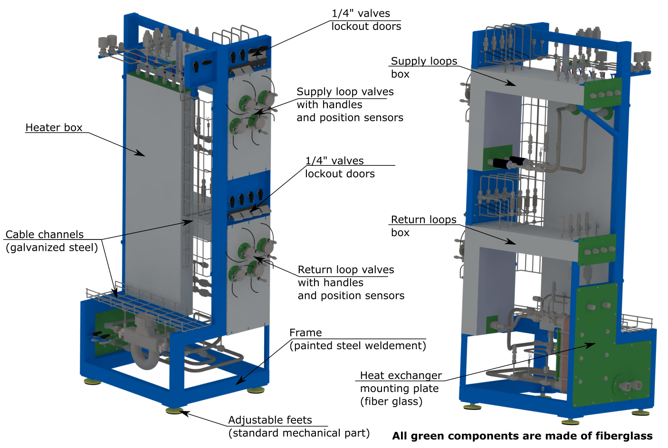
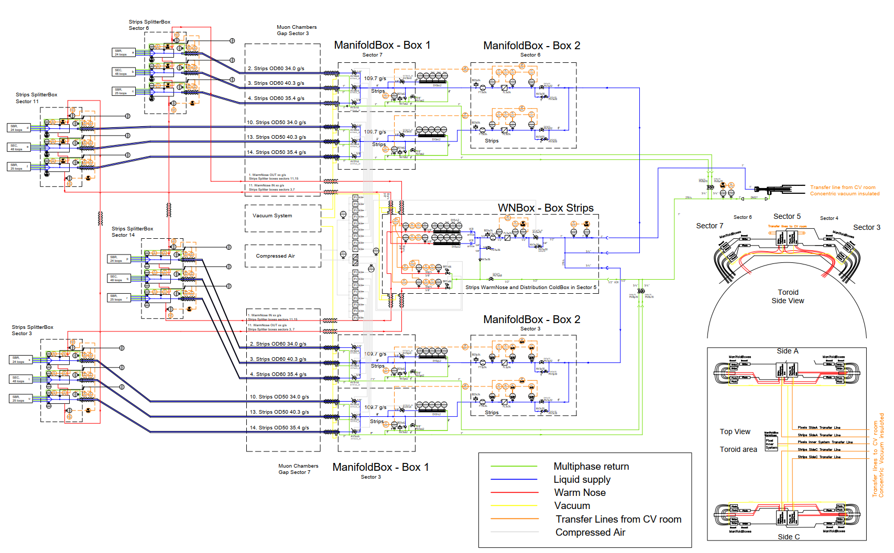
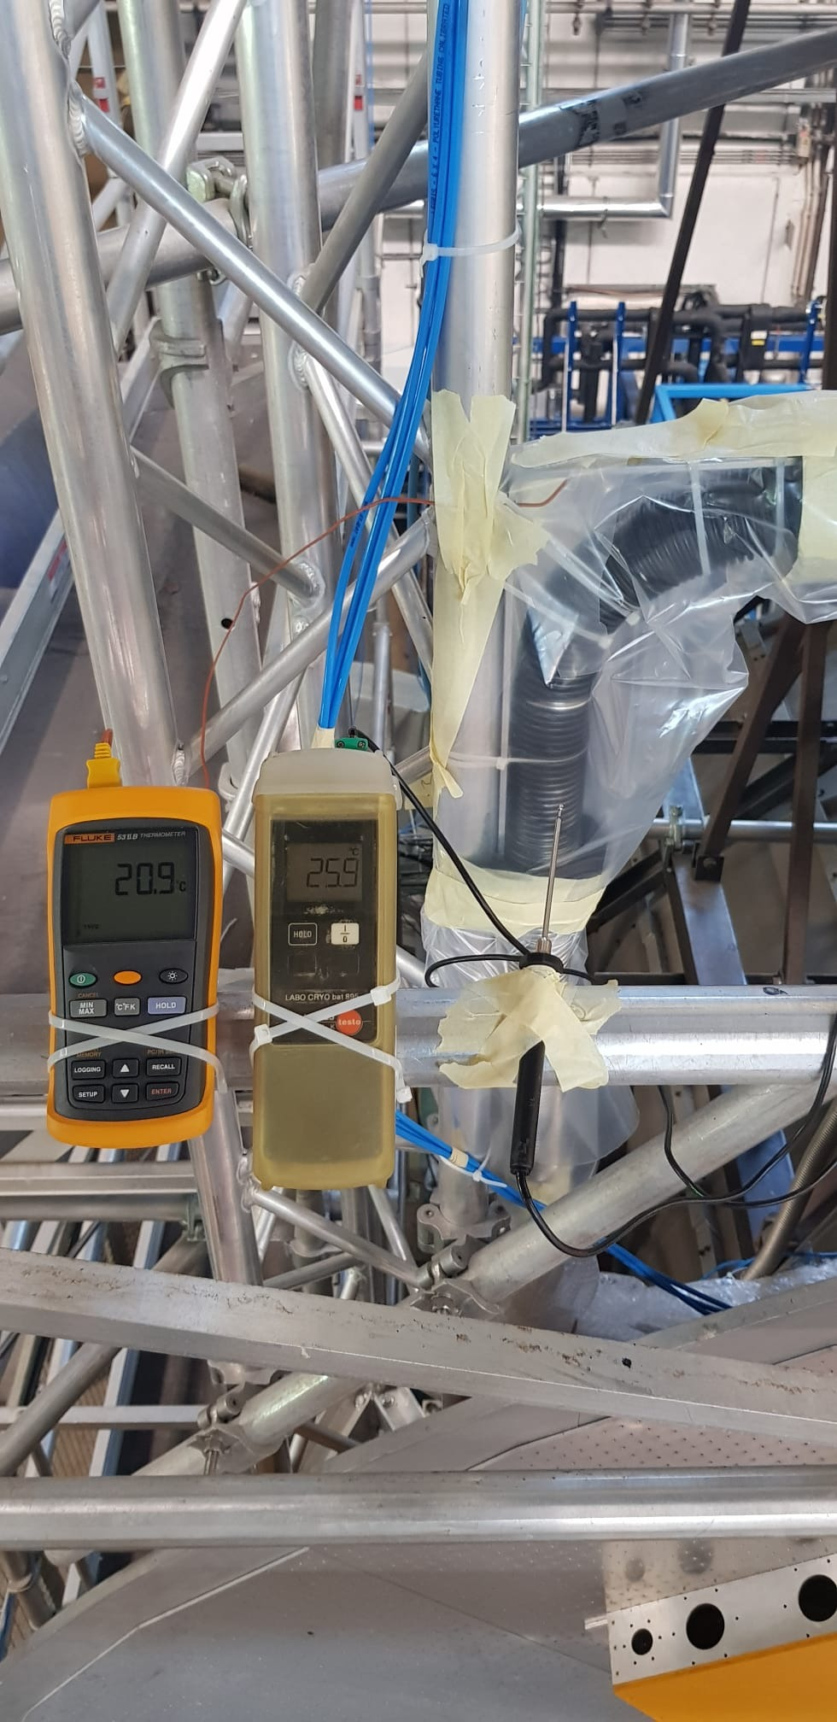
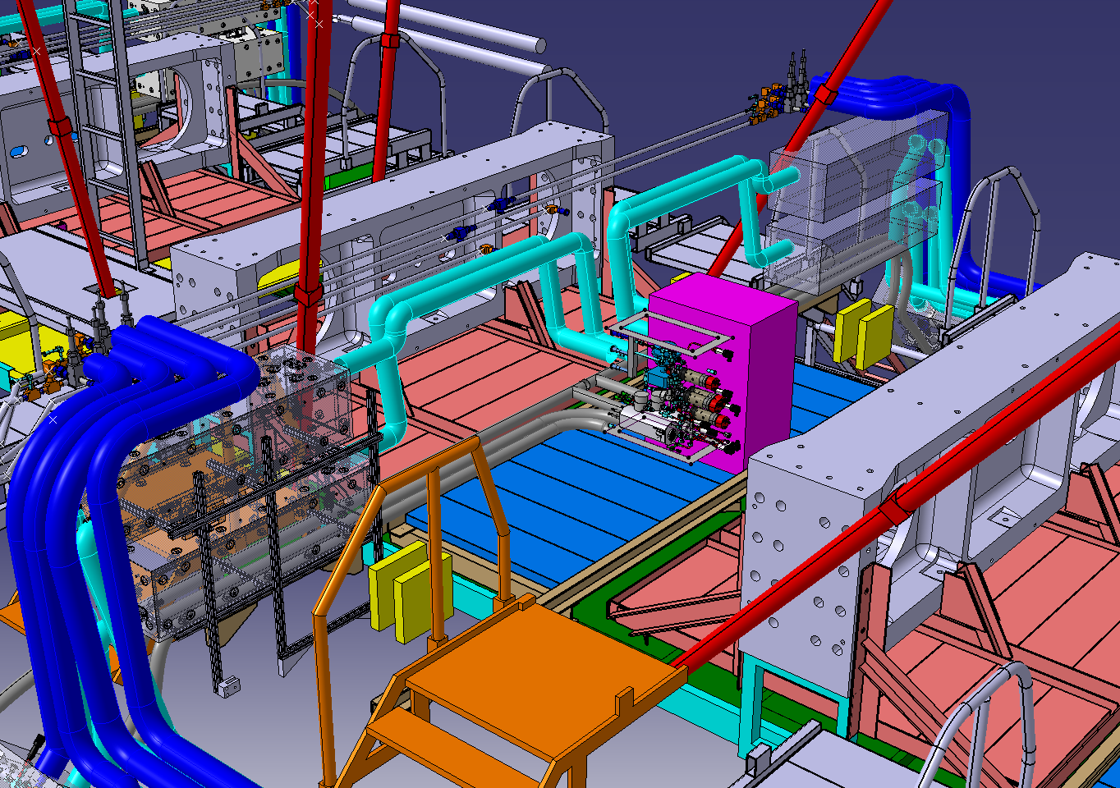
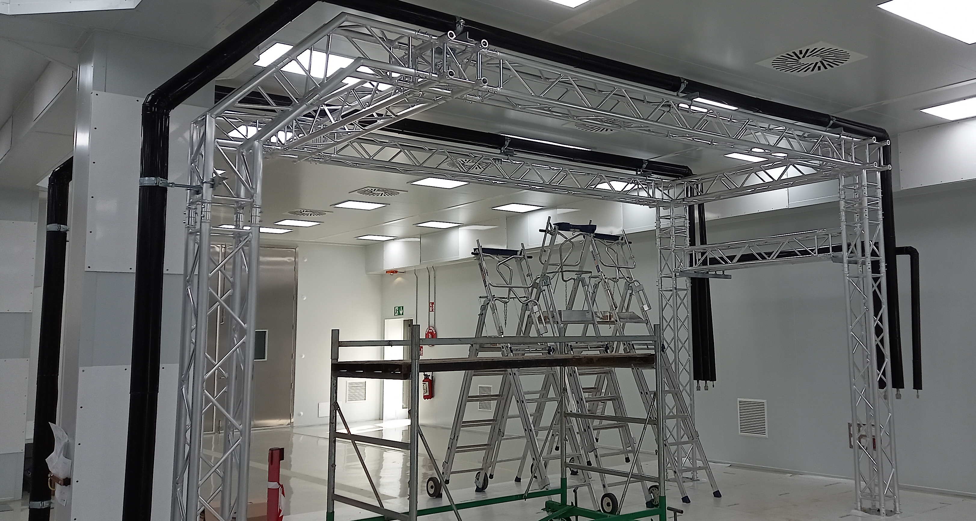
CO₂ distribution racks for SR1
CO₂ manifold boxes for ITK
Components testing for ITK CO₂ cooling in Baby-Demo (b180)
CO₂ transfer lines installation at SR1

Slide 10
2.2- CO2 project Infrastructure
USA15-CV room integration
  TC is in charge of steering the modification process of USA15-CV room infrastructure : (Raphael)
  Coordinating the integration,
  Organizing the sequence and the schedule of operations
Objectives 2022
  Design and integration of mezzanine structure to host the x42 CO2 control cabinets (Jan)
  Design and integrate the cable trays on the mezzanine and in USA15-CV (Jan, Peter)
    Control cabinet to accumulator and plant (Jan)
    Control cabinet to UX15 (Jan, Peter, Marco)
  Integration of various objects (HVAC, invertors, crane, ventilation,…) (Jan)
  Build up the USA15-CV activity schedule from LS2 up to LS3 schedules (Raphael)

Slide 11
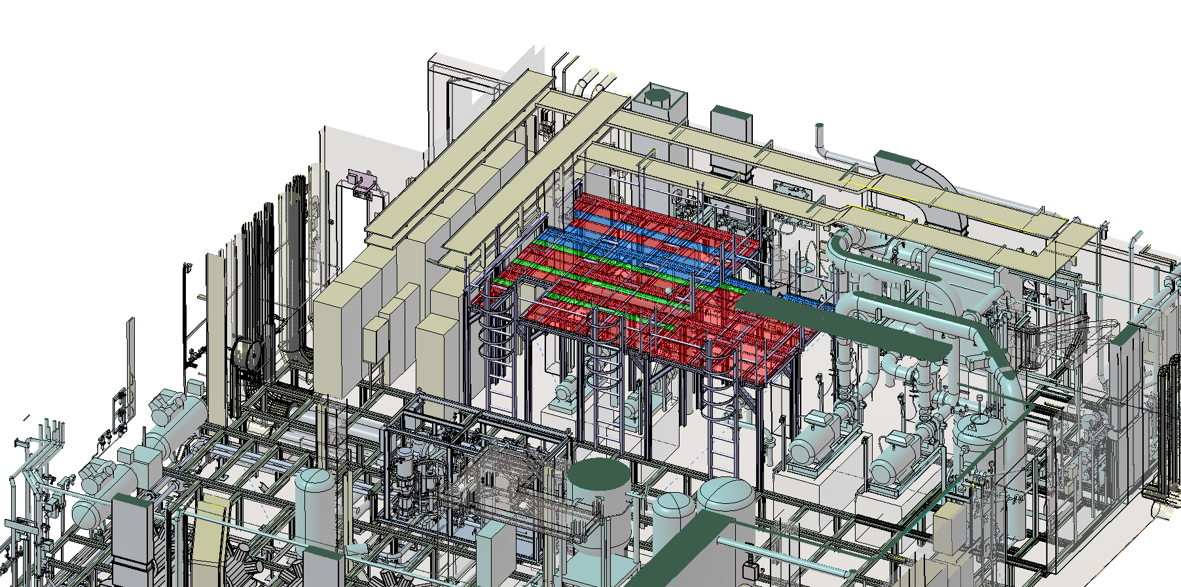
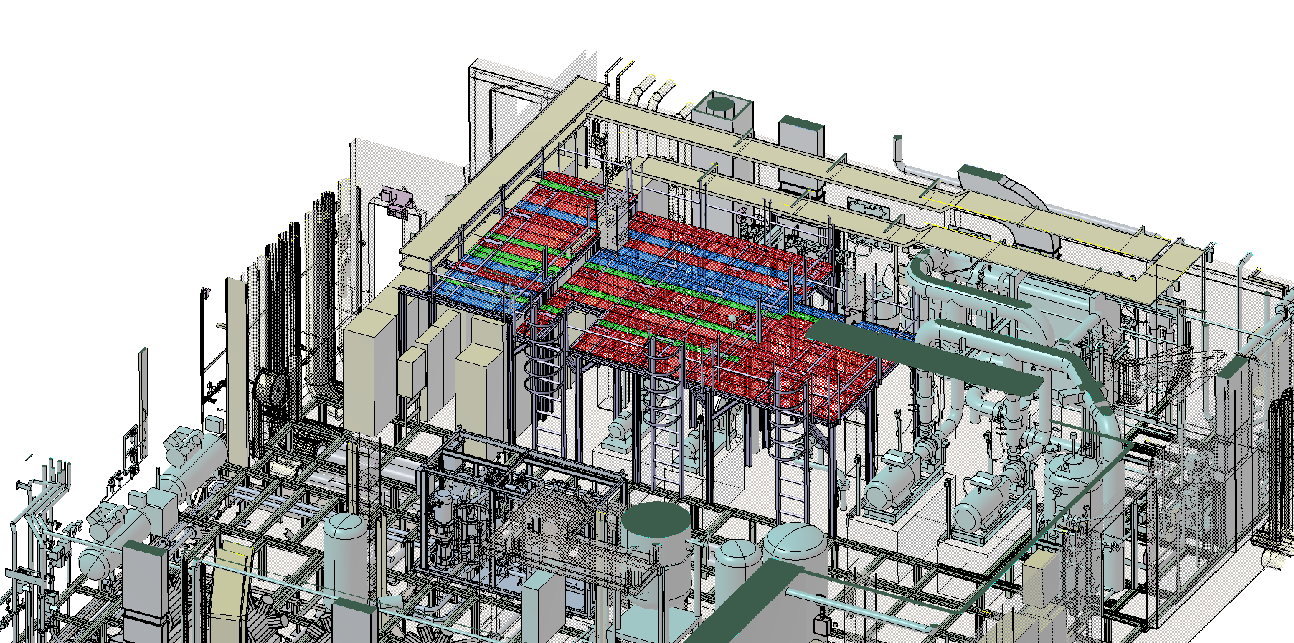
Construction phase of the mezzanine
The mezzanine structure will be installed in 2 steps.
  A partial installation during YETS 2022/23 to allow the installation of the control cabinets for the early installation
  Completion during the LS3 when evaporative services and control cabinets will be removed
YETS 2022/23
LS3

Slide 12
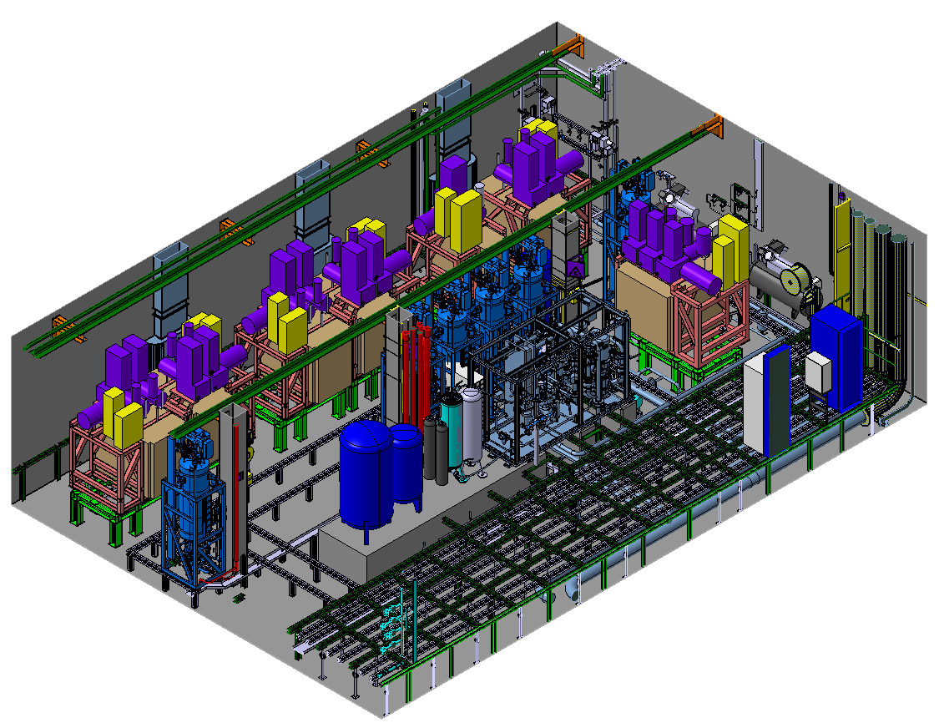
42x control and power cabinets
7x CO2 new compressors
6x Accumulators
Mezzanine structure
Installation during YETS 2022/23

Slide 13
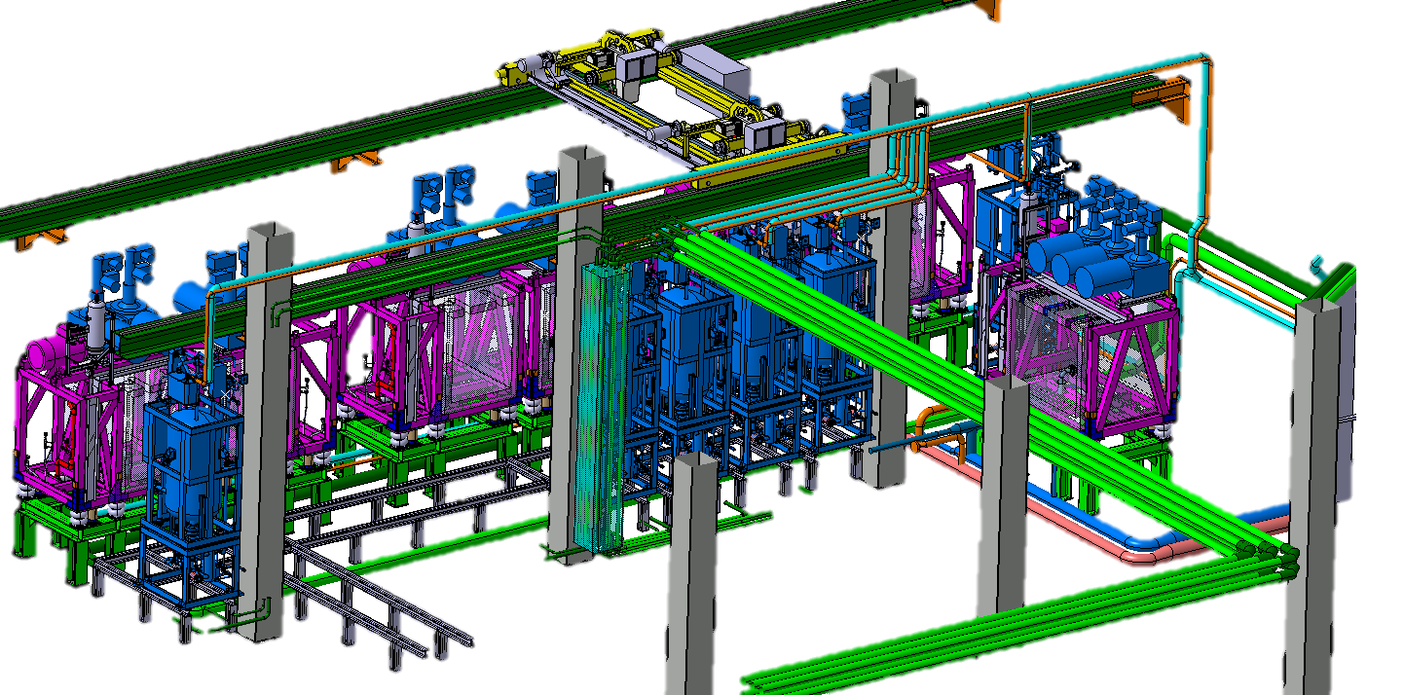
  Integrate and freeze the position of the 2PACL plants, support frame, accumulators (Jamie)
  Design the rail system to move the accumulators (Technical Student)
  Integrate and develop the piping system (CO2, R744, exhaust) between the different components (Jamie)
  Design the false floor structure (Jamie)

Slide 14
CO2 system in toroid
Objectives 2022
  Integration of the manifold boxes at Z=0 and MTL in the toroid (Jan)
  Coordinate the first installation step of the MTL (Martin D.)
  Integrate the HGTD manifold boxes (Peter, Jan)
  Integrate the ITK flex line from PP1 to PP2 manifold boxes (Martin S.)
  Modification of PP2 platform and their access (sect 3&7) (Martin S.)
  Integrate new strip and pixel PP2 boxes (Martin S.)
CO2 manifold box in sect 3&7
CO2 flex line crossing BIL

Slide 15
3- USA15 Rack room reorganization
Courtesy of Kostas
  Context:
    Some of the racks in USA 15 will be upgraded with new racks (ATCA) which demands more vertical space and different electrical infrastructure.
    The noise level will be close to 100db(A). For that reason, soundproof walls must be constructed in order to limit the noise transfer to the rest of USA15 room for safety reasons.
  Objectives in 2022
    Integrate ATCA racks (Konstantinos)
    Integrate separation wall in USA15 level 1 and level 2 (Konstantinos)
    Manage the interfaces with (Konstantinos)
      EN-CV (HVAC)
      EN-EL (electrical distribution)
      Existing racks
      Civil engineering structures
    Integrate cable trays and optimize path (Konstantinos, Marco)
    Safety aspects – noise – evacuation alarm (Laetitia, Laure, Mathilde)

Slide 16
Level 1
Level 2
28 NEW Racks to be installed in Level 1 up to now.
18 NEW Racks to be installed in Level 2 up to now.
The doors dimensions are 800mm x 2200mm.
New “proposed” position of the racks.
New rack model already implemented into the global USA15 model design.
New soundproof wall isolating the new “noisy "racks.
Wall around the stairs has been designed. In contact with the company in order to get more precise information about the structure for supporting the walls around the stairs.

Slide 17
4. Services activities requested for LS3
Courtesy of Marco
LS3
Muons
LAr
RPC
Replace all current LAr trigger cables, with optical fibres
Install all needed services for the displaced LVPS
sMDT
BIS MDT (sMDT) replacement of all fibers, LV, HV, alignment, etc. cables
Routing of fibres bundles for all other MDT chambers
ITk
Removal of all services coming out from IDEP
Installation of new cables for Pixel
ZDC
HV multi-conductor cables
BI RPC full services replacement (gas, HV, LV for both FE and trigger, control/monitoring, fibers)
All other RPC only fibres replacement
TGC
Routing of fibres bundles and installation of patch panels for BW
Tile
HGTD
Routing all services for this new detector
Replace all current Tile trigger cables, with optical fibres
Replacement of analog signal cables from TANXs to USA15
Installation of additional air-core cables
Others
Lucid?
Alpha?
L1 Calo,?
Magnets?
TDAQ?
Network?
Installation of new cables for Strips
Install needed cables for Cs system
Routing of fibres bundles and power and control cables for EIL4

Slide 18
System’s requests for LS3
ID/ ITk: Remove all ID (Pixel, SCT, TRT, common, etc.) services, because not needed for Phase II (estimated to be ≈16k cables and pipes). ≈5k existing services must be kept and reused. ≈4k new cables are needed
Tile: Removal of analog trigger, TTC+ROD readout fibers and CANbus cables (estimated to be ≈600 cables). Install new Optical trunk redout cables, HV cables and Cs system cables (≈400 cables) [EDMS 2670551]. Integration of new patch panel around barrel and endcap.
LAr: Removal of analog trigger, TTC, Data and SPAC readout fibers (estimated to be ≈500 cables). Install new Optical trunk readout cables, LVPS cables (≈300 cables) [EDMS 2682301]. Integration of new patch panel around barrel and endcap.
Muons (TGC, sMDT, RPC): Remove all fibers not needed for Phase II (estimated to be ≈1k cables). Install all needed cables for all BI upgrade, EIL4 and BW new electronics, and power system upgrade. The amount of new cables needed is still under evaluation (≈4k cables only for TGC BW and EIL4 and sMDT BIS). Integration of new patch panel on the coil for BIS and BIL.
HGTD: Integration and installation of all services (estimated to be ≈1k cables)
ZDC: Remove all signal cables from TANs to USA15 (estimated to be ≈80 cables). Install new analog signal cables from TANXs to USA15 (estimated to be ≈60 cables) + 10 new air-core cables (not done by TC)
OTHERS (Lucid, Alpha, L1 Calo, TDAQ, Network, Magnets, etc.): No request at the moment, but there will be! ☺

Slide 19
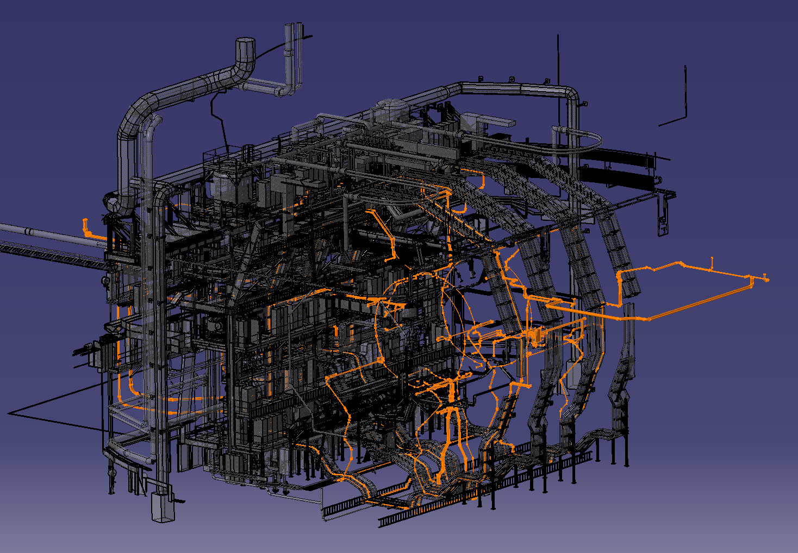
Objectives for 2022
The LS3 services study started even before LS2, but then it has been interrupted due to the many other priorities.
The objectives of cabling team for 2022 are :
Retrieval of information from all sub-detectors (Marco)
Preparation of list of cables to be removed (Marco)
Preparation of summary tables for new cables (Marco, Martin J., Martin S.)
Studying of the various cable paths on the CAD (Peter, Martin S., Martin J.)
Preliminary lengths estimation for various cables (Peter, Martin S., Martin J.)
Organize ITK services from PP1 to PP2, revise the organisation at PP2 with new cable trays (Martin S., Martin J. )
Verification, during the next TS and YETS, of the routing study and check the actual feasibility. (Marco, Peter, Mito)
Prepare dedicated cabling study documents for each sub detector (as it has been done for LS2) and saved into EDMS. These documents are used both as installation instructions and to keep the knowledge available for future needs. (Marco, Peter, Mito)
Cables & cable trays installation & removal (SW, SR1,…) (Mito, Mikhail)
Databases (cable, cable trays, labelling) development and management (Anna, Irina, Leandro)

Slide 20
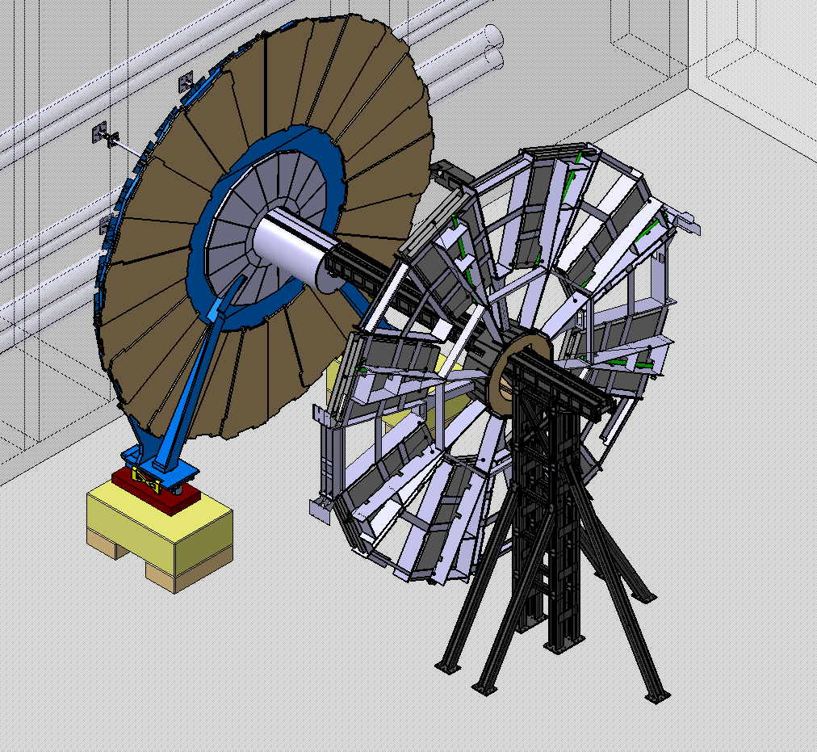
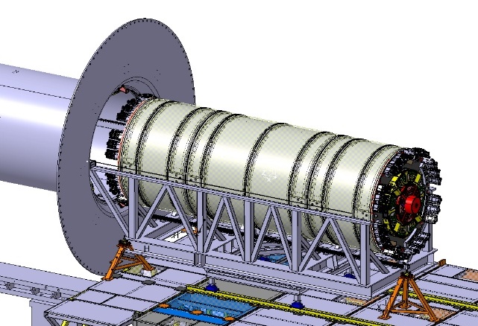
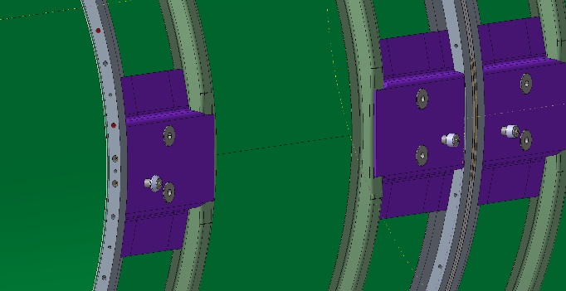
5 – Buildings layout
5.1 - B191 for JD/SW decommissioning : (Jamie, Raphael, Laetitia, Laure, Mathilde)
  Prepare the building layout
  Identify and design the required tooling
  Prepare sequence of decommissioning
  Organize discussion with RP and muon community
5.2 – b180 for ITK mock-up (Edouard, Joffrey)
  Prepare the building layout to practice ITK installation tooling
  Design the motorization of the insertion tooling
  Design wheel on ITK mock-up
  Reinforce the rotating table

Slide 21
6- ATLAS movement
For large opening on both sides, new minivans are required.
  Define the needs and specificities. Design Minivans V2. (Joffrey, Gevorg)
Prepare LS3 ATLAS configuration CAD models (Joffrey, Gevorg)
Prepare CAD models of scaffolding for each configuration (Joffrey, Gevorg)
Design interface between scaffolding and NSW air-pad (Joffrey, Gevorg)

Slide 22
7- Conclusion
LS3 is a large upgrade program for ATLAS,
  Each system have ambitious upgrade programs (muon, ID/ITK, HGTD, …)
  The consequences on the infrastructures are major (USA15-CV, USA15 Rack, services, access,cooling)
  The consequences on cabling activities are huge
The engineering preparation is fundamental
  To study different scenarios
  To schedule sequence of interventions,
  To prepare and ordered:
    Specific access means (in toroid)
    New tooling
    New cable trays
    Length of services
  To evaluate the required resources (personal)
Thanks to all, to be part and to be active in this new ATLAS adventure …

