Slide 1
TECHNICAL ACTIVITIES
ADO-PO / TC meeting may 2022
Joffrey Malaquin - may 24th 2022

Slide 2
Technical support - organization
ATLAS detector configuration
Support to detector installation and upgrades
General support
Infrastructure
Operational Team
    Gevorg
    Jamie
    Cédric
    Christian
    Louis
    Frederic
    Armen
Supervision
  Joffrey Malaquin
Opening / closing movements
Scaffoldings installation
+ design office
part time
Gate monitors
Sniffer maintenance
...
Specific access
Toolings manufacturing
Handling and mechanical installation
...
Safety
Logistics

Slide 3
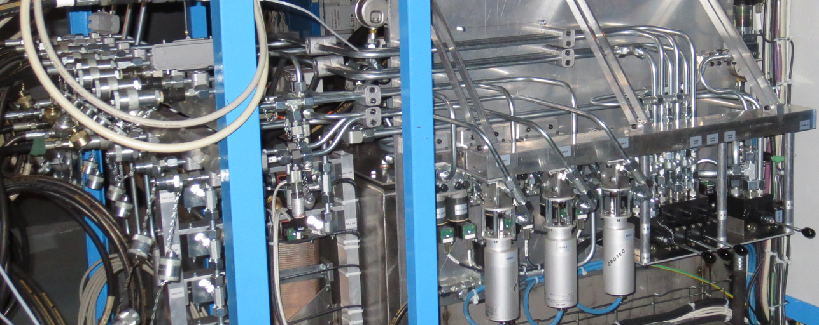
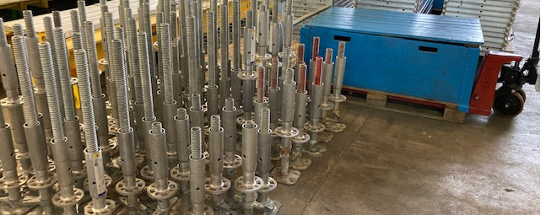
Getting ready for YETS 22-23
Movement system
  Periodic maintenance of detector movement system : hydraulics, flexibles, sensors...
  Improvement of NSW movement system components to streamline operations in UX15
Access scaffoldings
  Maintenance / replacement of components
  Manufacturing of new interface parts to decrease installation duration (NSW)
Documentation
  Update procedures following LS2 feedback
  Create new procedures to memorize and share knowledge of technicians

Slide 4
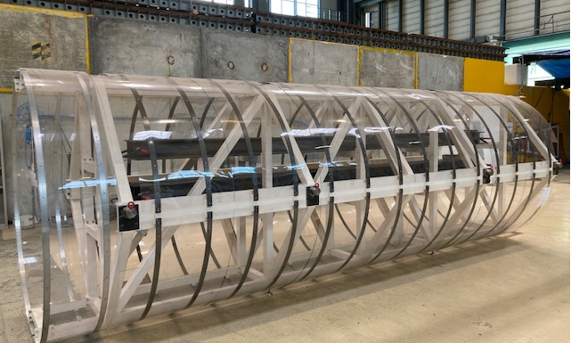
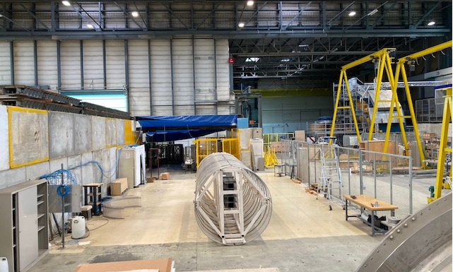
LS3 preparation activities
ITk lowering and insertion
New layouts inside buildings 180 / 191
LS2 assembly and test area (NSW) dismantling
Re-organization of the workspace in the frame of LS3
Upgrades of ITk mockup (mass, wheels) to test insertion operations
Design and procurement of components for insertion linear motor
Insertion system preliminary test with mockup foreseen in fall 2022

Slide 5
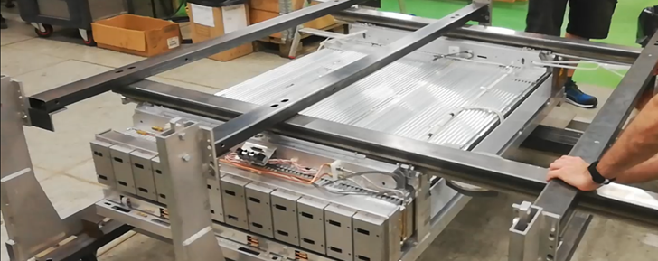
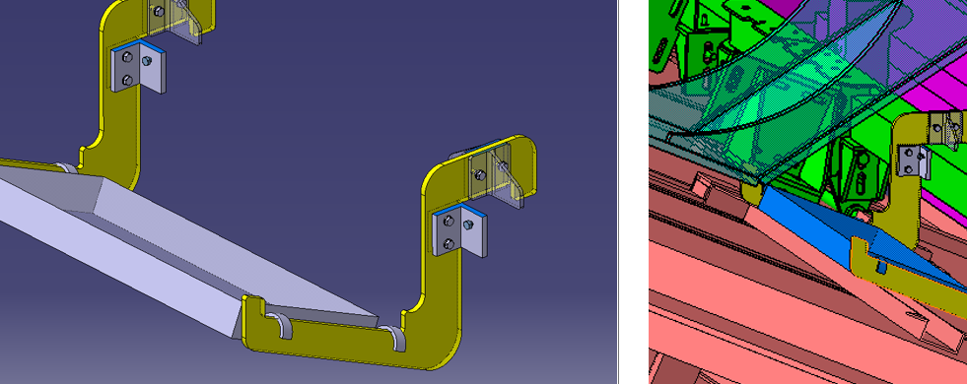
LS3 preparation activities
Muons support
  BIS test frame manufacturing and assembly
  Phase 2 access platforms and installation toolings : BIL RPC, BIS 1-6, MDT electronics...
Access improvements
  Improve minivans (currently 8) robustness to all possible configuration scenarios : handrails interfaces, access ladders, extensions compatibility, balconies...
  Evolution of standard opening scaffoldings to cope with phase 2 detectors needs

Slide 6
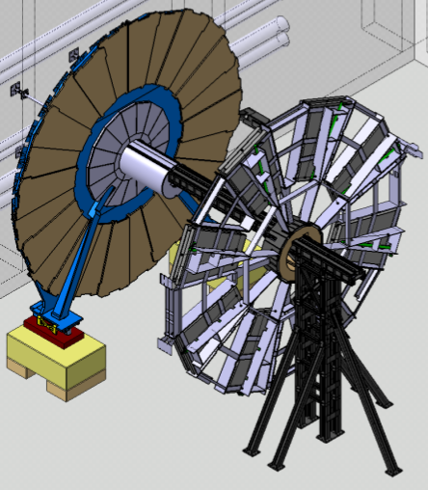
Other projects
JD-SW dismantling operations
  First steps expected in 2022 :
    Building 191 new layout installation
    Toolings manufacturing
    JD-SW lifting frame and lifting cylinder disassembly
    SW separation from JD
Mechanical workshop (b. 108)
  Renovation work ongoing in b.108 since January
  Machining tools reinstalled mid-may
2PACL steel frame
BT diffusion pumps access platforms

