Slide 1
MC RF WG WP summary and task structure proposal
Alexej Grudiev, Claude Marchand

Slide 2
Objectives, Deliverables and Resources
Summary from the LDG process 2021
Objectives
High-level Deliverables
1) Baseline design of the RF system for acceleration to high energy (SRF)
2) Application of high gradient SRF technology for muon accelerators (SRF)
3) Baseline design of the RF system for Muon cooling complex (NRF).
4) Conceptual design of the RF system for Muon Cooling Demonstrator (NRF).
5) RF test stand and test cavities for R&D on high gradient NRF in strong magnetic field (NRF).
6) Baseline design of RF power sources for muon collider RF systems
Resources | 1 | 2 | 3 |  | 1 | 2 | 3
Staff | 0.6 + 0.8 | 17.4 |  | Student
Postdoc | 3 + 3 | 6 |  | Material | 2900(9500)
Interested partners
CERN(resources in place), Uni of Rostock Jlab, CERN CEA, CERN, LBNL CEA, CERN, LBNL CEA, CERN, Uni of Strathclyde Uni of Lancaster, CERN
Resources are given in total number of FTE-years for the whole duration and in kEuro for material

Slide 3
Task structure goals
The aim of the tasks is to provide platform for more focused technical discussions related to task subject.
Task structure to large extend reflects the WP structure developed for the LDG process.
It is an attempt of its implementation given resources which might be available already now.

Slide 4
Task structure proposal
# | Task | Contact person
1 | Design of the RF systems for acceleration to high energy | Heiko Damerau (CERN)
2 | Application of SRF technology for muon accelerators | Roger Ruber (JLab)
3 | Design of the RF systems for muon cooling complex and demonstrator. | Alexej Grudiev (CERN)
4 | R&D on high gradient RF in strong magnetic field. | Sergey Arsenyev (CEA)
5 | RF power sources for muon collider RF systems | Graeme Burt (Uni of Lancaster)

Slide 5
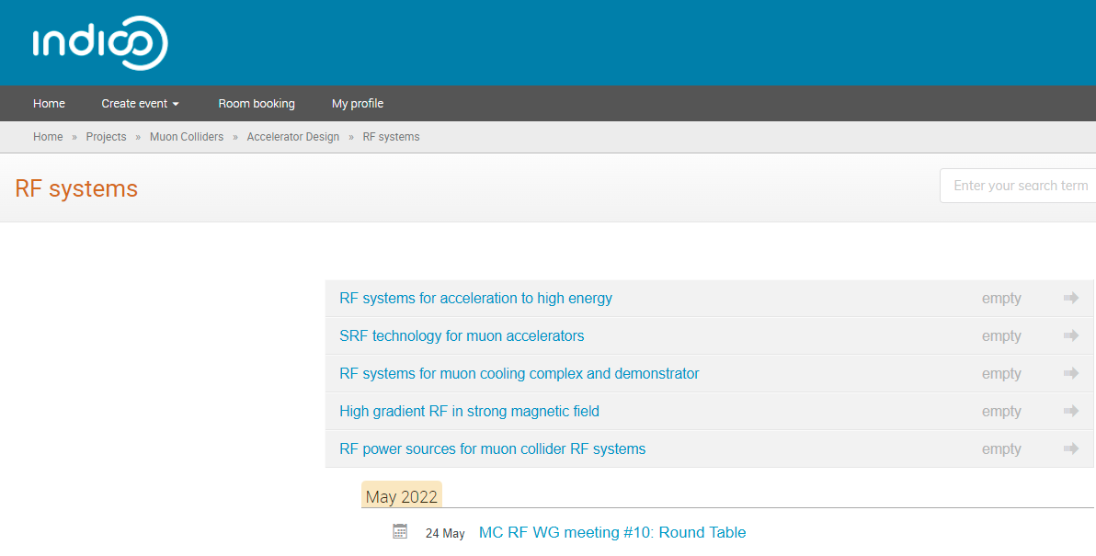
Indico structure

