Slide 1
Progress on Comparison to X-band Klystron-based CLIC Option
D. Schulte for the CLIC team
Special thanks to A. Grudiev, B. Jeanneret, Ph. Lebrun, G. McMonagle, I. Syratchev
CLIC-ACE February 3rd, 2010

Slide 2
Rational
Two concerns exist
A klystron-based machine can more easily demonstrate the basic RF unit
A klystron-based machine may be cheaper at lower energies
Want to address these issues with no prejudice
Focus on 500GeV machine since this is the point where concerns are most relevant

Slide 3
Strategy
Use current CLIC 500GeV design and simply replace the drive beam with klystrons
Minimal changes
May not be the optimum klystron based design
Optimise the CLIC 500GeV design for klystron, using heavily damped structures and remaining compatible with up-grade
We limit ourselfs to structures which have been developed in the process of the CLIC 500GeV optimisation
Full optimisation of CLIC for klystrons
Not done
Significant amount of work
Obviously profit from JLC-X/NLC work

Slide 4
Luminosity Comparison to NLC
 |  | CLIC 500GeV | NLC (TRC II)
Luminosity | 10³⁴cm⁻²s⁻¹ | 2.0 | 2.0
Beam Power | MW | 9.62 | 12.8
Horizontal/vertical emittance | nm | 2400/25 | 3600/40
Particles per bunch | 10⁹ | 6.8 | 7
Bunches per pulse |  | 354 | 192
Repetition rate | Hz | 50 | 120
Lower beam current per luminosity is due to smaller vertical emittance in CLIC
Smaller horizontal emittance in CLIC allows to run at smaller bunch charges
beamstrahlung fixes optimum N/σ_{x}

Slide 5
RF Comparison to NLC
 |  | CLIC 500GeV | NLC (TRC II) | NLC later
Loaded gradient | MV/m | 80 | 50 | 52
Structure length | mm | 230 | 900 | 600
Energy gain per structure | MV | 18.4 | 45 | 31.2
Structure input power | MW | 74.2 | 75 | 54
Inst. input RF power per GeV | GW | 4.03 | 1.666 | 1.89
RF pulse length | ns | 242 | 400 | 400
Number of bunches / spacing | ns | 354 x 0.5 | 192 x 1.4 | 192 x 1.4
Beam current in pulse | A | 2.2 | 0.8 | 0.8
RF input energy / pulse / GeV | J | 975 | 666 | 666

Slide 6
Replacing Drive Beam with Klystrons

Slide 7
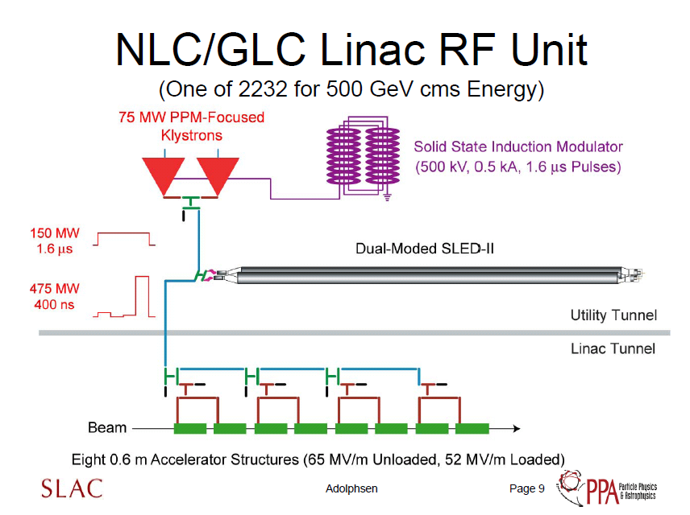
2x
Anticipated η=0.6 for klystron
30 meters
X3.16
η=0.92
54 MW / structure
250 MeV/unit

Slide 8
NLC Initial Baseline Design
75 MW Klystron (approx 2000 per LINAC)
Solenoid focussing (25kW per klystron)
55% efficiency
0.0002 duty cycle (120 Hz, 1.6µs)
Average RF output power of klystron 14.4kW
1 kW heater power per klystron
Line type modulator
Pulse transformer 20% wasted power with rise and fall time
Thyratron switch, 600 W per thyratron
Overall Power Requirement per Klystron/Modulator
55.3 kW
246 MW/two linac (2264 klystrons)
This technology is known and works

Slide 9
NLC Baseline Design circa 2002
75 MW Klystron (approx 2000 per LINAC)
ppm periodic permanent magnet focussing (no solenoids)
55% efficiency
0.0002 duty cycle (120 Hz, 1.6µs)
Average RF output power of klystron 14.4kW
1 kW heater power per klystron
Solid State Modulator (1 per two klystrons)
Pulse transformer 20% wasted power with rise and fall time
Overall Power Requirement per Klystron/Modulator(0.5)
37.5 kW (would at 50Hz be 16.2kW)
167 MW/two linacs
Klystron development was not finished, some problems with pulse width and high rep rate, peak power achieved
Modulators
Many iterations were done on different types of solid state switches, but still with pulse transformer. Only recently can we confidently say that this technology is properly developed
This will be our baseline, even if work is needed to fully demonstrate it

Slide 10
Pulse Compression Efficiency
240
480

Slide 11
Efficiency
Consider drive beam based machine up to roughly twice as efficient
But more work to be done at 500GeV drive beam based CLIC
some inconsistencies between Igor and Bernard
Need to include other systems in comparison
e.g. magnets of drive beam complex
Efficiency [%] | NLC | CLIC | achieved
Modulator | 70 | 70 | 60
Klystron | 55 | 55 | 53-56
SLED II | 81 | 65 | (78)
Waveguide | 92 | 92 | 77
total | 28.3 | 23 | 19.5
Klystron
 | Design | ready
Modulator | 90* | 86?
Klystron | 70 | 66
Waveguide 1GHz | 95
Structure | 97 | 95.3
Power extraction | 87
Waveguide 12GHz | 99 | 98
total | 50
Drive beam
*strongly depends
on rise and fall time

Slide 12
Klystron Number
We use
No parameter adjustment for
Integer number of structures per klystron pair
Integer compression factor
To be done done once we fix a design
But will not change the conclusions very much
Will adjust other parameters a bit, e.g. klystron power, RF pulse length
7200 klystrons for CLIC 500 baseline

Slide 13
Wall Plug Power
Drive beam CLIC 500
Average total RF input power 24.3MW
Wall plug 53.5MW (Igor), 89MW (Bernard)
Klystrons-based CLIC 500
Average total RF input power 24.3MW
112 MW wall plug (7200 klystrons)
NLC
Average total RF input power 47.3MW
Wall plug 167MW (4464 klystrons)
Note: 10% overhead included

Slide 14
Semi-optimised Structure

Slide 15
Reminder: 500 GeV Structure Choice
Structure has been optimised for luminosity per unit power
Figure of merit: L_{bx} / N η_{RF->beam}
Larger emittances than at 3TeV have been assumed
Upgrade potential has been included by requiring
Structure length be 23 or 48 cm
i.e. a 500 GeV structure replaces 1 or 2 3TeV-structures
RF pulse length be 240 or 480 ns
240ns for 23cm long structures
i.e. for 48cm long structures the drive beam decelerator can be 2 times longer
Input power per structure is similar to 3TeV
Did not quite make it but came close

Slide 16
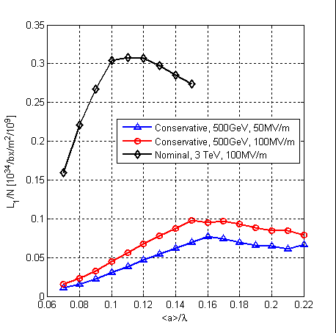
Luminosity at 500GeV
Short range wake limits bunch charge
Calculate:
Bunch charge N(G,a,f)
Luminosity L_{0.99}(G,a,f)
Limit on long-range wake at second bunch
Depends on assumptions on
emittances
beta-functions

Slide 17
Figure of Merit

Slide 18
Cost Calculation
Klystron-based machine has some cost reduction
No drive beam generation complex
No drive beam turn-arounds
No decelerators
But some cost increase
Second tunnel is needed for klystron, modulators and pulse compressors
Klystrons, modulators, pulse compressors etc.
Do not yet have a cost comparison of klystron-based vs. drive beam based machine
More work needed
But we have an estimate of the relative linac cost for the klystron-based machine
Allows to identify the best klystron-based machine

Slide 19
Cost versus Gradient

Slide 20
Linac Cost versus Luminosity per Power
5
2
3
CLIC drive beam baseline
NLC is at FoM 1.7/2.15
for Ε_{y}=40/25nm
Interesting structures

Slide 21
Structure Parameters
Case | 2 | 3 | 5 | basel. | NLC
Average accelerating gradient: <E_{a}> [MV/m] | 57 | 67 | 57 | 80 | 52
rf phase advance: ∆φ[º] | 120 | 120 | 150 | 150 | 150
Average iris radius/wavelength: <a>/λ | 0.145 | 0.14 | 0.16 | 0.145 | 0.17
Str. Length: l [mm] | 480 | 480 | 480 | 229 | 600
Bunch separation: N_{s} [rf cycles] | 6 | 6 | 6 | 6 | 16
Bunch population: N | 5.49×10⁹ | 4.95×10⁹ | 7.01×10⁹ | 6.8×10⁹ | 7×10⁹
Number of bunches in a train: N_{b} | 382 | 335 | 337 | 354 | 190
Pulse length: τ_{p} [ns] | 242 | 242 | 242 | 242 | 400
Input power: P_{in} [MW] | 76 | 84 | 89 | 74.2 | 54
Max. surface field: E_{surf}^{max} [MV/m] | 215.6 | 260 | 260 | 250
Max. temperature rise: ΔT^{max} [K] | 27.6 | 43 | 42 | 56
Structure efficiency: η [%] | 49.5 | 41.9 | 48 | 39.6 | ~31
Figure of merit: ηL_{b×} /N [a.u.] | 3.41 | 2.79 | 3.81 | 3.3 | 1.7/2.15
Relative lumi in peak @ 50 Hz | 0.73 | 0.55 | 0.94 | 1.0 | 1.0
Number of 75MW-klystrons per linac | 2520 | 2358 | 2934 | 3600 | 2232
Number of structures per klystron | 4.4 | 4 | 3.75 | 4.5 | 4
Power / two linacs [MW] | 78.6 | 73.6 | 91.4 | 112 | 167
Linac cost [arb. units] | 5107 | 4559 | 5521 | 5443 | ?

Slide 22
Structure Parameters
Case | 2 | 3 | 5 | basel. | NLC
G [MV/m] | 57 | 67 | 57 | 80 | 52
Str. Length: [mm] | 480 | 480 | 480 | 229 | 600
Δz [RF cycles] | 6 | 6 | 6 | 6 | 16
Bunch population: N [10⁹] | 5.49 | 4.95 | 7.01 | 6.8 | 7
Bunches per train: n_{b} | 382 | 335 | 337 | 354 | 190
Pulse length: τ_{p} [ns] | 242 | 242 | 242 | 242 | 400
Input power: P_{in} [MW] | 76 | 84 | 89 | 74.2 | 54
Structure efficiency: η [%] | 49.5 | 41.9 | 48 | 39.6 | ~31
Figure of merit: ηL_{b×} /N | 3.41 | 2.79 | 3.81 | 3.3 | 1.7/2.15
Rel. lumi in peak @ 50 Hz | 0.73 | 0.55 | 0.94 | 1.0 | 1.0
Klystrons per linac | 2520 | 2358 | 2934 | 3600 | 2232
Power / two linacs [MW] | 78.6 | 73.6 | 91.4 | 112 | 167
Linac cost [arb. units] | 5107 | 4559 | 5521 | 5443 | ?

Slide 23
Future
Documenting the current status
Report is being prepared
Some inconsistencies need to be fixed
E.g. power efficiency
Establish some cost model for 500GeV
Also needed for drive beam based machine
Based on CLIC cost evaluation
Further work once we have a scenario for CLIC energy staging
Emittances at 500GeV have strong impact on structure choice
Upgrade will place many constraints

Slide 24
Conclusion
Using current CLIC 500 design with klystrons requires 7200 klystrons
Prediction for wall plug to RF efficiency could indicate that drive beam is twice more efficient
But needs careful detailed evaluation on drive beam side
RF to beam efficiency is about 33% larger than for NLC structure due to heavy damping
Reducing the gradient to reduce the klystron number leads to about 5000 klystrons
But cost cannot be reduced strongly (<20% for main linac)
The cost for the different options does not seem to vary very strongly
Error of the model is still large
Comparison of cost klystron vs. drive beam remains to be done

