Slide 1
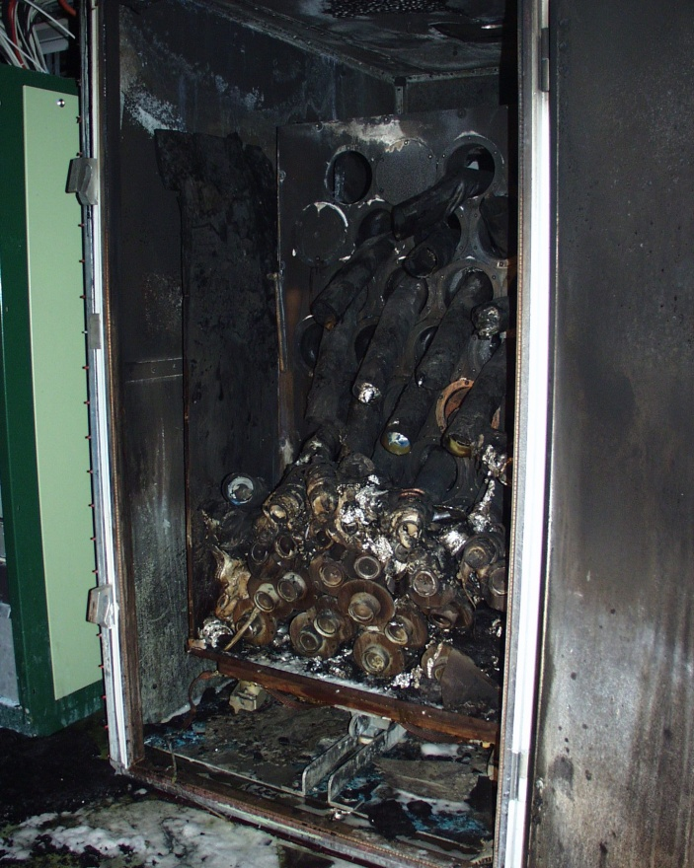
CTF3 program completion and upgrade to CTF3+
Introduction
CTF3 program completion
CTF3+
Conclusion

Slide 2
CTF3 2010 main goals (feasibility demonstration)
Drive Beam Generation
  Bunch train recombination 2 x 4 in DL and CR (from 3.5 to 28 A)
  Transverse rms emittance < 150 π mm mrad (combined beam)
  Bunch length control to < 1 mm rms (combined beam)
  Beam current stability ~ 0.1 % for combined beam
RF Power Production
  20.8 A beam-powered test of a single PETS (without re-circulation) in the TBTS
    135 MW (with 28 A potentially available in CLEX, the peak power can reach 240 MW)
    140 ns total pulse length
    A measured breakdown rate in the range of 10⁻⁴ or lower
    Operation of a few hundred hours at 1 Hz
  7.4(10) A beam-powered test of a single PETS with external recirculation in TBTS
    135 (81) MW circulating power or 65 (65) MW available for accelerating testing
    250 ns total pulse length, 100 (170) ns flattish-top
    A measured breakdown rate in the range of 10⁻⁴ or lower
    Operation of a few hundred hours at 5 Hz
    On/off/adjust will be demonstrated using the external reflection/recirculation system mounted on one of the PETS in TBL.
Two Beam Acceleration issues
  TBTS
    Improved measurements of power and energy loss.
    Breakdown transverse kick measurements.
    Probe Beam energy gain and beam loading tests.
  TBL
    The current schedule is to have 8 PETS installed as well as a spectrometer dump for energy spectrum studies, toward the summer 2010. This will allow to verify transport of a beam with up to 30% of the energy extracted.
done in 2009 – to be reestablished
close in vertical – horizontal to be done
ok in linac – to be done for combined beam
ok in linac – to be done for combined beam
up to >17A
no BDR measurements
up to >12A
no BDR measurements
operation at 1 Hz – 5 Hz tests
first measurements done – power meas. to be improved
>100 MV/m measured
only 1 PETS

Slide 3
2011 CTF3 main goals
Drive beam generation
  DL+CR recombination with higher current (MKS13 back)
  <150 π mm mrad emittance of combined beam
  Bunch length control to < 1 mm rms (combined beam)
  Beam current stability ~ 0.1 % for combined beam
  The above at 28 A combined beam in CLEX
Power production
  20.8 A beam-powered test of a single PETS (without re-circulation) in the TBTS
    135 MW (with 28 A potentially available in CLEX, the peak power can reach 240 MW)
    140 ns total pulse length
    A measured breakdown rate in the range of 10⁻⁴ or lower
    Operation of a few hundred hours at 1 Hz
  7.4 (10) A beam-powered test of a single PETS with external recirculation in TBTS
    135 (81) MW circulating power or 65 (65) MW available for accelerating testing
    250 ns total pulse length, 100 (170) ns flattish-top
    A measured breakdown rate in the range of 10⁻⁴ or lower
    Operation of a few hundred hours at 5 Hz
    On/off/adjust will be demonstrated using the external reflection/recirculation system mounted on the PETS in TBTS
Two Beam Acceleration issues
  TBTS
    Consistent power and energy loss measurements
    Probe Beam energy gain and beam loading tests
    Breakdown transverse kick measurements
  TBL
    Current schedule: 4 PETS installed as well as a spectrometer dump for energy spectrum studies, 8 toward the summer 2011 This will allow to verify transport of a beam with up to 30% of the energy extracted

Slide 4
Drive Beam generation
DL+CR recombination
  set up the beam with MKS13 (rematch optics)
<150 π mm mrad emittance of combined beam
  optimize dispersion
  verify DL/CR orbit closure
  verify DL/CR optics
Bunch length control to < 1 mm rms (combined beam)
  R₅₆ tuning in Frascati chicane and TL2 arc
  streak camera measurements in CLEX
Beam current stability ~ 0.1% for combined beam, improve slow variations
  optimize combined emittance
  systematically analyze jitter sources, find correlations
  improve overall klystron stability (at least up to best performing klystrons)

Slide 5
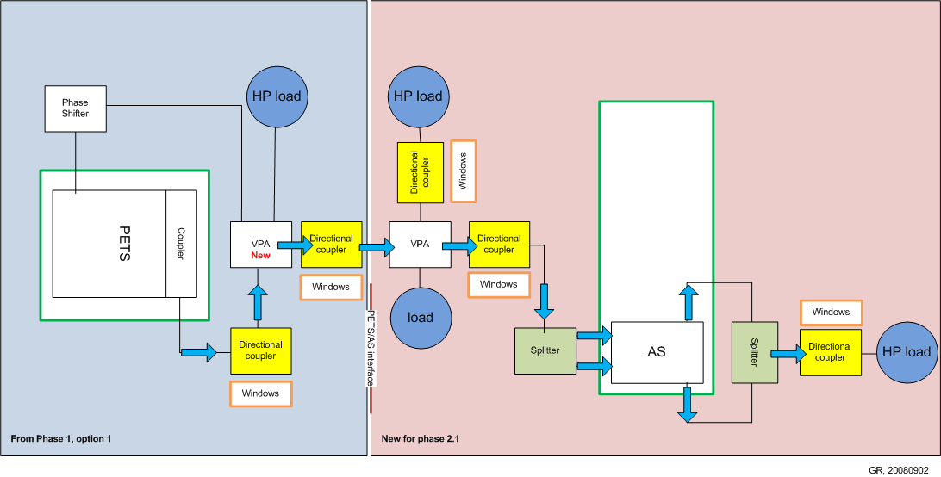
TBTS 12 GHz RF installation
Accelerating structure retuned (TD24) or exchanged (T24)
12 GHz network simplified
VPA suppressed

Slide 6
RF power
Careful calibration of 12 GHz power measurements
Breakdown rate measurements
(at high BD rate - extrapolation to lower rates)
Operation w/out recirculation – may have different breakdown rate…
Test of new PETS on-off scheme (components and concept)

Slide 7
Two beam issues
  TBTS
    Two-Beam test – 100 MV/m, at nominal structure temperature
    consistency between power & beam energy gain
    Drive beam, deceleration, power produced
    Probe beam, power delivered to accelerating structure, energy gain
    Beam Loading compensation experiment - by varying fast phase switches – check control of RF pulse shape with probe beam acceleration
    Measurement of breakdown kicks
    Measurement of effect of beam loading on breakdown rate
  TBL
    Measurement of deceleration / produced power
    Goal: deceleration by 30% (need 8 PETS installed)
    Measurement of energy spectrum
    Optics, steering algorithm studies

Slide 8
Other issues
CALIFES
  Fully reach nominal parameters (total charge)
  Bunch length measurements (RF defl. & screen)
PHIN
  2011: test of phase coding with beam
Other
  First measurements of phase stability (PETS output, RF pickups…)
  Operation at 5 Hz (or more)
  Control of beam losses
  Coherent Diffraction Radiation (RHUL collaboration)
  …

Slide 9
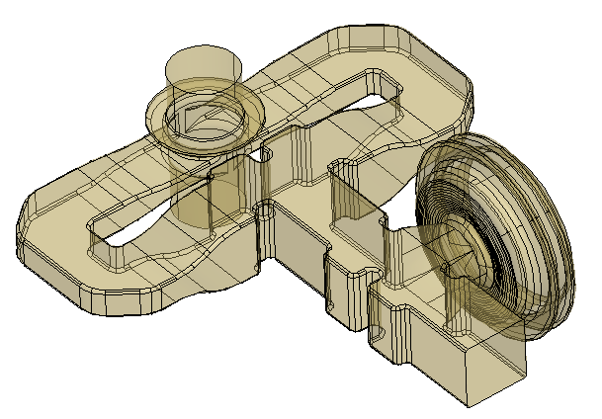
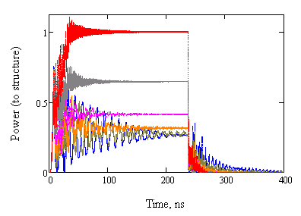
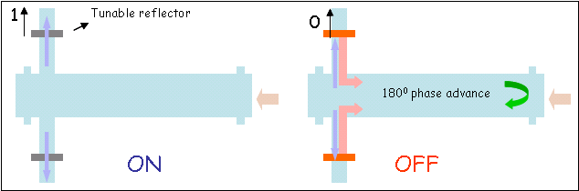
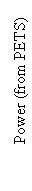
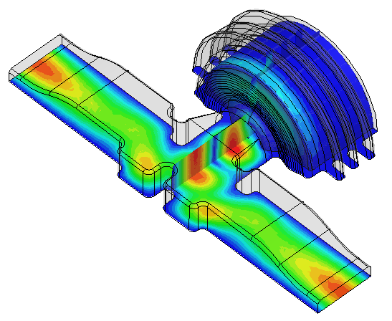
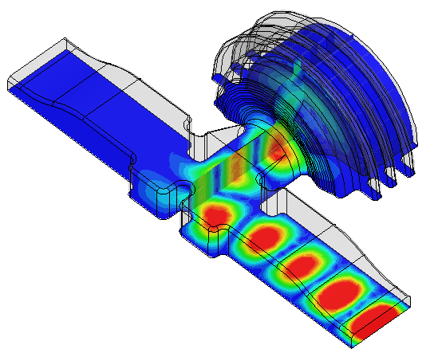
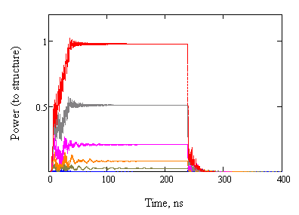
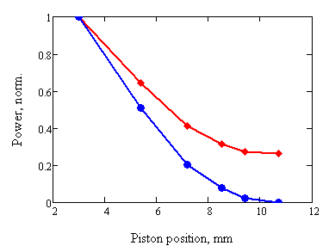
PETS on/off
PETS coupler design with integrated RF reflector
Reflection=0 dB
ON
ON
Power attenuation vs. piston position
(full reflection in OFF position)
OFF
-1 dB
Stroke 7.7 mm
-3 dB
-6dB
OFF, full
Components under construction
High power tests of components and concept validation (slow movement, external reflector at input coupler) can be done from summer 2011 in the TBTS PETS
replaces recirculation loop (lower losses, faster recirculation)
Stroke 7.7 mm
ON
PETS output (steady state)
0.26
Structure input
OFF, full

Slide 10
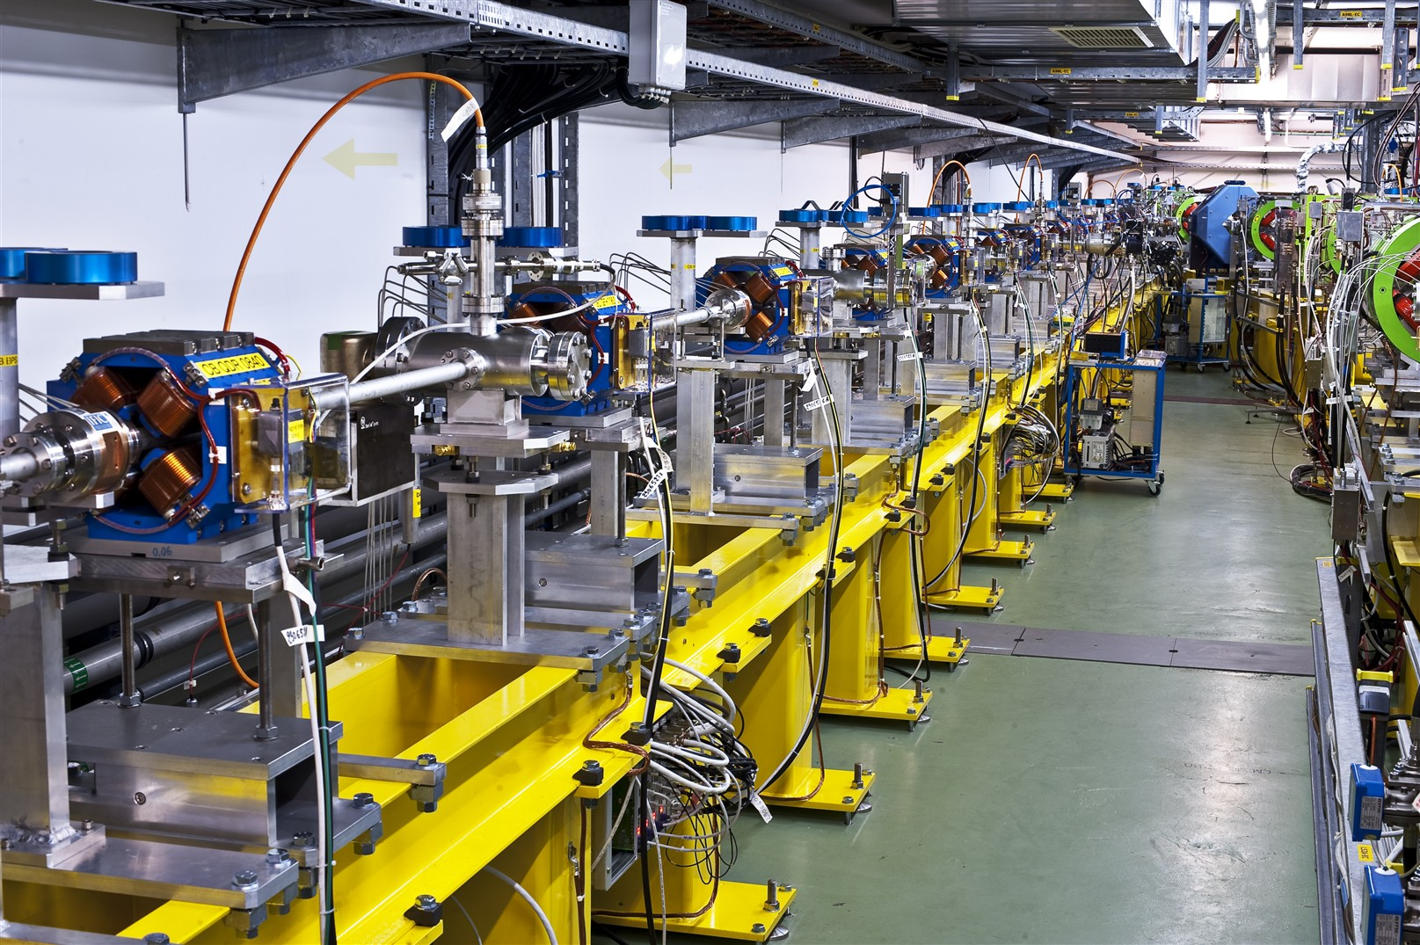
TBL completion
4 tanks installed by March 2011
4 more installed in summer 2011
=> Demonstration with 8 PETS
>30% deceleration
Another 4 PETS in shutdown 2011-2012
4 more with input coupler for priming
Perform full experimental program afterwards
>50% deceleration
Detailed program in talk by Steffen Döbert

Slide 11
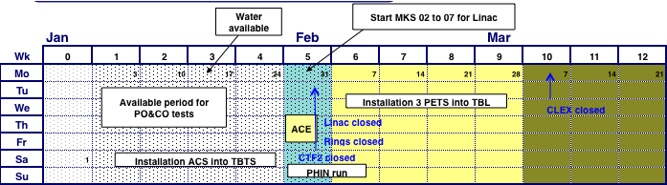
Schedule 2011
Early start of Linac + CR/DL (combination setup + studies)
Initial PHIN run for phase coding demonstration
CLEX stop in summer for installation of
  4 more PETS
  PETS ON/OFF mechanism
  different accelerating structure ?

Slide 12
Increased run-time
need higher statistics for BDR measurements
=> increase repetition rate
  test of 5 Hz running with 4x beam to CLEX TL2 spectrometer successful
    klystrons OK at 5 Hz
    radiation well within limits (to be verified when machine drifts)
  shielding in CLEX towards CTF2 added
  BPM readout at 5 Hz not operational, CO work in progress
=> running over nights and week-ends
  RF compression feedback reduced slow machine drifts drastically
  interlocks (losses, radiation) are in place
  CCC supervision for beam started
  could develop repetition rate feedback

Slide 13
Validation of DB scheme
Parameter | Unit | CLIC nominal | Present state | Objective 2011 | Objective 2012
I initial | A | 7 | 5 | 5 | 5
I final | A | 100 | 28 | 30 | 30
Q_{b} | nC | 8.4 | 4 | 2.5 | 2.5
Emittance, norm rms | π mm mrad | ≤ 150 | 100 (end of linac) ~ 150 (y, comb. beam) | ≤ 150 (comb. beam) | ≤ 150 (comb. beam)
Bunch length | mm | ≤ 1 | ≤ 1 (end of linac) | ≤ 1 (comb. beam) | ≤ 1 (comb. beam)
E | MeV | 2400 | 120 | 120 | 150
T_{pulse} initial | ∝s | 140 | 1.4 | 1.4 | 1.4
T_{pulse} final | ns | 240 | 140 (240) | 140 (240) | 140 (240)
Beam Load. Eff. | % | 97 | 95 | 95 | 95
Deceleration | % | 90 | 3 | 30 | 50
Phase stability @ 12 GHz | degrees | 0.2 | 1 | ?
Intensity stability |  | 7.510⁻⁴ to few 10⁻⁵ | 6 10⁻⁴ (linac) few 10⁻³ (DL) 10⁻² (combined beam) | 10⁻³ (combined beam)

Slide 14
CTF3 limitations
#1
CTF3
DL
CR
140 ns
DBA
CTF2
TBTS
<30A
CLEX
#2
< 280 ns
14 A
#3
~ 1200 ns
4 A
Combined beam current, limited to ~ 30 A
(possibly more for shorter pulses)
Pulse length limited to 140 ns (instead of 240 ns) @ 30 A
– alternative: 15 A, < 280 ns
Total drive beam peak power (now ~ 3.5 GW – CLIC 240 GW)

Slide 15
CTF3 beam power upgrade
35 MW
45 MW
Present
About 120 MeV
for final beam current of about 28 A
Total beam power 3.3 GW
e.g., enough to feed
24 accel. structures
(final drive beam energy 50 MeV)
girder
2
3
4
5
6
7
8
9
10
11
12
13
14
15
Ultimate ?
About 200 MeV
for final beam current of about 28 A
Total beam power 5.7 GW
e.g., enough to feed
50 accel. structures
(final beam energy 50 MeV)
girder
2
3
4
5
6
7
8
9
10
11
12
13
14
15

Slide 16
CTF3 beam power upgrade
Assumptions
  Need 3 additional power stations
  All modulators/klystrons upgraded to 45 MW nominal power
  RF pulse compression factor ~ 2 (about 38 MW/SICA input, including operational limits and losses)
  1.3 µs long RF pulse (needed for combination factor 8)
  Keep girder 10 for diagnostics (emittance, momentum, energy spread)
  Need new drive beam acc. structures
Further possibilities ?
  Add other power stations & structures (girder 10, CT line ?)
  Further upgrade klystrons
  Combine klystrons by two, double their number (space problem, maybe exceed structure limits…)

Slide 17
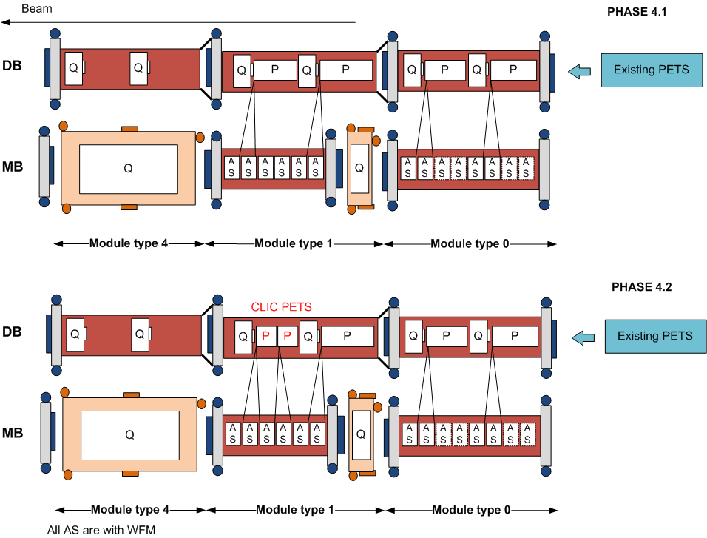
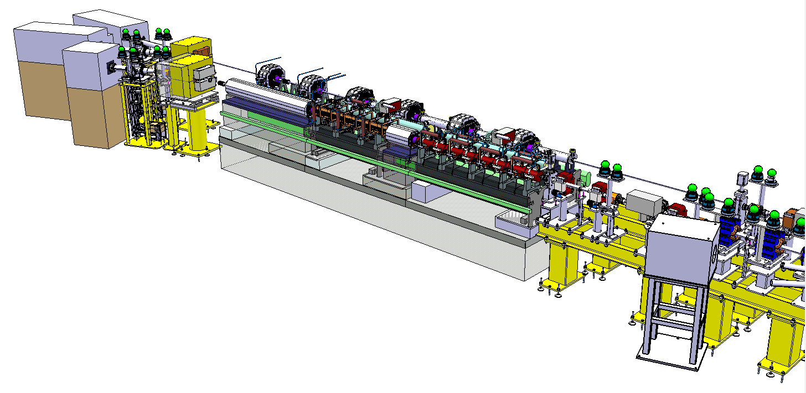
CLIC modules in CLEX
3 modules to be tested
with beam and RF
module layout compatible with CLEX requirements:
  double length PETS feeding two accelerating structures
  accelerating structures
  with all technical
  systems and
  damping features
First module to be ready
by end of 2011
Integration of test modules in CLEX
A. Solodko

Slide 18
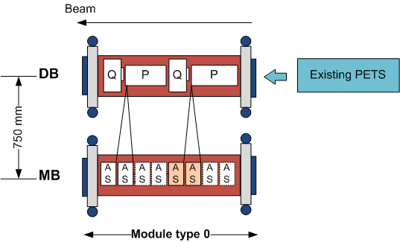
PROTOTYPE Module - CLEX: Phase 3
Phase 3 foresees the installation and testing of 1 module type 0: AS equipped with WFM (5 um accuracy / few WFM in the 1st powered AS)
3.1 / Nominal power and pulse length for 1 PETS and 2 AS
Recirculation
12 A and 240 ns
3.2 / No modifications on the module type 0 HW
No Recirculation
Current increase from 12 A to 19.2 A
Pulse length reduced from 240 ns to 140 ns

Slide 19
PROTOTYPE Module - CLEX: Phase 4
No modifications on the module type 0
Addition of new modules - type 1 and 4
Increase of current from 19.2 A to 22 A
Modification on the module type 1
(2 CLIC PETS)
Needed klystrons and PC

Slide 20
Plans for TBL beyond 2012
Upgrade to TBL+ as a test facility relevant for CLIC TDR work
12 GHz power production for structure conditioning
  less pulses than klystron test stand but:
    use of ON/OFF mechanism of PETS
    precondition with klystron and then with beam
    => develop conditioning scenario for CLIC conditioning with beam
    conditioning of PETS
Working experience with a real decelerator
  Power production as a function of beam parameters, alignment, stability, pulse shape, phase stability, beam loses, failure modes
Test bed for PETS development, ON/OFF, new designs, etc
Beam dynamics studies, pulse shaping, feedbacks, etc
=> more in talk by Steffen Döbert

Slide 21
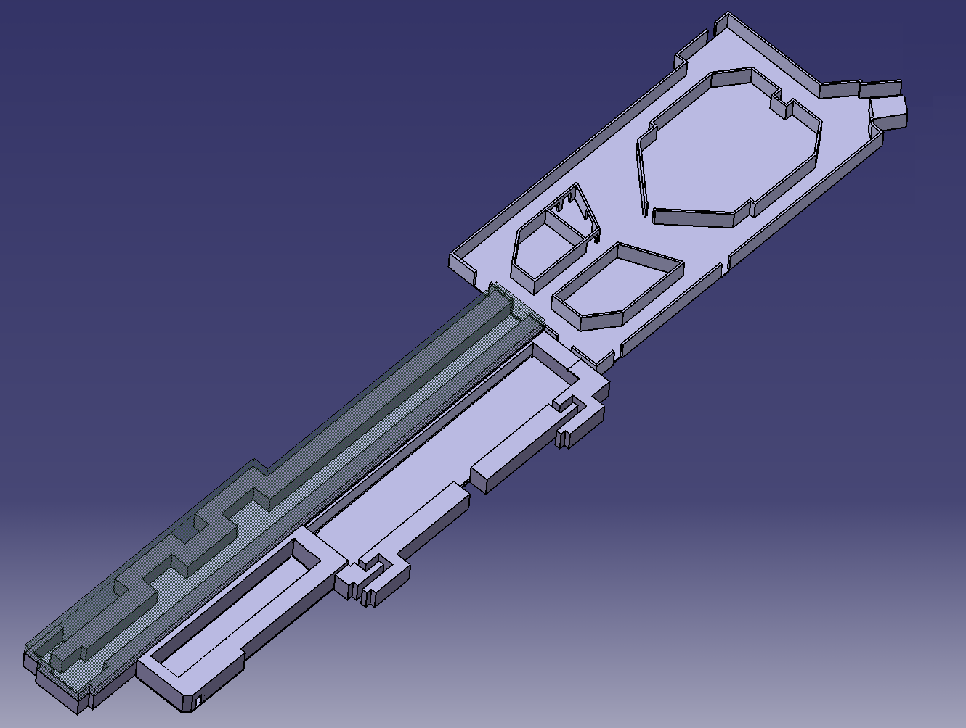
Phase measurements & feed-forward
DELAY
LOOP
Phase & energy measurement
COMBINER
RING
DRIVE BEAM
LINAC
Fast feed-forward kicker in final compression line
10 m
CLEX
CLIC Experimental Area
Phase monitor being developed (FP7) for 2012
=> more in following talk of Piotr Skowronski

Slide 22
TD phase - Preliminary schedule
 | 2010 |  |  |  | 2011 |  |  |  | 2012 |  |  |  | 2013 |  |  |  | 2014 |  |  |  | 2015 |  |  |  | 2016
 | 1 | 2 | 3 | 4 | 1 | 2 | 3 | 4 | 1 | 2 | 3 | 4 | 1 | 2 | 3 | 4 | 1 | 2 | 3 | 4 | 1 | 2 | 3 | 4 | 1 | 2 | 3 | 4
CTF3 TBTS operation | inst. | 1-2 structures, beam loading, breakdown kick
CTF3 TBL operation | inst. |  | Deceleration 8 PETS |  | final decelerator test (16 PETS, 50%)
Modules lab | initial tests, installation 2 modules |  |  |  | further tests, installation 4 modules |  |  |  | testing |  |  |  |  |  |  |  | pre-series production, industrialization
Modules CTF3 |  |  |  |  |  |  |  | 1 module inst. |  | testing 1 module |  | 3 modules inst. |  | testing 3 modules |  |  |  |  |  |  | > upgrades?
CTF3 phase feedback | design, hardware tests |  |  |  |  |  |  | installation |  | testing
CTF3 TBL+ |  |  |  |  |  |  |  | installation |  | commissio-ning |  | RF testing, potential upgrades
CLIC DB injector & linac / CLIC 0- | design |  |  |  |  |  | component construction (injector) |  |  |  |  | installation (inj) |  | commissioning (inj) |  |  | staged upgrade & testing
RF structures construction | precision metrology, fabr. procedures |  |  |  | up to 40 structures built, establish precision machining at CERN or elsewhere, 5 μm tolerances achieved |  |  |  |  |  |  |  |  |  |  |  | more than 200 structures built, final cost optimization, pre-series with industry
RF test infrastructure | CERN test stand inst. |  | CERN test stand testing and upgrades (at least two slots) |  |  |  |  |  | continue testing with increased capabilities, CERN or elsewhere, up to 10 slots |  |  |  |  |  |  |  | testing, up to 200 accelerating structures plus PETS and RF components
Prototypes of critical components | technical choices, design |  |  |  |  |  |  |  | construction, hardware tests |  |  |  |  |  |  |  | finalization, performance & cost optimization, industrialization for large scale components
Other systems, Civil Engineering… | detailed program definition |  |  |  | first phase (CDR baseline) |  |  |  |  |  |  |  |  |  |  |  | second phase (new baseline ?, project implementation plan)
Beam physics studies | CDR activities, feasibility studies |  |  |  |  |  | Performance and cost optimization |  |  |  |  |  |  |  |  |  | new baseline? Preparation for commissioning, operational scenarios…

Slide 23
Beyond CTF3
Plan to build one full-scale drive beam injector (up to ~ 30 MeV).
  Thermionic + bunching system solution preferred w.r.t. photoinjector (possibly build both)
  Time scale around 2013 => see Steffen Döbert’s talk
Need as well at least a few drive beam accelerator modules (klystron/modulator/structure)
=> see talks by Erk Jensen + ?
Present plan – add modules to arrive gradually at about 200 MeV (first bunch compression stage / 10% of average CLIC beam power))
Total cost: ~ 100 MCHF (including manpower)

Slide 24
Resources for CTF3+
Warning: Very rough estimates for time being
Project | Time- span | Estimated budget (MCHF)
Energy upgrade | 2011-2013 | 5 | 2 MKS +2 ACS
Rep. rate | 2011-2013 | 3 | 10 Hz
Consolidation, stability, operation | 2011-2016 | 8 | feedbacks, spares, etc
Phase feedback + monitor | 2011-2014 | 2
TBL+ | 2011-2016 | 4 | Modified tanks + testing infrastructure
Two-beam modules | 2013-2016 | 14.5 | 17 modules
CLIC DB injector | 2011- 2016 | 28 | 12 x1 GHz rf stations

Slide 25
Conclusion
We have a plan to complete CTF3 and extend it for TDR type of studies
Some choices have to be made
how much beam power is needed,
how many modules are reasonable
how many testing slots in TBL
do we want a production facility or dedicated experiments
We would like your input for this !

Slide 26
Spares

Slide 27
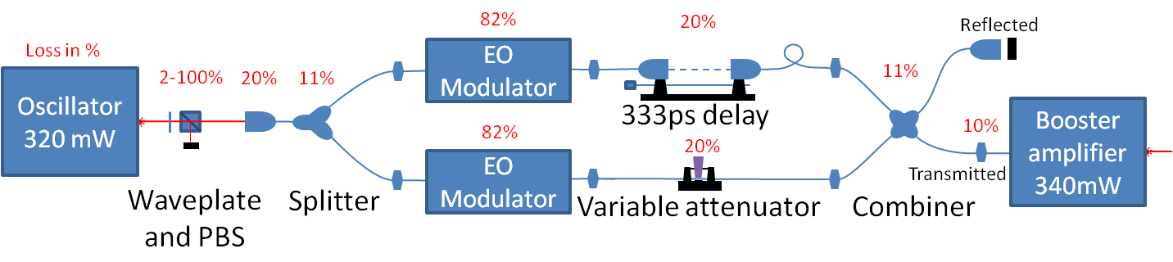
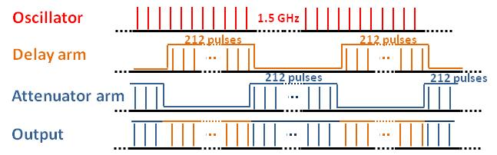
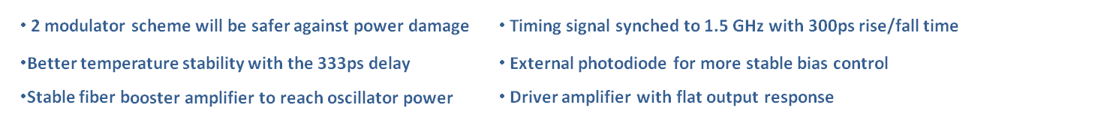
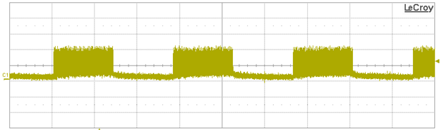
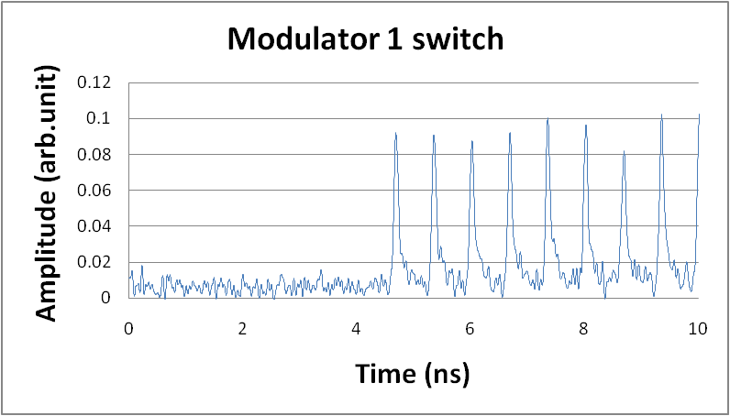
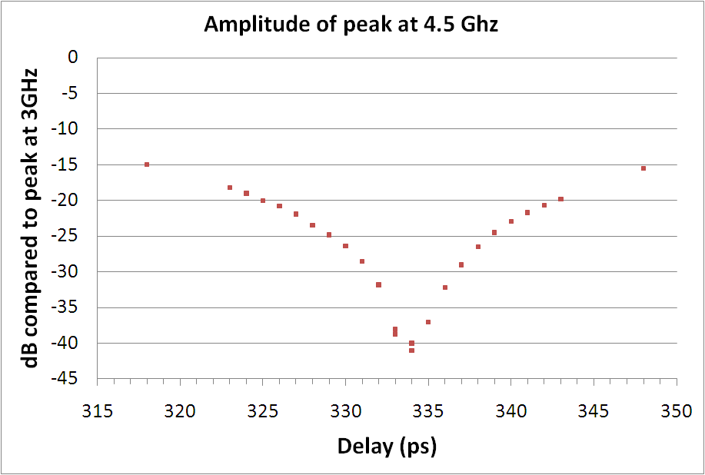
Phase coding for PHIN
M. Csatari Divall
NEW scheme
Modulator 1
280 ns
Switching with one modulator
Clean cutting between pulses
Delay optimization with <1ps accuracy
Optimization of 2 modulator scheme by end of January/2011
Integration into laser system for test planned in PHIN February/2011
Streak measurements on laser and electron beam February/ 2011

Slide 28
Feasibility demonstration
R1: Feasibility
  R1.2: Validation of drive beam generation scheme with fully loaded linac operation
  R1.1: Test of damped accelerating structure at design gradient and pulse length
  R1.3: Design and test of damped ON/OFF power extraction structure

