Slide 1
The CLIC Two-Beam Accelerator
Module & Requirements
Andrea Latina
for the CLIC Group
This presentation has been prepared with the help of
G. Riddone, W. Wuensch, I. Syratchev, A. Gridiev, M. Modena, H. Mainaud Durand
CLIC Advisory Committee – CERN, Feb 2-4 2011

Slide 2
Outline
Two-Beam Module Description
Module Design Process
Module Subsystems: Status, Specifications and Requirements

Slide 3
Introduction
CLIC is based on the two-beam acceleration concept
To facilitate the matching of the two beams, all components are assembled in 2m long modules of few different types. The modules make use of girders to meet the pre-alignment requirements (smoothing of adjacent girders)
Since each linac length is about 21 km, more than 10,000 modules are needed per linac
The Module defines boundary conditions for technical solutions for important systems: AS, PETS, RF distribution network, stabilization, alignment, vacuum, … and has to cope with the challenging requirements from each of them
It’s a cost driver for CLIC, as well as a performance driver

Slide 4
Two-Beam Module Design
Longitudinal Requirements
  Physics -> Beam Dynamics <-> Acc. Structures Design
  PETS Design and Optimization
  Module Layout
Transverse Requirements
  Stabilization
  Instrumentation
  Cooling
  Vacuum, …

Slide 5
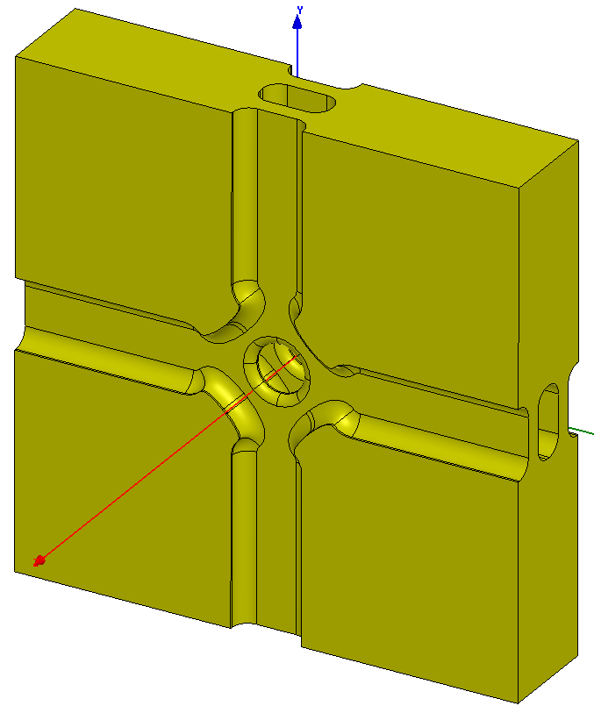
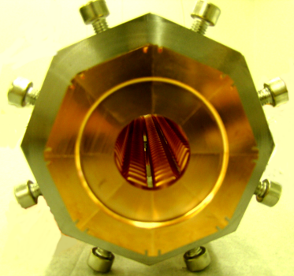
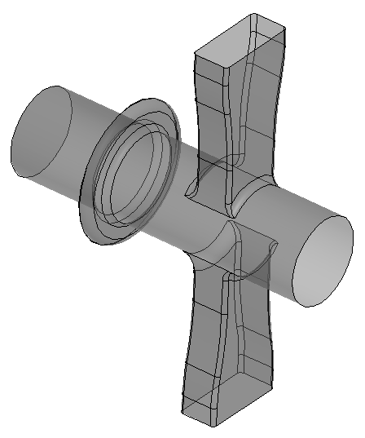
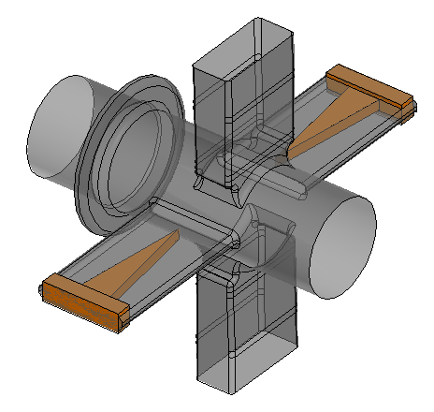
Two-Beam Module Design Chart
Luminosity per linac input power
BD <-> AC design
Beam dynamics (BD) constraints based on the simulation of the main linac, BDS and beam-beam collision at the IP:
N – bunch population depends on <a>/λ, Δa/<a>, f and <E_{a}> because of short-range wakes
N_{s} – bunch separation depends on the long-range dipole wake
PETS design
RF breakdown and pulsed surface heating constraints
Drive beam current and energy
RF power production needs
Beam transport and stability
Module layout and fabrication technology
Power extraction and transfer
AS cells
Two-Beam Module Layout
Pre-assembled PETS
RF power extractors

Slide 6
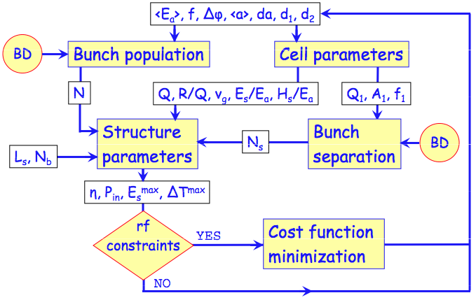
(1) Accelerating Structure Optimization
CLIC Main Linac Parameters
Parameter | Symbol | Value | Units
Energy CM | E_{cm} | 3000 | GeV
Luminosity | L_{99%} | 2 | 10³⁴cm⁻²s⁻¹
RF freq | f_{RF} | 11.994 | GHz
Repetition Rate | f_{rep} | 50 | Hz
Bunch population | N_{b} | 3.72 | 10⁹
Accelerating Structure Parameters
Structure | CLIC_G
Frequency: f [GHz] | 12
Gradient [MV/m] | 100
Average iris radius/wavelength: <a>/λ | 0.11
Input/Output iris radii: a_{1,2} [mm] | 3.15, 2.35
Input/Output iris thickness: d_{1,2} [mm] | 1.67, 1.00
Group velocity: v_{g}^{(1,2)}/c [%] | 1.66, 0.83
N. of reg. cells, str. length: N_{c}, l [mm] | 24, 229
Bunch separation: N_{s} [rf cycles] | 6
Number of bunches in a train: N_{b} | 312
Pulse length, rise time: τ_{p} , τ_{r} [ns] | 240.8, 22.4
Input power: P_{in} [MW] | 63.8
Max. surface field: E_{surf}^{max} [MV/m] | 245
Max. temperature rise: ΔT^{max} [K] | 53
Efficiency: η [%] | 27.7
Luminosity per bunch X-ing: L_{b×} [m⁻²] | 1.22×10³⁴
Bunch population: N | 3.72×10⁹
Figure of merit: ηL_{b×} /N [a.u.] | 9.1
Courtesy of A. Grudiev

Slide 7
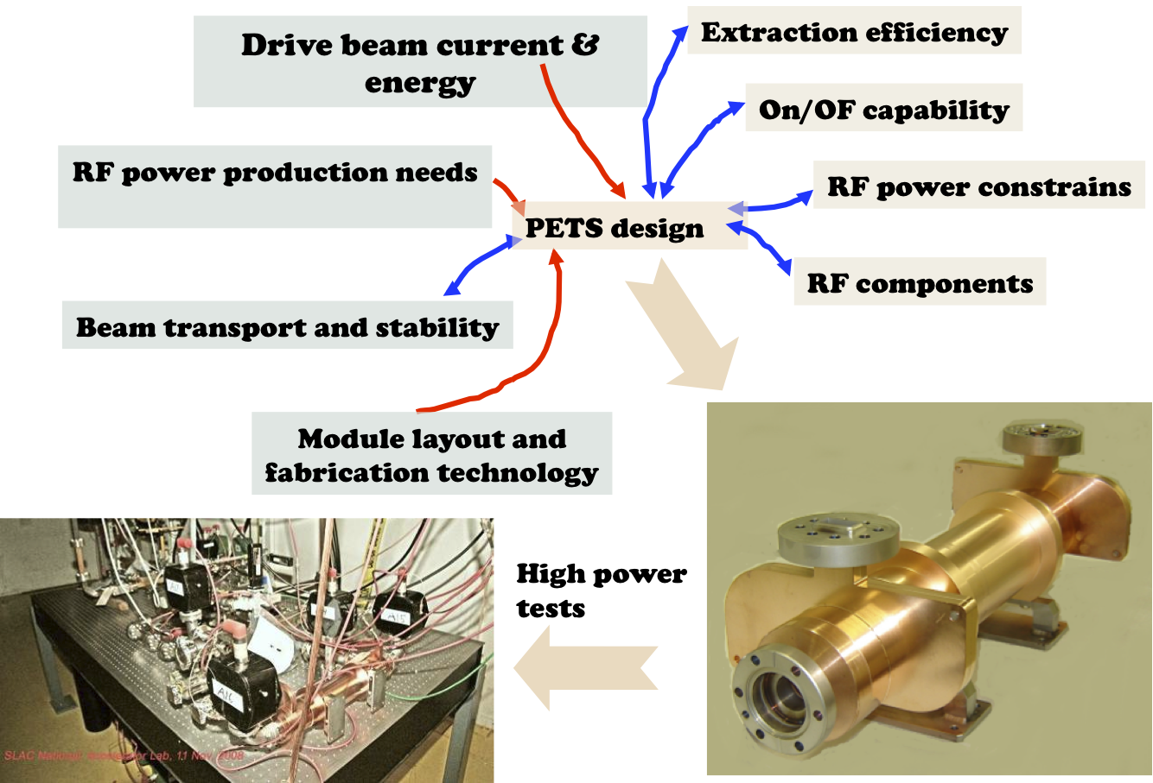
(2) PETS Design Development Chart
Courtesy of I. Syratchev

Slide 8
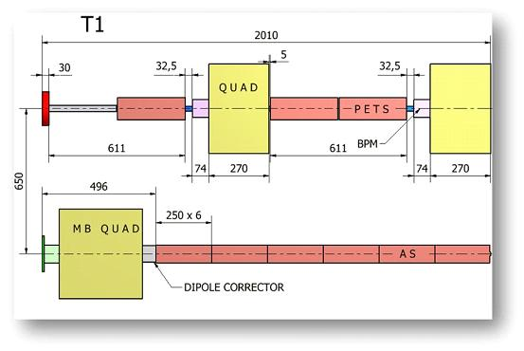
Module Parameters & Layout
Each module has a length multiple of two sets of PETS and 1 drive beam (DB) quad. Each PETS feeds 2 AS. As a result of this, the length of the CLIC Module is obtained as
L_{module}=L_{acc} x 8 + L_{int}=(250 x 8 + 10) mm=2010 mm
 | Act. Length [mm] | Aperture [mm] | Gradient [MV/m] | Power [MW]
PETS | 213 | 23 | 6.5 | 133.7
AS | 229 | 5 | 100 | 63.8
Parameter | 3 TeV | Unit
Module length | 2010 | mm
Length of PETS w/couplers | 308 | mm
PETS tolerance (1σ) | 31 | μm
Number of AS (in Module Type-I) | 6 | -
Length of AS | 250 | mm
There are five Types of Modules: ``Type-?’’ depending on the number of MB quadrupoles

Slide 9
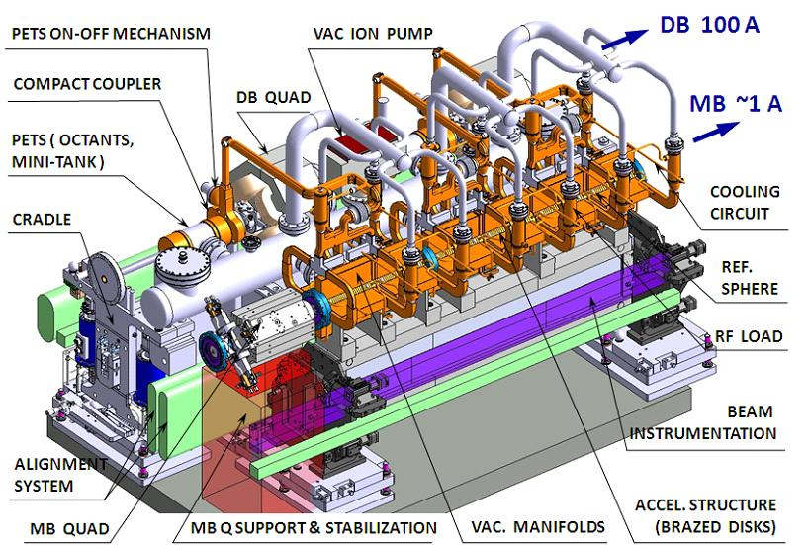
Two-Beam Module Type-I
Courtesy of A. Samoshkin, see G. Riddone’s talk

Slide 10
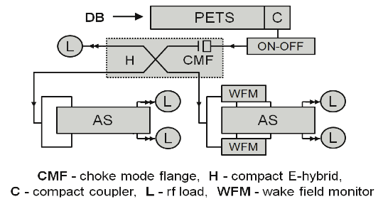
Module RF Network
The RF system comprises the connection between the PETS and ACS and then from the ACS to the high power loads.
The two-beam RF network includes the X-band rectangular wave-guides providing connection between PETS, AC and other supplementary devices.
It’s necessary to join the PETS outgoing waves by one channel. Because of the limited longitudinal space a compact coupler is needed.
In case of a breakdown in a AS it is necessary to interrupt the power produced by the corresponding PETS within 20 ms. “On-Off” mechanism

Slide 11
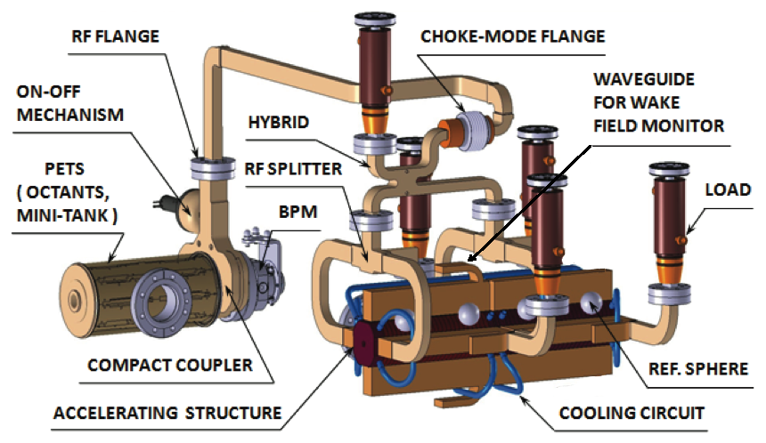
Module RF Network
Another requirement is to guarantee transverse alignment flexibility between the two beams and thus to allow for the power transmission without electrical contact
Another necessity is to have a split of power between two AS without any reflection to the feeding PETS in a broad frequency range
The power delivered from PETS to the two fed AS must be synchronized in phase

Slide 12
Main Beam RF Diagnostics
General layout in a DB Sector (~800m)
Two types of PETS+2AS units will be installed:
Reference (black) (2 units at the beginning and 2 units at the end of a DB sector)
  It will have more signals and with higher resolution
  The signals will be time resolved: dt ~ 0.5 ns (pulse shape)
Regular (blue) (all the rest)
  It will have 1 or 2 signals
  Integral over the pulse (1 or 2 numbers per pulse)
PETS+2AS unit: Reference
PETS+2AS unit: Regular
RF diagnostic
  RF breakdown in PETS and AS
  PETS on/off failure
  Provide references for the regular PETS+2AS units
Beam control
  RF power production
  Energy measurement and beam loading transient compensation
RF breakdown
PETS on/off failure
Courtesy of A. Grudiev

Slide 13
WakeField Monitors
Position monitors called Wakefield Monitors (WFM) are integrated to the structure for beam-based alignment (cost saving solution). There will be 1 WFM for each super-structure.
To achieve the target luminosity, the accelerating structures must be aligned to an accuracy of 3.5 μm with respect to the beam trajectory.
TM-like modes
TE-like modes
TBTS WakeField Monitor Prototype
Beam-based alignment of the cavities
The alignment of the accelerating structures in the CLIC main linac is necessary to remove the wakefield effects on the beam.
Simulations moving the articulation points showed that the emittance growth can be very well improved by aligning the accelerating structures to an accuracy of 3.5 μm
For our tolerance σ_{WFM} = 3.5 µm, we found ∆ε_{y} ≈ 0.5 nm.

Slide 14
Supporting Girders & Active-Pre Alignment
The pre-alignment of CLIC will have to guarantee a tolerance on the transverse positions of the girders of ± 10 μm (1σ) on a sliding window of 200m.
A simplification of the problem is to pre-align a number of components of each linac on girders, i.e. align the girders instead of aligning each of the components
Adjacent girders linked by a common articulation point
A simplification of the alignment by linking all the adjacent girders by a common articulation point. The alignment then consists in aligning each articulation point according to three degrees of freedom
Adjacent girders linked by a common articulation point
See talk by H. Mainaud Durand

Slide 15
Supporting Girders
The module design is based on a common girder that supports the components of each different system: such as AS, vacuum manifolds, RF components, PETS with their compact couplers, “On-Off” mechanism, vacuum connections as well as the DB quadrupoles equipped with BPM
The girders should provide a sufficient mechanical stability and assure continuity for the chain of components of one beam
The main components of each beam must be properly aligned to cope with beam and RF requirements
The MB Q must stay independent of other components and such require the self-governing supports, which should combine both alignment and stabilization functions. Five degrees of freedom
See talk by H. Mainaud Durand

Slide 16
Pre-Alignment & Stabilization Requirements
Main alignment requirements in the vertical plane
Component | Tolerance (1σ)
Accelerating Structures | 14 μm
PETS | 31 μm
Main beam quadrupoles | 17 μm
BPM for main beam quadrupole | 14 μm
Relative position of MB quad. and BPM | 5 μm
The AS are the most sensitive components
The stabilization system is required for the MB quadrupoles only
The quadrupole support has five degrees of freedom, to be adjusted coherently with the other MB components
A high mechanical stability is required for the MB quadrupoles: the requirement is not to exceed 1 nm in the vertical plane and 5 nm in the horizontal plane, for frequencies higher than 1 Hz. Two solutions are being studied at this purpose: active stabilization with nano-alignment between pulses; another is a combination of passive and active isolation
The alignment of the AS is achieved through WF monitors
See talk by D. Schulte

Slide 17
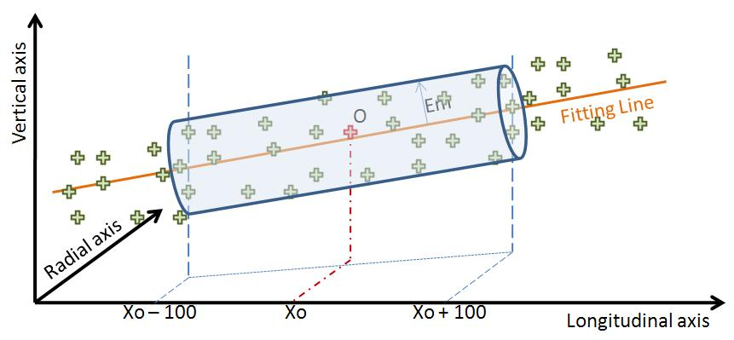
Active Pre-alignment
PRE-ALIGNMENT (beam off)
Mechanical pre-alignment
Active pre-alignment
Beam based alignment:
1:1, DFS, RF AS Alignment
Beam based feedbacks
Within +/- 0.1 mm (1s)
Within ± 3 mm (1s)
Determination of the position of the components in a general coordinate system thanks to alignment systems
Active pre-alignment
=
+
Re-adjustment thanks to actuators
After computation, for a sliding window of 200 m, the standard deviations of the transverse position of the zero of each component w.r.t a straight fitting line will be included in a cylinder with a radius of a few microns:
14 µm (RF structures & MB quad BPM)
17 µm (MB quad)
Adjustment: step size of the order of 1 µm
Courtesy of H. Mainaud Durand

Slide 18
Main Linac Mover Tolerances
Coarse mechanical motion
  girders, MB quadrupoles supports
  range: ≈ 1 mm
  resolution: Δ ≈ 1 μm
  precision: ≈ 0.5 μm
  speed: may take a few pulses, but controlled
Fine quadrupole motion
  resolution: Δ ≈ 5 nm
  range: ≈ 20 μm
  precision: ≈ 2 nm
  speed: from pulse to pulse
Very fine quadrupole motion (stabilization system)
  resolution: Δ order of ≈ 0.1 nm
  range and precision: site dependent
  speed: works in interval between pulses
See talk by D. Schulte

Slide 19
Main Beam Quadrupoles
There are 4 types of MB quadrupoles. They are different only for the active (magnetic) length, keeping all the cross-section dimensions and operational parameters identical.
Types | Mag. Length | Units
Type-1 | 35 cm | 308
Type-2 | 85 cm | 1268
Type-3 | 135 cm | 953
Type-4 | 185 cm | 1462
Cross-section and Extremities view of the MB Quadrupoles
Some of the quadrupoles are 2 m long and weight about 450 kg.
A beam steering capability is required along the Main Beams
The required steering capability is asked in one plane per magnet alternatively.
Two main solutions are being considered : a MBQ built-in correction scheme with extra-coils in each magnet (a) or an “ad hoc” small dipole corrector to be added to each MBQ (b).
View of the Beam Steering Corrector integration for the MBQ Type-4 (a) and Type-1 (b)
(a)
(b)
Courtesy of M. Modena

Slide 20
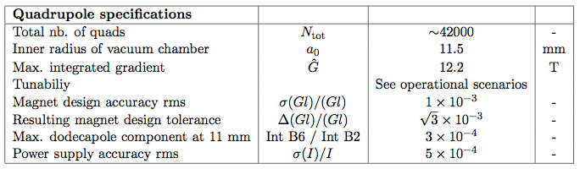
Drive Beam Quadrupoles
DB quadrupoles are present all along the beam in a FODO configuration with one F and one D quadrupole on each Module.
Decelerators are so characterized by the presence of 20740 quadrupoles on
each linac.
Specification: one quadrupole per meter gives beta function
(for most decelerated particles) of <β> = 1.25 m
  Deemed necessary for robust mitigation of dipole wake
  Gives r = 3.3 mm (out of a₀ = 11.5 mm) for ideal beam
Powered magnets is the baseline
  failure tolerant serial powering scheme is a necessity
Tuneable permanent magnets option investigated: it must cover all operational scenarios
BPM
Drive Beam Quadrupole prototype and BPM
Note that DB correctors will be the girder’s articulation points (baseline).
See E. Adli’s talk at IWLC 2010

Slide 21
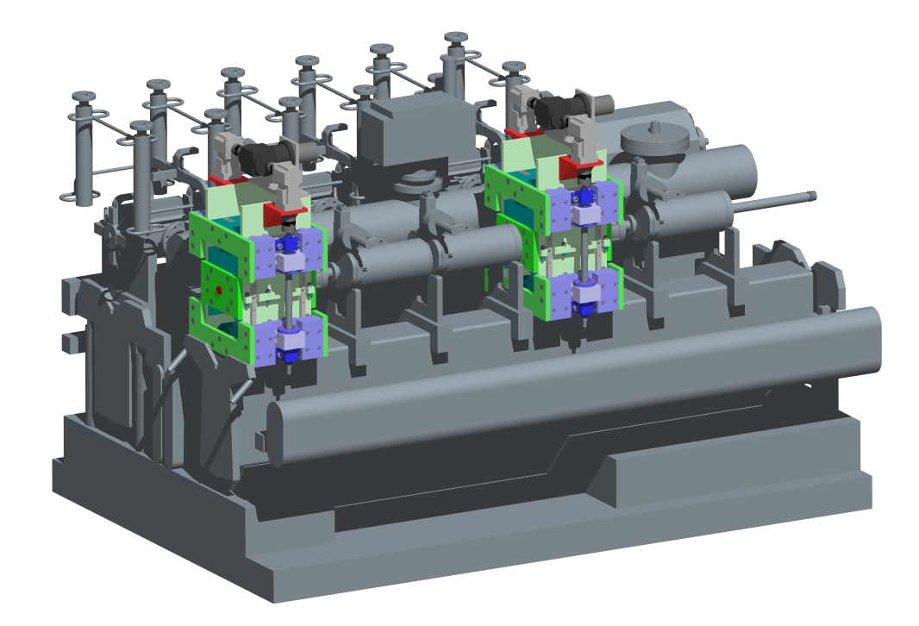
Drive Beam Quadrupoles
Daresbury Lab was asked to look at Permanent Magnet options and also to assess new techniques for building ~50 quads/day
  The CLIC drive beam needs a quadrupole every meter (~42,000)
  The electromagnet option will consume ~400W per magnet
  Want to maintain heat load in tunnel to <150W/m
Why Permanent Magnets?
  No direct power consumption
  No heatload in the tunnel
  Low running costs
  Higher integrated gradient (potentially)
Possible issues: Radiation Damage? Is large tuneability feasible? Is required motion control precision feasible? Sensitivity to material errors & temperature? Sufficient magnet quality?
Parameter | Value
Inscribed radius | 14 mm
PM size | 18 x 100 mm
PM angle | 40°
Magnet length | 230 mm
Maximum stroke | 64 mm
Gradient | 81 T/m (max) | 8.1 T/m (min)
Integrated gradient | 15.0 T (max) | 3.6 T (min)
Relative to nominal | 123% | 30%
Magnetic length | 241 mm
Good gradient region | ±7.0 mm
See Jim Clarke’s talk at IWLC 2010

Slide 22
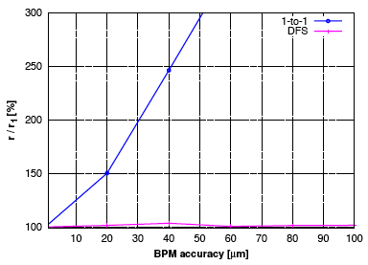
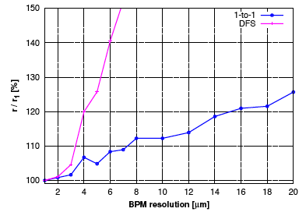
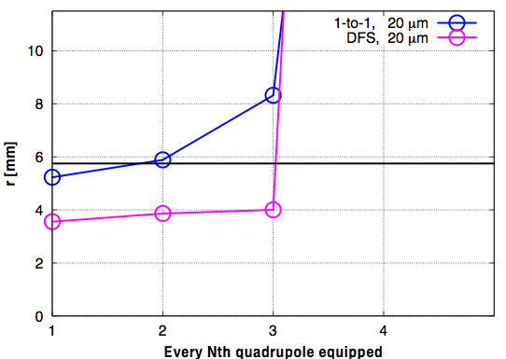
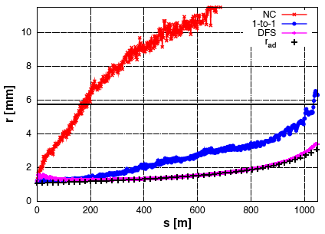
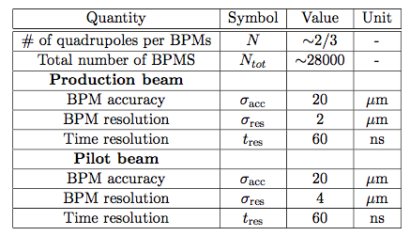
Drive Beam Beam Position Monitors
Beam-based correction performance drive the BPM specifications.
Target: negligible envelope growth due to quadrupole kicks.
Effect of BPM accuracy
Effect of BPM resolution
Effect of # of BPMs
Results with baseline parameters
See E. Adli’s talk at IWLC 2010

Slide 23
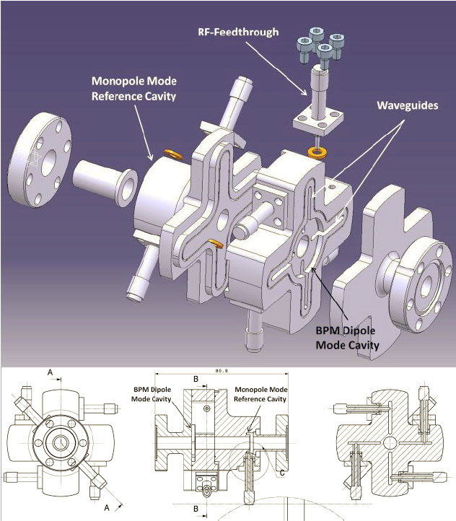
Main Beam Beam Position Monitors
- The BPM are required for measurement of beam trajectory
- The time resolution was set to less than 50 ns and the spatial one to 50 nm for the MB. The corresponding accuracy must be better than 5 μm
- A precision of 20 μm and resolution of about 2 μm are necessary for the DB
- The pre-alignment system will be needed for making possible the “first” beams pass through the linac.
- Then, beam-based alignment will be applied using 1:1 correction, Dispersion Free Steering and accelerating cavity alignment
See IWLC 2010, WG8, Instrumentation talks

Slide 24
Main Beam Transverse Tolerances
See talk by D. Schulte

Slide 25
Main to Drive Beam Phase Tolerance
Courtesy of D. Schulte

Slide 26
Cooling System
A significant part of the RF input power is transferred into heat in the RF structures.
The cooling system consists of 21 km long linear accelerator circuits with about 20K temperature difference for each module
Functions of the cooling system are:
  Cooling the system
  Providing micro-meter thermal stability to the accelerator tunnel
Sustaining the required alignment of 14 μm for ACS within 1σ requires a special development of the cooling system under dynamic heat load conditions
Ensuring mechanical stability of components, alignment and vacuum systems require evacuating the heat efficiently by specially designed water circuits
Any vibration induced by coolant flow can result in loss of machine performance
See talk by G. Riddone

Slide 27
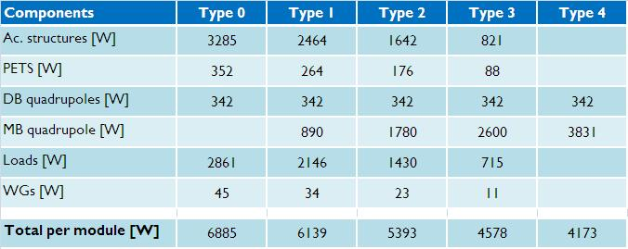
Estimated Power Dissipation
Per Accelerating Structure:
- loaded = 336 W
- unloaded = 410 W
Per Module:
See talk by G. Riddone

Slide 28
Vacuum: Requirements from Beam Dynamics
Proceedings of IPAC10 , J.-B. Jeanneret, G. Rumolo, D. Schulte
Simulations with the FASTION Code
New fast ion instability simulations show that the influence of field ionization for a threshold electric field value between 18 and 30 GV/m, which covers the common gas species H2, CO, N2 and H20, makes the beam unstable for partial pressures above 5 nTorr.
A dynamic pressure of 1 nTorr must be specified in order to ensure beam stability. In the future, we plan to simulate the fast ion instability for a more realistic composition of the residual gas
See talk by W. Wuensch

Slide 29
Concluding…
The layout of the two-beam acceleration modules has been presented, and each subsystem has been introduced
Answers to how to cope with the presented requirements and technical issues will be given in the following talks…
I wish to thank all the people that have helped me during the preparation of this talk.

