Slide 1
Experimental results on feasibility issues
R. Corsini for the CLIC/CTF3 Collaboration

Slide 2
CTF3
High-Power RF test stands
Others

Slide 3
Experimental results on feasibility issues
Talk Outline
Drive Beam Generation, CTF3 commissioning/operation
High Power RF tests, both at CTF3 and elsewhere
  PETS
  Structures
Other important experimental results
  Alignment
  Stabilization

Slide 4
CTF3 2010 main goals (feasibility demonstration)
Drive Beam Generation
  Bunch train recombination 2 x 4 in DL and CR (from 3.5 to 28 A)
  Transverse rms emittance < 150 π mm mrad (combined beam)
  Bunch length control to < 1 mm rms (combined beam)
  Beam current stability ~ 0.1 % for combined beam
RF Power Production
  20.8 A beam-powered test of a single PETS (without re-circulation) in the TBTS
    135 MW (with 28 A potentially available in CLEX, the peak power can reach 240 MW)
    140 ns total pulse length
    A measured breakdown rate in the range of 10⁻⁴ or lower
    Operation of a few hundred hours at 1 Hz
  7.4(10) A beam-powered test of a single PETS with external recirculation in TBTS
    135 (81) MW circulating power or 65 (65) MW available for accelerating testing
    250 ns total pulse length, 100 (170) ns flattish-top
    A measured breakdown rate in the range of 10⁻⁴ or lower
    Operation of a few hundred hours at 5 Hz
    On/off/adjust will be demonstrated using the external reflection/recirculation system mounted on one of the PETS in TBL.
Two Beam Acceleration issues
  TBTS
    Improved measurements of power and energy loss.
    Breakdown transverse kick measurements.
    Probe Beam energy gain and beam loading tests.
  TBL
    The current schedule is to have 8 PETS installed as well as a spectrometer dump for energy spectrum studies, toward the summer 2010. This will allow to verify transport of a beam with up to 30% of the energy extracted.
5th ACE – February 2010 slide

Slide 5
High-power RF testing
Demonstration goals for CDR (2010)
5th ACE – February 2010 slide
Structures: At least one CLIC prototype (TD24) with HOM damping features tested to nominal parameters
100 MV/m (loaded), 240 ns pulse length and
3*10⁻⁷/m breakdown rate
statistics of ~1000 h
PETS: At least one PETS power tested to nominal
field parameters at the output coupler with
HOM material installed
136 MW, 240 ns pulse length and
1*10⁻⁷/PETS breakdown rate
statistics of ~1000 h
more convincing if achieved with beam inside

Slide 6
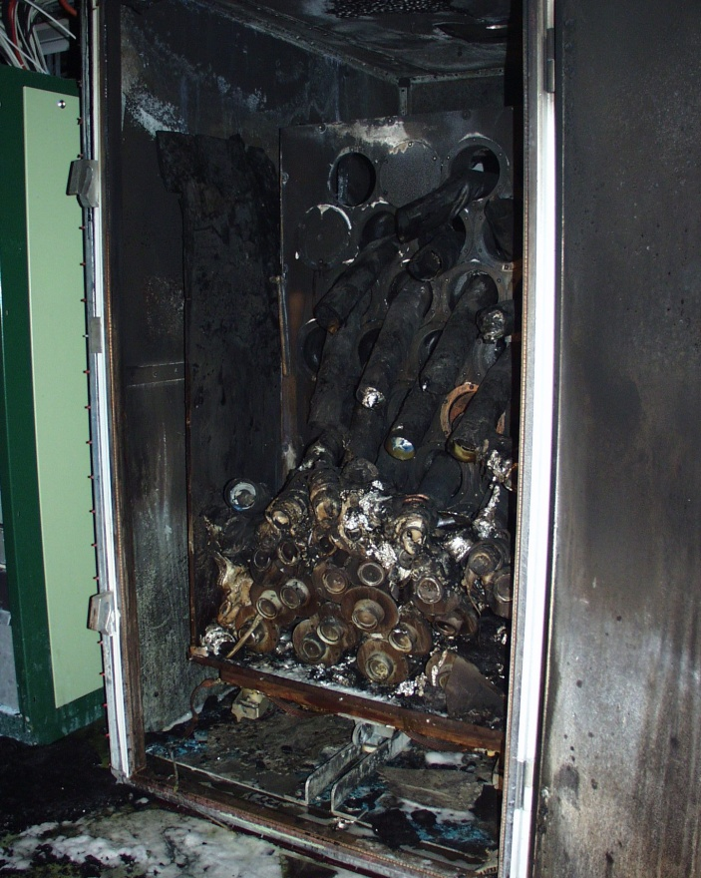
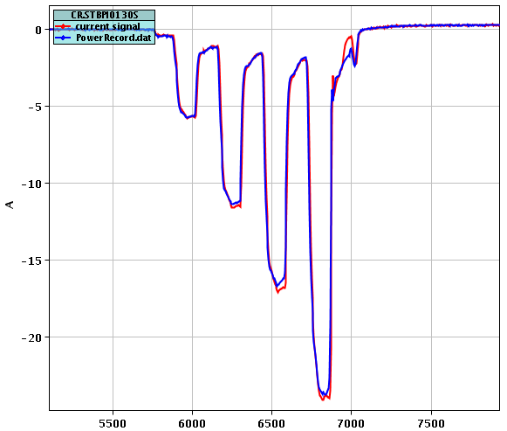
CTF3
Late start-up after fire in klystron gallery, in spite of fast and efficient recovery
Total delay about 6 months
CTF3 pulse-forming network after fire
Re-start with beam  24th June
First beam in CR  14th July
First CALIFES beam  end July
First D. Beam in TBTS  early August
Reduced current, from 4.5 A to 3.5 A in linac, in order to recover energy loss from missing klystron
~ 24 A

Slide 7
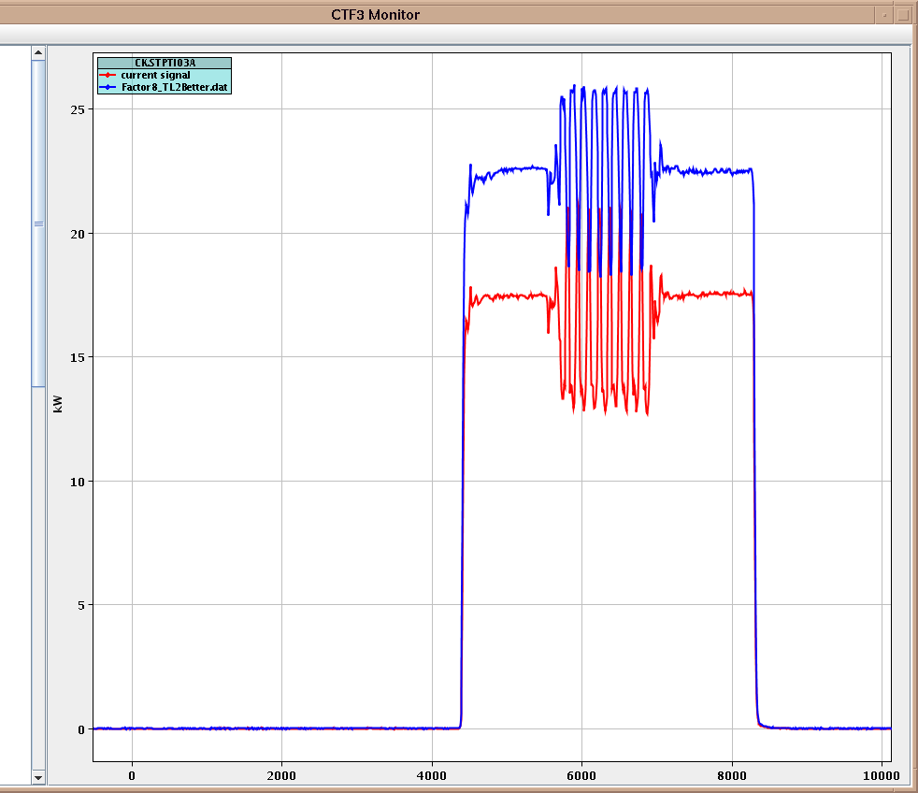
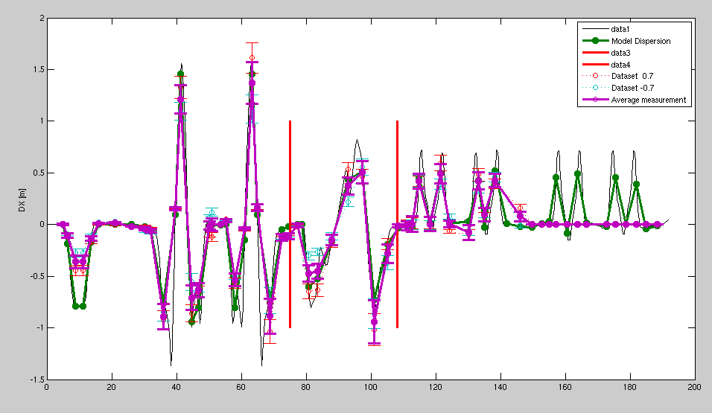
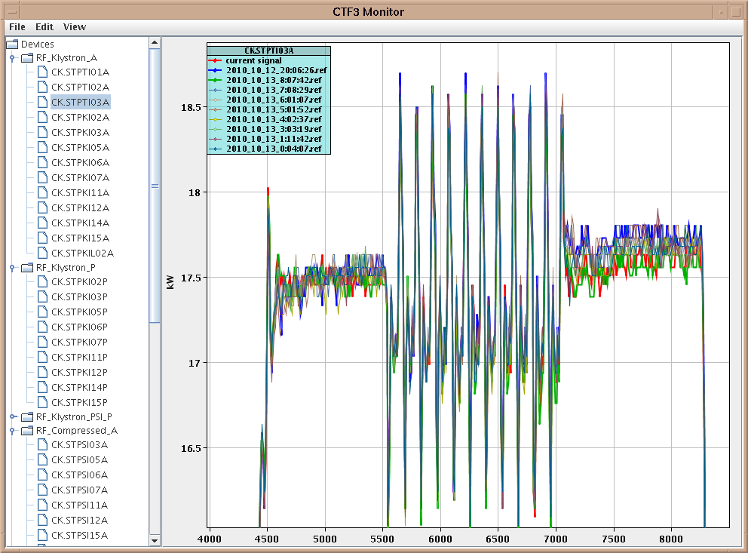
CTF3
Operational improvements
Careful setting up of RF pulses (minimize amplitude/phase variation)
Shaped RF pulse to minimize ∆E/E
Many optic checks, dispersion measurements, quad scans, response matrix studies, …  optics model much better understood and adapted
CTF3 now runs on design optics
 acceptance improved
CCC supervision of klystrons at night/WE
Extensive use of reference signals
 faster setting up of the machine, reproducibility
Simona Bettoni, Piotr Skowronski, Javier Barranco et al.
Tobias Persson
Dispersion
DL
TL1
CR

Slide 8
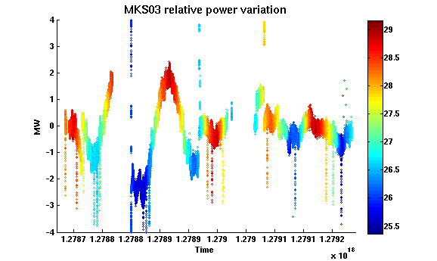
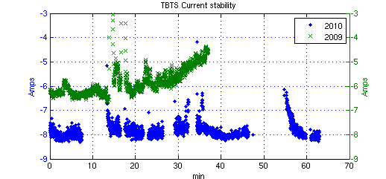
CTF3
Hardware upgrades, Feed-back systems
Improvements in low-level and high-power RF
Gun improvements (new heater power supply, …)
RF phase feedback – now fully operational
RF temperature feedback for pulse compression
 reproducibility, stability
Feed-backs plus optics improvements…
feed-back ON
Alexey Dubrovskiy

Slide 9
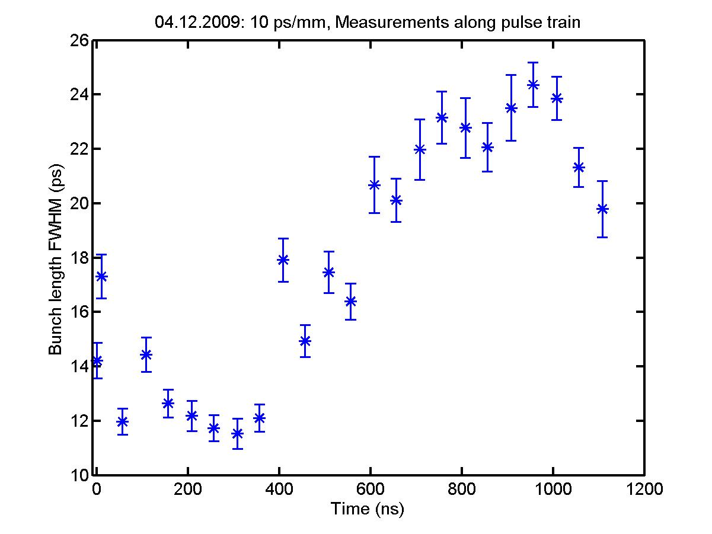
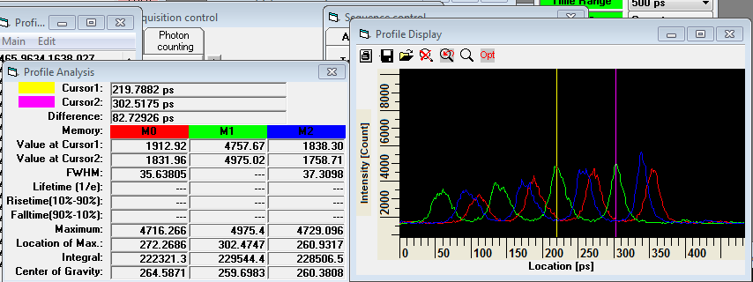
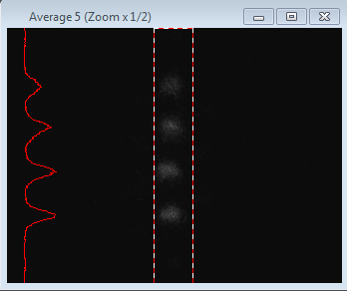
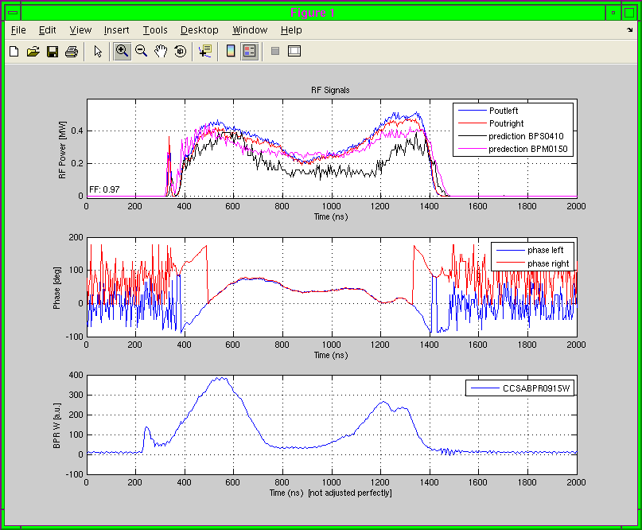
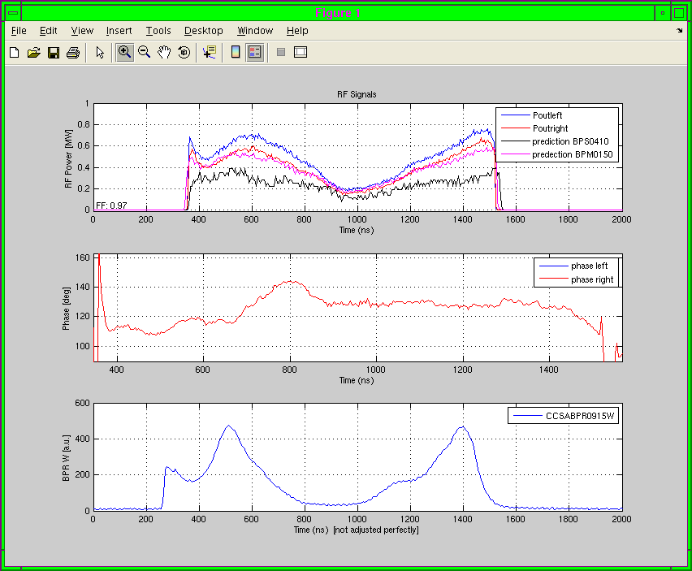
CTF3
Drive Beam Optimization for RF power production
Bunch length
Combination phase
Phase variation along the pulse
All affecting power production efficiency (form factor F)
Anne Dabrowski
bunch length
-between 2 and 2.5 mm rms
12 GHz RF phase
=>
20 deg
100 deg
Erik Adli, Reidar Lillestøl

Slide 10
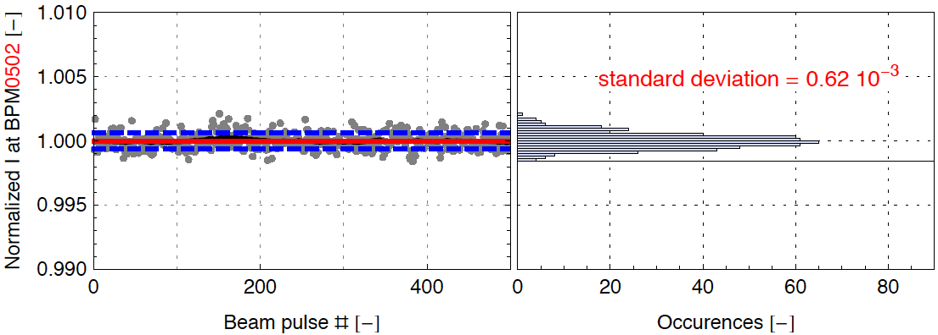
CTF3
Achieved current stability
Guido Sterbini, Simona Bettoni, et al.
New heater power supply, better set-point, improved measurement procedures
 ΔI/I ~ 0.75 – 1 10⁻³
Gun feed-back
 ΔI/I ~ 0.6 10⁻³ (or lower…)
Below CLIC DB specs!

Slide 11
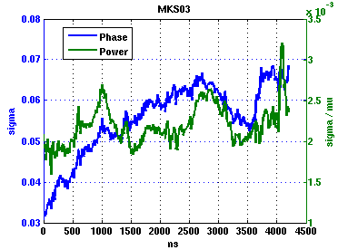
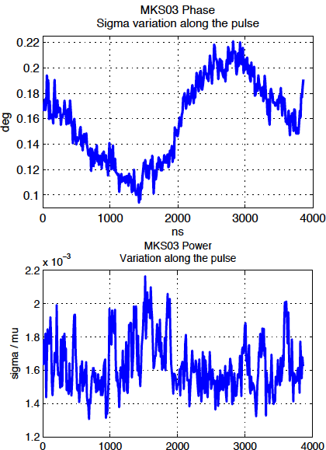
CTF3
Achieved klystron RF phase stability
Alexey Dubrovskiy
Measurements of klystron phase and power indicate
  pulse-to-pulse average phase stability with respect to local reference phase 0.035◦
  for each 10 ns times slice the pulse to pulse jitter is 0.07◦
  pulse-to-pulse power stability of < 0.2%
   gradient stability ≤ 0.1%
 Corresponds to CLIC drive beam accelerator specs

Slide 12
CTF3
Drive Beam Generation
Goals
  Bunch train recombination 2 x 4 in DL and CR (from 3.5 to 28 A)
  Transverse rms emittance < 150 π mm mrad (combined beam)
  Bunch length control to < 1 mm rms (combined beam)
  Beam current stability ~ 0.1 % for combined beam
Achievements
  Bunch train recombination 2 x 4 in DL and CR (from 3 to 24 A)
  Transverse rms emittance < 150 π mm mrad (combined beam) for vertical plane Horizontal plane still a large factor off for combined beam(~ 500 π mm mrad in CLEX)
  Bunch length control to ~ 2 mm rms (combined beam) - large R56 in end-of-linac chicane
  Beam current stability < 0.06 % at the end of linac or
  ~ 0.1 % for combination factor 2 (DL) and 4 (CR)
  still one order of magnitude off for combination factor 8
More on tomorrow talks by Frank Tecker, Steffen Dobert and Piotr Skowronski

Slide 13
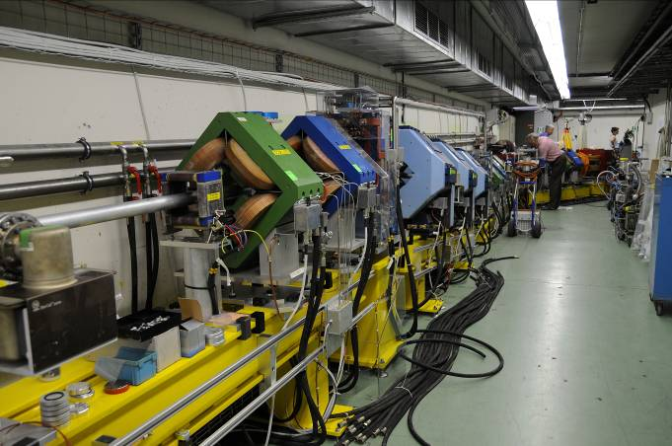
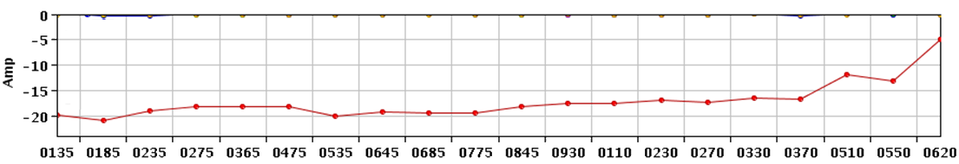
CTF3
Transfer Lines – Tl2, TL2’
previously difficult to transport the beam through TL2 (BPM system problems)
new BPM system works fine (except overloaded front-end crates)
optics model better understood (from kick measurements)
improved transport to TBTS and through PETS
> 17 A delivered to TBTS
  Small losses for non-combined beam
  Small losses in TL2 for combined beam
  Still to be improved: ring extraction, TL2’
Beam current along TL2, TL2’ and` TBTS
x8 recombination
Simona Bettoni

Slide 14
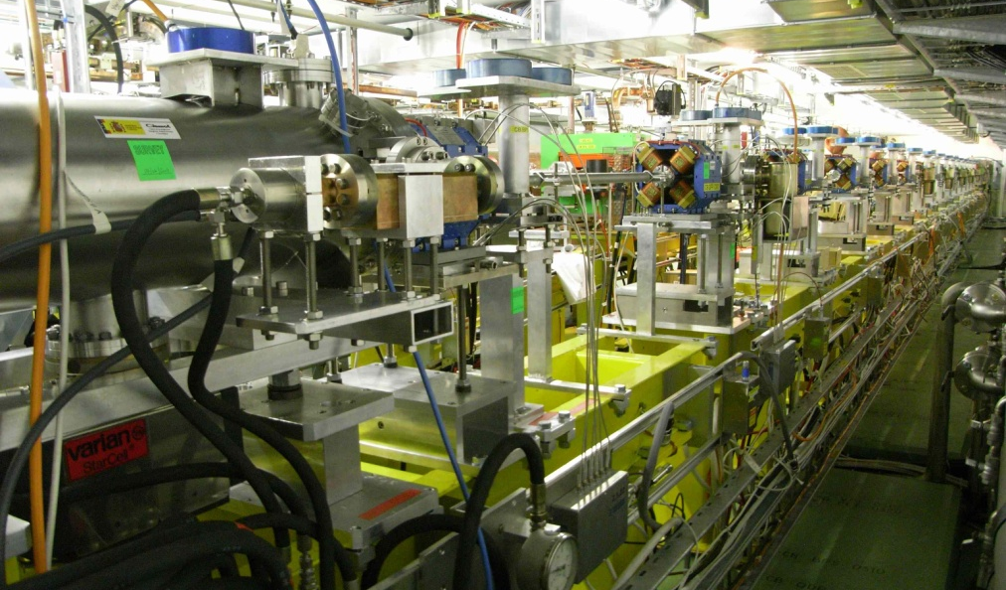
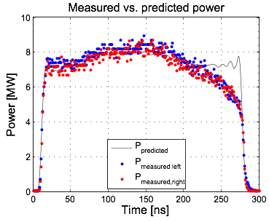
CTF3
TBL status
All quadrupole movers installed and tested
Time resolved spectrometer installed and tested
BPM’s with new read out electronics, diagnostic section with emittance meter
First commissioning and measurements performed
Beam matching and transport performed, BPM resolution measured
PETS qualified up to 50 MW
A total of 4 PETS installed in January
More on tomorrow talk by Steffen Dobert
Reidar Lunde Lillestøl, Steffen Doebert

Slide 15
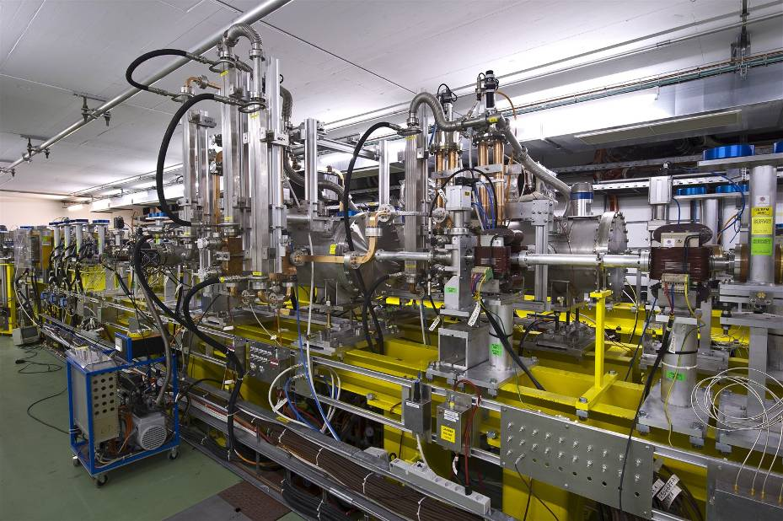
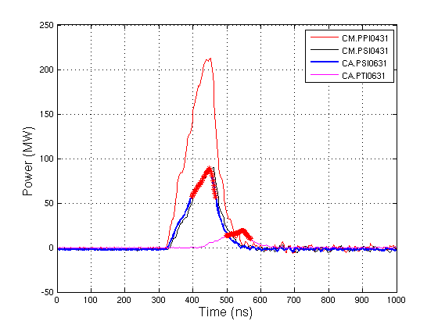
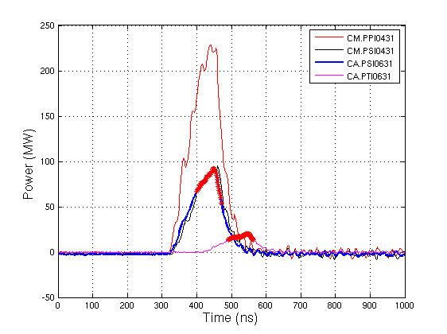
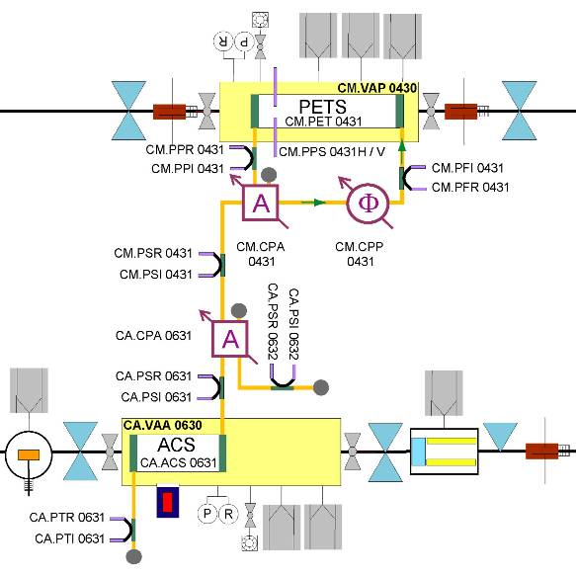
CTF3
PETS
RF Power Production - TBTS
PETS rapidly (~ 3x10⁵ pulses) reached record >200 MW peak RF power level, providing reliably pulses ~ 1o0 MW peak to accelerating structure.
About twice the power needed to demonstrate 100 MV/m acceleration in a two beam experiment with TD24_vg1.8_disk structure.
Roger Ruber

Slide 16
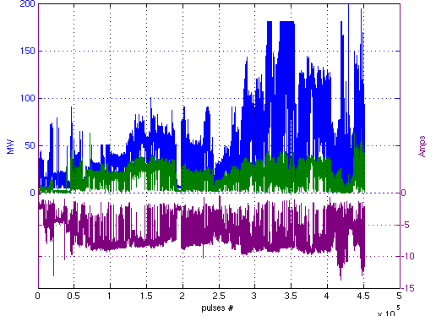
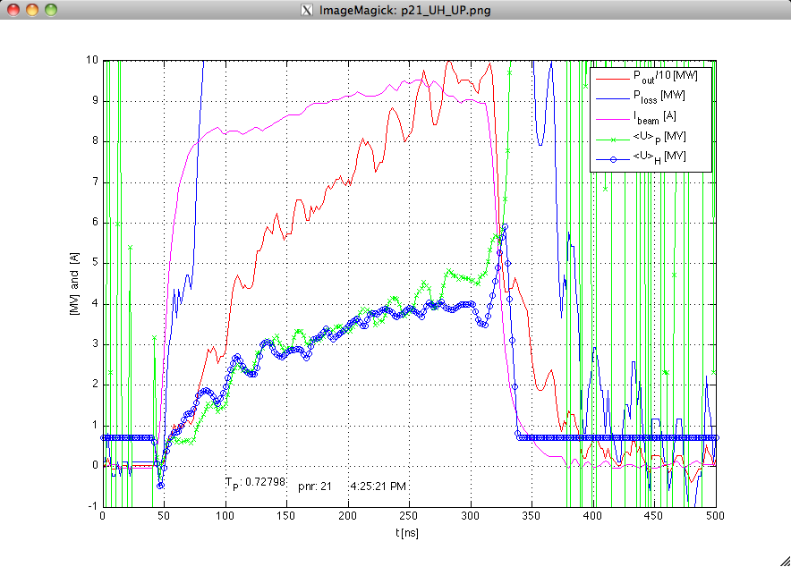
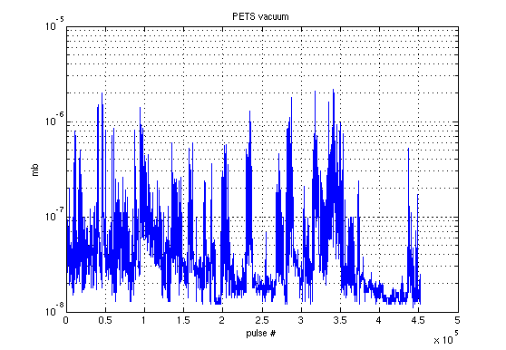
CTF3
PETS
RF Power Production - TBTS
Low breakdown rate operation
More on tomorrow talk by Erik
Power from PETS
Deceleration measurements
Power to structure
PETS Conditioning history
(not complete)
Beam current
150 hours at 0.8 Hz
Erik Adli

Slide 17
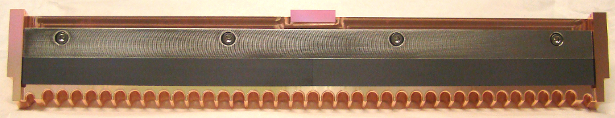
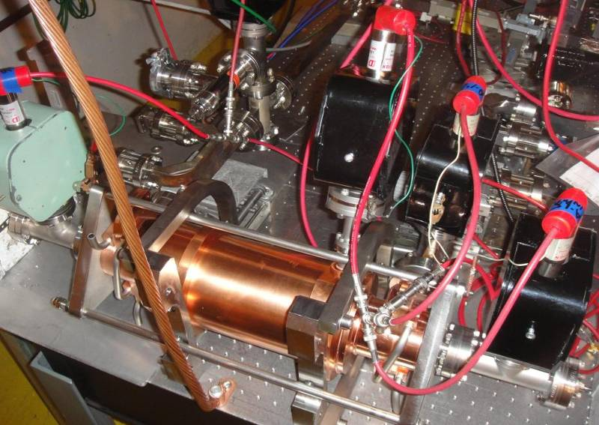
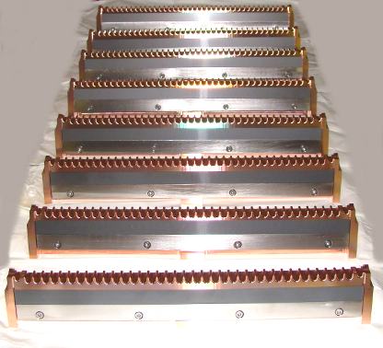
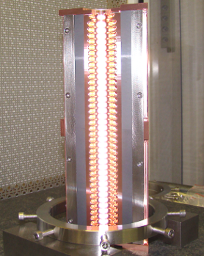
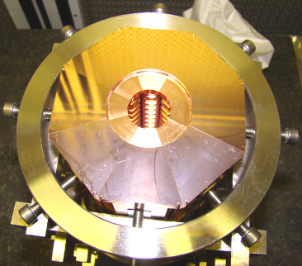
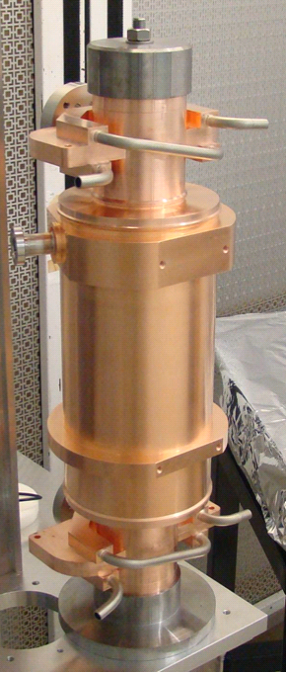
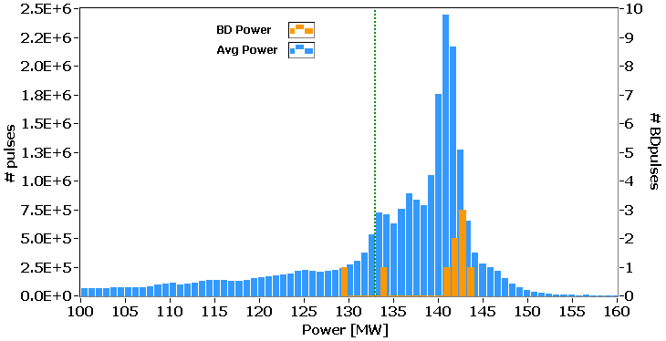
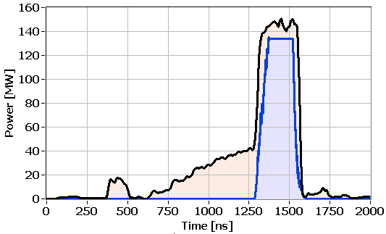
PETS
High power tests of the full PETS prototype (with damping material ) at ASTA/SLAC
PETS installed into the ASTA test area at SLAC
SiC load
August 2010
Igor Syratchev
Typical RF pulse shape in ASTA during the last 125 hours of operation
In total, 275 hours of testing time were accumulated
CLIC target
CLIC target pulse
The feasibility of the PETS operation at a peak RF power levels above the CLIC nominal was successfully demonstrated.
The tests were ended after 80 hours of operation without any breakdown giving BDR <2.4 x 10-7/pulse/m, close enough to the CLIC specification of 1 x 10-7/pulse/m.

Slide 18
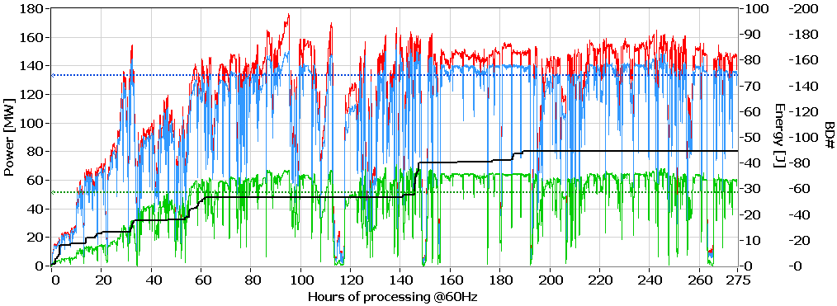
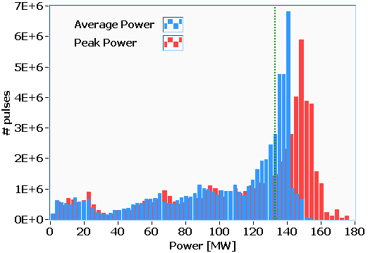
PETS
PETS @ ASTA - Processing history
Alessandro Cappelletti
Peak power
Avg power
Energy
BD
133 ns
266 ns
PETS/ASTA processing period
BD statistics accumulation period
(fixed power level)
CLIC target
CLIC target
CLIC target pulse
In total:
5.9 x 10⁷ pulses
90 breakdowns
Typical RF pulse shape in ASTA during the last 125 hours of operation
Average and peak power distributions

Slide 19
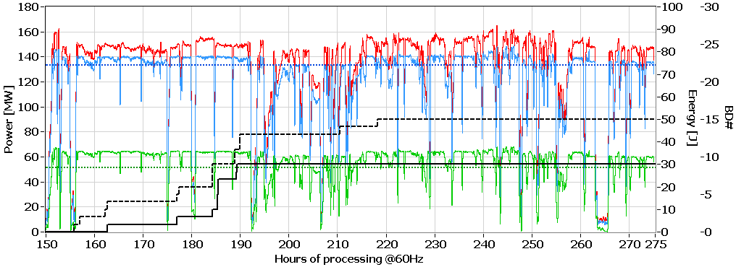
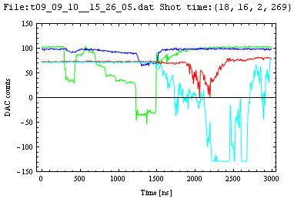
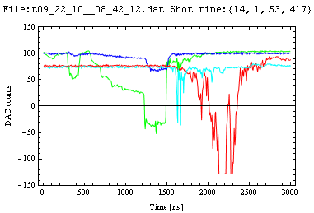
PETS
PETS @ ASTA - Breakdown rate
Alessandro Cappelletti
BDR statistics accumulation testing period (142 MW x 266 ns).
All registered events
CLIC target
Peak power
Avg power
Energy
BD
All breakdowns
During ~125 hours of testing, 15 events were logged into breakdown counter following Faraday cups signals. Six of them were discarded from breakdown statistic due to the late (in time) appearance of the dark current and thus irrelevant for CLIC.
Examples of discarded events

Slide 20
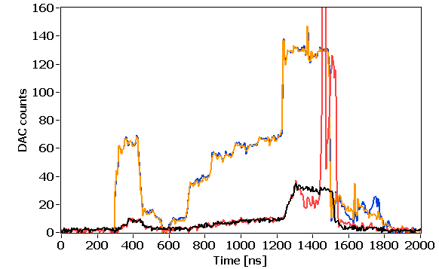
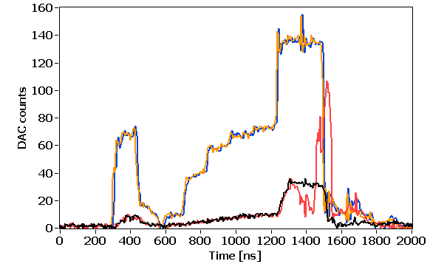
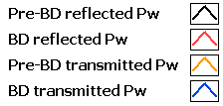
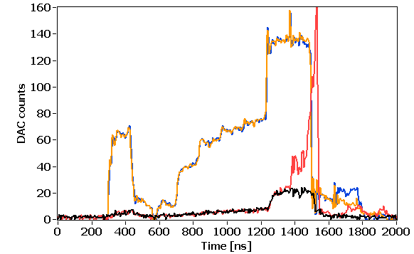
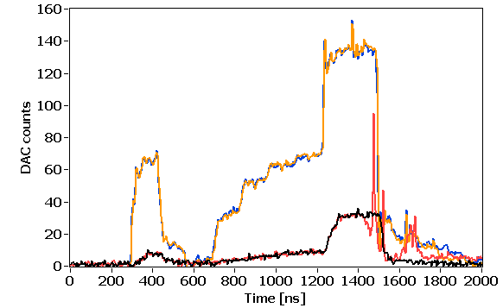
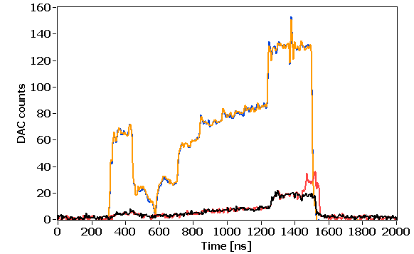
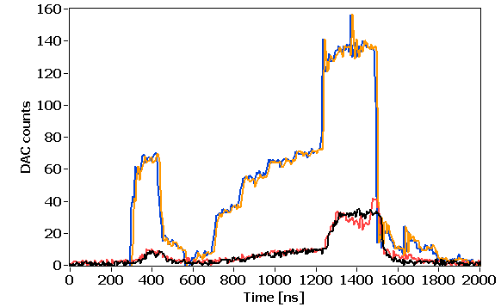
PETS
‘hard’ events examples
Alessandro Cappelletti
PETS @ ASTA Missing Energy
None of the registered breakdowns showed traces of pulse shortening (missing energy).
Any of these events will be practically undetectable in the CLIC environment.
‘soft’ events examples

Slide 21
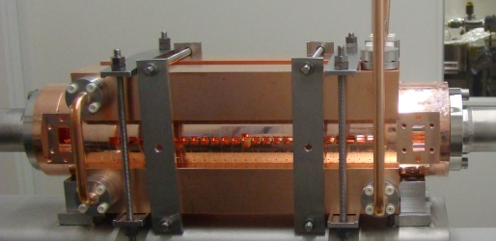
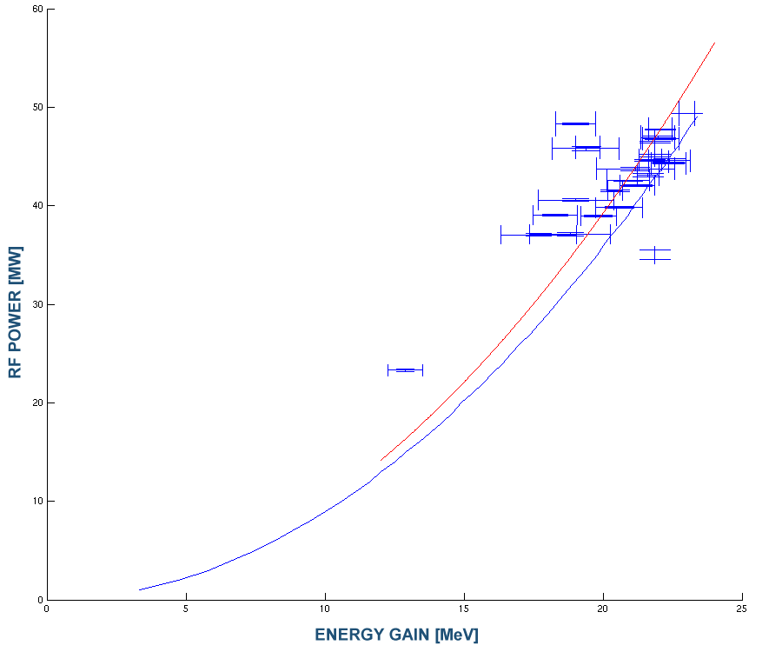
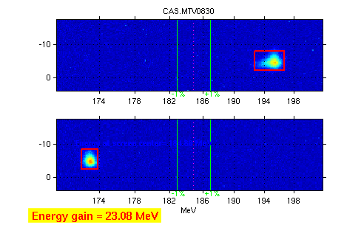
CTF3
Accelerating structures
Two-Beam Acceleration demonstration in CTF3 Two-Beam Test Stand
TD24
Maximum probe beam acceleration of 23 MeV measured
⇒ Corresponding to a gradient of 106 MV/m
measurements
Drive beam ON
PRELIMINARY
fit
Drive beam OFF
expected

Slide 22
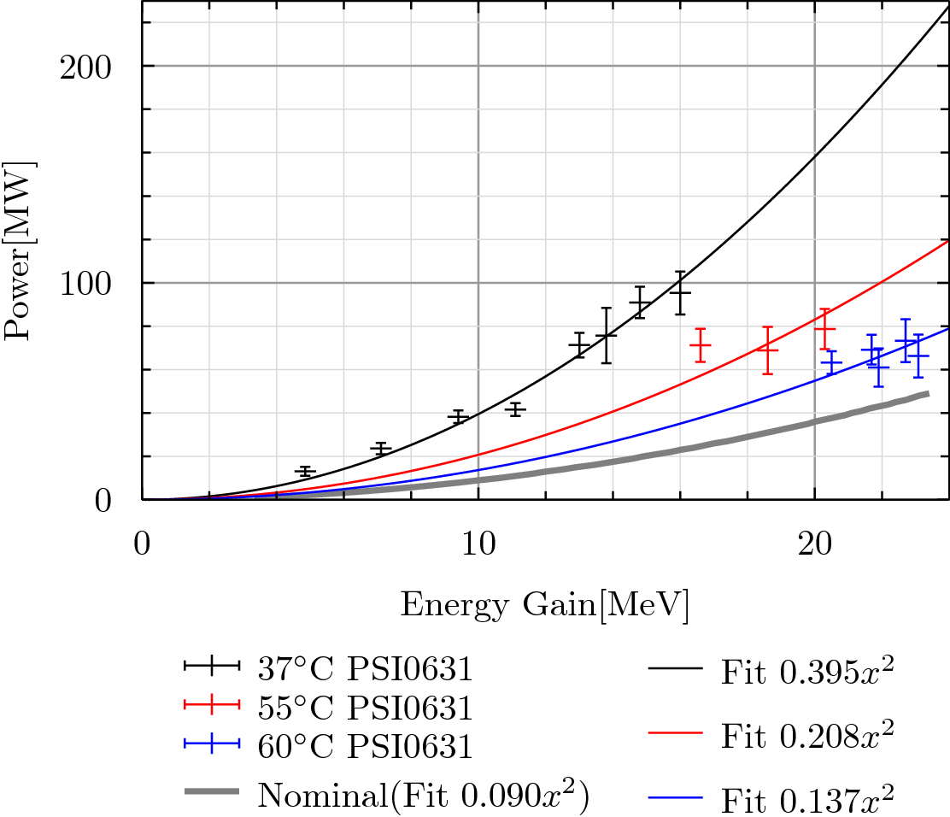

CTF3
Accelerating structures
Two-Beam Acceleration Test
Javier Barranco
Power measured at structure input
Power measured at structure output, renormalized using known attenuation
PRELIMINARY
PRELIMINARY

Slide 23


CTF3
Accelerating structures
Two-Beam Acceleration
Two-Beam Acceleration Test - History
PRELIMINARY
Temperature control + cross-calibration problem
New calibration + effective power increase
Javier Barranco

Slide 24




Two-Beam Acceleration Test – Detuning?
After having investigated all other potential explanations, the “missing energy gain” was
tracked down to a strong (+10 MHz) detuning of the accelerating structure with respect to the nominal frequency (ν₀ = 11.992 GHz).
The “smoking gun” was a measurement of the beam-induced signal from the probe beam, down-mixed to a frequency tunable reference
ν_{R} = ν₀ - 10 MHz
ν_{R} = ν₀
ν_{R} = ν₀ + 10 MHz

Slide 25



CTF3
Accelerating structures
Two-Beam Acceleration Test – detuning & temperature scan experiment
Nominal
Nominal + 10 MHz
The +10 MHz detuning was then confirmed by a “post-mortem” bead pull measurement
In order to recover the performance, a “quick-and-dirty” experiment with an hot water circuit was set up in the last week of the CTF3 run
Hot water tubes
Detuning at 30⁰
Detuning at 50⁰, 55 ⁰, 60 ⁰
Wilfrid Farabolini
Oleksiy Kononenko

Slide 26
CTF3
Accelerating structures
Two-Beam Acceleration
Two-Beam Acceleration Test - History
PRELIMINARY
Temperature control + cross-calibration problem
New calibration + effective power increase
Javier Barranco

Slide 27



Two-Beam test in TBTS
Full simulations
Power and phase measured at structure input (three consecutive pulses)
Oleksiy Kononenko
Unloaded Voltage Calculations
Vmax = 24.1 MV
Power measured at structure input
Reconstructed from output

Slide 28


CTF3
Accelerating structures
Two-Beam test in TBTS
Full simulations
Oleksiy Kononenko

Slide 29


Accelerating structures
Breakdown rate at 100 MV/m (unloaded) accelerating gradient and
scaled to 180 ns pulse length
New
Walter Wuensch
TD24
T18 – strong tapering
T18 – strong tapering
T24 – Higher efficiency
T18 – strong tapering
?
T24 – Higher efficiency
TD18 – waveguide damping
TD18 – waveguide damping
T18 (CERN) – strong tapering
log(BDR/m)
CLIC BDR specification
TD24 – CLIC nominal being tested with beam in CTF3 two-beam test stand.

Slide 30
Accelerating structures
Unloaded gradient at CLIC 4*10⁻⁷ BDR and 180 ns pulse length
T18 – strong tapering
1400
T18 – strong tapering
3900
T18 – strong tapering (continuation with recirculation)
280
T18 – strong tapering (CERN built)
550
TD18 – waveguide damping
1300
TD18 – waveguide damping
3200
T24 – high efficiency
600
T24 – high efficiency
650
MV/m
conditioning
time [hr]
Walter Wuensch

Slide 31
Accelerating structures
RF Process Results T24_SLAC_Disk1
Started at Sept/21/2010
1e-3(1/pulse/m) = 51.8/hour at 60 Hz for 0.24 m
Currently BDR at 98 MV/m@230ns is 7.4e-5/pulse/m (~3.8BKD/hr)
Walter Wuensch

Slide 32

Accelerating structures
Steady reduction of breakdown rate
More details in today’s talk by Walter
This data is from a TD18. In seven structures the breakdown rate decreased similarly during extended running while one T18 developed a hot cell and breakdown rate went up. Structure performance statistics is a priority for future tests.

Slide 33



Alignment
Stretched wire and MRN
Helene Mainaud Durand
TT1 facility
Simulations
Position & orientation of the metrological plates in the coordinate system of the tunnel
Monte Carlo method using theoretical readings of sensors
  ➔ in 97.5% of the cases, all the pre-alignment errors fit in a cylinder with a radius of 10 µm.
One of the objectives: to determine the precision and accuracy of a MRN consisting of overlapping stretched wires.

Slide 34


Alignment
Stretched wire and MRN
Helene Mainaud Durand
Results in TT1
More details in today’s talk by Helene
    Precision on a 140 m wire: better than 2 microns over 33 days
    Accuracy: 11 microns in vertical, 17 microns in radial. Can be improved!
  Vertical residuals of the 2 longest wires:
    σ (wire 1) = 1.6 µm
    σ (wire 2) = 0.5 µm
  Accuracy of the TT1 network adjusted by the least squares method in vertical:
    σ = 11 µm r.m.s (27 µm max. value)
  Subject of a PhD thesis: « Proposal of an alignment method for the CLIC linear accelerator: from the geodetic networks to the active pre-alignment » (T. Touzé)

Slide 35





Stabilization
Step 1: One degree of freedom scaled set-up
1 d.o.f.
scaled test bench
COLLETTE C., ARTOOS K., KUZMIN A., SYLTE M., GUINCHARD M. and HAUVILLER C., Active quadrupole stabilization for future linear particle colliders, Nuclear instruments and methods in physics research section A, vol.621 (1-3) pp.71-78 (2010).
Stef Janssens, Kurt Artoos

Slide 36



Stabilization
Experimental results - one d.o.f.
Objectives reached
Result: 0.6 nm at 1 Hz from 2.2 nm
day: 1.6 nm from 6.4 nm
0.44 nm at 4 Hz
Stef Janssens, Kurt Artoos

Slide 37


Stabilization
Step 3: 2 d.o.f. with type 1 mass
Objectives:
Validate the strategy and
controller in 2 d.o.f. Type 1
Validate flexural hinge design
Validate Mounting and assembly issues
Validate nano positioning in 2 d.o.f.
Stef Janssens, Kurt Artoos

Slide 38



Stabilization
Stabilization in 2 d.o.f.
Will be improved with guide
m
Lateral
stabilization
Vertical
stabilization
0.9 nm at 1 Hz
Can be improved still.
Stef Janssens, Kurt Artoos

Slide 39


Stabilization
Positioning in 2 d.o.f.
More details in today’s talks by Kurt (& Daniel)
Horizontal motion
Vertical motion
Measured x-y capacitive
Measured in legs
10 nm
Stef Janssens, Kurt Artoos

Slide 40
CONCLUSIONS
  CTF3 – Drive Beam Generation
    Fire, late start-up. But fast recovery and lots of operational improvements
    Most benchmarks met already
    Demonstrated beam current stability (in linac) better than CLIC specs – as well as klystron phase stability
    Some work still to be done on D.B generation
    Next steps: TBL deceleration with 4 PETS results by mid-2011
  PETS
    Fast RF conditioning of CTF3 PETS to power levels (200 MW) well above CLIC nominal
    RF conditioning of klystron driven PETS in ASTA to nominal parameters (power , pulse length and breakdown rate)
    Next steps: breakdown measurements in CTF3, PETS on-off (by end 2011), extend ASTA run
  Accelerating structures
    First two-beam acceleration test inCTF3, 100 MV/m measured
    Klystron- based structure tests ongoing, T18 series reached specs, T24 and TD18 close
    Next steps: breakdown measurements and TBA in CTF3, TD24 tests at KEK and SLAC
  Encouraging results for alignment and stabilization, very close to specs, see this afternoon talks for more details and outlook.

Slide 41
RESERVE SLIDES

Slide 42

Two-Beam test in TBTS

Slide 43



PETS testing @ ASTA, SLAC
The ASTA pulse compressor with variable delay lines
Experimental area
ASTA layout
RF pulse vs power in ASTA
Gate valve
Rf Phase
shifter
Uncompressed arm
3dB hybrid
SLED II with variable length and iris reflection
CLIC PETS
Two klystrons
50 MW@1.5us
PETS installed into the ASTA bunker at SLAC
July 2010

Slide 44



PETS @ ASTA - Breakdowns locations
Alessandro Cappelletti
266 ns
All breakdowns
Type-2 (input)
Type-1 (output)
In general, the breakdowns were grouped into two types of events with respect to the Faraday cups signals.
We suggested that this can help to identify the breakdown location by correlating the arrival times and amplitudes of the two. Following, “type-1” events are located close to the output coupler and “type-2” are closer to the input coupler.
We also observed that “hard” events are mostly associated with “type-1” events.
Type-1
(output)
Type-2
(input)
Total breakdowns 53
Type-1 23
Type-2 30
F2
F1

Slide 45
PETS
PETS @ ASTA - Breakdown rate
Alessandro Cappelletti
Portion of the statistical distribution contributing to the BDR calculation
1.55 x 10⁷ pulses
CLIC target
1.55 x 10⁷ pulses were accumulated in a 125 hours run with fixed peak power and pulse length.
8 PETS breakdowns were identified giving a breakdown rate of 1.06 x 10⁻⁶/pulse/PETS.
Most of the breakdowns were located in the upper tail of the distribution and happened at earlier stage of the run, which makes the integrated BDR estimate rather conservative.
During the last 80 hours no breakdowns were registered giving a BDR <2.4 x 10⁻⁷/pulse/m counting only the pulses with average power higher than the CLIC nominal.

Slide 46
CTF3 Achievements – What is still missing for feasibility – Drive Beam Generation
Transverse rms emittance
100 π mm mrad (end of linac)
Ring isochronicity α_{p} < 10⁻⁴
Bunch length control
< 1 mm rms (end of linac)
Factor 2 combination
in Delay Loop
(from 3.5 to 7 A)
Control of ring length to better than 0.5 mm
Beam current stability
~ 0.1 % end-of-linac,
~ 0.2 % combiner ring
~ 0.06 % end-of-linac !
Bunch train recombination factor 4 in Combiner Ring (from 3 to 12 A)
Full beam loading (95% transfer)
high current acceleration (up to 5 A)
Bunch train recombination 2 x 4 in DL and CR (from 3.5 to 28 A)
Transverse rms emittance
< 150 π mm mrad (combined beam)
Bunch length control
< 1 mm rms (combined beam)
Beam current stability
~ 0.1 % for combined beam
Sub-Harmonic bunching with
fast (< 6ns) 180° phase switch
(8.5% satellites)

Slide 47
CTF3 Achievements – What is still missing for feasibility – TBL / TBTS / CALIFES
8 PETS + spectrometer installed to verify transport of a 28 A beam with up to 30% of energy extracted.
Nominal probe beam to end of line (no accelerating structure)
Probe beam acceleration to 100 MV/m.
Beam-powered test of a PETS to nominal parameters (135 MW, 240 ns) with external recirculation (10 A) and without (20 A) – including probe beam
Improved power & drive beam energy loss measurements
(Break-down kick measurement).
Beam-powered test of a PETS with external recirculation to 170 MW, <200 ns - ~10 A beam current
Power & drive beam energy loss measurements.

Slide 48

Two-Beam test in TBTS

Slide 49



PHIN
specifications successfully demonstrated during the June run
Next run, 2011, with phase coding
Öznur Mete
(03 March 2010)
Emittance Measurement along the Pulse Train of 1.2µs

Slide 50






Laser
PHIN phase coding
Stabilization
NEW scheme
Feedback stabilization scheme
Input coupler
New setup
Marta Csatari Divall
all hardware components in place
fully adjustable timing system for amplification window needed
driver amplifier with flat output response ordered
Old driver amp.
New driver amp.

Slide 51


TBL
Reidar Lunde Lillestøl, Steffen Doebert
new GUI used for commissioning
and matching (MAD model)
successful matching based on quad scans
RF production consistent with expectations
form factor and phase information used to optimize DB generation
F = 0.97

